Slide 1
Designing a Noise Reduction Filter for Voice Signals
A simulated public-announcement case study using frequency-domain analysis and a basic low-pass filter.
ECE0402 • Signals, Systems & Probability
Junze Xie, Ming Chen, Zifan Xu, Yimin Chen &Wanting Luo
ECE0402 • Slide 1

Slide 2
Why this problem matters
Real problem
Voice recordings and public announcements often lose clarity when background noise is present.
High-frequency hiss is a useful starting point because it is common in recording chains and easier to analyze.
Controllable model
Explainable system
A simple, explainable filter is enough to show how Signals and Systems ideas work in a real application.
ECE0402 • Slide 2

Slide 3
Problem statement
Input: noisy voice corrupted by high-frequency hiss.
Output: a cleaner voice signal after filtering.
clean voice
?
noisy voice
filtered voice
hiss noise
ECE0402 • Slide 3

Slide 4
MAIN DESIGN QUESTION
Where should the filter cut off to reduce noise without making speech sound too dull?
ECE0402 • Slide 4

Slide 5

Simulated application scenario
We use a station background as the story, but we simulate the signal instead of recording a complex real environment.
Scene framing A short public-announcement style voice sample is corrupted by high-frequency hiss and then processed by a simple digital filter.
ECE0402 • Slide 5

Slide 6
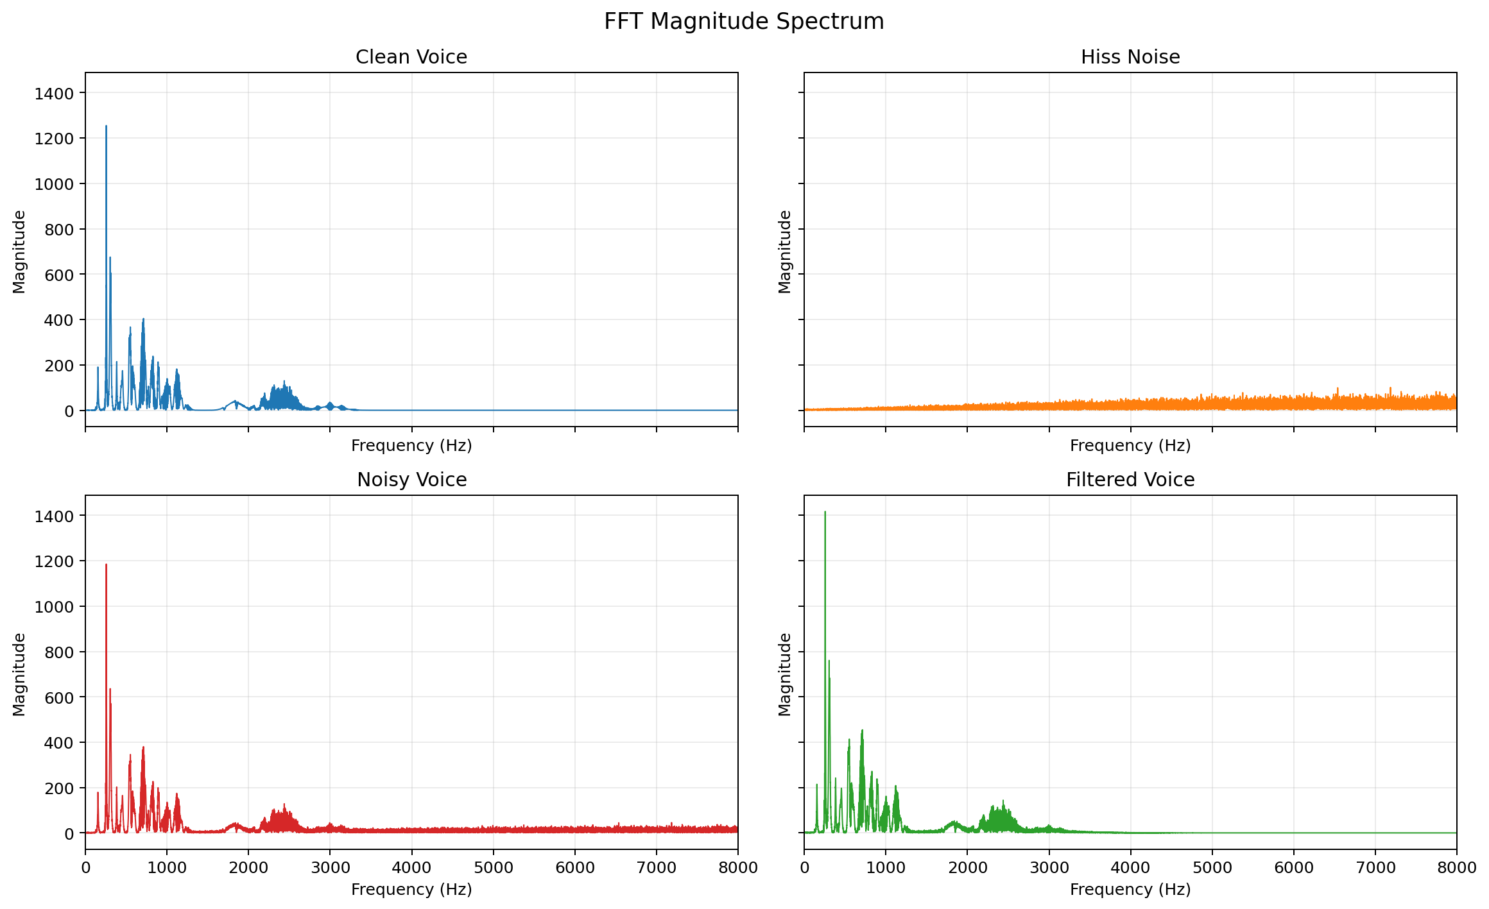
Signal characteristics
ECE0402 • Slide 6

Slide 7
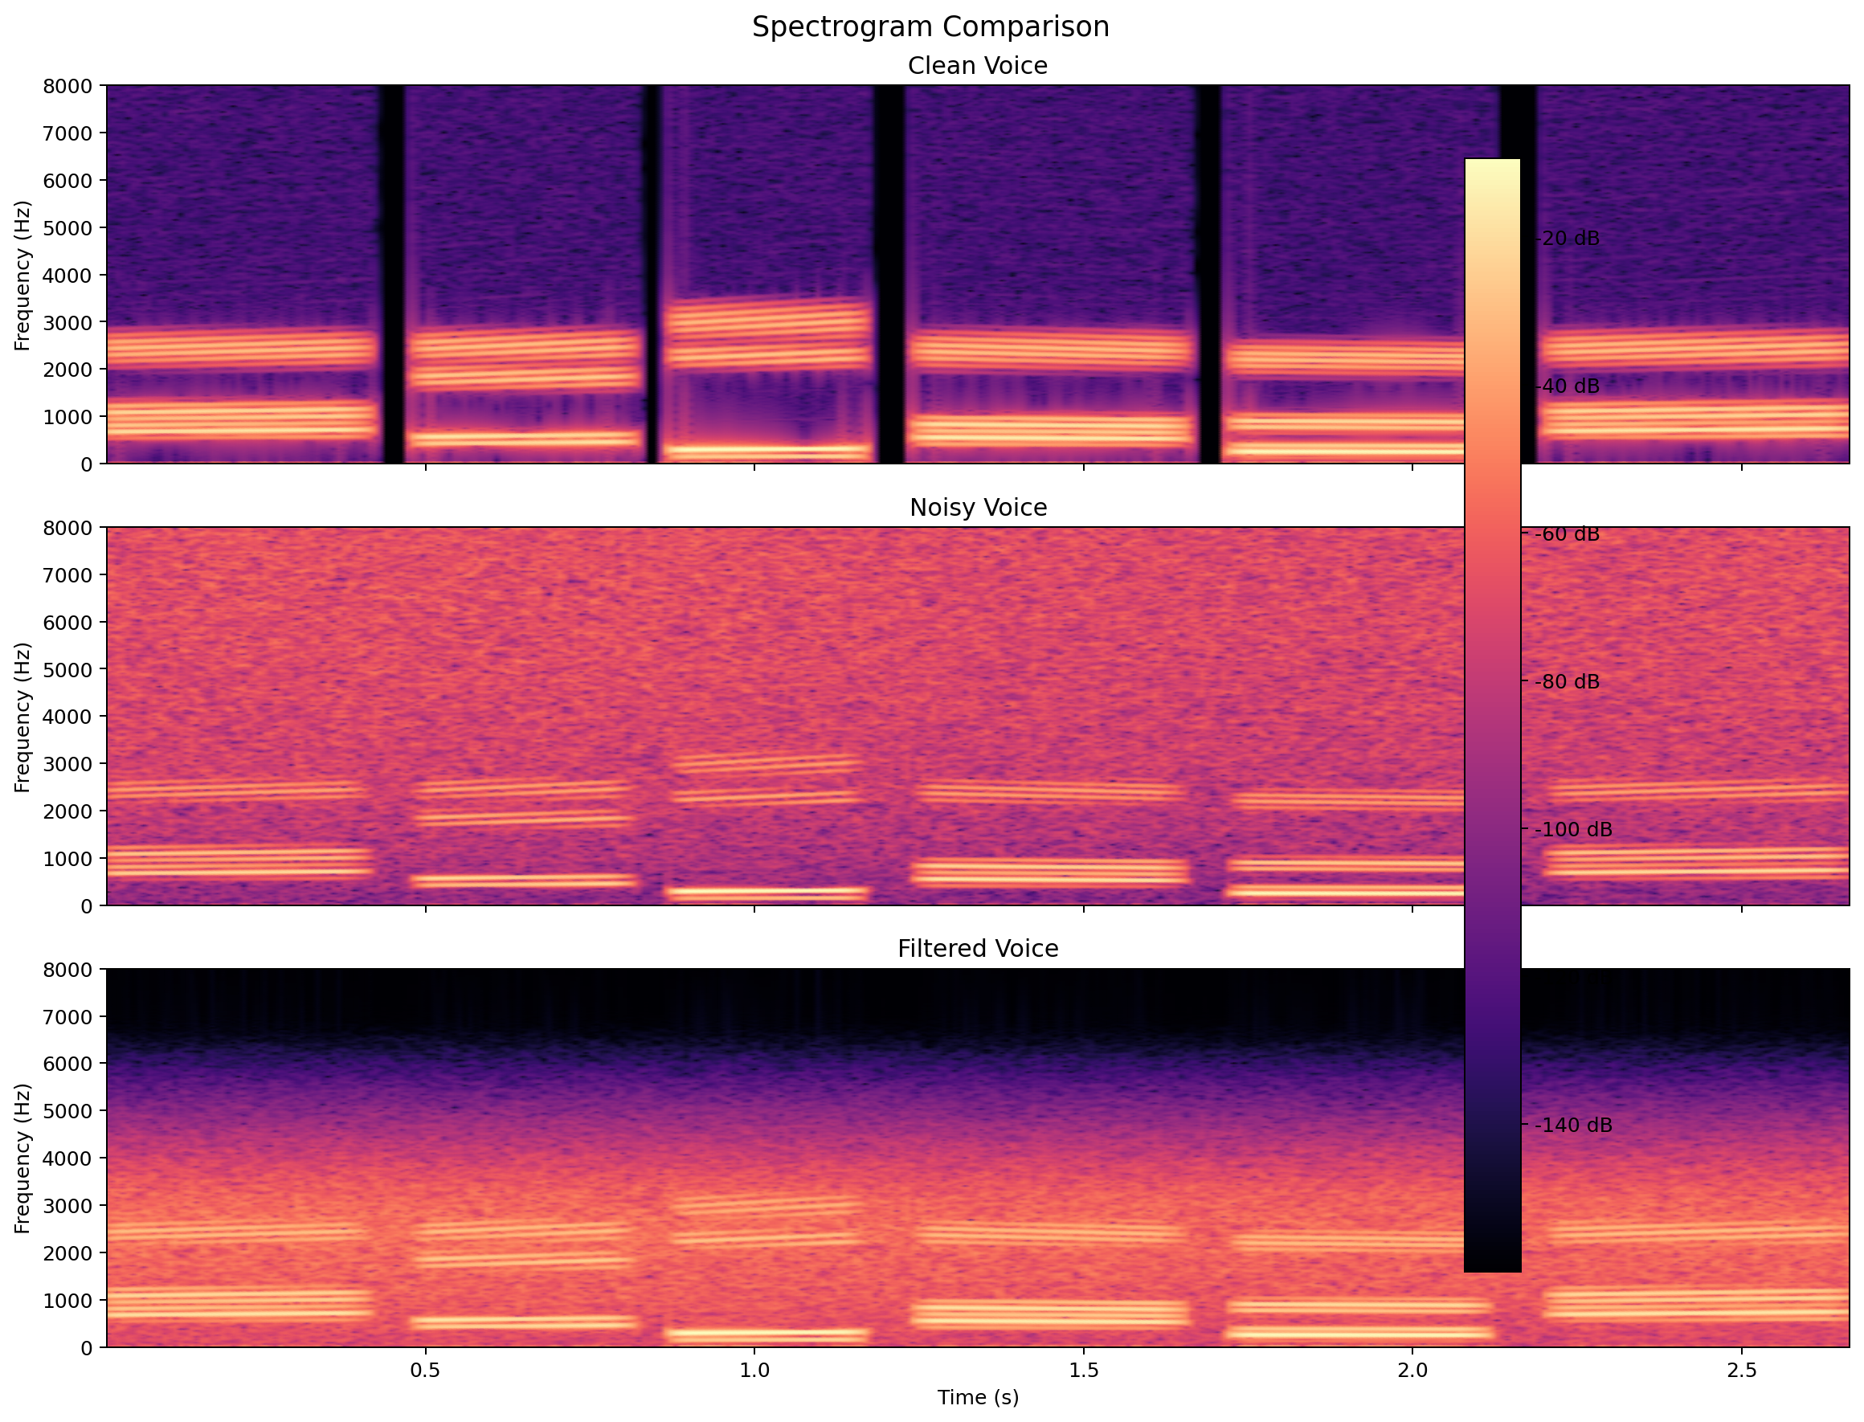
Why Fourier Transform helps
In the time domain, speech and noise are mixed together and hard to separate directly.
The Fourier Transform shows where energy is concentrated across frequencies.
That frequency view tells us why a low-pass filter is reasonable in this specific hiss scenario.
ECE0402 • Slide 7

Slide 8
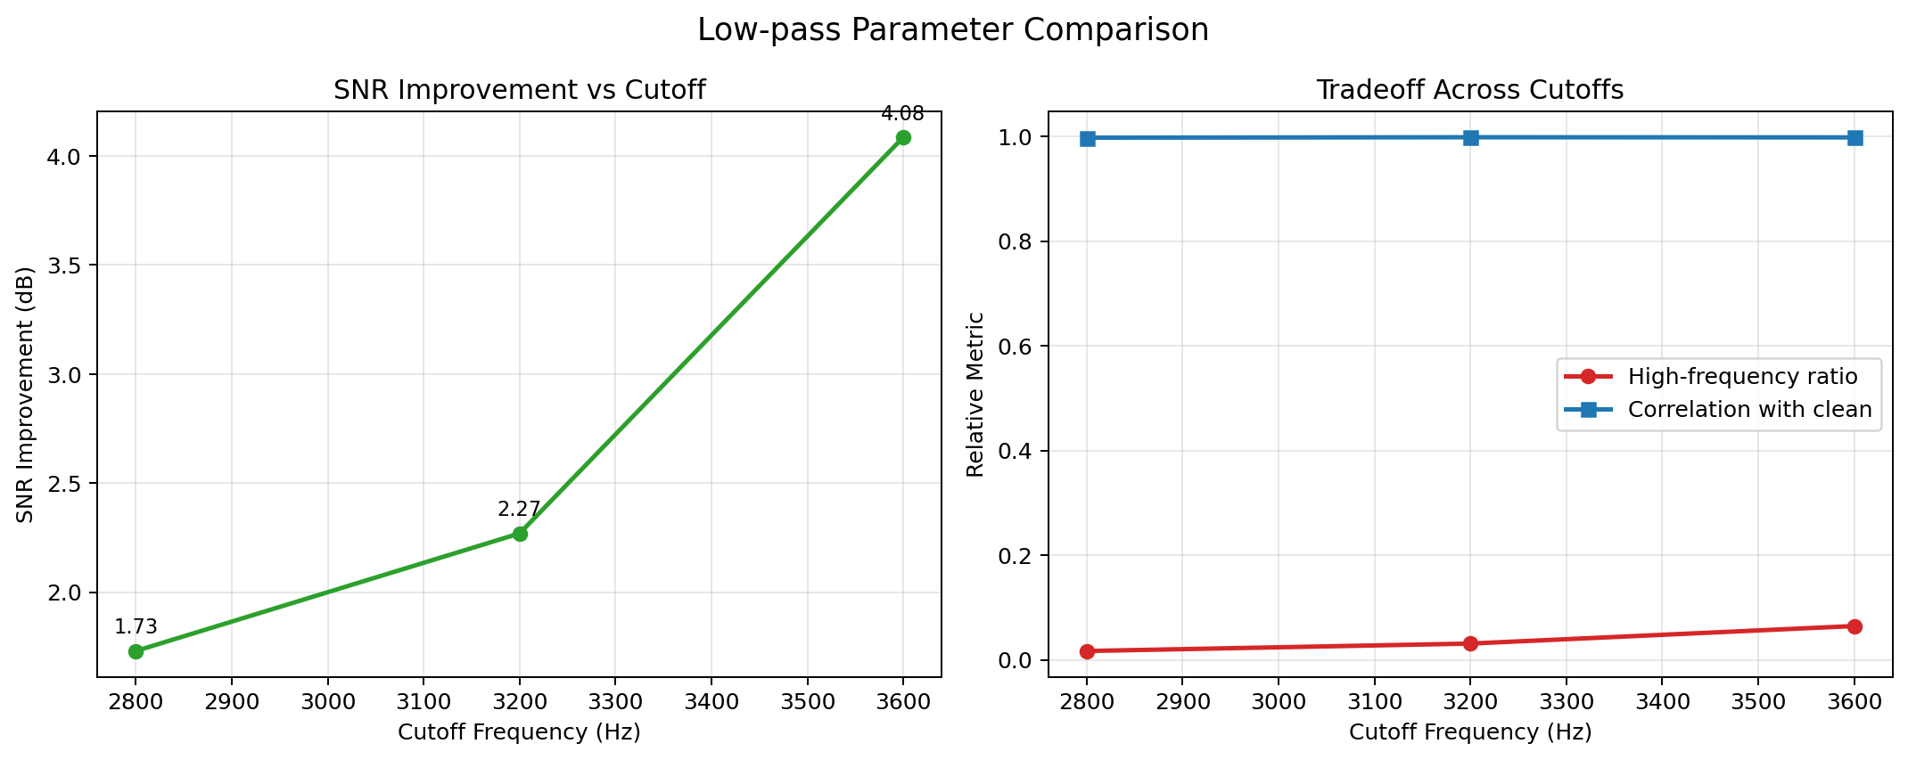
Filter design idea
2800 Hz removes more hiss, but speech starts sounding dull.
3600 Hz preserves more speech detail, but leaves more high-frequency noise behind.
3200 Hz gives the best presentation balance between audible improvement and naturalness.
ECE0402 • Slide 8

Slide 9
System workflow
clean voice
hiss noise
noisy voice
filtered voice
low-pass filter
Model a realistic but controllable scenario
Observe the signal in the frequency domain
Design and compare candidate filter parameters
Evaluate the result with audio and figures
ECE0402 • Slide 9

Slide 10

Demo setup
Clean Voice
Noisy Voice
Filtered Voice
ECE0402 • Slide 10

Slide 11
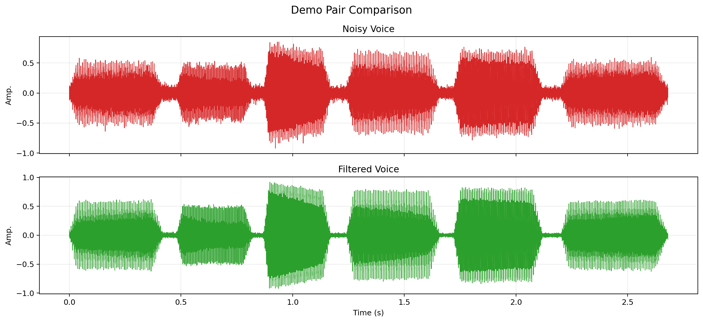
Results
Audible improvement supported by visual evidence
High-frequency hiss is visibly reduced after filtering.
Speech remains understandable in the processed output.
The improvement is clear, but some high-frequency speech detail is softened.
ECE0402 • Slide 11

Slide 12
Discussion and limitations
Suppression
The low-pass filter works because the simulated hiss is mainly high-frequency.
The same mechanism also removes some useful high-frequency speech detail.
A more realistic station environment would contain broader and more complex noise, which basic low-pass filtering cannot handle as cleanly.
Preservation
Tradeoff
ECE0402 • Slide 12

Slide 13
A simple filter can explain a lot.
We modeled a voice-noise problem, used frequency-domain analysis to guide the design, and showed that a basic low-pass filter can reduce hiss while preserving intelligibility.
ECE0402 • Slide 13

