Slide 1

Silence in the Spectrum: Unmasking Speech From Noise
ECE0402 • Signals, Systems & Probability
Group 6: Junze Xie, Ming Chen, Zifan Xu, Yimin Chen & Wanting Luo
ECE0402 • Slide 1

Slide 2
Project Snapshot
Public-announcement Voice
Signal Superposition Through the System
Low-pass Filter
Wiener-style Filter
Frequency Masking
Filtering is a Tradeoff
ECE0402 • Slide 2

Slide 3
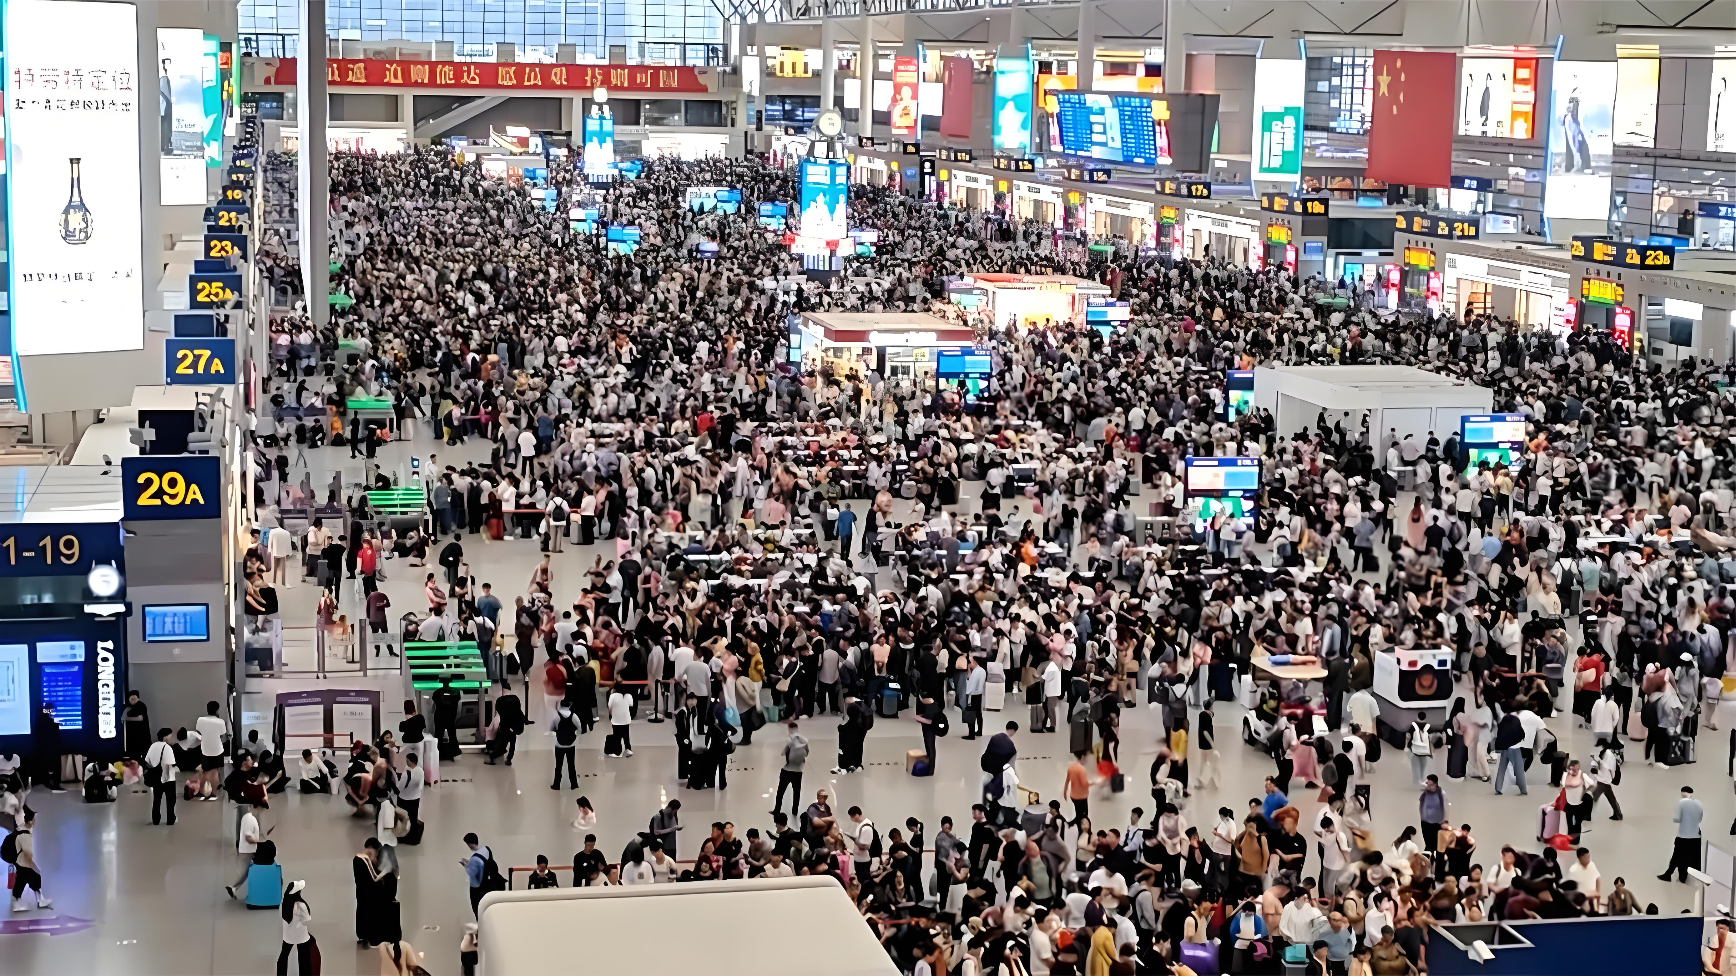
Scenario & Scope
In a public setting
Such as a train station
A phone call came through…
ECE0402 • Slide 4

Slide 4
Problem Remodeling
这里放图， 声音分成clean voice和hiss voice，进入系统，先频谱分析，然后确定频率，过滤波器，输出过滤后的音频。这一页只放这一个pipeline，红色部分可能结构补全，自己看代码，保证pipeline逻辑符合代码
ECE0402 • Slide 5

Slide 5
Assumption & Goal
Voice recordings and public announcements often lose clarity when background noise is present.
High-frequency hiss is a useful starting point because it is common, audible, and frequency-domain friendly.
Our goal is to remove the noise from background and preserve the voice from user.
ECE0402 • Slide 3

Slide 6
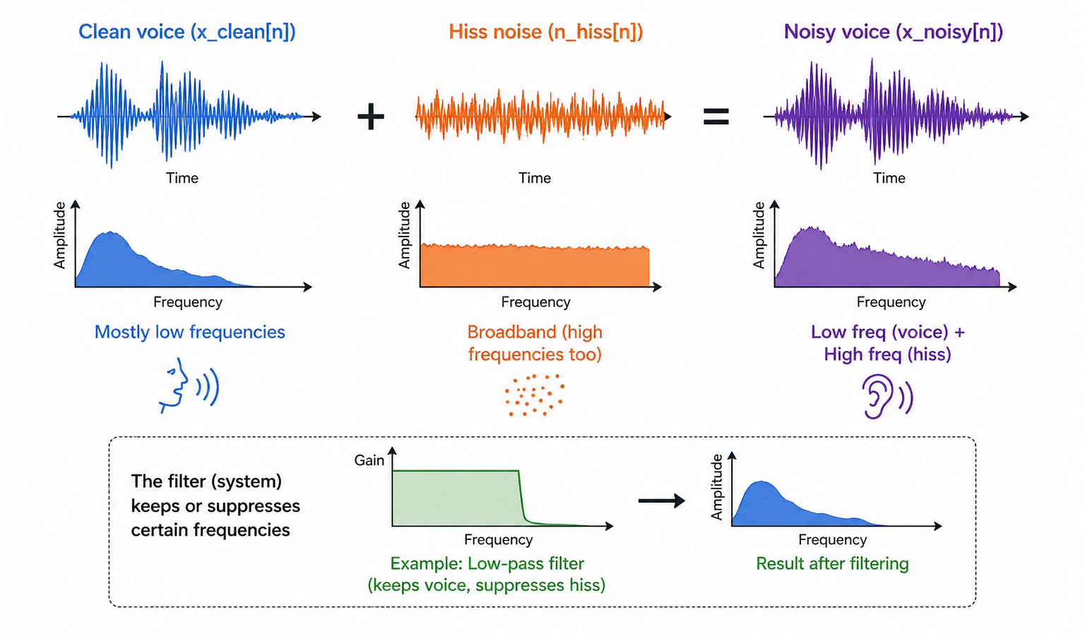
Signal model
$$X_{noise}\left[n\right]=X_{clean}\left[n\right]+N_{hiss}\left[n\right]$$
Clean voice and hiss are both signals
the noisy voice is a superposition
the filter is an input-output system
frequency response explains what the system keeps or suppresses
ECE0402 • Slide 6

Slide 7
Visualizing the signals
Waveform, spectrum, and spectrogram
waveform placeholder
FFT spectrum placeholder
spectrogram placeholder
Waveform shows time-domain shape. FFT shows overall frequency energy. Spectrogram shows how energy changes over time and frequency.
ECE0402 • Slide 7

Slide 8
Frequency-domain observation
Clean voice has structured low-to-mid frequency components.
Hiss noise raises the high-frequency background.
The noisy signal makes the high-frequency region visibly stronger.
PLACEHOLDER spectrum / spectrogram evidence
ECE0402 • Slide 8

Slide 9
Baseline: low-pass filter
A fixed frequency-domain mask
Low-pass filtering keeps lower frequencies and attenuates higher frequencies.
It is easy to explain and closely related to frequency response.
In mask language, low-pass is a fixed mask: pass below cutoff, suppress above cutoff.
PLACEHOLDER low-pass response / fixed mask
ECE0402 • Slide 9

Slide 10
Baseline parameter choice
Why cutoff is a design decision
Lower cutoff: stronger noise reduction, but speech becomes duller.
Higher cutoff: more speech detail, but more hiss remains.
The chosen cutoff is a balance between suppression and preservation.
PLACEHOLDER cutoff comparison figure
ECE0402 • Slide 10

Slide 11
Why low-pass is not enough
The baseline is explainable, but coarse
Low-pass uses the same attenuation pattern for the entire signal.
It does not know whether a time-frequency region is speech-dominant or noise-dominant.
This can reduce hiss, but it can also remove useful high-frequency speech detail.
This motivates a more flexible frequency-domain mask.
ECE0402 • Slide 11

Slide 12
Frequency-domain masking
A more flexible version of the same idea
Y(f) = M(f)X(f)
Y(t, f) = M(t, f)X(t, f)
PLACEHOLDER mask heatmap
M close to 1: preserve this component
M close to 0: suppress this component
Low-pass is a fixed mask; frequency masking can be more adaptive
ECE0402 • Slide 12

Slide 13
Wiener-style mask
A principled way to design the mask
M(f) = P_speech(f) / (P_speech(f) + P_noise(f))
If speech power is stronger, the mask moves closer to 1.
If noise power is stronger, the mask moves closer to 0.
This follows the intuition of Wiener filtering, without claiming an industrial-grade denoising system.
PLACEHOLDER Wiener gain curve / mask
ECE0402 • Slide 13

Slide 14
Improved method workflow
From STFT to masked enhanced voice
noisy voice
→
STFT
→
estimate noise
→
compute mask
→
apply mask
→
iSTFT
The improved method still uses the frequency-domain story, but makes the attenuation pattern more selective.
ECE0402 • Slide 14

Slide 15
Mask visualization
The main new figure for the upgraded demo
Noisy spectrogram placeholder
Wiener-style mask placeholder
Masked spectrogram placeholder
A good result page should show the logic visually: Noisy -> Mask -> Enhanced.
ECE0402 • Slide 15

Slide 16
Result comparison
Baseline versus Wiener-style masking
Noisy voice spectrogram / audio label
Low-pass result spectrogram / audio label
Mask result spectrogram / audio label
The goal is not to crown a perfect method, but to explain how a more flexible mask changes the filtering behavior.
ECE0402 • Slide 16

Slide 17
Demo
Audio slots to fill after the mask experiment is generated
AUDIO SLOT clean voice
AUDIO SLOT noisy voice
AUDIO SLOT low-pass result
AUDIO SLOT mask result
Play the same speech segment for every version.
Then connect what we hear to the spectrogram and mask figures.
Keep the demo short enough that the audience remembers the contrast.
ECE0402 • Slide 17

Slide 18
Limitations
What this system still cannot solve
The noise is simulated and simpler than a real station environment.
Mask quality depends on how well the noise power is estimated.
If speech and noise overlap strongly in the same time-frequency region, separation becomes difficult.
More advanced methods may require adaptive filtering or learning-based denoising.
PLACEHOLDER limitations / extension diagram
ECE0402 • Slide 18

Slide 19
A simple filter can become a richer system.
Conclusion
We modeled voice denoising as a Signals and Systems problem.
Low-pass filtering provides a clear baseline.
Frequency-domain masking extends the same idea in a more flexible way.
A Wiener-style mask gives a principled and visual way to design frequency-dependent attenuation.
ECE0402 • Slide 19

