Slide 1



SketchVisor: Robust Network Measurement for Software Packet Processing
Qun Huang, Xin Jin, Patrick P. C. Lee,
Runhui Li, Lu Tang, Yi-Chao Chen, Gong Zhang

Slide 2


Monitoring Traffic Statistics
Network management
Network-wide flow statistics
Traffic distribution
Flow
cardinality
Heavy
hitters

Slide 3
Sketch: A Promising Solution
Sketch: a family of randomized algorithms
Key idea: project high-dimensional data into small subspace
High-dimensional data
Randomized projection
Input data
Statistics
Subspace
Data structure
Small subspace:
low computation & communication overheads
Subspace reflects mathematical properties
Strong theoretical error bounds when querying for statistics

Slide 4
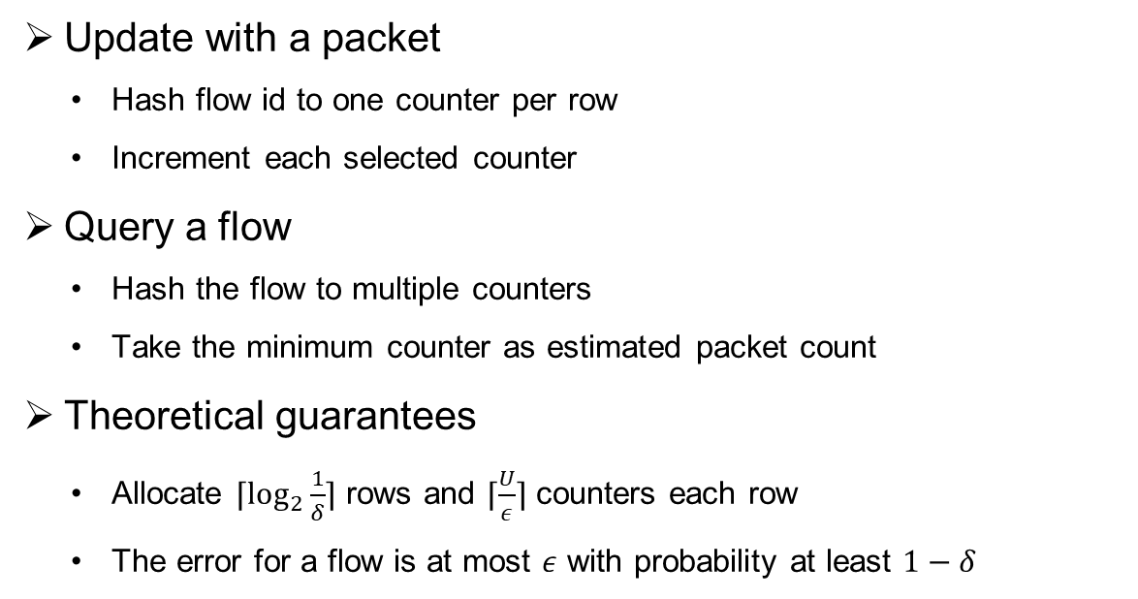
Example: Count-Min Sketch
Count flow packets
Update with a packet
Hash flow id to one counter per row
Increment each selected counter
Query a flow
Hash the flow to multiple counters
Take the minimum counter as estimated packet count
Theoretical guarantees
Allocate $⌈\log_{2}{\frac{1}{δ}}⌉$ rows and $⌈\frac{U}{ε}⌉$ counters each row
The error for a flow is at most $ε$ with probability at least $1−δ$
+1
Packet
+1
+1
+1
Each element is a counter

Slide 5
Our Focus
Sketch-based measurement atop software switches
Network-wide sketch
Local sketch
Local sketch
Local sketch
Local sketch
Hardware Switches

Slide 6
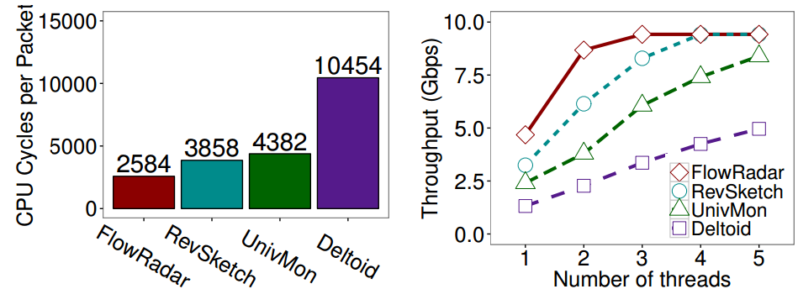
Limitation of Sketches
Basic sketches
Lack of generality
Limited query
More structures
Complicated sketches

Slide 7
Our Contributions
SketchVisor: Sketch-based Measurement System for Software Packet Processing
Performance
Catch up with underlying packet forwarding speed
Resource efficiency
Consume only limited resources
Accuracy
Preserve high accuracy of sketches
Generality
Support multiple sketch-based algorithms
Simplicity
Automatically mitigate performance burdens of sketches without manual tuning

Slide 8
Architecture: Double-Path Design
Control plane
Network-wide sketch
Merge two paths
Recover lost information
Transparent to users
Network-wide merge & recovery
Global normal path
Global fast path
Data plane
Switches
To control plane
Local normal path
Local fast path
User-defined sketches
High accuracy
(Relatively) slower
Fast path
High speed
(Relatively) less accurate
General for multiple sketches
Sketch 1
Sketch 2
Fast path
algorithm
Sketch 3
Sketch 4
Buffer
Packets
Forwarding

Slide 9
Key Questions
Data plane: how to design the fast path algorithm?
Control plane: how to merge the normal path and fast path?

Slide 10
Intuitions
Consider sketches which map flow byte counts into counters
Other sketches (e.g., Bloom Filter) can be converted
Each large flow has significant impact
Flows
Sketch counters
Large Flows
Many Small Flows
Each small flow
has limited impact
Aggregated impact of small flows is significant

Slide 11
Fast Path Algorithm
Ideal algorithm
Our practical algorithm
Infeasible with limited resources
How
Per-flow byte count
of large flows
(Approximate) per-flow byte count of large flows
Aggregated byte count of small flows
(Approximate) aggregated byte count of small flows
?
Easy
Byte of small flows = total byte – byte of large flows

Slide 12
Approximate Tracking of Large Flows
A small hash table
“Guess” and kick out potentially small flows when table is full
Each flow has three counters
Estimated errors due to flow kick-outs
Byte count
Flow ID
Counter 1
Counter 2
Counter 3
Flow 1
4
0
1
Flow 2
1
0
1
Flow 3
2
0
1

Slide 13
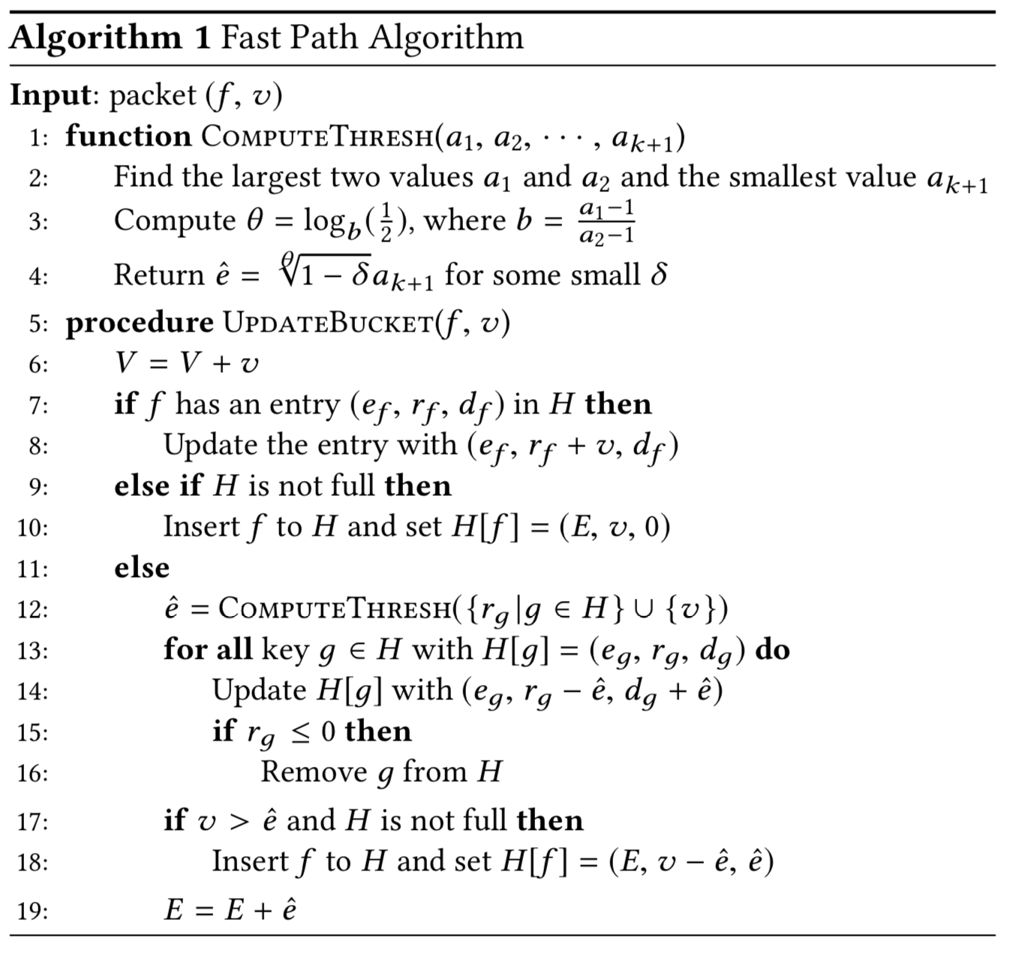
Fast Path Algorithm
E : the sum of all decremented byte counts.
V : the total byte count of packets in the fast path.

Slide 14
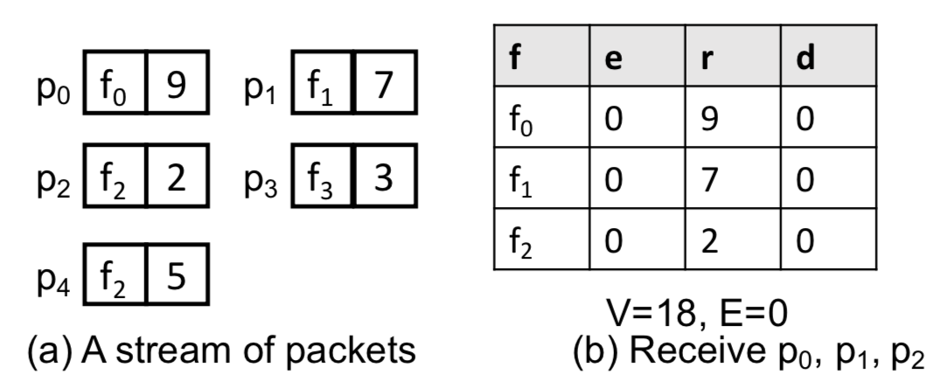
Fast Path Algorithm

Slide 15
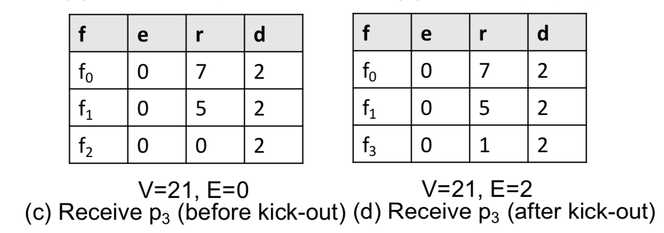
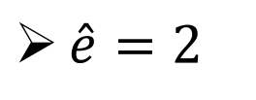
Fast Path Algorithm
$\hat{e}=2$

Slide 16
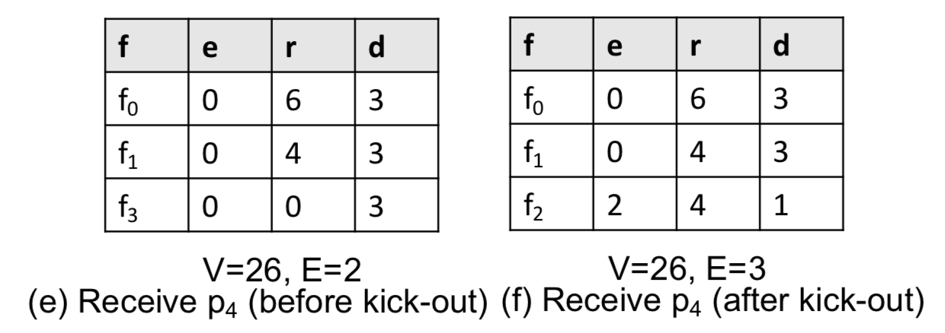
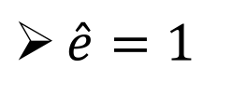
Fast Path Algorithm
$\hat{e}=1$

Slide 17
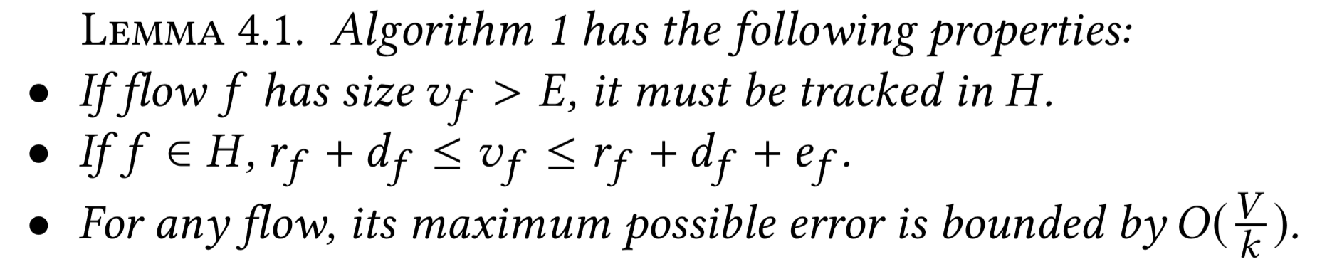
Fast Path Algorithm

Slide 18
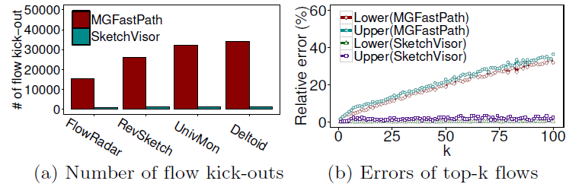
Performance and Accuracy
Theoretical analysis shows:
All large flows are tracked
Amortized O(1) processing time per packet
Bounded errors
Compared to Misra Gries top-k algorithm

Slide 19
Key Questions
Data plane: how to design a fast path algorithm?
Control plane: how to merge the normal path and fast path?

Slide 20
Control Plane: Challenge
Input insufficient to form network-wide sketches
Global normal path
Input 1: Incomplete sketch with missing values
Expected output:
Network-wide sketch
Network-wide recovery
Global fast path
Flow ID
Counter 1
Counter 2
Counter 3
Input 2: Approximate large
flows in fast path
Flow 1
4
0
1
Flow 2
1
0
1
Flow 3
2
0
1
Total byte count
Input 3: Total byte counts in fast path

Slide 21
Matrix Interpolation Problem
The recovery process can be expressed as
Expected output sketch (unknown)
Large flows in fast path (unknown)
T = N + sk(x + y)
Sketch in global normal path (known)
Small flows in fast path (unknown)

Slide 22
Matrix Interpolation Problem
Based on theoretical analysis and microbenchmarks
Expected output sketch (unknown)
Large flows in fast path (unknown)
T = N + sk(x + y)
Sketch in global normal path (known)
Small flows in fast path (unknown)

Slide 23
Matrix Interpolation Problem
Based on theoretical analysis and microbenchmarks
(low-rank structure)
Expected output sketch (unknown)
Large flows in fast path (unknown)
T = N + sk(x + y)
Sketch in global normal path (known)
Small flows in fast path (unknown)

Slide 24
Matrix Interpolation Problem
Based on theoretical analysis and microbenchmarks
(1. sparse vector)
(low-rank structure)
(2. each flow is bounded)
Expected output sketch (unknown)
Large flows in fast path (unknown)
T = N + sk(x + y)
Sketch in global normal path (known)
Small flows in fast path (unknown)

Slide 25
Matrix Interpolation Problem
Based on theoretical analysis and microbenchmarks
(1. sparse vector)
(low-rank structure)
(2. each flow is bounded)
Expected output sketch (unknown)
Large flows in fast path (unknown)
T = N + sk(x + y)
Sketch in global normal path (known)
Small flows in fast path (unknown)
(small and close values)

Slide 26
Matrix Interpolation Problem
Based on theoretical analysis and microbenchmarks
(1. sparse vector)
(low-rank structure)
(2. each flow is bounded)
Expected output sketch (unknown)
Large flows in fast path (unknown)
T = N + sk(x + y)
Total traffic is known
Sketch in global normal path (known)
Small flows in fast path (unknown)
(small and close values)

Slide 27
Recovery Approach
Existing Information
T = N + sk(x+y)
T has low-rank structure
values in y are small and close
x is sparse
Flows in x are bounded
Total traffic of x and y is known
Compressive sensing framework
Optimization problem
(encode existing information)
Solve optimization problem
An estimated network-wide sketch

Slide 28
Evaluation

Slide 29
Evaluation Setup
Prototype based on OpenVSwitch
Environments
Testbed: 8 OVS switches connected by one 10Gbps hardware switch
In-memory simulation: 1 – 128 simulation processes
Workloads: CAIDA
Measurement tasks
Heavy hitter detection
Heavy changer detection
Superspreader detection
DDoS detection
Cardinality estimation
Entropy estimation
Flow distribution estimation

Slide 30
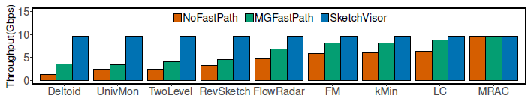
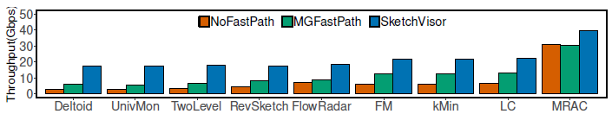
Throughput
Compared with two data plane approaches
NoFastPath: use only Normal Path to process all traffic
MGFastPath: use Misra-Gries Algorithm to track large flows in Fast Path
Achieve ~10 Gbps in testbed (single CPU core)
Achieve ~20 Gbps in simulation (single CPU core)

Slide 31
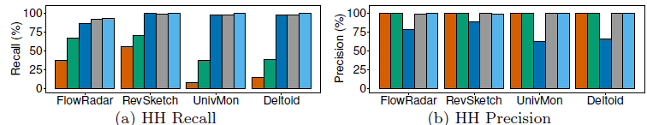
Accuracy
Compare with four recovery approaches
Ideal: an oracle to recover the perfect sketch
NR: no recovery at all
LR: only use lower estimate of large flows in Fast Path
UR: only use upper estimate of large flows in Fast Path
SketchVisor matches the ideal approach

Slide 32
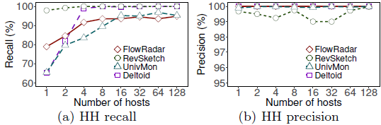
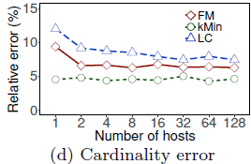
Network-wide Results
Recover sketch from 1-128 hosts
Accuracy improved as number of hosts increases
Work for both byte-based tasks (heavy hitter detection) and connection-based tasks (cardinality estimation)

Slide 33
Conclusion
SketchVisor: high-performance system for sketch algorithms
Double-path architecture design
Slower and accurate sketch channel (normal path)
Fast and less accurate channel (fast path)
Fast path algorithm in data plane
General and high performance
Recovery in control plane
Achieve high accuracy using compressive sensing
Implementation and evaluation
OpenVSwitch based implementation
Trace-driven experiments

