Slide 1
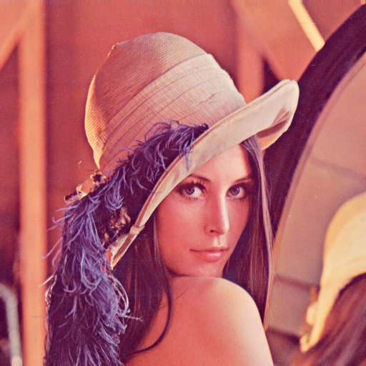

(a) Original
(a) CTR-parallel
(a) CTR-sequential

Slide 2
(a) Original
(a) ECB-parallel
(a) ECB-sequential

