Slide 1
Takada Lab
Progress Report
2025/10/17
Xihao Yang(M1_9)

Slide 2
Brief Introduction
Name: Yang Xihao(Harrison)
Born in China
Worked at Accenture China From 2024 to 2025
Operations Analyst
Handle user complaints to help Client improve testing and implementation to enhance the stability of mobile application.
Interest(Not related to Research):
C#
Research Topic (Tentative): Judging the Quality of Automated Test Repairs with Deep Learning

Slide 3
Reference paper：
Title: A Survey of Learning-based Automated Program Repair(ACM-2023)
Aim of this Paper: To summarize the current state-of-the-art research in the learning-based APR

Slide 4
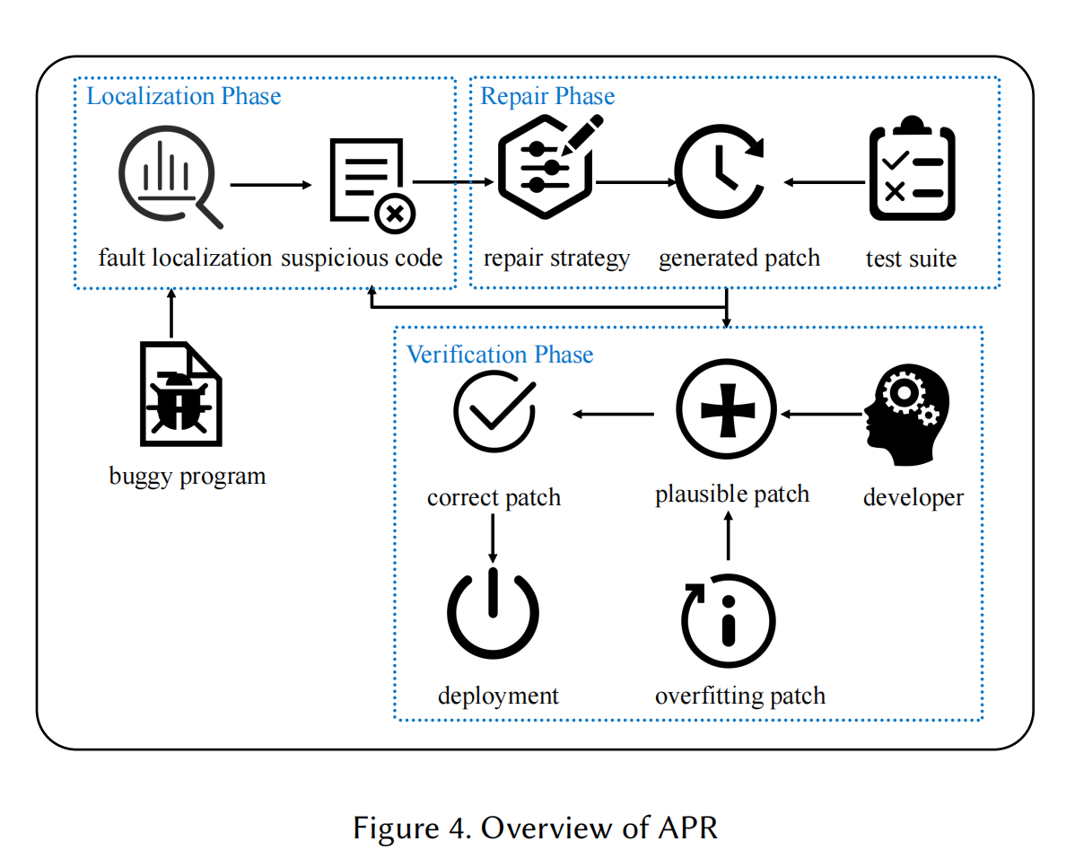
About paper
What is APR
APR= Automated program repair

Slide 5
About paper
Research Method
The process of learning-based APR techniques is two-fold
A training process with supervised learning on large labeled datasets (e.g., CoCoNut)
An evaluation process on a small set of labeled datasets (e.g., Defects4J)
Other open-source training and evaluation datasets

Slide 6
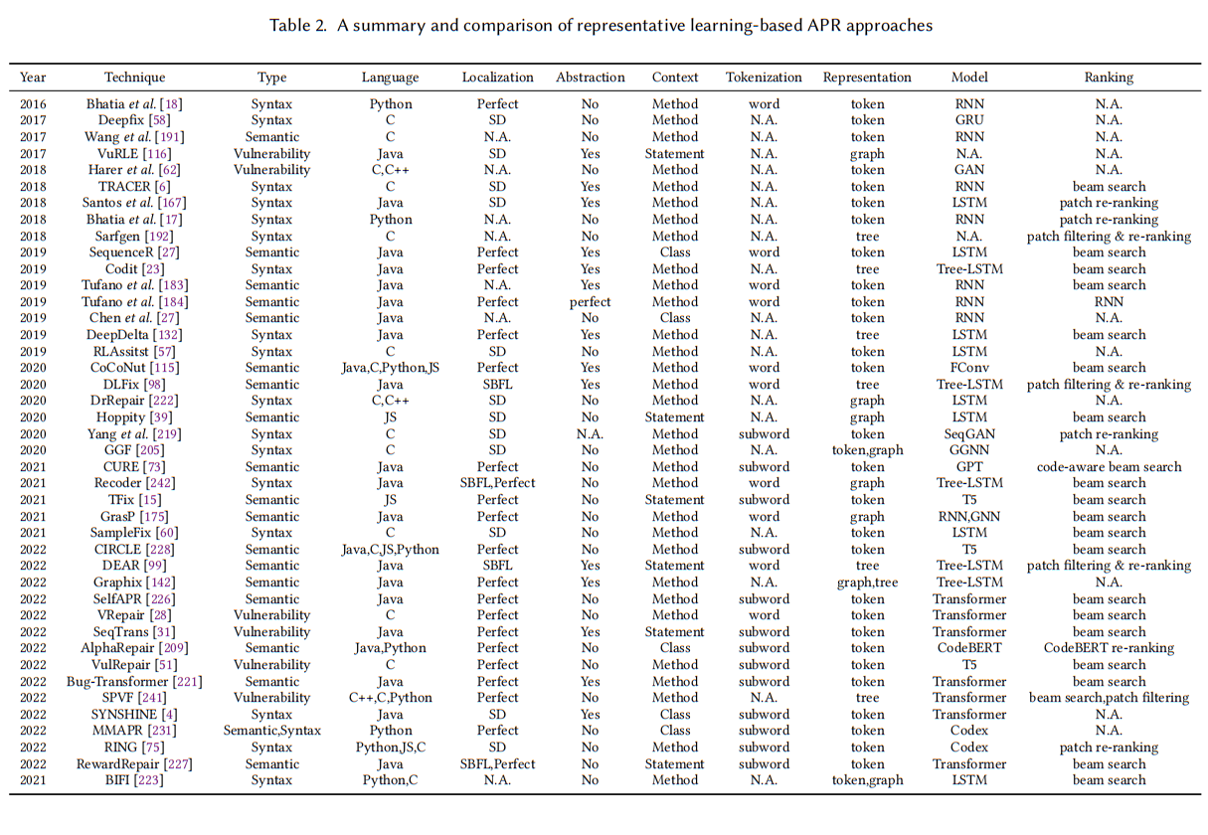
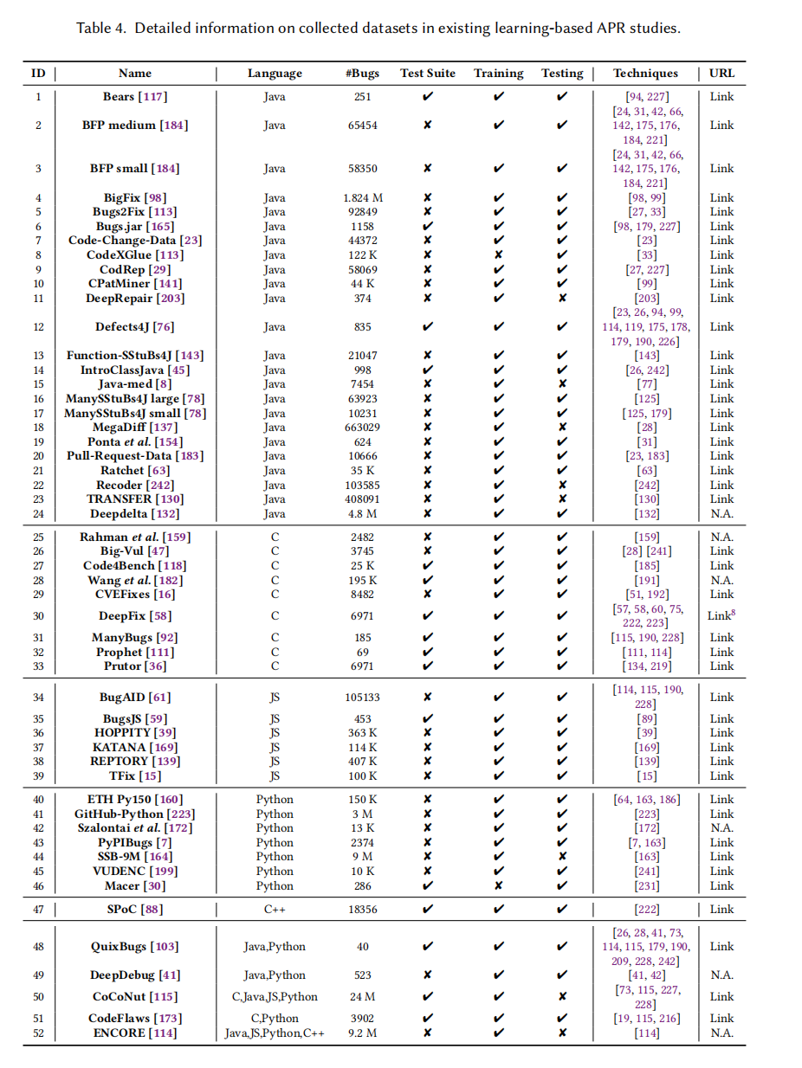

Slide 7
Existing problems
About paper
The Overfitting Issue
The main challenge mentioned as the Testing Suite relies is essentially an incomplete description of the functionality of the program. Therefore, even if a patch passes all tests, it may not actually fix the defect.
Incomplete Program Specification
Existing pattern-based techniques rely on manually designed templates. These templates are costly to create, have poor generalizability, and are difficult to apply to unseen bugs, thus limiting their effectiveness.
Inefficient Patch Validation
It can be extremely time-consuming to compile many candidate patches and repeat all test executions to identify plausible patches.

Slide 8
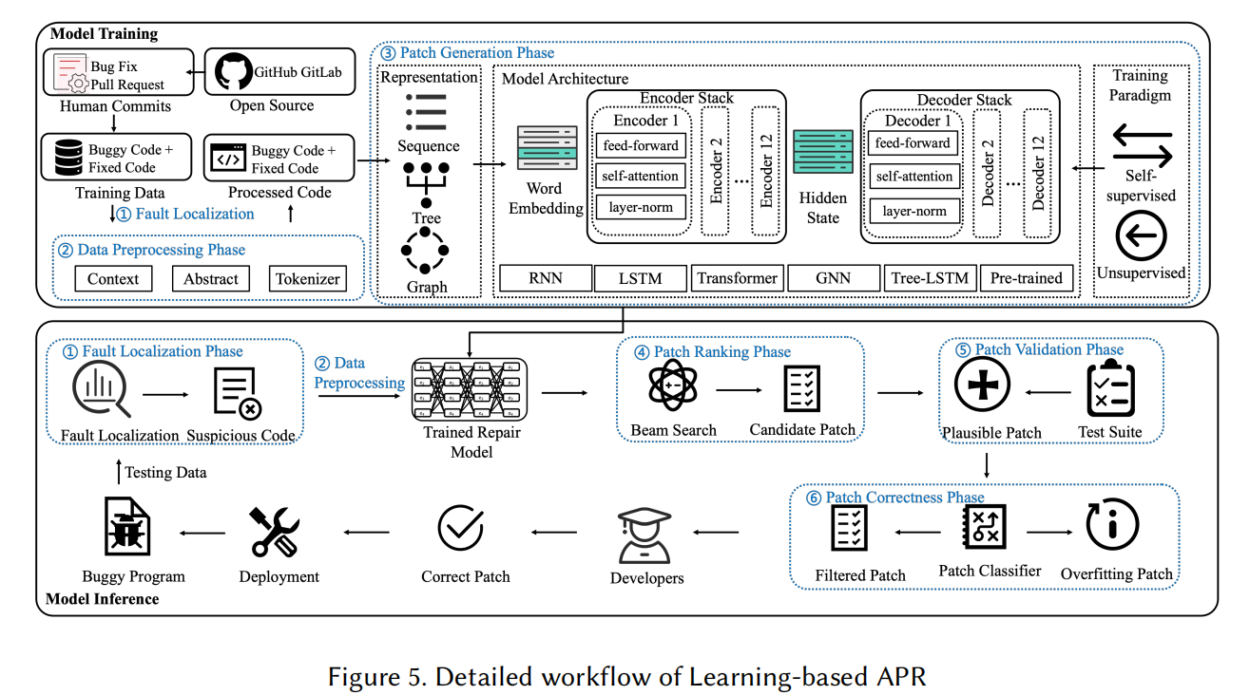
How can Software testing address Problems
About paper
The Overfitting Issue
A round of automated testing is first performed with the augmented test set generated by deep learning. Only patches that pass this round of more rigorous testing are considered as “Filtered Patch”

Slide 9
How can Software testing address Problems
About paper
Incomplete Program Specification
Essentially, this is an "upgrade" of the test suite with deep learning techniques before the APR process begins or during the validation phase.

Slide 10
How can Software testing address Problems
About paper
After receiving the list of candidate patches, instead of directly carrying out full-volume testing, a deep learning-based test sequencing model is used to intelligently arrange the order of test execution to achieve "fast screening".
Inefficient Patch Validation

Slide 11
Todo
1. Read papers about auto program repairing and software testing
2. Find if there are several in-depth papers related to my research
3. Find information about automatic judgement of test repairs and results
4. Clarify which stage of APR can deep learning based-software testing converged be introduced to optimize the process
5. Change or make some minor fix for the research topic if needed while gathering adequate information and acquire open-source dataset for further research

