Slide 1
CSE 105 theory of computation
Fall 2020 Week1

Slide 2
Table of Contents – Quickly Jump to a video’s slides
Monday | Wednesday | Friday | Other
Video 1 | Video 3 | Video 9 | Examples
Video 2 | Video 4 | Video 10
Video 0 | Video 5 | Video 11
 | Video 6 | Video 12
 | Video 7 | Video 13
 | Video 8 | Video 14
 | FAQ | FAQ

Slide 3
This week’s learning goals
Distinguish between alphabet, language, sets, and strings.
Write and debug regular expressions using correct syntax.
Determine if a given string is in the language described by a regular expression.
State the formal definition of (deterministic) finite automata.
Trace the computation of a finite automaton on a given string using its state diagram.
Translate between a state diagram and a formal definition.
Determine if a given string is in the language described by a finite automaton.

Slide 4
Monday
Videos 000-002
Today’s learning goals
Distinguish between alphabet, language, sets, and strings
Today’s textbook sections
None.

Slide 5
001.CSE105.Intro.mp4
Remember:
A computation is any type of calculation that includes both arithmetical and non-arithmetical steps and follows a well-defined model (such as an algorithm).

Slide 6
Before we start
We are committed to fostering a learning environment for this course that supports a diversity of thoughts, perspectives and experiences, and respects your identities (including race, ethnicity, heritage, gender, sex, class, sexuality, religion, ability, age, educational background, etc.). Our goal is to create a diverse and inclusive learning environment where all students feel comfortable and can thrive.
OPHD at (858) 534-8298, ophd@ucsd.edu , http://ophd.ucsd.edu.
Counseling and Psychological Services (CAPS) at 858 5343755 or http://caps.ucsd.edu
CARE at Sexual Assault Resource Center at 858 5345793 sarc@ucsd.edu http://care.ucsd.edu
Financial aid resources, the possibility of emergency grant funding, and off-campus housing referral resources are available. See CAPS and your college dean.
The JSOE IDEA Engineering Student Center will offer remote Engineering Learning Communities (group tutoring) beginning first week of spring quarter. More information is available here: http://jacobsschool.ucsd.edu/idea/programs/idea_studylab.shtmlThe Teaching and Learning Commons will also continue to offer their full suite of support programs. More information is available here: https://commons.ucsd.edu/

Slide 7



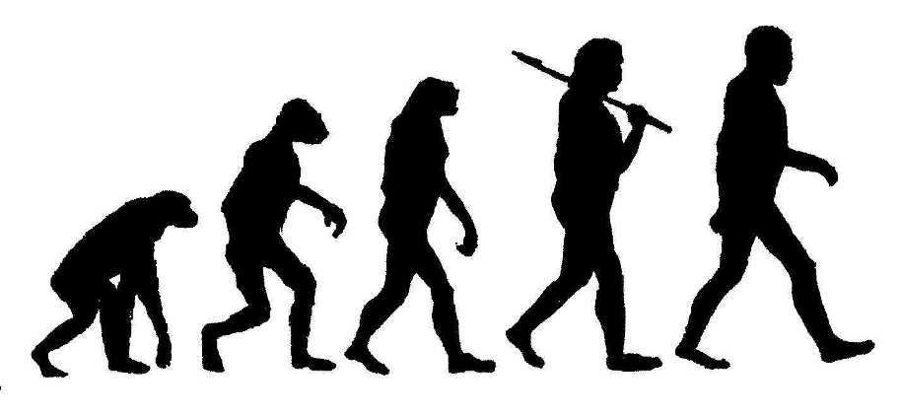
Theory of computability

Slide 8
CSE 105's big questions
What problems are computers capable of solving?
What resources are needed to solve a problem?
Are some problems harder than others?
Making a decision or computing a value based on some input
"Problem"?

Slide 9
Computational problems
Find a file on your computer
Determine if your code will compile
Find a run-time error in your code
Certify that your system is un-hackable
Which of these is hardest?

Slide 10
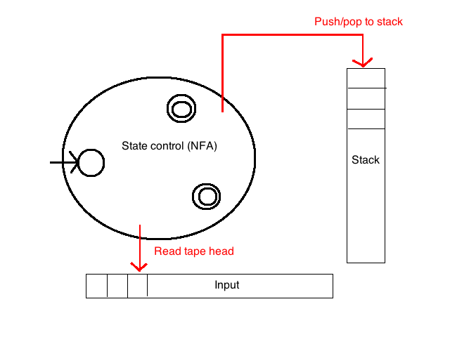
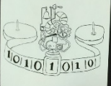
Hardest = uses more resources
Finite automata
Pushdown automata
Turing machine

Slide 11
Key Notation and Definitions (001)
In CSE105, we think about problems that computers might want to solve, whether they’re solvable, and how hard they are to solve.
A problem makes a decision or computes a value based on some input.
Quantum computers, DNA computers, etc. are all equally powerful as a Turing machine.

Slide 12
002.CSE105.Vocabulary.mp4
Remember:
Alphabet A non-empty finite set, usually denoted Σ
Symbol An element of the alphabet
String over Σ A finite list of symbols from Σ
Language over Σ A set of strings over Σ
Sipser pg. 13, 14, 64-65

Slide 13
Vocabulary review From CSE20, etc. Sipser p. 14
{ a,b,c,d,e } The set whose elements are a,b,c,d,e
{ a,b }* The set of finite strings over a,b
Includes empty string ε
Includes a, aa, aaa
Includes b, bb, bbb
Includes ab, ababab, aaaaaaabbb
Does not include infinite sequences of a's and b's
Has infinitely many different elements
| ababab | = 6 The length of the string ababab is 6
| { a,b,c,d,e } | = 5 The size of the set {a,b,c,d,e} is 5
A language (over alphabet Σ) is a set of strings (over Σ)

Slide 14
Key Notation and Definitions (002)
The empty string ε is a unique string of length 0
{ a,b }* is the set of all finite strings over a, b
Set Well-defined collection of distinct objects
Alphabet Σ Non-empty finite set, usually denoted by Σ
Symbol Element of the alphabet
String over Σ A finite list of symbols from Σ
Language over Σ A set of strings (over Σ)

Slide 15
000.CSE105.ResearchConsent.mp4
Remember:
You can always opt out of the study. Your data will be kept anonymous.

Slide 16
Key Notation and Definitions (000)
The study is trying to understand what makes effective teaching and learning.

Slide 17
Wednesday
Videos 003-008
Today’s learning goals
Write and debug regular expressions using correct syntax
Determine if a given string is in the language described by a regular expression.
Today’s textbook sections
Section 1.3 Definition 1.52, Example 1.53

Slide 18
003.CSE105.RegularExpressionsIntro.mp4

Slide 19
New vocabulary Sipser p. 14
{ a,b }* The set of finite strings over the symbols a, b
Includes empty string ε
Includes a, aa, aaa
Includes b, bb, bbb
Includes ab, ababab, aaaaaaabbb
Does not include infinite sequences of a's and b's
Has infinitely many different elements
Alphabet Nonempty set of symbols
String over alphabet Σ, Element of Σ*
Language over alphabet Σ, Subset of Σ*

Slide 20
Vocabulary review From CSE20, etc. Sipser p. 14
{ a,b,c,d,e } The set whose elements are a,b,c,d,e
{ a,b }* The set of finite strings over a,b
Includes empty string ε
Includes a, aa, aaa
Includes b, bb, bbb
Includes ab, ababab, aaaaaaabbb
Does not include infinite sequences of a's and b's
Has infinitely many different elements
| ababab | = 6 The length of the string ababab is 6
| { a,b,c,d,e } | = 5 The size of the set {a,b,c,d,e} is 5
A language (over alphabet Σ) is a set of strings (over Σ)

Slide 21
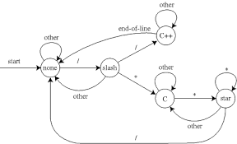
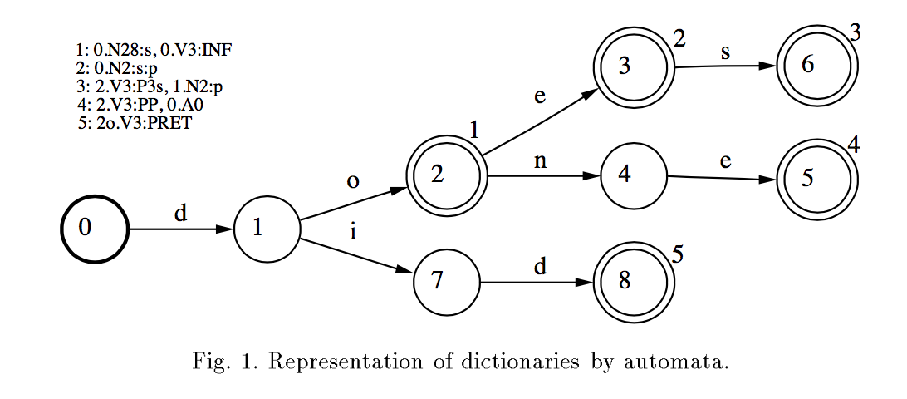
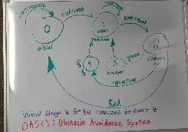
Simplest computations / patterns
Text processing
grep, regexp
Tokenizing
Natural language processing
Hardware design
Moore machines, Mealy machines: CSE 140
Controllers / Robots
SPIS!

Slide 22
Build up from simplest patterns
Alphabet here is {0,1}
∅
{001, 110}
{0,1}*
Regular expressions give us syntax to describe languages

Slide 23
Key Notation and Definitions (003)
How do we describe a language?
List it … if it’s a finite set
Describe condition for membership … but can get complicated
Recursive descriptions of elements: regular expressions

Slide 24
004.CSE105.RegularExpressions.mp4
Remember:
For A and B, both sets of strings over the same alphabet:
Union
Concatenation
Kleene Star
Sipser p. 44, Definition 1.23

Slide 25
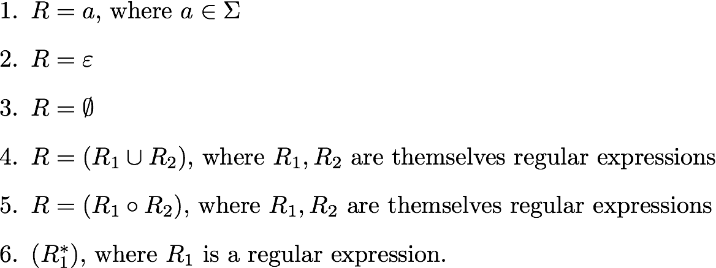
Regular expression Sipser 1.52 p. 64
R is a regular expression over the alphabet Σ if
Σ is shorthand for (0 U 1) if Σ = {0,1}, Parentheses may be omitted, R⁺ means RR*, R^{k} means R concatenated with itself k times

Slide 26
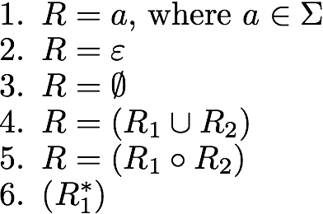
Regular expression Sipser 1.52 p. 64
Which languages are described by each of these regular expressions?

Slide 27
Key Notation and Definitions (004)
Σ is shorthand for (0 U 1) if Σ = {0,1}. Parentheses may be omitted
R⁺ means RR*
R^{k} means R concatenated with itself k times
R is a regular expression over the alphabet Σ if
Sipser 1.52 p. 64

Slide 28
005.CSE105.RegularExpressionsExamples.mp4
Remember:
A regular expression is just a way to write strings.

Slide 29
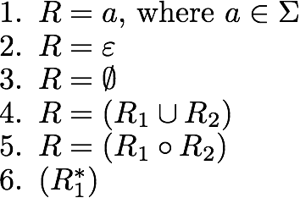


Examples
Σ = {0,1}
L ( (0 U 1) U1 ) = { }
L ( ) = { }
L ( ) = { }
Notes:
For review quiz: Which of the following strings is not in the language described by
( ( (00)*(11) ) U 01 )*
00
01
1101
empty string
I don't know
And: Let L be the language over {a,b} described by the regular expression
((a U Ø) b*)*
Which of the following is not true about L?
Some strings in L have equal numbers of a's and b's
L contains the string aaaaaa
a's never follow b's in any string in L
L can also be represented by the regular expression (ab*)*
More than one of the above.

Slide 30
Key Notation and Definitions (005)
R* is Kleene star
Regular Expression in Practice
Compilers: first phase of compiling transforms Strings to Tokens keywords, operators, identifiers, literals
One regular expression for each token type
Other software tools: grep, Perl, Python, Java, Ruby, …

Slide 31
006.CSE105.RegularExpressionsDefinitionsRecap.mp4
Remember:
R is a regular expression over the alphabet Σ if
Sipser 1.52 p. 64

Slide 32
First model
Code input as strings
Model memory using states
Text processing
grep, regexp
Natural language processing
Hardware design
Moore machines, Mealy machines: CSE 140
Controllers / Robots
SPIS!

Slide 33
Definitions pp. 13, 14, 64-65
Alphabet non-empty finite set
Symbol element of alphabet
String over Σ finite list of symbols from Σ
Language over Σ set of strings over Σ
Regular expression over Σ R
syntactic expression built up recursively
Language described by a regular expression L(R)
set of strings matching pattern given by r.e.

Slide 34
Key Notation and Definitions (006)
When trying to solve a question, we’re basically getting an input string and deciding whether it is or isn’t a member of some set we’re trying to describe.
From a regular expression, we can deduce the set of strings that are described by the regular expression.
A regular expression over Σ usually denoted R
Syntactic expression built up recursively
A language described by a regular expression L(R)
Set of strings matching pattern given by r.e.

Slide 35
007.CSE105.RegularExpressionsMoreExamples.mp4
Remember:
The empty set ∅ or {} is the unique set that has no elements. Its size (or cardinality) is 0.
The empty string ε is the unique string of length 0.

Slide 36
Regular expressions
Which regular expression describes a language that includes the string a ?
a*b*
a(ba)*b
a* U b*
(aaa)*
( U a)b

Slide 37
Key Notation and Definitions (007)
L( a*· ∅ ) = ∅ because empty set describes the empty language. There are no strings described by the empty set. The second part can’t possibly exist, so no string can exist in this language.
There is a implied concatenation between a*b*.
a* includes the empty string.
A string is a finite length of symbols.
The cardinality of the set of all strings is countably infinite.
A regular expression by itself is just a piece of syntax, not a set.
The language described by the regular expression is a set.

Slide 38
008.CSE105.RegularExpressionsGrep.mp4

Slide 39
In practice
How do computers check if a string is in the language described by a regular expression?
grep 'password' /etc/passwd

Slide 40
Key Notation and Definitions (008)
Σ* Is anything that is a string over the alphabet

Slide 41
Wednesday FAQ (003-008)
Q: "Since L(a) = {a} and L(ε) = {ε}, why is L(∅) not equal to {∅}?"
A: In L(a) and L(ε), a and ε are regular expressions. When we want to get the languages of these regular expressions, these languages are represented as sets. In {a} and {ε}, a and ε are used to represent elements in these sets, and in these 2 cases, the regular expressions both happen to represent the only string in the language. In L(∅), ∅ is the regular expression that represents the empty set, therefore in its language, there will be no elements. That is, L(∅) = ∅. The two sets ∅ and {∅} are different! The first has zero elements and the second has one element (the empty set).

Slide 42
Wednesday FAQ (003-008) cont.
Q: "Are regular expressions sets?"
A: A regular expression represents a pattern that we can use to build a set of strings. The regular expression itself is not a set. The language of a regular expression is a set.
Q: "Can we have a symbol in the alphabet that is more than 1 character long?"
A: We can, but generally it is a lot easier for us to keep our symbols at 1 character. That way, we won't get confused with what is a symbol in the alphabet and what is a string in a language.

Slide 43
Wednesday FAQ (003-008) cont.
Q: "Does Kleene star include the empty string?"
A: Yes, Kleene star lets us repeat an expression as many times as we want, and that includes 0 times.
Q: "Can we use sigma in a regular expression to represent the set that contains all the symbols in the alphabet?"
A: Yes, Sigma itself is used as an abbreviation as part of a regular expression to represent the alphabet (the set of all symbols).
Q: "What does it mean to 'concatenate' 2 sets?"
A: Concatenating sets A and B would result in a set where each element is a string from A concatenated with a string from B.

Slide 44
Friday
Videos 009-014
Today’s learning goals
State the formal definition of (deterministic) finite automata.
Trace the computation of a finite automaton on a given string using its state diagram.
Translate between a state diagram and a formal definition.
Determine if a given string is in the language described by a finite automaton.
Today’s textbook sections
Section 1.1 Figure 1.4, Definition 1.5

Slide 45
009.CSE105.DFAIntro.mp4
Remember:
The language described by a regular expression is a set.

Slide 46

Pre-class reading
Tracing the computation of a finite automata using its state diagram.
Formal definition of finite automaton.
From the website:

Slide 47
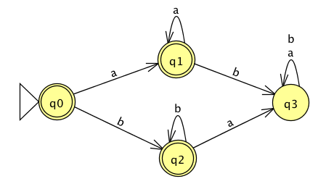
Deterministic Finite Automaton Sipser p. 34
Start state(s)?
Accept state(s)?
Transitions?

Slide 48
Deterministic Finite Automaton Sipser p. 34
Start state(s) q0 (only one start state)
Accept state(s) q1, q2, q0
Transitions (state, character) → next state

Slide 49
Deterministic Finite Automaton Sipser p. 34, 40
Input:
Output:
Computation of the machine on an input string
Sequence of states in the machine, starting with the initial state, determined by transitions of the machine as it reads additional input symbols.

Slide 50
Deterministic Finite Automaton Sipser p. 34, 40
Input: String over {a, b}
Output: Accept / reject
Computation of the machine on an input string
Sequence of states in the machine, starting with the initial state, determined by transitions of the machine as it reads additional input symbols.

Slide 51
Deterministic Finite Automaton Sipser p. 34, 40
Computation of the machine on an input string
Sequence of states in the machine, starting with the initial state, determined by transitions of the machine as it reads additional input symbols.
Machine accepts the input string if state reached at end of computation on accept state.
Machine rejects the input string if state reached at end of computation is not in accept state.
The language recognized by the machine is the set of strings it accepts.

Slide 52
Key Notation and Definitions (009)
Machine accepts the input string if state reached at end of computation on accept state.
Machine rejects the input string if state reached at end of computation is not in accept state.
The language recognized by the machine is the set of strings it accepts.
The only thing an automata can remember is what’s coded by the current state.
The computation on the empty string starts at the start state and has nothing else to do.
The start state has a triangle next to it.
The accept state is denoted by a double circle.
Transitions are indicated by edges .
(state, character) → next state

Slide 53
010.CSE105.DFAFirstExamples.mp4
Remember:
A machine accepts the input string if the state reached at the end of the computation is an accept state.

Slide 54
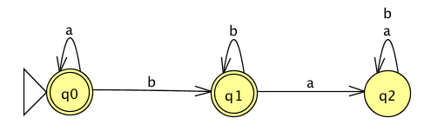
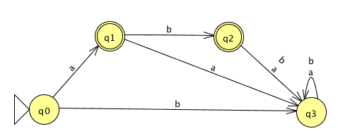
Examples
1. 2.
3.
Which of these automata accept the same language?
All of them
1 and 2
1 and 3
2 and 3
E. None of the them (they each recognize different languages)

Slide 55
Key Notation and Definitions (010)
To determine the language an automata accepts, try some test strings and trace through the computation.

Slide 56
011.CSE105.DFAFirstExamplesSolution.mp4
Remember:
DFA accept-states have double circles around them.

Slide 57
Examples
1. 2.
3.
Which of these automata accept the same language?
All of them
1 and 2
1 and 3
2 and 3
E. None of the them (they each recognize different languages)

Slide 58
Examples
1. 2.
3.
Which of these automata accept the same language?
All of them
1 and 2
1 and 3
2 and 3
E. None of the them (they each recognize different languages)

Slide 59
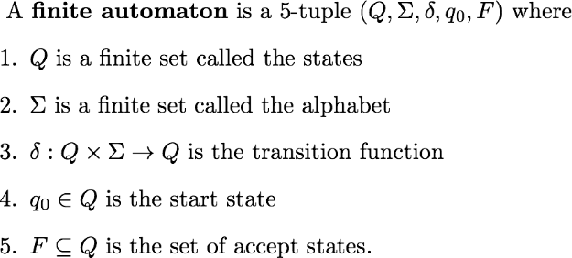
Deterministic finite automaton Sipser p. 35 Def 1.5
No circles and arrows, same information!

Slide 60
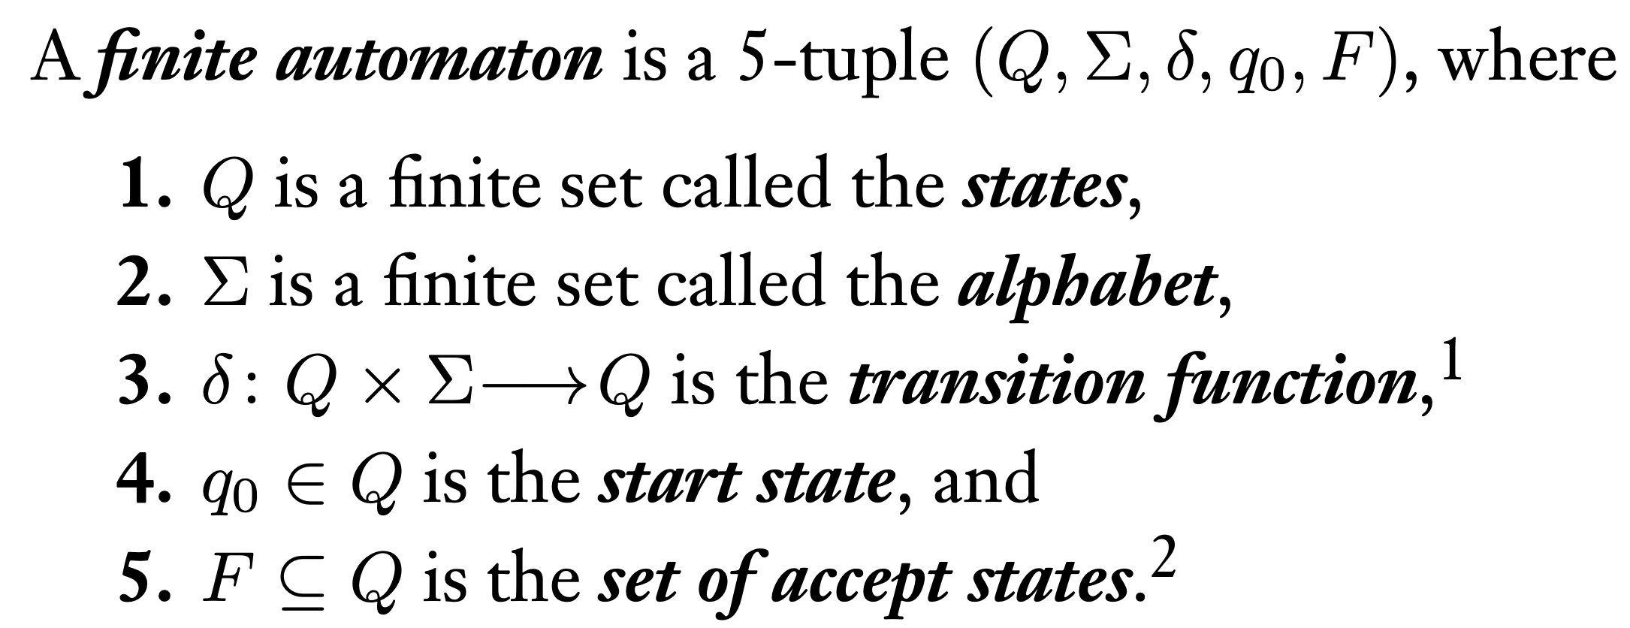
Key Notation and Definitions (011)
Not an element of the language of the machine means not accepted by the machine.
Sipser p. 35 Def 1.5

Slide 61
012.CSE105.JFlapDemo.mp4

Slide 62
Key Notation and Definitions (012)
Step by state: Given an input string, JFlap will show you step by step what state the machine is in.

Slide 63
013.CSE105.DFAFormalDefinition.mp4
Remember:
Alphabet Σ Non-empty finite set, usually denoted Σ
Symbol Element of alphabet

Slide 64
Deterministic finite automaton Sipser p. 35 Def 1.5
How many outgoing arrows from each state?
May be different number at each state.
Must be 2.
Must be |Q|.
Must be |Σ|
I don't know.

Slide 65



Deterministic finite automaton Sipser p. 35 Def 1.5
How many outgoing arrows from each state?
May be different number at each state.
Must be 2.
Must be |Q|.
Must be |Σ|
I don't know.

Slide 66
An example
Define M = where the function δ is specified by its table of values:
Draw the state diagram for the DFA with this formal definition.
Input in Q x Σ | Output in Q
(q1,a) | q3
(q2,a) | q2
(q3,a) | q3
(q4,a) | q2
Input in Q x Σ | Output in Q
(q1,b) | q2
(q2,b) | q2
(q3,b) | q4
(q4,b) | q4

Slide 67
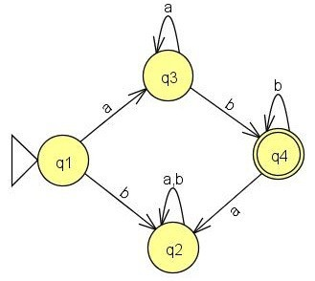
An example
What's an example of a
length 1 string accepted by this DFA?
length 1 string rejected by this DFA?
length 2 string accepted by this DFA?
length 2 string rejected by this DFA?

Slide 68
Key Notation and Definitions (013)
When reading a symbol from the alphabet as input, the transition function describes describes what the next state will be.
Each state in a DFA has |Σ| outgoing transitions: exactly one outgoing edge for each character in the alphabet.
Not every state needs to be reachable. The definition of DFA doesn’t specify that each state needs to have an incoming arrow.

Slide 69
014.CSE105.DFAAnalysis.mp4

Slide 70
Deterministic finite automaton Sipser p. 35 Def 1.5
How many outgoing arrows from each state?
May be different number at each state.
Must be 2.
Must be |Q|.
Must be |Σ|
I don't know.

Slide 71
An example
Define M = where the function δ is specified by its table of values:
Draw the state diagram for the DFA with this formal definition.
Input in Q x Σ | Output in Q
(q1,a) | q3
(q2,a) | q2
(q3,a) | q3
(q4,a) | q2
Input in Q x Σ | Output in Q
(q1,b) | q2
(q2,b) | q2
(q3,b) | q4
(q4,b) | q4

Slide 72
An example
What's an example of a
length 1 string accepted by this DFA?
length 1 string rejected by this DFA?
length 2 string accepted by this DFA?
length 2 string rejected by this DFA?

Slide 73
An example
What's the best description of
the language recognized by this DFA?
Starts with b and ends with a or b
Starts with a and ends with a or b
a's followed by b's
More than one of the above
I don't know.
and using set notation?

Slide 74
An example
This DFA recognizes
the language of all strings
of the form a's followed by b's
i.e. { a^{n}b^{k} | n,k ≥ 1}

Slide 75
An example
{ a^{n}b^{k} | n,k ≥ 1}
Is this the same as the language
described by
a*b*
a(ba)*b
a* U b*
(aaa)*
None of the above

Slide 76
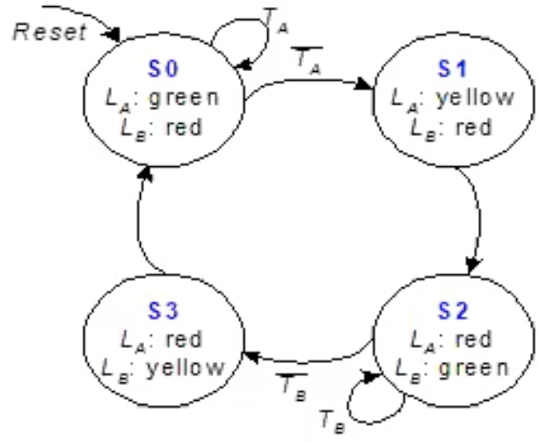
Key Notation and Definitions (014)
There are lots of languages that DFAs cannot recognize.
DFAs are only capable of capturing relatively simple patterns.
Multiple machines can recognize the same language.
Regular expressions capture a pattern and DFAs implement these regular expressions.
A finite state machine similar to a DFA that functions as a simple traffic light controller. Credit: John Eldon, UCSD CSE140L

Slide 77
Friday FAQ (009-014)
Q: "Does it matter what order the names of the states are in? (like q0, q1, q2, etc)"
A: No, it does not matter. These are just labels that we use to differentiate between one state and another. Oftentimes, the start state will be q0, but it does not have to be.
Q: "What is the output of a DFA?"
A: The output is whether the string that we are running the computation on is accepted or not.

Slide 78
Friday FAQ (009-014) cont.
Q: "Can a DFA have more than 1 start state?"
A: A DFA can only have 1 start state. In the formal definition of a DFA, the start state is the 4th value in the 5-tuple, and that value is a single state in the machine.
Q: "Can a DFA have more than 1 accept state?"
A: A DFA can have as many accept states as we want, and it can even have no accept states. In the formal definition of a DFA, the accept states are in the 5th value in the 5-tuple, and that value is a set of states in the machine.

Slide 79
Friday FAQ (009-014) cont.
Q: "What is the 'language of the machine'?"
A: The language of the machine is the set of all strings that the machine would accept.
Q: "Does the machine have to read all the symbols in the string and end on an accept state for it to be accepted, or can the string get accepted if it encounters an accept state at any point in the computation?"
A: The string will not be accepted unless its computation first reads all the symbols in the string and then ends on an accept state.

Slide 80
Friday FAQ (009-014) cont.
Q: "What does it mean for the machine to be 'deterministic'?"
A: It means that for every possible string over the alphabet of the language, the string can be read (but not necessarily accepted). Every state in the machine will have a transition to another state for every symbol in the alphabet.
Q: "Does every language have a DFA that represents it?"
A: No, not all languages can be represented by a DFA. We will see examples of languages that cannot be represented by any DFA in a few weeks. We will learn about other types of machines that can represent some of these languages later in the course.

Slide 81
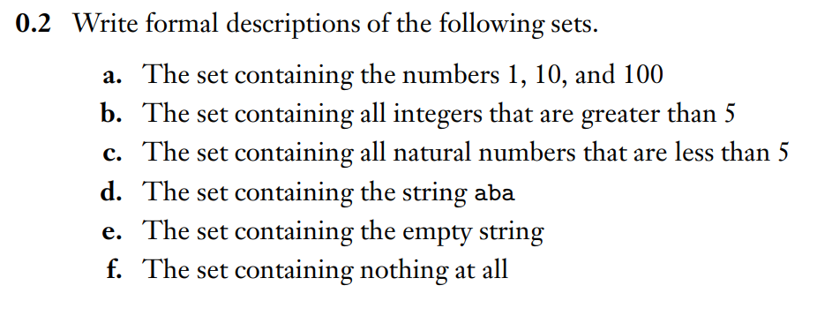
Describing Sets Formally
Example 1
Ch. 0 Exercises pg. 25

Slide 82
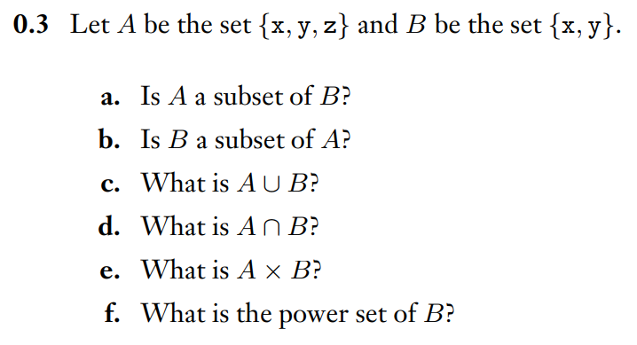
Set Relationships and Operations
Example 2
Ch. 0 Exercises pg. 26

Slide 83
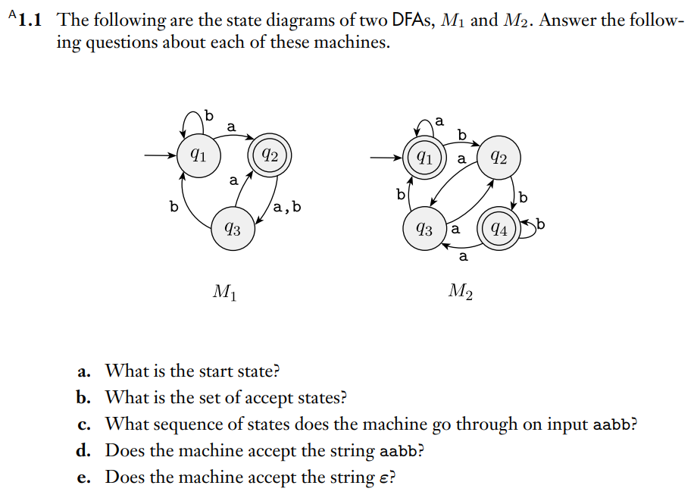
Analyzing a DFA
Example 3
Ch. 1 Exercises pg. 83

Slide 84
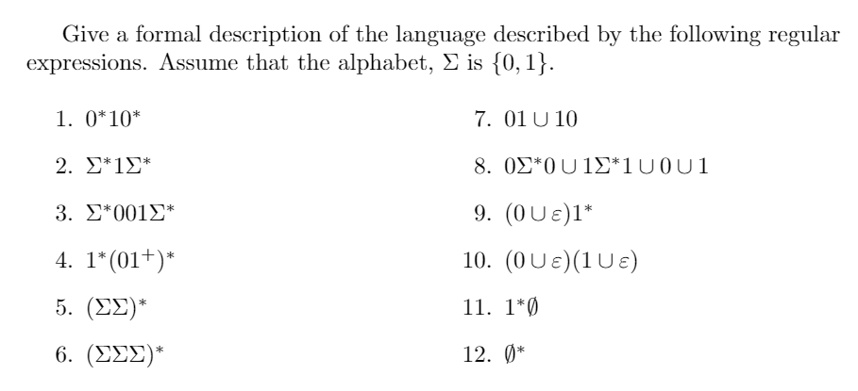
Understanding Regular Expressions
Example 4
Section 1.3 Example 1.53

Slide 85
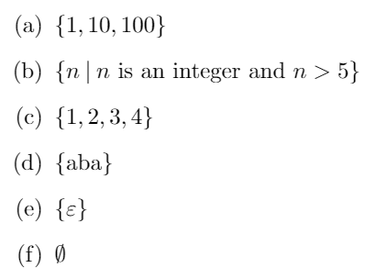
Example 1 Solution

Slide 86
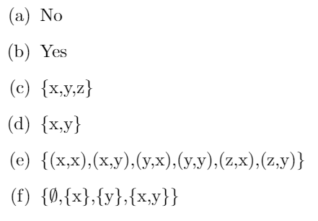
Example 2 Solution

Slide 87

Example 3 Solution
Ch. 1 Solutions pg. 94

Slide 88
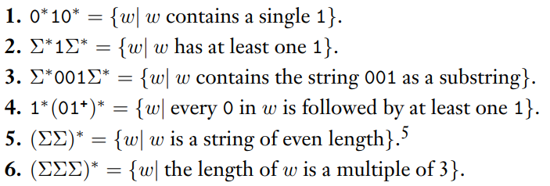
Example 4 Solution

Slide 89
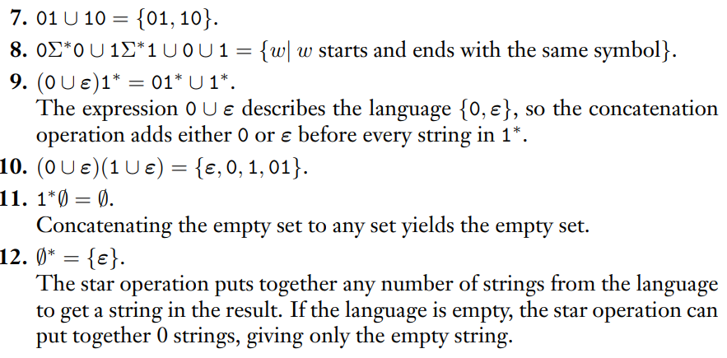
Example 4 Solution(cont.)

