Slide 1
CSE 105 theory of computation
Fall 2020 Week 8

Slide 2
Table of Contents – Quickly Jump to a video’s slides
Monday | Wednesday | Friday
Video 102 | Video 107 | Video 114
Video 103 | Video 108 | Video 115
Video 104 | Video 109 | Video 116
Video 105 | Video 110 | Video 117
Video 106 | Video 111 | Examples
Examples | Video 112 | FAQ
FAQ | Video 113
 | Examples
 | FAQ

Slide 3
This week’s learning goals
Explain what it means for one problem to reduce to another
Define computable functions, and use them to give mapping reductions between computational problems
Define and explain ATM and HALTTM
Build and prove mapping reductions between computational problems

Slide 4
Monday
Videos 102-106
Today’s learning goals
Explain what it means for one problem to reduce to another
Define computable functions, and use them to give mapping reductions between computational problems
Today’s textbook sections
Section 4.2 Theorem 4.22 (p. 209)

Slide 5
102.CSE105.ATMRecap.mp4
Remember:
Through contradiction and by feeding machine M its own code as input, we proved that A_{TM} is recognizable and NOT decidable

Slide 6
A_{TM} Sipser p. 207
A_{TM} = {<M,w> | M is a TM and w is in L(M) }
Define the TM R_{ATM} = "On input <M,w>:
Simulate M on w.
If M accepts, accept. If M rejects, reject."
R_{ATM} is a Turing machine that recognizes A_{TM.}
No Turing machine decides A_{TM.}

Slide 7
A_{TM} Sipser p. 210
Recognizable
Not decidable
Fact (Theorem 4.22): A language is decidable iff it and its complement are both recognizable.
Corollary 4.23: The complement of A_{TM} is unrecognizable.

Slide 8
Key Notation and Definitions (102)
A language is decidable iff it and its complement are both recognizable. (Theorem 4.22)
No Turing machine decides A_{TM.}
The complement of A_{TM} is unrecognizable. (Corollary 4.23)

Slide 9
103.CSE105.UnrecognizableLanguages.mp4

Slide 10
A_{TM} Sipser p. 210
Recognizable
Not decidable
Fact (Theorem 4.22): A language is decidable iff it and its complement are both recognizable.
Corollary 4.23: The complement of A_{TM} is unrecognizable.

Slide 11
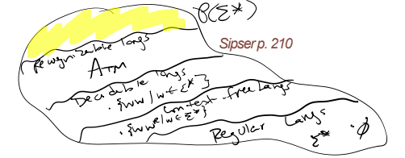






A_{TM} Sipser p. 210
Recognizable
Not decidable
Fact (Theorem 4.22): A language is decidable iff it and its complement are both recognizable.
Corollary 4.23: The complement of A_{TM} is unrecognizable.

Slide 12
Key Notation and Definitions (103)
A language being decidable means “we can say both yes and no answers about string membership in a language in finite time.”
A language being recognizable means “we can say yes about string membership in a language in finite time.”
Anytime we can prove that a set is undecidable yet recognizable, its complement will be unrecognizable.

Slide 13
104.CSE105.ComplementOfATM.mp4
Remember:
A_{DFA}
E_{DFA}
EQ_{DFA}
are all decidable

Slide 14
Decidable | Recognizable (and not decidable) | Co-recognizable (and not decidable)
A_{DFA} | A_{TM} | A_{TM}^{C}
E_{DFA}
EQ_{DFA}
Give algorithm!
Diagonalization

Slide 15





Decidable | Recognizable (and not decidable) | Co-recognizable (and not decidable)
A_{DFA} | A_{TM} | A_{TM}^{C}
E_{DFA}
EQ_{DFA}
Give algorithm!
Diagonalization

Slide 16



























Slide 17
Key Notation and Definitions (104)
Co-recognizable = complement is recognizable
A_{TM}^{C} is undecidable

Slide 18
105.CSE105.UndecidabilityProofStrategies.mp4
Remember:
Cantor's diagonal argument: there is an infinite amount of sets that cannot be put into one-to-one correspondence with the infinite set of natural numbers.

Slide 19
Do we have to diagonalize?

Slide 20
Decidable | Recognizable (and not decidable) | Co-recognizable (and not decidable)
A_{DFA} | A_{TM} | A_{TM}^{C}
E_{DFA}
EQ_{DFA}
Give algorithm!
Diagonalization

Slide 21
Idea Sipser pp. 215-216
If problem X is no harder than problem Y
…and if Y is easy
…then X must also be easy

Slide 22
Idea Sipser pp. 215-216
If problem X is no harder than problem Y
…and if X is hard
…then Y must also be hard

Slide 23
Idea Sipser pp. 215-216
If problem X is no harder than problem Y
…and if Y is decidable
…then X must also be decidable
If problem X is no harder than problem Y
…and if X is undecidable
…then Y must also be undecidable

Slide 24
Idea Sipser pp. 215-216
If problem X is no harder than problem Y
…and if Y is decidable
…then X must also be decidable
If problem X is no harder than problem Y
…and if X is undecidable
…then Y must also be undecidable
“Problem X is no harder than problem Y” means
“Can convert questions about membership in X to questions about membership in Y”

Slide 25


Idea Sipser pp. 215-216
If problem X is no harder than problem Y
…and if Y is decidable
…then X must also be decidable
If problem X is no harder than problem Y
…and if X is undecidable
…then Y must also be undecidable
“Problem X is no harder than problem Y” means
“Can convert questions about membership in X to questions about membership in Y”

Slide 26
Mapping reduction Sipser p. 235
Problem A is mapping reducible to problem B means there is a computable function f: Σ* → Σ* such that for all strings x in Σ*
x is in A iff f(x) is in B

Slide 27
Key Notation and Definitions (105)
“Problem X is no harder than problem Y” means
“Can convert questions about membership in X to questions about membership in Y”
If problem X is no harder than problem Y
…and if Y is decidable/undecidable
…then X must also be decidable/undecidable

Slide 28
106.CSE105Sp20.ReductionsIntro.mp4

Slide 29
Key Notation and Definitions (106)
If we can find a fast solution for one hard problem that other problems reduce to, we can find fast solution for lots of other problems.

Slide 30

The Complement of $E_{TM}$
Example 1
Ch. 4 Exercises pg. 211

Slide 31
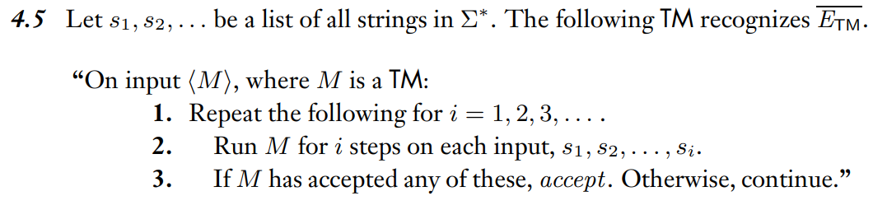
Example 1 Solution
Ch. 4 Solutions pg. 213

Slide 32
Monday FAQ (102-106)
Q: "Why is A_{TM} not decidable, and how did we figure that out?"
A: A_{TM} contains elements in the format <M,w> where M is a TM and w is a string in L(M). In order for A_{TM} to be decidable, we need to be able to build a machine M₁ that recognizes it and halts on all inputs <M,w>. As a subroutine in M₁, we would need to run M on w to see if w is in L(M). However, there is no guarantee that M is a decider, so the computation of M on could loop, thus preventing the subroutine from reaching an accept or reject state in M₁. Therefore, we cannot build a machine M₁ that both recognizes A_{TM} and is a decider. So A_{TM} cannot be decidable.

Slide 33
Monday FAQ (102-106) cont.
Q: "How can a language be recognizable but not decidable?"
A: A language is decidable if we can build a Turing machine that halts on all inputs. A machine whose language is decidable will always give us a "yes" or "no" answer to the question of whether a string is in the language or not. A machine whose language is recognizable (but not decidable) will always give us a "yes" answer if a string is in the language, but it may or may not give us a definite "no" answer if the string is not in the language. There can be machines that recognize all the strings in the language but are not decidable because they may not explicitly reject the strings not in the language.

Slide 34
Monday FAQ (102-106) cont.
Q: "How would we know that one problem is harder than another?"
A:

Slide 35
Wednesday
Videos 107-113
Today’s learning goals
Define and explain A_{TM} and HALT_{TM}
Build and prove mapping reductions between computational problems
Today’s textbook sections
Section 5.3 Definition 5.17, Examples 5.18-5.19 (p. 234)

Slide 36
107.CSE105Sp20.MappingReductionDefinition.mp4
Remember:
A function is a binary relation over two sets that associates every element of the first set to exactly one element of the second set.

Slide 37
Mapping reduction Sipser p. 235
“Problem A is mapping reducible to problem B” means that there is a computable function f: Σ* → Σ* such that for all strings x in Σ*
x is in A iff f(x) is in B

Slide 38
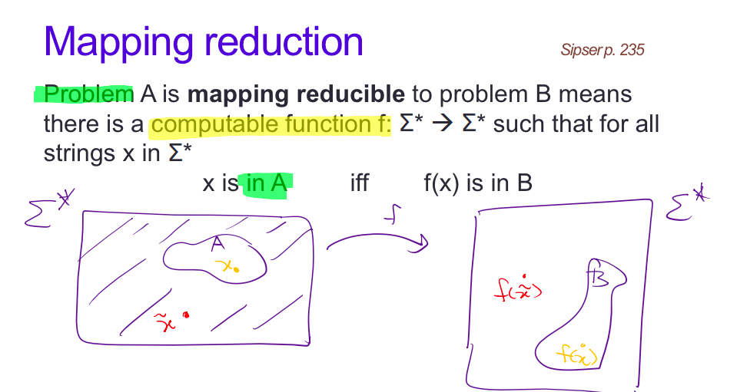

Slide 39
Key Notation and Definitions (107)
“Problem A is mapping reducible to problem B” means that there is a computable function f: Σ* → Σ* such that for all strings x in Σ*
x is in A iff f(x) is in B
Mapping reductions give an alternate way of answering the question “is x in A?”.
Translate x and ask if a related item f(x) is in B.

Slide 40
108.CSE105.ComputableFunctionDefinition.mp4

Slide 42
Mapping reduction Sipser p. 235
Problem A is mapping reducible to problem B means there is a computable function f: Σ* → Σ* such that for all strings x in Σ*
x is in A iff f(x) is in B
Computable function?
A function f: Σ* → Σ* is computable iff there is some Turing machine such that, for each x, on input x halts with exactly f(x) followed by all blanks on the tape

Slide 43
Key Notation and Definitions (108)
A function f: Σ* → Σ* is computable iff there is some Turing machine such that, for each x, the computation of the machine halts and f(x) followed by all blanks is left on the tape.
Outputs of computable functions are strings.
The Turing machine produces the output of the function on its tape.

Slide 44
109.CSE105.ComputableFunctionFirstExamples.mp4
Remember:
Turing machine’s tape has infinite length.

Slide 45
Computable functions (aka maps)
Which of the following functions are computable?
The string x maps to the string xx.
The string <M> (where M is a TM) maps to <M’> where M’ is the Turing machine that acts like M does, except that if M tries to reject, M’ goes into a loop; strings that are not the codes of TMs map to ε.
The string x maps to y, where x is the binary representation of the number n and y is the binary representation of the number 2n
All of the above.
None of the above.

Slide 46




Computable functions (aka maps)
Which of the following functions are computable?
The string x maps to the string xx.
The string <M> (where M is a TM) maps to <M’> where M’ is the Turing machine that acts like M does, except that if M tries to reject, M’ goes into a loop; strings that are not the codes of TMs map to ε.
The string x maps to y, where x is the binary representation of the number n and y is the binary representation of the number 2n
All of the above.
None of the above.

Slide 47
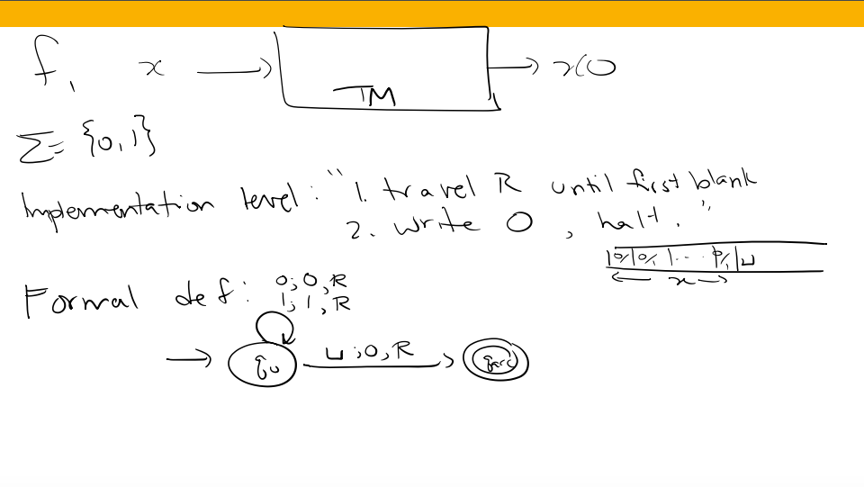

Slide 48
Key Notation and Definitions (109)
To produce a binary representation of 2n, we read the string representation of n, record it onto the tape, and append a 0 to the end.

Slide 49
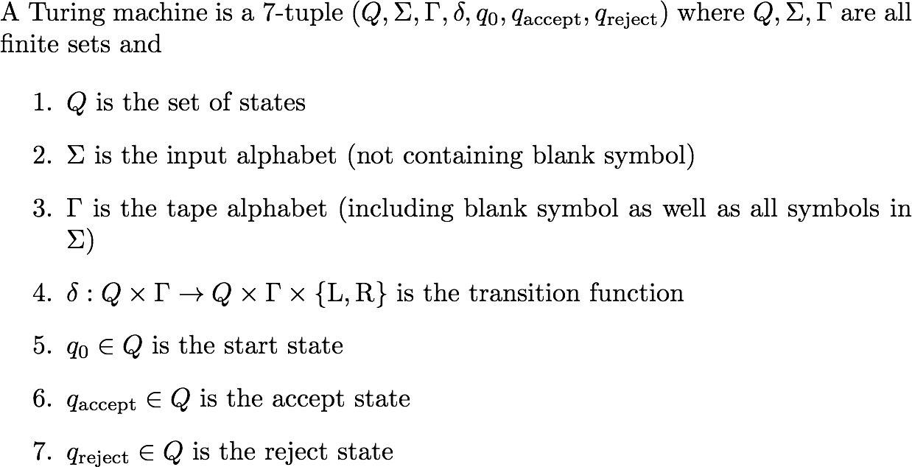
110.CSE105.ComputableFunctionComplicatedExample.mp4
Remember:
Definition 3.3, Sipser 3.1, pg.168

Slide 50
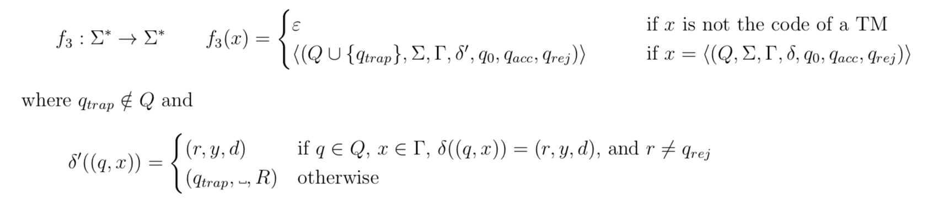
Computable functions (aka maps)
Which of the following functions are computable?
The string x maps to the string xx.
The string <M> (where M is a TM) maps to <M’> where M’ is the Turing machine that acts like M does, except that if M tries to reject, M’ goes into a loop; strings that are not the codes of TMs map to ε.
The string x maps to y, where x is the binary representation of the number n and y is the binary representation of the number 2n
All of the above.
None of the above.

Slide 51







Computable functions (aka maps)
Which of the following functions are computable?
The string x maps to the string xx.
The string <M> (where M is a TM) maps to <M’> where M’ is the Turing machine that acts like M does, except that if M tries to reject, M’ goes into a loop; strings that are not the codes of TMs map to ε.
The string x maps to y, where x is the binary representation of the number n and y is the binary representation of the number 2n
All of the above.
None of the above.

Slide 52

Mapping reduction Sipser p. 235
Problem A is mapping reducible to problem B means there is a computable function f: Σ* → Σ* such that for all strings x in Σ*
x is in A iff f(x) is in B
Computable function?
A function f: Σ* → Σ* is computable iff there is some Turing machine such that, for each x, on input x halts with exactly f(x) followed by all blanks on the tape

Slide 53
Computable functions (aka maps)
Which of the following functions are computable?
The string x maps to the string xx.
The string <M> (where M is a TM) maps to <M’> where M’ is the Turing machine that acts like M does, except that if M tries to reject, M’ goes into a loop; strings that are not the codes of TMs map to ε.
The string x maps to y, where x is the binary representation of the number n and y is the binary representation of the number 2n
All of the above.
None of the above.

Slide 54
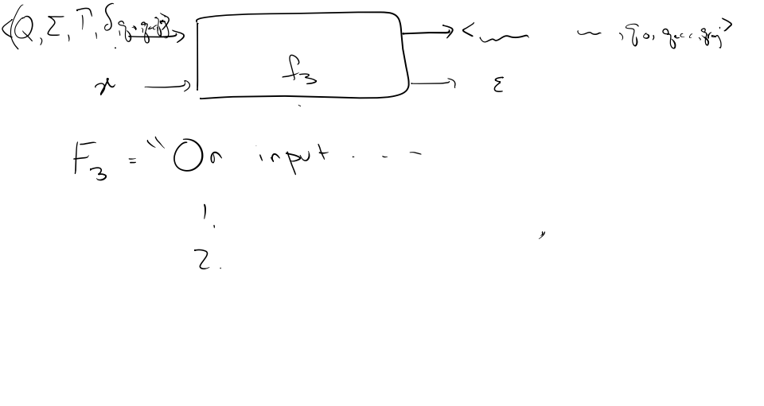

Slide 55
Key Notation and Definitions (110)
Oftentimes, if an input doesn’t pass the type check, we have a constant output of ε. Hence, the tape is empty.
The function TM never actually runs the machine that’s given to it as a string.

Slide 56
111.CSE105.MappingReductionExample1.mp4
Remember:
A function f: Σ* → Σ* is computable iff there is some Turing machine such that, for each x, the computation of x halts with exactly f(x) followed by all blanks on the tape

Slide 57
“No harder than”?
Which of the following statements are true?
{0^{i}1^{j} | i,j >=0} is no harder than A_{TM}
A_{TM} is no harder than itself
A_{DFA} is no harder than {ww | w is a string over {0,1}}
EQ_{DFA} is no harder than A_{DFA}
All of the above

Slide 58
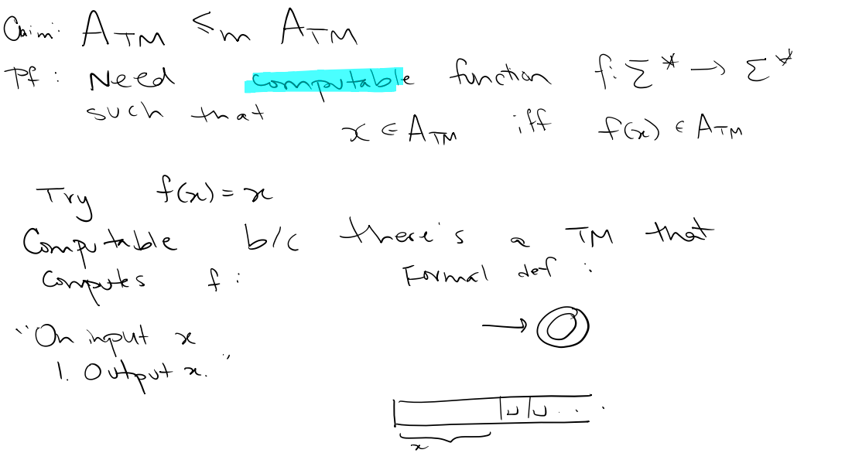

Slide 59
Key Notation and Definitions (111)
To prove a statement regarding problem difficulty, we need to produce a computable function.
To make sure that the function is computable, if we have a Turing machine that computes the function and the function is well-defined on all strings, then the TM witnesses a mapping reduction.

Slide 60
112.CSE105.MappingReductionExample2.mp4
Remember:
A_{DFA} is decidable

Slide 61
“No harder than”?
Which of the following statements are true?
{0^{i}1^{j} | i,j >=0} is no harder than A_{TM}
A_{TM} is no harder than itself
A_{DFA} is no harder than {ww | w is a string over {0,1}}
EQ_{DFA} is no harder than A_{DFA}
All of the above

Slide 62
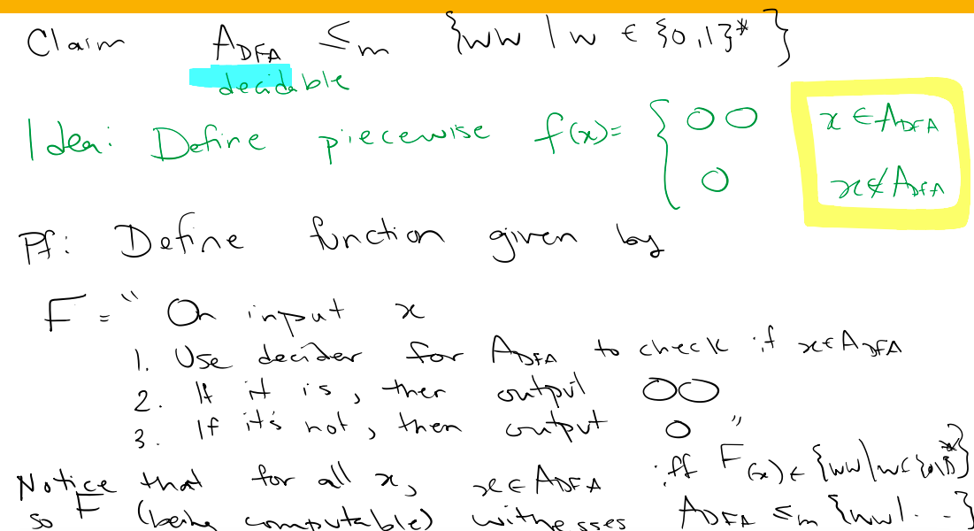

Slide 63
Key Notation and Definitions (112)
When defining a computable function, we’re writing out a high-level description of a Turing Machine.
The function is well-defined for all strings if the algorithm will halt and give an output (no matter what the input string is) and won’t produce two different outputs for a single input.

Slide 64
113.CSE105.MappingReductionExample3.mp4
Remember:
A function f: Σ* → Σ* is computable iff there is some Turing machine such that, for each x, the computation of x halts with exactly f(x) followed by all blanks on the tape

Slide 65
“No harder than”?
Which of the following statements are true?
{0^{i}1^{j} | i,j >=0} is no harder than A_{TM}
A_{TM} is no harder than itself
A_{DFA} is no harder than {ww | w is a string over {0,1}}
EQ_{DFA} is no harder than A_{DFA}
All of the above

Slide 66
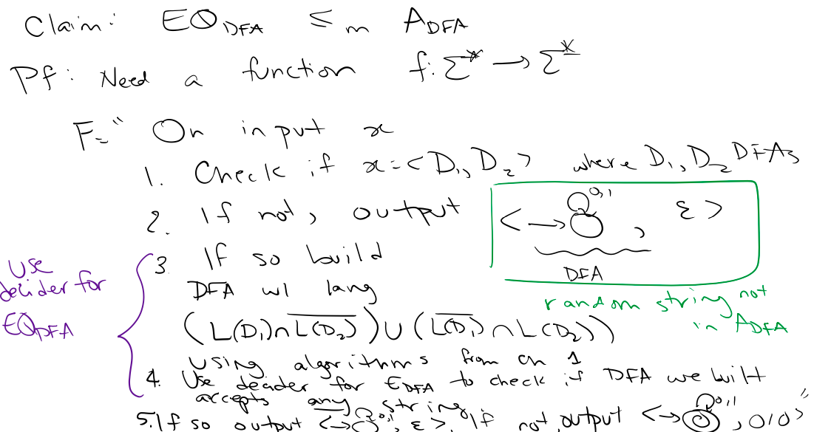

Slide 67
Key Notation and Definitions (113)
EQ_{DFA} is decidable
We can abbreviate steps that we “know” how to do (something that has been proven before and has a known algorithm, such as a decider for EQ_{DFA})

Slide 68


$A_{TM}≤_{m}E_{TM}$?
Example 1
Ch. 5 Exercises pg. 239

Slide 69


Undecidability of ${EQ}_{TM}$
Example 2
Prove that ${EQ}_{TM}$ is decidable.
(Hint: try reducing $E_{TM}$ to ${EQ}_{TM})$
Theorem 5.4 pg. 220

Slide 70
Proving Decidability
Example 3
Ch. 5 Exercises pg. 239

Slide 71
Example 1 Solution

Slide 72
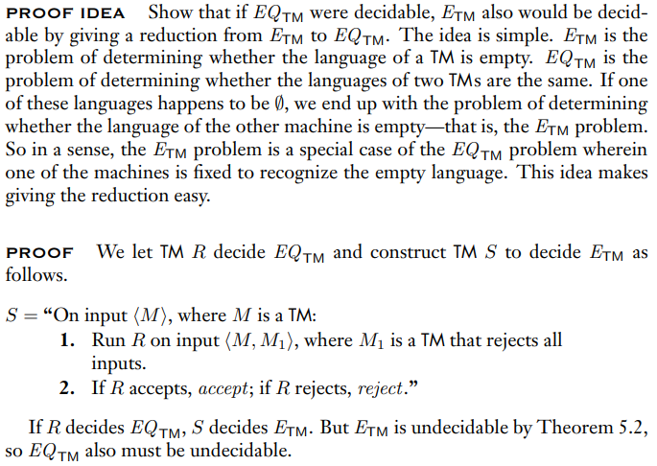
Example 2 Solution
Theorem 5.4 pg. 220

Slide 73
Wednesday FAQ (107-113)
Q: "Why do we need to create a Turing machine for f?"
A: Remember that all computable computations are computable by a Turing machine. We want to show that there is a computable function for f, so creating a Turing machine for f will show that f is computable.
Q: "What are the requirements for the function we would use to witness a mapping reduction from A to B?"
A: The function should be computable, and it should be able to take any input x in A and output a value f(x) that is in B. If x is not in A, then f(x) should not be in B.

Slide 74
Wednesday FAQ (107-113)
Q: "When making a machine that computes f(x), why do we want to change the tape of the machine?"
A: We want to show that there is a computable function f, where the input x can map to another element f(x). By building a Turing machine where the tape starts out containing the input x, does a computation, and results in the tape containing f(x), we can show that there is a computable function from x to f(x).
Q: "Does the machine that computes f have to accept x?"
A: It doesn't have to, but the convention is that we do make it accept. We are not trying to build a machine that accepts or rejects a string; we are trying to build a machine that takes an input and produces an output on the tape.

Slide 75
Friday
Videos 114-117
Today’s learning goals
Define and explain core examples of computational problems, including A**, E**, EQ**, (for ** either DFA or TM) and HALT_{TM}
Explain what it means for one problem to reduce to another
Define computable functions. Use them to give mapping reductions between computational problems.
Today’s textbook sections
Section 5.3 Theorem 5.22 (p. 236)

Slide 76
114.CSE105.HaltingProblem.mp4
Remember:
“Problem X is no harder than problem Y” means that we
“can convert questions about membership in X to questions about membership in Y”

Slide 77
The halting problem!
HALT_{TM} = { <M,w> | M is a TM and M halts on input w}
A_{TM} = { <M,w> | M is a TM and w is in L(M)}
How is HALT_{TM} related to A_{TM} ?
They're the same set.
HALT_{TM} is a subset of A_{TM}
A_{TM} is a subset of HALT_{TM}
They have the same type of elements but no other relation.
I don't know.

Slide 78
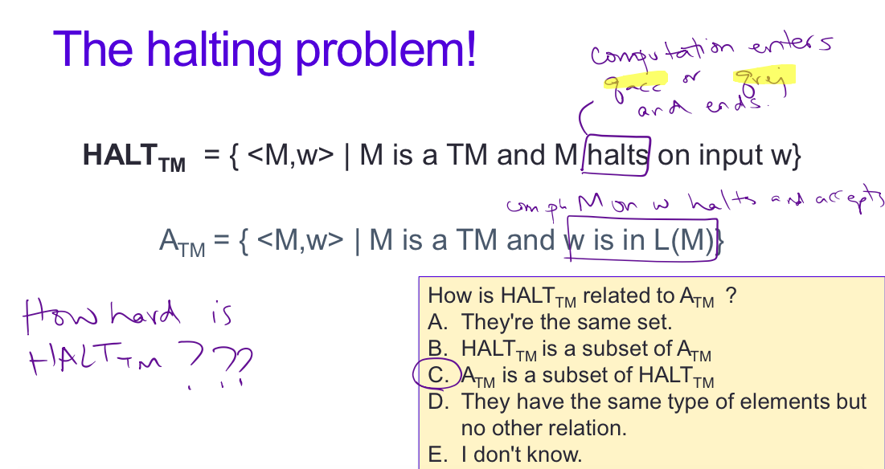
The question of subsets is completely different from the question of difficulty

Slide 79
The halting problem!
HALT_{TM} = { <M,w> | M is a TM and M halts on input w}
A_{TM} = { <M,w> | M is a TM and w is in L(M)}
But subset inclusion doesn't determine difficulty!

Slide 80
Key Notation and Definitions (114)
HALT_{TM} = { <M,w> | M is a TM and M halts on input w}
HALT_{TM} Set of code for machines and strings where the machine halts on input w.
Subset relation doesn’t imply anything about difficulty level since the question of subsets is completely different from the question of difficulty

Slide 81
115.CSE105.ReducingATMtoHALTTM.mp4
Remember:
If problem X is no harder than problem Y
…and if Y is decidable/undecidable
…then X must also be decidable/undecidable

Slide 82
The halting problem!
HALT_{TM} = { <M,w> | M is a TM and M halts on input w}
A_{TM} = { <M,w> | M is a TM and w is in L(M)}
Goal: build function f: Σ* → Σ* such that for every string x,
x is in A_{TM} iff f(x) is in HALT_{TM}

Slide 83








The halting problem!
HALT_{TM} = { <M,w> | M is a TM and M halts on input w}
A_{TM} = { <M,w> | M is a TM and w is in L(M)}
Goal: build function f: Σ* → Σ* such that for every string x,
x is in A_{TM} iff f(x) is in HALT_{TM}

Slide 84
Reducing A_{TM} to HALT_{TM} Sipser Example 5.24
Desired function by cases:
If x = <M,w> and w is in L(M): map to <M’, w’> in HALT_{TM}
If x = <M,w> and w is not in L(M): map to <M’, w’> not in HALT_{TM}
If x ≠ <M,w> : map to some string not in HALT_{TM}

Slide 85




Reducing A_{TM} to HALT_{TM} Sipser Example 5.24
Desired function by cases:
If x = <M,w> and w is in L(M): map to <M’, w’> in HALT_{TM}
If x = <M,w> and w is not in L(M): map to <M’, w’> not in HALT_{TM}
If x ≠ <M,w> : map to some string not in HALT_{TM}

Slide 86

Reducing A_{TM} to HALT_{TM} Sipser Example 5.24
Define computable function:
F = “On input x:
Type-check whether x= <M,w> for some TM M, and string w. If not, output const_{out} .
Construct the following machine M’
M’= “On input y:
Run M on y.
If M accepts, accept.
If M rejects, enter a loop.”
Output <M’, w>”
F is defined by high-level description of TM: each step must be algorithmic!

Slide 87
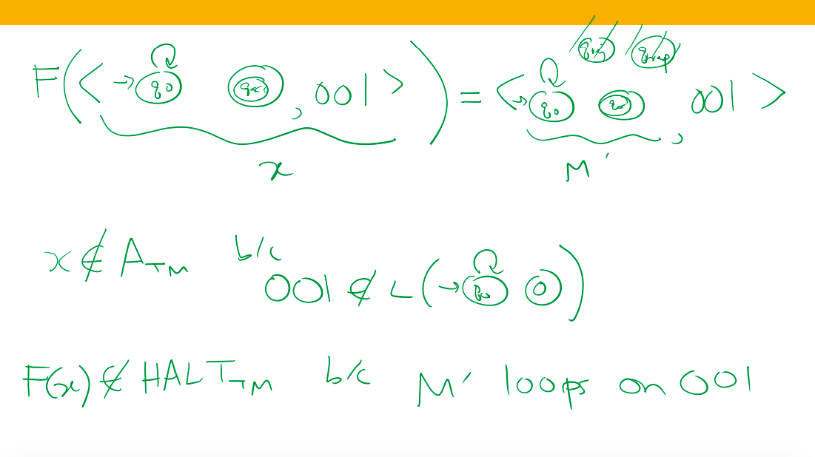

Slide 88
Reducing A_{TM} to HALT_{TM} Sipser Example 5.24
Check how function behaves by cases:
If x = <M,w> and w is in L(M): map to <M’, w’> in HALT_{TM}?
If x = <M,w> and w is not in L(M): map to <M’, w’> not in HALT_{TM} ?
If x ≠ <M,w> : map to some string not in HALT_{TM} ?

Slide 89
Other direction?
Goal: build function that f: Σ* → Σ* such that for every string x,
x is in HALT_{TM} iff f(x) is in A_{TM}
What function should be used for f(x) in the reduction?
Use the function F from previous reduction
Use the inverse of the function F from previous reduction
Use a different computable function
Impossible to find a computable function that works!

Slide 90
Key Notation and Definitions (115)
When reducing A_{TM} to HALT_{TM}, the mapping reduction needs to handle two cases at the same time.
Mapping reduction: ≤_{M}
A_{TM} mapping reduces to HALT_{TM} and HALT_{TM} mapping reduces to A_{TM}

Slide 91
116.CSE105.MappingReductionApplications.mp4
Remember:
A mapping reduction translates a string to another related string that we know more about.

Slide 92
Mapping reduction Sipser p. 235, 237
Problem A is mapping reducible to problem B means there is a computable function f: Σ* → Σ* such that for all strings x in Σ*
x is in A iff f(x) is in B
Warm up: If A is mapping reducible to B then the complement of A is mapping reducible to the complement of B.
Theorems 5.22, 5.28: If A is mapping reducible to B…
… and B is decidable, then A is decidable.
… and A is undecidable, then B is undecidable.
… and B is recognizable, then A is recognizable.
… and A is unrecognizable, then B is unrecognizable.

Slide 93
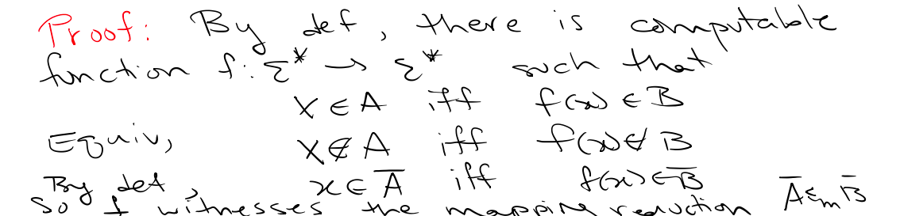
Mapping reduction Sipser p. 235, 237
Problem A is mapping reducible to problem B means there is a computable function f: Σ* → Σ* such that for all strings x in Σ*
x is in A iff f(x) is in B
Warm up: If A is mapping reducible to B then the complement of A is mapping reducible to the complement of B.

Slide 94
Mapping reduction Sipser p. 235, 237
Problem A is mapping reducible to problem B means there is a computable function f: Σ* → Σ* such that for all strings x in Σ*
x is in A iff f(x) is in B
Warm up: If A is mapping reducible to B then the complement of A is mapping reducible to the complement of B.
Theorems 5.22, 5.28: If A is mapping reducible to B…
… and B is decidable, then A is decidable.
… and A is undecidable, then B is undecidable.
… and B is recognizable, then A is recognizable.
… and A is unrecognizable, then B is unrecognizable.

Slide 95
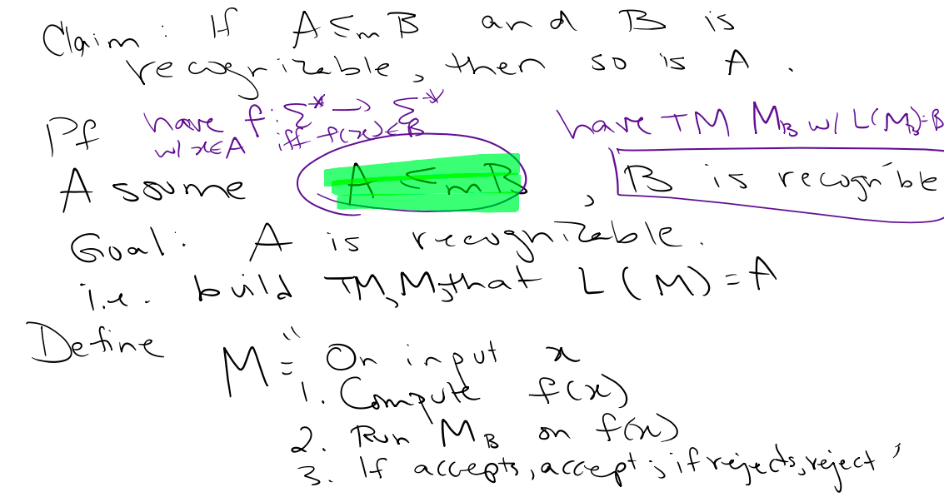

Slide 96
Key Notation and Definitions (116)
If A ≤_{M} B and B is recognizable, then so is A.
If A is mapping reducible to B, then the complement of A is mapping reducible to the complement of B.

Slide 97
117.CSE105Sp20.MappingReductionStrategy.mp4
Remember:

Slide 98
Decidable | Undecidable but recognizable | Undecidable and unrecognizable
A_{DFA} | A_{TM} | A_{TM}^{C}
E_{DFA} | HALT_{TM} | HALT_{TM}^{C}
EQ_{DFA}
Fact: A_{TM} mapping reduces to HALT_{TM}
Fact: HALT_{TM} mapping reduces to A_{TM}
Give algorithm!
What about E_{TM} and EQ_{TM} ?

Slide 99

Mapping reduction Sipser p. 235, 237
Problem A is mapping reducible to problem B means there is a computable function f: Σ* → Σ* such that for all strings x in Σ*
x is in A iff f(x) is in B
Warm up: If A is mapping reducible to B then the complement of A is mapping reducible to the complement of B.
Theorems 5.22, 5.28: If A is mapping reducible to B…
… and B is decidable, then A is decidable.
… and A is undecidable, then B is undecidable.
… and B is recognizable, then A is recognizable.
… and A is unrecognizable, then B is unrecognizable.

Slide 100
Key Notation and Definitions (117)
Fact: A_{TM} mapping reduces to HALT_{TM}
Fact: HALT_{TM} mapping reduces to A_{TM}
Decidable | Undecidable but recognizable | Undecidable and unrecognizable
A_{DFA} | A_{TM} | A_{TM}^{C}
E_{DFA} | HALT_{TM} | HALT_{TM}^{C}
EQ_{DFA}

Slide 101
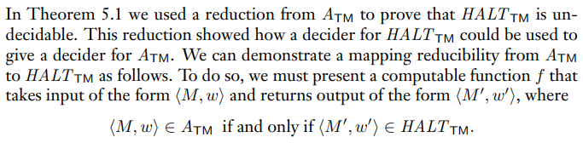

Reducing $A_{TM}$ to ${HALT}_{TM}$
Example 1
Example 5.24 pg. 236

Slide 102
Proving Decidability
Example 2
Ch. 5 Exercises pg. 239

Slide 103
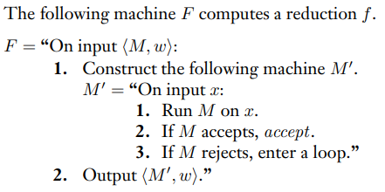
Example 1 Solution
Ch. 5 Solutions pg. 237

Slide 104


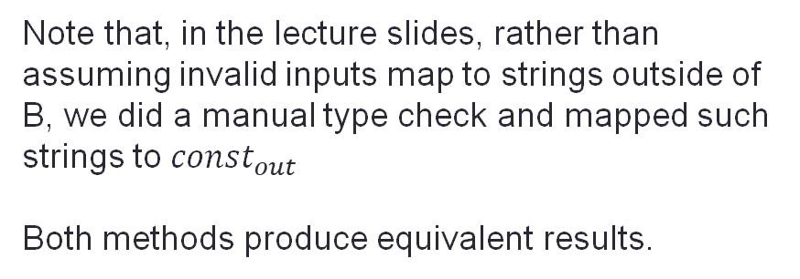
Example 1 Solution(cont.)
Note that, in the lecture slides, rather than assuming invalid inputs map to strings outside of B, we did a manual type check and mapped such strings to ${const}_{out}$
Both methods produce equivalent results.
Example 2.24 pg. 236-237

Slide 105

Example 2 Solution
Ch. 5 Solutions pg. 242

Slide 106
Friday FAQ (114-117)
Q: "If A is mapping reducible to B, then will B also be mapping reducible to A?"
A: Not necessarily. A being mapping reducible to B just means that B is at least as hard as A. B could be harder than A, or B could be equally as hard as A. B would only be mapping reducible to A if they were equally as hard.

Slide 107
Friday FAQ (114-117) cont.
Q: "When reducing A_{TM} to HALT_{TM}, why do we want to build a machine that enters a loop if M would reject?"
A: If a string <M,w> is in A_{TM}, we would want it to map to a string that is in HALT_{TM}. If M rejects w, it means that <M,w> is not a string in A_{TM}, so we would want it to map to a string that is not in HALT_{TM}. By creating a machine M' that would loop on an input w that M would reject, we can produce a string <M',w> that is not in HALT_{TM}, since the computation of M' on w would never halt.

