Slide 1
CSE 105 theory of computation
Fall 2020 Week 9

Slide 2
Table of Contents – Quickly Jump to a video’s slides
Wednesday | Friday
Video 118 | Video 122
Video 119 | Video 123
Video 120 | Video 124
Video 121 | Video 125
Examples | Examples
FAQ | FAQ

Slide 3
This week’s learning goals
Define and explain core examples of computational problems, including A**, E**, EQ**, (for ** either DFA or TM) and HALTTM ​
Explain what it means for one problem to reduce to another​
Define computable functions. Use them to give mapping reductions between computational problems.
Distinguish between computability and complexity
Articulate motivating questions of complexity

Slide 4
Wednesday
Videos 118-121
Today’s learning goals
Define and explain core examples of computational problems, including A**, E**, EQ**, (for ** either DFA or TM) and HALTTM ​
Explain what it means for one problem to reduce to another​
Define computable functions. Use them to give mapping reductions between computational problems.
Today’s textbook sections
None

Slide 5
118.CSE105.ETMisUndecidablePart1.mp4

Slide 6
E_{TM} = { <M> | M is TM, L(M) is empty}
Decidable
Undecidable, recognizable, with recognizable complement
Undecidable, recognizable, with unrecognizable complement
Undecidable, unrecognizable, with recognizable complement
Undecidable, unrecognizable, with unrecognizable complement
Give an example of a string in E_{TM} , and a string not in E_{TM}

Slide 7
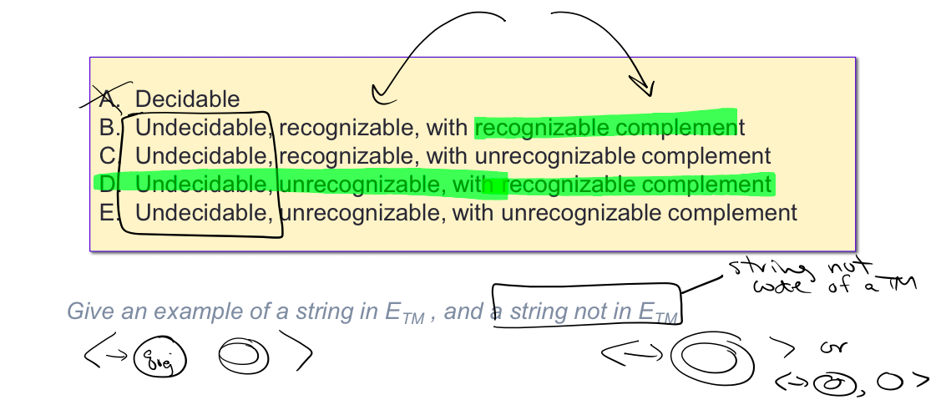
E_{TM} = { <M> | M is TM, L(M) is empty}

Slide 8
Decidable | Undecidable but recognizable | Undecidable and unrecognizable
A_{DFA} | A_{TM} | A_{TM}^{C}
E_{DFA} | HALT_{TM} | HALT_{TM}^{C}
EQ_{DFA}
Fact: A_{TM} mapping reduces to HALT_{TM}
Fact: HALT_{TM} mapping reduces to A_{TM}
Give algorithm!
What about E_{TM} and EQ_{TM} ?

Slide 9
Claim: A_{TM} is no harder than E_{TM}^{C}
In other words: we want to mapping reduce A_{TM} to E_{TM}^{C}
Define computable F : Σ* → Σ*
Input string | Output string

Slide 10

Claim: A_{TM} is no harder than E_{TM}^{C}
In other words: we want to mapping reduce A_{TM} to E_{TM}^{C}
Define computable F : Σ* → Σ*
Input string | Output string

Slide 11
Key Notation and Definitions (118)
For a set to be decidable, we should be able to, in finite time, say a yes-or-no answer about membership.
The class of undecidable languages is closed under complement.

Slide 12
119.CSE105.ReduceATMtoETMcomplement.mp4
Remember:
"Problem A is mapping reducible to problem B" means that there is a computable function f: Σ* → Σ* such that for all strings x in Σ*:
x is in A iff f(x) is in B

Slide 13
Claim: A_{TM} is no harder than E_{TM}^{C}
In other words: we want to mapping reduce A_{TM} to E_{TM}^{C}
Define computable F : Σ* → Σ*
Input string | Output string

Slide 14
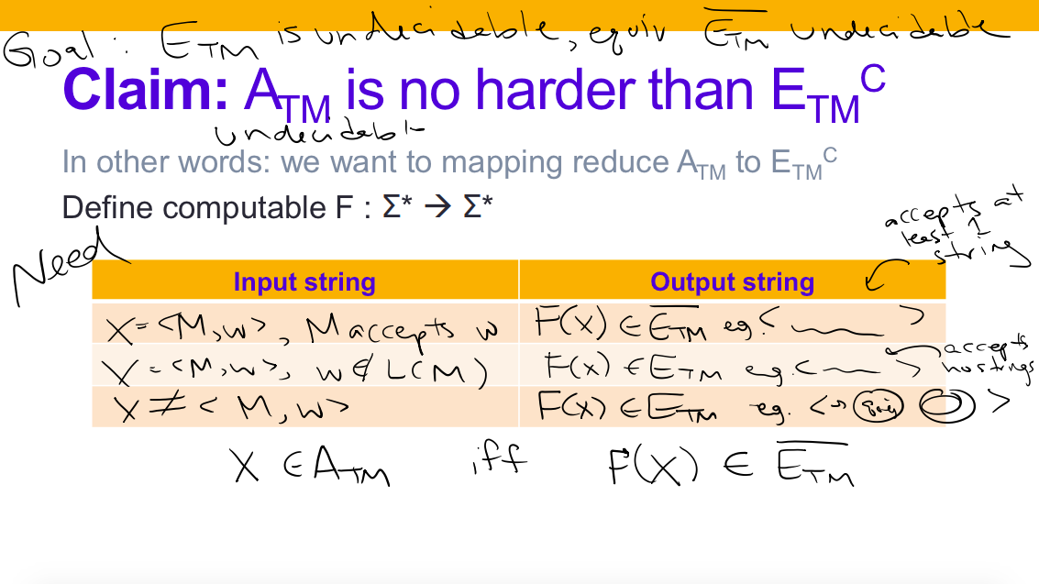

Slide 15
Claim: A_{TM} is no harder than E_{TM}^{C}
In other words: we want to mapping reduce A_{TM} to E_{TM}^{C}
Define computable F : Σ* → Σ*
Input string | Output string
<M,w> where M accepts w | <M_{x}’> where L(M’_{x}) nonempty
<M,w> where M does not accept w | <M_{x}’> where L(M’_{x}) empty
x not encoding any <M,w>

Slide 16
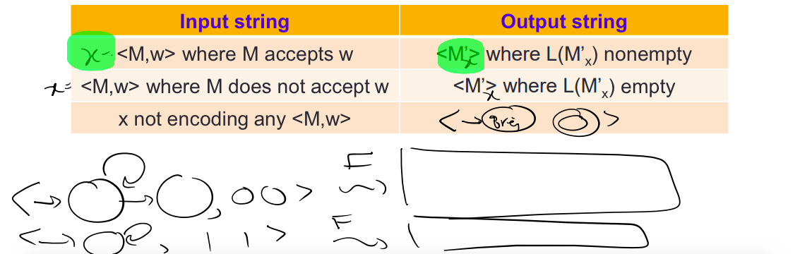
Claim: A_{TM} is no harder than E_{TM}^{C}
In other words: we want to mapping reduce A_{TM} to E_{TM}^{C}
Define computable F : Σ* → Σ*
Input string | Output string
<M,w> where M accepts w | <M_{x}’> where L(M’_{x}) nonempty
<M,w> where M does not accept w | <M_{x}’> where L(M’_{x}) empty
x not encoding any <M,w>

Slide 17
Claim: A_{TM} is no harder than E_{TM}^{C}
In other words: we want to mapping reduce A_{TM} to E_{TM}^{C}
Define computable F : Σ* → Σ*
Thus, x is in A_{TM} iff F(x) is in E_{TM}^{C}.
Since A_{TM} is undecidable, so is E_{TM}^{C} and hence also E_{TM}.
Input string | Output string
<M,w> where M accepts w | <M_{x}’> where L(M_{x}’) =
<M,w> where M does not accept w | <M_{x}’> where L(M_{x}’) =
x not encoding any <M,w>

Slide 18
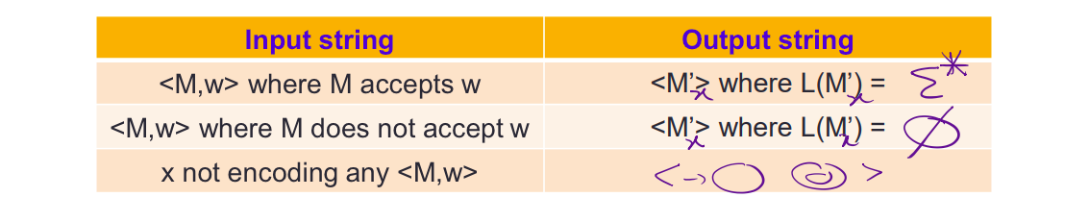
Claim: A_{TM} is no harder than E_{TM}^{C}
In other words: we want to mapping reduce A_{TM} to E_{TM}^{C}
Define computable F : Σ* → Σ*
Thus, x is in A_{TM} iff F(x) is in E_{TM}^{C}.
Since A_{TM} is undecidable, so is E_{TM}^{C} and hence also E_{TM}.
Input string | Output string
<M,w> where M accepts w | <M_{x}’> where L(M_{x}’) =
<M,w> where M does not accept w | <M_{x}’> where L(M_{x}’) =
x not encoding any <M,w>

Slide 19
Claim: A_{TM} is no harder than E_{TM}^{C}
In other words: we want to mapping reduce A_{TM} to E_{TM}^{C}
Define computable F : Σ* → Σ*
F = “On input x:
Type-check whether x= <M,w> for some TM M, and string w. If not, output .
Construct the following machine M’_{x}
M’= “On input x:
Ignore x and run M on w.
If M accepts, accept.
If M rejects, reject.”
Output <M’_{x}>”

Slide 20
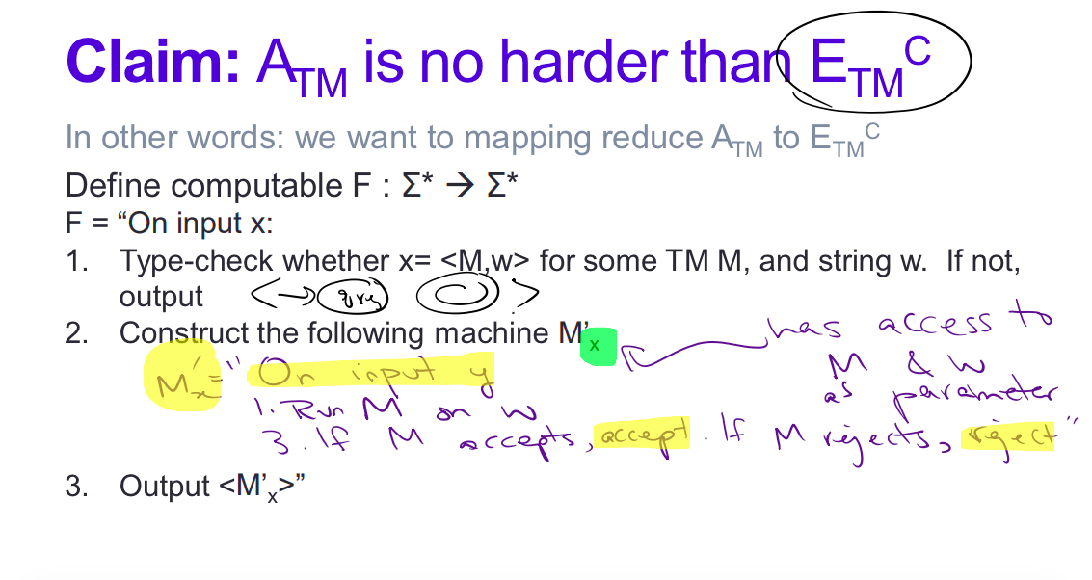

Slide 21
Key Notation and Definitions (119)
The hope in constructing M’ is that we’ve encoded enough in M’ about M and w, so that the language of M’ being empty or not tells us whether M accepted w or not.
M’ will either accept all strings or no strings at all.

Slide 22
120.CSE105.MappingReductionSteps.mp4

Slide 23
Claim: A_{TM} is no harder than E_{TM}^{C}
In other words: we want to mapping reduce A_{TM} to E_{TM}^{C}
Define computable F : Σ* → Σ*
Thus, x is in A_{TM} iff F(x) is in E_{TM}^{C}.
Since A_{TM} is undecidable, so is E_{TM}^{C} and hence also E_{TM}.
Input string | Output string
<M,w> where M accepts w | <M_{x}’> where L(M_{x}’) =
<M,w> where M does not accept w | <M_{x}’> where L(M_{x}’) =
x not encoding any <M,w>

Slide 24
Key Notation and Definitions (120)
Intuitive yes or no → What is the contract I need to have with my computable function → How do I cleverly encode things.

Slide 25
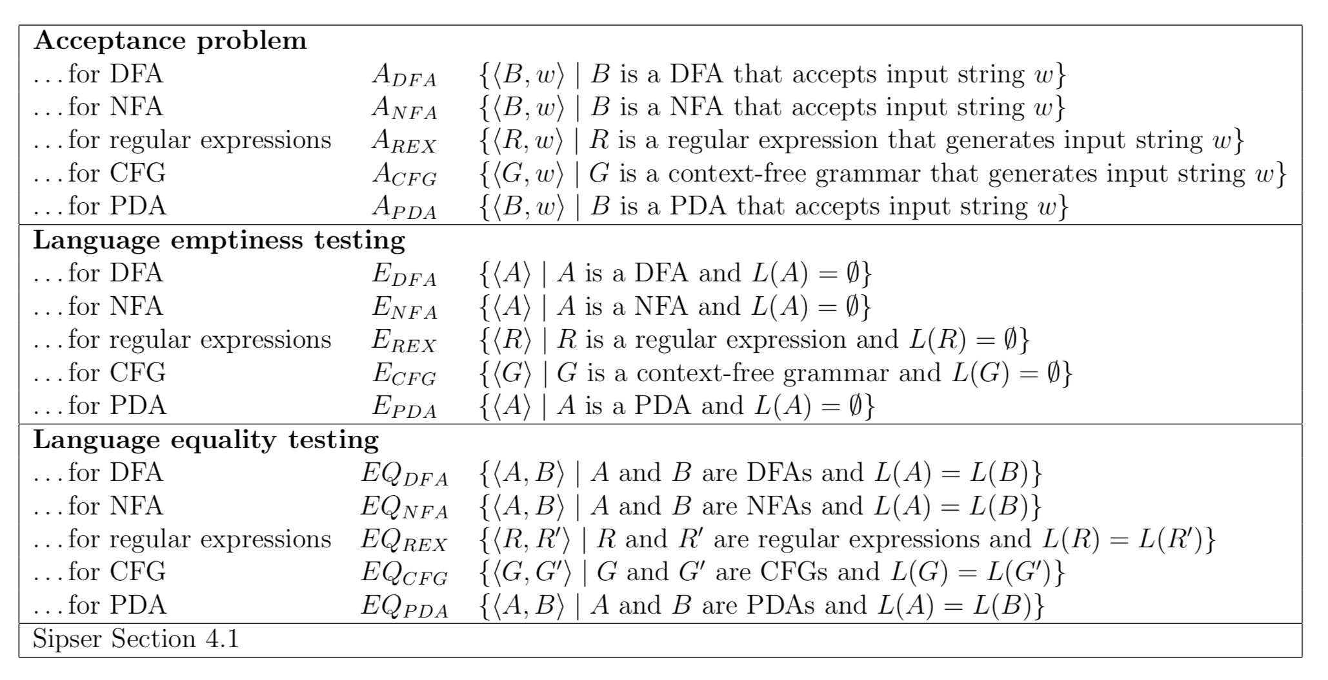
121.CSE105.EQTM
Remember:

Slide 26
EQ_{TM} = { <M₁, M₂> | M₁, M₂ TMs, L(M₁)=L(M₂)}
Decidable
Undecidable, recognizable, with recognizable complement
Undecidable, recognizable, with unrecognizable complement
Undecidable, unrecognizable, with recognizable complement
Undecidable, unrecognizable, with unrecognizable complement
Give an example of a string in EQ_{TM} , and a string not in EQ_{TM}

Slide 27


EQ_{TM} = { <M₁, M₂> | M₁, M₂ TMs, L(M₁)=L(M₂)}
Decidable
Undecidable, recognizable, with recognizable complement
Undecidable, recognizable, with unrecognizable complement
Undecidable, unrecognizable, with recognizable complement
Undecidable, unrecognizable, with unrecognizable complement
Give an example of a string in EQ_{TM} , and a string not in EQ_{TM}

Slide 28
Decidable | Undecidable but recognizable | Undecidable and unrecognizable
A_{DFA} | A_{TM} | A_{TM}^{C}
E_{DFA} | HALT_{TM} | HALT_{TM}^{C}
EQ_{DFA}
Fact: A_{TM} mapping reduces to HALT_{TM}
Fact: HALT_{TM} mapping reduces to A_{TM}
Give algorithm!
What about E_{TM} and EQ_{TM} ?

Slide 29
Claim: HALT_{TM} is no harder than EQ_{TM}
In other words: we want to mapping reduce HALT_{TM} to EQ_{TM}
Define computable F : Σ* → Σ*
Input string | Output string

Slide 30
Claim: HALT_{TM} is no harder than EQ_{TM}
In other words: we want to mapping reduce HALT_{TM} to EQ_{TM}
Define computable F : Σ* → Σ*
Input string | Output string
<M,w> where M halts on w | <M₁,M₂> where L(M₁)=L(M₂)
<M,w> where M loops on w | <M₁,M₂> where L(M₁)≠L(M₂)
x not encoding any <M,w>

Slide 31
Claim: HALT_{TM} is no harder than EQ_{TM}
In other words: we want to mapping reduce HALT_{TM} to EQ_{TM}
Define computable F : Σ* → Σ*
F = “On input x:
Type-check whether x= <M,w> for some TM M, and string w. If not, output <M₂> where M₂ = “On input y 1. Accept” .
Construct the following machine M₁
M₁= “On input y:
If y is not equal to w, accept. Otherwise, go to step 2.
Run M on w.
If M accepts w, accept y.
If M rejects w, accept y.”
Output <M₁, M₂>”

Slide 32
Claim: HALT_{TM} is no harder than EQ_{TM}
In other words: we want to mapping reduce HALT_{TM} to EQ_{TM}
Define computable F : Σ* → Σ*
Thus, x is in HALT_{TM} iff F(x) is in EQ_{TM.}
Since HALT_{TM} is undecidable, so is EQ_{TM}
Input string | Output string
<M,w> where M halts on w | <M₁, M₂> where L(M₁) = Σ* =L(M₂)
<M,w> where M loops on w | <M₁, M₂> with L(M₁) = Σ* - {w}, L(M₂) = Σ*
x not encoding any <M,w> | <M₂> where L(M₂) = Σ*

Slide 33
EQ_{TM}
HALT_{TM} mapping reduces to EQ_{TM}
HALT_{TM} is undecidable
HALT_{TM} is recognizable, so HALT_{TM}^{C} is unrecognizable
Therefore: EQ_{TM} is undecidable and its complement is unrecognizable.
Is EQ_{TM} itself recognizable?
Prove HALT_{TM}^{C} mapping reduces to EQ_{TM}

Slide 34
Claim: HALT_{TM}^{C} is no harder than EQ_{TM}
In other words: we want to mapping reduce HALT_{TM}^{C} to EQ_{TM}
Define computable F : Σ* → Σ*
Input string | Output string
<M,w> where M loops on w | <M₁,M₂> where L(M₁)=L(M₂)={}
<M,w> where M halts on w | <M₁,M₂> where L(M₁)={w}≠L(M₂)={}
x not encoding any <M,w>

Slide 35
Key Notation and Definitions (121)
HALT_{TM} mapping reduces to EQ_{TM}
HALT_{TM} is undecidable
HALT_{TM} is recognizable, so HALT_{TM}^{C} is unrecognizable
Therefore: EQ_{TM} is undecidable and its complement is unrecognizable.

Slide 36
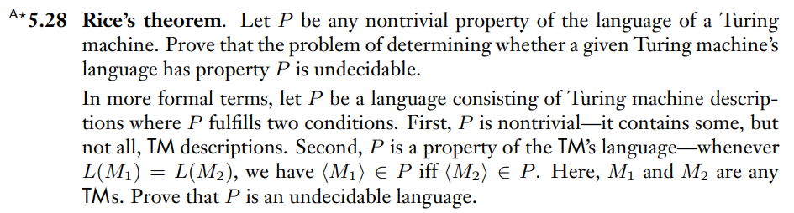
Rice’s theorem
Example 1
Ch. 5 Problems pg. 241

Slide 37
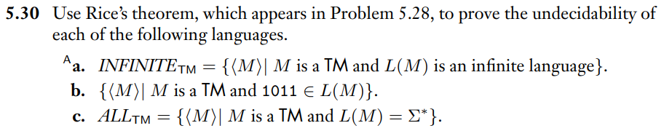
Applying Rice’s theorem
Example 2
Ch. 5 Problems pg. 241

Slide 38
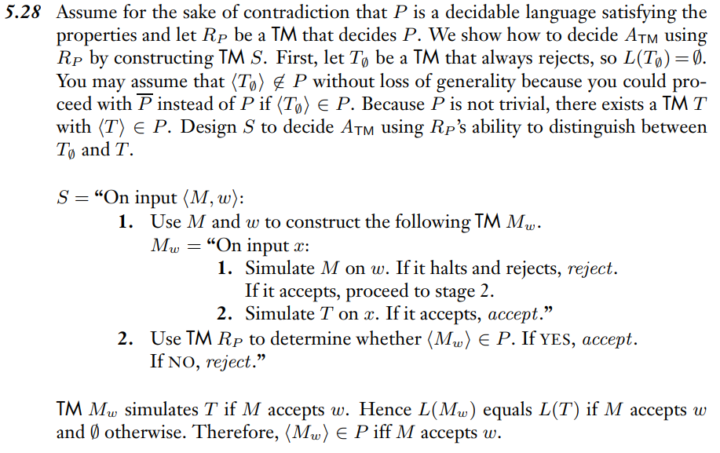
Example 1 Solution
Ch. 5 Solutions pg. 243

Slide 39
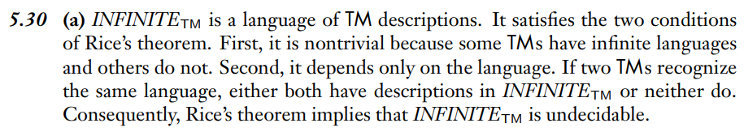
Example 2 Solution
Ch. 5 Solutions pg. 244

Slide 40
Wednesday FAQ (118-121)
Q: "What is const_{out} and where does it come from?"
A: const_{out} is usually the value we want to output when the type check fails. If we are trying to build a function in which x ∈ A iff f(x) ∈ B, then a value x₁ whose type check fails would not be in A, so f(x₁) should also not be in B. Therefore, const_{out} is just any value we choose that is not in B.

Slide 41
Wednesday FAQ (118-121) cont.
Q: "What are the different stages of mapping reductions problems?"
A:
Identify the relevant sets. The goal is to prove that some set B is hard (undecidable/unrecognizable). We need to choose another set A that we know to be hard and that we will prove mapping reduces to B.
Write specs for the desired computable function.
Create and define the computable function.
Prove that the function works (confirm that it meets the specs).

Slide 42
Friday
Videos 122-125
Today’s learning goals
Distinguish between computability and complexity
Articulate motivating questions of complexity
Today’s textbook sections
None

Slide 43
122.CSE105.ComplexityMotivation.mp4
Remember:
Common big-O notation functions
O(1) constant
O(log n) logarithmic
O(n^{c}), 0 < c < 1 fractional power
O(n) linear
O(n log n) loglinear
O(n²) quadratic
O(c^{n}) 1 < c exponential
O(n!) factorial

Slide 44
Today's learning goals Sipser Ch 7
Distinguish between computability and complexity
Articulate motivating questions of complexity
Section 7.1: time complexity, asymptotic upper bounds.
Section 7.2: polynomial time, P
Section 7.3: NP, polynomial verifiers, nondeterministic machines.

Slide 45
Complexity theory Chapter 7
In the "real world", computers (and Turing machines) don't have infinite tape, and we can't afford to wait unboundedly long for an answer.
"Decidable" isn't good enough – we want "Efficiently decidable"

Slide 46
Not just decidable …
For a given algorithm working on a given input, how long do we need to wait for an answer? How does the running time depend on the input in the worst-case? average-case? Expect to have to spend more time on larger inputs.

Slide 47
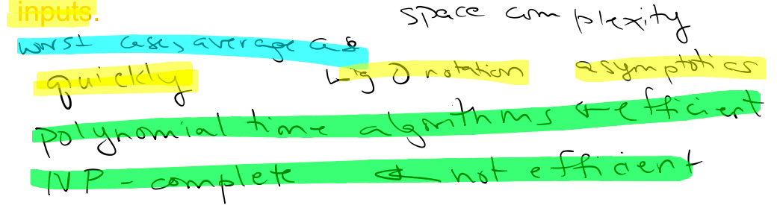




Not just decidable …
For a given algorithm working on a given input, how long do we need to wait for an answer? How does the running time depend on the input in the worst-case? average-case? Expect to have to spend more time on larger inputs.

Slide 48
Not just decidable …
For a given algorithm working on a given input, how long do we need to wait for an answer? How does the running time depend on the input in the worst-case? average-case? Expect to have to spend more time on larger inputs. Space complexity
worst case, average case
quickly big-O notation, asymptotic
polynomial time algorithms (efficient)
NP-complete (not efficient)

Slide 49
Key Notation and Definitions (122)
"Decidable" isn't good enough – we want "Efficiently decidable” so that solutions could be useful in real world applications.
The idea of asymptotic is to formalize how long we would have to wait for an answer.
Polynomial time algorithms (efficient)
NP-complete (not efficient)

Slide 50
123.CSE105.ComplexityFirstDefinitions.mp4
Remember:
Common big-O notation functions
O(1) constant
O(log n) logarithmic
O(n^{c}), 0 < c < 1 fractional power
O(n) linear
O(n log n) loglinear
O(n²) quadratic
O(c^{n}) 1 < c exponential
O(n!) factorial

Slide 51
Measuring time
For a given algorithm working on a given input, how long do we need to wait for an answer? Count steps! How does the running time depend on the input in the worst-case? average-case? Big-O
Can we detect problems that are efficiently solvable?

Slide 52

Measuring time
For a given algorithm working on a given input, how long do we need to wait for an answer? Count steps! How does the running time depend on the input in the worst-case? average-case? Big-O
Can we detect problems that are efficiently solvable?
time = steps = # applications of transition function

Slide 53
Time complexity
For M a deterministic decider,
its running time or time complexity is the function
f: N → R⁺ given by
f(n) = maximum number of steps M takes before halting,
over all inputs of length n.
Plus, instead of calculating precisely, estimate f(n) by using big-O notation.
worst-case analysis

Slide 54

Time complexity classes
TIME(t(n)) = { L | L is decidable by a TM running in O(t(n)) }
Exponential
Polynomial
Brute-force search
Includes many everyday algorithms.
Invariant under many models of TMs

Slide 55
Key Notation and Definitions (123)
Each application of the transition function of a TM is one step.
time = steps = # applications of transition function
For M a deterministic decider, its running time or time complexity is the function f: N → R⁺ given by
f(n) = maximum number of steps M takes before halting,
over all inputs of length n.
Polynomial time is invariant under different models of TM. Simulating a two-tape TM with a one-tape TM would only incur a quadratic factor cost.
Squaring a polynomial will get a higher degree polynomial but is still polynomial time.
Everything that is efficiently decidable with a one-tape TM is also efficiently decidable with other models of TMs.

Slide 56
124.CSE105.ComplexityClassesExamples.mp4
Remember:
Set A well-defined collection of distinct objects
Alphabet Σ A non-empty finite set, usually denoted by Σ
Symbol An element of the alphabet
String over Σ A finite list of symbols from Σ
Language over Σ A set of strings (over Σ)

Slide 57
Time complexity classes
TIME(t(n)) = { L | L is decidable by a TM running in O(t(n)) }
Exponential
Polynomial
Brute-force search
Includes many everyday algorithms.
Invariant under many models of TMs

Slide 58

Time complexity classes
TIME(t(n)) = { L | L is decidable by a TM running in O(t(n)) }
Exponential
Polynomial
Brute-force search
Draw TM that decides each examples.
Write t(n)
Prove in O(1)
Includes many everyday algorithms.
Invariant under many models of TMs
Time(1) = { {ε}, Σ*, ∅, L(OΣ*),… }
Time(n) = { {w | w has a 0}, {0^{n}1^{n} | n ≥ 0},
A_{DFA}?......}
Also Time(1) ⊆ Time(n)

Slide 59
Key Notation and Definitions (124)
A TM that witnesses time complexity Σ* is the TM whose start state is the same as its accept state and for all strings, it has one step in the computation.
A function that’s in O(1) is also in O(n) because O(n) is an asymptotic upper bound.

Slide 60
125.CSE105.ComplexityOfADFA.mp4
Remember:

Slide 61
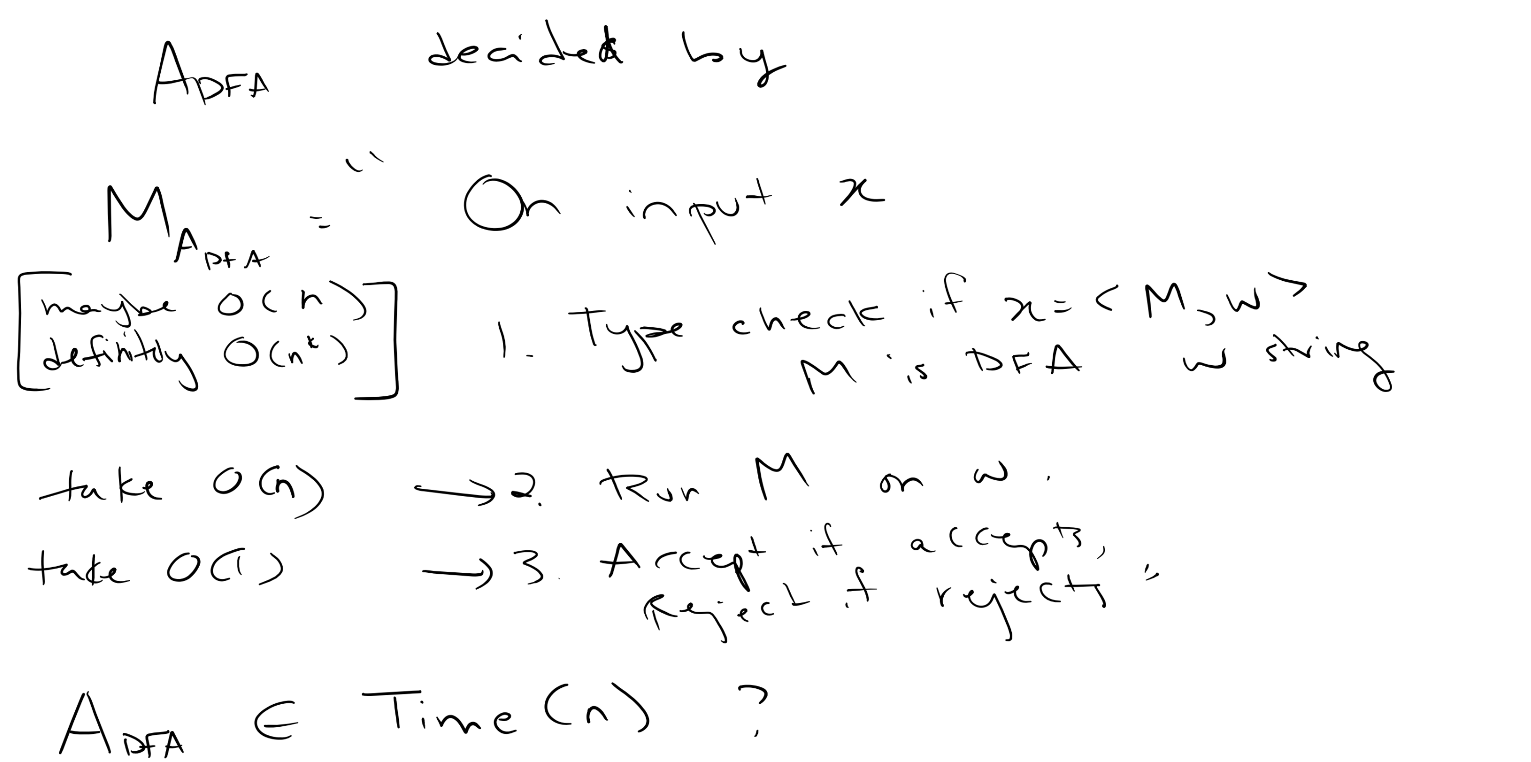

Slide 62
Key Notation and Definitions (125)
A type check can be definitely done in O(n^{k}), but if optimized, it can be done in O(n). Both are polynomial time.

Slide 63
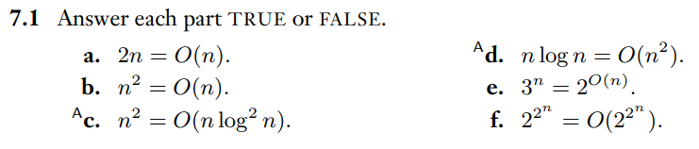
Review of Big-O Notation
Example 1
Ch. 7 Exercises pg. 322

Slide 64

Example 1 Solution
Ch. 7 Solutions pg. 329

Slide 65
Friday FAQ (122-125)
Q: "What is the difference between computability and complexity?"
A: Computability is about what can be computed and what problems can be solved. Complexity is about how efficiently those problems can be solved.
Q: "Is everything in Time(1) also in Time(n)?"
A: Yes, just like how everything in O(1) is also in O(n), since Big-O represents an upper bound. If something is no faster than Time(1), then it will also be no faster than Time(n). We are looking at upper bounds, not exact asymptotic bounds.

