Slide 1


Electronic Computer Systems
FPGA car parking system
Francisco Duarte - 102325 | Leonardo Rosa - 102324

Slide 2
Introduction
FPGA car parking system
The goal of this project is to develop a small version of a car parking system.
In the entrance, there would be a motion sensor detecting whenever a car enters in the park. Once the sensor is triggered the system requires a password. If the password is correct the car can go through and the system would count that as one more car in the park. Otherwise, if the password is wrong the car can’t go through and the gate stays locked.
Features:
14 park slots,
Entry and Exit detection,
Password security system,
Tracking the number of parked cars.

Slide 3
Project Description
FPGA car parking system – Example with HC-SR501
Occupied Spots
Basic I/O
switches
Pmod Ports
A/Ds & D/As
Level shifter or VD
3.3V - 5V
Display
7segment
FPGA
basys3
Sensor
HC-SR501
External 5V supply
Number of occupied spots
Entry detection

Slide 4
Considerations
FPGA car parking system
Possibly using a ultrasound sensor (HC-SR04) or a motion detector sensor (HC-SR501) as the entrance sensor and switches as ocupied parked areas,
The HC-SR04 sensor probably needs a level shifter because of the 5V supply,
Having the switches working as spot counters and show it on the 7 segment display,
Design a hardware connection with the peripheral (sensor).

Slide 5
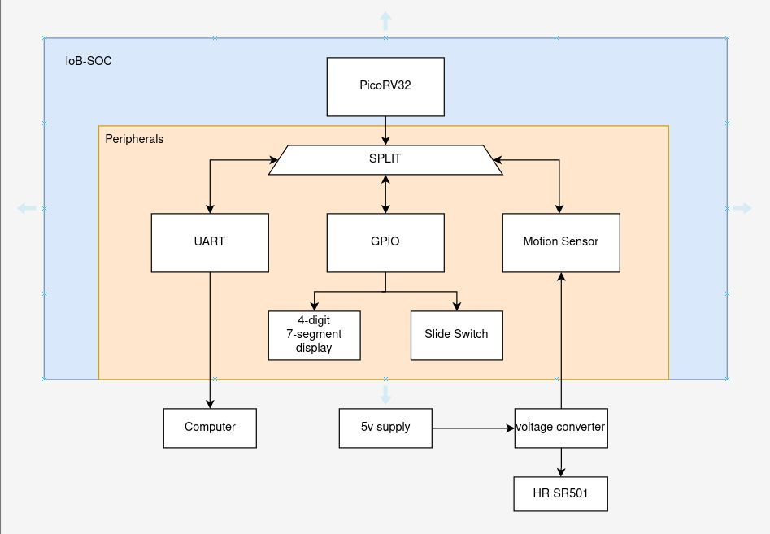
Dependencies Diagram
FPGA car parking system

