Slide 1
Automatic Set Instance Extraction using the Web
Richard C. Wang and William W. Cohen
Language Technologies Institute
Carnegie Mellon University
Pittsburgh, PA 15213 USA

Slide 2
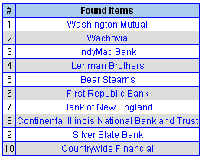
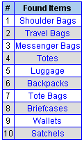

Challenge
Automatic Set Instance Extraction using the Web
Discovering set instances, or hyponyms, of any given semantic class name
  x is a hyponym of y if x is a (kind of) y
“Failed Banks”
“Bags”
“Hair Styles”
These are real examples from our system described in this paper
<number> / 21

Slide 3
Outline
Automatic Set Instance Extraction using the Web
Background – SEAL
Proposed Approach – ASIA
Evaluation
Conclusion
<number> / 21

Slide 4
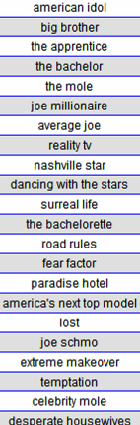
Background – SEAL
Automatic Set Instance Extraction using the Web
Set Expander for Any Language
  Wang & Cohen, ICDM 2007
An example of set expansion
  Given an input query (seeds):
    { survivor, amazing race }
  The output answer is:
    { american idol, big brother, ... }
A well-known SE system is Google Sets™
  http://labs.google.com/sets
<number> / 21
Notes:
Suppose there is a set expansion system, and someone inputs the words spit, boogers, and ear wax (which we’ll refer to them as seeds)
Then the system should return other disgusting words such as puke, toe jam, and sweat.
More formally, we assume there exist some target set S_t, and when given a small number of seeds where each is a member of the target set S_t,
Then the answer is a listing of other probable elements where each is also a member of that target set S_t.
A popular and famous example of a web-based set expansion system is Google Sets.

Slide 5
Background – SEAL
Automatic Set Instance Extraction using the Web
Features
  Independent of human & markup language
    Support seeds in English, Chinese, Japanese, Korean, ...
    Accept documents in HTML, XML, SGML, TeX, WikiML, …
  Does not require pre-annotated training data
    Utilize readily-available corpus: World Wide Web
Research contributions
  Automatically construct wrappers for extracting candidate items
  Rank candidates using random walk
<number> / 21
Notes:
We propose our set expansion system, called SEAL, which stands for Set Expander for Any Language.
As hinted by its name, SEAL is completely independent of human language.
Unlike Google Sets, which only supports English, SEAL supports English, Chinese, Japanese, Korean, and I’ve even seen Russian, Portuguese, and Spanish in the log file too, all produces decent results.
It is also completely independent of markup language, that means it can process documents written in HTML, XML, SGML, etc.
Another important feature is that it does not require any pre-annotated training data at all.
Since we already have a enormously huge and readily-available corpus on the Internet, why don’t we utilize it?
Based on this idea, we designed SEAL to learn wrappers from web documents on the fly, by using only a few input seeds.
SEAL is based on two research contributions.
The first one is that it can automatically construct wrappers to extract lists of entities from semi-structured web documents.
The second one is that it uses random graph walk to rank extracted entities such that the ones that are most probable to be in the target set are ranked higher.

Slide 6
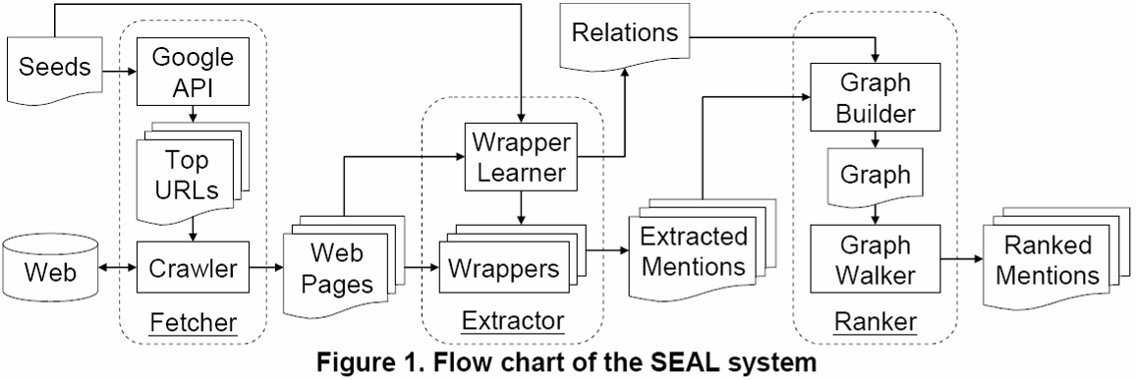
SEAL’s Pipeline
Automatic Set Instance Extraction using the Web
Pentax
Sony
Kodak
Minolta
Panasonic
Casio
Leica
Fuji
Samsung
…
Canon
Nikon
Olympus
Fetcher: Download web pages containing all seeds
Extractor: Construct wrappers for extracting candidate items
Ranker: Rank candidate items using Random Walk
<number> / 21
Notes:
SEAL is composed of three primary components.
<@> The first one is the Fetcher, which downloads web documents from the Internet
<@> The second one is the Extractor, which learns wrappers from those web documents.
<@> The third one is the Ranker, which ranks candidate entities extracted by those wrappers.
I will explain in detail what each component does.

Slide 7
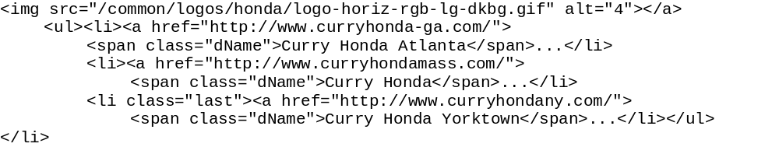
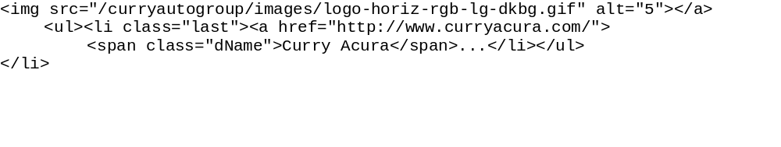

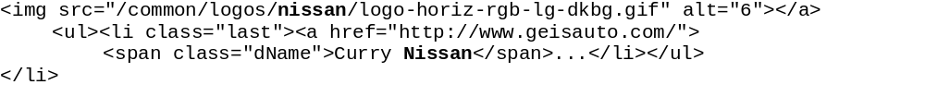
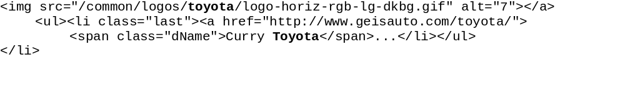
Can you find common contexts that bracket every seed instance?
I guess not!
Let’s try our Extractor …
Our Extractor finds maximally-long contexts that bracket at least one instance of every seed
Notes:
Can you find any common contexts that bracket all instances of every seed?
<@> Such common context does not exist in this example, so what should we do?
<@> We will now try our proposed extractor, which we will call it the Extractor E2.
<@> Extractor E2 finds maximally-long contexts that bracket at least one instance of every seed. What does that mean?
<@> As shown on the screen, the highlighted contexts surround at least one instance of every one of the three seeds.
<@> We construct a wrapper using these contexts and apply it back to this example to extract more candidate entity mentions; such as honda and acura.
We repeat this process until no more common contexts can be found.
<@><@><@><@> As shown on the screen, honda atlanta and honda yorktown are not what we want
<@><@> They are what we call the noisy entity mentions.
We will use the Ranker to try to push them down in the final resulting ranked list.

Slide 8
Outline
Automatic Set Instance Extraction using the Web
Background – SEAL
Proposed Approach – ASIA
Evaluation
Conclusion
<number> / 21

Slide 9
Proposed Approach – ASIA
Some Instances
Semantic Class Name
Noisy Instance Provider
Noisy Instance Expander
Bootstrapper
More Instances
Noisy Instances
Automatic Set Instance Acquirer (ASIA)

Slide 10
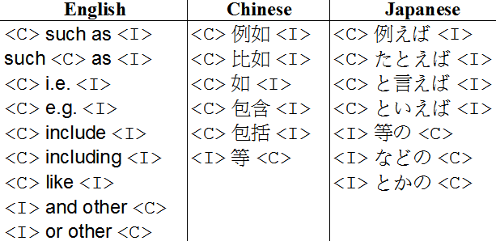
Noisy Instance Provider (NIP)
Manually constructed hyponym patterns
  based on Marti Hearst’s work in 1992
Query search engines for each hyponym pattern + a class name
  e.g. “car makers such as”
Extract all candidates I from returned web snippets
  A snippet often contains multiple excerpts
Rank each candidate i in I based on
  # of patterns, snippets, and excerpts containing i (more = better)
  # of characters between i and C in every excerpt (fewer = better)

Slide 11
Noisy Instance Expander (NIE)
The Extractor in NIE is a variation of that used in SEAL
Performs set expansion on web pages queried by a class name + some list words
  List words are words that often appear on list-containing pages
  Example query: “car makers” (list OR names OR famous OR common)
SEAL’s Extractor | NIE’s Extractor
Requires the longest common contexts to bracket at least one instance of every seed per web page | Requires the common contexts that bracket the most unique seeds to be as long as possible per web page

Slide 12
Bootstrapper
An iterative version of SEAL (iSEAL)
  Wang & Cohen, ICDM 2008
iSEAL makes several calls to SEAL. In each call, iSEAL…
  expands a few seeds, and
  aggregates statistics

Slide 13
Bootstrapper
Automatic Set Instance Extraction using the Web
Initial Seeds
Used Seeds
<number> / 21

Slide 14
Outline
Automatic Set Instance Extraction using the Web
Background – SEAL
Proposed Approach – ASIA
Evaluation
Conclusion
<number> / 21

Slide 15
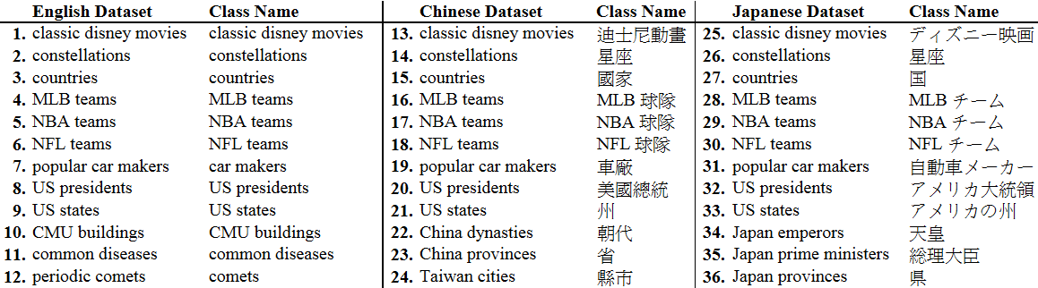
Evaluation Datasets
36 datasets and each of their class names used as input to ASIA

Slide 16
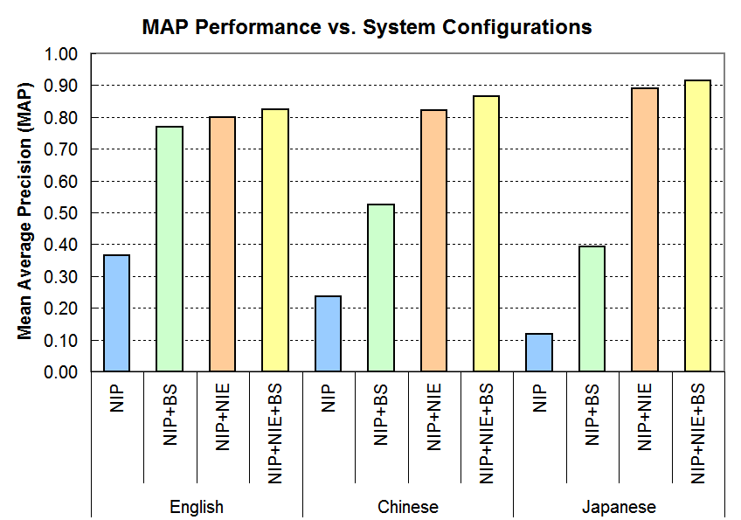
Evaluation Results

Slide 17
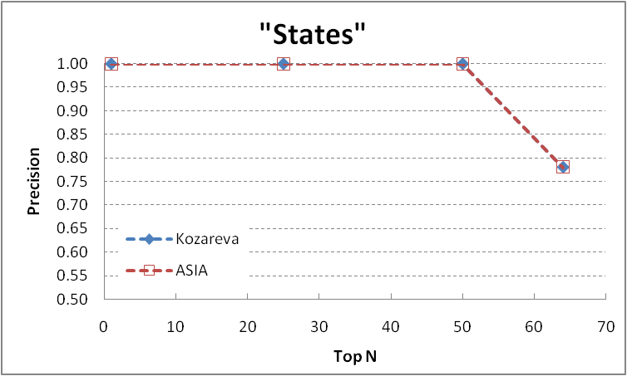
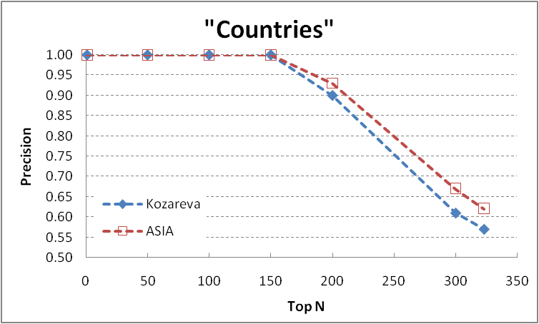
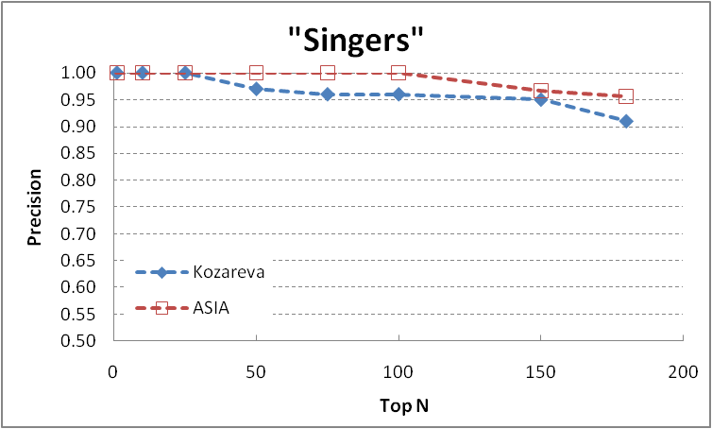
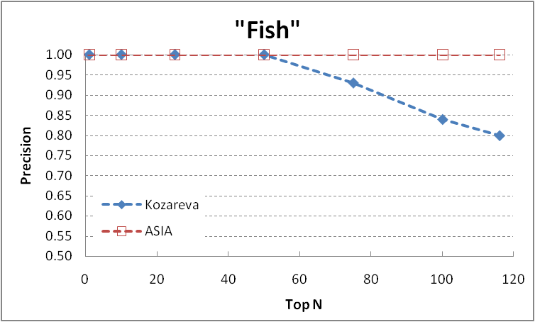
Comparison to:
Kozareva, Riloff, and Hovy, ACL 2008
Input to Kozareva: a class name + a seed

Slide 18
Comparison to:
Snow et al., ACL 2006
Automatic Set Instance Extraction using the Web
Definition:
  Original WN – WordNet 2.1
  Extended WN – Snow’s (+30K) extension of WN 2.1
Selecting semantic classes for evaluation:
  In Extended WN hierarchy, focus on leaf semantic classes extended by Snow that have ≥ 3 hyponyms
  Filter out those classes if the hyponyms from ASIA do not overlap with more than half of the hyponyms in the Original WN
  Randomly select a dozen remaining classes
<number> / 21

Slide 19
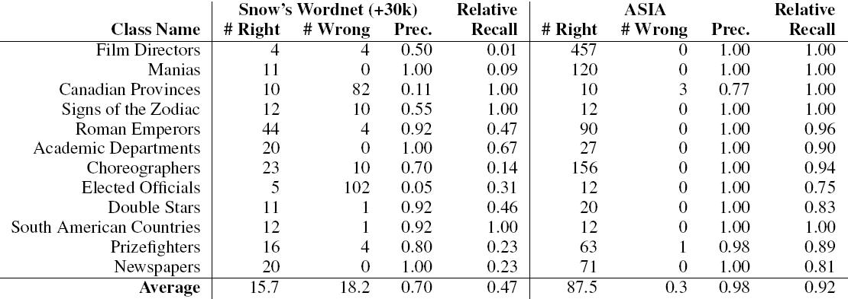
Comparison to:
Snow et al., ACL 2006

Slide 20
Conclusion
ASIA is nearly language-independent
  Can be easily extended to support other languages by adding a few hyponym patterns
ASIA outperforms other English systems
  Even though some of those use more input than just a semantic class name
ASIA is quite efficient
  Requiring only a few seconds per problem on a single-CPU machine

Slide 21
The End – Thank You!
Automatic Set Instance Extraction using the Web
Try out Boo!Wa! at www.BooWa.com
  Send any feedback to: rcwang@cs.cmu.edu
<number> / 21

Slide 22
Evaluation Method
Automatic Set Instance Extraction using the Web
Evaluation metric: Mean Average Precision
  Contains recall and precision-oriented aspects
  Sensitive to the entire ranking
Evaluation procedure:
  Input a semantic class name to ASIA
  Compute MAP for the output list
<number> / 21

Slide 23
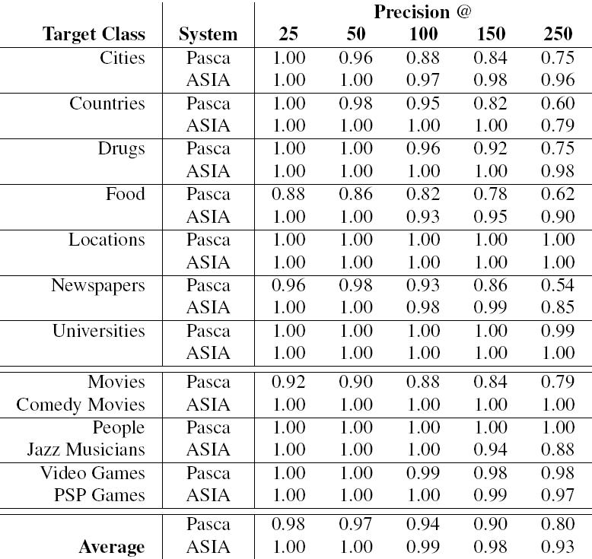
Comparison to Pasca, CIKM 2007

Slide 24
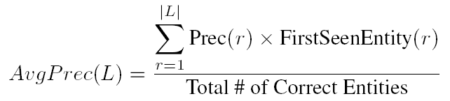
Evaluation Method
Automatic Set Instance Extraction using the Web
Mean Average Precision
  Commonly used for evaluating ranked lists in IR
  Contains recall and precision-oriented aspects
  Sensitive to the entire ranking
  Mean of average precisions for each ranked list
If a list contains multiple synonyms of an entity e, then we only evaluate e once.
A binary function that returns 1 iff (a) and (b) are true:
(a) Synonym at r is correct
(b) It’s the highest-ranked synonym of its entity in the list
where L = ranked list of extracted items, r = rank
Evaluation Procedure
(per combination of iterative process, seeding strategy, and ranker – 20 in total)
  Perform 10 iterative expansions on each of the 36 datasets 3 times
  At each iteration, compute MAP for the 108 (3 x 36) ranked lists
<number> / 21
Notes:
We use Mean Average Precision to evaluate our ranked list.
Because it is commonly used for evaluating ranked results in the field of IR, and it contains recall and precision-oriented aspects.
MAP is defined as the mean of average precisions for each ranked list.
We calculate average precision using the formula shown, where L is the ranked list of extracted mentions, and r is the rank.
<@> Precision r is the precision at rank r
<@> NewEntity r is a binary function, which returns 1 if conditions (a) and (b) are true.
Basically, it ensures that, as we go down a ranked list, we are only evaluating the first encountered mention of every entity.
<@> True Entities is the total number of true entities in this particular dataset that is used for evaluation.
The evaluation procedure goes like this:

