Slide 1
Anomaly Localization
2/7/2024

Slide 2
Anomaly Localization
Dataset: motor_SST_Knee
Data: (6, 4000) vector, 1~3rows from IM, 4~6 rows from PMSM
Target: Detect which machine cause the change wave

Slide 3

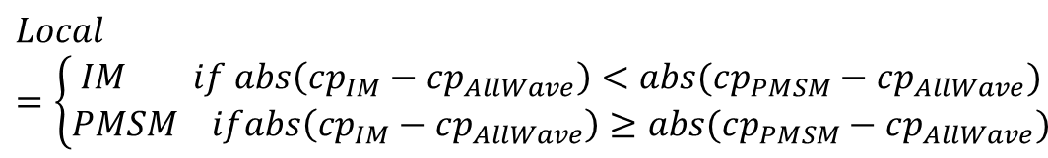
Method
Detect change point
Origin Signal
6×4000
Remove first 400 initialization data
Origin Signal
6×3600
$$cp_{IM}, cp_{PMSM}, cp_{AllWave}$$
Divide into PMSM, IM
IM
3×3600
PMSM
3×3600
$$Local=\left\{\begin{aligned}IM if abs\left(cp_{IM}−cp_{AllWave}\right)<abs(cp_{PMSM}−cp_{AllWave}) \\ PMSM ifabs\left(cp_{IM}−cp_{AllWave}\right)≥abs(cp_{PMSM}−cp_{AllWave})\end{aligned}\right.$$
Sum on first dimension
Calculate envelop of signal Apply moving average with window size 200
Acccuracy: IM 0.6875 PMSM: 0.8125
IM
1×3400
PMSM
1×3400
AllWave
1×3600

Slide 4
IM:
1-8(bearing fault)
17-24(FDI attack)
65-72(bearing fault)
81-88(FDI attack)
PMSM:
9-16(intern-turn fault),
25-32(FDI attack)
73-80(intern-turn fault)
89-96(FDI attack)
Wrong prediction in IM: 21, 22, 23, 24, 66, 72, 85, 86, 87, 88
Wrong prediction in PMSM: 25, 26, 27, 28, 91, 92
Red number means FDI attack

Slide 5
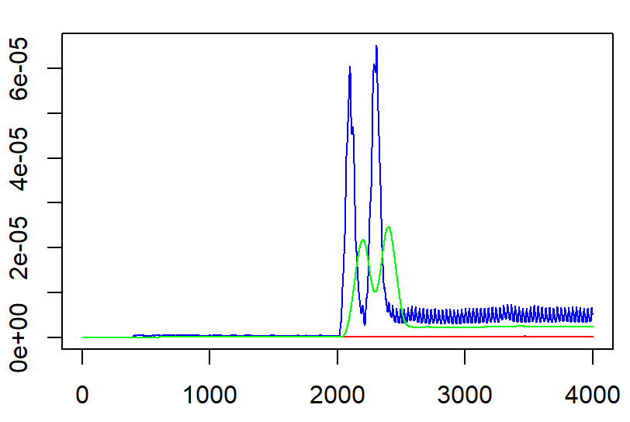
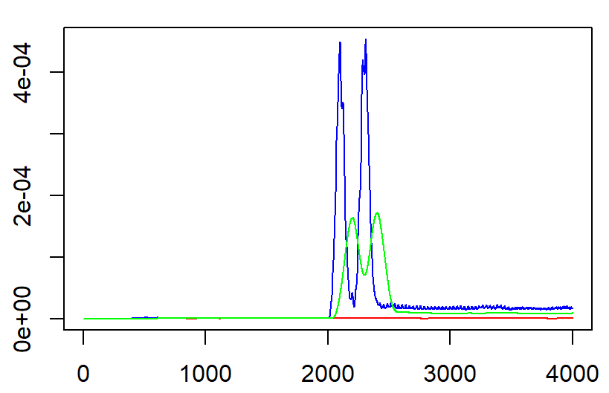
Case 21-24, 85-88 predict:PMSM, ground truth: IM
origin : ——
IM : ——
PMSM :——

Slide 6
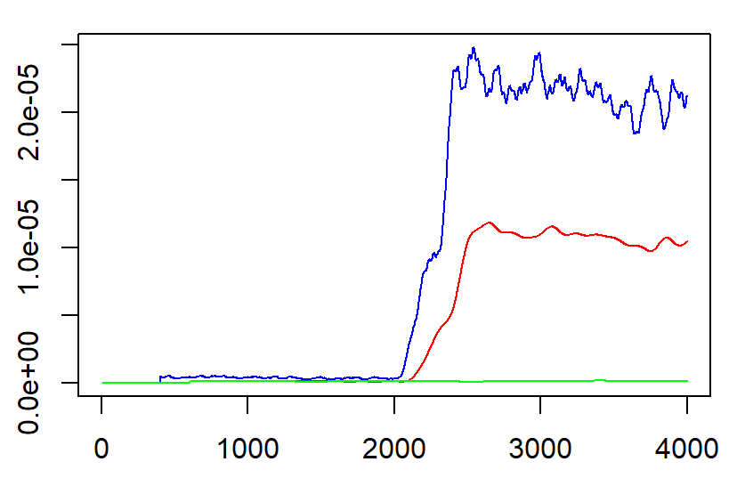
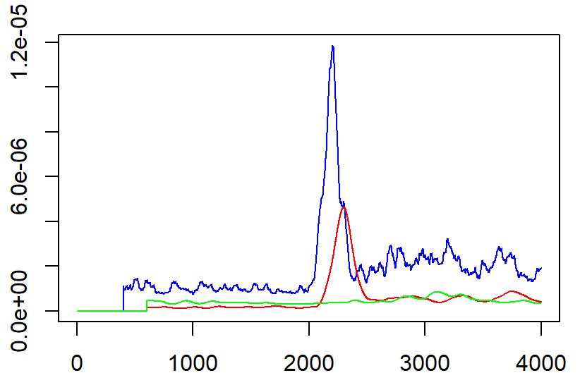
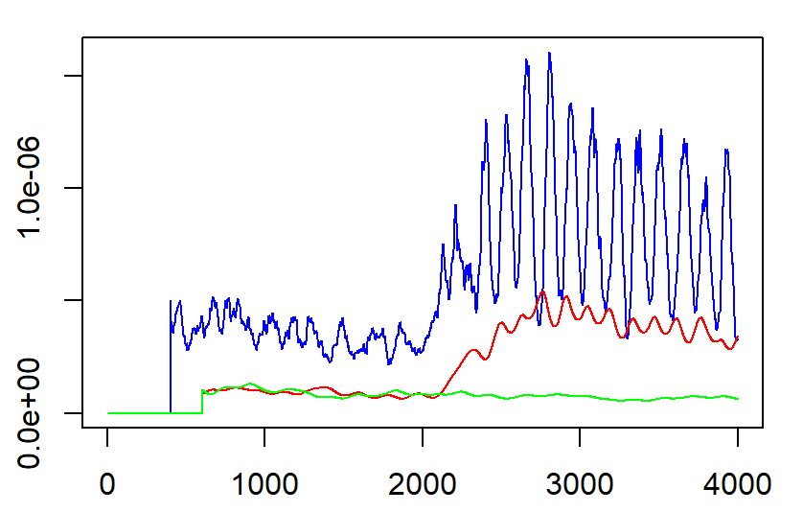
Case 25-28, 91-92 predict:IM, ground truth: PMSM
origin : ——
IM : ——
PMSM :——

Slide 7
THANKS!

Slide 8
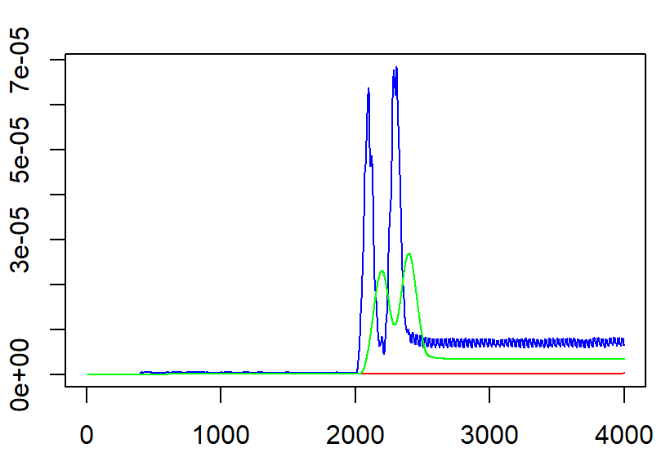
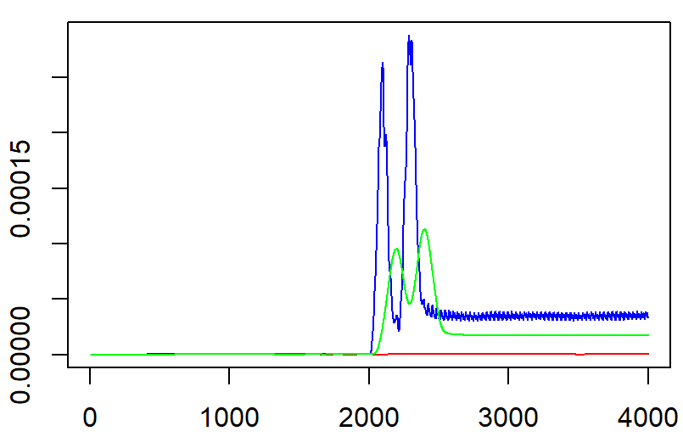
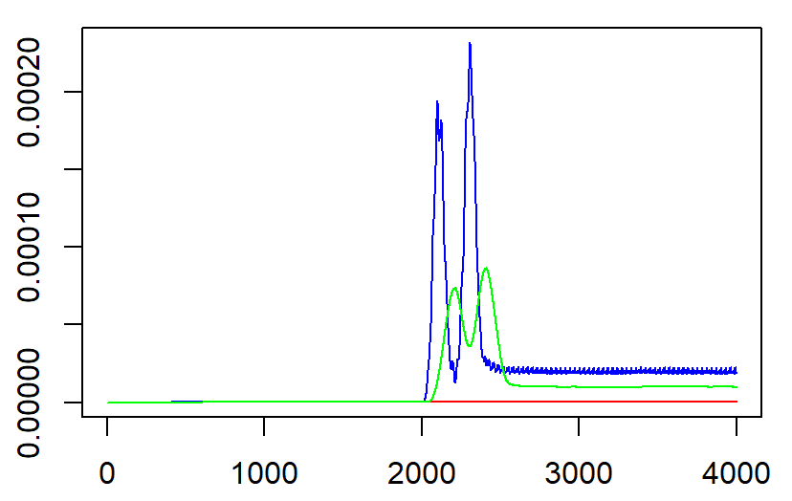
21-24

Slide 9
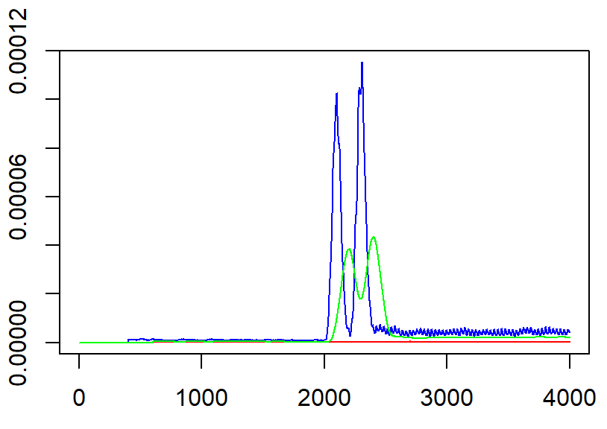
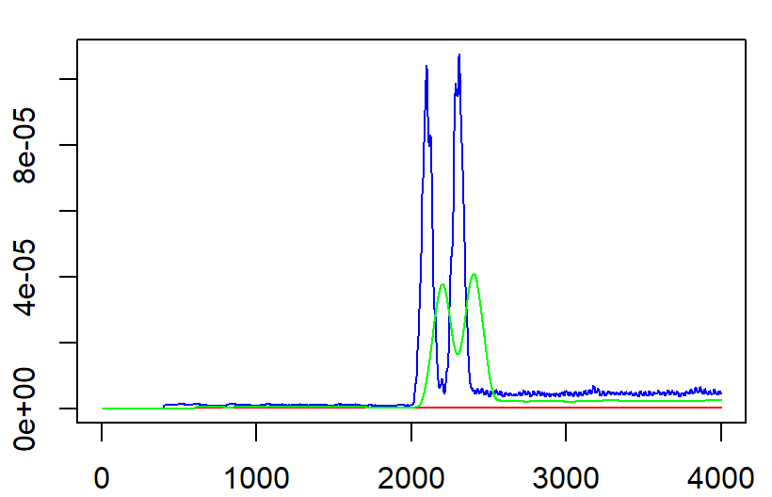
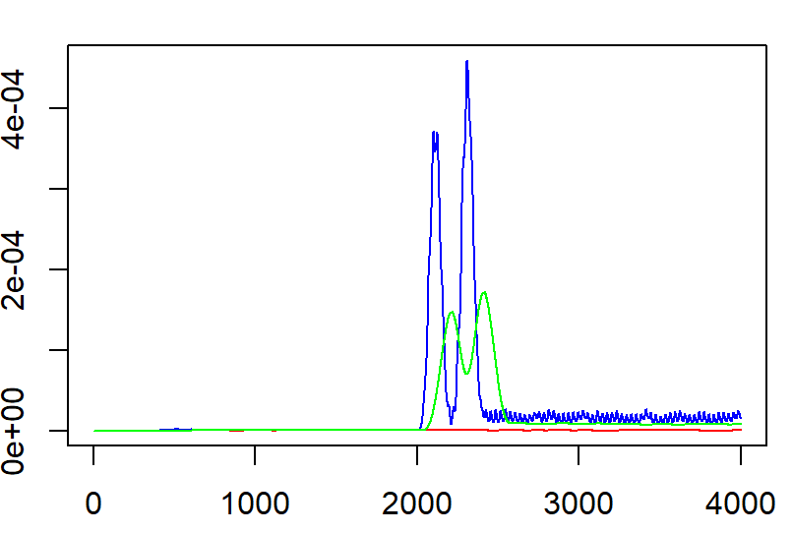
85-88

Slide 10
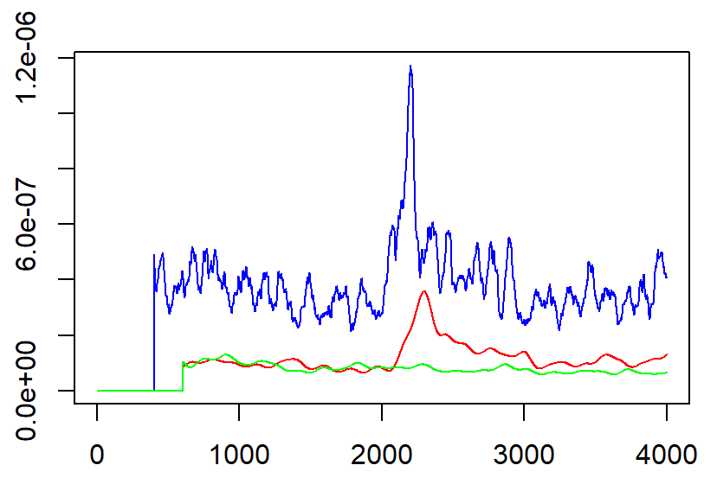
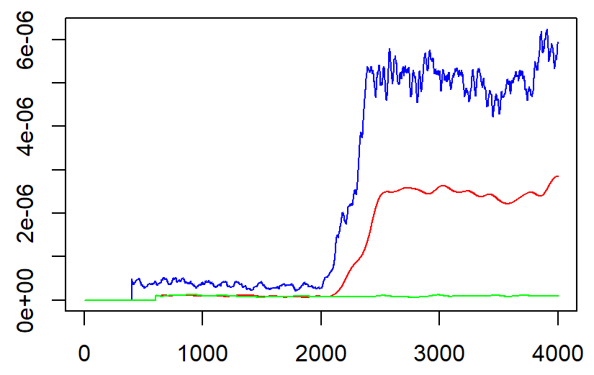
25-28

Slide 11
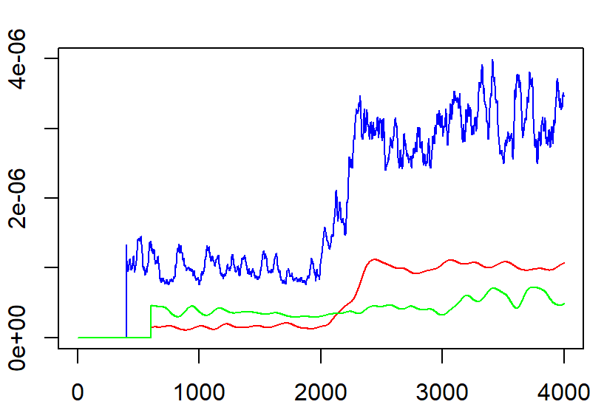
91-92

