Slide 1
SMART POWER MONITORING SYSTEM
SMART POWER

Slide 2

Do you know WHY IT TAKES HOURS OF TIME TO GET POWER BACK AFTER A FAULT IN ELECTRIC GRID ?

Slide 3




FAULTS THAT OCCUR IN ELECTRIC GRID
BURNT FUSE
TRANSFORMER
BREAK DOWN
BROKEN WIRES
SHORT
CIRCUITS
And many more…..

Slide 4
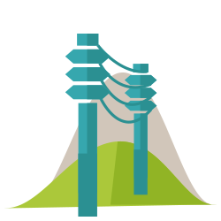
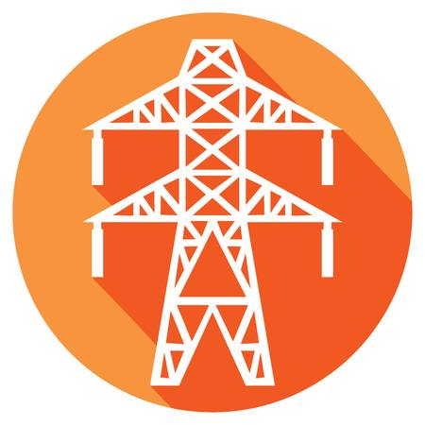

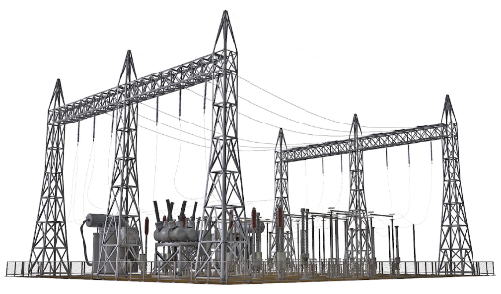

Problem Occurred…..!
Outside
Power lines
POWER CUT
SUBSTATION
Problem may be Inside or outside the city.
Then finding the fault becomes really difficult
Transformers
Inside

Slide 5



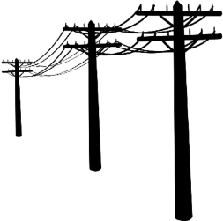

Problem in Main Power Lines
Search All POLES
OK Done..!
Problem in
POWER LINES
Group of 10 ..more
IF the Problem is outside the city
For Repairing the Outer Grid a group of 10 or more employees will start checking for the faulty wire over the HIGHT TENSION POLES
which may takemore than 2 Hours to find it and It is really Hazardous for them during nights due to broken or short circuit wires
Repair the Problematic WIRE

Slide 6



Problem in Local internal GRID
Get the failure area location
OK Done..!
Blown Transformer
Problem in
Local GRID
Blown FUSE
Group of 10 ..more
IF the Problem is Inside the city
For Repairing the Inner Grid Network a group of 10 or more employees will start checking for the faulty point which may take more than 3 Hours to find it and the problem may be related to Transformer or Fuses or Broken wires etc…
Broken wire

Slide 7
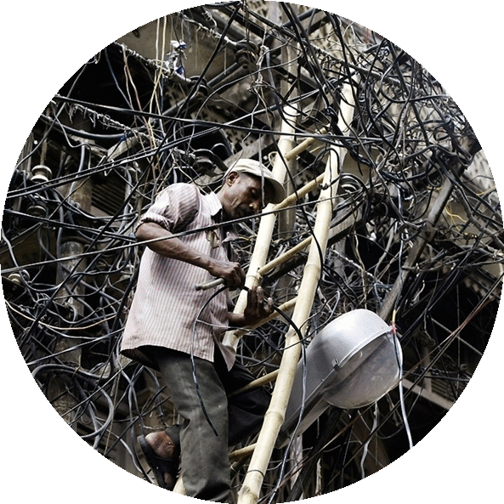
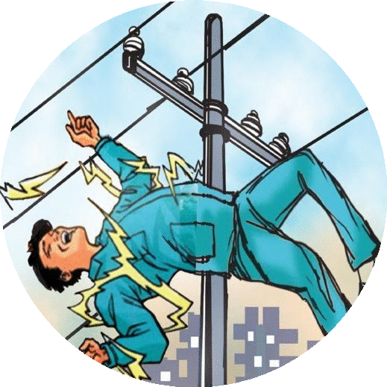

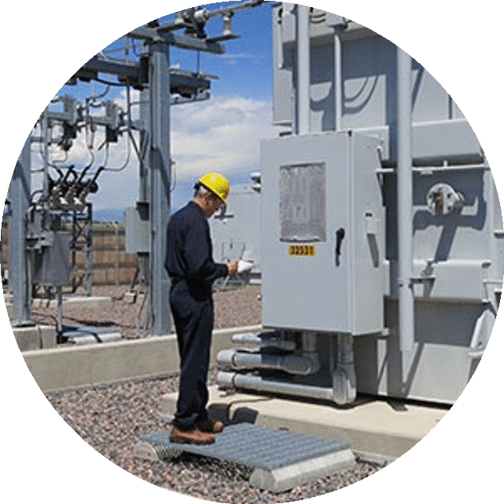
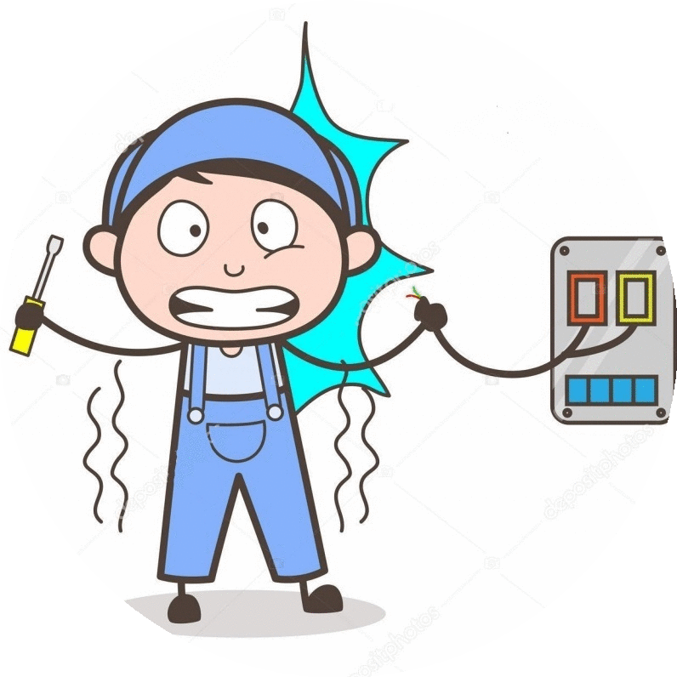
GRID Under Maintanence
Problem in
Local GRID
Employee
There are many deaths Cases of Employees due to Lack of perfect Communication between the Operator and the worker

Slide 8

There are many more problems related to Electric Grid both electrical and Physical which results in death of lot of electricians and It is also a time consuming process which may be more in complex Grid Networks

Slide 9
To Over come All These Problems we have designed a Control System
called
SMART POWER MONITORING SYSTEM

Slide 10
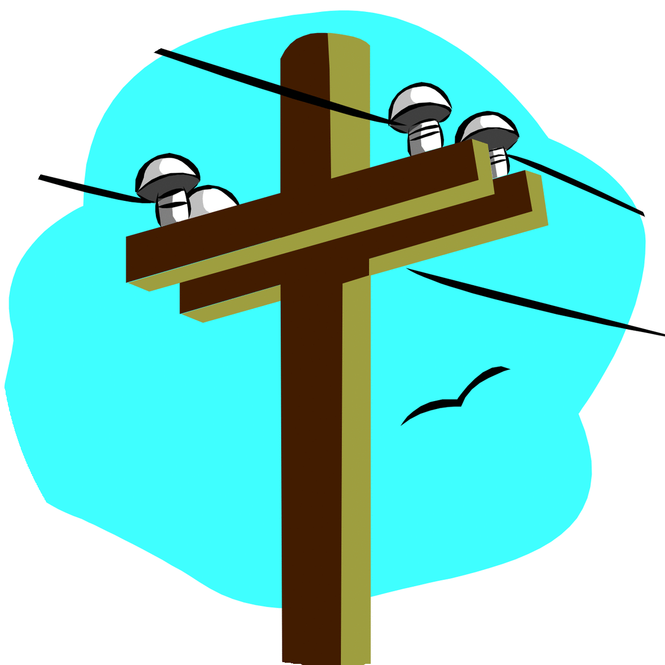



SPM SYSTEM FEATURES
FAULT TRACKING
&
DETECTION
MAINTENANCE
GRID Diagnosis
DATA REPORT
ACB CONTACTER
VOLTAGE
READING
ANTI-POWER THEFT
many more features…..

Slide 11
ADVANTAGES
1
2
3
4
5
6
Early Problem Prediction and Pre-Notification
Eliminates 80% of time wastage
Replacing Fuses with ACB
Avoids Mis-communication between Employees
Faster Grid diagnosis
Portable, Safe and Secure

Slide 12


DATA REPORT
DAY 1
DAY 2
DAY 3
DAY 4
DAY 5
DAY 6
DAY 7
Voltage
Current

Slide 13

T H A N K YOU

