Slide 1
FIR 32 taps Streaming and cascade interface
Olivier TREMOIS, Software Marketing AI Engine Tools
Daniele BAGNI, DSP / ML Specialist for EMEA
6 April 2020

Slide 2
Agenda
Architectural study
AI Engine refresh
The design in Vitis AIE EA
The design in Model Composer EA
Conclusion

Slide 3
Architectural study
Olivier TREMOIS, Software Marketing AI Engine Tools
Daniele BAGNI, DSP / ML Specialist for EMEA

Slide 4
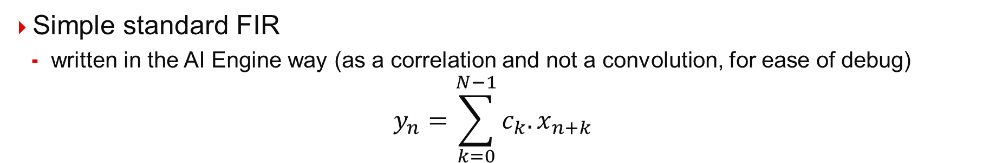
What is this FIR ?
Simple standard FIR
written in the AI Engine way (as a correlation and not a convolution, for ease of debug)
$$y_{n}=\sum_{k=0}^{N−1}{c_{k}.x_{n+k}}$$
data
0
1
2
3
4
5
6
7
8
9
10
11
12
13
14
15
16
17
18
19
20
21
22
23
24
25
26
27
28
29
30
31
32
33
34
35
36
37
38
39
40
41
42
43
44
45
46
47
0
1
2
3
4
5
6
7
8
9
10
11
12
13
14
15
16
17
18
19
20
21
22
23
24
25
26
27
28
29
30
31
→ y₀
Coefficients
Aligned On
Different
Data
0
1
2
3
4
5
6
7
8
9
10
11
12
13
14
15
16
17
18
19
20
21
22
23
24
25
26
27
28
29
30
31
→ y₁
0
1
2
3
4
5
6
7
8
9
10
11
12
13
14
15
16
17
18
19
20
21
22
23
24
25
26
27
28
29
30
31
→ y₂
0
1
2
3
4
5
6
7
8
9
10
11
12
13
14
15
16
17
18
19
20
21
22
23
24
25
26
27
28
29
30
31
→ y₃
0
1
2
3
4
5
6
7
8
9
10
11
12
13
14
15
16
17
18
19
20
21
22
23
24
25
26
27
28
29
30
31
→ y₄

Slide 5
AI Engine vector processor performance: 1/2
Operand 1 (bit) | Operand 2 (bit) | Output (bit) | Number of GMACs @ 1 GHz
8 real | 8 real | 16 real | 128
16 real | 8 real | 48 real | 64
16 real | 16 real | 48 real | 32
16 real | 16 complex | 48 complex | 16
16 complex | 16 real | 48 complex | 16
16 complex | 16 complex | 48 complex | 8
16 real | 32 real | 48/80 real | 16
16 real | 32 complex | 48/80 complex | 8
16 complex | 32 real | 48/80 complex | 8
16 complex | 32 complex | 48/80 complex | 4
32 real | 16 real | 48/80 real | 16
32 real | 16 complex | 48/80 complex | 8
32 complex | 16 real | 48/80 complex | 8
32 complex | 16 complex | 48/80 complex | 4
32 real | 32 real | 80 real | 8
32 real | 32 complex | 80 complex | 4
32 complex | 32 real | 80 complex | 4
32 complex | 32 complex | 80 complex | 2
32 SPFP | 32 SPFP | 32 SPFP | 8
8 cplx GMACs
SPFP: IEEE Single Precision Floating Point
Notes:
1 GHz @ all speedgrades – up to 1.3 GHz at fastest speedgrades

Slide 6
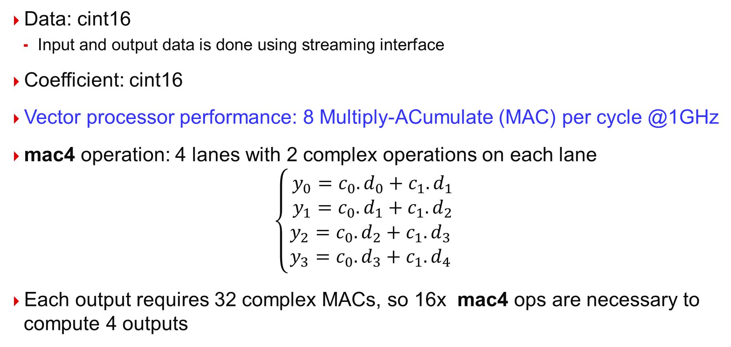
AI Engine vector processor performance 2/2
Data: cint16
Input and output data is done using streaming interface
Coefficient: cint16
Vector processor performance: 8 Multiply-ACumulate (MAC) per cycle @1GHz
mac4 operation: 4 lanes with 2 complex operations on each lane
$$\left\{\begin{matrix} y_{0}=c_{0}.d_{0}+c_{1}.d_{1} \\ y_{1}=c_{0}.d_{1}+c_{1}.d_{2} \\ y_{2}=c_{0}.d_{2}+c_{1}.d_{3} \\ y_{3}=c_{0}.d_{3}+c_{1}.d_{4}\end{matrix}\right.$$
Each output requires 32 complex MACs, so 16x mac4 ops are necessary to compute 4 outputs

Slide 7
AI Engine data transfer performance
DM Interface
256
256
256
Locks
North Mem I/F
2 streams in, 2 streams out
32 bits/cycle @1GHz
Or 128 bits / 4 cycles
A single stream read can be issued per cycle
Using the 2 streams and the 128-bit option → 64 bits/cycle on average
The Memory I/F (DM) connected to the AIE core takes one of the four Mem I/F (North, South, East, West)
Program Memory
Memory I/F (DM)
256
256
256
128
AI
Engine
32
Streams FIFO
32
256
Engine Debug
Interface
32
Stream Out
West Mem I/F
32
32
256
32
Lock
Interface
128
32
DM Interface
256
128
Stream In
PROGRAM_CNTR
128
32
Locks
128
Error Status
Signal (EVENTS)
Tile CNTR In
Stall Signal
East Mem I/F
256
South Mem I/F
From Event Logic
Mem Collision
256
Clock & Reset
From Lock
Stall
Logic
From PS
256
DM Interface
Ctrl Registers
Stream FIFO
Empty/Full
Locks
256
256
256
Locks
DM Interface

Slide 8
Single AI Engine implementation
Data transfer: 4 input/output samples
For each new 4 output samples, we need 4 new input samples = 128 bits
128 bits can be read or written every 4 clock cycles
Compute: 4 output samples
The AI Engine must perform 32 (taps) x 4 (output samples)= 128 cpx MACs
Each new 4 output samples require 16 cycles (8 cpx MACs/cycle is the limit)
This architecture is compute bounded
4 samples/16 cycles → 1 sample/4 cycles @ 1GHz
Max input sample rate: 250 MSPS

Slide 9
1 AI Engine Architecture
AI Engine
8 GMACs
16 bits cpx
250 MSPS
16 bit complex
250 MSPS
16 bit complex

Slide 10
Cascade of Four AI Engines
In order to improve performances, compute can be dispatched onto four AI Engines
Data transfer: 4 input/output samples
For each new 4 output samples, we need 4 new input samples = 128 bits
128 bits (4 samples) can be read/written every 4 clock cycles
Compute: 4 output samples
Each AI Engine performs 32/4 (taps) x 4 (output samples) = 32 cpx MACs
Each new 4 output samples require 4 cycles (8 cpx MACs/cycle is the limit)
This architecture is balanced between transfer and compute
4 samples/4 cycles → 1 sample/cycle @ 1GHz
Max input sample rate: 1 GSPS

Slide 11
4 AI Engine Architecture: 1 GSPS input/output data rate
Cascade
stream
Cascade
stream
Cascade
stream
AI Engine
8 GMACs
16 bits cpx
AI Engine
8 GMACs
16 bits cpx
AI Engine
8 GMACs
16 bits cpx
AI Engine
8 GMACs
16 bits cpx
1 GSPS
Output
data
1 GSPS
16 bit complex
1 GSPS
16 bit complex
1 GSPS
16 bit complex
1 GSPS
16 bit complex

Slide 12
How to achieve higher sample rates
Four AI Engines in a row achieves highest efficiency for data transfers AND compute
Need to divide the input and output data streams into multiple individual streams
A first approach is to separate input and output data into even and odd indexes, in that case also the N coefficients are separated in two: odd (N/2) and even (N/2) indexes
odd coeffs of index: [ 0, 2, 4, 6, 8, 10, 12, 14, 16, 18, 20, 22, 24, 26, 28, 30]
even coeffs of index: [ 1, 3, 5, 7, 9, 11, 13, 15, 17, 19, 21, 23, 25, 27, 29, 31]

Slide 13




Even Output
Compute $y_{0}$
0
1
2
3
4
5
6
7
8
9
10
11
12
13
14
15
16
17
18
19
20
21
22
23
24
25
26
27
28
29
30
31
32
33
34
35
36
37
38
39
40
41
42
43
44
45
46
47
0
1
2
3
4
5
6
7
8
9
10
11
12
13
14
15
16
17
18
19
20
21
22
23
24
25
26
27
28
29
30
31
Even Data
Even Coefficients
0
1
2
3
4
5
6
7
8
9
10
11
12
13
14
15
16
17
18
19
20
21
22
23
24
25
26
27
28
29
30
31
32
33
34
35
36
37
38
39
40
41
42
43
44
45
46
47
0
1
2
3
4
5
6
7
8
9
10
11
12
13
14
15
16
17
18
19
20
21
22
23
24
25
26
27
28
29
30
31
Odd Data
Odd Coefficients
$$y_{0}$$
Compute $y_{2}$
0
1
2
3
4
5
6
7
8
9
10
11
12
13
14
15
16
17
18
19
20
21
22
23
24
25
26
27
28
29
30
31
32
33
34
35
36
37
38
39
40
41
42
43
44
45
46
47
0
1
2
3
4
5
6
7
8
9
10
11
12
13
14
15
16
17
18
19
20
21
22
23
24
25
26
27
28
29
30
31
Even Data
Even Coefficients
0
1
2
3
4
5
6
7
8
9
10
11
12
13
14
15
16
17
18
19
20
21
22
23
24
25
26
27
28
29
30
31
32
33
34
35
36
37
38
39
40
41
42
43
44
45
46
47
0
1
2
3
4
5
6
7
8
9
10
11
12
13
14
15
16
17
18
19
20
21
22
23
24
25
26
27
28
29
30
31
Odd Data
Odd Coefficients
$$y_{2}$$
The 2 parts are operating as 2 single rate filters:
Even coefficients on even data
Odd coefficients on odd data

Slide 14
Even Output
Compute $y_{0}$
0
1
2
3
4
5
6
7
8
9
10
11
12
13
14
15
16
17
18
19
20
21
22
23
24
25
26
27
28
29
30
31
32
33
34
35
36
37
38
39
40
41
42
43
44
45
46
47
0
1
2
3
4
5
6
7
8
9
10
11
12
13
14
15
16
17
18
19
20
21
22
23
24
25
26
27
28
29
30
31
Even Data
Even Coefficients
0
2
4
6
8
10
12
14
16
18
20
22
24
26
28
30
32
34
36
38
40
42
44
46
0
2
4
6
8
10
12
14
16
18
20
22
24
26
28
30
Odd Data
Odd Coefficients
1
3
5
7
9
11
13
15
17
19
21
23
25
27
29
31
33
35
37
39
$$y_{0}$$
41
43
45
47
1
3
5
7
9
11
13
15
17
19
21
23
25
27
29
31
Compute $y_{2}$
0
1
2
3
4
5
6
7
8
9
10
11
12
13
14
15
16
17
18
19
20
21
22
23
24
25
26
27
28
29
30
31
32
33
34
35
36
37
38
39
40
41
42
43
44
45
46
47
0
1
2
3
4
5
6
7
8
9
10
11
12
13
14
15
16
17
18
19
20
21
22
23
24
25
26
27
28
29
30
31
Even Data
Even Coefficients
0
2
4
6
8
10
12
14
16
18
20
22
24
26
28
30
32
34
36
38
40
42
44
46
0
2
4
6
8
10
12
14
16
18
20
22
24
26
28
30
Odd Data
Odd Coefficients
1
3
5
7
9
11
13
15
17
19
21
23
25
27
29
31
33
35
37
39
41
$$y_{2}$$
43
45
47
1
3
5
7
9
11
13
15
17
19
21
23
25
27
29
31
The 2 parts are operating as 2 single rate filters:
Even coefficients on even data
Odd coefficients on odd data

Slide 15





Odd Output
Compute $y_{1}$
0
1
2
3
4
5
6
7
8
9
10
11
12
13
14
15
16
17
18
19
20
21
22
23
24
25
26
27
28
29
30
31
32
33
34
35
36
37
38
39
40
41
42
43
44
45
46
47
0
1
2
3
4
5
6
7
8
9
10
11
12
13
14
15
16
17
18
19
20
21
22
23
24
25
26
27
28
29
30
31
Even Data
Odd Coefficients
0
1
2
3
4
5
6
7
8
9
10
11
12
13
14
15
16
17
18
19
20
21
22
23
24
25
26
27
28
29
30
31
32
33
34
35
36
37
38
39
40
41
42
43
44
45
46
47
0
1
2
3
4
5
6
7
8
9
10
11
12
13
14
15
16
17
18
19
20
21
22
23
24
25
26
27
28
29
30
31
Odd Data
Even Coefficients
$$y_{1}$$
First even sample must be discarded
Compute $y_{3}$
0
1
2
3
4
5
6
7
8
9
10
11
12
13
14
15
16
17
18
19
20
21
22
23
24
25
26
27
28
29
30
31
32
33
34
35
36
37
38
39
40
41
42
43
44
45
46
47
0
1
2
3
4
5
6
7
8
9
10
11
12
13
14
15
16
17
18
19
20
21
22
23
24
25
26
27
28
29
30
31
Even Data
Odd Coefficients
0
1
2
3
4
5
6
7
8
9
10
11
12
13
14
15
16
17
18
19
20
21
22
23
24
25
26
27
28
29
30
31
32
33
34
35
36
37
38
39
40
41
42
43
44
45
46
47
0
1
2
3
4
5
6
7
8
9
10
11
12
13
14
15
16
17
18
19
20
21
22
23
24
25
26
27
28
29
30
31
Odd Data
Even Coefficients
$$y_{3}$$
The 2 parts are operating as 2 single rate filters:
Even coefficients on odd data
Odd coefficients on even data

Slide 16
Odd Output
Compute $y_{1}$
0
1
2
3
4
5
6
7
8
9
10
11
12
13
14
15
16
17
18
19
20
21
22
23
24
25
26
27
28
29
30
31
32
33
34
35
36
37
38
39
40
41
42
43
44
45
46
47
0
1
2
3
4
5
6
7
8
9
10
11
12
13
14
15
16
17
18
19
20
21
22
23
24
25
26
27
28
29
30
31
Even Data
Odd Coefficients
0
2
4
6
8
10
12
14
16
18
20
22
24
26
28
30
32
34
36
38
40
42
44
46
1
3
5
7
9
11
13
15
17
19
21
23
25
27
29
31
Odd Data
Even Coefficients
1
3
5
7
9
11
13
15
17
19
21
23
25
27
29
31
33
35
37
39
41
$$y_{1}$$
43
45
47
0
2
4
6
8
10
12
14
16
18
20
22
24
26
28
30
Compute $y_{3}$
0
1
2
3
4
5
6
7
8
9
10
11
12
13
14
15
16
17
18
19
20
21
22
23
24
25
26
27
28
29
30
31
32
33
34
35
36
37
38
39
40
41
42
43
44
45
46
47
0
1
2
3
4
5
6
7
8
9
10
11
12
13
14
15
16
17
18
19
20
21
22
23
24
25
26
27
28
29
30
31
Even Data
Odd Coefficients
0
2
4
6
8
10
12
14
16
18
20
22
24
26
28
30
32
34
36
38
40
42
44
46
1
3
5
7
9
11
13
15
17
19
21
23
25
27
29
31
Odd Data
Even Coefficients
1
3
5
7
9
11
13
15
17
19
21
23
25
27
29
31
33
35
37
39
41
43
$$y_{3}$$
45
47
0
2
4
6
8
10
12
14
16
18
20
22
24
26
28
30
The 2 parts are operating as 2 single rate filters:
Even coefficients on odd data
Odd coefficients on even data

Slide 17
Odd/Even Cascades of AI Engines 1/3
Separation in 2 channels odd/even allows data rate increase
Each AI Engine take care of Odd or Even samples
For a 1 GSPS input rate, an AI Engine can take care of 8 taps (8GMACs)
Separate the N/2 odd and even indexed coefficients in two chunks each one, each chunk has N/4 coefficients:
chunk_0_0 with N/4 coeffs of index: [ 0, 2, 4, 6, 8, 10, 12, 14]
chunk_0_1 with N/4 coeffs of index: [16, 18, 20, 22, 24, 25, 28, 30]
chunk_1_0 with N/4 coeffs of index: [ 1, 3, 5, 7, 9, 11, 13, 15]
chunk_1_1 with N/4 coeffs of index:[17, 19, 21, 23, 25, 27, 29, 31]

Slide 18
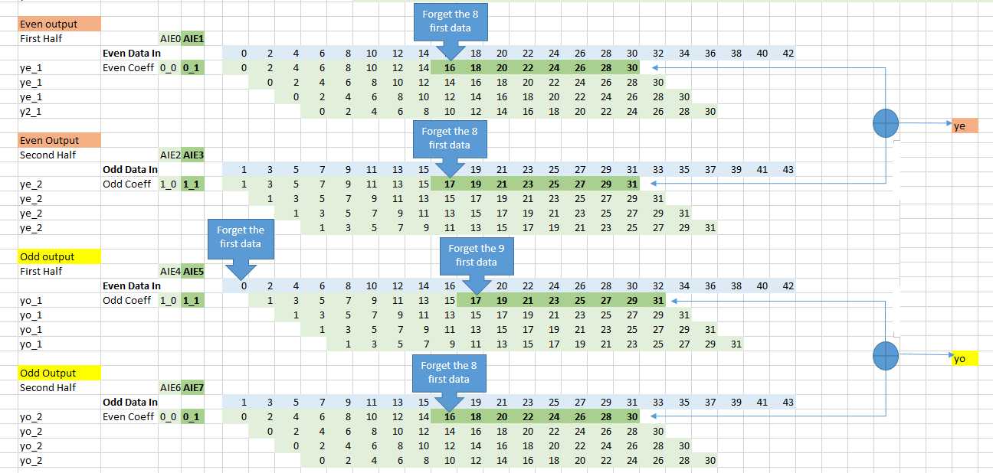
Odd/Even Cascades of AI Engines 2/3
chunk_0_0
chunk_0_1
chunk_1_0
chunk_1_1

Slide 19
Odd/Even Cascades of AI Engines 3/3
On 1 channel Even and Odd samples have their own 16 tap filter
2 AI Engines can process Even samples, and 2 other AIE the Odd samples
Even and Odd samples can be each @ 1GSPS for a total of 2 GSPS
This architecture is balanced between transfer and compute
8 samples/4 cycles → 2 samples/cycle @ 1GHz
Max input sample rate: 2 GSPS

Slide 20
8 AI Engine Architecture: 2 GSPS input/output data rate
Cascade
streams
Even Data
1 GSPS
Odd Data
1 GSPS
AIE 0
coef_0_0
0,2,4,…,14
AIE1
coef_0_1
16,18,20,…,30
AIE2
coef_1_0
1,3,5,…,15
AIE3
coef_1_1
17,19,21,…,31
1 GSPS
Even
Output
AIE4
coef_1_0
1,3,5,…,15
AIE5
coef_1_1
17,19,21,…,31
AIE6
coef_0_0
0,2,4,…,14
AIE7
coef_0_1
16,18,20,…,30
1 GSPS
Odd
Output
1 GSPS
Even Data
1 GSPS
Odd Data

Slide 21
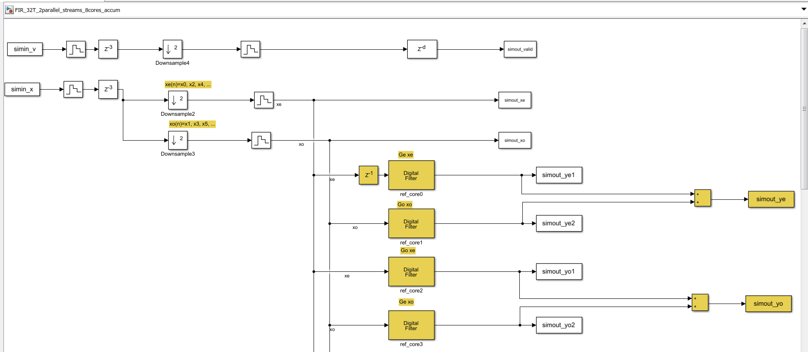
Simulink model of the 4 AI Engines system @ 1GSPS

Slide 22
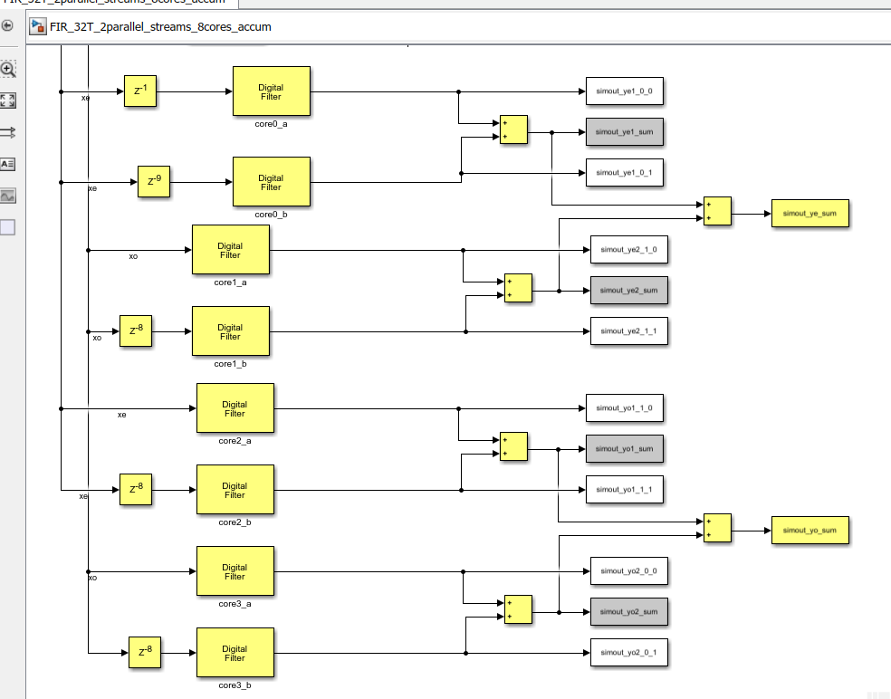
Simulink model of the 8 AI Engines system @ 2GSPS

Slide 23
Can we go further ?
Balance between transfer and compute being 8 taps per AIE core
Data can be divided into 4 channels: indices 4n, 4n+1, 4n+2, 4n+3
4 AI Engine on each output channel, so in total 4x 4 AI Engines
16 AI Engine can achieve 4GSPS input/output overall data rate
16 cores x 1GHz x 8 (cplx MAC) / 32taps = 4 GSPS I/O throughput
Similarly:
32 AI Engine can achieve 8GSPS input/output overall data rate
32 cores x 1GHz x 8 (cplx MAC) / 32taps = 8 GSPS I/O throughput
64 AI Engine can achieve 16GSPS input/output overall data rate
64 cores x 1GHz x 8 (cplx MAC) / 32taps = 16 GSPS I/O throughput

Slide 24
AI Engine Refresh
Olivier TREMOIS, Software Marketing AI Engine Tools

Slide 25
Refresh: AIE List of Data Types
Vector data types:
 | 128 bit | 256 bit | 512 bit | 1024 bit
Complex | v2cint32 | v4cint32 | v8cint32 | v16cint32
 | v4cint16 | v8cint16 | v16cint16 | v32cint16
Real | v4int32 | v8int32 | v16int32 | v32int32
 | v8int16 | v16int16 | v32int16 | v64int16
Accumulator data types:
 | 320/384 bit | 640/768 bit
Complex | v2cacc80 | v4cacc80
 | v4cacc48 | v8cacc48
Real | v4acc80 | v8acc80
 | v8acc48 | v16acc48

Slide 26
Refresh: Accumulator and Vector Types
Complex Vector (128b)
Complex Vector (128b)
16b
16b
16b
16b
16b
16b
16b
16b
v4cint16
16b
16b
16b
16b
16b
16b
16b
16b
v4cint16
Complex MAC SIMD Unit
Complex Accumulator(384b)
v4cacc48
48b
48b
48b
48b
48b
48b
48b
48b

Slide 27
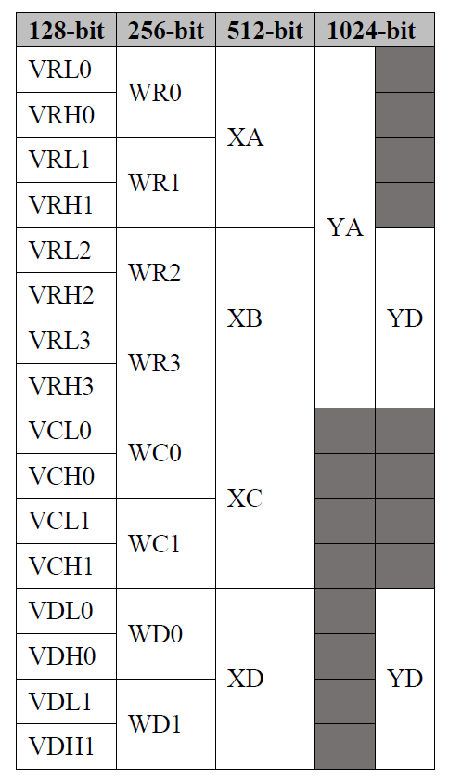
Refresh: AIE Vector Register File
512b
XA
XB
XC
XD
256b
WR0
WR2
WC0
WD0
128b
VRL0
VRL2
VCL0
VDL0
128b
VRH0
VRH2
VCH0
VDH0
WR1
WR3
WC1
WD1
VRL1
VRL3
VCL1
VDL1
VRH1
VRH3
VCH1
VDH1
YA (1024b) = XA, XB
YD (1024b) = XB, XD
Vector Register File:
16x 128b vector regs
8x 384b vector accumulators
768b
BM0
BM1
BM2
BM3
384b
AML0
AML1
AML2
AML3
384b
AMH0
AMH1
AMH2
AMH3

Slide 28

Refresh: AIE Register Management with Large Vectors
AI Engine uses multiple registers to implement wide vector and accumulator types
Examples :
v8cint16 occupies two 128-bit vector registers (256 bit)
v16cint16 occupies four 128-bit vector registers (512 bit)
v4acc80 occupies one 384-bit accumulator registers
XB
WR0
VRL0
VRH0
WR1
VRL1
VRH1
BM1
AML1
AMH1

Slide 29
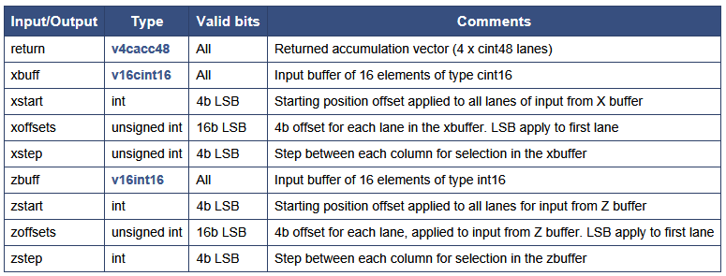
Refresh: mul4 intrinsic for 16x16 bits complex
Intrinsic signature:
Intrinsic parameters:
v4cacc48 mul4 ( v16cint16 xbuff, int xstart, unsigned int xoffsets, int xstep, v16int16 zbuff,
int zstart, unsigned int zoffsets, int zstep)

Slide 30
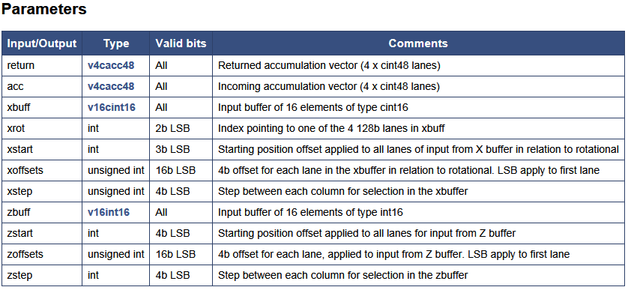
Refresh: mac4 intrinsic for 16x16 bit complex
Intrinsic signature:
Intrinsic parameters:
v4cacc48 mac4 ( v4cacc48 acc, v16cint16 xbuff, int xrot, int xstart, unsigned int xoffsets,
int xstep, v16int16 zbuff, int zstart, unsigned int zoffsets, int zstep)

Slide 31
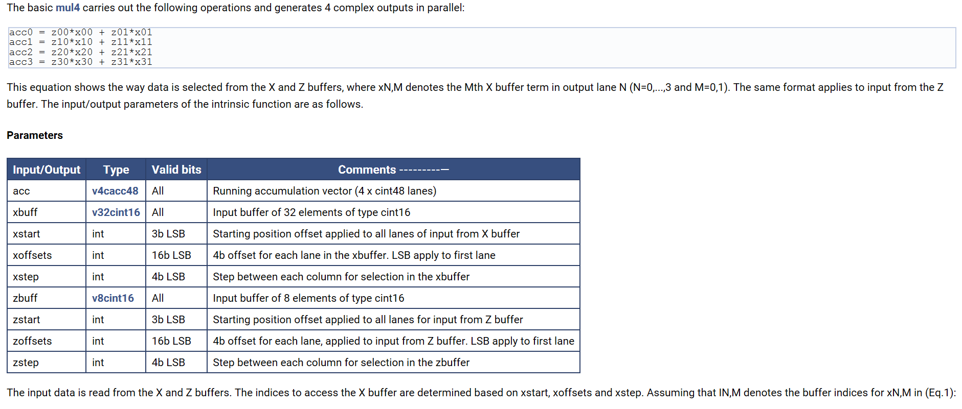
Refresh: 16-bit complex by 16-bit complex mult 1/4

Slide 32
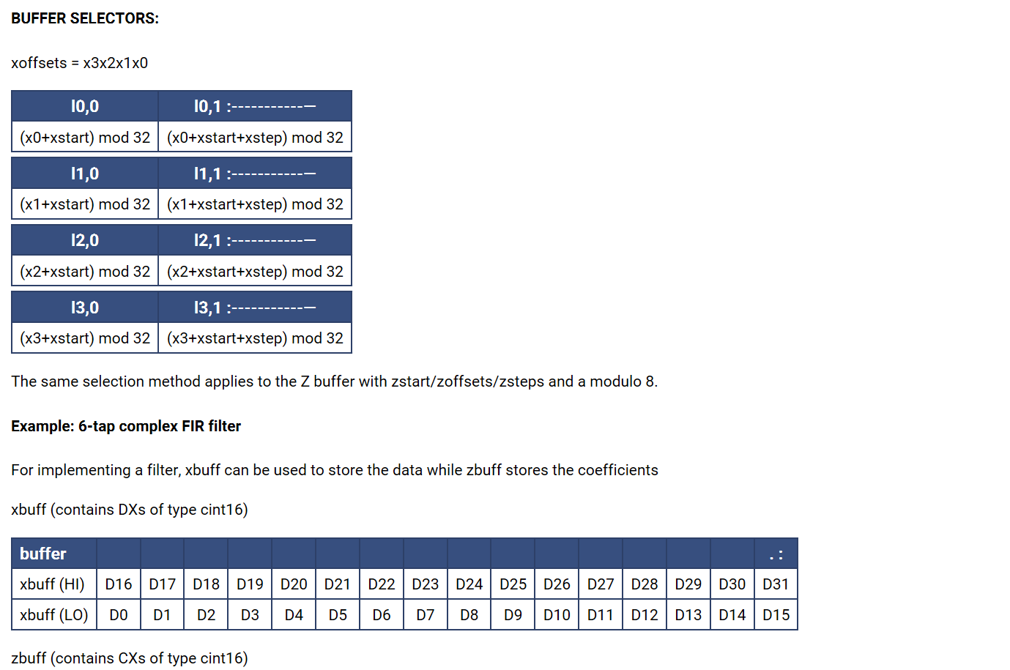
Refresh: 16-bit complex by 16-bit complex mult 2/4

Slide 33
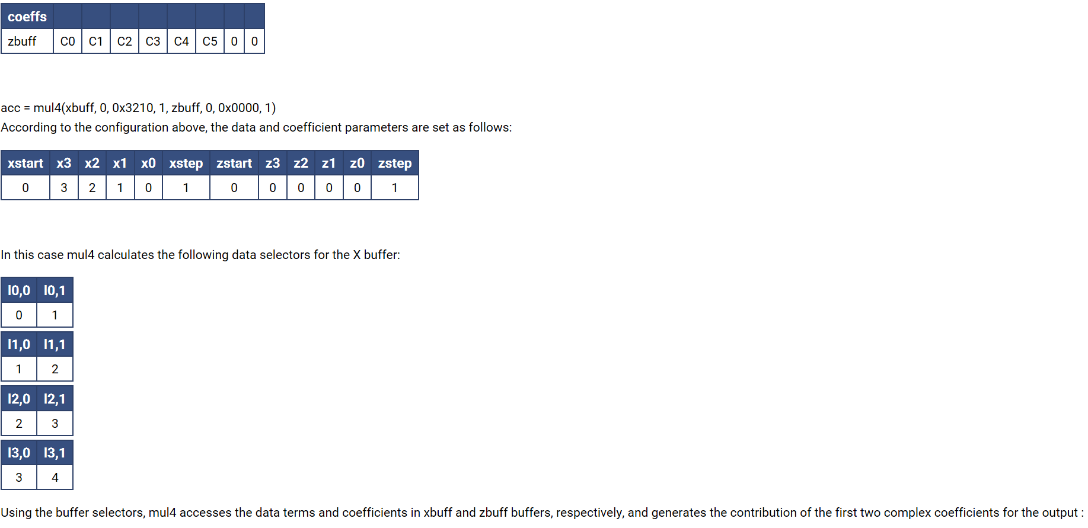
Refresh: 16-bit complex by 16-bit complex mult 3/4

Slide 34
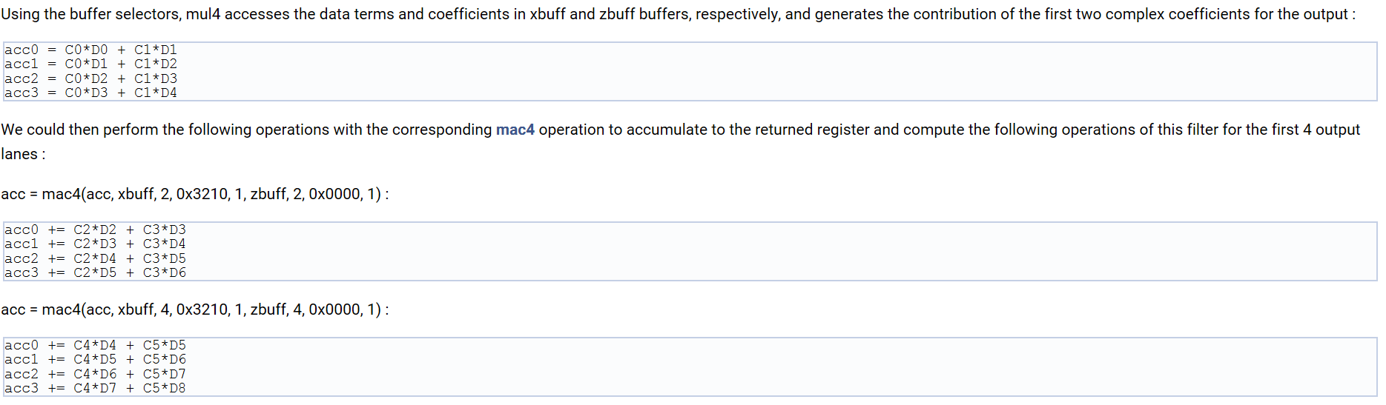
Refresh: 16-bit complex by 16-bit complex mult 4/4

Slide 35
Refresh: upd_v(…,N,…) / upd_w(…,N,…) 1/2
This family of intrinsic functions allows substitution of a 4 or 8 lane complex vector into a larger vector
Usage
upd_v(buf,N,val) upd_w(buf,N,val)
Examples
upd_v(buf,N,val) allows replacement of a 128-bit subset of a vector
upd_v(buf,<0..3>,val) : Replace four of the 16-lanes in a v16cint16
upd_v (buf,<0..7>,val) : Replace four of the 32-lanes in a v32cint16
upd_w(buf,N,val) allows replacement of a 256-bit subset of a vector
upd_w(buf,<0..1>,val) : Replace eight of the 16-lane in a v16cint16
upd_w(buf,<0..3>,val) : Replace eight of the 32-lanes in a v32cint16

Slide 36
Refresh: upd_v(…,N,…) / upd_w(…,N,…) 2/2
upd_v(buf,<0..3>,val) : Replace four of the 16-lanes in a v16cint16
upd_v (buf,<0..7>,val) : Replace four of the 32-lanes in a v32cint16
upd_w(buf,<0..1>,val) : Replace eight of the 16-lane in a v16cint16
upd_w(buf,<0..3>,val) : Replace eight of the 32-lanes in a v32cint16
upd_v(buf,1,val)
upd_v(buf,3,val)
upd_v(buf,0,val)
upd_v(buf,2,val)
upd_v(buf,1,val)
upd_v(buf,3,val)
upd_v(buf,5,val)
upd_v(buf,7,val)
upd_v(buf,0,val)
upd_v(buf,2,val)
upd_v(buf,4,val)
upd_v(buf,6,val)
upd_w(buf,0,val)
upd_w(buf,1,val)
upd_w(buf,0,val)
upd_w(buf,1,val)
upd_w(buf,2,val)
upd_w(buf,3,val)

Slide 37
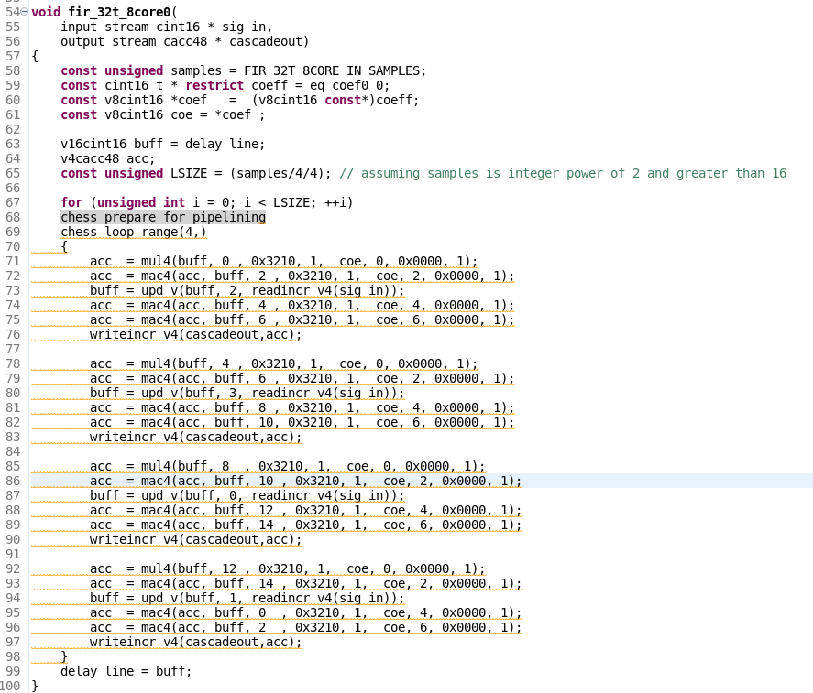
fir_32t_8core0.cpp

Slide 38
Example with 8-tap complex FIR – mul4
32b
xbuff
xbuff is v16cint16
vector of length 16,
16 bit complex integers
16b
zbuff is v8cint16
vector of length 8,
16 bit complex integers
zbuff
d0 d1 d2 d3 d4 d5 d6 d7 d8 d9 d10 d11 d12 d13 d14 d15
Line
a₀ = c₀d₀ + c₁d₁ + c₂d₂ + c₃d₃
a₁ = c₀d₁ + c₁d₂ + c₂d₃ + c₃d₄
a₂ = c₀d₂ + c₁d₃ + c₂d₄ + c₃d₅
a₃ = c₀d₃ + c₁d₄ + c₂d₅ + c₃d₆
c0 c1 c2 c3 c4 c5 c6 c7
c0 c1 c2 c3 c4 c5 c6 c7
c0 c1 c2 c3 c4 c5 c6 c7
c0 c1 c2 c3 c4 c5 c6 c7

Slide 39
Example with 8-tap complex FIR – mul4
32b
xbuff
xbuff is v16cint16
vector of length 16,
16 bit complex integers
16b
zbuff is v8cint16
vector of length 8,
16 bit complex integers
zbuff
d0 d1 d2 d3 d4 d5 d6 d7 d8 d9 d10 d11 d12 d13 d14 d15
Line
a₀ = c₀d₀ + c₁d₁ + c₂d₂ + c₃d₃
a₁ = c₀d₁ + c₁d₂ + c₂d₃ + c₃d₄
a₂ = c₀d₂ + c₁d₃ + c₂d₄ + c₃d₅
a₃ = c₀d₃ + c₁d₄ + c₂d₅ + c₃d₆
c0 c1 c2 c3 c4 c5 c6 c7
c0 c1 c2 c3 c4 c5 c6 c7
c0 c1 c2 c3 c4 c5 c6 c7
c0 c1 c2 c3 c4 c5 c6 c7

Slide 40
Example with 8-tap complex FIR – mul4
32b
xbuff
xbuff is v16cint16
vector of length 16,
16 bit complex integers
xstart
16b
zbuff is v8cint16
vector of length 8,
16 bit complex integers
zbuff
zstart
xstart
xoffsets
xstep
zstart
zoffsets
zstep
acc = mul4 (xbuff, 0, 0x3210, 1, zbuff, 0, 0x0000, 1);
xstep
zstep
d0 d1 d2 d3 d4 d5 d6 d7 d8 d9 d10 d11 d12 d13 d14 d15
a₀ = c₀d₀ + c₁d₁ + c₂d₂ + c₃d₃
a₁ = c₀d₁ + c₁d₂ + c₂d₃ + c₃d₄
a₂ = c₀d₂ + c₁d₃ + c₂d₄ + c₃d₅
a₃ = c₀d₃ + c₁d₄ + c₂d₅ + c₃d₆
c0 c1 c2 c3 c4 c5 c6 c7
c0 c1 c2 c3 c4 c5 c6 c7
zoffsets
xoffsets

Slide 41
Example with 8-tap complex FIR – mul4
32b
xbuff
xbuff is v16cint16
vector of length 16,
16 bit complex integers
xstart
16b
zbuff is v8cint16
vector of length 8,
16 bit complex integers
zbuff
zstart
xstart
xoffsets
xstep
zstart
zoffsets
zstep
acc = mul4 (xbuff, 0, 0x3210, 1, zbuff, 0, 0x0000, 1);
xstep
zstep
d0 d1 d2 d3 d4 d5 d6 d7 d8 d9 d10 d11 d12 d13 d14 d15
a₀ = c₀d₀ + c₁d₁
a₁ = c₀d₁ + c₁d₂
a₂ = c₀d₂ + c₁d₃
a₃ = c₀d₃ + c₁d₄
c0 c1 c2 c3 c4 c5 c6 c7
c0 c1 c2 c3 c4 c5 c6 c7
zoffsets
xoffsets

Slide 42
Example with 8-tap complex FIR – mac4
32b
xbuff
xbuff is v16cint16
vector of length 16,
16 bit complex integers
xstart
16b
zbuff is v8cint16
vector of length 8,
16 bit complex integers
zbuff
zstart
xstart
xoffsets
xstep
zstart
zoffsets
zstep
acc = mac4 (acc, xbuff, 2, 0x3210, 1, zbuff, 2, 0x0000, 1);
xstep
zstep
d0 d1 d2 d3 d4 d5 d6 d7 d8 d9 d10 d11 d12 d13 d14 d15
a₀ += c₂d₂ + c₃d₃
a₁ += c₂d₃ + c₃d₄
a₂ += c₂d₄ + c₃d₅
a₃ += c₂d₅ + c₃d₆
c0 c1 c2 c3 c4 c5 c6 c7
c0 c1 c2 c3 c4 c5 c6 c7
c0 c1 c2 c3 c4 c5 c6 c7
c0 c1 c2 c3 c4 c5 c6 c7
zoffsets
xoffsets

Slide 43
Example with 8-tap complex FIR – mac4
32b
xbuff
xbuff is v16cint16
vector of length 16,
16 bit complex integers
xstart
16b
zbuff is v8cint16
vector of length 8,
16 bit complex integers
zbuff
zstart
xstart
xoffsets
xstep
zstart
zoffsets
zstep
acc = mac4 (acc, xbuff, 4, 0x3210, 1, zbuff, 4, 0x0000, 1);
xstep
zstep
d0 d1 d2 d3 d4 d5 d6 d7 d8 d9 d10 d11 d12 d13 d14 d15
a₀ += c₄d₄ + c₅d₅
a₁ += c₄d₅ + c₅d₆
a₂ += c₄d₆ + c₅d₇
a₃ += c₄d₇ + c₅d₈
c0 c1 c2 c3 c4 c5 c6 c7
c0 c1 c2 c3 c4 c5 c6 c7
c0 c1 c2 c3 c4 c5 c6 c7
c0 c1 c2 c3 c4 c5 c6 c7
zoffsets
xoffsets

Slide 44
Example with 8-tap complex FIR – mac4
32b
xbuff
xbuff is v16cint16
vector of length 16,
16 bit complex integers
xstart
16b
zbuff is v8cint16
vector of length 8,
16 bit complex integers
zbuff
zstart
xstart
xoffsets
xstep
zstart
zoffsets
zstep
acc = mac4 (acc, xbuff, 6, 0x3210, 1, zbuff, 6, 0x0000, 1);
xstep
zstep
d0 d1 d2 d3 d4 d5 d6 d7 d8 d9 d10 d11 d12 d13 d14 d15
a₀ += c₆d₆ + c₇d₇
a₁ += c₆d₇ + c₇d₈
a₂ += c₆d₈ + c₇d₉
a₃ += c₆d₉ + c₇d₁₀
c0 c1 c2 c3 c4 c5 c6 c7
c0 c1 c2 c3 c4 c5 c6 c7
c0 c1 c2 c3 c4 c5 c6 c7
c0 c1 c2 c3 c4 c5 c6 c7
zoffsets
xoffsets

Slide 45
The Design in Vitis AI EA
Olivier TREMOIS, Software Marketing AI Engine Tools
Daniele BAGNI, DSP/ML Specialist for EMEA

Slide 46
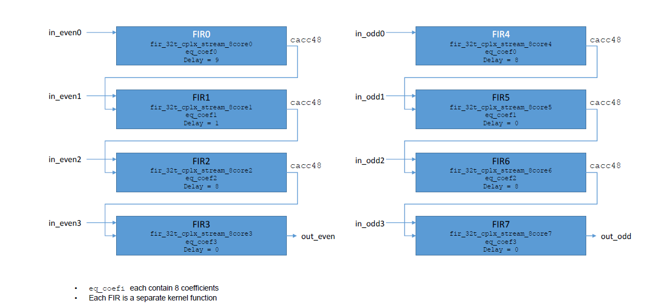
Correct Architecture
in_even2
eq_coef0_0; Delay=0
eq_coef1_0; Delay=1
in_even3
eq_coef0_1; Delay=8
eq_coef1_1; Delay=9
in_odd0
eq_coef1_0; Delay=0
eq_coef0_0; Delay=0
in_odd1
eq_coef1_1; Delay=8
eq_coef0_1; Delay=8

Slide 47
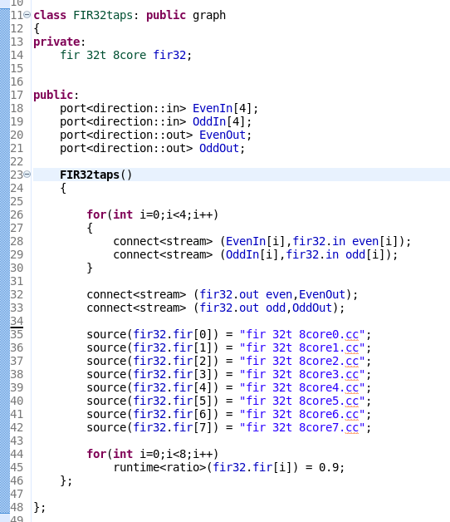
graph.h

Slide 48
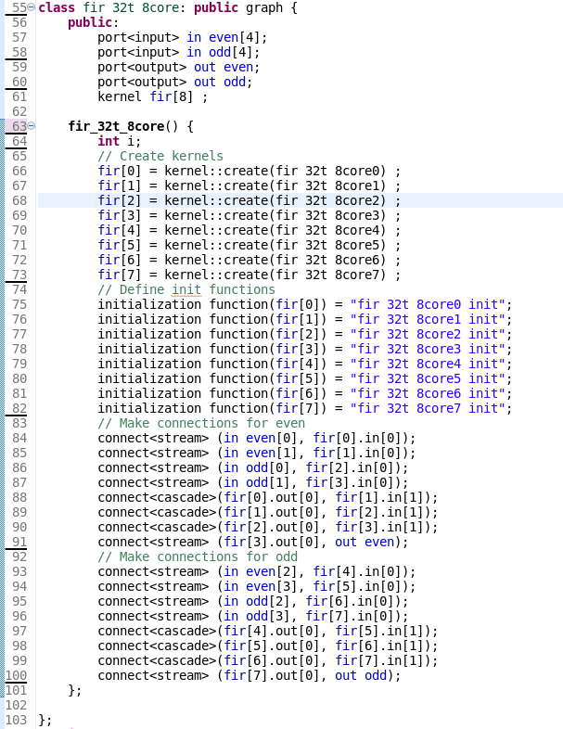
fir_32t_8core.h

Slide 49
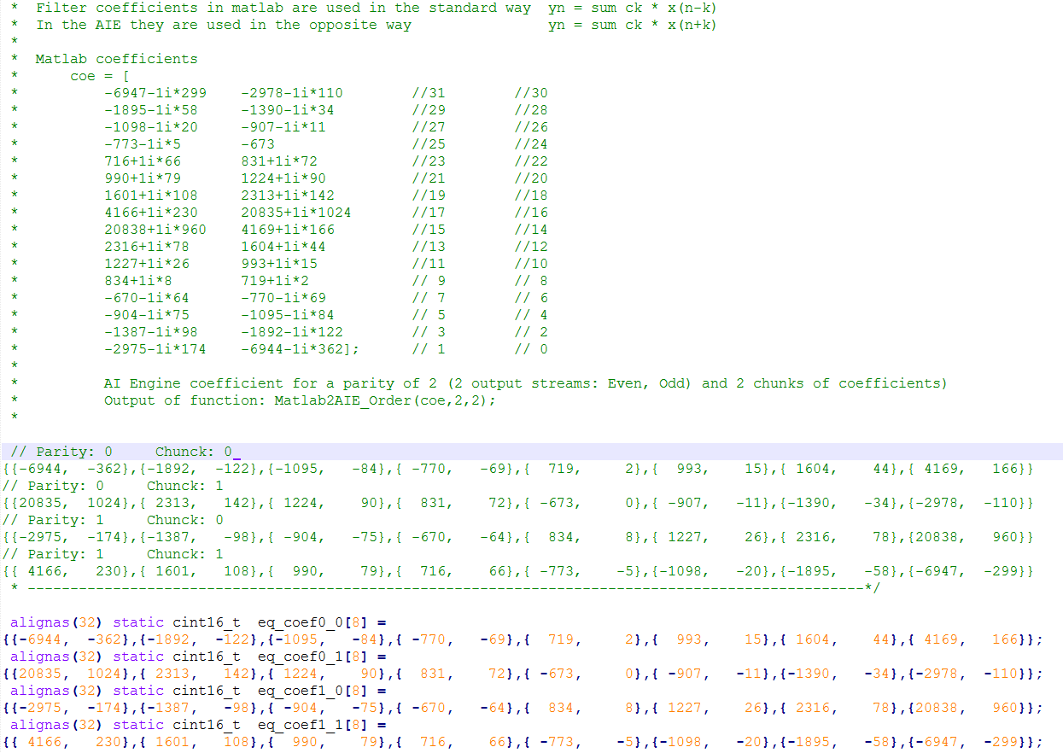
fir_32t_8core_const.h

Slide 50
fir_32t_8core0.cpp

Slide 51
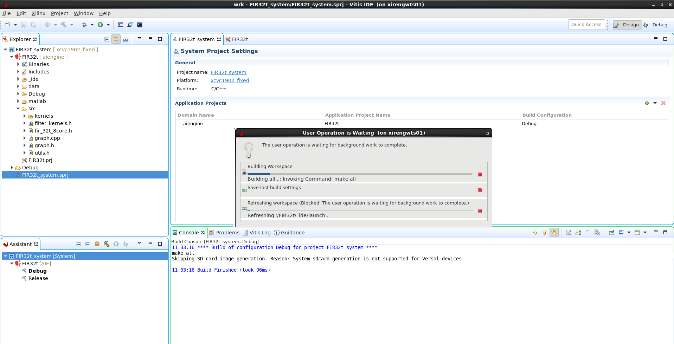
Compile the system in Vitis

Slide 52
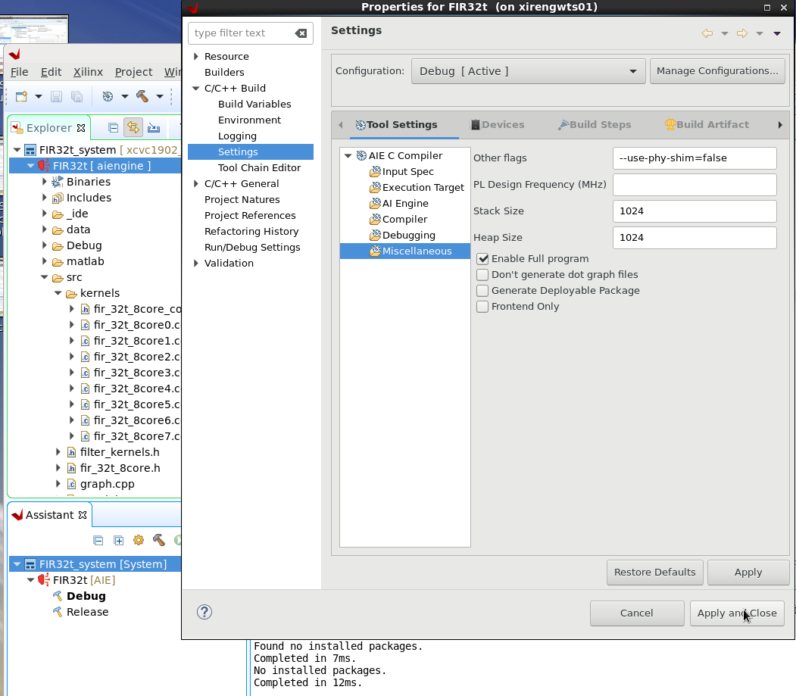
SystemC Simulation 1/2

Slide 53
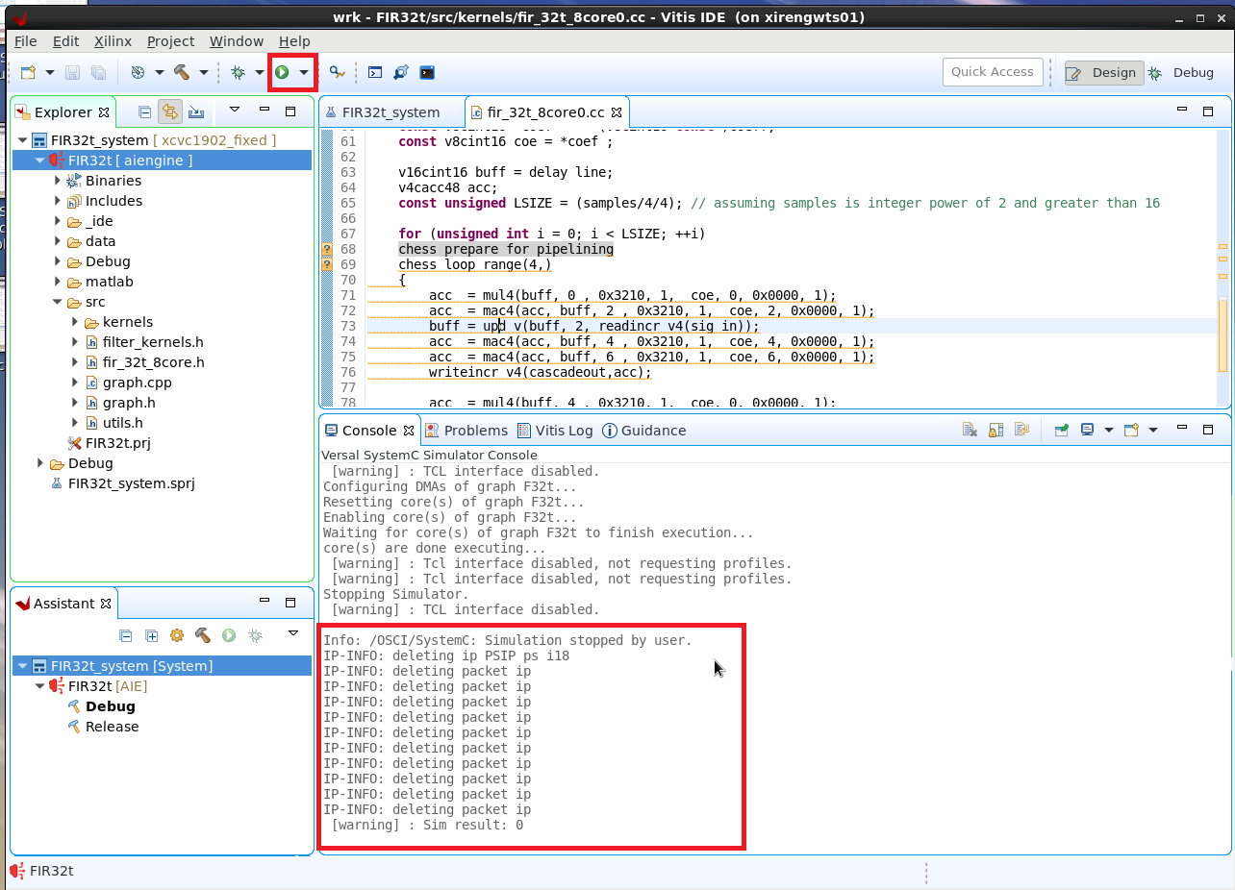
SystemC Simulation 2/2

Slide 54
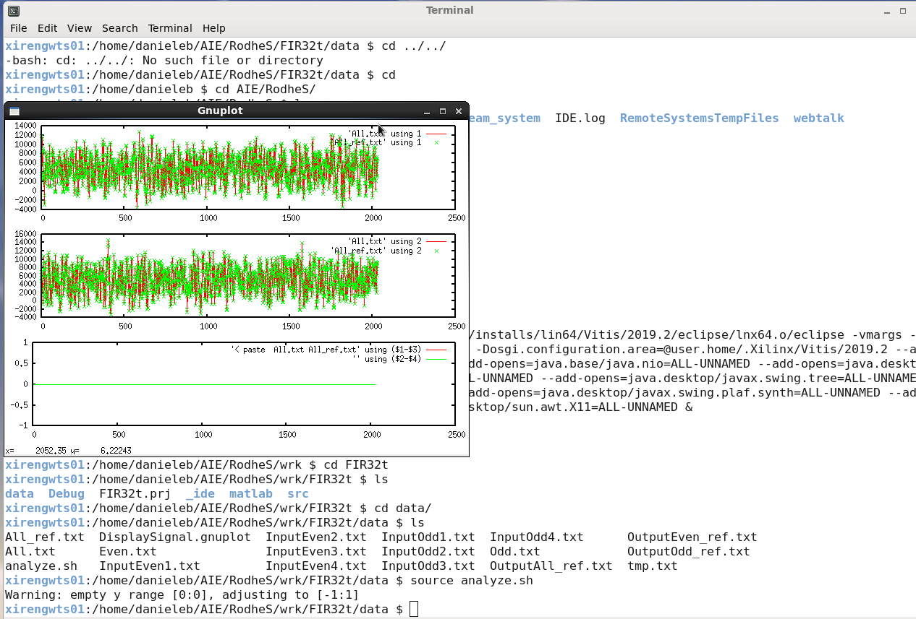
Compare results vs. reference 1/2

Slide 55
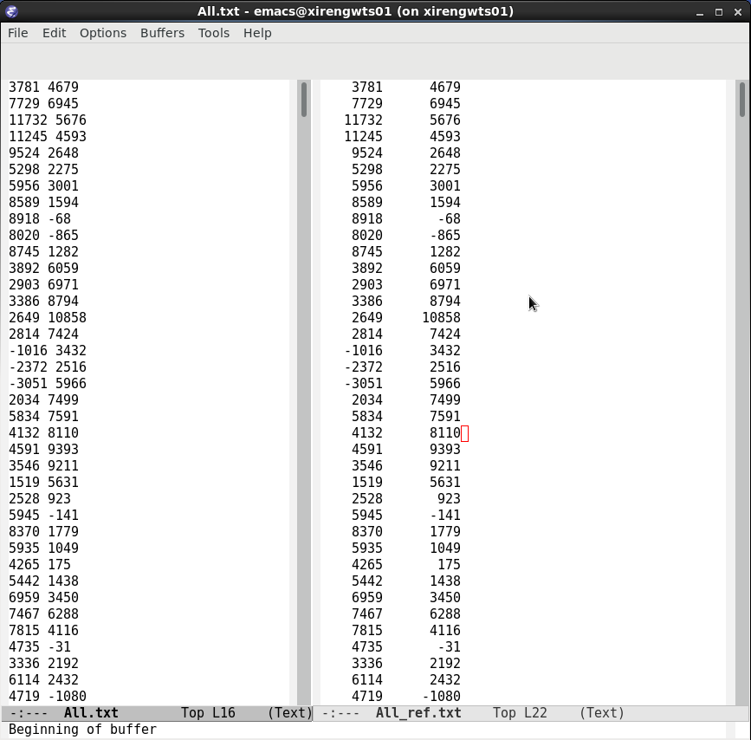
Compare results vs. reference 2/2

Slide 56
The Design in Model Composer EA
Daniele BAGNI, DSP/ML Specialist for EMEA

Slide 57
Conclusion

Slide 58
Summary
Design constraints:
one AIE core delivers 8 complex 16-bit MAC @ 1GHz on 4 parallel I/O data
one 32-taps complex FIR filter requires 32 complex MAC per output
1 AIE core can sustain 1 stream at 250 MSPS data rate:
1GHz x 8 (cplx MAC) / 32taps = 250 MSPS I/O throughput
4 AIE cores can sustain 1 stream at 1 GSPS data rate:
4 cores x 1GHz x 8 (cplx MAC) / 32taps = 1 GSPS I/O throughput
8 AIE cores can sustain overall 2 GSPS data rate:
8 cores x 1GHz x 8 (cplx MAC) / 32taps = 2 GSPS I/O throughput

Slide 60
I/O Bandwidth

Slide 61
About DDR
By directing the traffic via the PL interface tiles (not NoC), the bottleneck will be in the DDR
Versal DDR controller supports up to DDR4-3200 and LPDDR4-4266. That's Mb/s per pin.
So, max per controller is 64*4266Mb/s = 273024 Mb/s = 34.1 GB/s.
VC1902 has 4 controllers, making the aggregate bandwidth to 4x of that = 1092 Gb/s.
Done very impressive simulations on getting data out from the DDRs to the PL via the NoC:
really easy to achieve only ~40% of this bandwidth
much harder is to get into ranges of 80%, and although rare, up to 90% efficiency can be achieved, but not to be expected. There's no easy way to say how to achieve high efficiency - even if you have well behaving access patterns (long sequential bursts, no random access), to get above 50% you generally need to consider the internals and intricacies of the particular memory component (banks, channels, interleaving, bank groups (in DDR4), and different penalties of different types of misses etc).
On VC1902 with 4 memory controllers we've been able to get ~800Gb/s aggregate bandwidth with very well behaving access patterns.

Slide 62
About DDR
Then table 3 of AM009 (p 36) gives the PL to AIE and back bandwidth figures. Assuming 50/50 read and write bandwidth, the theoretical max of 546Gb/s would require 17 connections that have 32Gb/s capacity.
For PL to AI having 8 connections per tile this is 2 full tiles and one extra, and AIE to PL having 6 connections per tile, it's 2 tiles and 5 extra.
All in all, the VC1902 has 39 AIE-PL interface tiles, so even in theoretical maximum case, the full bandwidth of DDR would only take ~3/39 = ~8% of the available communication capacity.

