Slide 1
Vivado Design Suite
Revision Control Recommendations
February 2015
Notes:
This presentation covers key recommendations in Vivado 2014.1 for customers.

Slide 2
Agenda
Overview of Revision Control
Recommendations for Vivado Project Setup
Using Git and Make
Q&A

Slide 3
Revision Control Benefits
Automates Critical Management of Development
Milestones are “backed up”
Revert to previous milestone if necessary
Changes are logged
Speeds up Compiles
Dependency Tracking – only build when inputs change
Take advantage of parallelization – independent steps can run in parallel
Most Customers Use Some Form of Rev Control
Subversion, Perforce, ClearCase, Git, RCS

Slide 4
Vivado Revision Control Philosophy
Designed to be “Friendly” to Revision Control
But we do not have direct integration with specific tools
Generally prefer ASCII-based internal files (xml project files)
Tolerate read-only sources “locked” in revision control
Tolerate hidden “dot” files inserted by revision control tools
Minimize file updates on opening projects and only write changes
Work with Different Use Models
IDE vs non-GUI
Project vs non-project
Distributed vs Centralized Revision Control Tools
We do not recommend revision control on “active” projects
Separate “sources” outside projects works best
You save off a project – but easy to corrupt projects if you don’t get all files

Slide 5
Helpers for Revision Control
Tcl script to recreate a project
Write_project_tcl creates a “template” that you can use/modify
IP Integrator has write_bd_tcl
Creates a tcl script to recreate just the bd
Highly version dependent – like the ip
Remote sources beginning in 2015.1 (until then easy workaround)
Make files with Tcl scripts
Reproduce the project given input sources
“Standalone” project file is an alternative for Tcl sources
Diff/Merge Tools from Revision control
Scripts to recursively check in/out directories
Diff versions and staged changes
Report changes between versions
Back out and revert committed changes

Slide 6
Project with Sources Under Revision Control
project_1.xpr
project_1.srcs
project_1.data
project_1.runs
project_1.ioplanning
constrs_1
sources_1
project_1.cache
sim_1
Remote Sources
HDL (Verilog/VHDL)
IPI BD (entire dir)
IP XCI (entire dir)
Sys Gen IP XCI (entire dir)
XDC Constraints
Tcl Scripts
Sim Testbenches
COE/BMM/ELF

Slide 7
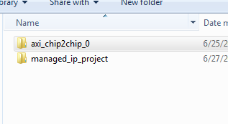
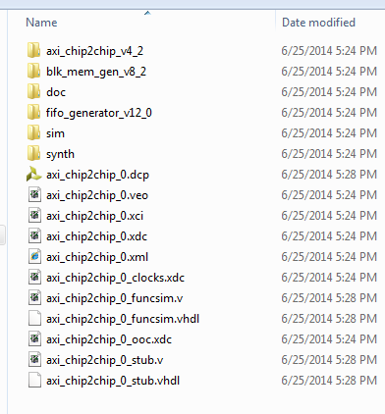
IP Under Revision Control
Use Standalone Manage IP
Put the IP outside the project to be checked into revision control
Choose a directory – normally at same level as working project
Check in the directory next to the managed_ip_project folder
And everything below it (.xci, .dcp, .veo, . Xml)
all subdirectories
Instantiate - Adding .xci as remote source
Make sure “copy into project” option is not selected
Must be fully generated, preferably w/ dcp

Slide 8
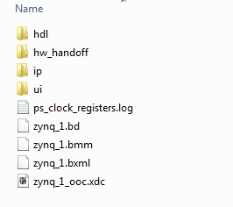
IP Integrator Under Revision Control
Create the block diagram in a remote directory
Just like IP, and make sure it is fully generated
Iterate until happy w/ BD
Check in entire directory
And all subdirectories
Add .bd as a remote source in top project
Read only is fine for implementation
Must be fully generated

Slide 9
Custom IP with IP Integrator
Build a small “managed ip” project for IP
Package it up to a directory
Creates component.xml and xgui dirs
Revision control this directory
To edit/update from an instantiated project:
From within IPI BD select IP, choose Edit in IP Packager
Creates a small temp directory and allows RTL edits and re-packaging
Make sure you up revision each time
Report_ip_status and upgrading should work like Xilinx IP
Important!

Slide 10
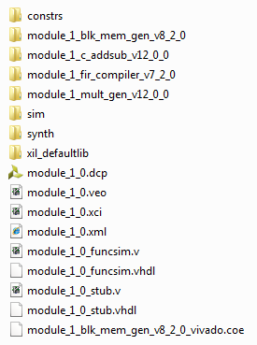
System Generator Under Revision Control
Build System Generator “Standalone”
vs “composite” integration mode with Vivado
Package SysGen Block like any other custom IP
IP repo used in IPI or Managed IP project for RTL
Make sure it is fully generated (RTL) with DCP (OOC)
Check it into revision control, like IP
Entire directory, including all subdirs
Add .xci to top project as a remote source
add_sources Tcl command, relative file path

Slide 11
Git File Life Cycle
Tracked Files
Unmodified
Modified
Staged
Git Rep.
Ignored
Files
add
checkout
remove
edit files
stage files
commit

Slide 12
Working with Source Files (Git) – 1/2
Set Up New Repository in existing directory
Initialize git (creates .git subirectory):
Start Tracking file changes:
Create your initial “snapshot”:
Use the latest snapshot (possibly making local changes)
git init
git add *.v
git add *.vhd
find . –name “*” | xargs git add
git commit –m “Initial project version”
git clone \\full_path_to_master\myProject.git

Slide 13
Working with Source Files (Git as an Example) – 2/2
Staging
Query
Discard any local changes and revert to last commit
Report differences between staged and last commit
Removing files from version tracking
Ignore tracking (add files to ignore to .gitignore)
Branching and Merging
Advanced workflows possible – following software design models
git status
git checkout
git diff
git rm foo.tcl
cat .gitignore

Slide 14
Make Brief primer on dependency management
Make is an open source tool to build things from source files
Takes a “makefile” which describes how to build:
Inputs to a compilation step
Command to exectue
Order of operations when there are many steps
Steps that don’t need running are skipped (based on files and timestamps)
Targets/dependencies are usually files on disk – commands generate files
Makefile Structure
target: dependencies …
commands
…
Documentation:
http://www.gnu.org/software/make/manual/html_node/index.html
This is a Tab Character – don’t forget it!

Slide 15
Standard Conventions with Make
Call make with a specific target – generates just that target
Call make with no arguments – run the first target
First target is “all”
Builds everything in the project
“All” is a phony target (no file on disk)
Dependencies are all the inputs (and outputs of intermdieate steps)
Last target is “clean”
Deletes everything in the project dir (except Makefile)
Always start clean

Slide 16
Summary
Revision Control Basics w/ Git and Make
Build projects with controlled changes
Back out revisions to specific milestones
Vivado Revision Control Methodology Recommendations
RTL, IP, IPI, HLS IP, System Generator IP, Custom RTL IP
Hands On Labs
Walk Through Project Setup, managing changes
Q & A

Slide 17
Backup

Slide 18
Recommended Directory Structure
Root Dir
Work
HDL/TB
HLS
BD
IP/CIP
Scripts
XDC
DSP
All Sources are under revision control (dark red)
Can be local disk space, or remote/shared location
Read only or writeable depending on rev. control tool
Working directory is “ignored” – not under revision control (blue)
You will create all your projects here – and reference remote sources (../)
Build “Bottom Up” – copy intermediate deliverables for IP into rev ctrl

Slide 19

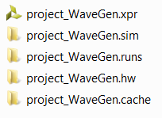
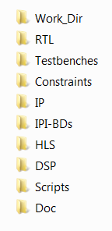
Recommended Directory Structure
Manage different source types in separate remote directories
Use a Work directory to compile the design and to create Vivado Projects
Set up the Vivado Projects with Remote Sources from the various directories
Elect to not copy them into the Project
Either manage revisions from the remote sources area directly or use it as a local sandbox for the project

Slide 20

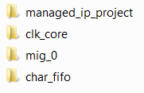

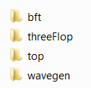
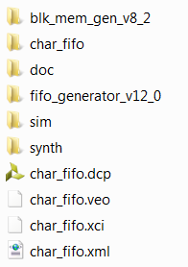





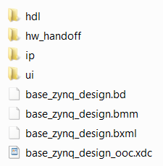
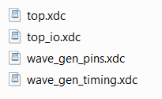
Recommended Files to Manage - 1 of 2
If using Projects, manage just the .xpr file and/or the Tcl recreate script
Use the write_project_tcl command to create a script to re-create the Project
Manage both files in case Tcl does not work
Do not check in the Project sub-directories
Use your own judgment on directory structures for RTL, XDC, etc.
For IP and IP Integrator sources, manage the entire directory tree
Sources can be used in future Vivado releases

Slide 21







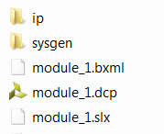




Recommended Files to Manage - 2 of 2
Manage High-Level Synthesis source files, scripts, example projects, and packaged IP
Manage entire System Generator directory for DSP sources
Manage Scripts and Docs as desired

Slide 22


Minimum Set of Recommended Files - 1 of 2
For IP, check in the .xci file only
The .xci file can be used recreate the IP output products
IP can only be recreated using the version of Vivado the IP was created with
For IP Integrator, check in the .BD file and/or the Tcl recreate script
Use the write_bd_tcl command to recreate script for the block design
Manage both files in case the Tcl does not work
Projects can be recreated with just the .xpr file or Tcl script
Use the write_project_tcl command to create a script to re-create the Project

Slide 23
Minimum Set of Recommended Files - 2 of 2
Manage High-Level Synthesis source files, scripts, example projects, and packaged IP
Manage entire System Generator directory for DSP sources
Manage Scripts and Docs as desired

Slide 24
Lab 1
Set up a new project with “ThreeFlop” RTL and XDC
Create a Makefile to call vivado with 3 targets:
Setup creates a project with remote sources
Compile opens the project and launches run to bitstream
Clean – deletes everything except the Makefile
Use Git Commands to check in all sources, the Makefile, scripts
git init
git add
git commit –m “initial project checkin”

Slide 25
Lab 2
Create a Managed IP project for AXI_IIC
Using a script fully generate the IP with OOC flow
Check it into revision control
Iterate and change a customization option

Slide 26
Lab 3
Create a Block diagram system with remote BD
Use write_bd_tcl to generate the BD
Modify the tcl to create the bd “remote” to project
Add a bd generation target in makefile
Take the output of the generation (the remote bd) and check in to revision control
Iterate on a small change

Slide 27
Lab 4
Package up custom IP RTL for IPI
Using the bft RTL
Build a script to create a small project
For packaging purposes
Take the output directory – check into revision control
Edit from within BD to change the RTL
Check in changes into git
Make sure and change version so update is automated

Slide 28
Lab 5
Build HLS-Based IP from C++ Sources
Build a script and add a make target
Once generated, check in remote IP repository

Slide 29
Lab 6
Given a System Generator DSP Subsystem
Fully generated – no need to have Matlab licenses
Check in SysGen module into revision control
Modify setup script and Makefile to add in slx
Verify compilation takes sysgen HDL and links

