Slide 1
Using Revision Control with Vivado
June 2015

Slide 2

Agenda
Overview of revision control (10 min)
Recommendations for Vivado (20 min)
Lab exercise using Git and Make (80 min)
Summary / Next Steps / Q&A (10 min)

Slide 3
Why use revision control?
Automates critical management of development
Milestones are “backed up”
Can revert to previous milestone if necessary
Changes are logged
Reduces compile times
Dependency tracking – only build when inputs change
Take advantage of parallelization – independent steps can run in parallel
Most customers use some form of revision control
The UltraFast Design Methodology Guide (UG949) recommends using revision control with Vivado Design Suite
Notes:
The parallelization benefit comes from following the recommended methodology for revision control. This methodology focuses on dependency management, leverages bottom up design and allows the launching of OOC runs in parallel. There will be no runtime required to update things that don’t need to be updated.

Slide 4












Which revision control systems do you use?
Notes:
Here are 12 examples of revision control systems. This is not a comprehensive list.

Slide 5
Vivado revision control philosophy
Designed to be “friendly” to revision control
No direct integration with specific tools
Generally prefer ASCII-based internal files (XML project files)
Tolerate hidden “dot” files and read-only sources “locked” in revision control
Minimize file updates on opening projects and only write changes
Work with different use models
GUI (IDE) vs non-GUI (TCL scripting)
Project vs non-project flows
Distributed vs centralized revision control repositories
Notes:
It is clear that Vivado can’t be integrated with all of the revision control systems that customers may want to use. Therefore, Xilinx has a philosophy for Vivado Design Suite to make it as easy as possible for the customer to use Vivado with the revision control system of their choice.
Note that sources files are ASCII – even for data files. COE, BMM, etc are all ASCII.

Slide 6
Recent improvements in Vivado
2015.1
Only the .bd file is required to recreate a block design
Compared to 2014.1 the average number of files per IP is about 1/3
Increased / focused testing around recommended methodology
Updates to Chapter 2 in the UltraFast DMG coming June 8th!
Updated Revision Control Quick Take Video coming soon!
New Lunch and Learn coming soon!
2015.3
Introduction of core container – one file per IP
Reduction of side files required by IP Integrator
Further reduction in the number of files per IP
New revision control tutorial available via DocNav

Slide 7
Two documented revision control strategies
Xilinx recommendation
Maximum Flexibility
Option to use IP in future releases of Vivado without upgrading
Shorter runtime to rebuild project
Minimum Files
The least number of files to manage at the expense of flexibility and run time

Slide 8

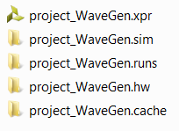
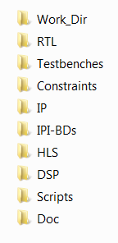
Overview of recommended directory structure
Manage different source types in separate remote directories
Use a “work” directory to compile the design and to create Vivado projects
Set up the Vivado project with remote sources from the various directories
Elect to not copy them into the project
Either manage revisions from the remote sources area directly or use it as a local sandbox for the project

Slide 9
Project with sources under revision control
project_1.xpr
project_1.srcs
project_1.data
project_1.runs
constrs_1
sources_1
project_1.cache
sim_1
Remote Sources
HDL (Verilog/VHDL)
IPI BD (entire dir)
IP XCI (entire dir)
Sys Gen IP XCI (entire dir)
XDC Constraints
Tcl Scripts
Simulation Testbenches
COE/BMM/ELF
Notes:
From a high level, this is how it would look. Only the items inside the gold clouds are managed by the revision control system.

Slide 10


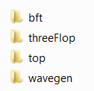




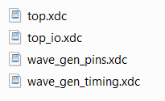
Maximum flexibility - Recommended files to manage
If using projects, manage just the .xpr file or the Tcl recreate script
Use the write_project_tcl command to create a script to re-create the project
Do not check in the project sub-directories
Use your own judgment on directory structures for RTL, XDC, etc.
For IP and IP Integrator sources, manage the entire directory tree
Generated sources can be used in future Vivado releases
Notes:
Going down one level of abstraction deeper, this is how it would look with the recommended flow that allows maximum flexibility.
The primary recommendation is to use TCL otherwise use the XPR. Make sure to test the XPR to make sure data is not missed and to check relative paths.

Slide 11







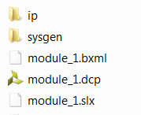




Maximum flexibility - Recommended files to manage
Manage Vivado HLS source files, scripts, example projects, and packaged IP
Manage the entire System Generator directory for DSP sources
Manage Scripts and Docs as desired
For SDK, manage the .hdf file
Notes:
Manage any handoff files.

Slide 12



Minimum files - Recommended files to manage
If using projects, manage just the .xpr file or the Tcl recreate script
Use the write_project_tcl command to create a script to re-create the project
Do not check in the project sub-directories
For IP, check in the .xci file only
The .xci file can be used recreate the IP output products
IP can only be recreated using the version of Vivado the IP was created with
For IP Integrator, check in the .BD file or the Tcl recreate script
Use the write_bd_tcl command to create a script for the block design
Notes:
Note that some IP have side files – Block Memory Generator, SysMon and FIR Compiler, for example.

Slide 13
Minimum files – Recommended files to manage
Manage Vivado HLS source files, scripts, example projects, and packaged IP
Manage the entire System Generator directory for DSP sources
Manage Scripts and Docs as desired
For SDK, manage the .hdf file

Slide 14
Knowledge check
What should be checked into a revision control system?
BD
IP
Constraints
Project directories
Verilog sources
VHDL sources
All of the above
Which of the two documented approaches to revision control is the preferred approach that Xilinx recommends?
Maximum flexibility or Minimum files

Slide 15
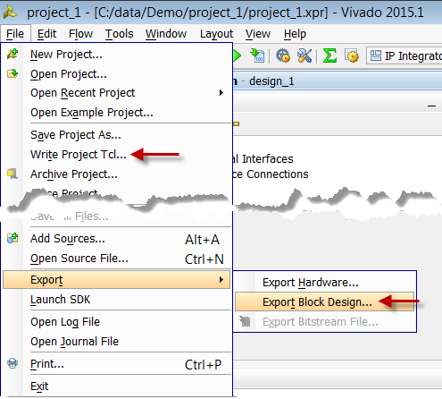
Best practices for revision control
Create a Tcl script to recreate a project
Write_project_tcl creates a “template” that you can use/modify
IP Integrator has write_bd_tcl
Creates a Tcl script to recreate just the bd
Highly version dependent – like the IP
Script check-in / check-out flow
Notes:
Diff/merge tools from revision control
Scripts to recursively check in/out directories
Diff versions and staged changes
Report changes between versions
Back out and revert committed changes

Slide 16
Git and Make Primer

Slide 17
Git file life cycle
Tracked Files
Unmodified
Modified
Staged
Git Rep.
Ignored
Files
add
checkout
remove
edit files
stage files
commit

Slide 18
Working with source files in Git
To set up a new repository in an existing directory
Initialize git (creates .git subirectory):
Start tracking file changes:
Create your initial “snapshot”:
Use the latest snapshot (possibly making local changes)
git init
git add *.v
git add *.vhd
find . –name “*” | xargs git add
git commit –m “Initial project version”
git clone \\full_path_to_master\myProject.git

Slide 19
Working with source files in Git
Staging
Query
Discard any local changes and revert to last commit
Report differences between staged and last commit
Removing files from version tracking
Ignore tracking (add files to ignore to .gitignore)
Branching and Merging
Advanced workflows possible – following software design models
git status
git checkout
git diff
git rm foo.tcl
cat .gitignore

Slide 20
Make – A brief primer on dependency management
Make is an open source tool to build things from source files
Takes a “makefile” which describes how to build:
Inputs to a compilation step
Commands to execute
Order of operations when there are multiple steps
Steps that don’t need to be run are skipped (based on files and timestamps)
Targets/dependencies are usually files on disk – commands generate files
Makefile structure
target: dependencies …
commands
…
Documentation:
http://www.gnu.org/software/make/manual/html_node/index.html
This is a Tab Character – don’t forget it!

Slide 21
Standard conventions with Make
Calling “make” with a specific target – generates just that target
Calling “make” with no arguments – runs the first target
First target is “all”
Builds everything in the project
“All” is a phony target (no file on disk)
Dependencies are all the inputs (and outputs of intermediate steps)
Last target is “clean”
Deletes everything in the project dir (except Makefile)
Always start clean

Slide 22
Using Git and Make with Vivado
Lab Exercise
80 Minutes

Slide 23
Lab overview
This 80 minute lab exercise is broken down into 6 main sections
Simple RTL project creation
Simple IP project creation
Custom IP creation
IP creation using Vivado HLS
Block design creation in IP Integrator
Top level integration
This representative design will allow you to understand the recommended methodology for various Vivado sources
Notes:
You must do the pre-work before attempting this lab.

Slide 24
Lab Section 1 – Simple RTL Project
Learn how to set up a very small RTL project and demonstrate project creation with Tcl scripts, Make and dependencies

Slide 25
Lab Section 2 – Simple IP Project
Learn how to build an IP source using scripts and managed IP projects to be used as a remote source in a project

Slide 26
Lab Section 3 – Custom IP
Learn how to package HDL as a custom IP for inclusion in IP Integrator

Slide 27
Lab Section 4 – Vivado HLS
Learn how to build from C-based sources using scripts and packaging IP to be used in IP Integrator

Slide 28
Lab Section 5 – IP Integrator
Learn how to build a block design in IP Integrator to be used as a remote source

Slide 29
Lab Section 6 – Top Level Integration
Put it all together with a top level wrapper, including a System Generator IP as a remote source – compile and generate a bit stream

Slide 30
What you just accomplished
In the last hour you built a fresh Vivado project
Set up directories
Set up required scripts
Set up a methodology for generating the design
Now you can iterate on the design and allow ‘make’ to help manage dependencies for you
You can check in and check out as you reach key milestones
Now you can help your customers!
Notes:
The provided solution contains both approaches. The TCL script contains a switch to control which revision control approach is desired.

Slide 31
Summary
There are two documented approaches to decide which files to manage
Maximum flexibility / least rebuild time
Minimum number managed files
A key is to use remote sources and not to manage the project directories
This lab used Git but the methodology can be applied to other revision control flows
Available documentation / materials coming soon!
Chapter 2 in UG949, Quick Take Video, Lunch and Learn
Xilinx recommendation

Slide 32
Next steps
If you ran out of time today, finish this lab. Ask questions if you get stuck.
Take the TSC content and deliver it as a Lunch and Learn to your customers
Fill out the TSC survey

Slide 33
Q & A

Slide 34
Thank You

Slide 35
Backup

Slide 36
Recommended directory structure
Root Dir
Work
HDL/TB
HLS
BD
IP/CIP
Scripts
XDC
DSP
All Sources are under revision control (dark red)
Can be local disk space, or remote/shared location
Read only or writeable depending on rev. control tool
Working directory is “ignored” – not under revision control (blue)
You will create all your projects here – and reference remote sources (../)
Build “Bottom Up” – copy intermediate deliverables for IP into rev ctrl

Slide 37
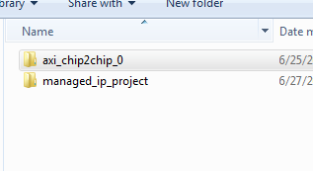
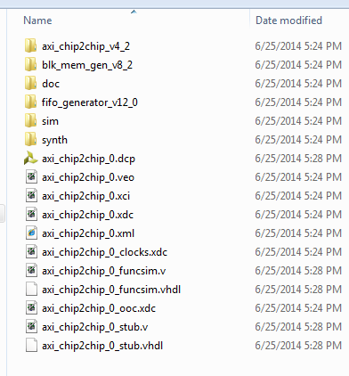
IP under revision control
Use Standalone Manage IP
Put the IP outside the project to be checked into revision control
Choose a directory – normally at same level as working project
Check in the directory next to the managed_ip_project folder
And everything below it (.xci, .dcp, .veo, . Xml)
all subdirectories
Instantiate - Adding .xci as remote source
Make sure “copy into project” option is not selected
Must be fully generated, preferably w/ dcp

Slide 38
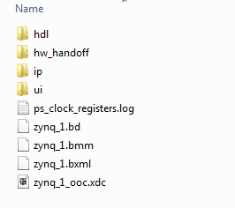
IP Integrator under revision control
Create the block diagram in a remote directory
Just like IP, and make sure it is fully generated
Iterate until happy w/ BD
Check in entire directory
And all subdirectories
Add .bd as a remote source in top project
Read only is fine for implementation
Must be fully generated

Slide 39
Custom IP with IP Integrator
Build a small “managed ip” project for IP
Package it up to a directory
Creates component.xml and xgui dirs
Revision control this directory
To edit/update from an instantiated project:
From within IPI BD select IP, choose Edit in IP Packager
Creates a small temp directory and allows RTL edits and re-packaging
Make sure you up revision each time
Report_ip_status and upgrading should work like Xilinx IP
Important!

Slide 40
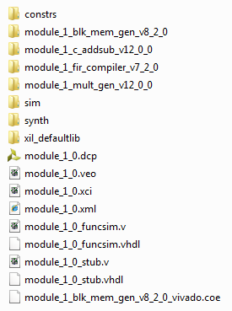
System Generator under revision control
Build System Generator “Standalone”
vs “composite” integration mode with Vivado
Package SysGen Block like any other custom IP
IP repo used in IPI or Managed IP project for RTL
Make sure it is fully generated (RTL) with DCP (OOC)
Check it into revision control, like IP
Entire directory, including all subdirs
Add .xci to top project as a remote source
add_sources Tcl command, relative file path

