Slide 1
Vivado Design Suite
Version Control Recommendations
June 2014
Notes:
This presentation covers key recommendations in Vivado 2014.1 for customers.

Slide 2
General Revision Control Philosophy
Designed to be “Friendly” to Revision Control
But we do not have direct integration with specific tools
Generally Prefer ASCII-based internal files (xml project files)
Tolerate read-only sources “locked” in revision control
Tolerate hidden “dot” files inserted by version control tools
Minimize file updates on opening projects and only write changes
Work with Different Use Models
IDE vs non-GUI
Project vs non-project
Distributed vs Centralized Revision Control Tools
We do not recommend revision control on “active” projects
Separate “sources” outside projects works best
You save off a project – but easy to corrupt projects if you don’t get all files

Slide 3
Helpers for Revision Control
Tcl script to recreate a project
Write_project_tcl creates a “template” that you can use/modify
IP Integrator has write_bd_tcl
Creates a tcl script to recreate just the bd
Highly version dependent – like the ip
Doesn’t currently work w/ remote sources
Make files with Tcl scripts
Reproduce the project given input sources
Diff/Merge Tools from Revision control
Scripts to recursively check in/out directories
Diff versions and staged changes
Report changes between versions
Back out and revert committed changes

Slide 4
Revision Control Improvements in 2014.1
Files needed to recreate the project
All source files remote to the project
XPR file only (recreates all the project files from remote sources)
IP Integrator Block Design (.BD from standalone directory)
IP from the IP Catalog (.XCI)
System Generator projects (.SLX)
Issues addressed in IP Integrator
AXI Interconnect instance names are now preserved
XCI files not changed on disk until BD is saved
Notes:
We have not drastically changed our revision control recommendations. We still recommend users place “source” files in directories outside the active project. These source files include HDL, constraints, and other input files. This also includes IP from the Manage IP project which is pointed to by the xci file, as well as IPI subsystems created in remote directories. Tcl scripts are generally used to recreate the project from these sources which are placed under revision control. If these sources are fully generated (IP and IPI sources), even if they are “read only” under revision control – the project or projectless flows can faithfully reproduce the design, with some minor gaps that we are still working on (ipi bds with saved text and locations are not yet saved in the .bd – a separate ascii file would be required to reproduce those customizations). We still do not recommend placing active projects directly under revision control – nor do we advocate partially checking in generated target files from IP or IPI subsystems.
What is new in 2014.1 is now revision control users are able to use just the XPR project file without all the project directory structure to recreate the project from the remote sources to reproduce the project without creating/managing a Tcl script to recreate the project. The xpr project file can be used “standalone” – much like an ip .xci file can be used to reproduce all the generated output products. The .bd still requires all the .xci files beneath it – and this is why we are still advocating IPI subsystems to be placed in a separate directory – and all files under that directory put in revision control – after the IPI system is stable and not changing (much).
Vivado now also has support for fully generated read-only sources.
IP Integrator has changed in three ways to make using revision control easier:
When running “Validate Design” and the AXI Interconnect is updated, the instance and file names do not change
When IP parameters are changed, the BD on disk is not changed until changes are saved
Deleting an IP and closing the BD without saving changes with not affect the design

Slide 5
Project with Sources Under Revision Control
project_1.xpr
project_1.srcs
project_1.data
project_1.runs
project_1.ioplanning
constrs_1
sources_1
project_1.cache
sim_1
Remote Sources
HDL (Verilog/VHDL)
IPI BD (entire dir)
IP XCI (entire dir)
Sys Gen SLX (entire dir)
XDC Constraints
Tcl Scripts
Sim Testbenches
COE/BMM/ELF

Slide 6
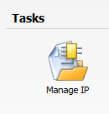
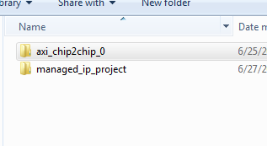
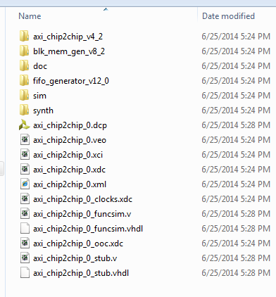
IP Under Revision Control
Use Standalone Manage IP
Put the IP outside the project to be checked into revision control
Choose a directory – normally at same level as working project
Check in the directory next to the managed_ip_project folder
And everything below it (.xci, .dcp, .veo, . xmlall subdirectories
Instantiate by adding .xci file as remote source
Make sure “copy into project” option is not selected
Must be fully generated, preferrably w/ dcp

Slide 7
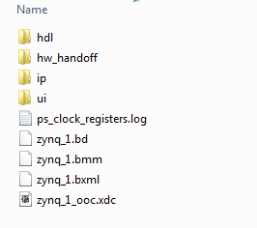
IP Integrator Under Revision Control
Create the block diagram in a remote directory
Just like IP, and make sure it is fully generated
Iterate until happy w/ BD
Check in entire directory
And all subdirectories
Add .bd as a remote source in top project
Read only is fine for implementation
Must be fully generated

Slide 8
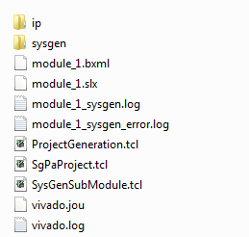
System Generator Under Revision Control
Build System Generator in a Standalone directory
Like IP – separated from project
Currently doesn’t support OOC
Check it into revision control, like IP
Entire directory, including subdirs
Add .slx to top project
It will be copied into the project, and generated
Matlab license required (otherwise add the dcp remote)

Slide 9
Version Control File Life Cycle
Tracked Files
Unmodified
Modified
Staged
Git Rep.
Ignored
Files
add
checkout
remove
edit files
stage files
commit

Slide 10
Working with Source Files (Git as an Example) – 1/2
Set Up New Repository in existing directory
Initialize git (creates .git subirectory):
Start Tracking file changes:
Create your initial “snapshot”:
Use the latest snapshot (possibly making local changes)
git init
git add *.v
git add *.vhd
find . –name “*” | xargs git add
git commit –m “Initial project version”
git clone \\full_path_to_master\myProject.git

Slide 11
Working with Source Files (Git as an Example) – 2/2
Staging
Query
Discard any local changes and revert to last commit
Report differences between staged and last commit
Removing files from version tracking
Ignore tracking (add files to ignore to .gitignore)
Branching and Merging
Advanced workflows possible – following software design models
git status
git checkout
git diff
git rm foo.tcl
cat .gitignore

Slide 12
Lab 1
Set up a new project with “ThreeFlop” RTL and XDC
Create a Makefile to call vivado with 3 targets:
Setup creates a project with remote sources
Compile opens the project and launches run to bitstream
Clean – deletes everything except the Makefile
Use Git Commands to check in all sources, the Makefile, scripts
git init
git add
git commit –m “initial project checkin”

Slide 13
Lab 2
Create a Managed IP project for AXI_IIC
Using a script fully generate the IP with OOC flow
Check it into revision control
Iterate and change a customization option

Slide 14
Lab 3
Create a Block diagram system with remote BD
Use write_bd_tcl to generate the BD
Modify the tcl to create the bd “remote” to project
Add a bd generation target in makefile
Take the output of the generation (the remote bd) and check in to revision control
Iterate on a small change

Slide 15
Lab 4
Package up custom IP RTL for IPI
Using the bft RTL
Build a script to create a small project
For packaging purposes
Take the output directory – check into revision control
Edit from within BD to change the RTL
Check in changes into git
Make sure and change version so update is automated

Slide 16
Lab 5
Build HLS-Based IP from C++ Sources
Build a script and add a make target
Once generated, check in remote IP repository

Slide 17
Lab 6
Given a System Generator DSP Subsystem
Fully generated – no need to have Matlab licenses
Check in SysGen module into revision control
Modify setup script and Makefile to add in slx
Verify compilation takes sysgen dcp and links

