Slide 1
DSP——FIR Filter Module 2: HLS Basic Knowledge

Slide 2
Outline
Vitis™ HLS Design Methodology
Baseline Codes
Optimization
Code Hoisting
Array Partitioning
Loop Fission
Loop Unrolling & Loop Pipelining
Review and Consolidate
Stretch Goals

Slide 3
Vitis™ HLS Design Methodology

Slide 4
Vitis™ HLS Design Methodology
Define Performance Specification
1. Throughput Goal
2. Latency Goal
3. Datapath Width
4. Number of accelerated kernels
5. Interface Bandwidth
Build Macro Architecture
1. Use a Load – Compute – Store type of architecture
Refine Micro Architecture For Optimization
1. Pipeline
2. Unroll
3. Array Partition
There are three high level steps.

Slide 5
Define Performance Specification
In fact, hardware design is a trade-off between time and resource usage.
We always want to speed up the design with less time and less resources.
For this fir project, we can use one cycle to complete the Time delay line at the fastest, and then use one cycle to complete the accumulation, that is, use two cycles to complete the output of the filtered signal at one time point. There are a total of 100 outputs of the filtered signal, theoretically requiring about 200 cycles.
The resources we can use are the resources of the PYNQ board.

Slide 6
Build Macro Architecture
Stream In
(AXI-Stream)
LOAD
BUFFER
COMPUTE BLOCK(s)
STORE
BUFFER
Load moves data from global memory to compute block(s)
Store moves data from compute block(s) to global memory
This type of an architecture helps with a good RTL implementation.
This architecture helps with ‘task-level parallelism’.
At the same time, in this project, according to the requirements, the data types we use are arrays and scalars, so we choose AXI4-Lite (s_axilite), and AXI4 master (m_axi) interfaces.( which will be introduced in Module 3)

Slide 7
In the following pages, we will talk about
Refine Micro Architecture For Optimization
in detail.

Slide 8
Baseline codes

Slide 9
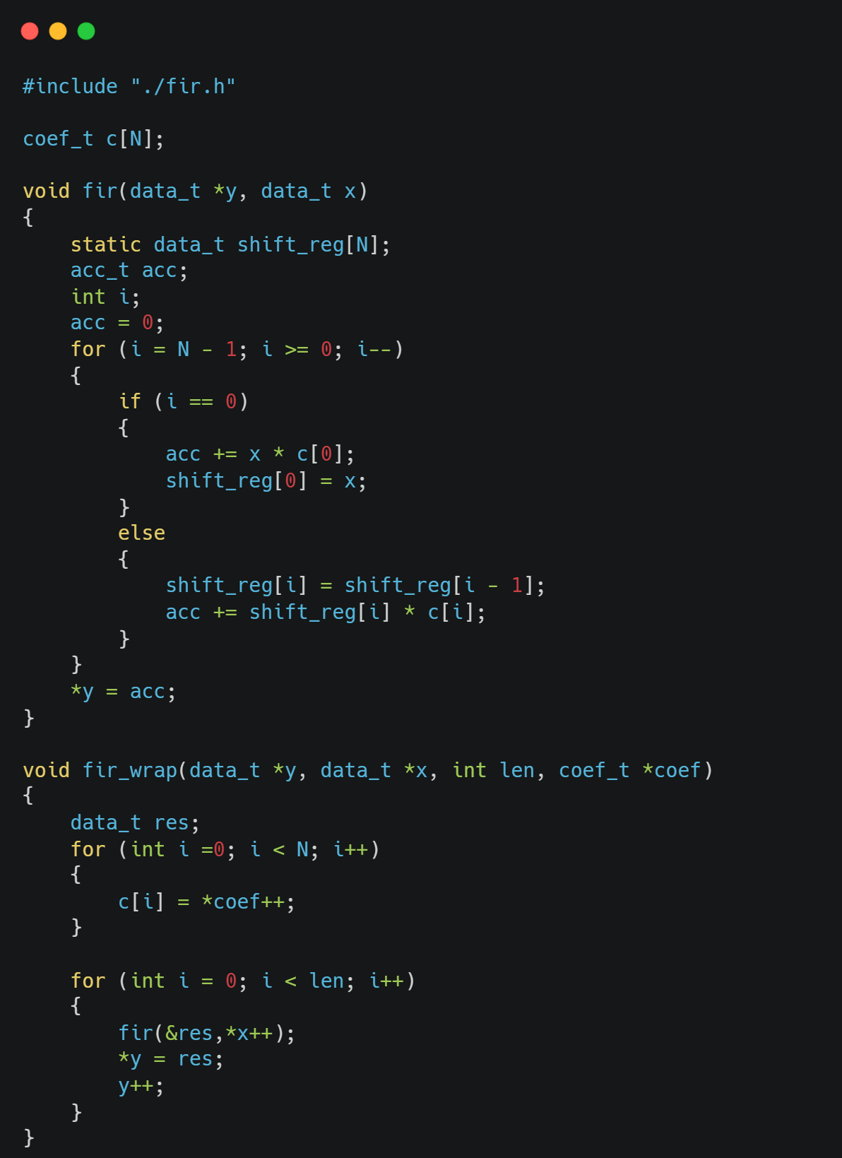
Baseline Codes
$$y\left[n\right]=h\left[0\right]x\left[n−0\right]+h\left[1\right]x\left[n−1\right]+…+h\left[k\right]x[n−k]$$
fir function: Complete the filtered signal at a certain point.
fir_wrap function : Call the fir function according to the for loop to complete the filtered signal for a period of time.
Disadvantage: there is a large amount of control logic present and it is executed serially.
What is the resource usage
and runtime with the baseline codes?
Notes:
In the fir function, each loop has two basic operations. First, it multiplies and accumulates the current input signal, puts the result in acc, and moves the elements of the shift_reg array forward. At the end of the loop, the acc variable stores the result of the current filtered signal, giving the final output. But within this function, there is a large amount of control logic present and it is executed serially.

Slide 10
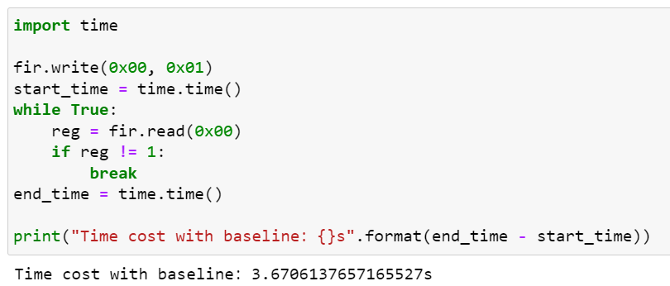
Baseline Codes
Question: Why do we focus on metrics
such as latency and resource usage?
The software runs in 0.48 seconds.
The baseline hardware code runs in 3.67 seconds,
and the resources on the FPGA are not fully utilized.
 | Latency | BRAM | DSP | FF | LUT | Time
Software |  |  |  |  |  | 0.48s
Baseline | 20607 | 2 | 3 | 532 | 520 | 3.67s
~7.6 times slower !
Notes:
We can see that the Latency of the FIR IP without any optimization is 20607 and the resource usage is less.
We ran it on the PYNQ board and got Baseline to run in about 3.67 seconds. This is an 7.6x delay over running it on Python alone, but we can improve it with subsequent optimizations.

Slide 11
Optimization

Slide 12
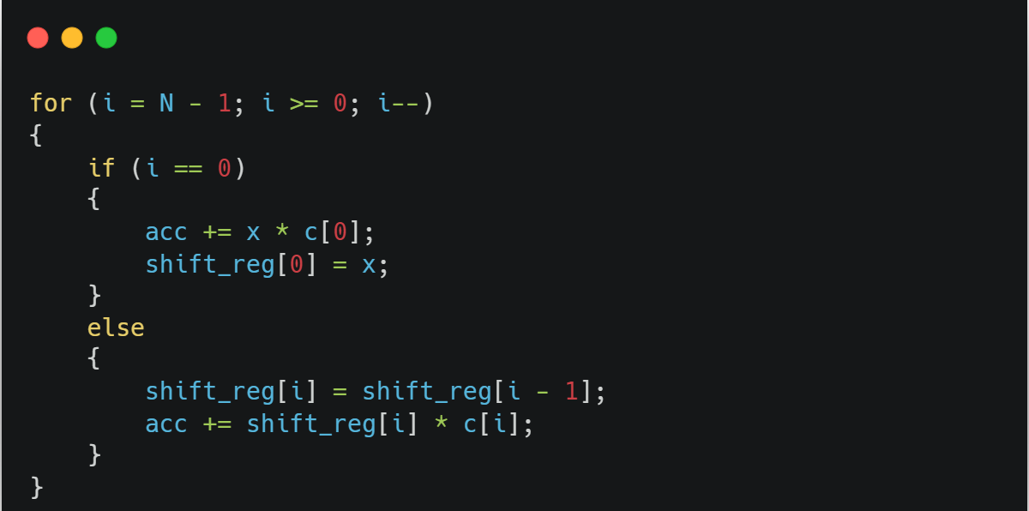
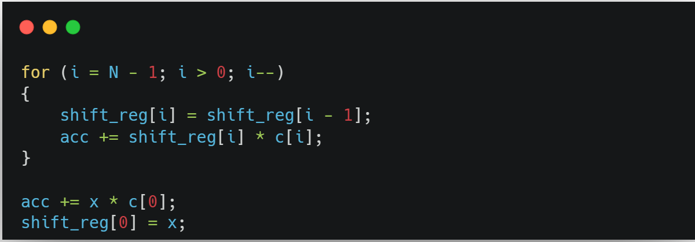
Code Hoisting
At each loop, HLS generates a logic circuit to perform the if-else statement check to determine if the condition is met. But the if statement will be satisfied only at the last loop.
We can remove the if-else branch statement in the for loop while ensuring correct functionality.
We can execute the conditional statement at the end of the loop.
Notes:
At each loop, HLS generates a logic circuit to perform the `if-else` statement check to determine if the condition is met. So the `if-else` branch statement in the `for` loop is inefficient and we can optimize it. We can remove the `if-else` branch statement in the `for` loop while ensuring correct functionality. We can see that the `if` statement will be satisfied only at the last loop, so we can execute the conditional statement at the end of the loop.

Slide 13
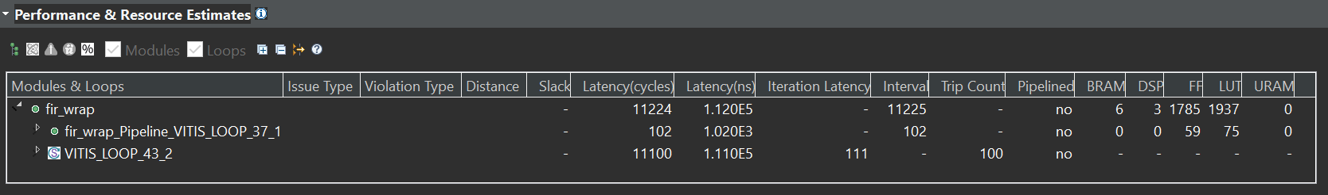
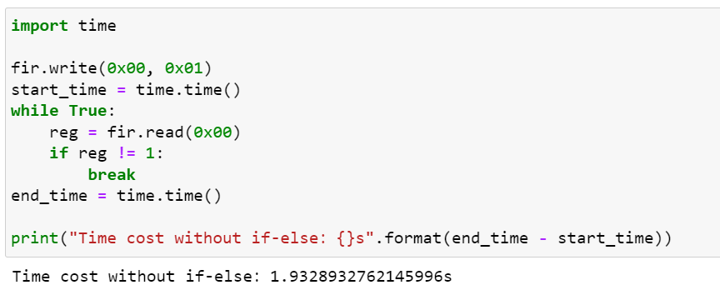
Code Hoisting
 | Latency | BRAM | DSP | FF | LUT | Time
Software |  |  |  |  |  | 0.48s
Baseline | 20607 | 2 | 3 | 532 | 520 | 3.67s
Code hoisting | 11224 | 6 | 3 | 1785 | 1937 | 1.93s

Slide 14
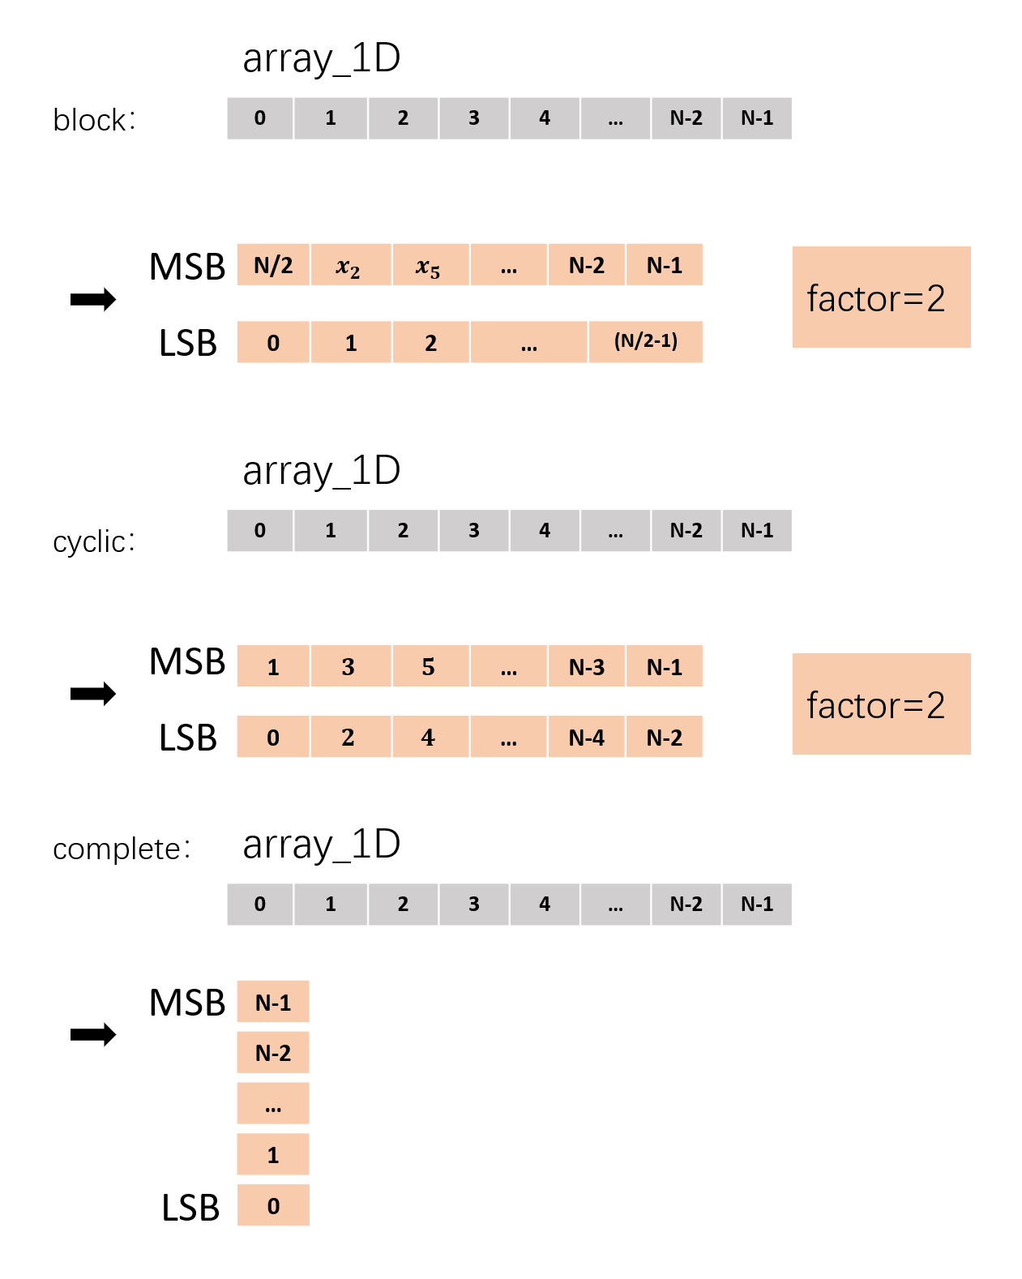
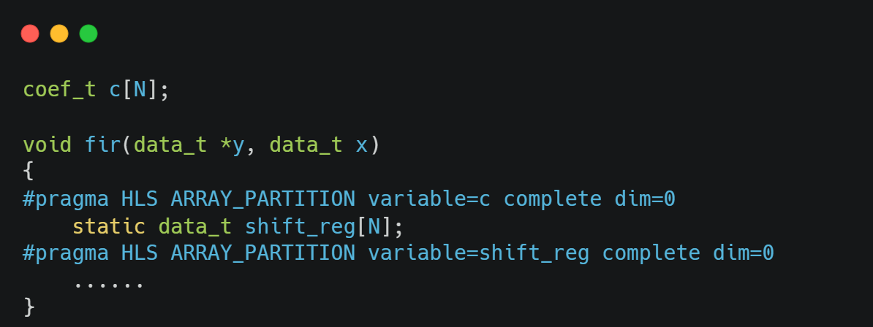
Array Partitioning
increase the amount of data accessed)
For example, c[] and shift_reg[] arrays, they have only one read/write port each time.
We split the array so that the read and write interfaces become multiple and can be executed in parallel for the optimization later.
Question: What should be the partition method for 2D arrays?
Notes:
c[] and shift_reg[] arrays, they have only one read/write port each time, which makes the amount of data access limited each time, and can only get an equal amount of data by increasing the number of accesses, which will inevitably increase the Latency. write multiple values at the same time.
For array partition,
`variable` refers to the variable name of the array to be partitioned, and `complete` means that each element of the array will be partitioned into independent units, so that each element can be read and written independently of each other, without interference, to pave the way for the optimization later. Of course, you can also replace `complete` with others, such as `block` and `cyclic`. `block` means splitting the array horizontally, `cyclic` means splitting the array vertically, and the keyword `factor=<int>` means splitting into several groups of data.

Slide 15
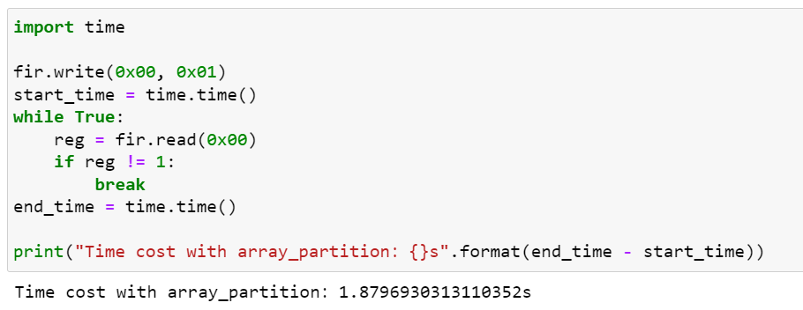
Array Partitioning
 | Latency | BRAM | DSP | FF | LUT | Time
Software |  |  |  |  |  | 0.48s
Baseline | 20607 | 2 | 3 | 532 | 520 | 3.67s
Code hoisting | 11224 | 6 | 3 | 1785 | 1937 | 1.93s
Array partitioning | 10605 | 0 | 3 | 6790 | 2092 | 1.87s
Notes:
After adding the above compilation directive, we can see that the latency does not change much in the HLS synthesis report, because we have not added the subsequent operation steps. The resources of FF and LUT are significantly increased due to the array partitioning.
On the PYNQ board, the run time is about 1.88 seconds, which is just a little faster than before. Our step is mainly for the follow-up, so the effect is rather limited for now.

Slide 16
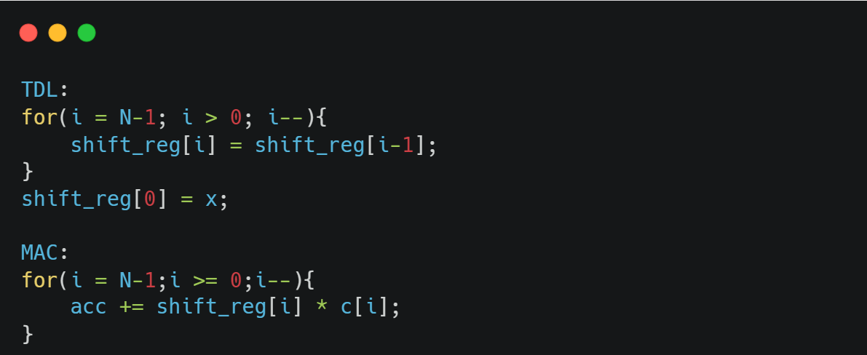
Loop Fission
We can split this one loop into two loops and perform different optimization operations for different loop characteristics.
Here is the code after splitting the loop. TDL is the Time Delay line, and MAC is the multiply-accumulate operation.
Fissing the loop alone does not provide any substantial optimization for latency and resources, which is prepared for later optimiazation.
Notes:
We can split this one loop into two loops and perform different optimization operations for different loop characteristics. Here is the code after splitting the loop, TDL is the Time Delay line, and MAC is the multiply-accumulate operation. Naming the loops in this way allows us to better analyze them in the synthesis report.
Of course, fissing the loop alone does not provide any substantial optimization for Latency and resources, and we have to add subsequent optimizations to achieve a 1+1>2 effect. Here, we do not show the hardware resource utilization and runtime after loop fission. Because this part does not improve the hardware structure, it is mainly in the preparation for the later optimization.

Slide 17
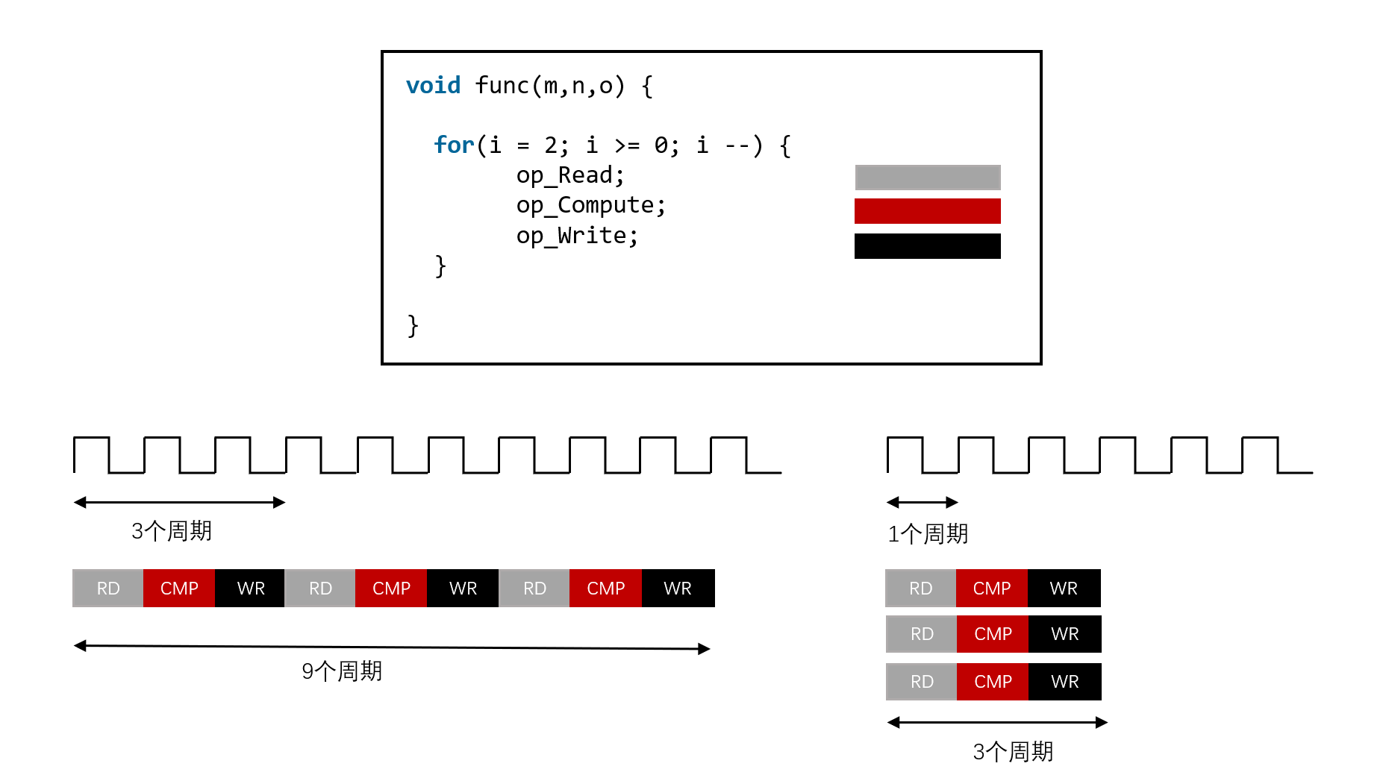
Loop Unrolling & Loop Pipelining
Unroll means creating multiple independent operations instead of a single set of operations.
The UNROLL pragma transforms loops by creating multiples copies of the loop body in the RTL design, which allows some or all loop iterations to occur in parallel.
（1）non-unrolled loop （2）unrolled loop
Notes:
Unroll means creating multiple independent operations instead of a single set of operations. Obviously then, the use of resources must increase dramatically. Let's use a loop as an example. As shown in the figure below, if a for loop needs to loop 3 times, in the non-parallel case, it needs to execute read, compute, and write 3 times in a sequential loop. 1 ALU (e.g., adder, multiplier, divider, etc.) can be reused 3 times, spending a total of 9 cycles. In the case of full parallel expansion, 3 reads, calculations, and writes can be performed simultaneously. In this case, 1 ALU is not sufficient for 3 calculations at the same time, and 3 ALUs are needed to complete the same amount of operations for a total of 3 cycles.

Slide 18
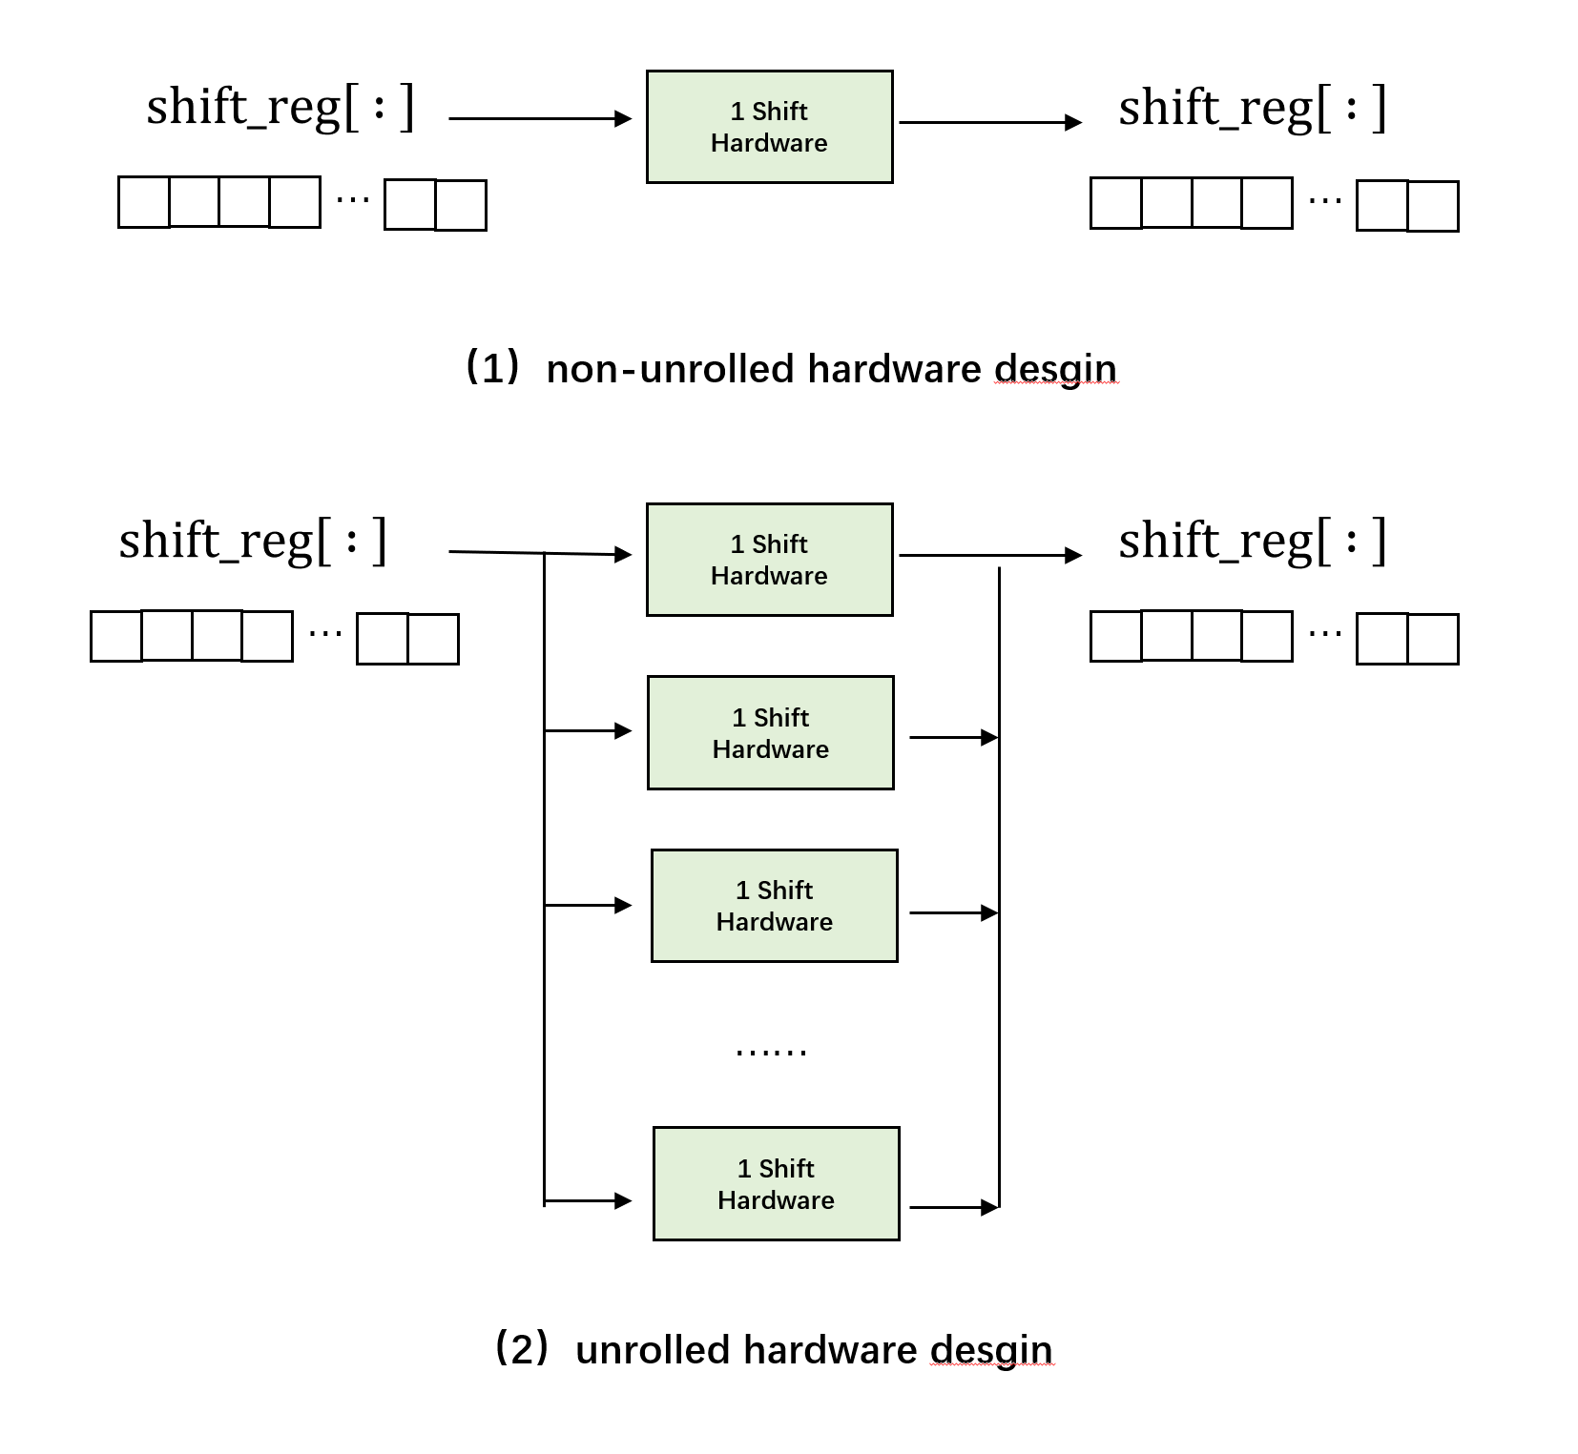
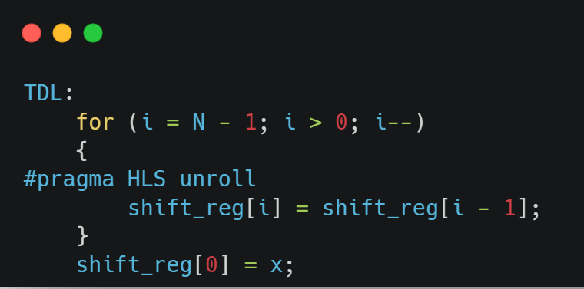
Loop Unrolling & Loop Pipelining
Corresponding changed hardware structure
For more information on the use of unroll and the choice of parameters,
you can visit this website: https://docs.xilinx.com/r/en-US/ug1399-vitis-hls/pragma-HLS-unroll
Notes:
In the TDL loop, when we add #pragma HLS unroll, the compiler expands all this code, i.e., performs all shift operations in one loop iteration, greatly reducing the number of iterations. This also requires that we have N-2 accesses to the shift_reg array. This is where the array splitting we laid out earlier comes in handy. We go ahead and fiss the shift_reg array into separate registers, making it possible to read and write to each register each cycle.
The hardware design comparison diagram is shown below. In a non-parallel loop, we only have limited resources, so we need to wait until the previous operation is done before proceeding to the next one. In a parallel loop, we can do the same operation at the same time and save time.

Slide 19
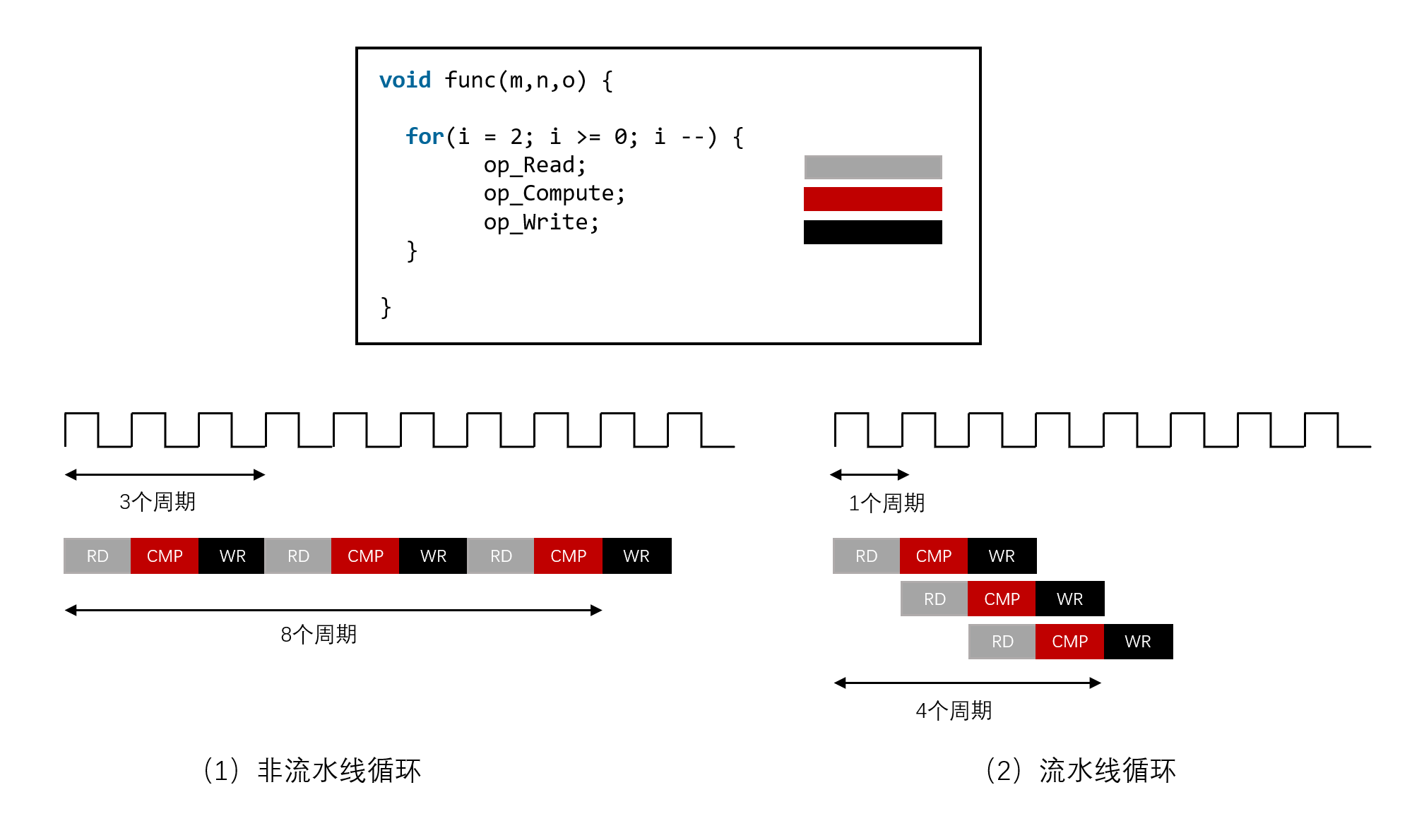
Loop Unrolling & Loop Pipelining
Reduces the initiation interval (II) for a function or loop by allowing the concurrent execution of operations.
shows the default sequential operation where there are three clock cycles between each input read (II=3), and it requires eight clock cycles before the last output write is performed.
shows the pipelined operations that show one cycle between reads (II=1), and 4 cycles to the last write.
（1）non-pipelined loop （2）pipelined loop
Notes:
Another common approach is the pipeline operation. The concept of pipeline in a factory is similar in that each production unit focuses on a particular segment of work to increase efficiency and productivity. Pipelining is a quasi-parallel processing implementation technique in which multiple instructions overlap during program execution. It reduces the initiation interval (II) for a function or loop by allowing the concurrent execution of operations,measured in clock cycles. Pipeline does not add as much to resources as unroll, but it essentially makes resources less vacant.

Slide 20
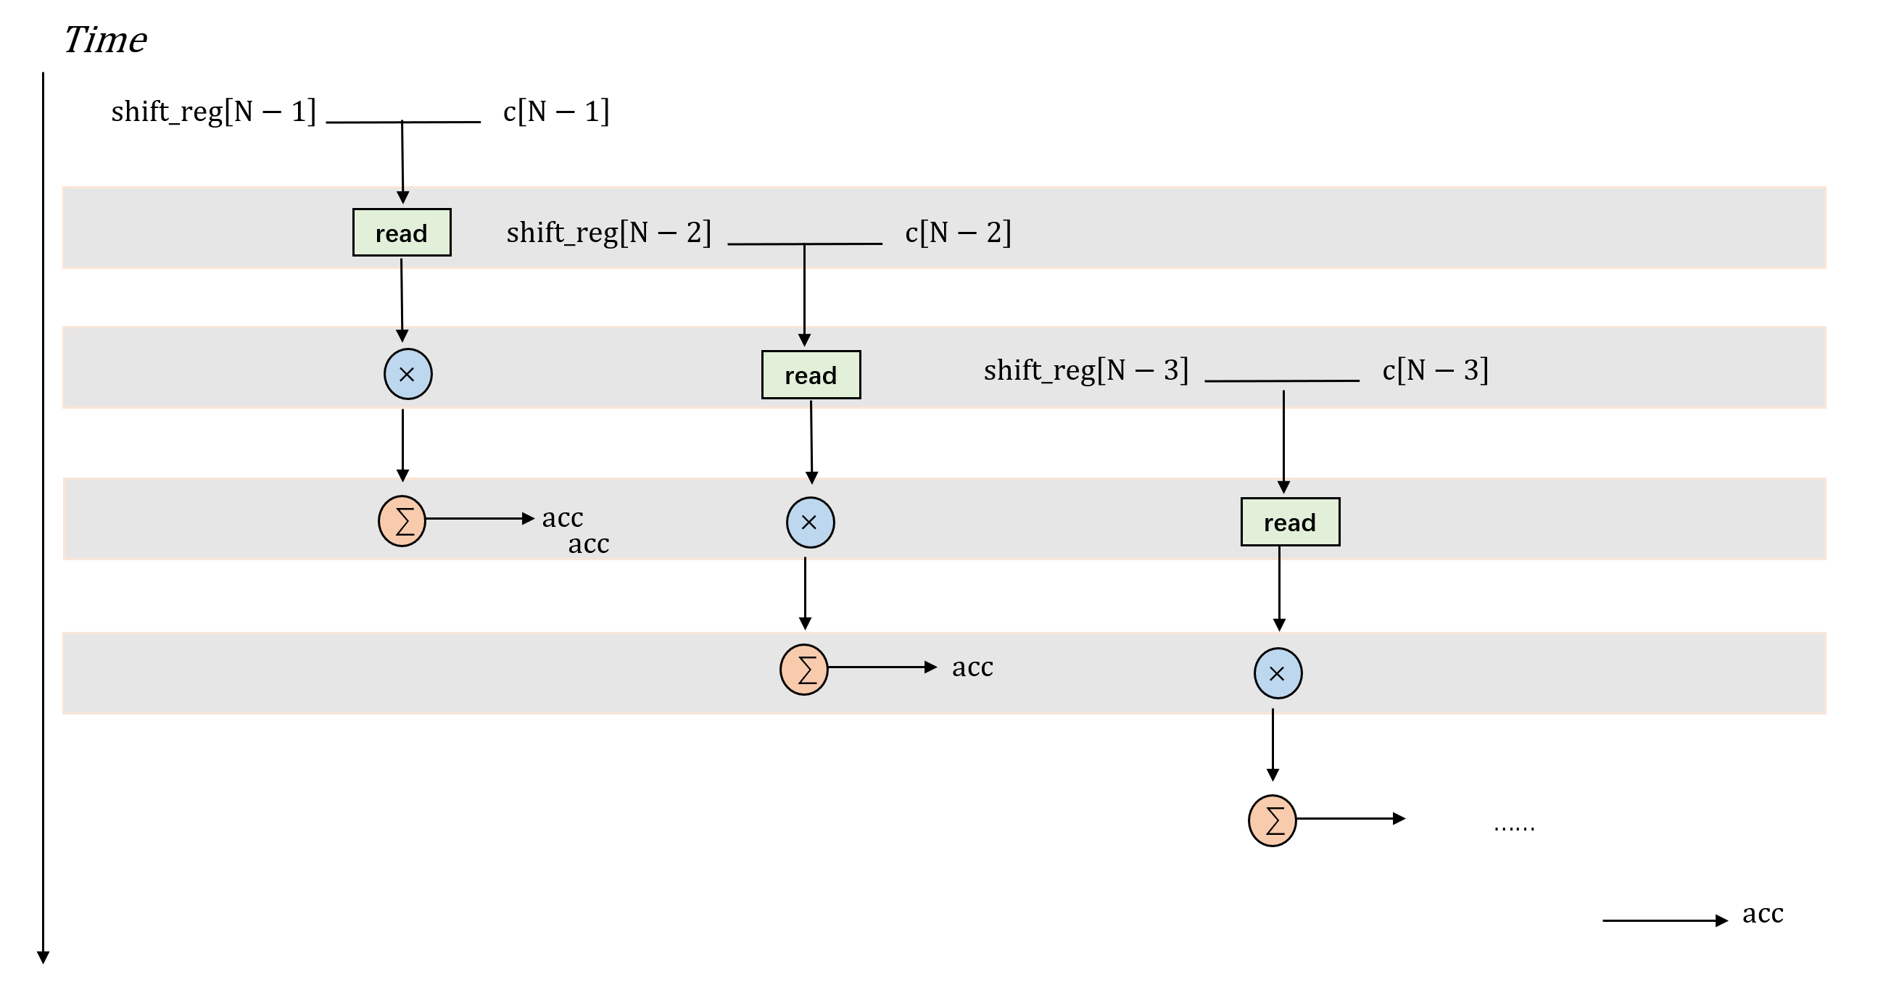
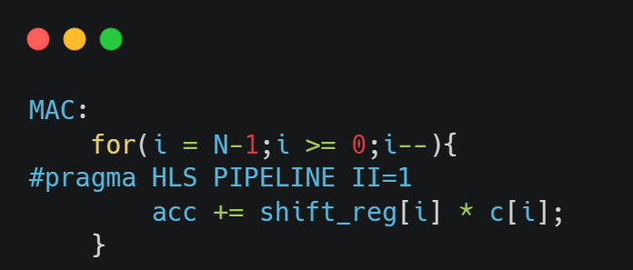
Loop Unrolling & Loop Pipelining
Corresponding changed hardware structure
For more information on the use of pipeline and the choice of parameters,
you can visit this website: https://docs.xilinx.com/r/en-US/ug1399-vitis-hls/pragma-HLS-pipeline
Notes:
Consider the MAC loop. In the MAC loop, we need to perform four operations, which are read c[], read shift_reg[], multiply c[] and shift_reg[], and accumulate operation. There is no dependency between the two array reads, but it takes one cycle to provide the memory address and another cycle to complete the data transfer, so it still takes two cycles to complete. The multiply and accumulate operations have dependencies and take two cycles to complete. Therefore, it takes four cycles to complete a MAC. Then with unpipelined operation, it takes 4N cycles to complete the MAC cycle. When we pipelined, the second iteration starts from the second cycle and the third drop starts from the third cycle, and it takes N+3 cycles to complete N iterations. Also II indicates the number of clock cycles from this loop to the start of the next loop in case there are dependencies or resource constraints between internal operations. We can adjust the value of II manually, or let the HLS tool tell you the most optimal value that can be achieved.

Slide 21
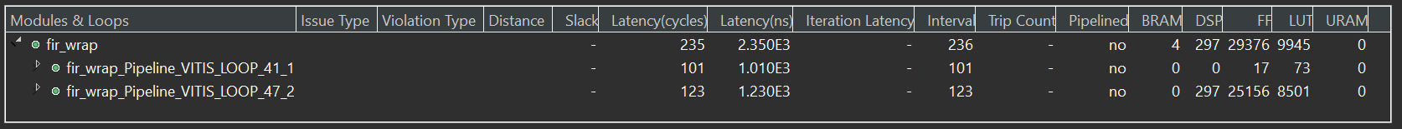
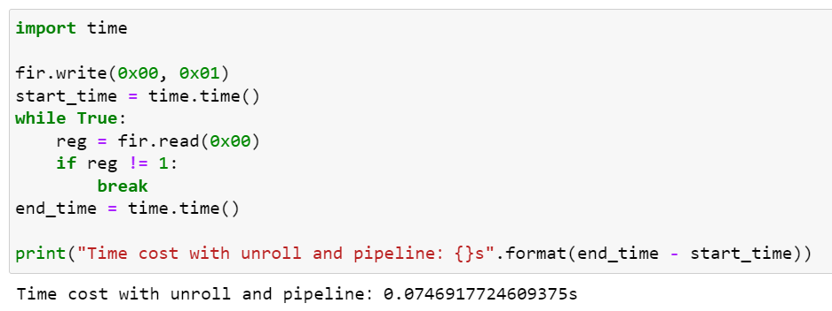
Loop Unrolling & Loop Pipelining
 | Latency | BRAM | DSP | FF | LUT | Time
Software |  |  |  |  |  | 0.48s
Baseline | 20607 | 2 | 3 | 532 | 520 | 3.67s
Code hoisting | 11224 | 6 | 3 | 1785 | 1937 | 1.93s
Array partitioning | 10605 | 0 | 3 | 6790 | 2092 | 1.87s
Loop unrolling & Loop Pipelining | 235 | 4 | 297 | 29376 | 9945 | 0.07s
~7 times faster !
Notes:
After the optimization of loop unfolding and loop flow, Latency is reduced from more than 10,000 to more than 200, which improves the performance by nearly 50 times. The utilization of the computing hardware DSP and the storage lookup hardware FF and LUT is also dramatically increased. Although the DSP may exceed the resources already available on the PYNQ board in the HLS synthesis report, it is automatically partially optimized to work properly on PYNQ in the subsequent tool chain.

Slide 22
Review and Consolidate
1. Which optimization method can unroll multiple iterations in a loop into independent operations?
A. Data flow optimization
B. Loop unrolling
C. Array Partitioning
D. Pipeline
Answer: B. Loop unrolling

Slide 23
Review and Consolidate
2. Which optimization method can divide the computing task into multiple parallel stages to process different data?
Loop Unrolling
Array Partitioning
C. Dataflow optimization
D. Pipeline
Answer: D. Pipeline

Slide 24
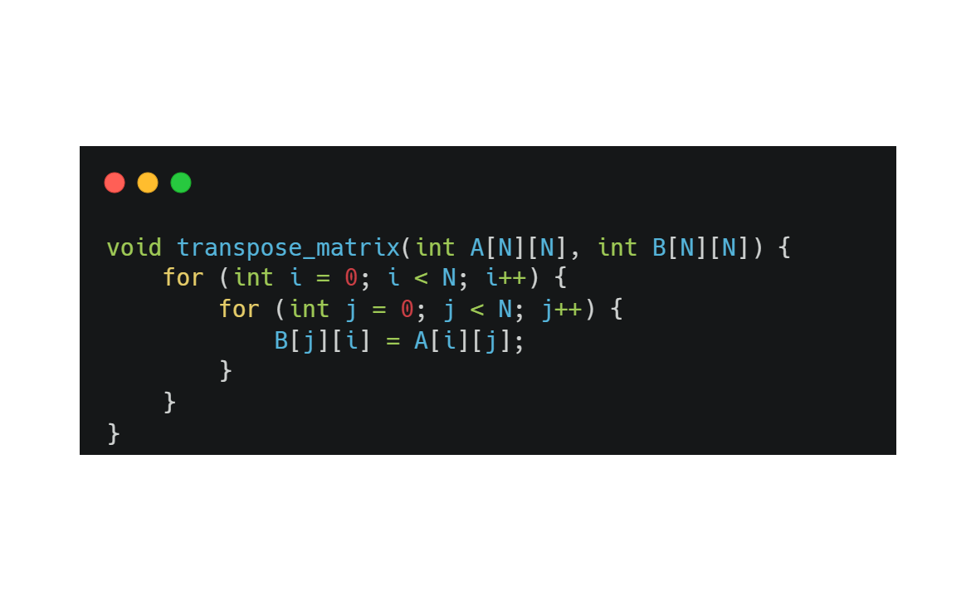
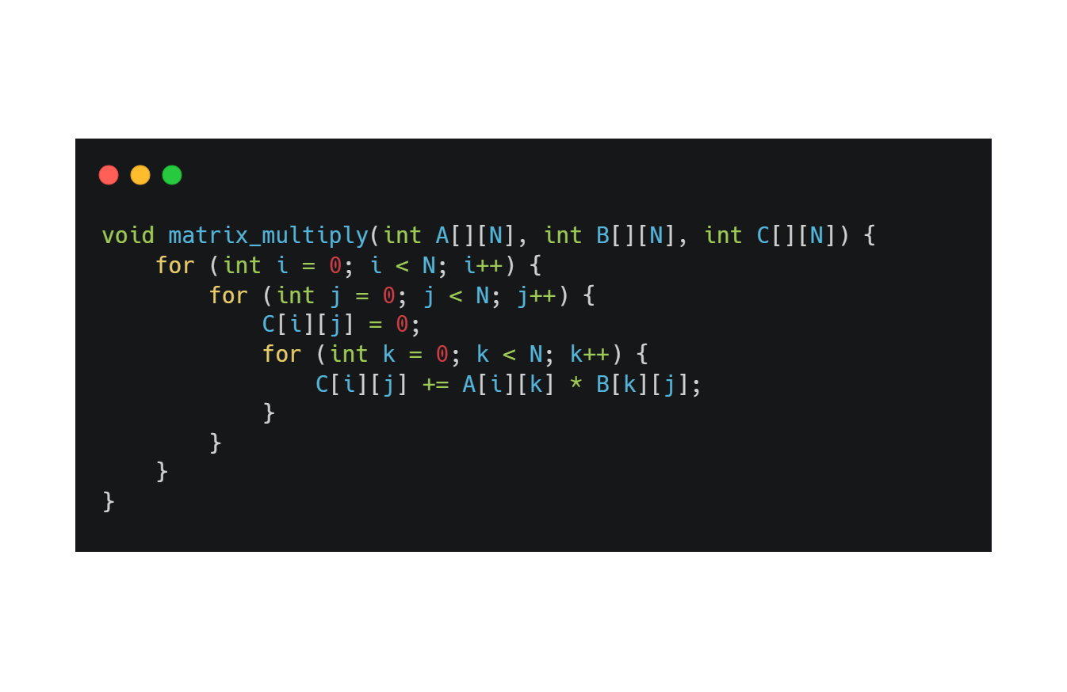
Review and Consolidate
3. The codes demonstrate a simple matrix transpose function and matrix multiply function. Which optimization methods can be applied to them respectively to improve performance?
The answer is not unique.
matrix transpose function
matrix multiply function

Slide 25
Three Optimization Pillars for HLS
In fact, for HLS, there are three optimization pillars.
So far, the above optimizations for FIR have been based on the pipeline layer optimization. For the other two levels of optimization, we will conduct them in the subsequent AIE and FFT.
If you want to learn more, you can visit the following website:xxxx
PIPELINE
SIMD
vectors
Dataflow

Slide 26
Stretch goals

Slide 27
Stretch Goals
You have already learnt some methodology of hardware design. Then you can use these skills and search for additional information to accomplish these tasks.
1. Please use the basic knowledge of HLS above to implement an accelerated core for FFT.
https://en.wikipedia.org/wiki/Fast_Fourier_transform
2. After completing the IP design, we are about to run this IP on PYNQ, so how is it connected to the hardware? And how is the specific call of the software hardware implemented? (which will be discussed in Module 3)

