Slide 1
DSP——FIR Filter Module 3: Software and hardware collaborative design

Slide 2
Outline
AXI4 Data Transfer Protocol
PYNQ Development Flow
Loading Overlay
Allocating Memory for IP Use
Configuring IP
Starting IP
Visualization Results
Stretch Goals

Slide 3
AXI4 Data Transfer Protocol

Slide 4
AXI4 Data Transfer Protocol
Paradigm | Description | Interface Types | C-Argument Type
Stream | Data is streamed into the kernel from another streaming source, such as video processor or another kernel, and can also be streamed out of the kernel. | AXI4-Stream (axis) | hls::stream
Register | Data is accessed by the kernel through register interfaces performed by register reads and writes. | AXI4-Lite adapter (s_axilite) | Scalar variable (pass by value), Pointer to a scalar, Reference
Memory | Data is accessed by the kernel through memory such as DDR, HBM, PLRAM/BRAM/URAM | AXI4 Memory Mapped (m_axi) | Array, Pointer to an array
AXI4 is a data transfer protocol, and all interface class IPs in FPGA design are equipped with AXI4 interface.
The AXI4 interfaces supported by Vitis HLS include the AXI4-Stream interface (axis), AXI4-Lite (s_axilite), and AXI4 master (m_axi) interfaces.
Notes:
Once we download the bitstream into the board, our hardware and software will start to operate in concert. The most important of these is the data transfer from PS to PL. AXI4 is a data transfer protocol, and all interface class IPs in FPGA design are equipped with AXI4 interface. The AXI4 interfaces supported by Vitis HLS include the AXI4-Stream interface (axis), AXI4-Lite (s_axilite), and AXI4 master (m_axi) interfaces. The m_axi mode specifies an AXI4 Memory Mapped interface. The s_axilite mode specifies an AXI4-Lite slave interface. The axis mode specifies an AXI4-Stream interface.

Slide 5
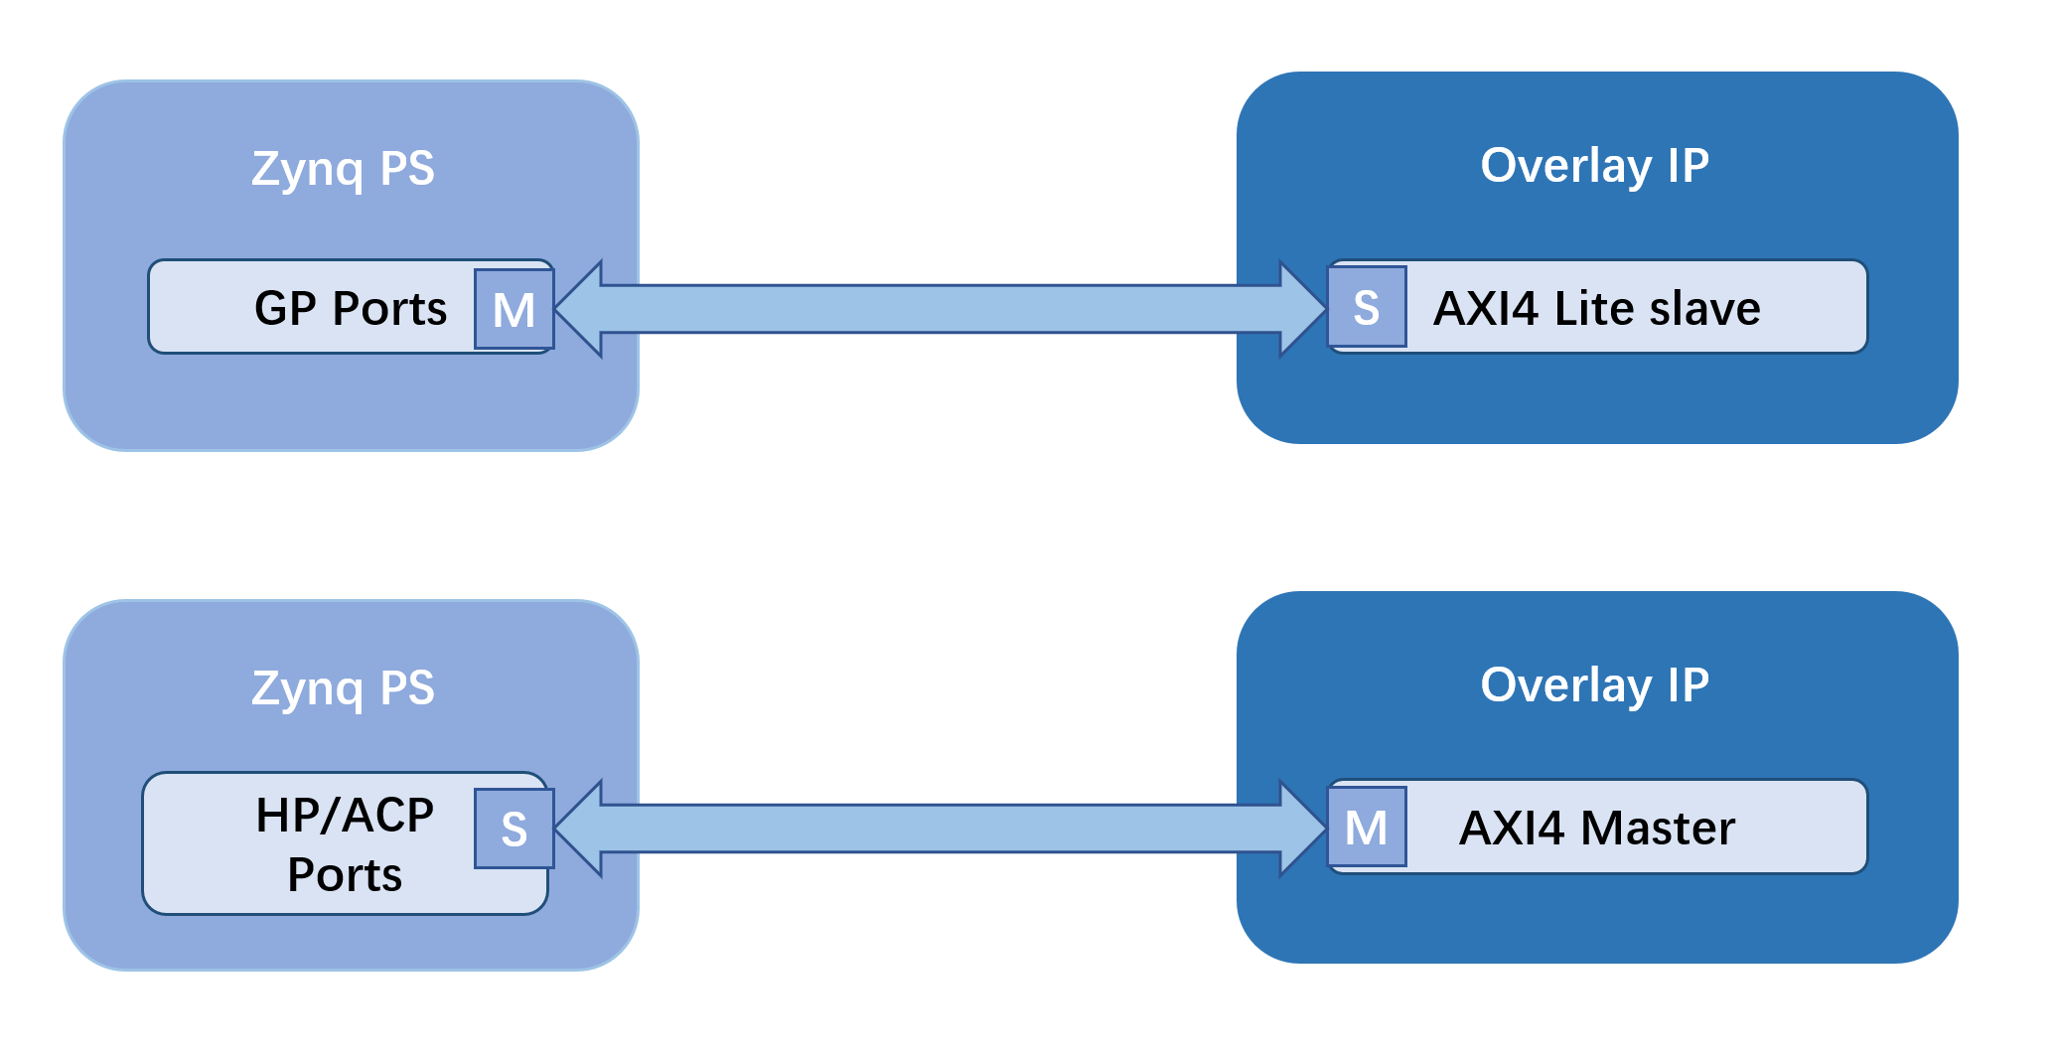
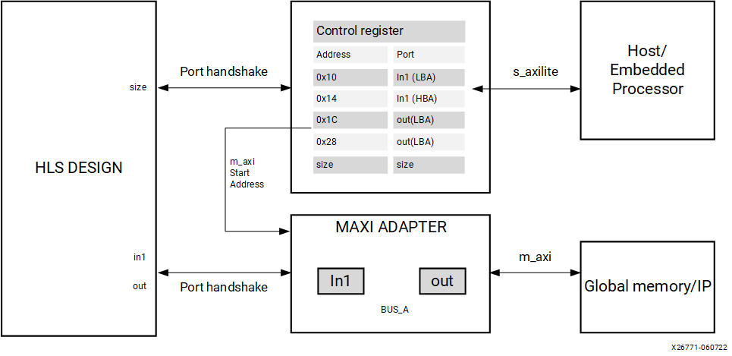
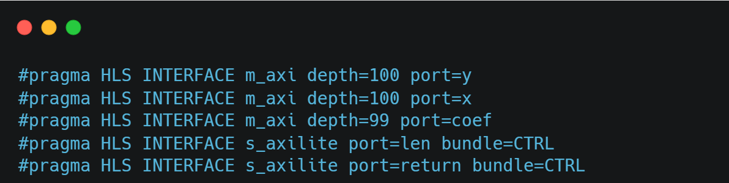
AXI4 Data Transfer Protocol
Question: How to change the c++ code if using AXI4 Stream?
If you want to know more about AXI4, you can refer to the official user manual: https://docs.xilinx.com/r/en-US/ug1399-vitis-hls/AXI-Adapter-Interface-Protocols https://docs.xilinx.com/v/u/en-US/ug1037-vivado-axi-reference-guide
Notes:
The HLS design will have both the s_axilite adapter for the base address, and the m_axi to perform read and write transfer to the global memory. （right）
In PYNQ, for long arrays of data, the axi type interface is generally used, which corresponds to the HP/ACP port on the Zynq for high performance transfer. For smaller data, which only requires configuration, the axilite type is suitable, which corresponds to the GP port on the Zynq with normal performance.(left)
Question: How to change the c++ code if using AXI4 Stream?
We will introduce it in Sobel PBL.

Slide 6
PYNQ Development Flow

Slide 7
PYNQ Development Flow
3.1
Loading overlay
3.2 Allocating memory for IP use
3.3 Configuring IP
3.4
Starting IP
3.5 Visualization results

Slide 8
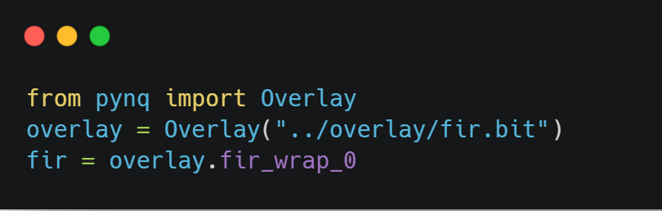
3.1 Loading Overlay
The Overlay part encapsulates the interface for the ARM CPU to interact with the PL part of the FPGA.
Using the simple Overlay() method.
With the overlay.fir_wrap_0 statement, we can interact with the IP in the form of an accessed Python object.

Slide 9
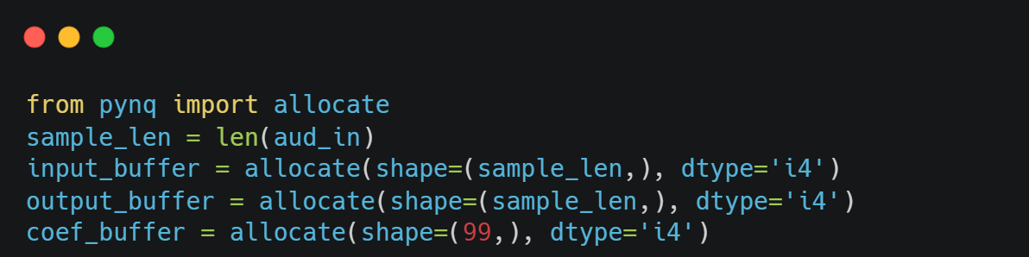
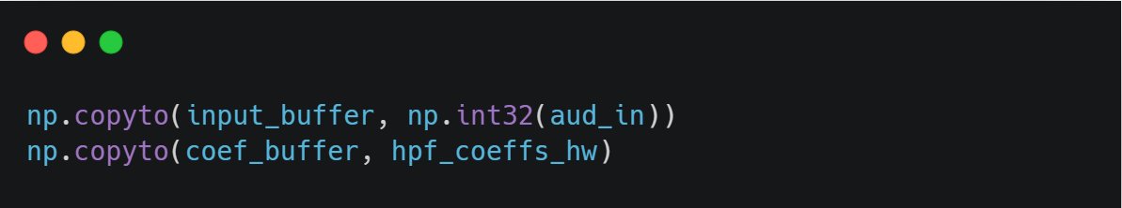
3.2 Allocating Memory for IP Use
The pynq.allocate function is used to allocate memory space that can be used by the IP in PL.
We need to specify the size of the memory space and the data type.
We take the audio data and coefficient data from python's local memory and copy it to the memory we just allocated.
Notes:
Allocate: design the variable, data length and data type.

Slide 10
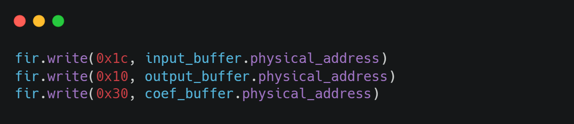
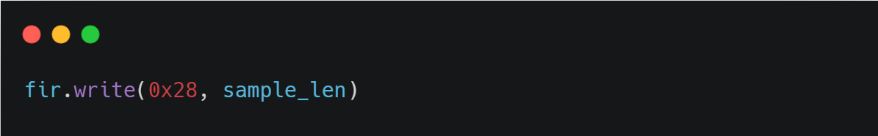
3.3 Configuring IP
For this project, there are four input and output ports. For each input or output, it has its own address. We use write( ) to write the address.
0x1c, the address of the input data
0x10, the address of the output data
0x30, the address of the filter coefficients
0x28, the length of the data to be processed
For the data length, we can write the value directly in the corresponding register.
Notes:
Using write() to write the physical address

Slide 11
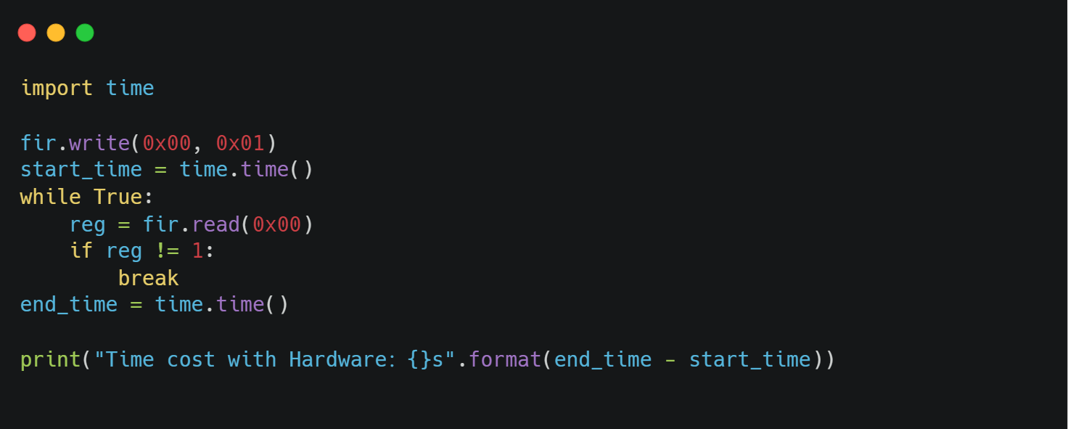
3.4 Starting IP
The control signal is located at address 0x00, which we can write and read to control whether the IP start and listen is completed.
Notes:
Record the time by using control signal

Slide 12
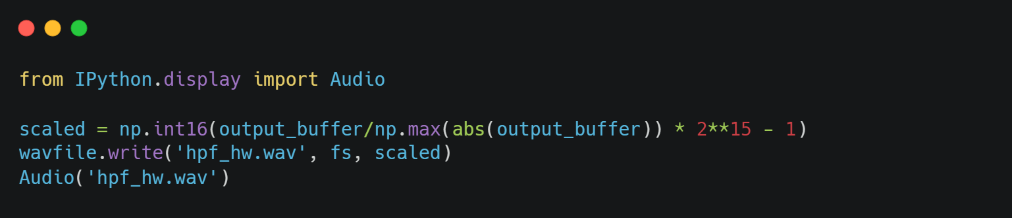
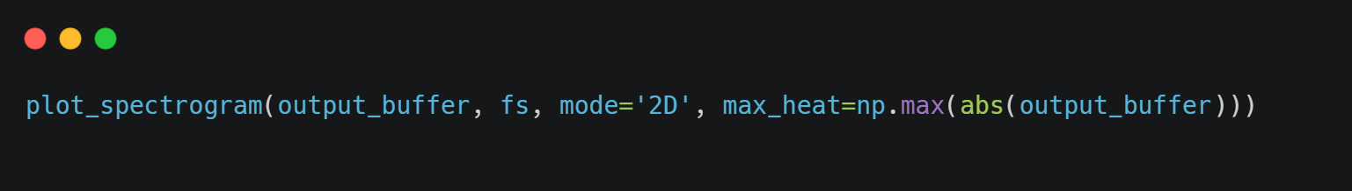
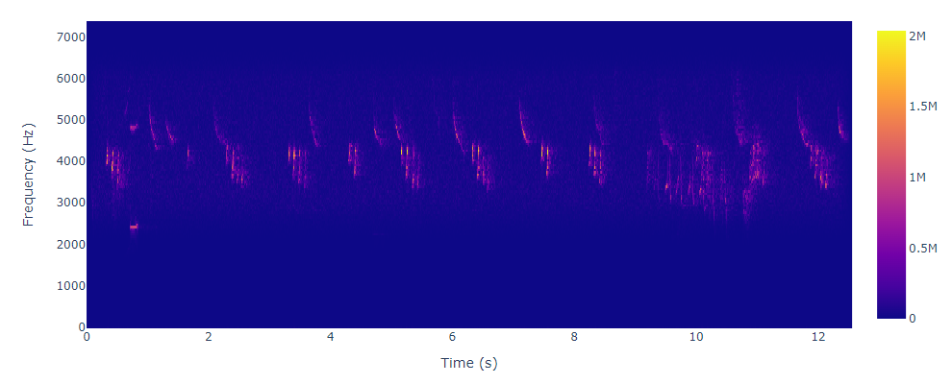


3.5 Visualization Results
Question: How to change the python code if using AXI4 Stream?
Only the voice of chaffinch is remained.
Notes:
Question: How to change the python code if using AXI4 Stream?
We will introduce it in Sobel PBL.

Slide 13
Stretch Goals

Slide 14
Stretch Goals
So far, we've taken three modules. Good job!
Here is a mini-challenge that you can complete based on what you have learned in the 3 modules.
1. Complete the writing of a light-up IP and test it on the board.
Besides, if you want to learn more, you can find more information about PYNQ in the website:
https://github.com/Xilinx/PYNQ
http://www.pynq.io/home.html

