Slide 1


Prediction of merchandise category
Team：Ace

Slide 2
Abstract
01
Approach
02
Exhibition
03
04

Slide 3
Abstract
01
With the development of Internet trade, there are multiple goods for selling on the website. But, how can we classify those items into categories accurately?
04

Slide 4
Abstract
Now, machine learning as a prevailing subject can deal with the problem precisely and efficiently. Therefore, we apply it to this project.

Slide 5
Approach
First, we process the description of every goods with Chinese character segmentation algorithm and
extract the key words of the text.
Second, put the key words into the categories the description belongs to.
Third, if there already have been the same words in the category, we will increase the weight of the key word.
04

Slide 6
Approach
01
After that, we built two tables, category table and word table, to store the data have been processed.
As follows:
04

Slide 7
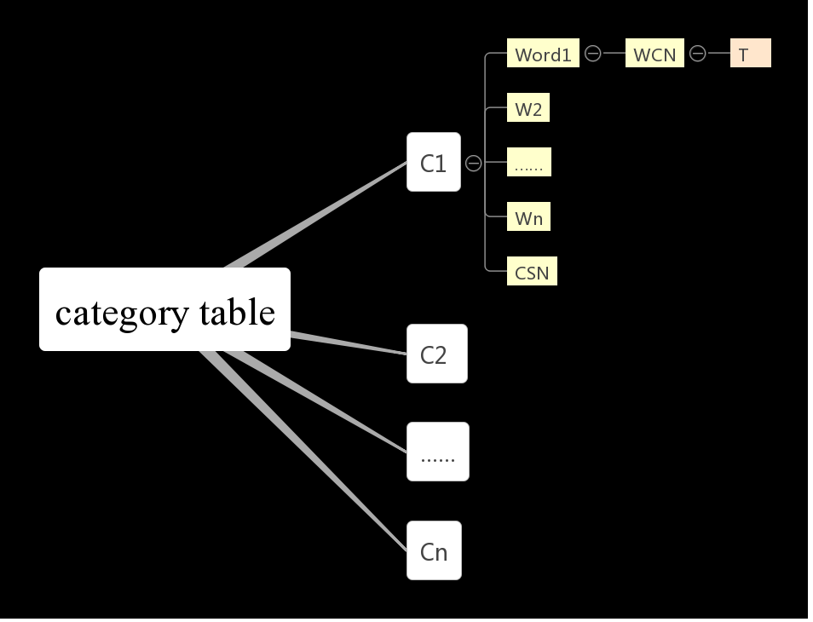
类表设计

Slide 8
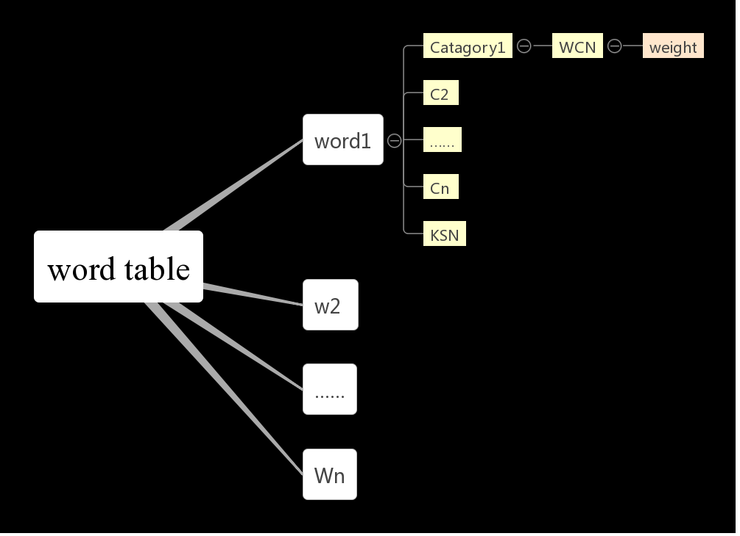

Slide 9
Approach
We set a threshold for every words to make sure that allover words chosen are reliable and useful to avoid the influence of noise.
Last but not least, we calculate the altogether
weight and get the maximum of weight.

Slide 10
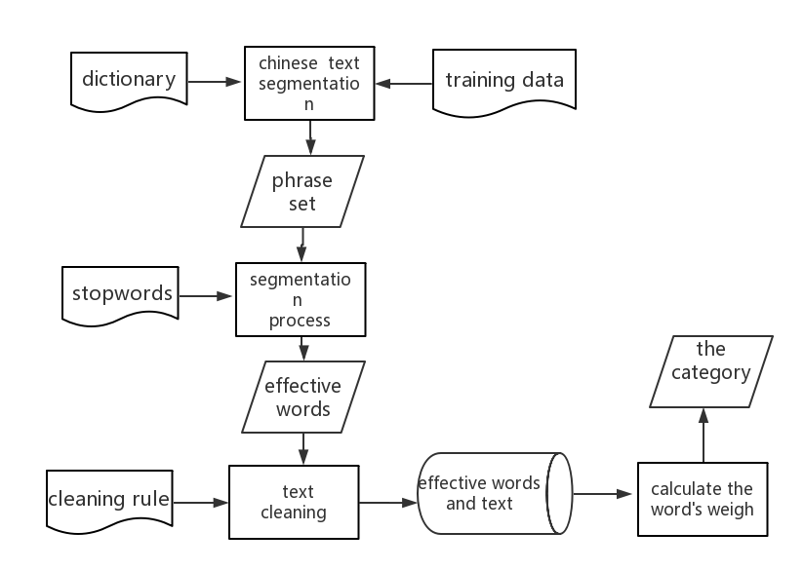
System procedure

Slide 11
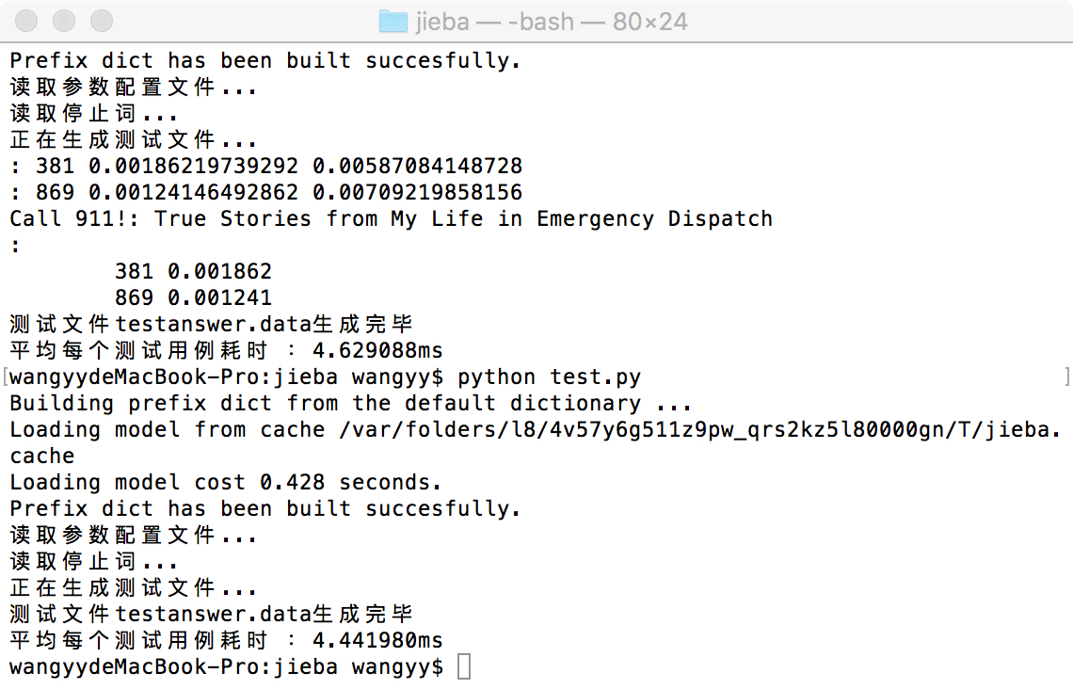
Exhibition
In time aspect:
01
04

Slide 12
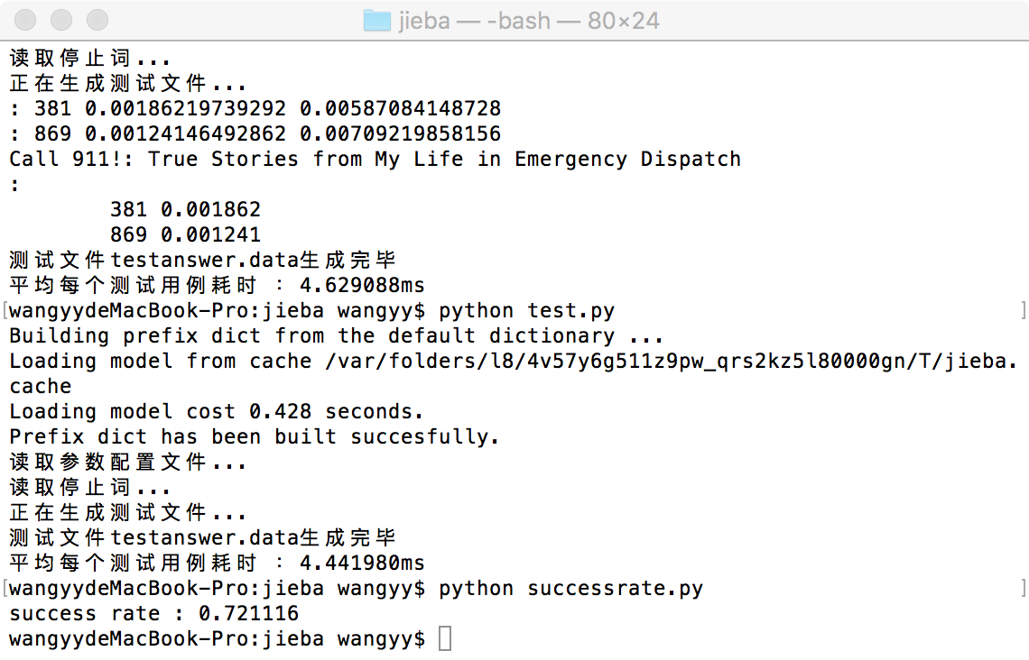
Exhibition
In accuracy aspect:

Slide 13
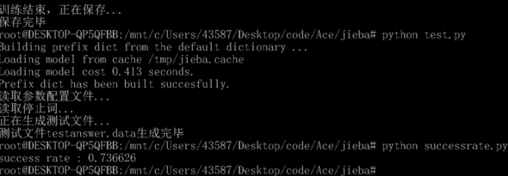
Exhibition
For increasing accuracy, we add user dictionary to get a better segmentation result.

Slide 14
Thanks for watching

