Slide 1
R Talk: GSA Subcontracting Obligations
Boxplot visualization to show action obligation dollars by naics code.

Slide 2
What’s to know?
Objective: To help small businesses (government contractors) make informative decisions around competing for bids based off any potential relationships between NAICS and obligation dollars from large prime vendors who are contractually obligated to allocate funds to work with small businesses.
1) What’s the relationship between action obligation dollars and NAICS code, if any?
2) Can I make any predictions that will help small business government contractors making successful bidding decisions?

Slide 3
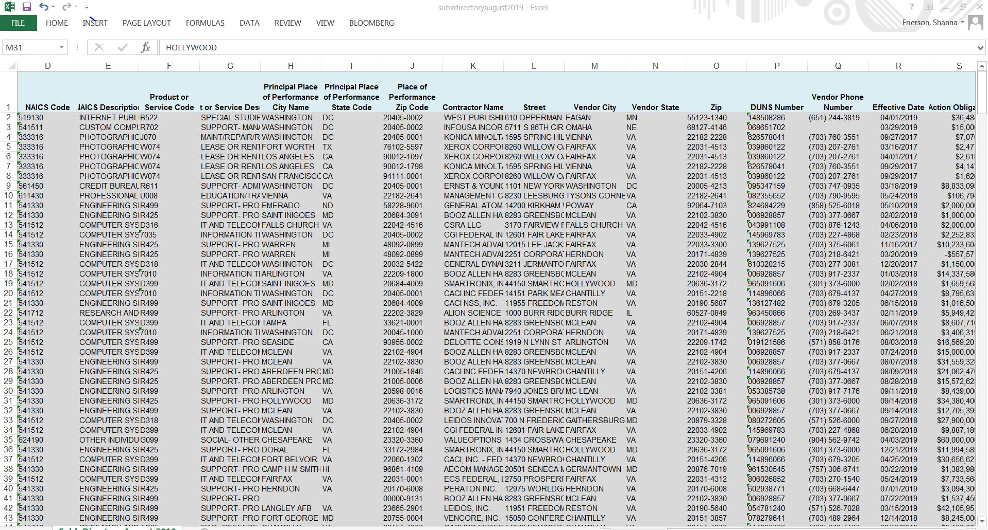
Source data from gsa – Relatively clean! Surprisingly!

Slide 4
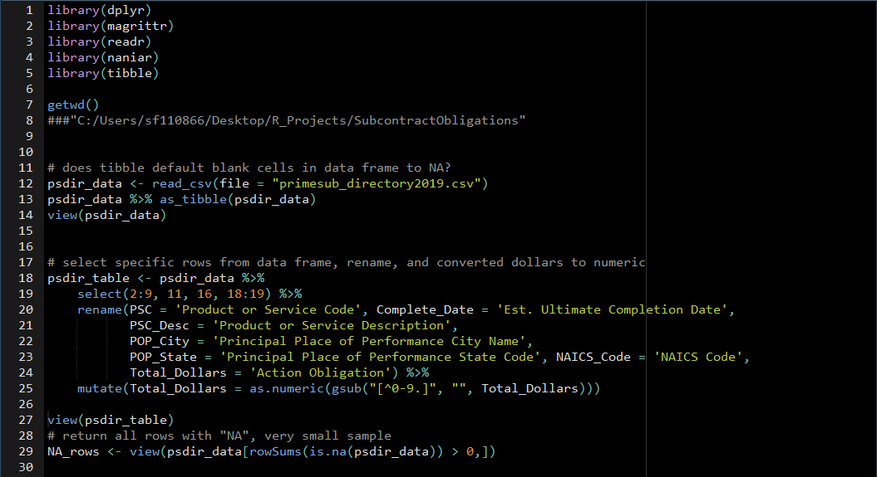
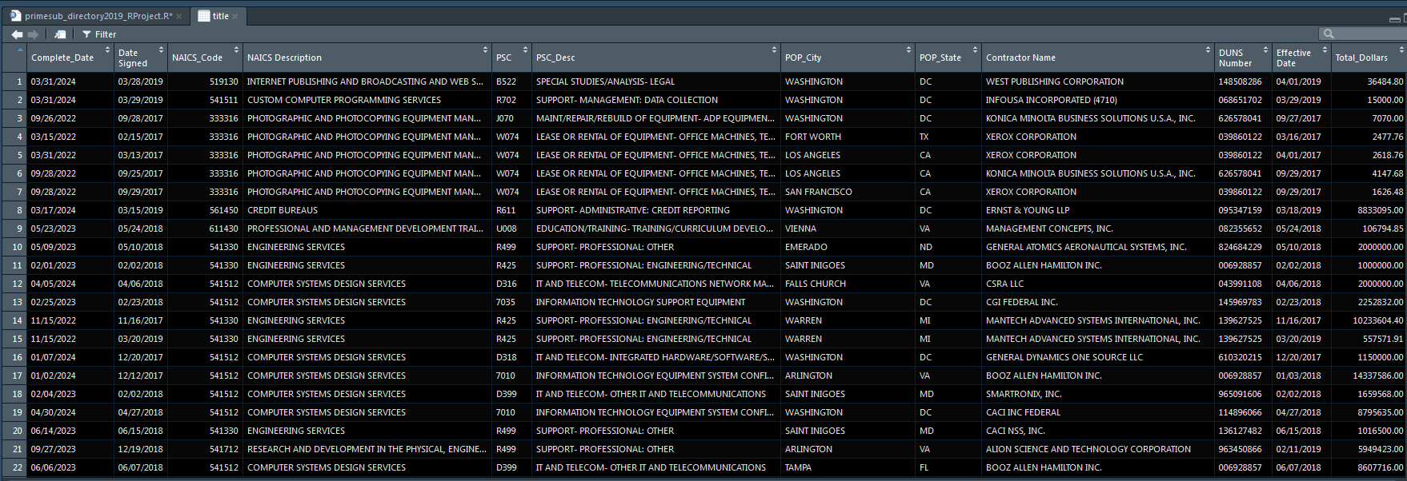

Slide 5
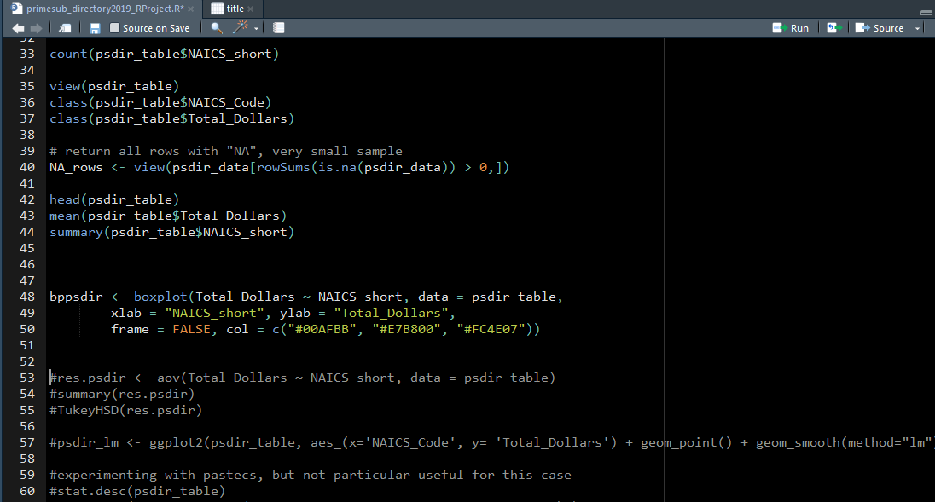
Box Plot

Slide 6
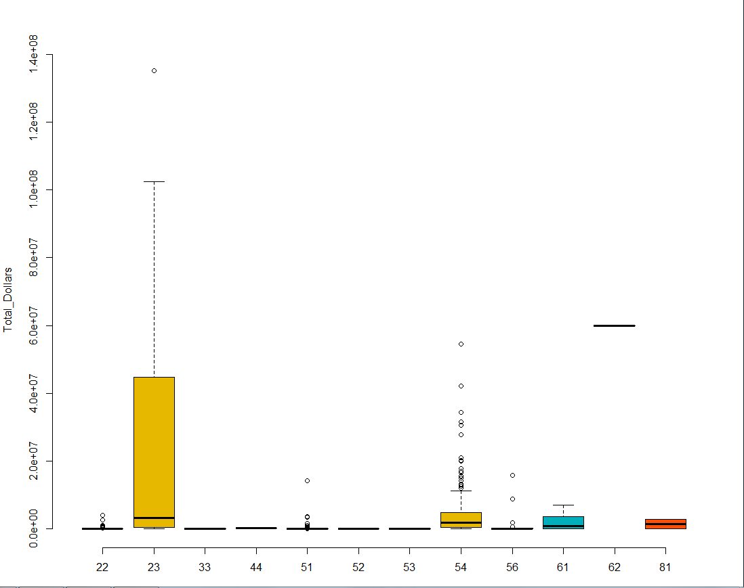

Slide 7
Observations and Questions for enhancements
This clearly didn’t work, but why? A boxplot only shows the range of dollars for each NAICS category, but it’s not enlightening on potential relationships between NAICS and dollars. It just shows with

Slide 8
Sources
https://www.gsa.gov/governmentwide-initiatives/gsa-open-data/gsa-datasets

