Slide 1
R Talk: GSA Subcontracting Obligations
Boxplot visualization to show action obligation dollars by naics code.

Slide 2
What’s to know?
1) What’s the relationship between action obligation dollars and NAICS code, if any?
2) Can I make any predictions that will help small business government contractors making successful bidding decisions?

Slide 3
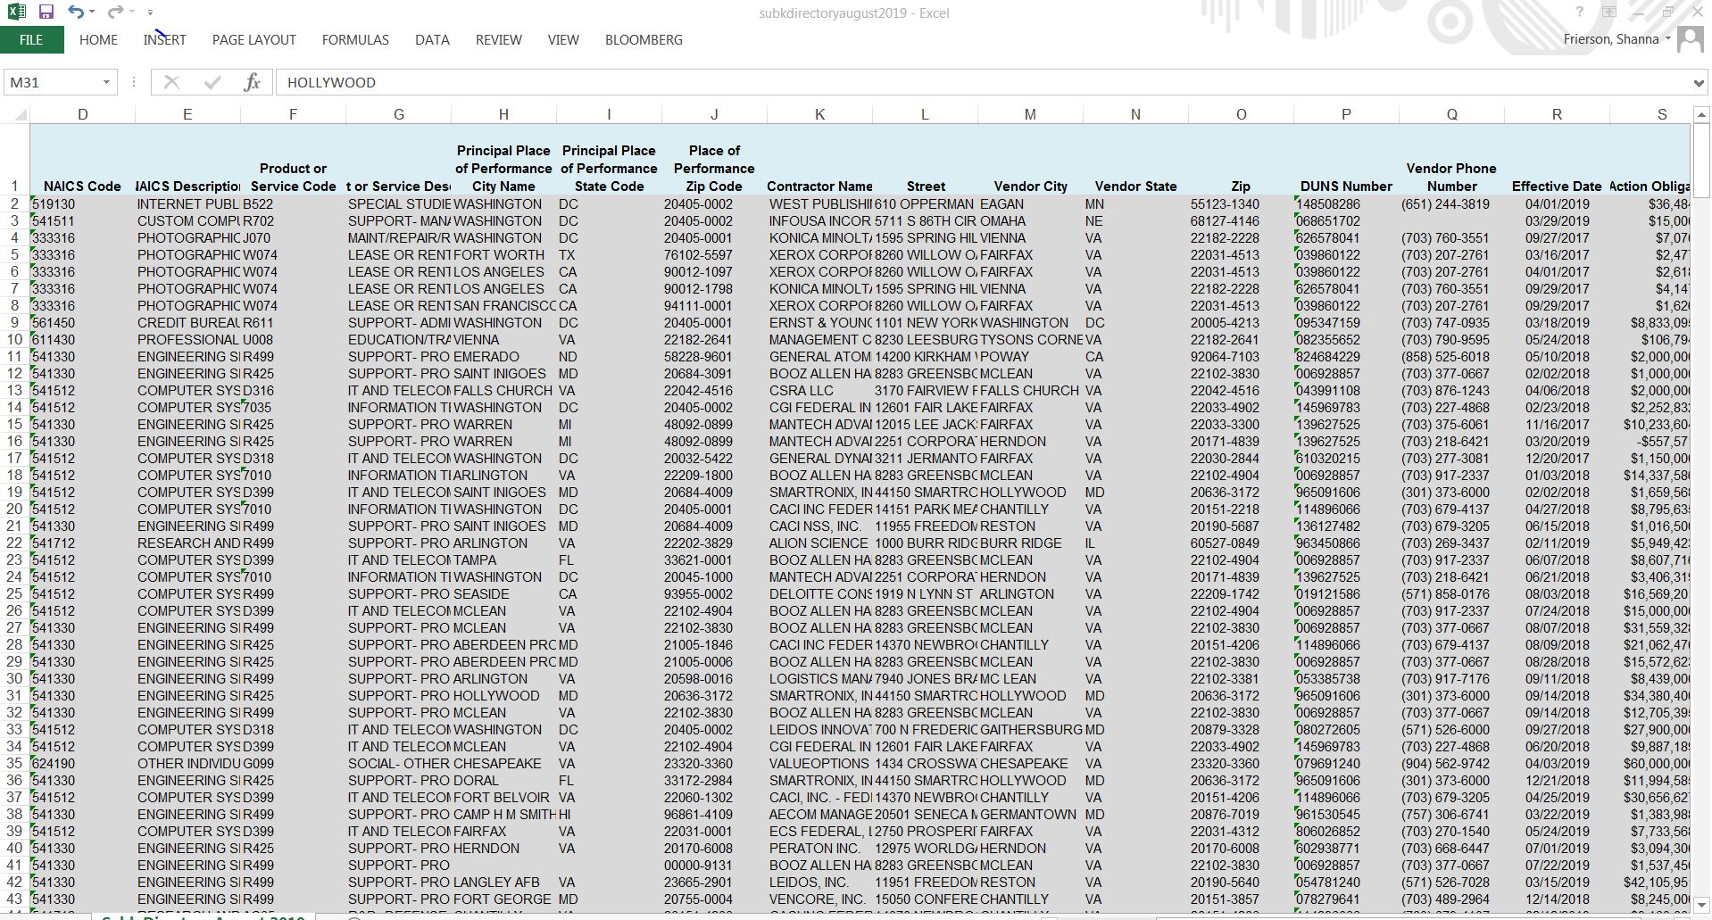
Source data from gsa – Relatively clean! Surprisingly!

Slide 4
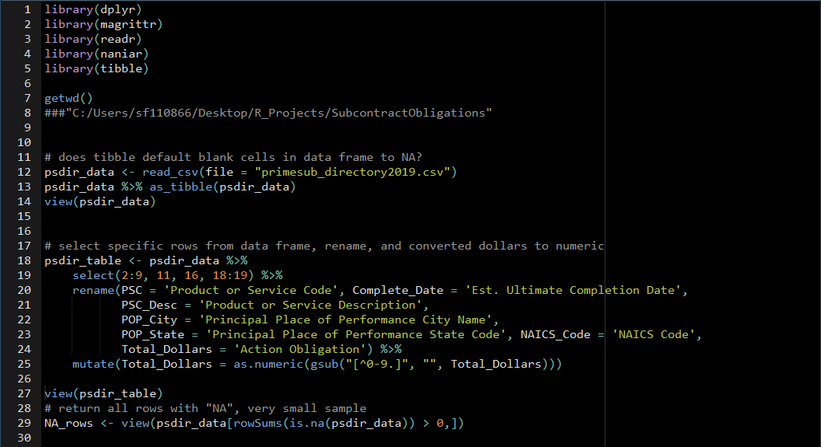
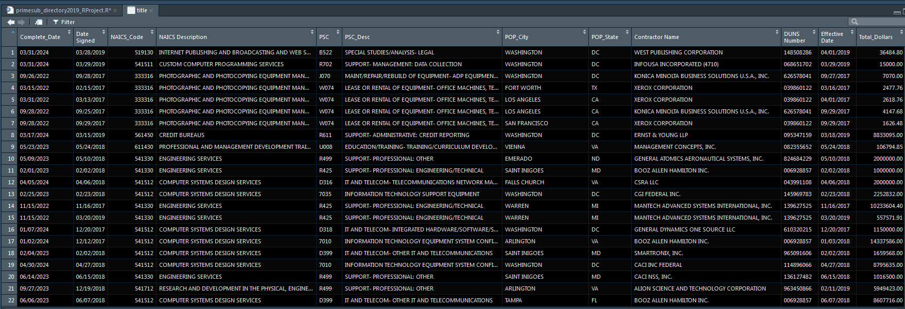

Slide 5
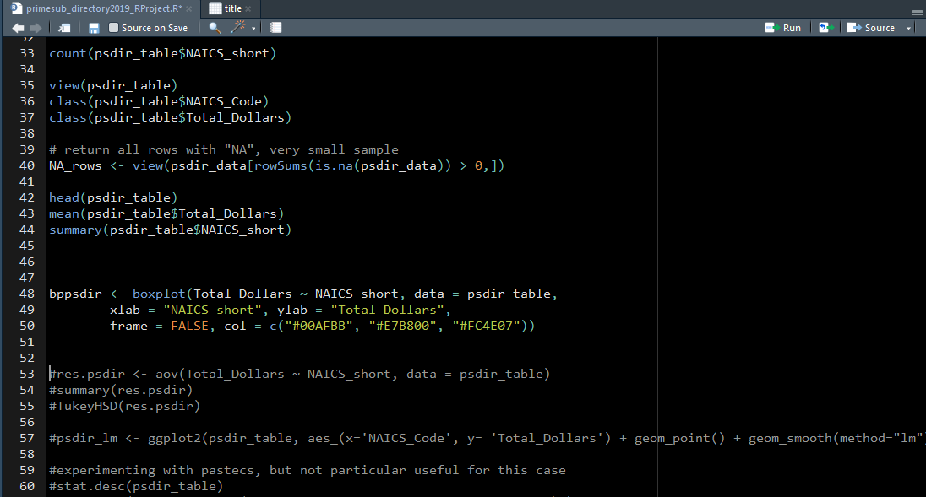
Box Plot

Slide 6
