Slide 1
Overnight progress
EMBER
Real inputs. GPU execution. Fire modelling.
Team progress update · 29 September 2026
EMBER / 1
Notes:
0:00–0:20
Good morning. Here is a quick update on our overnight progress with EMBER. We worked on three areas: adding real terrain and wind data, improving GPU execution efficiency, and developing the fire spread model. I’ll briefly explain where each area stands.
Source: team progress reported by the presenter on 29 September 2026.

Slide 2
Real terrain and wind
Elevation
Wind
Real heights aligned with
the Collserola simulation grid
ERA5 reanalysis snapshot
for a selected date and hour
Richer inputs for reproducible test cases
Current route: scalar CPU • Uniform, constant wind per run
The simulation is not yet a calibrated wildfire forecast
EMBER / 2
Notes:
0:20–1:25
My contribution was improving the real data inputs for our Collserola case. We now include elevation and a wind snapshot from ERA5 reanalysis, alongside the existing fuel map.
The elevation data is aligned with the simulation grid, so differences in height can influence the slope between neighbouring cells. The wind input gives us a direction and speed for a selected date and hour, instead of relying only on manually chosen values.
For now, that wind is constant across the area and throughout the run. This workflow runs on the scalar CPU version; it is not yet integrated with the GPU version.
The main advance is richer, reproducible environmental inputs. These inputs make our test cases more realistic, but they do not yet make the simulation a calibrated wildfire forecast.
Sources: docs/real-environment.md and docs/real-terrain.md in the EMBER repository; presenter’s contribution report. Elevation: Copernicus DEM GLO-30. Weather: ERA5 reanalysis delivered through Open-Meteo. No claim of GPU parity or physical calibration.

Slide 3
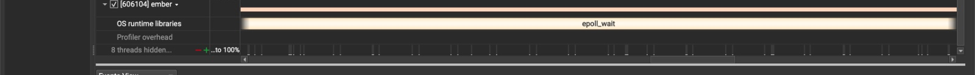
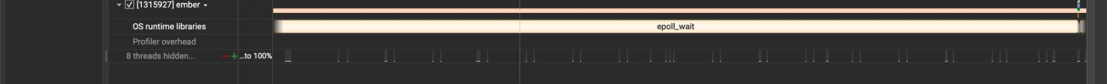
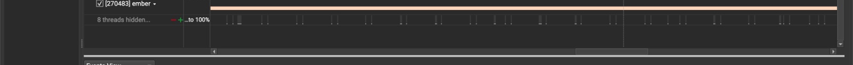
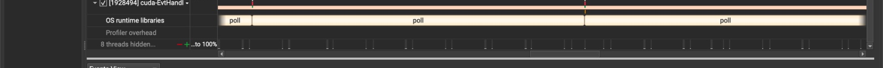
GPU execution profiling
Julián / Profiling scenario execution across four MPI processes
MPI 0
MPI 1
MPI 2
MPI 3
Execution traces guide optimisation; speedup still needs a matched benchmark
EMBER / 3
Notes:
1:25–2:30
Julián continued working on the efficiency of the GPU simulation. These screenshots show execution profiles in NVIDIA Nsight Systems for four MPI processes, labelled zero to three.
Each row shows a sequence of scenarios assigned to one process. The repeated blocks let us inspect how the work is organised, including scenario execution and CUDA synchronisation calls.
The value of these profiles is that they make the execution pattern visible. They help guide optimisation and show where we should measure overhead more carefully.
We do not have a matched before and after benchmark in these screenshots, so I am not claiming a specific speedup. The next measurement should compare the same workload and configuration, checking both execution time and correctness. That will let us quantify the benefit of the changes.
Sources: four original WhatsApp screenshots supplied by the presenter, 29 September 2026, 08:24:07, 08:24:22, 08:24:37 and 08:25:05. Cropped to the scenario and CUDA API timeline rows. Screenshots show ranks 0–3; they are not a before/after benchmark.

Slide 4
Fire model development
Jesús / Two approaches investigated in issue #4
rothermel-fire-model
Implemented • Compilation and testing pending
normalized-fuel-model
Branch created for the alternative approach
Both branches created from dev
EMBER / 4
Notes:
2:30–3:25
Jesús focused on the fire model. He investigated the two approaches described in issue number four and created two branches from dev: rothermel-fire-model and normalized-fuel-model.
The Rothermel model is already implemented in the first branch. However, it still needs to be compiled and tested, so we should describe it as implementation progress, not as a validated result.
The second branch provides a separate place to explore the normalised fuel approach. We are not claiming that this alternative has already been implemented.
This gives us a clear starting point for the next stage: check that the Rothermel implementation builds, test its behaviour, and then assess how it can fit with the rest of EMBER.
Source: Jesús’s direct report supplied by the presenter: investigated both approaches in issue #4; created rothermel-fire-model and normalized-fuel-model from dev; implemented Rothermel in the first branch, pending compilation and testing.

Slide 5
Next steps
01
Compile and test Rothermel
02
Benchmark the GPU changes
03
Work towards integration
Proposed next steps • Integration and validation remain ahead
EMBER / 5
Notes:
3:25–4:00
Our proposed next steps are to compile and test the Rothermel model, measure the GPU changes with comparable benchmarks, and move towards integrating the environmental inputs with the other developments.
The three workstreams are progressing, but they are not yet one fully integrated, validated system.
That is our overnight update: richer real data inputs, continued GPU optimisation, and an implemented Rothermel model awaiting validation. Thank you.
Proposed next steps based on the reported status; not claims of completed work.

