Slide 1
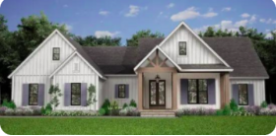
House Price Prediction Analysis
Data-Driven Insights for Real Estate Market
Prepared by : Sikandar Shrestha
Dulce X. Cid Sanabria
Date: 2nd December, 2025, Tuesday
Data Source link: https://www.kaggle.com/datasets/zafarali27/house-price-prediction-dataset/data
Github code link: https://github.com/XimenaCS/STA-6923/blob/main/sta6923-projectHouse-v3.Rmd

Slide 2



AGENDA
Executive Summary
Project Goal
Visualization Findings
- Finding 1: Price Vs Area
- Finding 2: Price Vs Cat. Predictors
- Finding 3: Piechart (categorical variables)
- Finding 4: Histogram (Price)
Best Model Performance
Recommendations
Conclusion
Q&A

Slide 3

Executive summary
Big Idea!
(1)Built a regression model to predict residential property values & identify key market drivers.
Scope:
(1) Analyzed a comprehensive dataset of 2000 properties with 8 distinct factors including Area, Bedrooms, Bathrooms, Floors, YearBuit, Location, Garage.
Key Outcome:
(1) After rigorous testing of multiple algorithms, an Elastic Net Regression Model was selected as the final model based the R² and RMSE.
(2)Despite being the best performing model, its low explanatory power (R²) shows the fundamental limitation of the dataset.
(3)A significant portion of housing price variation is driven by factors not captured in the given dataset.
Recommendation:
(1)The available predictors (area, rooms, location, garage, etc) do not appear to capture the key factors that typically influence housing prices in the real world.
(2)Because of the low value of R2, the relationship is not linear, that means some important predictors are missing such as neighborhood attributes, proximites services, renovations, market conditions etc.
(3)Practical use would require collecting more informative variables or revisiting how the data were generated to ensure that realistic price–feature relationships exist.

Slide 4
Project Goal
Identify Key Factors: Determine and quantify the most significant factors influencing house prices.
Exploratory Analysis: Uncover hidden patterns, trends, and correlations within the housing market data.
Model Building: Split the data into train & test ( validation set), select the most effective predictive model ( algorithm) to estimate the property price.
Deliver Actionable Insights: Provide a clear, interpretable analysis for buyers, sellers, & real estate professionals to make informed financial decisions.

Slide 5
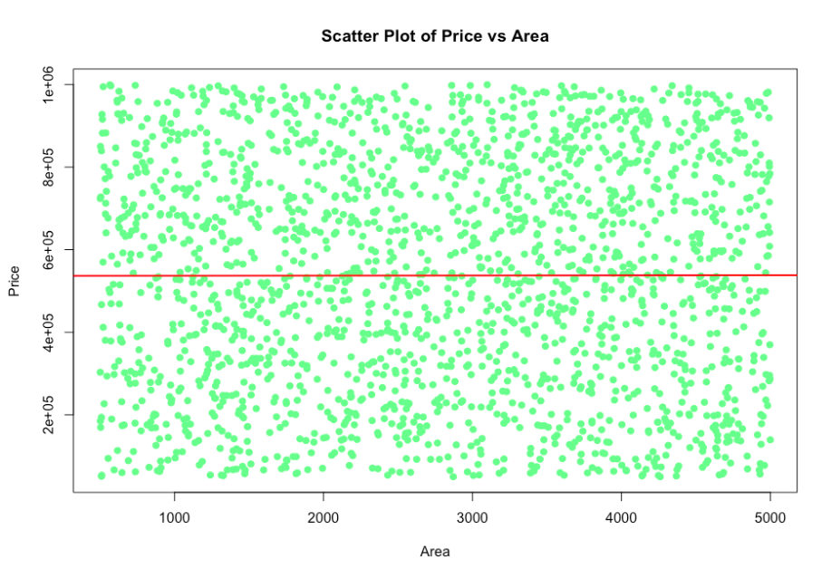
Visualization 1: Title: ScatterPlot between ‘Price’ VS ‘Area’
Critical Observations:
1) No Visible Correlation: The scatter points are spread uniformly across all area values, so there is no clear upward or downward trend.
2)Random Price Distribution: House prices appear to be randomly distributed, regardless of the property's size. A small home is just as likely to be expensive as a large one, and vice-versa.
3) Flat Regression line: The regression line (red line) is horizontal, which statistically confirms that Area has no linear relationship with Price in this dataset.

Slide 6
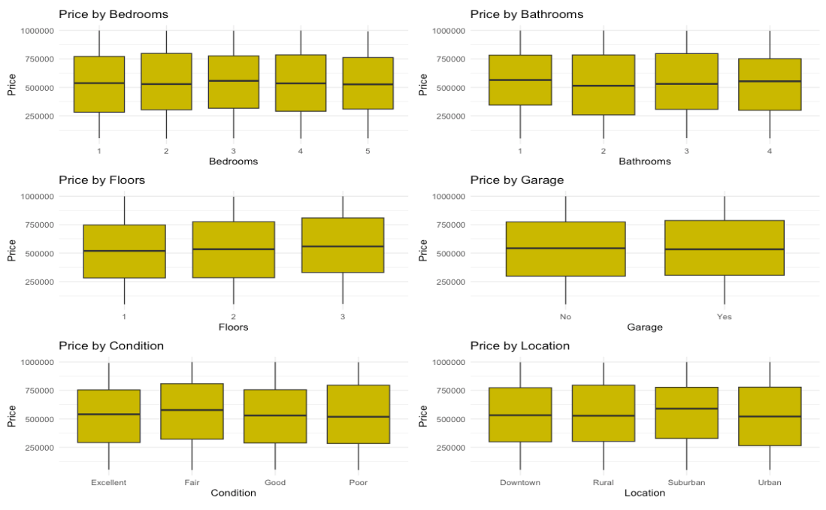
Visualization 2: Boxplot Between Categorical variables vs Price
1)Boxplots illustrate how housing prices vary across the different categories of each variable.
2) Flat Medians: The central line in each box (median price) is remarkably consistent across different variables.
3) Overlapping Ranges: The interquartile ranges heavily overlap for almost all categories. This means there is no distinct significant influence on Price.
4) High Variability Within Groups: For each category, the price range (from minimum to maximum) is extremely wide, referring that another, more influential factor is also causing this volatility.
5) No single factor alone is a dominant price driver.
6) The true price is likely determined by combined of a new created features and interaction terms between bedrooms, bathrooms, floors, location, condition etc.

Slide 7
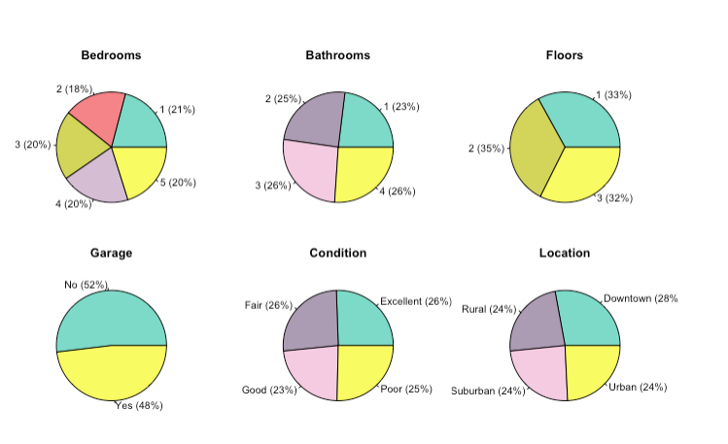
Visualization 3: PieChart of Categorical variables
1)The pie charts illustrate an overview of the distribution of each categorical variable in the dataset.
2)Piechart shows the dataset is well-balanced and representative across the categorical features, providing a solid foundation for analysis.
3) Bedrooms, Bathrooms, & Floors show moderate variation.
4) Garage Avaiability: A nearly perfect 50%-50% split between properties with and without a garage.
5)No Major Skews: There are no extreme imbalances in any single category.

Slide 8
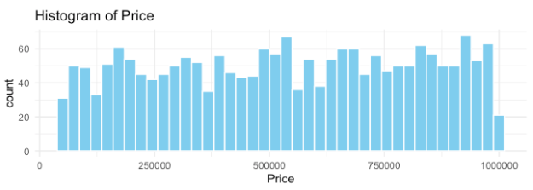
Visualization 4: Histogram of Price
1) The distribution of home Price is fairly uniform across the full range ( from budget-friendly to premium luxury), with a slight linear trend.
2) No Normal Distribution: Unlike many markets, house prices in this dataset are not clustered around the central tendency, so it is not a `bell curve`.

Slide 9

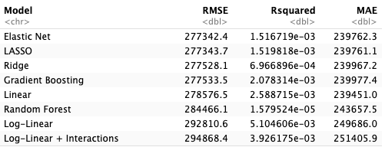
Best PERFORMANCE Model:
While all models performed poorly, Elastic Net is chosen as the best model based on the following:
1) The Elastic Net model has the lowest RMSE and MAE in the comparison table, while also handling multicollinearity and selecting useful features automatically.
2)Its structure is close to a linear model, which makes its coefficients easier to interpret compared with more complex models.
3)Although its improvement over LASSO and Ridge is small, Elastic Net offers a good middle ground between the two methods.And it provides a robust approach that handles correlated variables better than either one alone.
Conclusion:
For these reasons, Elastic Net is chosen as the "best" model. However, the very low R² and relatively high errors show that the model has limited ability to explain or predict housing prices in this dataset.

Slide 10
Recommendation:
1)Prioritize Data Enrichment: The available predictors do not capture the key factors that drive house price in the market. Important features are absent such as location Quality (eg: school district rating, crime rates, neighborhood attributes etc.), Property Attributes (eg: lot size, renovation year, architectural style etc.), market conditions etc.
2)Dataset Simulated: The weak relationships between Price and the predictors, observed both in the exploratory analysis and in the models’ low R² values, suggest that the dataset may be simulated. Also, the relationship is not linear or some important predictors are missing (eg lot size, neighborhood rating, renovations e.t.c.).
3)Manage Stakeholder Expectations:Clearly communicate with skakeholder that the very low R² and relatively high errors show that the model has limited ability to explain or predict housing prices in this dataset.
4) Implement a Feedback Mechanism: Using new data to iteratively retrain and improve the model over time.

Slide 11

Conclusions:
Although Elastic Net is reported as the selected model, the broader conclusion is that this dataset is not suitable for accurate house price prediction. Practical use would require collecting more informative variables or revisiting how the data were generated to ensure that realistic price–feature relationships exist.

Slide 12
Q&A:?

