Slide 1

CREDIT CARD FRAUD USA
Machine Learning Chris Tanner
Wood Walker
Emilia Roberts
Ximena Castillo

Slide 2
CREDIT CARD FRAUD
Credit card fraud was the most common type of identity theft in 2023, with 426,000 reported cases. That's down from 448,000 cases reported in 2022 but well above pre-pandemic levels.
Types of credit card fraud
There are two types of credit card fraud:
New account: An identity thief uses your information to open a credit card account in your name.
Existing account: An identity thief uses a credit card that you opened. This is usually done by stealing the credit card information.
2
Notes:
Ximena

Slide 3
REPORTS BY AGE
e
45%
30%
ARKETING
Those in the 30-to-39 age range have recorded the most identity theft reports for years, including in 2023.
1%
SCHEDULING
Group of 80 and over
3
Notes:
Ximena

Slide 4
WHAT DOES THE DATA LOOK LIKE?
https://www.kaggle.com/datasets/kelvinkelue/credit-card-fraud-prediction/data
This dataset offers a variety of attributes valuable for comprehensive analysis. It contains 555,719 instances and 22 attributes, a mix of categorical and numerical data types. Importantly, the dataset is complete with no null values.
 | trans_date_trans_time | cc_num | merchant | category | amt | first | last | gender | street | city | state | zip | lat | long | city_pop | job | dob | trans_num | unix_time | merch_lat | merch_long | is_fraud
0 | 21/06/2020 12:14 | 2.29E+15 | fraud_Kirlin and Sons | personal_care | 2.86 | Jeff | Elliott | M | 351 Darlene Green | Columbia | SC | 29209 | 33.9659 | -80.9355 | 333497 | Mechanical engineer | 19/03/1968 | 2da90c7d74bd46a0caf3777415b3ebd3 | 1.37E+09 | 33.98639 | -81.2007 | 0
1 | 21/06/2020 12:14 | 3.57E+15 | fraud_Sporer-Keebler | personal_care | 29.84 | Joanne | Williams | F | 3638 Marsh Union | Altonah | UT | 84002 | 40.3207 | -110.436 | 302 | Sales professional, IT | 17/01/1990 | 324cc204407e99f51b0d6ca0055005e7 | 1.37E+09 | 39.4505 | -109.96 | 0
2 | 21/06/2020 12:14 | 3.60E+15 | fraud_Swaniawski, Nitzsche and Welch | health_fitness | 41.28 | Ashley | Lopez | F | 9333 Valentine Point | Bellmore | NY | 11710 | 40.6729 | -73.5365 | 34496 | Librarian, public | 21/10/1970 | c81755dbbbea9d5c77f094348a7579be | 1.37E+09 | 40.49581 | -74.1961 | 0
6
Notes:
Emilia

Slide 5
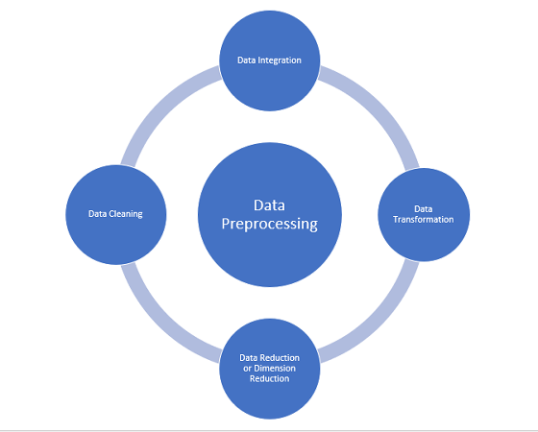
Data Pre-Processing and Pipeline
Removal of identification categories and reducing scope of model
(credit card number, names)
After testing, also removed state identification due to complications with neural net learning and skewed data due to fraud cases being so low
AAAAAAAAAAAAAAAA
Notes:
Emilia

Slide 6
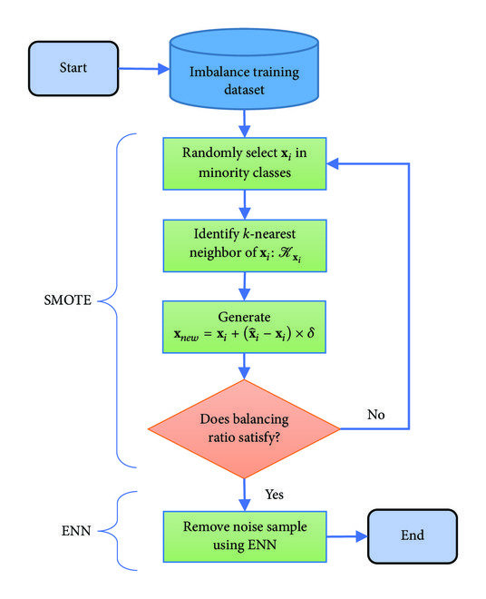
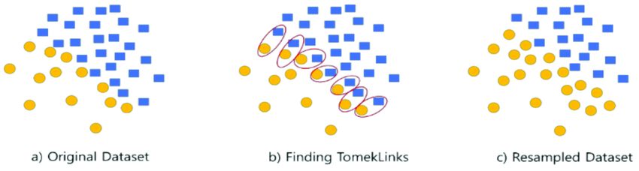
Imbalanced Data and Fixes
Dataset is very skewed in one direction (i.e. 1k fraud cases in 1 million credit card transactions
Can present issues in training neural nets
They are prone to just saying all fraud cases are non-fraud, resulting in missed fraud cases while still having very high accuracy.
SMOTEENN algorithm is used to “balance” dataset by creating new entries for minority case
AAAAAAAAAAAAAAAA
Notes:
Emilia

Slide 7
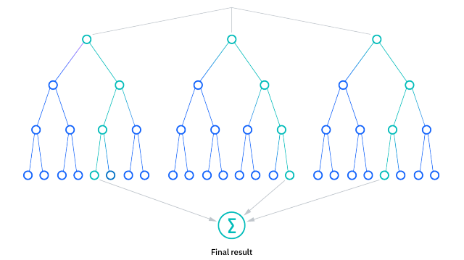
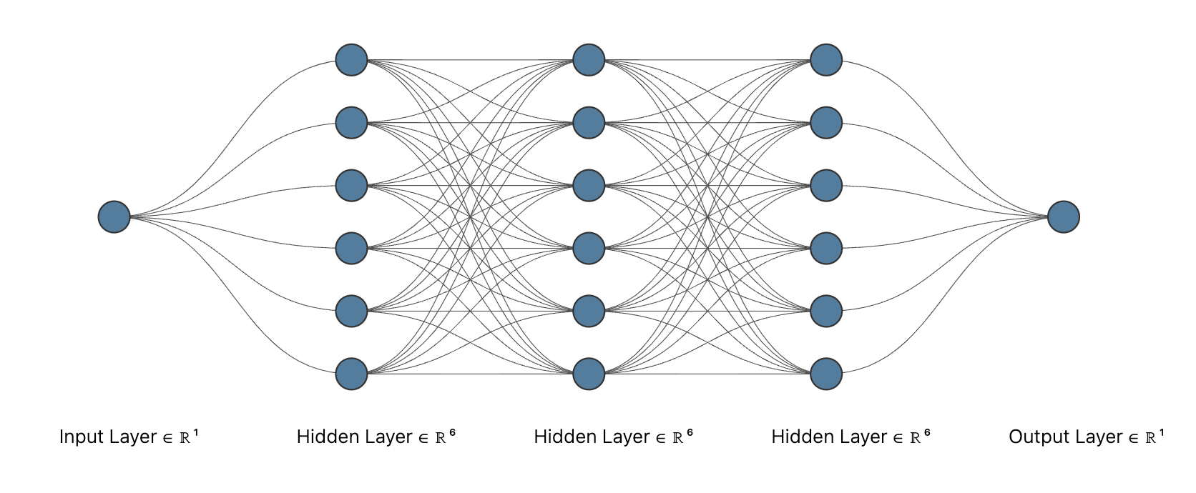
Data Fitting: Neural Net and Random Forest
- Wanted to compare two different models and their weights
- Chose relatively simple neural net model -> 3 hidden layers each with six neurons (relu activation), which sigmoidal output later
- Compared to random forest (# estimators = 500)
- Output would be used to determine if new data was fraud based on input parameters for further checks
AAAAAAAAAAAAAAAA
Notes:
Emilia

Slide 8
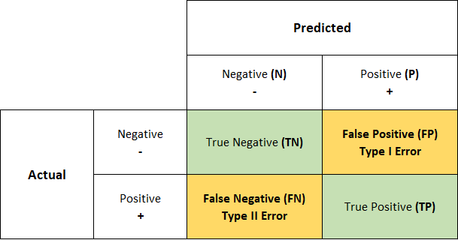

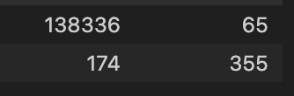
Confusion Matrix
Want to reduce Type II error as much as possible
This is a missed fraud case
Type I is less of a big deal, can be resolved much more easily
Neural net has much better Type II error rate than random forest, but much higher false positive rate
AAAAAAAAAAAAAAAA
Neural Net
Random Forest
Notes:
Emilia

Slide 9
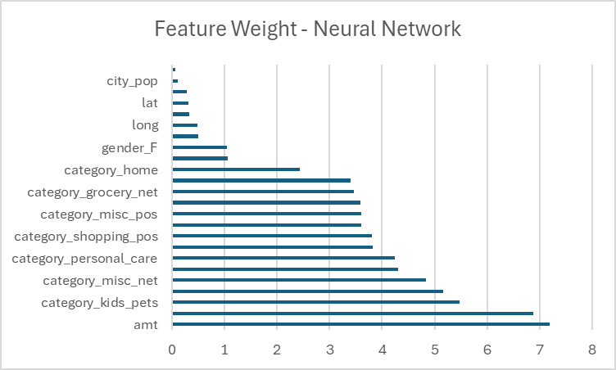
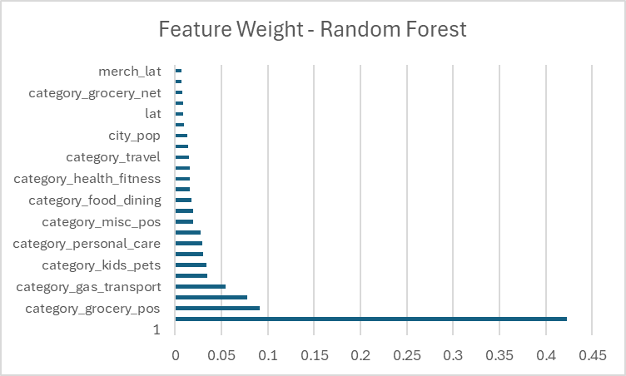
HOW IS THE WEIGHT DISTRIBUTED?
8
Notes:
Ximena

Slide 10
Feature/Aspect | Neural Networks | Random Forests
What Are They? | Like a complex brain made up of layers of "neurons" connected by "synapses". | A team of decision-making trees where each tree contributes to the final decision.
How Do They Learn? | They learn by adjusting the strength of the connections based on mistakes. | Each tree learns by looking at different parts of the data and making the best splits to understand it.
Complex Patterns | Great at noticing complicated patterns because they can twist and turn data in complex ways. | They look at data more straightforwardly, like a series of yes/no questions to reach a decision.
Understanding Why | Tricky to understand why they make a certain decision because of their complexity. | Easier to see why they made a decision by following the path down the trees.
Clear as Mud? | Often seen as a "mystery box" because it's hard to see inside. | More like an open book, where you can see how decisions are made.
9
Notes:
Ximena

Slide 11
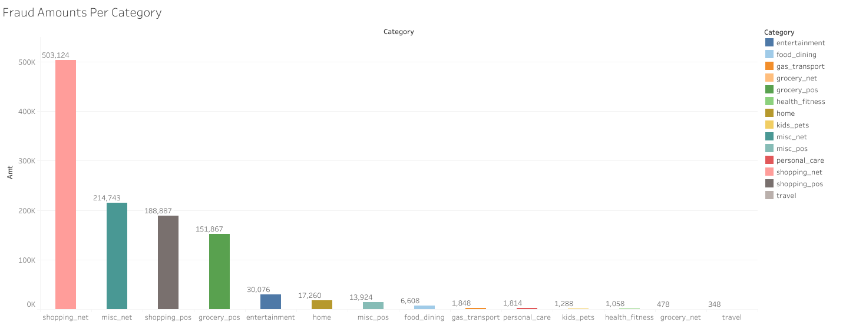

Slide 12
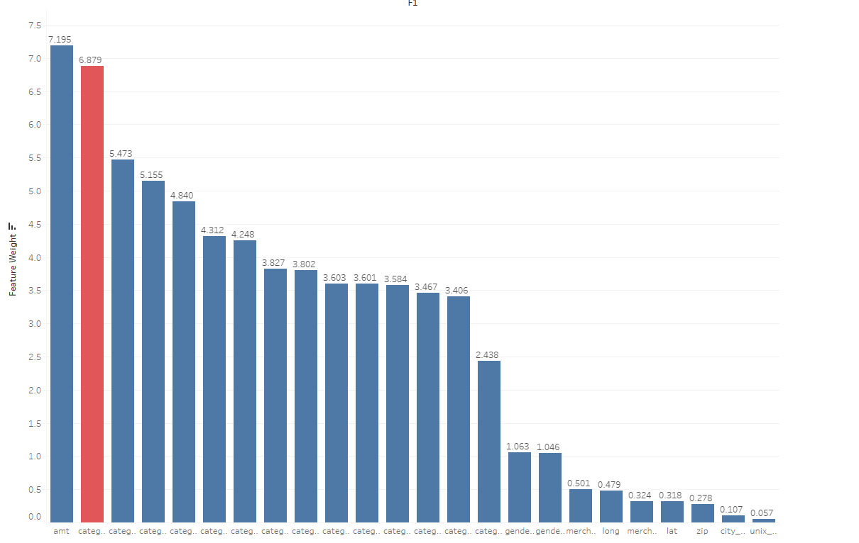
Online Transaction Fraud
Ranked in top 3 in both Random Forest & Neural Network for measured weight
Accounted for over 40% of all money involved in fraudulent transactions

Slide 13

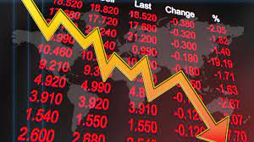

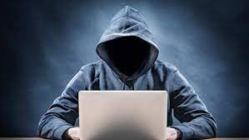

Problem will continue to grow…
Online vs In-Person Shopping
63:37 Ratio in America [4]
Projected $362 Billion In merchant loses [1]
2023-2028
Federal Trade Commission
15% Increase Q4-Q1 in 2023 in fraud [2]
Comparative Ease
Less Validation
Global Reach
Increase in data breaches [3]

Slide 14

Fraud and eCommerce
85% of shopping is done online globally
Latest reports indicate over 48 Billion was lost last year in online shopping
Every 100 dollars lost in fraud equates to nearly 207 lost for the actual business
1 out of every 4 shoppers partake in ‘Friendly Fraud’
Most eCommerce companies use at least 5 different fraud detection tools
55% use credit card verification services.
50% use identity verification services.
44% use two-factor phone authentication.
39% use 3-D secure authentication.
34% use internal customer order history.
The average company manually screens nearly 20% of orders
15% of which end up being fraud [6]

Slide 15
Ways fraud happen
Account Takeover
Exactly what it sounds like. Fraud that happens after a users credentials are stolen and used to make unauthorized purchases. Usually resulting in a chargeback.[5]
Friendly Fraud
When purchases are made online by a consumer who plans on claiming fraud on the purchase, essentially getting free products from businesses and retailers. [5]
Triangulation Fraud
Involves a scammer using a stolen credit card to buy an item from an actual retailer like Amazon. Then the scammer sells these products on a third party site site directly to another consumer. Makes it very hard to detect after products have already been sold to the end consumer.[5]

Slide 16
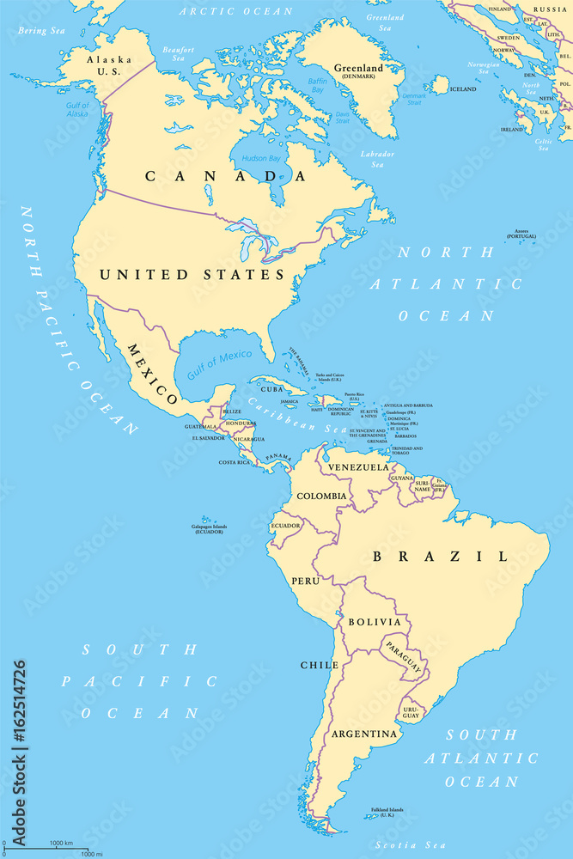
Geographical Breakdowns
North America
Over a third of US consumers have reported being a victim of fraud at one point or another
42% of global fraud occurs in North America
South America
20% of revenue lost to fraud
1 in 25 orders are fraudulent in this region

Slide 17
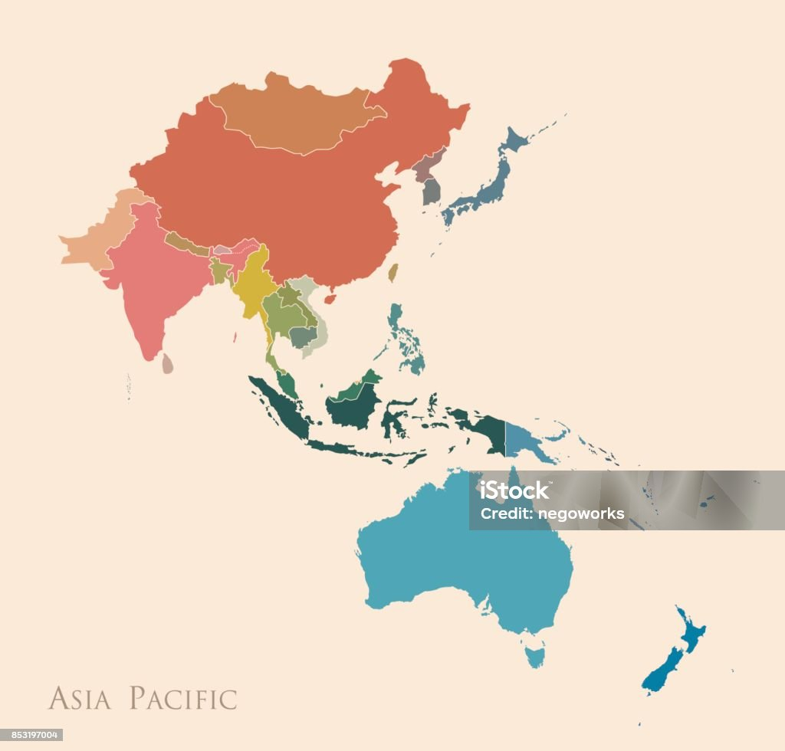
Geographical Breakdowns
Asia accounts for over 60% of retail shopping online - 570% increase since 2016
Fraud losses expected to exceed 200 Billion in 2024
2.6% of orders are flagged as suspected fraud
32% of shoppers abandon orders due to payment issues
47% abandon due to any inconvenience
21% attempt again [7]

Slide 18
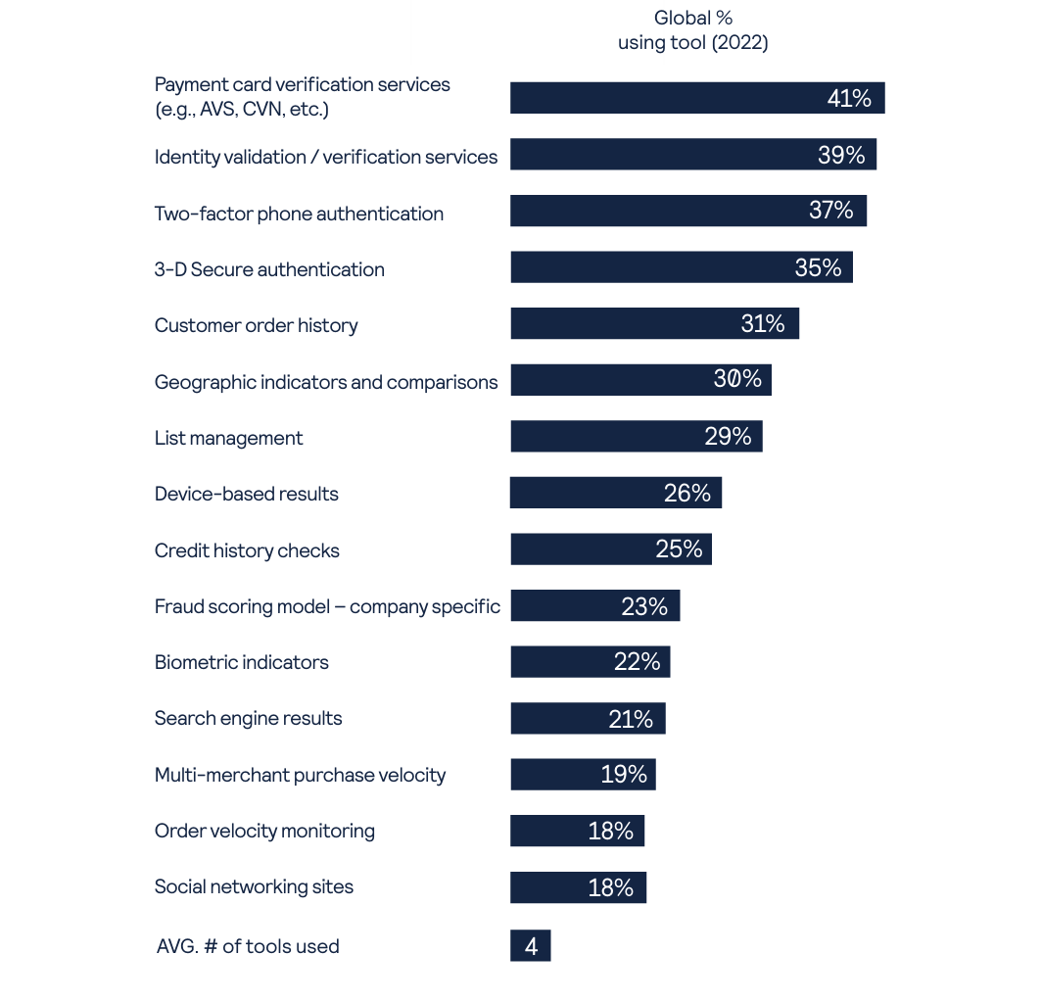
50 Billion dollar market [6]
4 in 10 retailers using machine learning for fraud management as of 2023 [8]

Slide 19
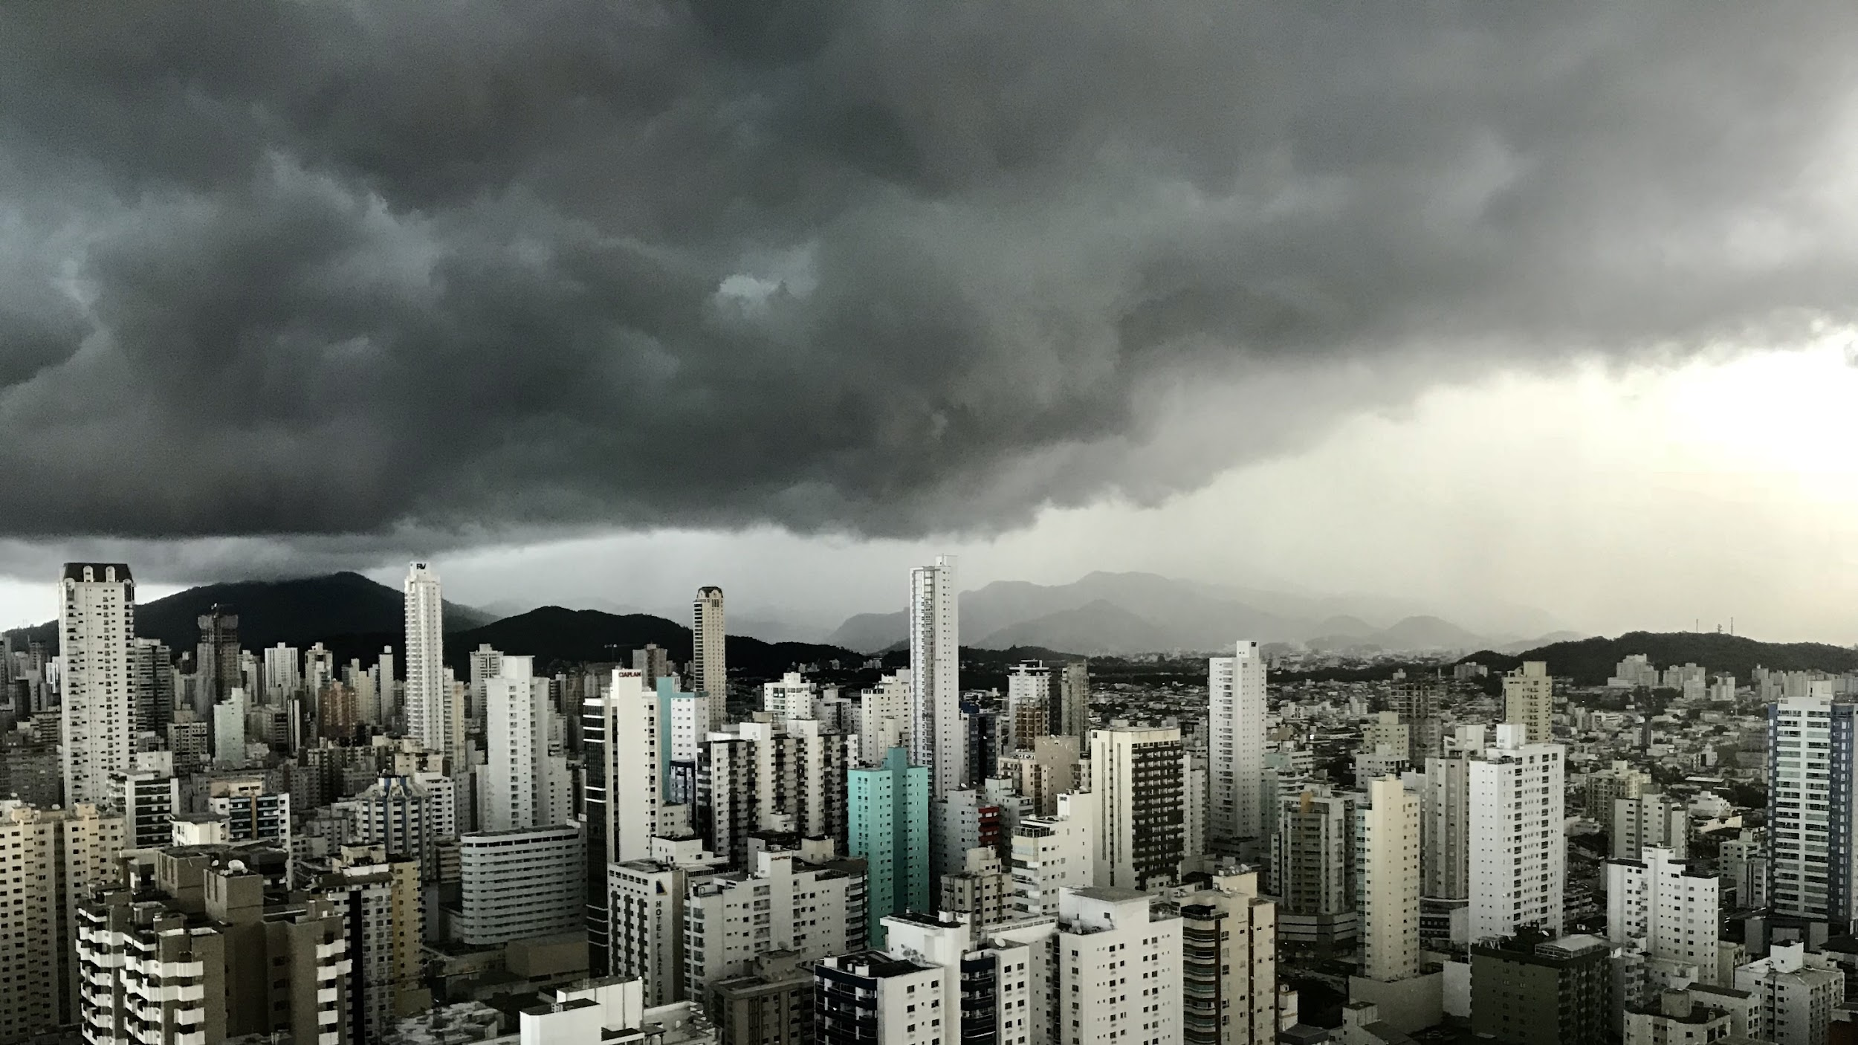

THANK YOU

Slide 20
References
[1] https://www.juniperresearch.com/research/fintech-payments/fraud-identity/online-payment-fraud-research-report/
[2] https://www.findlaw.com/legalblogs/consumer-protection/credit-card-fraud-is-on-the-rise-how-can-you-protect-yourself/#:~:text=According%20to%20the%20Federal%20Trade,the%20first%20quarter%20of%202022.
[3] https://www.thalesgroup.com/en/worldwide/security/press_release/2024-thales-data-threat-report-reveals-rise-ransomware-attacks#:~:text=Malware%20stands%20out%20as%20the,primary%20targets%20for%20such%20attacks.
[4] https://www.mailmodo.com/guides/in-store-vs-online-shopping-statistics/
[5] https://b2b.mastercard.com/news-and-insights/blog/ecommerce-fraud-trends-and-statistics-merchants-need-to-know-in-2024/
[6] https://explodingtopics.com/blog/ecommerce-fraud-stats
[7] https://content.ekata.com/rs/756-OJA-475/images/IG_APAC_Ecommerce_Dos_and%20Dont%27s.pdf
[8] https://www.cybersource.com/en-us/solutions/fraud-and-risk-management/fraud-report.html#cw-243544106

