Slide 1
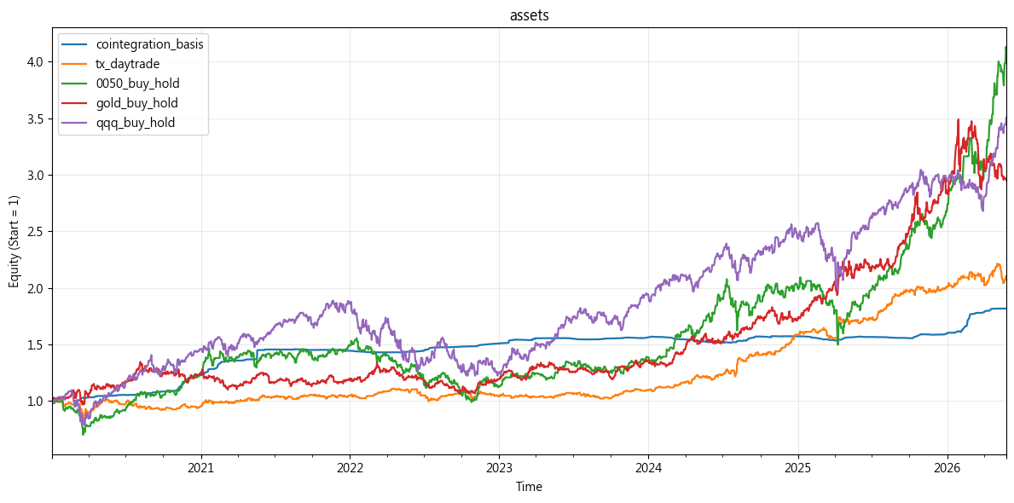
 | Total Return | CAGR | Volatility | Sharpe | Max Drawdown | Max DD Duration | Profit Factor | Win Rate | Odds | Avg Win | Avg Loss | Avg Return (Exp) | Kelly
cointegration_basis | 81.75% | 6.83% | 2.59% | 2.64 | -3.48% | 356 days | 4.14 | 55.61% | 3.31 | 0.10% | -0.03% | 0.04% | 0.42
tx_daytrade | 79.20% | 9.94% | 11.93% | 0.83 | -20.08% | 587 days | 1.26 | 54.13% | 1.07 | 0.66% | -0.62% | 0.07% | 0.11
0050_buy_hold | 310.06% | 25.86% | 22.36% | 1.16 | -36.38% | 779 days | 1.23 | 53.74% | 1.06 | 1.04% | -0.99% | 0.10% | 0.10
sp500_buy_hold | 130.80% | 14.01% | 20.55% | 0.68 | -33.92% | 745 days | 1.15 | 54.42% | 0.97 | 0.83% | -0.86% | 0.06% | 0.07
gold_buy_hold | 195.20% | 18.48% | 18.64% | 0.99 | -20.87% | 1211 days | 1.20 | 55.39% | 0.97 | 0.81% | -0.84% | 0.07% | 0.09
qqq_buy_hold | 250.56% | 21.74% | 24.93% | 0.87 | -35.12% | 715 days | 1.18 | 56.26% | 0.92 | 1.06% | -1.16% | 0.09% | 0.09
bitcoin_buy_hold | 985.48% | 29.32% | 50.17% | 0.58 | -76.63% | 846 days | 1.16 | 50.90% | 1.12 | 2.23% | -2.00% | 0.15% | 0.07
這是投資組合有用到的策略跟資產

Slide 2
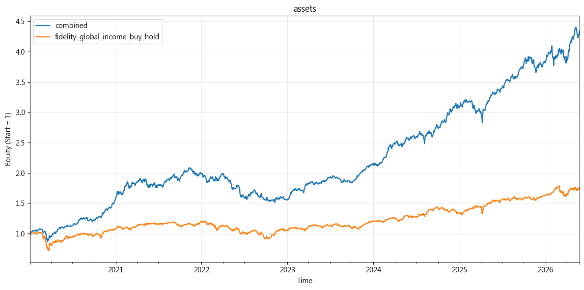
 | Total Return | CAGR | Volatility | Sharpe | Max Drawdown | Max DD Duration | Profit Factor | Win Rate | Odds | Avg Win | Avg Loss | Avg Return (Exp) | Kelly
combined | 332.48% | 17.11% | 11.79% | 1.45 | -27.55% | 752 days | 1.30 | 55.11% | 1.06 | 0.52% | -0.49% | 0.07% | 0.13
fidelity_global_income_buy_hold | 74.09% | 8.76% | 14.63% | 0.60 | -29.60% | 712 days | 1.13 | 53.90% | 0.96 | 0.63% | -0.66% | 0.04% | 0.06
用equal weight組合得到這個combined
用富達全球入息當bench mark

Slide 3
weight
cointegration_basis | 0.166667
tx_daytrade | 0.166667
0050_buy_hold | 0.166667
gold_buy_hold | 0.166667
qqq_buy_hold | 0.166667
bitcoin_buy_hold | 0.166667
Covariance matrix
 | cointegration_basis | tx_daytrade | 0050_buy_hold | gold_buy_hold | qqq_buy_hold | bitcoin_buy_hold
cointegration_basis | 1.000000 | 0.000345 | 0.003447 | 0.015841 | -0.026136 | -0.004634
tx_daytrade | 0.000345 | 1.000000 | 0.379232 | 0.072160 | 0.121226 | 0.053838
0050_buy_hold | 0.003447 | 0.379232 | 1.000000 | 0.086730 | 0.119741 | 0.010159
gold_buy_hold | 0.015841 | 0.072160 | 0.086730 | 1.000000 | 0.121370 | 0.100832
qqq_buy_hold | -0.026136 | 0.121226 | 0.119741 | 0.121370 | 1.000000 | 0.371207
bitcoin_buy_hold | -0.004634 | 0.053838 | 0.010159 | 0.100832 | 0.371207 | 1.000000

Slide 4
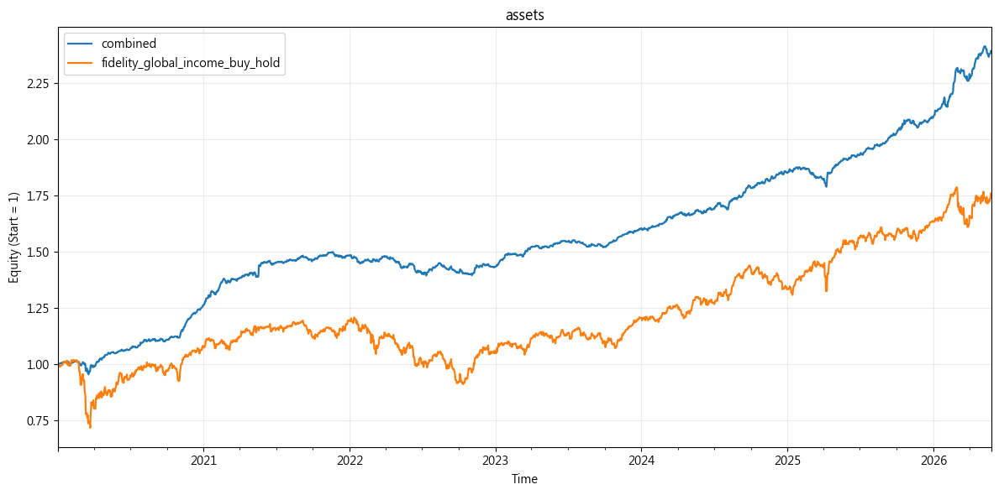
weight
on_basis | 0.617864
tx_daytrade | 0.132459
0050_buy_hold | 0.071635
gold_buy_hold | 0.091073
qqq_buy_hold | 0.060186
bitcoin_buy_hold | 0.026783
這裡是用risk parity做的長這樣
 | Total Return | CAGR | Volatility | Sharpe | Max Drawdown | Max DD Duration | Profit Factor | Win Rate | Odds | Avg Win | Avg Loss | Avg Return (Exp) | Kelly
combined | 139.30% | 9.87% | 3.99% | 2.47 | -6.96% | 481 days | 1.62 | 57.72% | 1.19 | 0.17% | -0.14% | 0.04% | 0.22
fidelity_global_income_buy_hold | 74.09% | 8.76% | 14.63% | 0.60 | -29.60% | 712 days | 1.13 | 53.90% | 0.96 | 0.63% | -0.66% | 0.04% | 0.06

Slide 5
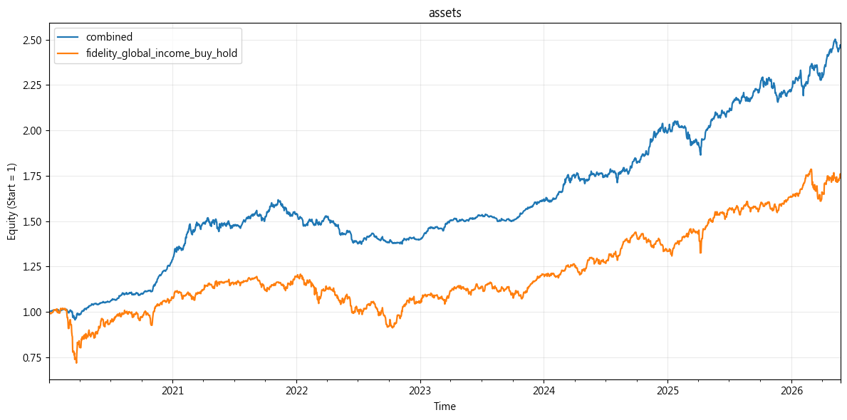
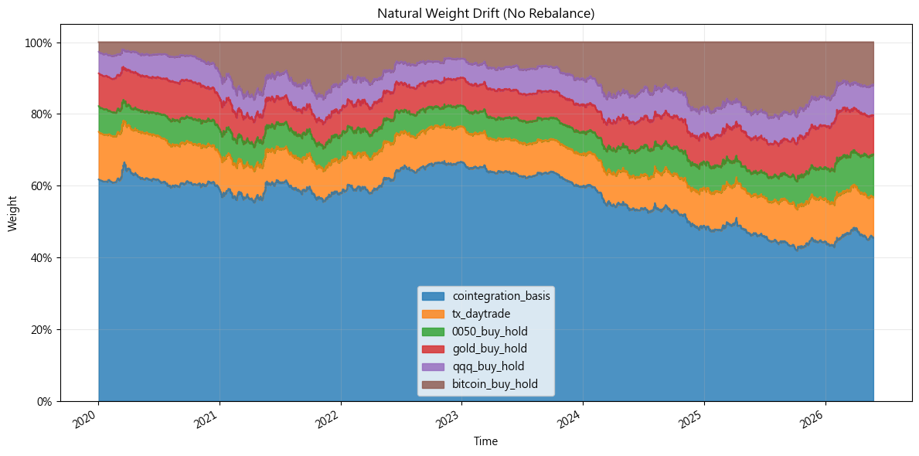
這是自然飄移，不考慮再平衡的長相
 | Total Return | CAGR | Volatility | Sharpe | Max Drawdown | Max DD Duration | Profit Factor | Win Rate | Odds | Avg Win | Avg Loss | Avg Return (Exp) | Kelly
combined | 146.72% | 10.23% | 6.70% | 1.53 | -15.10% | 783 days | 1.32 | 55.33% | 1.06 | 0.30% | -0.28% | 0.04% | 0.13

Slide 6
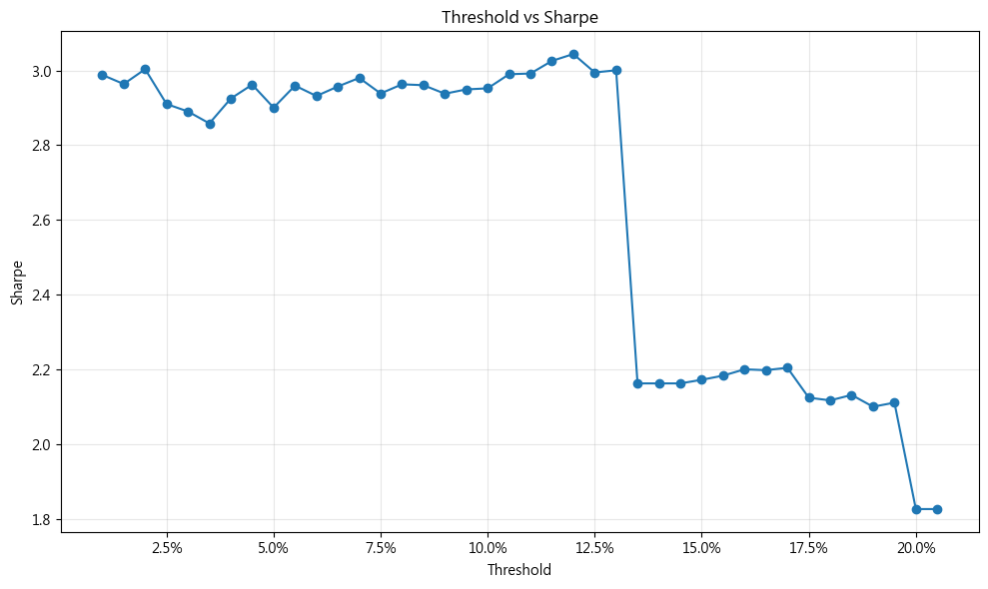
 | 年化報酬 | 年化波動 | Sharpe | MDD | Turnover | 再平衡次數 | 平均 RC 偏離
Threshold
0.010000 | 0.147340 | 0.049309 | 2.99 | -6.97% | 1.88 | 67 | 0.009633
0.015000 | 0.146423 | 0.049406 | 2.96 | -7.19% | 1.29 | 32 | 0.012767
0.020000 | 0.149416 | 0.049748 | 3.00 | -6.58% | 1.23 | 23 | 0.017299
0.025000 | 0.146803 | 0.050445 | 2.91 | -7.82% | 0.91 | 15 | 0.018674
0.030000 | 0.147439 | 0.051013 | 2.89 | -8.07% | 1.01 | 14 | 0.022848
0.035000 | 0.148134 | 0.051827 | 2.86 | -8.28% | 0.75 | 9 | 0.030109
0.040000 | 0.150432 | 0.051433 | 2.92 | -8.22% | 0.94 | 10 | 0.028257
0.045000 | 0.152346 | 0.051432 | 2.96 | -7.62% | 0.87 | 8 | 0.028135
0.050000 | 0.149908 | 0.051685 | 2.90 | -8.20% | 0.68 | 6 | 0.032569
0.055000 | 0.152085 | 0.051390 | 2.96 | -8.07% | 0.76 | 6 | 0.034982
0.060000 | 0.152112 | 0.051886 | 2.93 | -7.82% | 0.64 | 5 | 0.034083
0.065000 | 0.148398 | 0.050184 | 2.96 | -7.54% | 0.42 | 3 | 0.033118
0.070000 | 0.149249 | 0.050083 | 2.98 | -7.39% | 0.45 | 3 | 0.034194
0.075000 | 0.150422 | 0.051192 | 2.94 | -7.18% | 0.33 | 2 | 0.035199
0.080000 | 0.150758 | 0.050881 | 2.96 | -6.99% | 0.34 | 2 | 0.034840
0.085000 | 0.150466 | 0.050823 | 2.96 | -6.99% | 0.35 | 2 | 0.035110
0.090000 | 0.152867 | 0.052035 | 2.94 | -6.71% | 0.39 | 2 | 0.034939
0.095000 | 0.153369 | 0.052001 | 2.95 | -6.71% | 0.40 | 2 | 0.035223
0.100000 | 0.153882 | 0.052125 | 2.95 | -6.71% | 0.41 | 2 | 0.035065
0.105000 | 0.155745 | 0.052090 | 2.99 | -6.57% | 0.44 | 2 | 0.036928
0.110000 | 0.155960 | 0.052128 | 2.99 | -6.57% | 0.45 | 2 | 0.037161
0.115000 | 0.157588 | 0.052086 | 3.03 | -6.52% | 0.47 | 2 | 0.037044
0.120000 | 0.158273 | 0.051995 | 3.04 | -6.48% | 0.49 | 2 | 0.037393
0.125000 | 0.160376 | 0.053552 | 2.99 | -6.53% | 0.51 | 2 | 0.039906
0.130000 | 0.160499 | 0.053491 | 3.00 | -6.53% | 0.52 | 2 | 0.039879
0.135000 | 0.159088 | 0.073574 | 2.16 | -15.33% | 0.33 | 1 | 0.109910
0.140000 | 0.159088 | 0.073574 | 2.16 | -15.33% | 0.33 | 1 | 0.109910
0.145000 | 0.159088 | 0.073574 | 2.16 | -15.33% | 0.33 | 1 | 0.109910
0.150000 | 0.159994 | 0.073663 | 2.17 | -15.33% | 0.33 | 1 | 0.110158
0.155000 | 0.160989 | 0.073743 | 2.18 | -15.33% | 0.34 | 1 | 0.110381
0.160000 | 0.162337 | 0.073790 | 2.20 | -15.33% | 0.35 | 1 | 0.110601
0.165000 | 0.162855 | 0.074105 | 2.20 | -15.33% | 0.36 | 1 | 0.112484
0.170000 | 0.163715 | 0.074277 | 2.20 | -15.33% | 0.37 | 1 | 0.113232
0.175000 | 0.165167 | 0.077765 | 2.12 | -15.33% | 0.38 | 1 | 0.125277
0.180000 | 0.165712 | 0.078283 | 2.12 | -15.33% | 0.39 | 1 | 0.129635
0.185000 | 0.166855 | 0.078287 | 2.13 | -15.33% | 0.40 | 1 | 0.130107
0.190000 | 0.165509 | 0.078820 | 2.10 | -15.33% | 0.42 | 1 | 0.135934
0.195000 | 0.166383 | 0.078828 | 2.11 | -15.33% | 0.42 | 1 | 0.136089
0.200000 | 0.151523 | 0.082987 | 1.83 | -15.33% | 0.00 | 0 | 0.151206
0.205000 | 0.151523 | 0.082987 | 1.83 | -15.33% | 0.00 | 0 | 0.151206
所以我們訓練一個再平衡的threshold

Slide 7
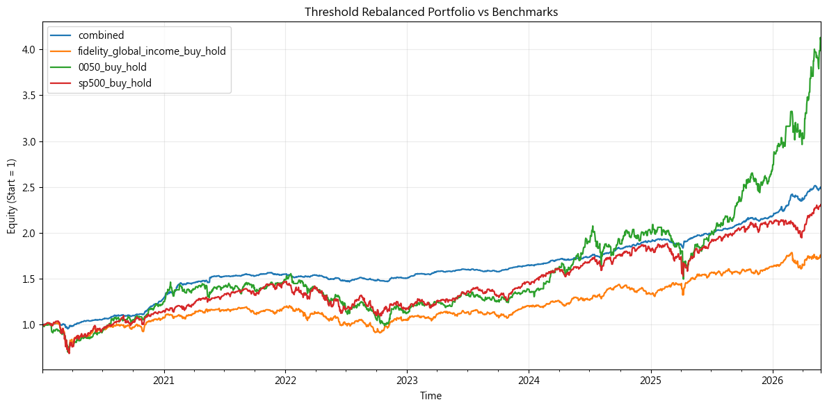
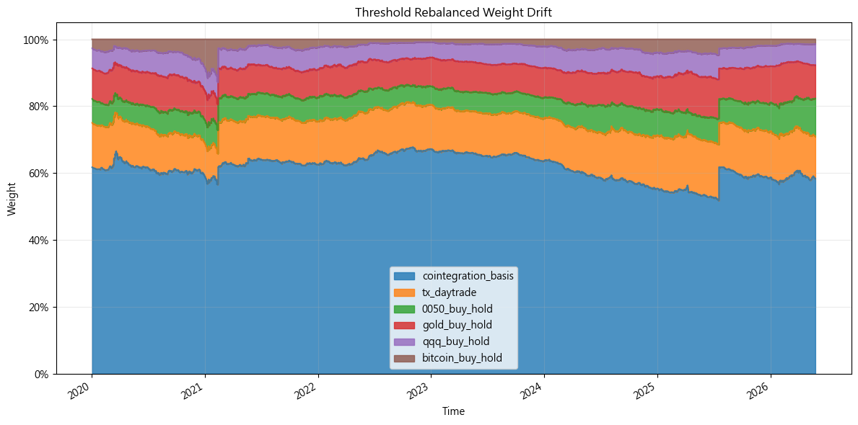
這是最後結果
 | Total Return | CAGR | Volatility | Sharpe | Max Drawdown | Max DD Duration | Profit Factor | Win Rate | Odds | Avg Win | Avg Loss | Avg Return (Exp) | Kelly
combined | 149.97% | 15.40% | 5.10% | 3.02 | -6.45% | 487 days | 1.64 | 57.08% | 1.23 | 0.18% | -0.14% | 0.04% | 0.22
0050_buy_hold | 310.06% | 24.69% | 21.89% | 1.13 | -36.38% | 779 days | 1.23 | 53.74% | 1.06 | 1.04% | -0.99% | 0.10% | 0.10
sp500_buy_hold | 130.80% | 13.97% | 20.51% | 0.68 | -33.92% | 745 days | 1.15 | 54.42% | 0.97 | 0.83% | -0.86% | 0.06% | 0.07
fidelity_global_income_buy_hold | 74.09% | 9.06% | 14.85% | 0.61 | -29.60% | 712 days | 1.13 | 53.90% | 0.96 | 0.63% | -0.66% | 0.04% | 0.06

Slide 8
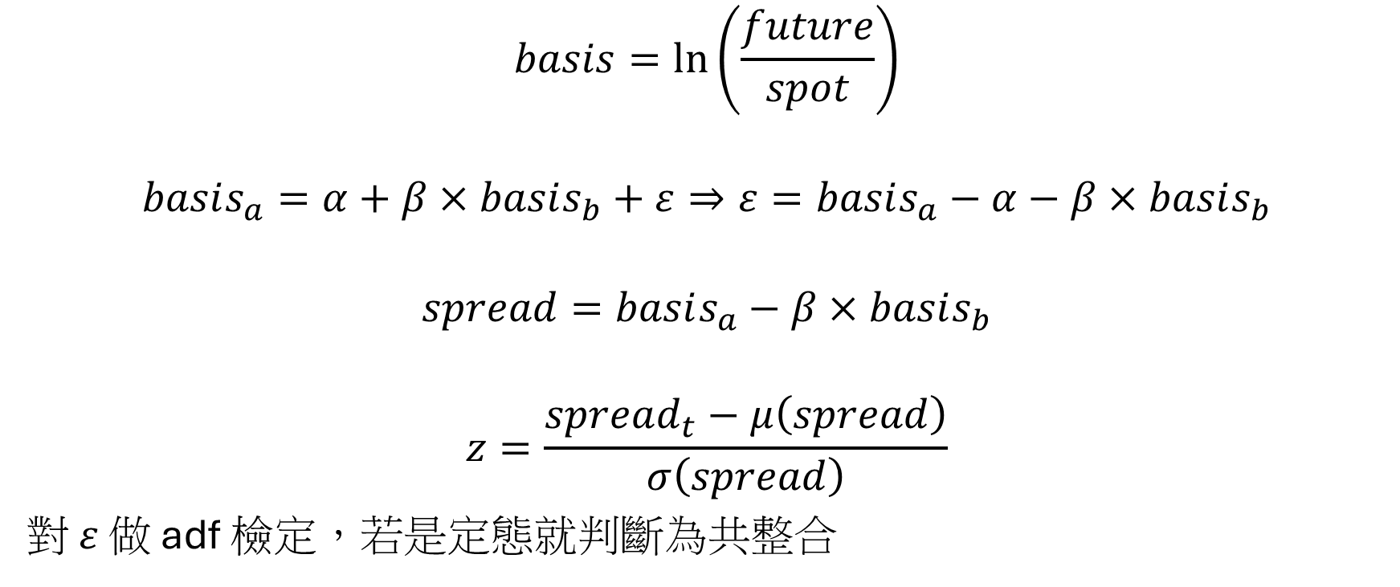
這裡解釋共整合是怎麼出來的
$$basis=\ln\left(\frac{future}{spot}\right)$$
$$basis_{a}=α+β×basis_{b}+ε⇒ε=basis_{a}−α−β×basis_{b}$$
$$spread=basis_{a}−β×basis_{b}$$
$$z=\frac{spread_{t}−μ\left(spread\right)}{σ\left(spread\right)}$$
對 $ε$ 做 adf 檢定，若是定態就判斷為共整合

Slide 9
"Smart Contract Platform": {
"id": "smart-contract-platform",
"symbols": [
"0GUSDT",
"ABEYUSDT",
"ADAUSDT",
"AERGOUSDT",
"AEVOUSDT",
"AIOZUSDT",
"AIUSDT",
"AKTUSDT",
"ALEOUSDT",
]
},
"Layer 1 (L1)": {
"id": "layer-1",
"symbols": [
"0GUSDT",
"ABEYUSDT",
"ADAUSDT",
]
},
"Proof of Work (PoW)": {
"id": "proof-of-work-pow",
"symbols": [
"0XBTCUSDT",
"ABBCUSDT",
"ABEYUSDT",
"ABYUSDT",
"AIONUSDT",
"ALPHUSDT",
因為怕只是湊巧遇到定態，所以用板塊去做配對，避免data mining

Slide 10
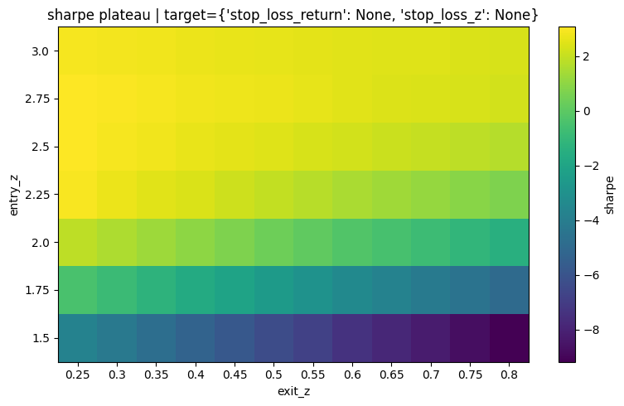
這是訓練的參數，plateau_score = median_sharpe - sharpe_std
entry_z_values = np.arange(1.5, 3.1, 0.25)
exit_z_values = np.arange(0.25, 0.81, 0.05)
這是用rolling windows去做的
這是參數
FORMATION_WINDOW = "60D"
TRADING_WINDOW = "30D"
SCAN_STEP = "30D"
FEE_RATE = 0.0004
STOP_LOSS_RETURN = -0.02
STOP_LOSS_Z = 3.5

Slide 11
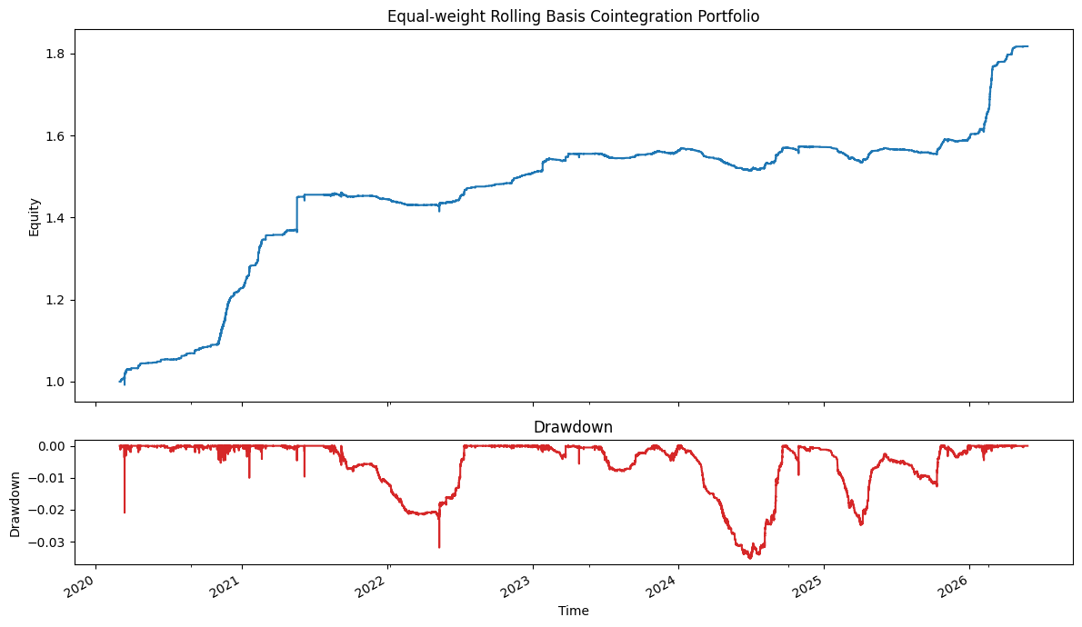
 | total_return | annual_return | annual_volatility | sharpe | max_drawdown | trades | win_rate | avg_active_pairs
value | 0.817525 | 0.100526 | 0.032676 | 3.076452 | -0.035337 | 5596.0 | 0.870979 | 10.0
basis_rows | basis_symbols | funding_rows | funding_symbols | sectors | rolling_pairs | backtested_pair_windows | trades
56075 | 192 | 14970 | 191 | 8 | 1627 | 760 | 5596

Slide 12
這裡解釋台指期當沖怎麼做的
以因子作為排序依據，檢視因子值高低是否對後續當沖報酬具有方向性影響。
流程如下：
計算每筆交易時點的因子值
配對後續當沖報酬率
將報酬率扣除平均值，得到 demeaned return
依照因子值由小到大排序
對排序後的 demeaned return 進行累積加總
觀察累積曲線是否呈現穩定型態

Slide 13
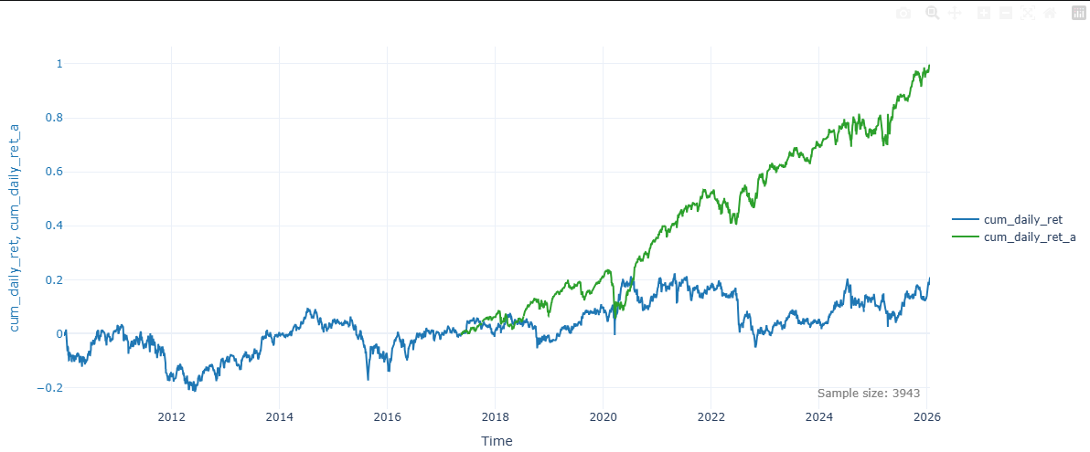
日、夜盤漲跌差很多
推測背後有不同的因子推動，所以分成日、夜盤策略
有後綴_a的是夜盤
綠線：夜盤開盤到收盤的累積報酬
藍線：日盤開盤到收盤的累積報酬

Slide 14
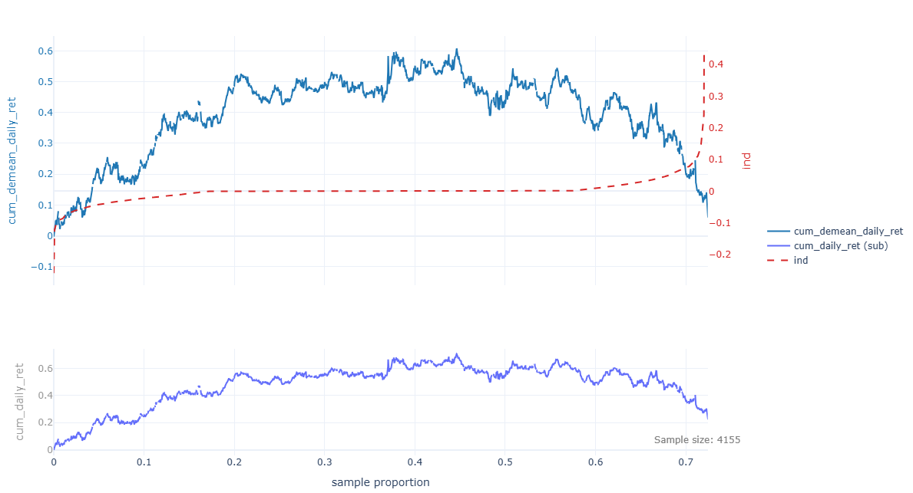
MOVE因子
MOVE = 0.2 × IV_2Y + 0.2 × IV_5Y + 0.4 × IV_10Y + 0.2 × IV_30Y

Slide 15
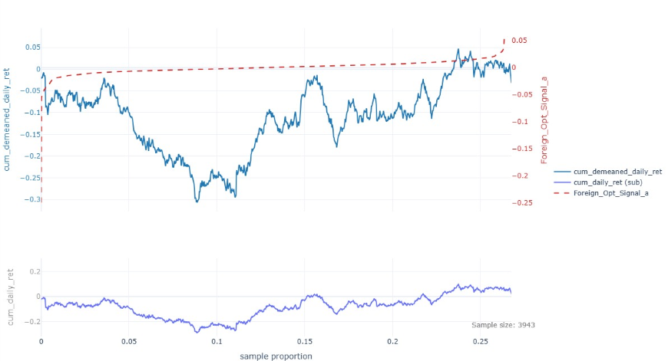

夜盤外資選擇權因子
$$\frac{\left(longCall−shortCall\right)−\left(longPut−shortPut\right)}{longCall+shortCall+longPut+shortPut}$$

Slide 16
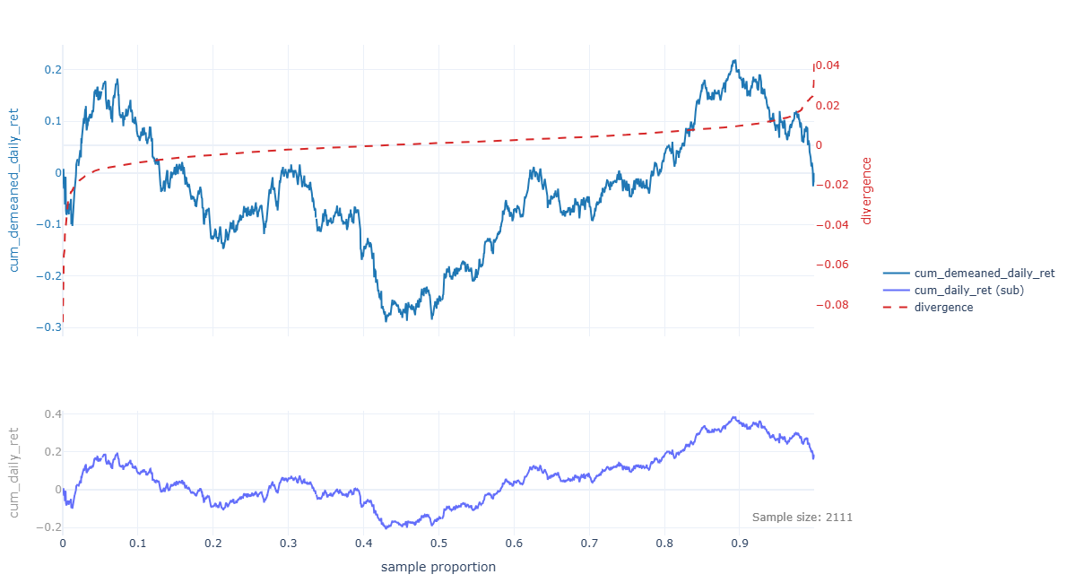

價格乖離
$$\frac{Close_{a}}{ma_{3}}$$

Slide 17
策略邏輯
move_split = df['MOVE_ind'] < 0.0001
gap_s_l = df['gap'] < 0.001
foreign_split = df['Foreign_Opt_Signal_a'] < -0.0035
divergence_f_r = df['divergence'] < -0.0015
# --- execute Layers ---
df.loc[move_split & ~gap_s_l, 'pos_day'] = 1.0
df.loc[move_split, 'pos_day'] = 1.0
df.loc[~move_split & foreign_split, 'pos_day'] = -1.0
df.loc[~move_split & ~foreign_split & ~divergence_f_r, 'pos_day'] = 1.0

Slide 18
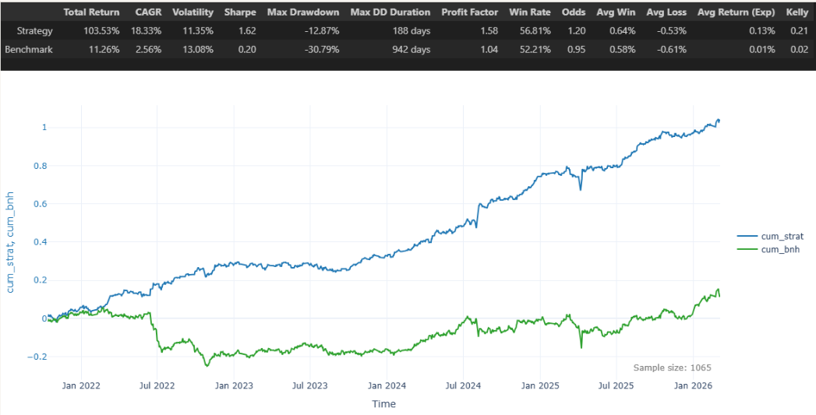
回測結果

