Slide 1
Lecture 4 Cardinality of sets
CSC304
Stephen Lucci

Slide 2
Keywords to Live By
Alphabet
String
Concatenation
Binary Operation
Length of a String
Empty String
Identity
Substring
Prefix
Suffix
Proper Prefix
Proper Suffix
Subword
Kleene Closure
Positive Closure
Language
Language Expression
Palindrome
Problem Specification
Optimization Problem
Travelling Salesman Problem (TSP)
Decision Problem
Language of a Problem

Slide 3
I Want the Punch Line First
This lesson deals with the cardinality of sets.
As a consequence of our discussion, we’ll find that there are more problems in Computer Science than there are algorithms.
Therefore, there must exist problems that are unsolvable.

Slide 4
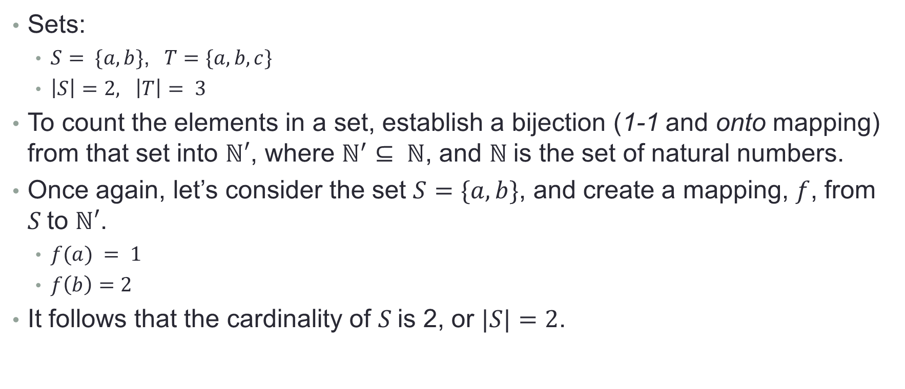
Counting (When it’s not a 4 Letter Word)
Sets:
$S= \{a,b\}$,$T=\{a,b,c\}$
$\left|S\right|=2, \left|T\right|= 3$
To count the elements in a set, establish a bijection (1-1 and onto mapping) from that set into $ℕ′$, where $ℕ^{′}⊆ ℕ$, and $ℕ$is the set of natural numbers.
Once again, let’s consider the set $S=\{a,b\}$, and create a mapping, $f$, from $S$to $ℕ′$.
$f(a) = 1$
$f\left(b\right)=2$
It follows that the cardinality of $S$is 2, or $|S|=2$.

Slide 5
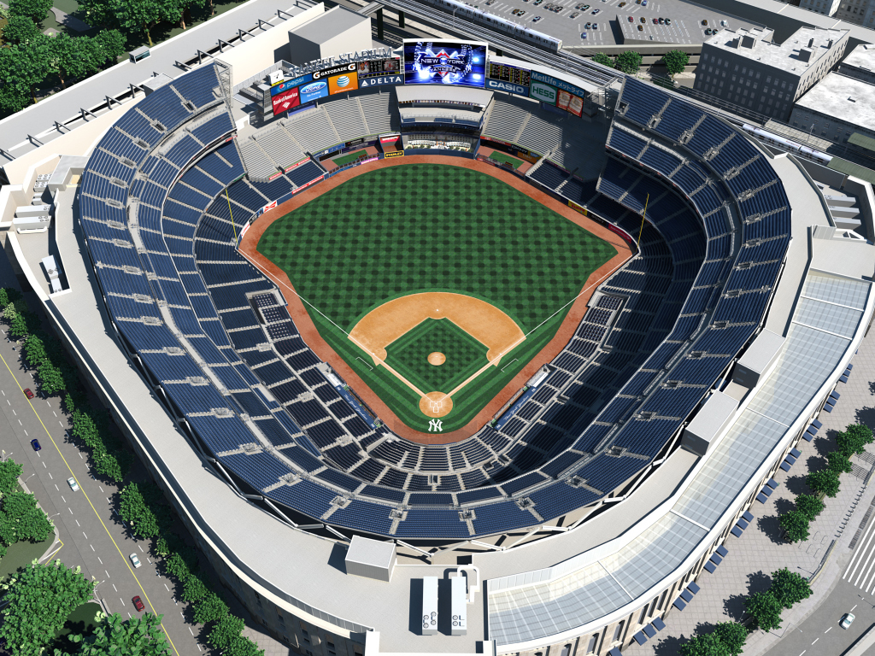
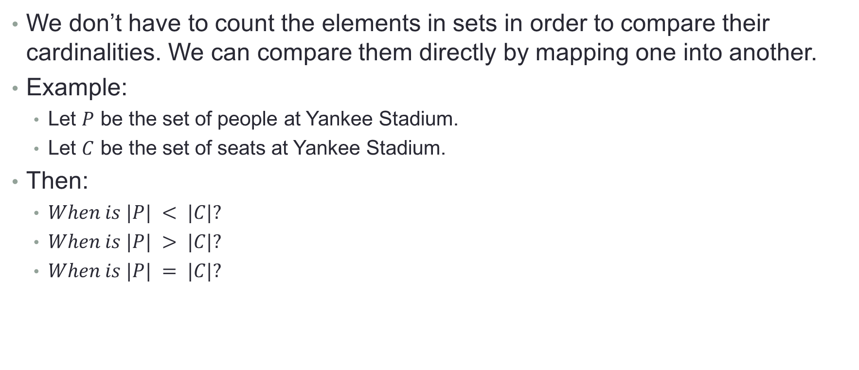
Comparing the Cardinality of Sets
We don’t have to count the elements in sets in order to compare their cardinalities. We can compare them directly by mapping one into another.
Example:
Let $P$ be the set of people at Yankee Stadium.
Let $C$ be the set of seats at Yankee Stadium.
Then:
$When is |P| < |C|?$
$When is |P| > |C|?$
$When is |P| = |C|?$

Slide 6
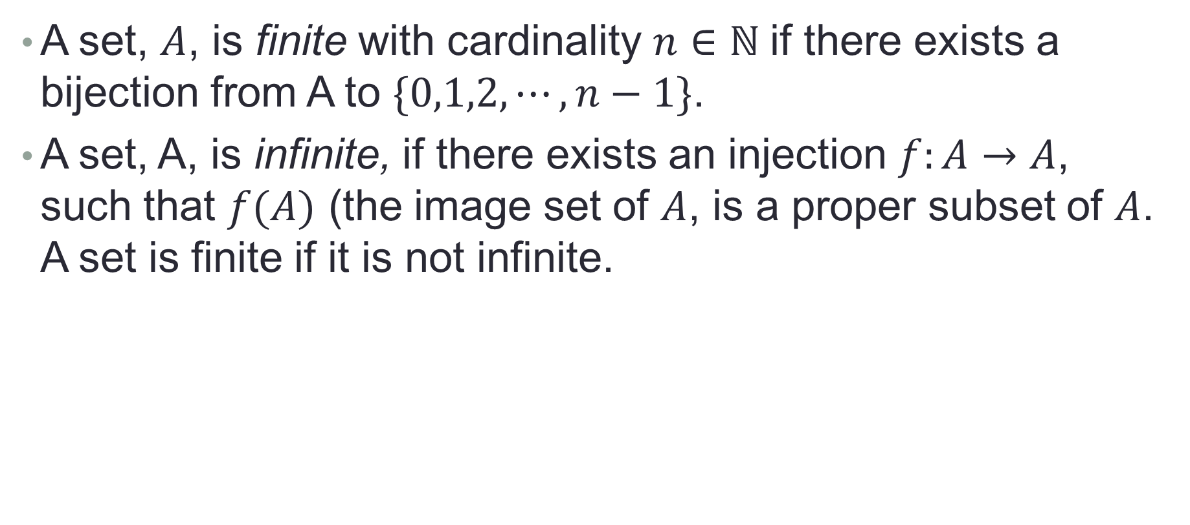
Finite and Infinite Sets
A set, $A$, is finite with cardinality $n∈ℕ$if there exists a bijection from A to $\{0,1,2, ⋯, n−1\}$.
A set, A, is infinite, if there exists an injection $f:A→A$, such that $f(A)$ (the image set of $A$, is a proper subset of $A$. A set is finite if it is not infinite.

Slide 7
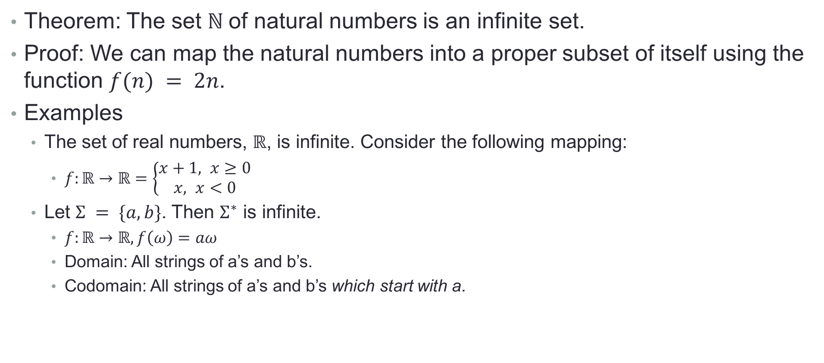
Finite and Infinite Sets
Theorem: The set $ℕ$of natural numbers is an infinite set.
Proof: We can map the natural numbers into a proper subset of itself using the function $f(n) = 2n$.
Examples
The set of real numbers, $ℝ$, is infinite. Consider the following mapping:
$f:ℝ→ℝ=\left\{\begin{aligned}x+1, x≥0 \\ &x, x<0\end{aligned}\right.$
Let $Σ = \{a,b\}$. Then $Σ^{∗}$ is infinite.
$f:ℝ→ℝ, f\left(ω\right)=aω$
Domain: All strings of a’s and b’s.
Codomain: All strings of a’s and b’s which start with a.

Slide 8
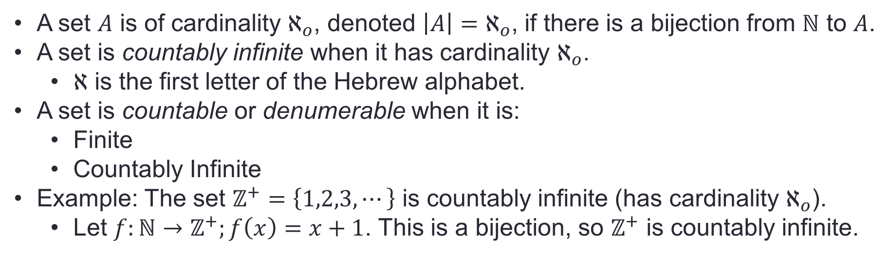
Finite and Infinite Sets
A set $A$ is of cardinality $ℵ_{o}$, denoted $\left|A\right|=ℵ_{o}$, if there is a bijection from $ℕ$ to $A$.
A set is countably infinite when it has cardinality $ℵ_{o}$.
$ℵ$ is the first letter of the Hebrew alphabet.
A set is countable or denumerable when it is:
Finite
Countably Infinite
Example: The set $ℤ^{+}=\left\{1,2,3, ⋯\right\}$ is countably infinite (has cardinality $ℵ_{o}$).
Let $f:ℕ→ℤ^{+};f\left(x\right)=x+1$. This is a bijection, so $ℤ^{+}$ is countably infinite.

Slide 9
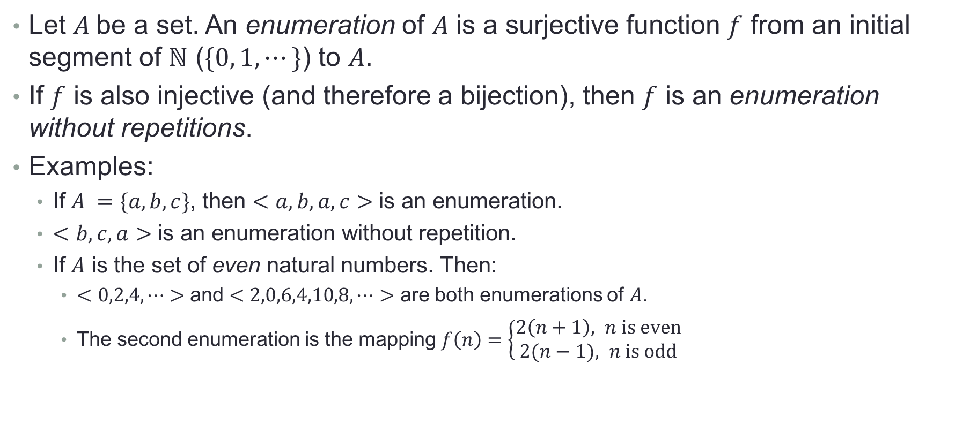
Countable and Uncountable Sets
Let $A$be a set. An enumeration of $A$ is a surjective function $f$ from an initial segment of $ℕ$ ($\{0, 1, ⋯\}$) to $A$.
If $f$ is also injective (and therefore a bijection), then $f$ is an enumeration without repetitions.
Examples:
If $A =\{a,b,c\}$, then $<a,b,a,c>$ is an enumeration.
$<b,c,a>$ is an enumeration without repetition.
If $A$ is the set of even natural numbers. Then:
$<0,2,4,⋯>$ and $<2,0,6,4,10,8, ⋯>$ are both enumerations of $A$.
The second enumeration is the mapping $f\left(n\right)=\left\{\begin{aligned}2\left(n+1\right), n \text{is} \text{even} \\ &2(n−1), n \text{is} \text{odd}\end{aligned}\right.$

Slide 10
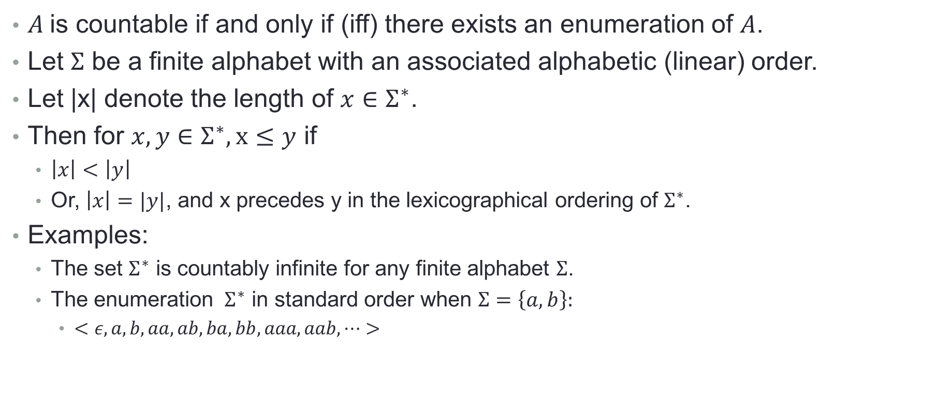
Countable and Uncountable Sets
$A$is countable if and only if (iff) there exists an enumeration of $A$.
Let $Σ$ be a finite alphabet with an associated alphabetic (linear) order.
Let |x| denote the length of $x∈Σ^{∗}$.
Then for $x,y∈Σ^{∗}, x≤y$ if
$\left|x\right|<\left|y\right|$
Or, $\left|x\right|=|y|$, and x precedes y in the lexicographical ordering of $Σ^{∗}$.
Examples:
The set $Σ^{∗}$ is countably infinite for any finite alphabet $Σ$.
The enumeration $Σ^{∗}$ in standard order when $Σ=\left\{a,b\right\}:$
$<ε, a,b,aa,ab,ba,bb,aaa,aab,⋯>$

Slide 11
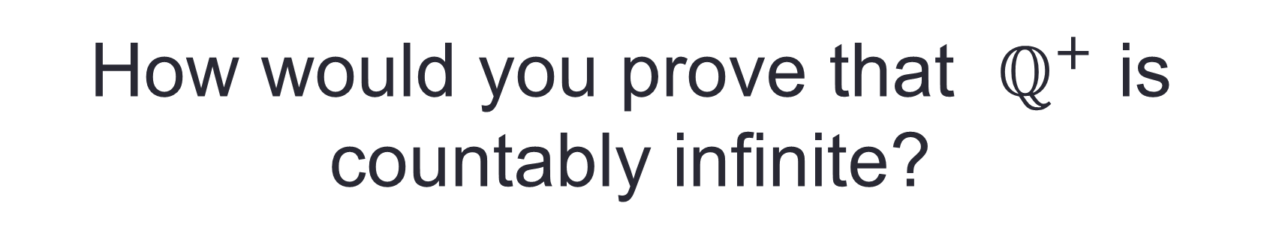
Cardinality of the Rationals
The set of positive rational numbers, $ℚ^{+}$ is countably infinite.
How would you prove that $ℚ^{+}$ is countably infinite?

Slide 12
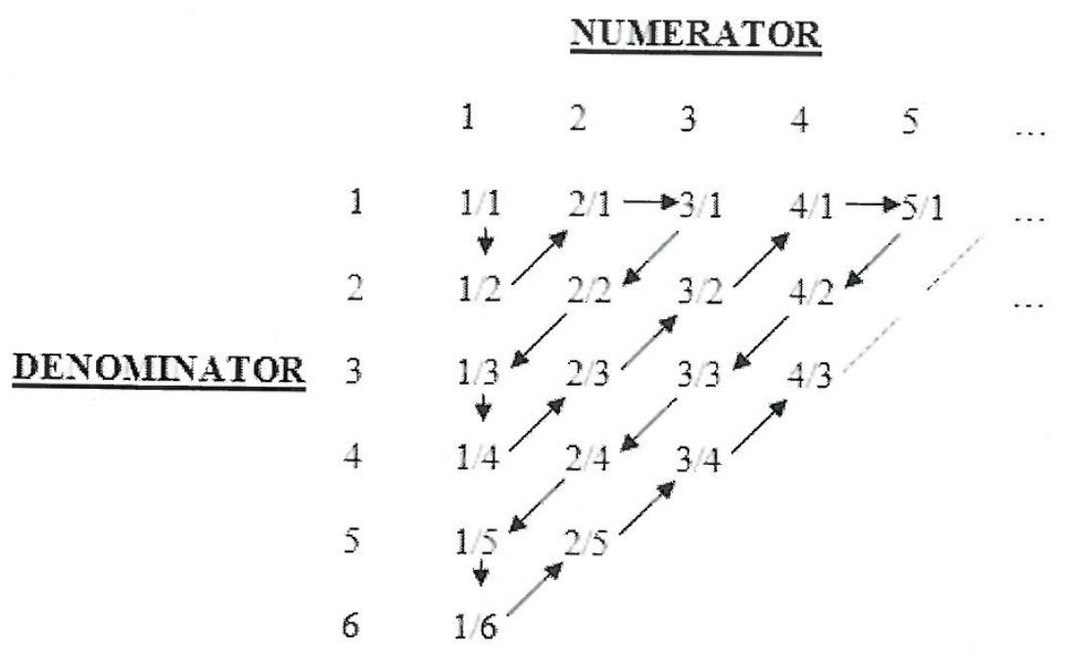
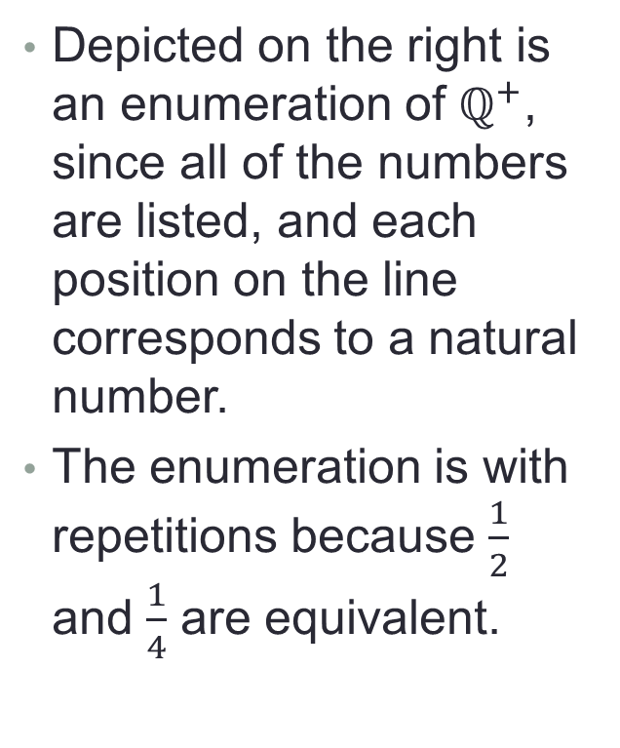
Cantor’s First Diagonalization Proof
Depicted on the right is an enumeration of $ℚ^{+}$, since all of the numbers are listed, and each position on the line corresponds to a natural number.
The enumeration is with repetitions because $\frac{1}{2}$ and $\frac{1}{4}$ are equivalent.

Slide 13
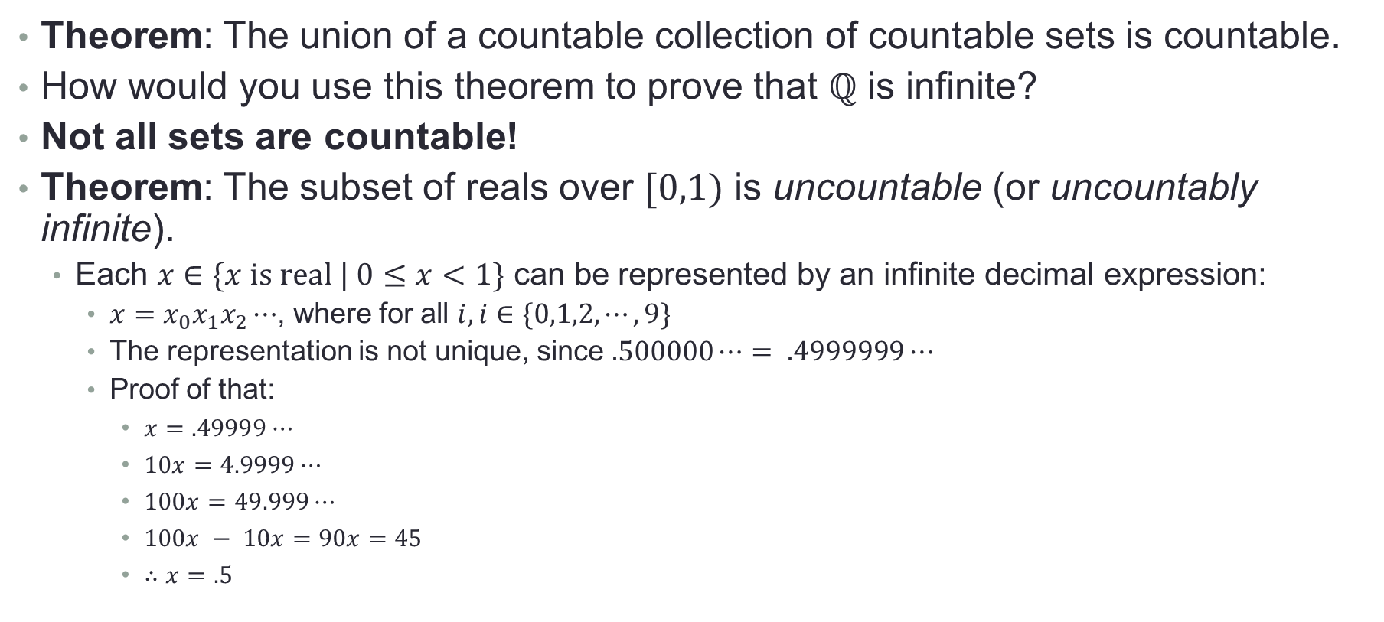
The Reals are Uncountably Infinite
Theorem: The union of a countable collection of countable sets is countable.
How would you use this theorem to prove that $ℚ$ is infinite?
Not all sets are countable!
Theorem: The subset of reals over $[0,1)$ is uncountable (or uncountably infinite).
Each $x∈\{x \text{is} \text{real}\text{ | }0≤x<1\}$ can be represented by an infinite decimal expression:
$x=x_{0}x_{1}x_{2}⋯$, where for all $i, i∈\{0,1,2,⋯,9\}$
The representation is not unique, since $.500000⋯= .4999999⋯$
Proof of that:
$x=.49999⋯$
$10x=4.9999⋯$
$100x=49.999⋯$
$100x − 10x=90x=45$
$∴x=.5$

Slide 14
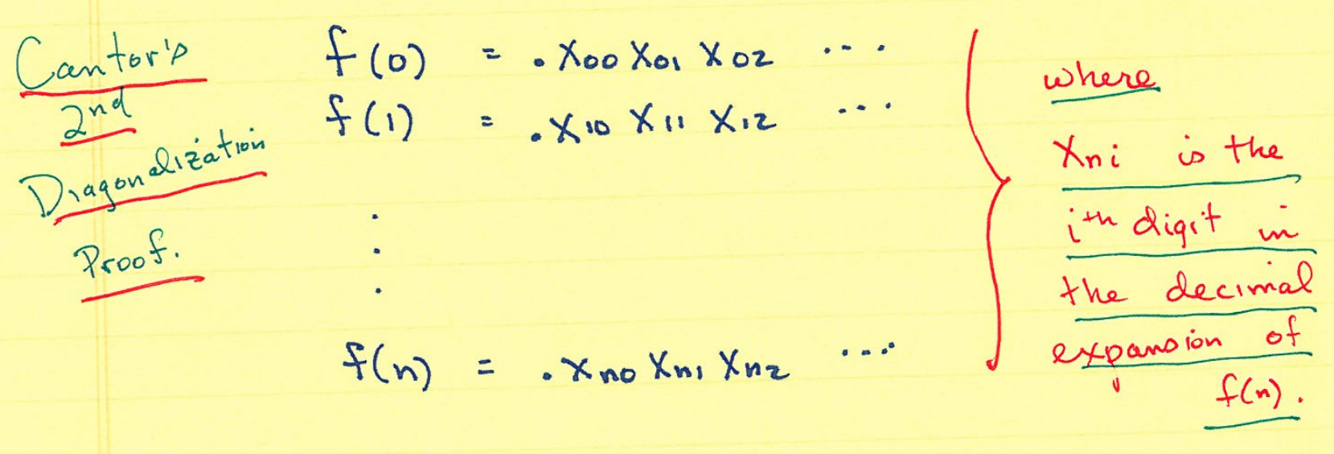
Cantor’s Second Diagonalization Proof
We’ll prove our statement using a Proof By Contradiction.
First, we assume that [0,1) is countable. Since it’s countable, there exists an enumeration for it. We’ll produce it.

Slide 15
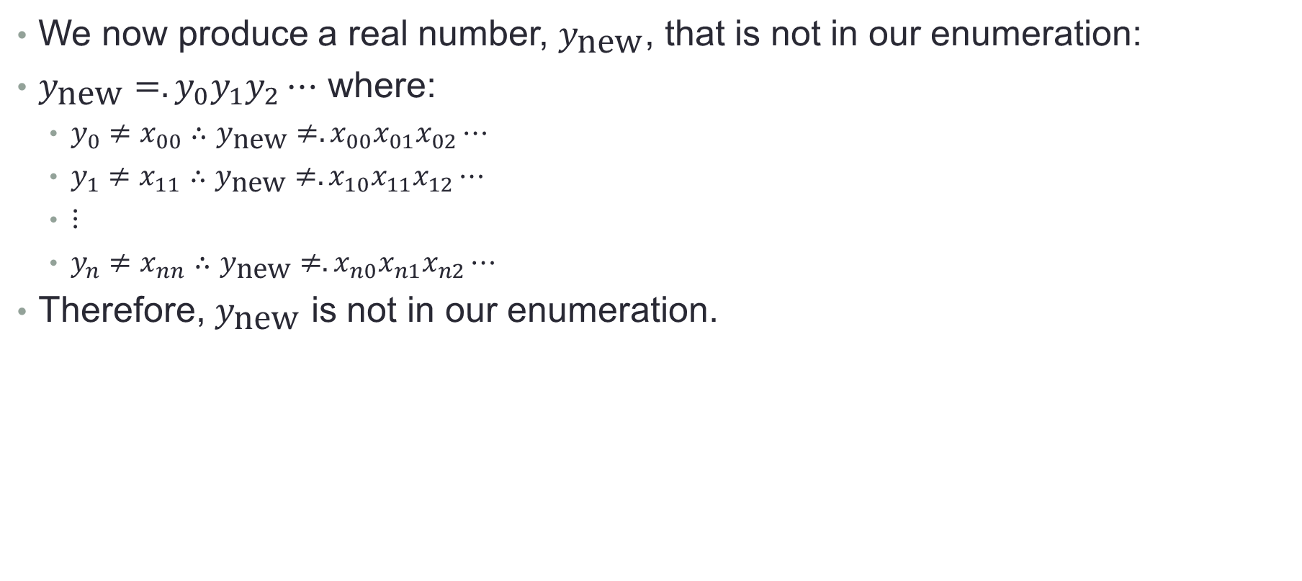
Cantor’s Second Diagonalization Proof
We now produce a real number, $y_{\text{new}}$, that is not in our enumeration:
$y_{\text{new}}=.y_{0}y_{1}y_{2}⋯$ where:
$y_{0}≠x_{00}∴y_{\text{new}}≠.x_{00}x_{01}x_{02}⋯$
$y_{1}≠x_{11}∴y_{\text{new}}≠.x_{10}x_{11}x_{12}⋯$
$⋮$
$y_{n}≠x_{nn}∴y_{\text{new}}≠.x_{n0}x_{n1}x_{n2}⋯$
Therefore, $y_{\text{new}}$ is not in our enumeration.

Slide 16
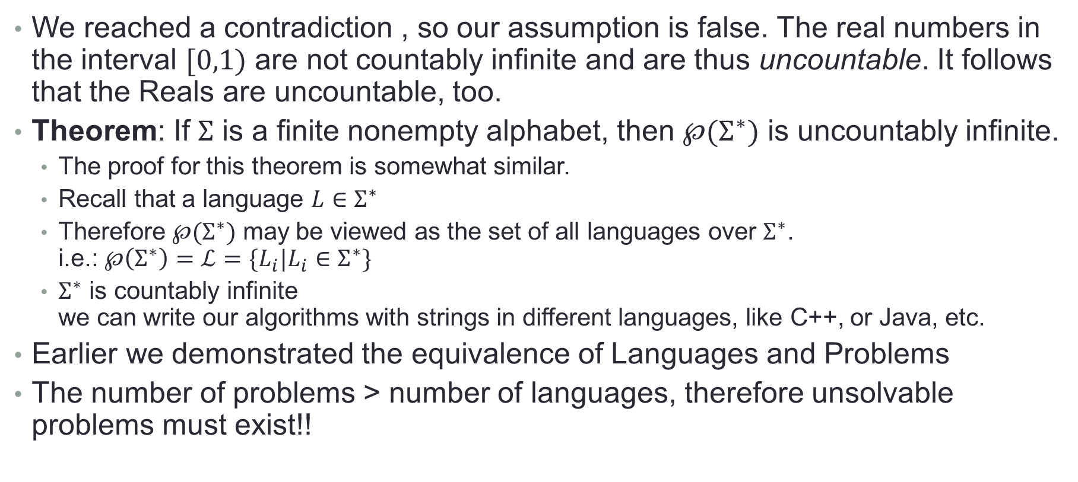
The Reals are Uncountable
We reached a contradiction , so our assumption is false. The real numbers in the interval $[0,1)$ are not countably infinite and are thus uncountable. It follows that the Reals are uncountable, too.
Theorem: If $Σ$ is a finite nonempty alphabet, then $℘(Σ^{∗})$ is uncountably infinite.
The proof for this theorem is somewhat similar.
Recall that a language $L∈Σ^{∗}$
Therefore $℘(Σ^{∗})$ may be viewed as the set of all languages over $Σ^{∗}$. i.e.: $℘\left(Σ^{∗}\right)=ℒ=\{L_{i}|L_{i}∈Σ^{∗}\}$
$Σ^{∗}$ is countably infinite we can write our algorithms with strings in different languages, like C++, or Java, etc.
Earlier we demonstrated the equivalence of Languages and Problems
The number of problems > number of languages, therefore unsolvable problems must exist!!

