Slide 3

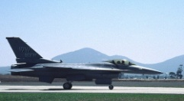

Images
. . .
Extract feature
Features
Sparse representation
Visual Words
Compute histogram
Coefficients Histogram
…

Slide 4
Find domain bins
Training Samples
Feature Extraction
Weight Learning
Visual Words
Test Sample
Feature Extraction
Quantization
Pooling
Classifiers
Confidence
Representing
Classification

