Slide 1
Ad-Hoc query-processing engine
Group: 精卫填海
Members: Xin Jin, Su Zhang

Slide 2

Agenda
Project Overview
High Level Architecture
Query Structure
Internal process of the project
Performance Evaluation
Technologies

Slide 3
Project Overview
Current OLAP query processing struggles with complex queries that require multiple joins and group by, making the queries hard to read and understand, also resulting in slow execution and system overload.
Our Ad-Hoc query solution addresses these issues by decoupling aggregation and grouping variables, enabling internal comparisons within and across different groups. Our Ad-Hoc query processing engine efficiently handles complex queries
Using MF and partially EMF query constructs, to simply query expression And increase efficiency.

Slide 4
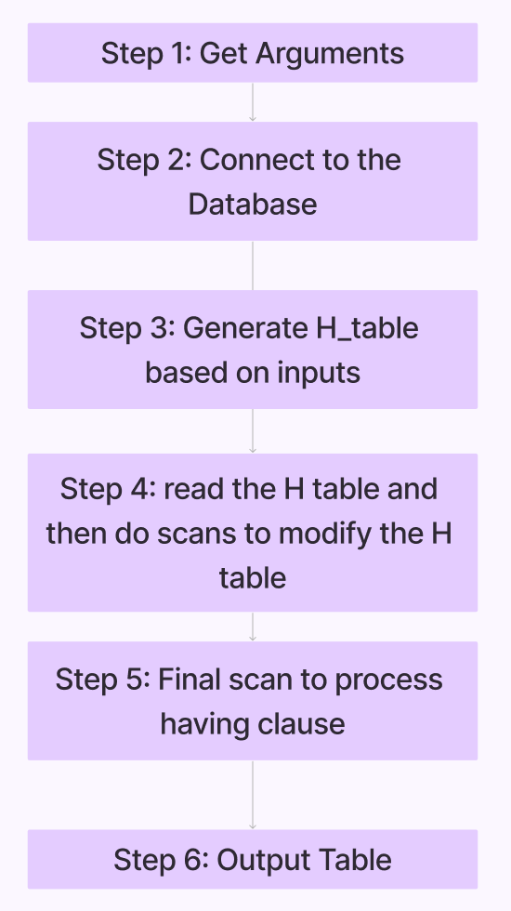

High Level Architecture
Get the Arguments for the Φ Operator: Obtain the six arguments required for the Φ operator either from a file or through manual input.
Connect to the Database: Establish a connection to the PostgreSQL database using the psycopg2 library and import the required data.
Generate Code for Creating Data Structure of the H Table: Define the data structure for the H table based on the grouping attributes and aggregates specified in the Φ operator arguments.
Generate Code Implementing Modified Algorithm: Implement a modified version of Algorithm 3.1 from the second research paper to compute the aggregates for the OLAP queries efficiently.

Slide 5

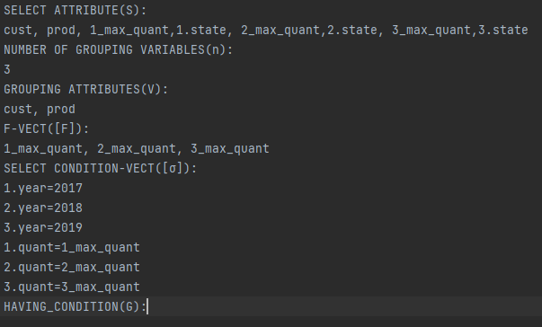
Query Structure and Execution
Queries are imported using either txt format, or manually input.
Queries are presented to the program in a list of parameters to the Phi operator.

Slide 6
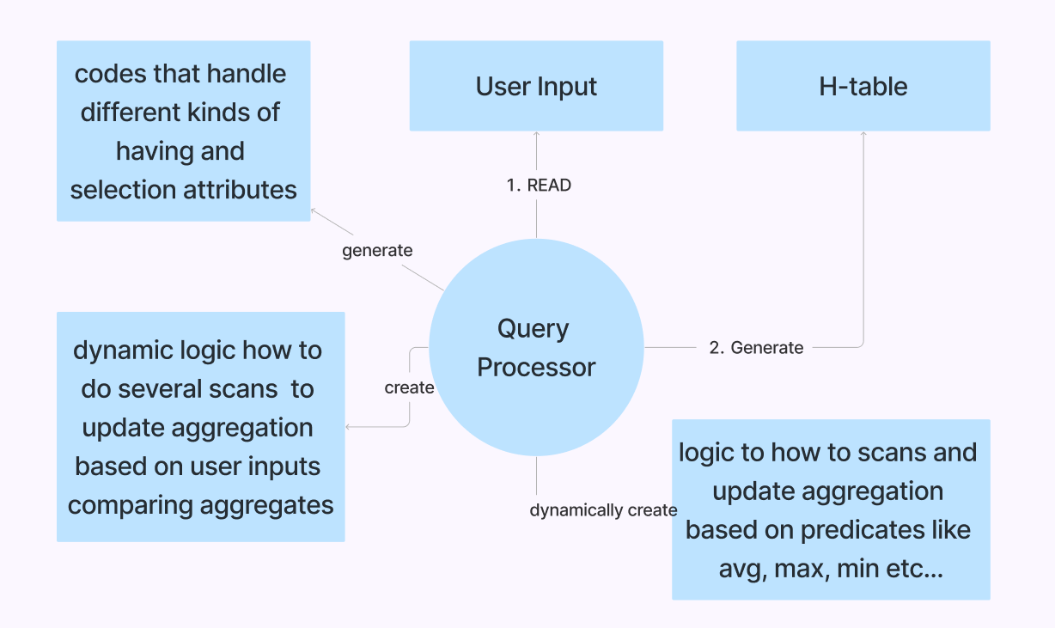
Internal process of the project
Input Handling:
Processing Arguments:
Generating Phi Operator Arguments:
Generating Phi Operator Body:
Generating H Table Class:
Aggregation Code Generation:
Second Scan:
Output Generation:
Execution:

Slide 7
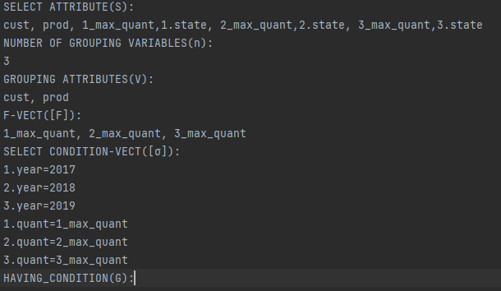
Performance Evaluation
Our ad-hoc processor engine swiftly executes the query, generating results in under 1 second. In contrast, the SQL query, albeit functional, requires approximately 27 seconds to produce output."

Slide 8
Technologies for the project
Python: programming language.
PostgreSQL: database system.
Psycopg2: Python-PostgreSQL database adapter for connecting and operating.
Pytest: testing framework for python test.
Python-dotenv: Library for loading environment variables.
Tabulate: utility for formatting output tables in a human readable form.

Slide 9
Technical Limitation
In traditional SQL, the GROUP BY operation may display multiple values in cases of duplicates. However, in our project, we address this limitation by employing a single scan approach that retrieves the most recent entry, ensuring that only one result is displayed even in cases of duplicates.
In our system, there's a requirement to calculate aggregations upfront before utilizing them for subsequent scans. This process can be computationally intensive, especially for aggregations like averages, which necessitate storing sum and count variables to compute the average at the end.

Slide 10

Thank you
Xin Jin, Su Zhang

