Slide 1
Probabilistic grammars for equation discovery
Jure Brence, Ljupco Todorovski, Saso Dzeroski
Knowledge-Based Systems
Yucong He
20241022

Slide 2

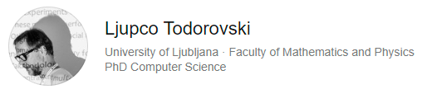

Authors
Notes:
Jure:
Jožef Stefan Institute研究助理
应该是saso的博士生
哲学博士
Ljupco:
斯坦福博士后，University of Ljubljana信息学教授，
主要兴趣是Machine Learning
Computational Scientific Discovery Equation discovery Learning Models of Dynamic Systems (Process-Based Modeling) Learning Declarative Bias for Process-Based Modeling Meta-Level Learning and Combining multiple classifiers
Sašo Džeroski 是约瑟夫·斯蒂芬研究所 (斯洛文尼亚卢布尔雅那) 知识技术系主任，也是约瑟夫·斯蒂芬国际研究生院的全职教授。他还是欧洲航天局 (意大利弗拉斯卡蒂) 的客座教授。他是欧洲人工智能协会 (EurAI) 的研究员，以表彰他在“人工智能领域的开创性工作”。他是马其顿科学与艺术学院院士和欧洲科学院院士。他的工作重点是科学人工智能。他与他的团队开发了机器学习方法，这些方法可以在有领域知识的情况下从复杂数据中学习可解释的模型：这些方法包括多目标预测、半监督和关系学习以及从数据流中学习的方法。他还开发了计算科学发现的方法，包括学习动态系统可解释模型的方法。这些方法已成功应用于许多不同的应用领域（环境科学，包括生态学/生态建模，以及生命科学，包括系统生物学/系统医学）。他参与了许多国际和国家研究项目，目前包括欧盟资助的项目 TAILOR、ELIAS、ASSAS、PARC 和 INQUIRE。他组织了许多重要的国际会议，包括 ECML PKDD 2017、ICML 2005 和 1999、DS 2019 和 2014、MLSB 2010 和 2009 以及 ILP 1999 和 1997。

Slide 3





Equation Discovery and ILP
Equation Discovery： Based on Background Knowledge, find an Equation that accurately describes a Phenomenon (observed data) by automatically generating mathematical formulas.
+, ×
h = v×t
v = a×t
🍎
$$\&$$
$$h=\frac{1}{2}×g×t^{2}$$
$$⇒$$
m = 0.2 kg
h = 9.8 m
t = 1 s
g = 9.8 m/s²
🌏
Equation
BK
Phenomenon
observed data
B
$$∪$$
H
$$⊢$$
E
ILP: Based on Background Knowledge, find an Hypothesis that accurately prove the Example.
Notes:
公式发现和逻辑推理的关系

Slide 4
Outline
Context-free grammars - Context-free grammars - Probabilistic context-free grammars
Grammar-guided equation discovery - Settings - Monte-Carlo sampling
Theoretical analysis

Slide 5
Context-free grammars

Slide 6

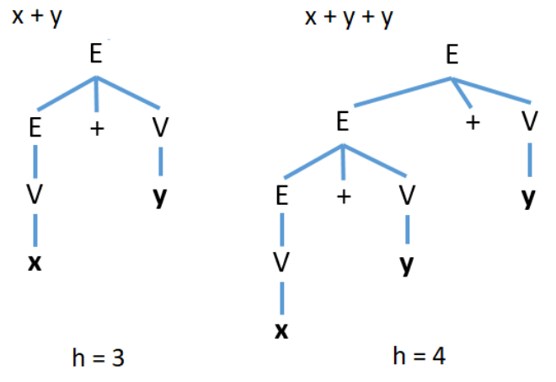
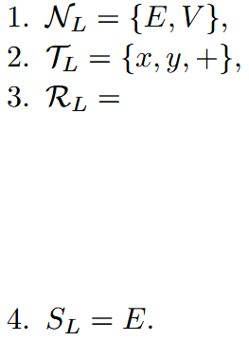
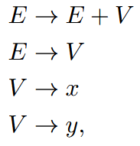

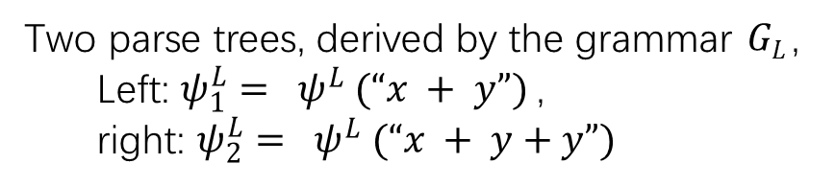
Context-free grammars
Two parse trees, derived by the grammar $GL$,
Left: $ψ_{1}^{L}= ψ^{L} (“x + y”)$,
right: $ψ_{2}^{L}= ψ^{L} (“x + y+y”)$

Slide 7


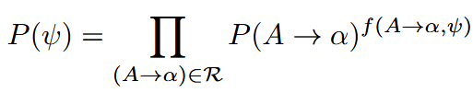




Probabilistic context-free grammars

Slide 8

Probabilistic context-free grammars

Slide 9
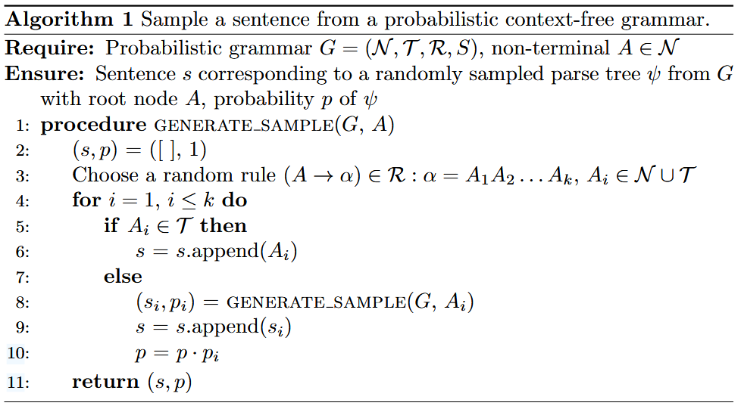
Generate samples

Slide 10
Grammar-guided equation discovery

Slide 11
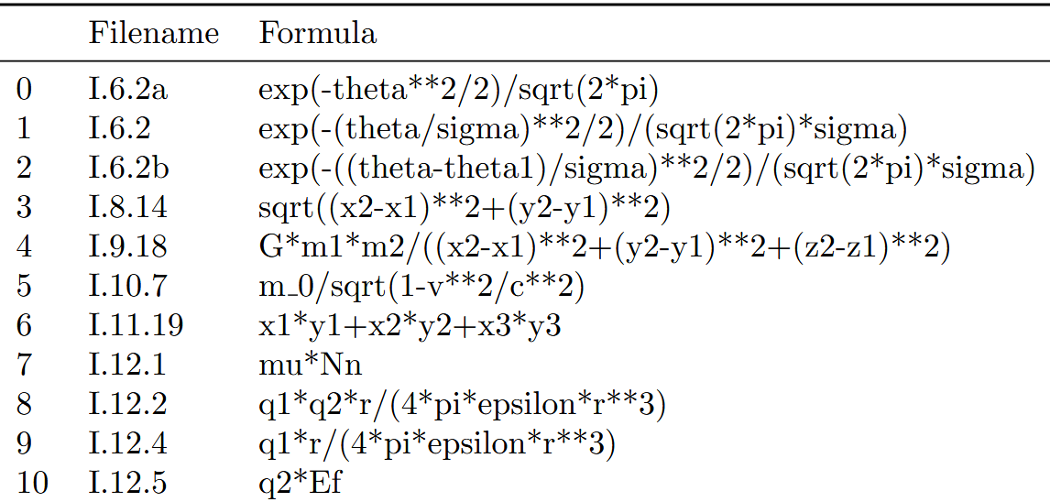
Feynman database
100 formulas in total

Slide 12
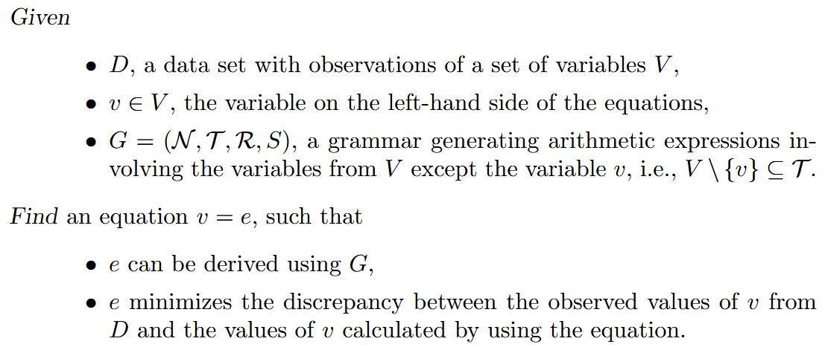
Settings

Slide 13

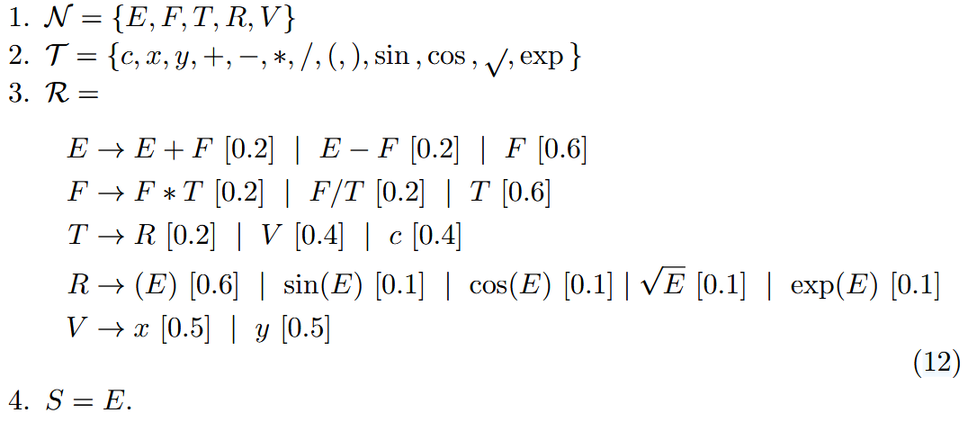
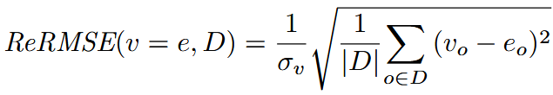
Settings

Slide 14
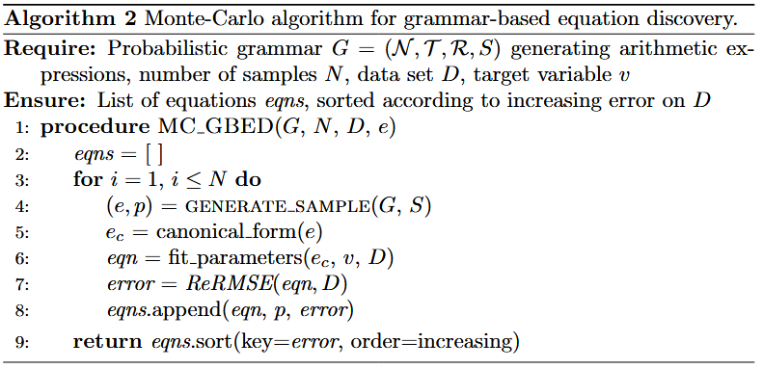
Monte-Carlo sampling algorithm
Algorithm1

Slide 15
Theoretical analysis

Slide 16



Two groups of analyses
Deterministic grammar & Probabilistic context-free grammars
Biased probabilistic grammar & Unbiased probabilistic grammar
[0.3]
[0.1]

Slide 17



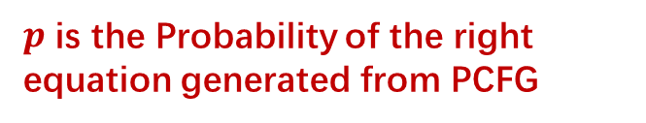
Expected number of equations
The Expected Number of parse trees we have to sample from a given grammar
1. Model the sampling of parse trees from a given PCFG as a Bernoulli process
$p$ is the Probability of the right equation generated from PCFG
2. Dealing with a deterministic grammar
N_{G}(h) : Number of Trees with height from 2 to h
n_{G}(h) : Number of Trees with height of h

Slide 18
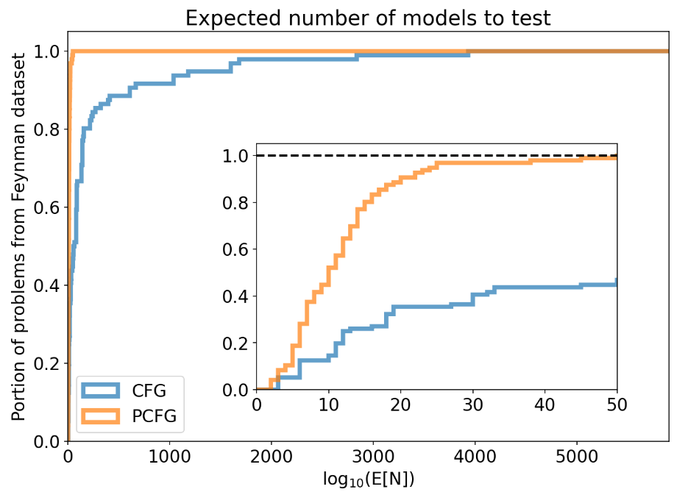

Probabilistic vs deterministic
We are interested in how many of the target equations from the Feynman database we can expect to reconstruct by taking at most n sample parse trees from a given grammar.

Slide 19



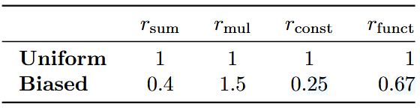
Biased vs. unbiased probabilistic grammar

Slide 20
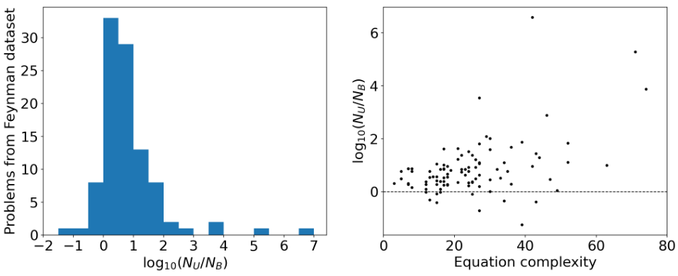
Biased vs. unbiased probabilistic grammar
N_{B} < N_{U}
N_{B} < N_{U}

Slide 21
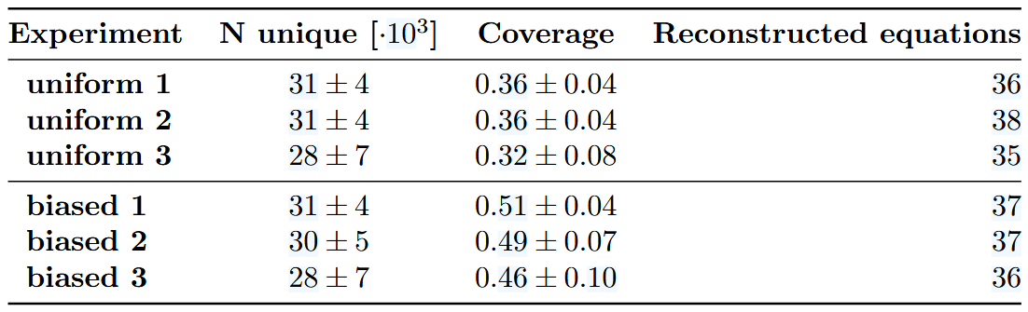
Result

Slide 22
Conclusion
Equation Discovery is an ILP Problem
PCFG can reduce the expected number of equations needed to be reconstructed
Algorithms can be improved by encoding background into PCFG
The task of formula discovery cannot be solved using PCFG alone

