Slide 1
Automated Theorem Proving, ATP
YucongHe
2024/7/26

Slide 2
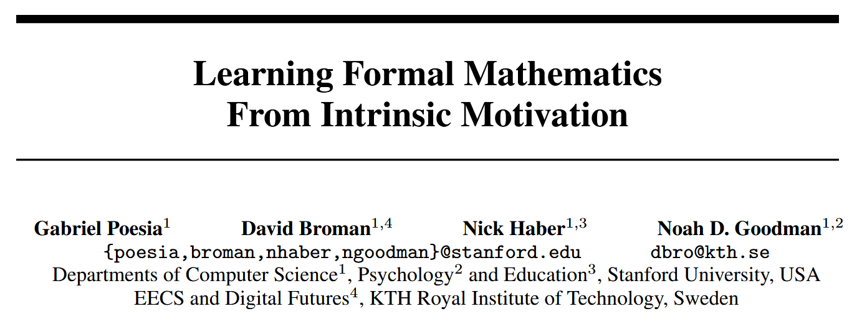
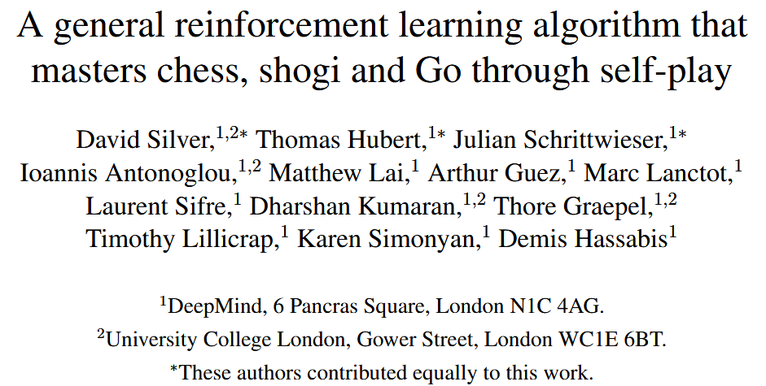
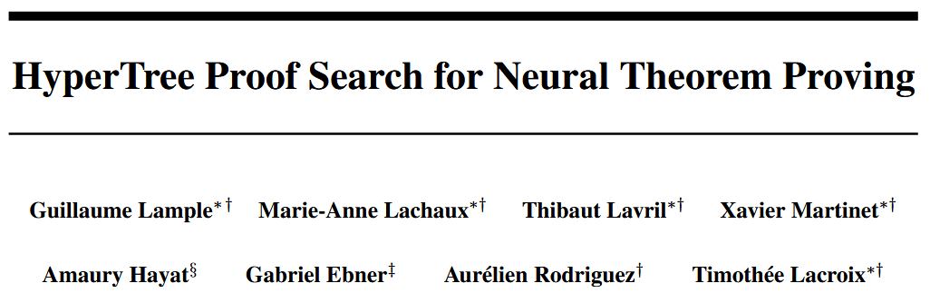

Slide 3
History of Automated Theorem Proving
is (x+y)×z = x×z+y×z right ?
Logic Theory Machine
(Newell and Simon)
Reinforcement learning:
AlphaZero
Interactive Theorem Provers
1950s
1960s
1980s
2000s
2010s
Resolution Principle and Standardization
Deep learning
Main Conference:
Artificial Intelligence and Theorem Proving AITP 9th
Conference on Intelligent Computer Mathematics CICM 17th

Slide 4
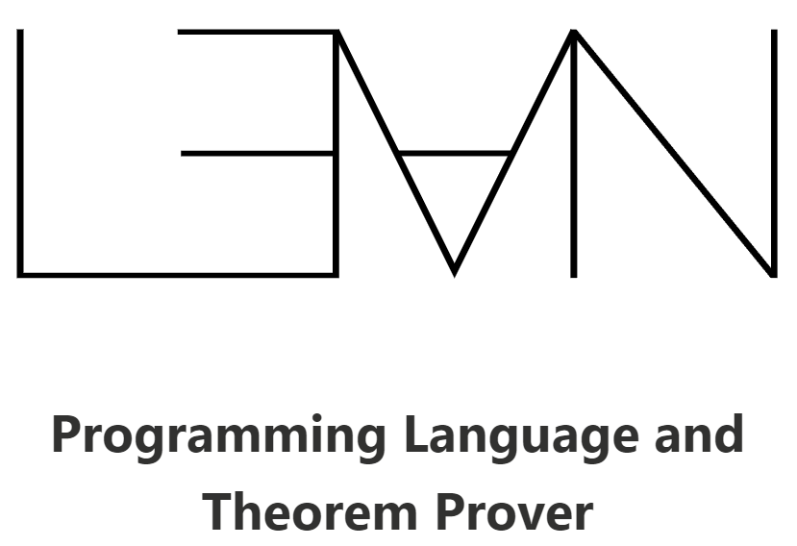
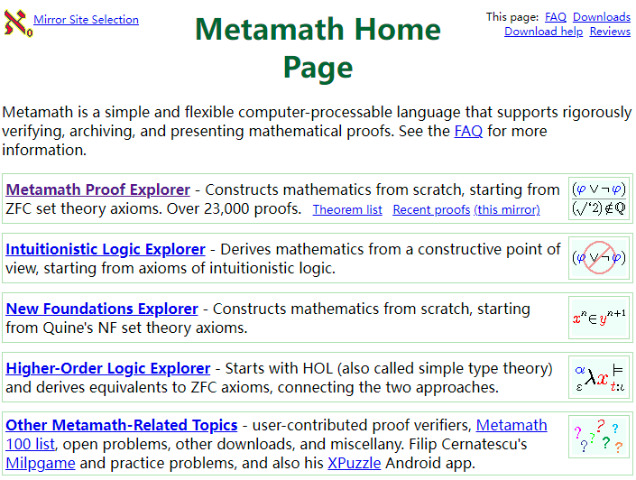

Conferences
Metamath 是一种简单而灵活的计算机可处理语言，支持严格验证、存档和呈现数学证明。
Mathlib是一个开放源代码项目，旨在为Lean 构建一套完整的数学理论库。 它涵盖了广泛的数学领域，包括算术、代数、几何、逻辑和实分析等，并且还在持续增长中。
Mizar 是一个著名的形式化证明系统，已有几十年的发展历史，拥有一个庞大的数学定理库

Slide 5
AlphaZero (2018)
David Silver et al. , A general reinforcement learning algorithm that masters chess, shogi, and Go through self-play. Science, 362,1140-1144(2018).
Notes:
谷歌下属公司Deepmind

Slide 6
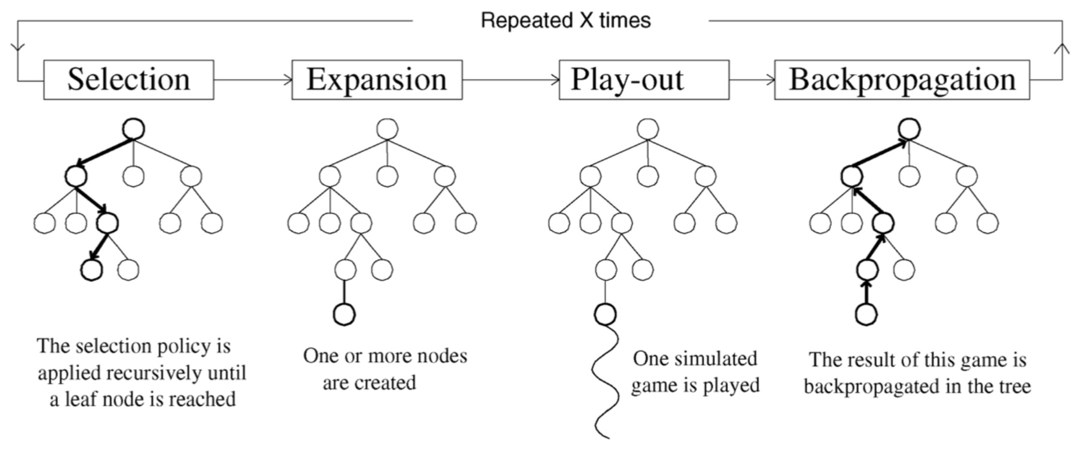
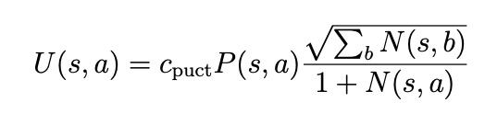
AlphaZero: MCTS
Monte Carlo Tree Search
• Value Network (Exploit): Helps to evaluate each node to guide Monte Carlo Tree Search
• Policy Network (Explore): Helps to guide Monte Carlo Tree Search to select better actions
Notes:
选择：从根节点 R 开始，递归选择某个子节点直到达到叶子节点 L。当在一个节点s，怎么选择子节点 s∗ 呢？Tree Policy就是选择节点（落子）的策略，它的好坏直接影响搜索的好坏，所以是MCTS的一个研究重点。比如上面说的选择平均赢子数最多的走法就是一种Tree Policy。而目前广泛采用的策略有UCT。
扩展：如果 L 节点上围棋对弈没有结束，那么创建一个子节点 C。
模拟：根据Default Policy从扩展的位置模拟下棋到终局，计算节点 C 的质量度。完全随机落子就是一种最简单的Default Policy。当然完全随机自然是比较弱的，通过加上一些先验知识等方法改进这一部分能够更加准确的估计落子的价值，增加程序的棋力。Default Policy可以使用深度学习网络，比如AlphaGo Zero。反向
传播：根据 C 的质量度，沿着传递路径反向传递，更新它爸爸爷爷祖先的质量度

Slide 7
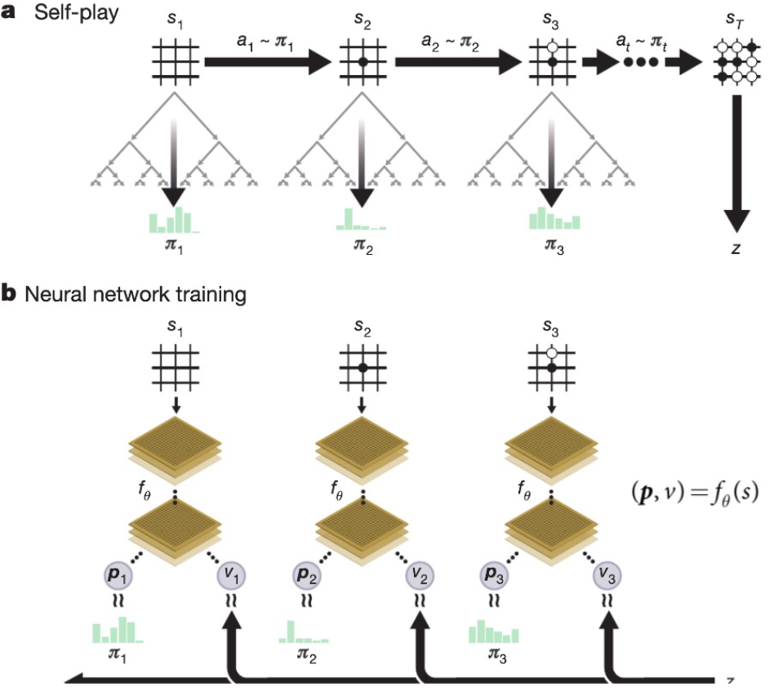

AlphaZero: Training
Learning via Self Play
Generate data using self-play games
Train so that policy network p mimics the improved policy distribution 𝝅 generated by MCTS
Train so that value network output v matches the game outcome z for all time steps

Slide 8
HyperTree Proof Search (2022)
Lample, G. et al. HyperTree Proof Search for Neural Theorem Proving. Advances in Neural Information Processing Systems 35, 26337–26349 (2022).
Notes:
Meta ai

Slide 9
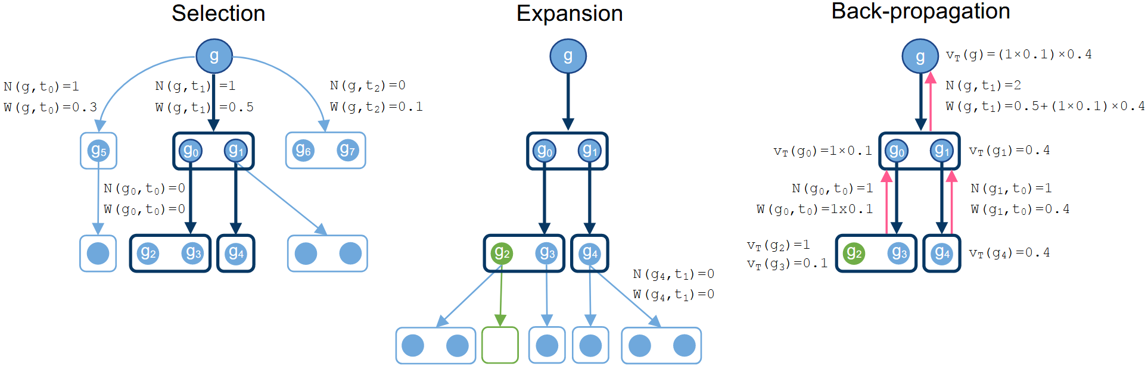
HyperTree Proof Search: Overview
Notes:
visit counts N (g, t) and total action values W (g, t)

Slide 10
HyperTree Proof Search: Challenges
Challenges to apply AlphaZero-like methods
• Infinite Action (Tactic) Space
• MCTS is not just from start node to leaf, but needs to keep track of all subgoals
• Need to prevent cycles whereby tactics lead back to the same subgoal

Slide 11
HyperTree Proof Search: Contributions
A key difference between previous work and ours is that our proof search operates on a hypergraph. Thus, whereas MCTS goes down a path from the root to an unexpanded node during its selection phase, our algorithm will instead create a partial proof hypertree, leading to a set of either solved or unexpanded nodes.
Tactics are sampled in an auto-regressive fashion (token by token) by the decoder (Seq2Seq) , based on the previously generated tokens, and on a representation of the goal provided by the encoder.
Notes:
不止探索最有可能的那一个动作，而是探索一组
用语言模型来进行提示，启发式搜索
即使针对一个固定模型，理想参数也可能取决于特定目标。如果一个输入语句只能通过深层证明来证实，我们应该偏重深度而非广度，以及每个节点的少数策略。如果证明预计是浅显的并使用稀有策略，我们希望对深度探索进行惩罚，并增加每个节点采样的策略数量。最后，要调整的参数太多，运行每个实验都很昂贵。因此，我们不将 HTPS 超参数设置为固定值，而是在每个证明开始时从预定义范围中对其进行采样。

Slide 12
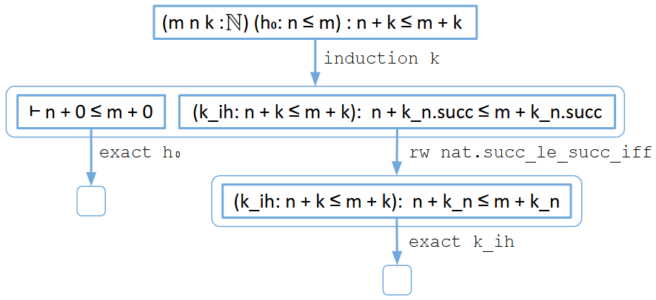
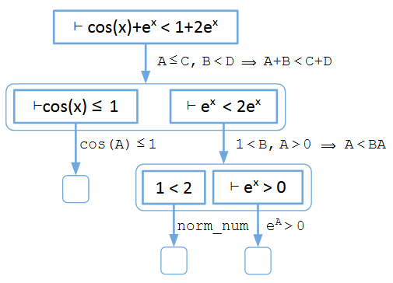
HyperTree Proof Search: Examples

Slide 13
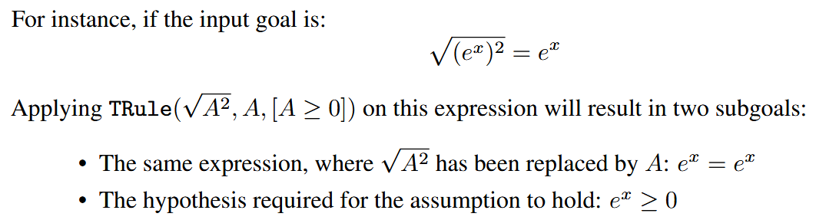
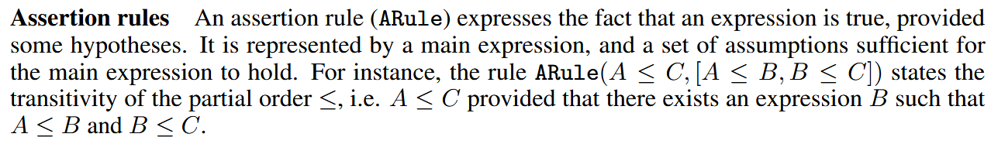
HyperTree Proof Search: Rules of equations
The environment contains two types of rules: Transformations and Assertions
Notes:
这两个都是基于规则的，扩展性有限
文章因为研究的公式都比较简单，不需要很强的启发式搜索

Slide 14
HyperTree Proof Search
Things to learn
Goal G is divided into multiple small goals g by rules.
Using language models as a tool for heuristic search.
Two types of rules for Depth-First or Breadth-First Search.
Notes:
学习的点：
使用规则进行问题划分，把G划分成很多子任务
用语言模型作为搜索引导
规则的分类？

Slide 15
MINIMO (Mathematics from Intrinsic Motivation)
Poesia, Gabriel, et al. "Learning Formal Mathematics From Intrinsic Motivation." arXiv preprint arXiv:2407.00695 (2024).
Notes:
斯坦福

Slide 16
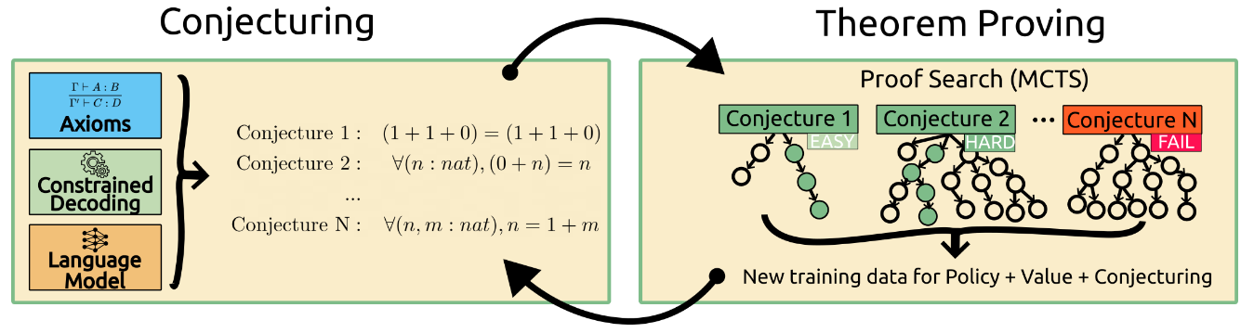
MINIMO: Overview
Contributions
a method for conjecturing using LMs that generates valid conjectures by construction in an arbitrary theory
a hindsight relabeling method for sparse reward environments
Notes:
两个亮点：
生成新规则的方法：大模型组合
应对稀疏性的方法

Slide 17
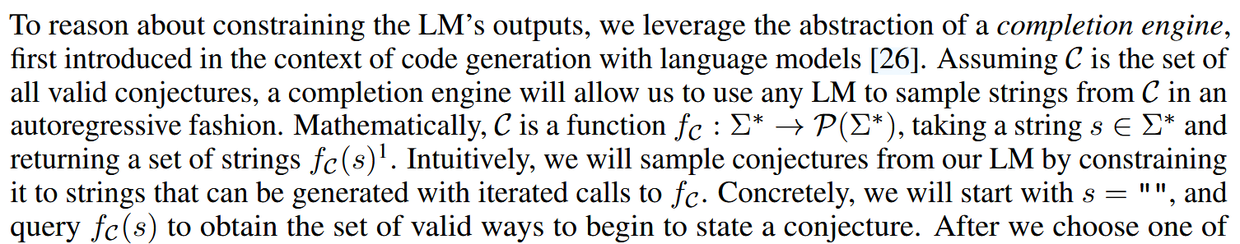
MINIMO: Congecturing
Conjecturing

Slide 18
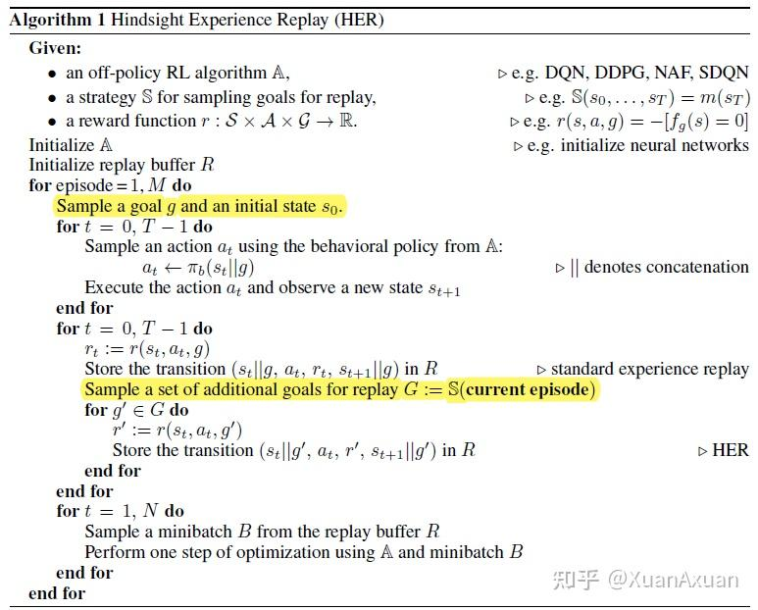
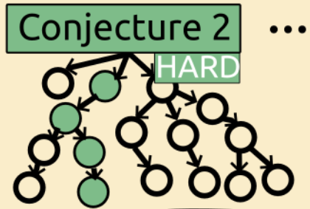

MINIMO: Hindsight Experience Replay (HER)
a reinforcement learning algorithm designed for sparse reward environments.
We apply this idea to extract training examples for both the policy and value functions from proof search trees, by picking nodes after forward actions that produced a proof, and walking upwards in the tree until we find a backward action (since those change the goal). That path then becomes a successful trajectory after we relabel the goal.

Slide 19
MINIMO
Things to learn
Hindsight Experience Replay (HER)
But forward actions in the proof search tree often construct proofs for other propositions, even if they are irrelevant for proving the original goal.

