Slide 1
Named Entity Recognition without Gazetteers
Andrei Mikheev, Marc Moens and Claire Grover
Proceedings of EACL, 1999
Presented by Xin-Shuang Zhang

Slide 2
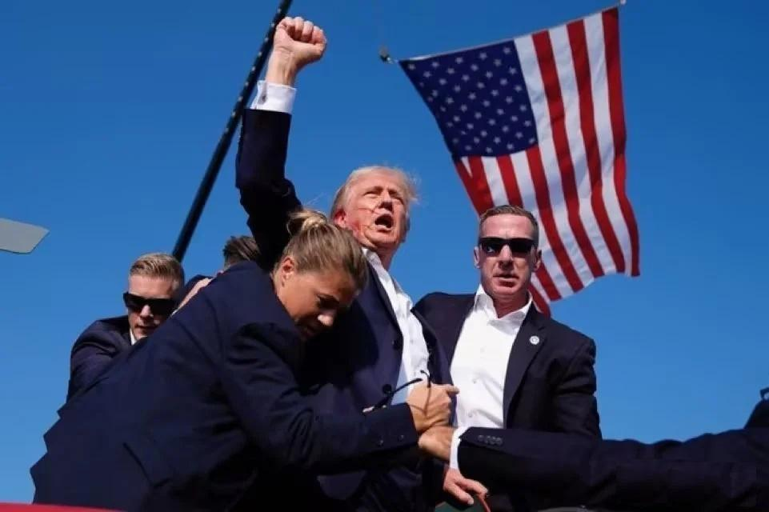
Named Entity Recognition (NER)
A NLP Classification Task: Process text to identify certain occurrences of words or expressions as belonging to particular categories of Named Entities (NE).
Input:
Former President Donald Trump was shot and injured in an assassination attempt on Saturday night during a rally in Butler, Pennsylvania.
Output:
Former President: title
Donald Trump: person
Saturday night: date
Butler: location
Pennsylvania: location

Slide 3
List Lookup
One might think that NER could be done by using lists of names of people, places and organisations, but that is not the case.
Huge
Be out of date
Variations: e.g. Imperial College London
Overlaps: e.g. Adam
Conjunctions: e.g. China International Trust and Investment Corp
This raises several questions: how important are gazetteers?

Slide 4
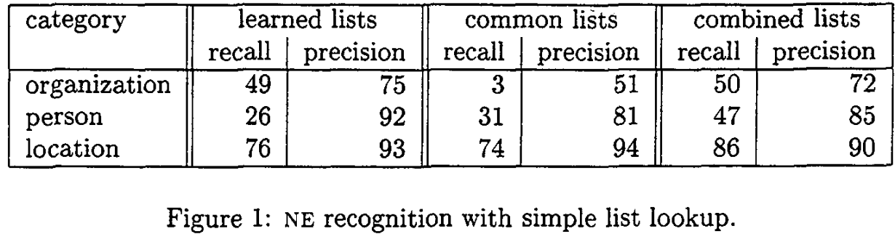
A Minimal NER System
The system would need no grammars or even information about tokenization but simply mark up known strings in the text.
learned lists: Induced from the MUC-7 training data (200 articles)
common lists: Acquired from public resources
combined lists: combined the two gazetteers

Slide 5
Motivation
internal (phrasal) evidence
external (contextual) evidence
e.g. One of the texts contained “UTited States and Russia” , for “UTited States ”,
internal evidence: it contained the word “States”
external evidence: it occurred in a conjunction with “Russia”, a known location
These two facts in combination meant that the system correctly identified “UTited States” as a location.
In our MUC system, we implemented this approach as a staged combination of a rule-based system with probabilistic partial matching.

Slide 6
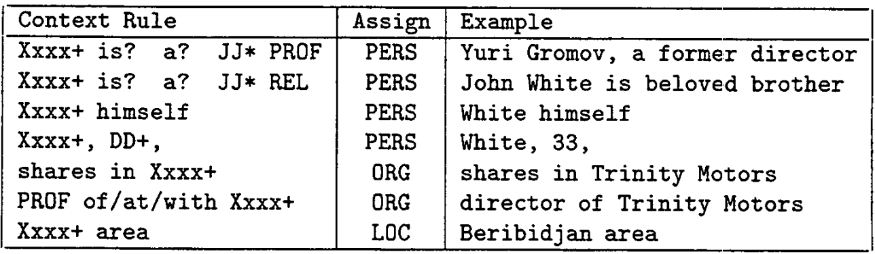
Step 1. Sure-fire Symbolic Transduction
The sure-fire rules rely on known corporate designators (Ltd., Inc., etc.), person titles (Mr., Dr., Sen.), and definite contexts such as those in Figure below:
The sure-fire rules apply after POS tagging and simple semantic tagging, such as: JJ (adjective), PROF (professions), REL (relatives), DD (digits)

Slide 7
Step 2. Probabiiistic Partial Match (I)
The system then generates all possible partial orders of the composing words preserving their order, and marks them if found elsewhere in the text.
Partially matched words for “Adam Kluver Ltd” (tagged as an organisation by the sure-fire rule)
“Kluver Ltd”
organization? YES!
contextual information
maximum entropy model
output
Probability
Distribution
organization? YES!
“Adam Ltd”
feature extraction
“Adam Kluver”
organization? NO!
If the model provides a positive answer for a partial match, the system makes a definite assignment.

Slide 8
Step 3. Rule Relaxation
The system applies the grammar rules again, but with relaxed constraints and using information from existing markup and the compiled gazetteer.
If (conditions) then (makes a assignment)
e.g.
“Adam Kluver”: organization or person? (It is only at this late stage that a list of names is used. )
“China International Trust and Investment Corp”: Whether parts of the conjunctions were used previously.
“Suspended Ceiling Contractors Ltd”: Whether the modifier was seen with the organization name elsewhere in the text.
“Murdoch’s News Corp”: The “Murdoch’s” could be part of the name of the organisation, or could be a possessive (所有格).

Slide 9
Step 4. Probabiiistic Partial Match (II)
As in Partial Match 1, this process of partial matching is again followed by a probabilistic assignment supported by the maximum entropy model.
e.g. Conjunction Resolution
“he works for Xxx and Yyy”: It is more likely that Xxx and Yyy are two entities of the same type.

Slide 10
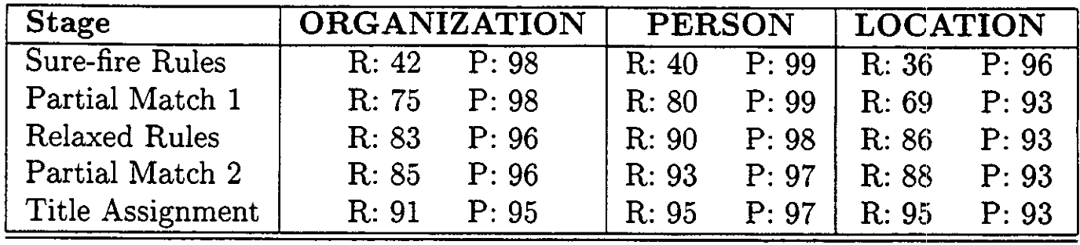
In Summary
Scores obtained by the system through different stages of the analysis.
R - recall P - precision.
match (rule-based, high precision but low recall)
partially matching (statistical model, recall increases)
alternating use by stage, combining knowledge and data

