Slide 1
Computers, Programming Languages and How We Got Here
CSCI-UA.0002
Introduction to Computer Programming

Slide 2
Agenda
Go over syllabus
Attendance / Brief Introductions
https://pollev.com/craigkapp (sign in using your NYU account)
Computers, Programming Languages & How We Got Here (slide deck)
Registration issues

Slide 3
Attendance & (very!) brief Introductions

Slide 4
Live Polling
Visit https://pollev.com/craigkapp
Log in using your NYU account

Slide 5
CS Placement Exam
If you have more than a basic level of experience with Computer Programming this may not be the course for you
The course you are enrolled in only counts towards the CS minor in Web Programming and is a pre-requisite for students with no programming experience before taking CS101
One option would be to take CSCI-UA.0003 – Introduction to Computer Programming with Limited Prior Experience.
You can also take a short test in the language of your choice (Java, Python, C, C++ or JavaScript) to test out of this class
This will allow you to join a section of the next course in the CS sequence – CS101 – right away
CS101 counts towards:
The CS minor in Web Programming
The CS minor
The joint CS / Math minor
The CS major

Slide 6

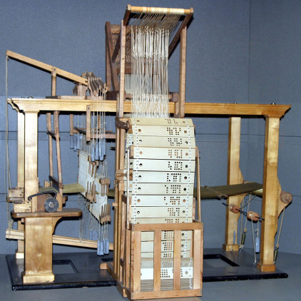
What is a computer?
Any machine that processes information and generates output can be considered a computer.
Computers are often electronic in nature, but that isn’t always the case.

Slide 7
Hardware
“The Guts”

Slide 8
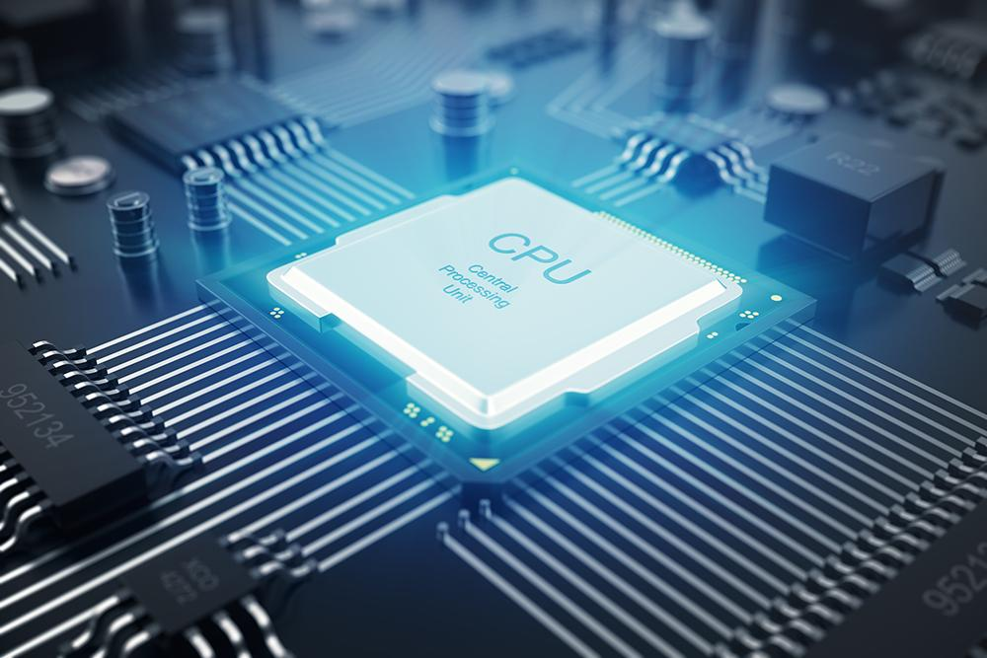
Processors
Every computer has at least one processor
The process acts as the computer’s “brain” and coordinates all activity
As far as a bring goes, the process isn’t very bright – it can only perform four distinct actions:
Receive a new instruction (Fetch)
Make sense of this instruction (Decode)
Perform the action associated with the instruction (Execute)
Store the result of the action (Store)

Slide 9
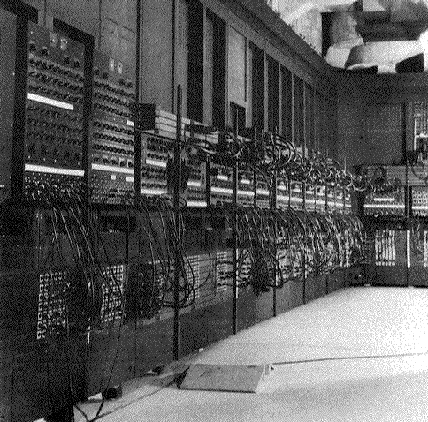
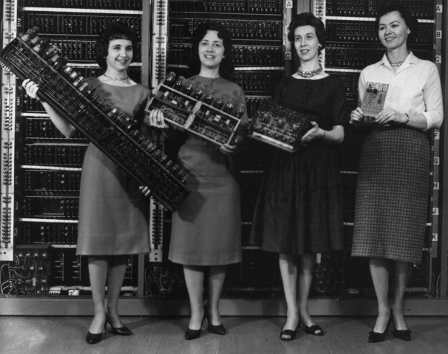
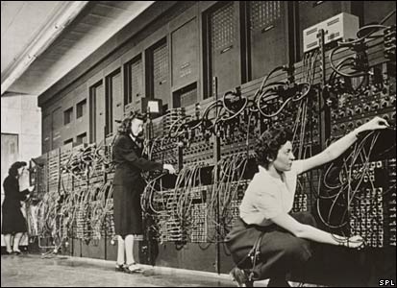
The ENIAC (1945)

Slide 10
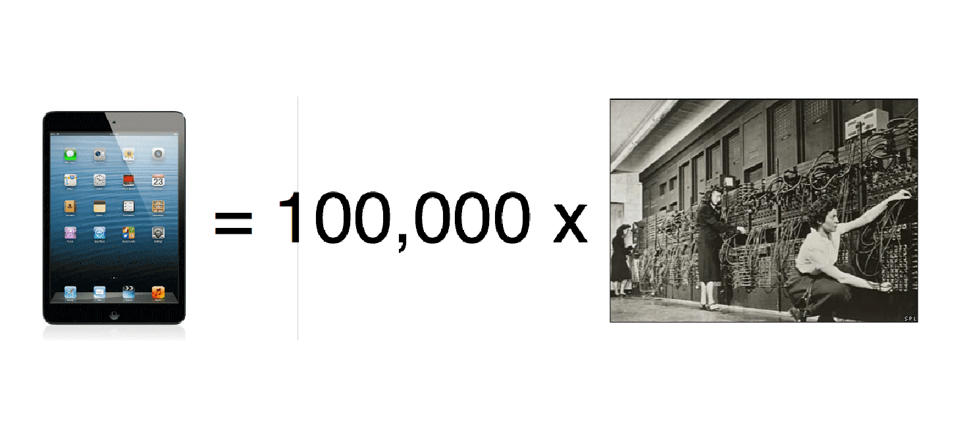
iPad vs. ENIAC

Slide 11
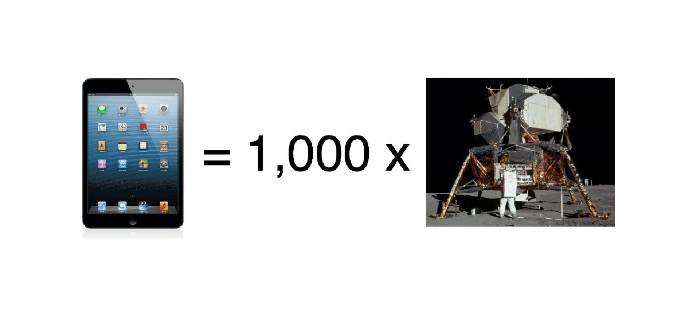
iPad vs. Apollo Space Program

Slide 12
Moore’s Law
Advances in chip design have facilitated these technologies thanks to Moore’s Law.
The empirical observation that at our rate of technological development, the complexity of an integrated circuit, with respect to minimum component cost will double in about 24 months.
Expected to continue until around 2025.

Slide 13
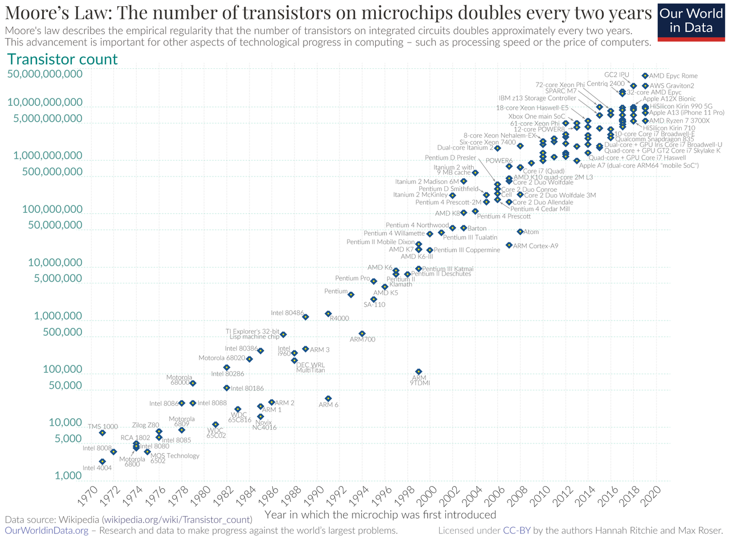
Moore's Law

Slide 14
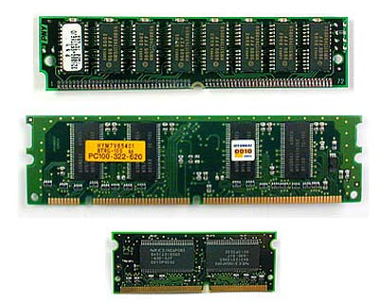
Memory
Computers, like us, need short term memory to function properly
We call this RAM or “Random Access Memory”
It’s very fast!
We call it “Random” since the computer can selectively read and write to it’s RAM at will – (think of accessing any song on a CD versus accessing that same song on a cassette tape)
When a computer turns off, it loses its short term memory (we call this volatility)
In general, the more RAM a system has, the better it performs.

Slide 15
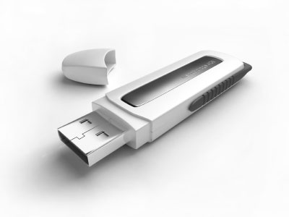
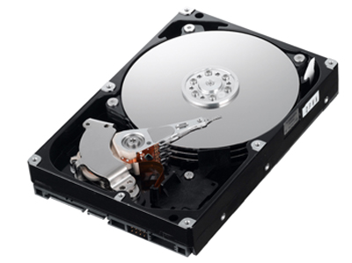
Storage
Temporary storage is accomplished in memory (RAM)
We use RAM for short term memory because it is very fast, but it is also volatile and loses information if it is denied of electricity
Long term storage is, by definition, non-volatile – it has the ability to persist even if the power is off

Slide 16
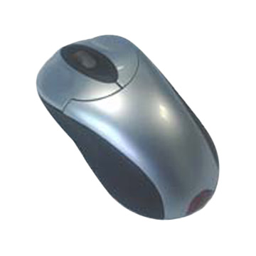
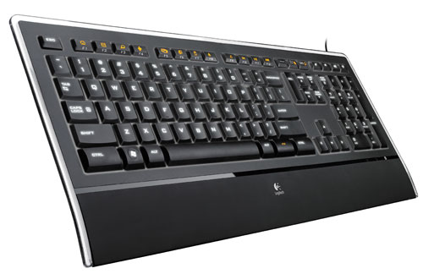
Input Devices
Input devices allow us to communicate “real world” information into a format that the computer can understand

Slide 17
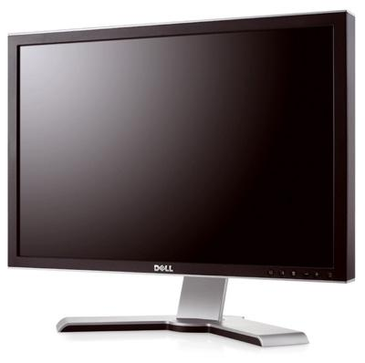
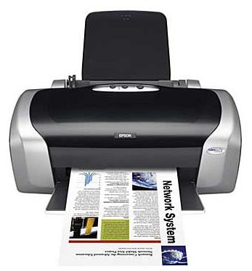
Output Devices
Output devices translate the internal workings of your computer into “real world” stimulus

Slide 18
Software
“The Ideas”

Slide 19
What is Software?
Software is, in essence, a set of instructions that tell our computers how to behave.
Software is fluid, and can easily be changed up updated
Hardware is rigid, and cannot perform that were not originally planned for during the device’s design

Slide 20

The Operating System
Specialized software that coordinate all activities among hardware
Contains instructions for running application software
Also know as a “platform” or “software platform”
programs that run on different operating systems are known as “cross platform” applications.
The OS is the internal “Traffic Cop” of your computer

Slide 21

Application Software
Software that serves to help “users more productive and/or assist them with personal tasks” (Shelly, Cashman & Vermaat)
Application Software is described as a set of programs that are designed to perform specific tasks for the user.

Slide 22
Data Storage

Slide 23
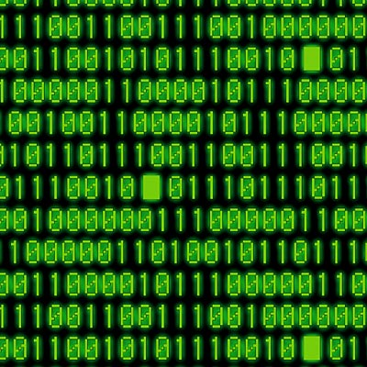
It’s all Zeros and Ones …
Everything that communicates with a computer “speaks” the same language (binary)
Only two “letters” in this language – “0” and “1” which really correspond to electrical impulses (+5v / -5v)

Slide 24
Binary
Only 2 "letters" in the entire language (0 and 1)
A single 0 or 1 is referred to as a "bit”
bit: 1
Groupings of 8 bits are referred to as a "byte”
byte: 01001011
1 byte has the possibility of having 256 unique "states"

Slide 25
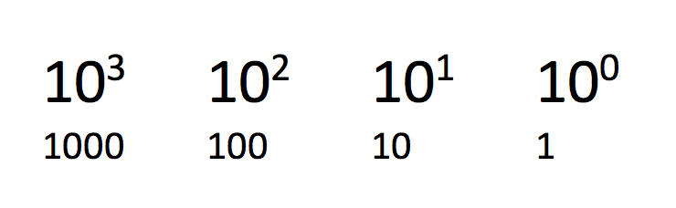
Decimal Place Values

Slide 26
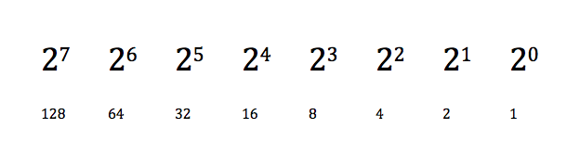
Binary Place Values

Slide 27
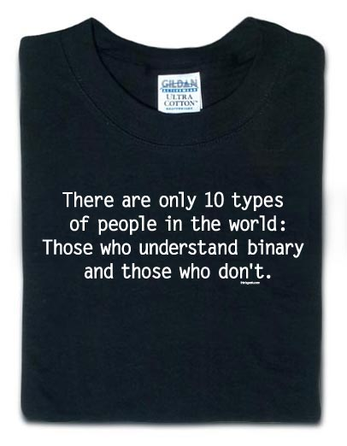
Now you can understand this shirt

Slide 28
Digitization
As you can see, any decimal number (base 10) can be encoded using Binary (base 2)
Computers deal with more than just numbers though - they often need to work with text, images, sounds, movies, large data sets
In order for software to be able to handle these non-numeric values these items must first be “digitized” and converted into Binary

Slide 29
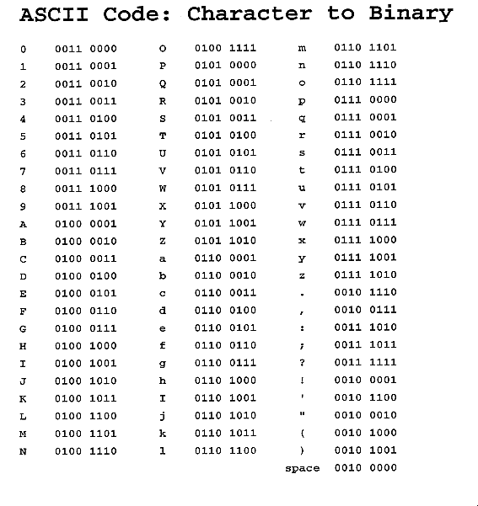
Encoding Characters

Slide 30
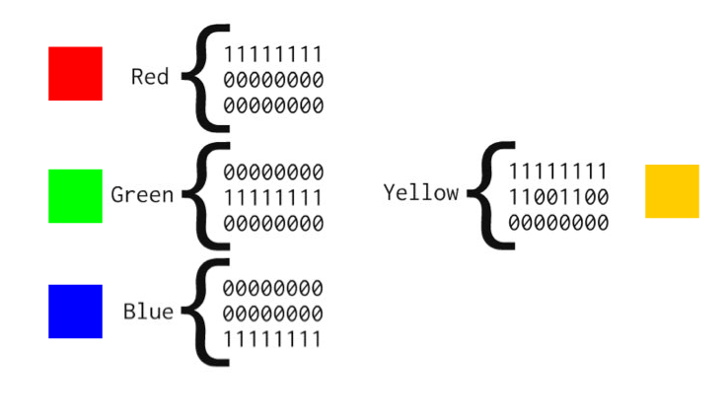
Encoding Images

Slide 31
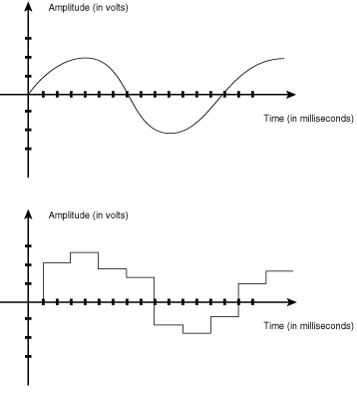
Encoding Audio

Slide 32
How a Program Works

Slide 33
Computers aren’t smart!
(they’re just really, really, really, really, really, really fast!)

Slide 34
Most computers can only do a handful of things
Read information from memory
Add, subtract, multiply, divide numbers
Move data to memory or to permanent storage
Compare values

Slide 35
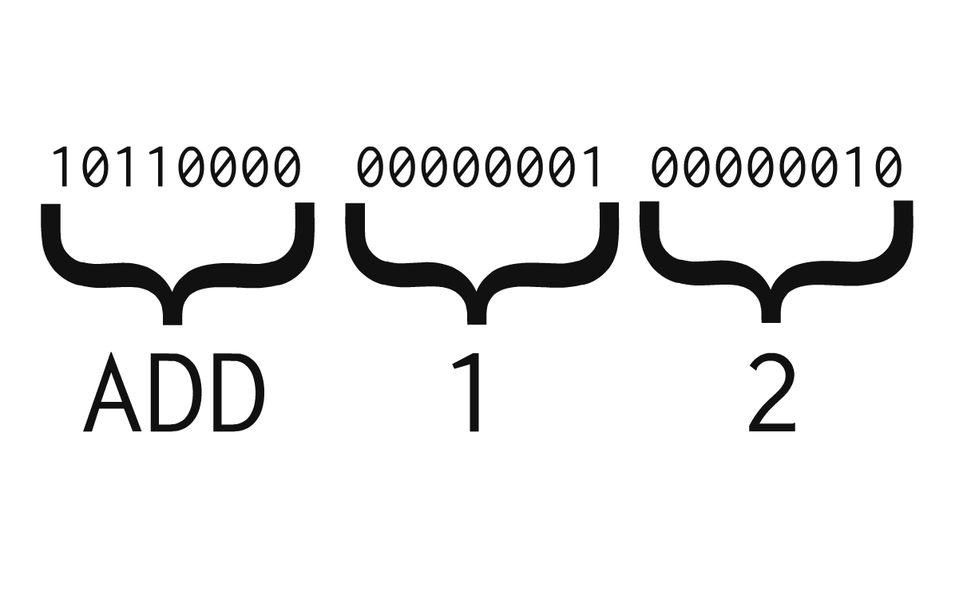
“Machine Language”

Slide 36
So what can a computer do?
Processors can only perform a few very simple operations
Each processor has a fixed number of capabilities, called its “instruction set”
Each manufacturer maintains its own instruction set

Slide 37
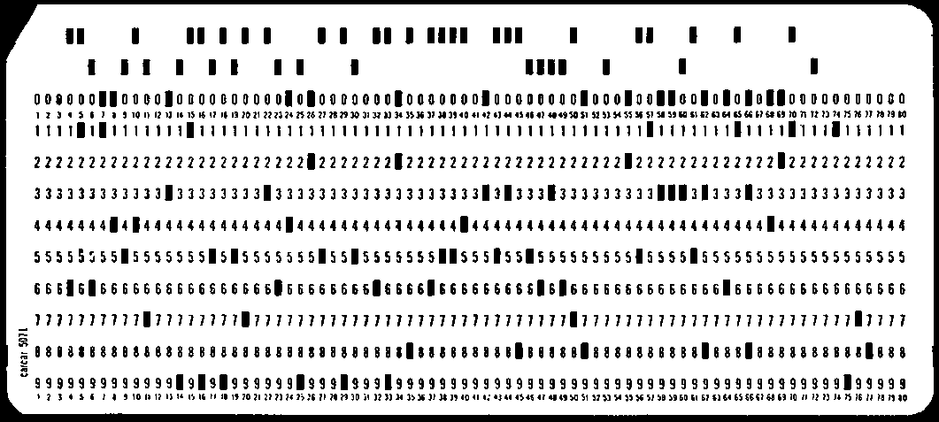
For a program to be meaningful we need lots of instructions!
Usually on the order of millions or billions
Programs are generally stored on external devices, but they must be copied into memory as needed
Once in memory the CPU can begin to work its magic
Fetch
Decode
Execute
Store

Slide 38
Would you want to program like this?

Slide 39
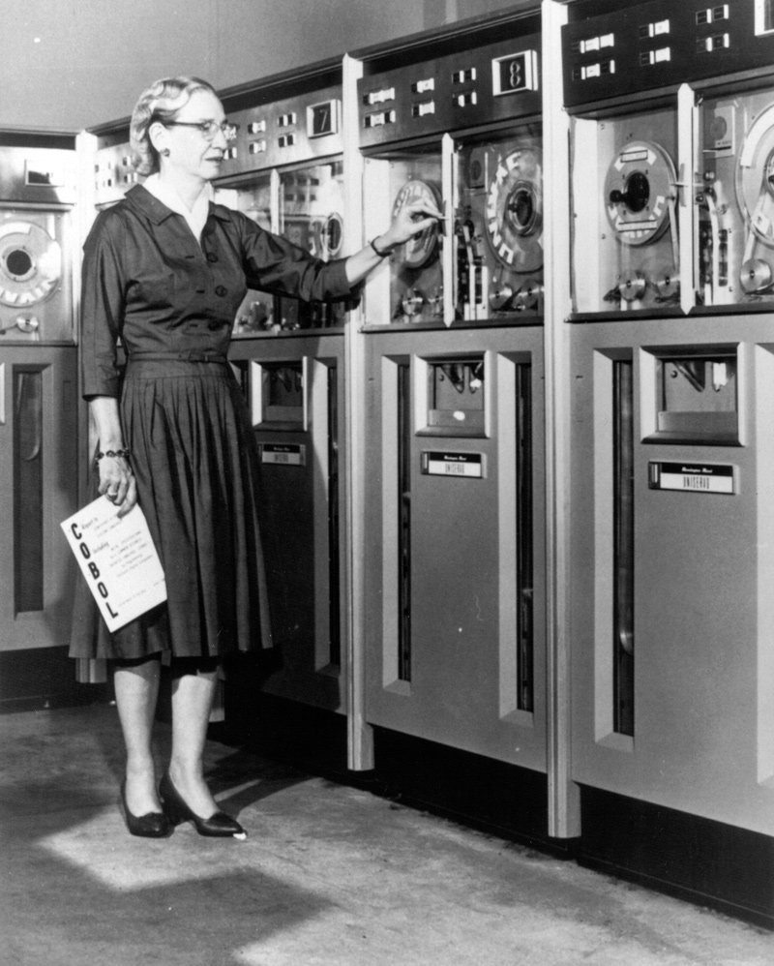
High Level Languages
Program was solved in the 1950’s when Grace Hopper, a captain in the US Navy, invented COBOL
The big idea: Take English words and translate them into machine language in a way that was “device independent”
Allowed programmers to concentrate on the tasks the needed doing, not on the mechanics of how a machine worked

Slide 40
High Level Languages: COBOL vs. Python
COBOL
PYTHON
DISPLAY "Hello, World!"
print("Hello, World!")

Slide 41
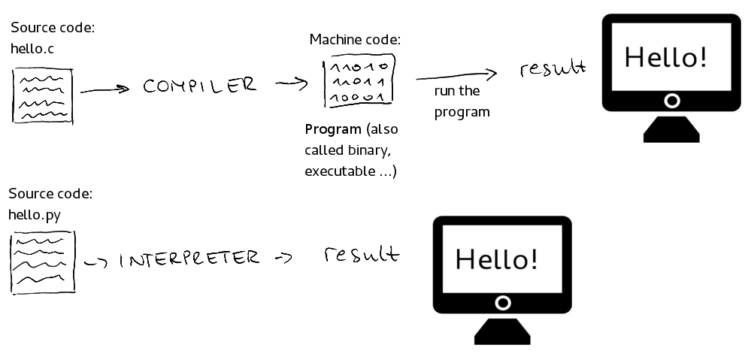
Compilers & Interpreters

Slide 42
Many, many high level languages
COBOL
Java
Visual Basic
PHP
C
C++
Python
JavaScript

Slide 43
High-Level Programming Language Structure

Slide 44
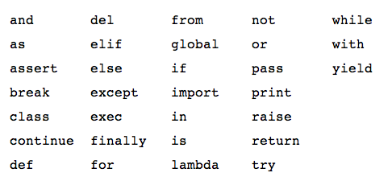
Programming Language Structure: Key Words
Defined list of words that make up the language
Sometimes called “Reserved Words”

Slide 45
Programming Language Structure: Operators
Special symbols that perform basic actions on pieces of data
Operators can be mathematical (addition, subtraction, division, etc.)
Operators can also be logical and compare values (i.e. greater than, less than, membership in a set, equality, etc.)
5 + 2
'Pikachu' + 'Pokemon'
10 > 2
47 in (10, 20, 30, 40)

Slide 46
Programming Language Structure: Statement
Instructions that you write, consisting of keywords, operators, punctuation, etc
answer = average * 2

Slide 47
Programming Language Structure: Syntax
Set of rules that must be followed when writing a program
if name == 'charmander':
print ('Hi there!')
else:
print ('Who are you?')

Slide 48
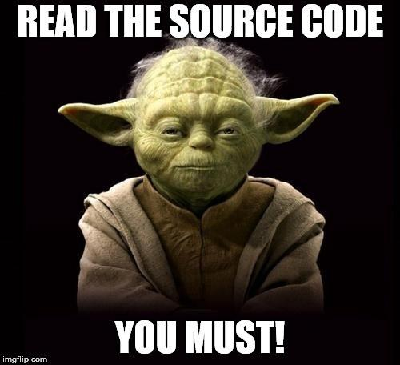
High Level Languages: Code
All statements you write while programming is referred to as “code” or “source code” (we generally don’t say “source codes”)

Slide 49

Python
This semester we will be working with Python
High level interpreted language
Used extensively as both a production language as well as a teaching language
Two modes
Interactive
Script
IDLE
Integrated Development Environment

Slide 50
“Hello, World!”

Slide 51
For next time …
Complete the ”Day 1 Exit Ticket” in Brightspace
Complete "Self-Paced Learning Module #1" on Ed

