Slide 1
Decision Structures & Boolean Logic
CSCI-UA.0002
Introduction to Computer Programming

Slide 2
Assignment 2 Questions?

Slide 3
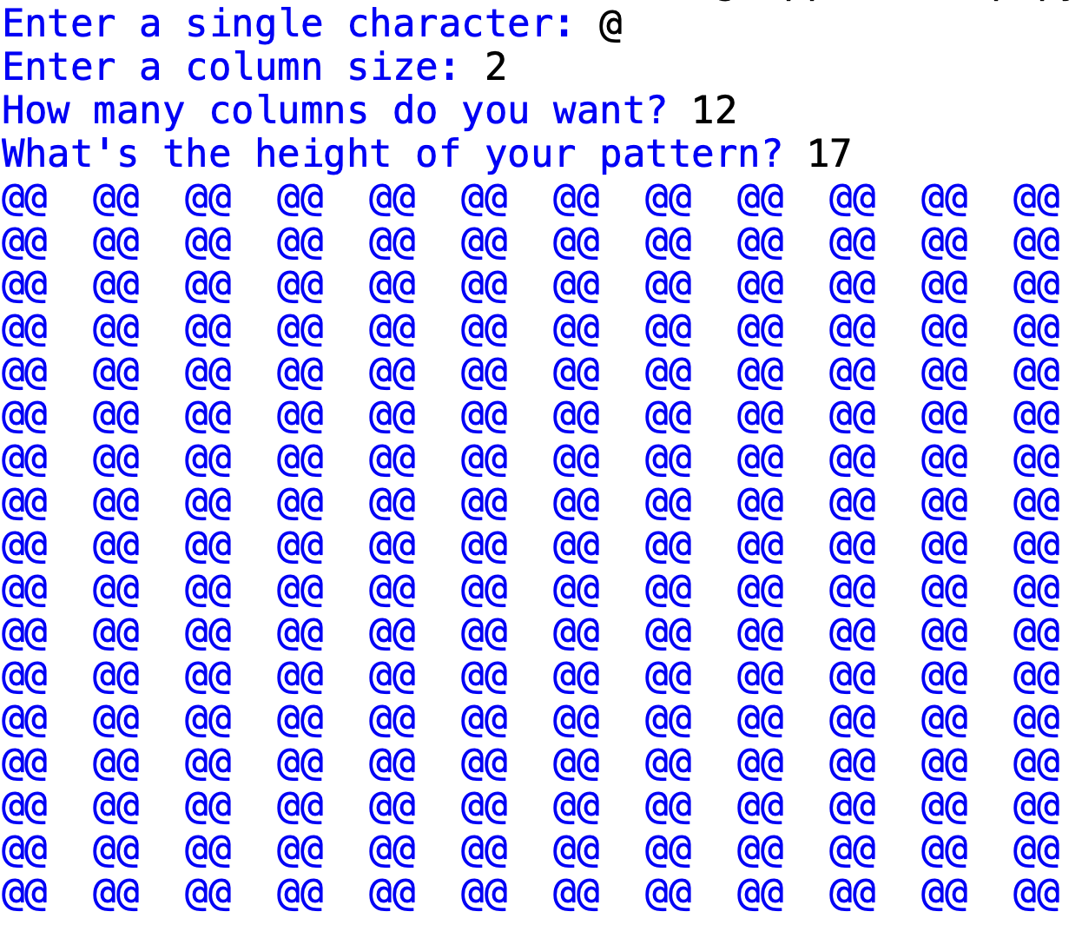
Programming Challenge: Write this program

Slide 4
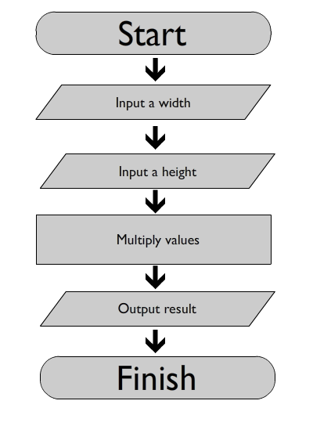
Sequential Structures
What we have been programming so far is known as a "sequential structure"
Sequential structures are sets of statements that execute in the order in which they appear
Unfortunately not all programs can be written this way, as there are certain times when we need to deviate from a linear structure and adapt our program based on information provided.

Slide 5
Calculating Overtime Pay
If a worker works more than 40 hours in a week he or she is entitled to overtime pay.
Overtime pay is calculated at the rate of 1.5 times the worker's hourly rate.
This additional rate is only applied to hours worked above the 40 hour limit.

Slide 6
Calculating Overtime Pay: Algorithm
Input: Hourly rate of pay
Input: Number of hours worked in 1 week
Process: If the hours worked is less than 40, simply multiply hourly rate by hours worked
Process: If the hours worked is greater than 40:
Multiply hourly rate by hours worked for 40 hours.
Subtract 40 from the the total hours to obtain the overtime hours
Multiply overtime hours by 1.5 times the rate of pay
Add overtime pay to base pay
Output: Total Pay

Slide 7
The Selection Statement
Allows your program to "ask a question" and respond accordingly.
Simplest form – perform an action only if a certain condition exists
If the condition is not met, then the action is not performed

Slide 8
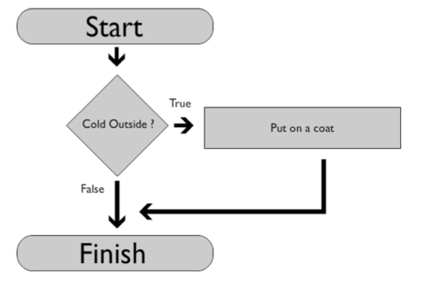
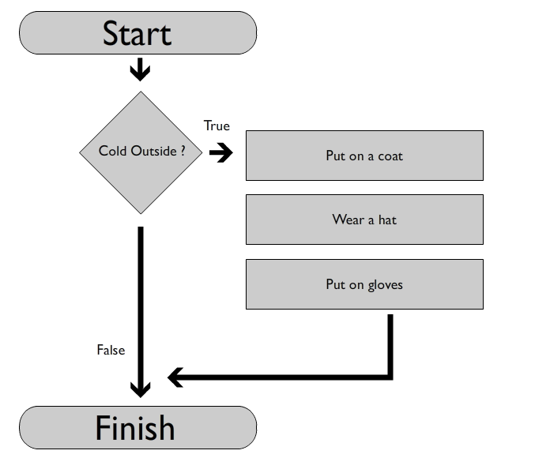
The Selection Statement: An Example
In this program we begin by asking a question – "is it cold outside?"
If the answer to this question is yes ("True") then we can execute an alternate set of commands
Otherwise we can continue with the program as-is

Slide 9
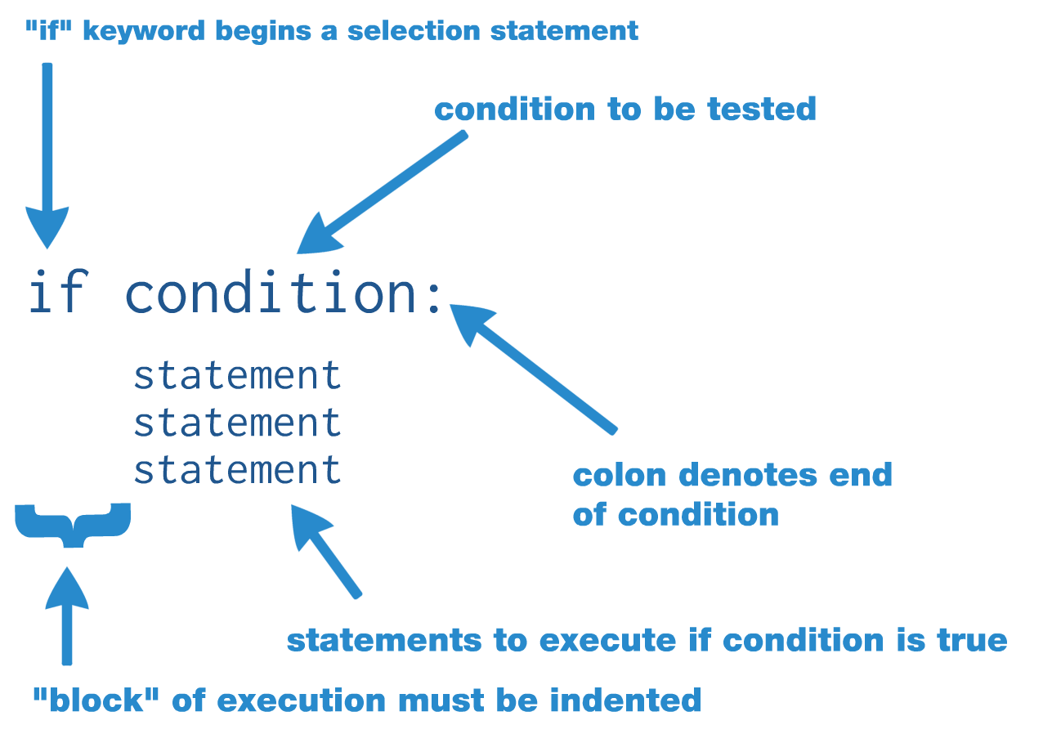
Selection Statements in Python

Slide 10
Boolean Expressions

Slide 11
Writing a condition
The trick to writing a selection statement is in constructing a condition that matches the question you are trying to ask the computer
All selection statements must have a condition to "test"
Think of conditions as "yes or no" questions. They can only be answered by one of two options – "True" or "False"

Slide 12
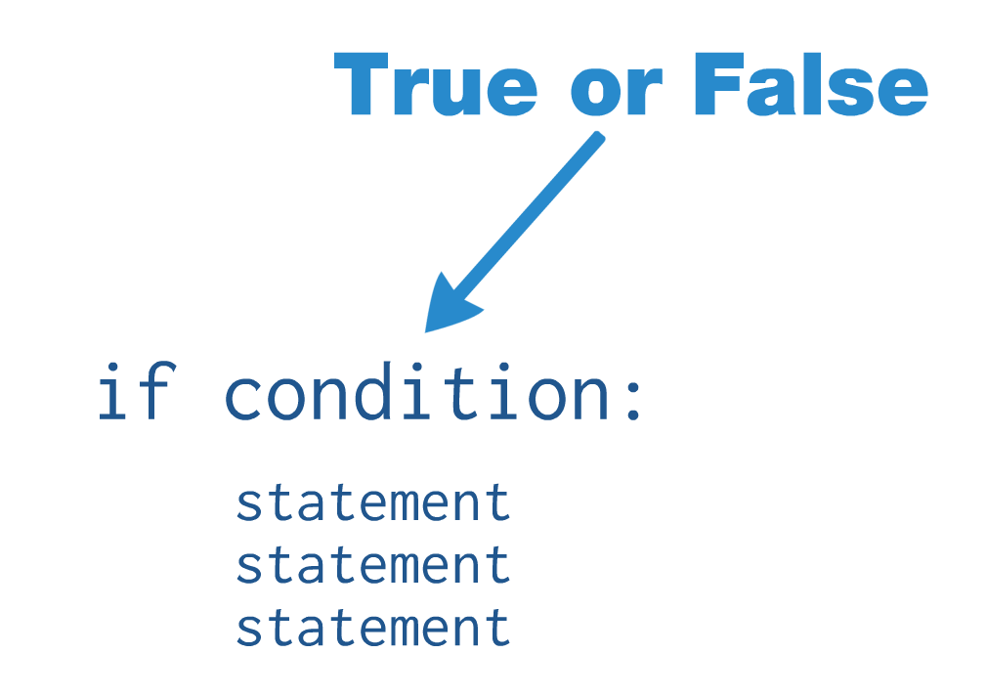
Testing a Boolean Expression in Python

Slide 13
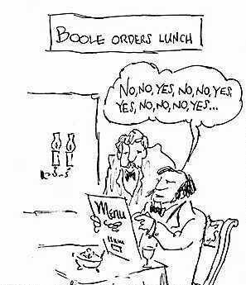
George Boole
The term "Boolean" refers to George Boole, a 19th century English philosopher and mathematician
Boole developed a system of mathematics that allows us to work with the abstract concepts of "true" and "false"
Boole is considered one of the founders of modern computer science, as his work underpins the way in which modern computers process binary data

Slide 14
Writing a Boolean Expression
Boolean expressions can be used as the condition in an "if" statement
They are generally formed using "relational operators" which allow you to test to see whether a specific relationship exists between two (or more) values
All Boolean expressions evaluate to a True or False value

Slide 15
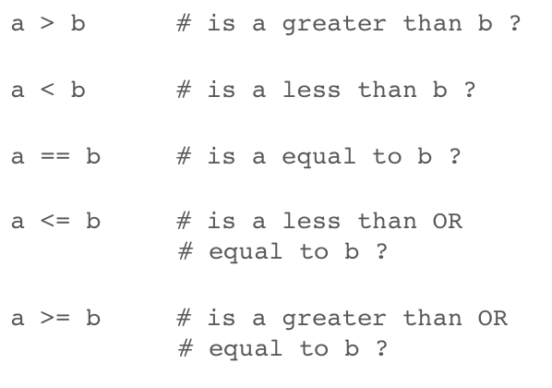
Relational Operators

Slide 16
Evaluating a Boolean Expression
pen = 10
sword = 7
if pen > sword:
print('the pen is mightier than the sword!')
# pen > sword
# 10 > 7
# True

Slide 17
Let's Evaluate!
# given these variables
a = 99
b = 7
c = -5
d = 92
# evaluate these expressions
a > b
b < c
b >= c
c <= d
a == b + d
d <= a + c
c != b

Slide 18
Boolean Operator Tips
Don't confuse "==" with "="
"=" is used for assigning values to variables
"==" is used for testing to see if two values are identical
Use "!=" if you want to test if two values are different
The "<=" and ">=" operators test for more than one relationship
"<=" tests to see if a value is less than OR equal to another
">=" tests to see if a value is greater than OR equal to another

Slide 19
"Truthiness"
When constructing a Boolean expression you will generally need to utilize a relational operator
If you omit a relational operator Python will evaluate your expression using the 'truthiness' of the data being evaluated. For example: a = 1 if a: print("!")
In this program the "!" will print because the variable a is holding a non-zero value. It is assumed to be True because it is not zero.
For the numeric data types, a False value is 0 or 0.0
For the string data type, a False value is an empty string ""

Slide 20
Logical Operators
All programming languages provide a set of "logical operators"
These operators can be used to create complex Boolean expressions that evaluate more than one condition at the same time
There are three main logical operators that we use regularly in programming
and
or
not

Slide 21
Logical Operators: Example
x = 10
y = 5
a = 20
b = 25
if x > y and a < b:
print('yes!')
else:
print('no!')

Slide 22
The "and" operator
"and" can be used to combine two Boolean expressions
The resulting Boolean expression will evaluate to be True if the two Boolean expressions it is connecting both evaluate to be True
True and True => True
True and False => False
False and True => False
False and False => False

Slide 23
Let's evaluate! ("and" operator)
a = 5
b = 10
print(a > b and a > 1)
print(a > 1 and b > a)
print(a == 5 and b < 100)
print(a > 1 and b < 1 and b > a)
print(a > 1 and b > 1 and b > a)

Slide 24
The "or" operator
"or" can also be used to combine two Boolean expressions
The resulting Boolean expression will evaluate to be True if EITHER of Boolean expressions it is connecting evaluates to be True
True or True => True
True or False => True
False or True => True
False or False => False

Slide 25
Let's evaluate! ("or" operator)
a = 5
b = 10
print(a > b or a > 1)
print(a > 1 or b > a)
print(a == 5 or b < 100)
print(a > 1 or b < 1 or b > a)
print(a > 1 or b > 1 or b > a)

Slide 26
The "not" operator
The "not" operator is a unary operator that reverses the logical value of its argument
This means that it will "flip" a True value into a False value, and vice versa

Slide 27
Digital Logic & Design Demo

Slide 28
Let's write some programs!

Slide 29
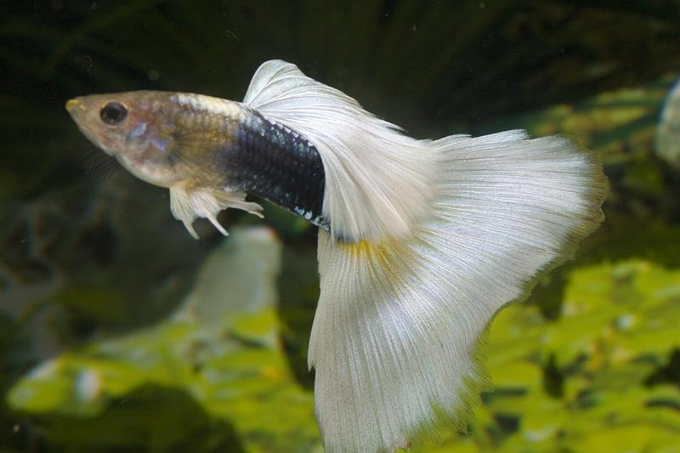
Programming Challenge: Freezing / Boiling Guppies
Guppies are hardy fish, but they can't live in all water temperatures.
The acceptable range for guppies is between 72 and 86 degrees Fahrenheit.
Write a program that asks the user for a temperature. Then display one of two messages based on the information provided:
You're going to freeze your guppy!
You're going to boil your guppy!

Slide 30

Programming Challenge: Number Guessing Game (part 1)
Ask the user to guess a number between 1 and 10. Assume they will enter an Integer.
Pick a number between 1 and 10 that is your "secret" number (for example, 5)
If the user types in your secret number, tell them that they win!
If the user types in a number less than or greater than your secret number, tell them that they're either above or below the number and to try again

Slide 31
Programming Challenge: Calculating a bonus
You're the manager of a large, distributed sales force
You want to create an easy to use tool that will allow your sales staff to do the following:
Input their monthly sales amount
Determine if they made their monthly quota of $10,000
If they made their quota, they are eligible for a bonus of $500
If they made their quota, they should receive a "Good Job!" message
At the end of the program you should print out how much their bonus will be ($0 or $500)

Slide 32
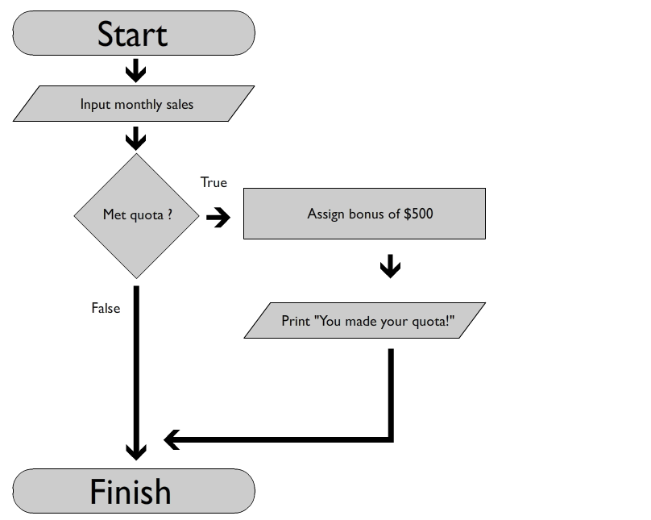
Programming Challenge: Calculating a bonus (flowchart)

Slide 33
Extension
All sales people should receive 1% commission on their sales
If a sales person made over 50,000, they should receive 5% commission on their sales (instead of 1%) – this is in addition to their $500 bonus for making their quota
Print out their total take-home amount (bonus + commission) at the end of the program

Slide 34
The IF – ELSE structure

Slide 35
Simple Selection Statements
The selection statements we have been writing so far have only allowed us to create a single alternate branch of execution
There are many times when we need to create multiple branches of execution based on the value of a Boolean expression

Slide 36
The IF-ELSE structure
The IF-ELSE structure allows you to perform one set of statements if a condition is true, and another if it is false

Slide 37
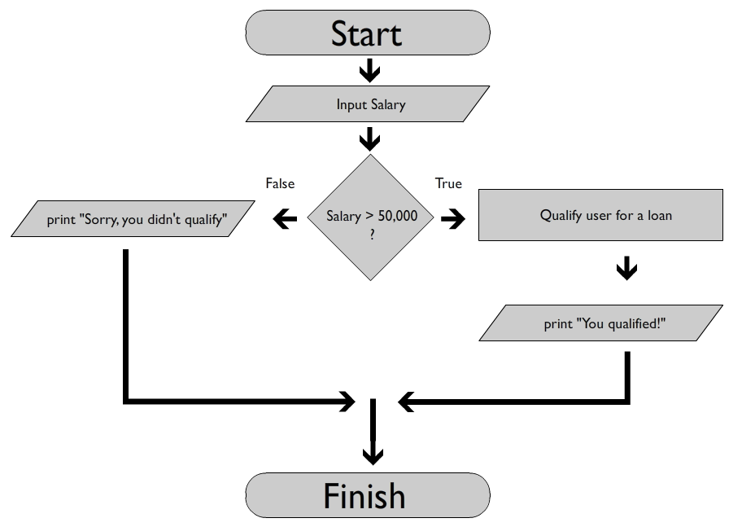
The IF-ELSE structure (flowchart)

Slide 38
The IF-ELSE structure
(code)
if temperature < 32:
print("it's freezing outside!")
else:
print("it's not so bad outside!")

Slide 39

Programming Challenge: Calculating Overtime Pay
If a worker works more than 40 hours in a week he or she is entitled to overtime pay.
Overtime pay is calculated at the rate of 1.5 times the worker's hourly rate.
This additional rate is only applied to hours worked above the 40 hour limit.

Slide 40
Nested Decision Structures

Slide 41
Nested Decision Structures in Python
Sometimes you need to ask "follow up" questions after you've evaluated the value of a Boolean expression
Python allows you to "nest" decision structures inside one another, allowing you to evaluate additional conditions
Indentation is key – Python will use the indentation level of a structure to determine its relationship to any previous statements

Slide 42
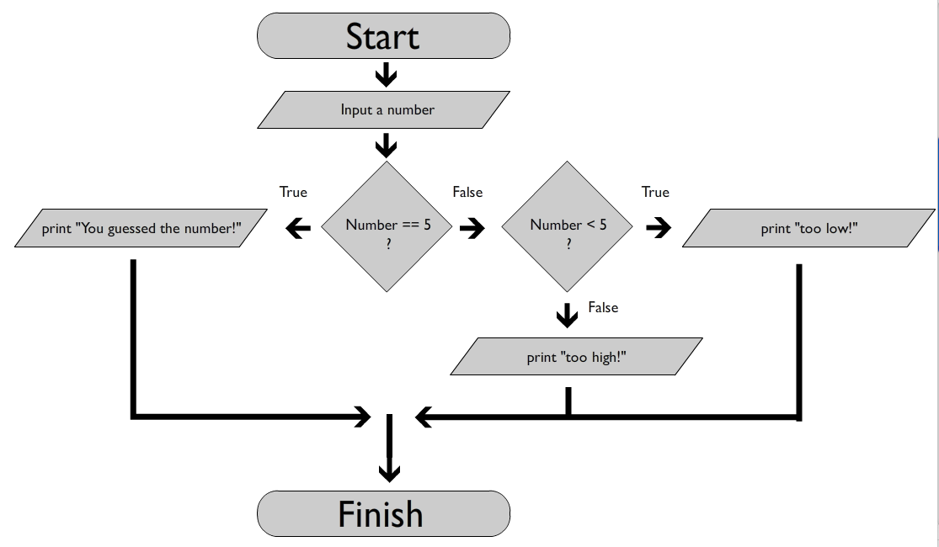
Guess the Number using Nested Decision Structures (flowchart)

Slide 43
Programming Challenge: Guess the Ball Game v2
Rewrite the "guess the number" game using a nested decision structure.
If the user guesses the number they win. If they don't you should tell them to guess higher or lower next time depending on their answer.

Slide 44
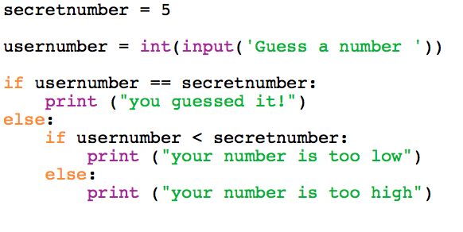
Guess the Number using Nested Decision Structures (code)

Slide 45
Programming Challenge: Freezing / Boiling / OK Guppies
Guppies are hardy fish, but they can't live in all water temperatures.
The acceptable range for guppies is between 72 and 86 degrees Fahrenheit.
Write a program that asks the user for a temperature. Then display one of three messages based on the information provided:
You're going to freeze your guppy!
You're going to boil your guppy!
Your guppy is going to be fine!

Slide 46

Programming Challenge: Grade determination program
Write a program that asks the user to enter in a number greater than or equal to zero and less than or equal to 100. If they do not you should alert them and end the program.
Next, determine the letter grade associated with the number. For example, and A is any grade between 90 and 100. Report the letter grade to the user.

Slide 47
Programming Challenge: Loan Qualification
You're working for a small bank that wants to write a program to allow its customers to pre-qualify themselves for a personal loan
Rules for qualification are as follows:
Borrower must make more than $50,000 per year and be at his or her job for at least 2 years
The 2 year job requirement can be waived, however, for borrowers making more than $100,000 per year
Write a program to ask the user for their yearly salary as well as the # of years they have been at their current company. Use the rules above to output the string 'You qualify' or 'You do not qualify'

Slide 48
IF-ELIF-ELSE Structure

Slide 49
Testing a series of conditions
Testing a series of conditions using an IF-ELSE structure can result in a large amount of indentations
Sometimes this can cause your code to become difficult to read
Example: Grade determination program
Input: ask the user for a numeric grade (i.e. 95)
Process: convert the grade to its letter format (A through F)
Output: print the letter grade

Slide 50
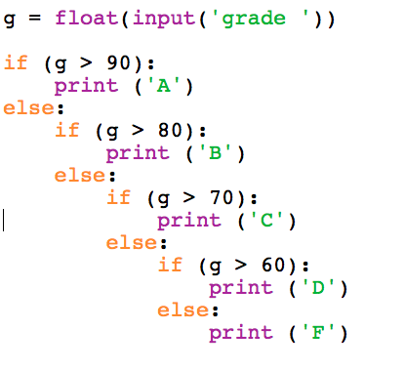
Grade Determination Program

Slide 51
IF-ELIF-ELSE
You can simplify complex IF statements by using the ELIF structure
ELIF is an optional structure that can be placed between your IF and ELSE statements
It allows you to evaluate additional conditions at the same level as the original IF statement
Conditions are tested in the order in which they are written. Once a condition evaluates to True all future conditions are skipped
An ELSE statement at the end of a decision structure is considered the "catch all" statement – if all conditions above end up failing then the statements inside the ELSE block will execute
However, using an ELSE statement at the end of your decision structure is optional.
There is no logical need for an IF-ELIF-ELSE statement. You can always write a program without it by using a standard IF-ELSE block. The advantage of an IF-ELIF-ELSE statement is that your code may end up being be more readable / understandable.

Slide 52
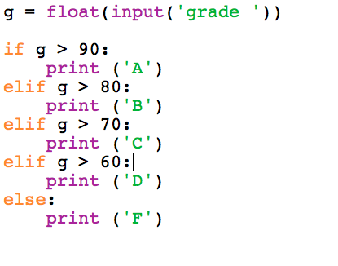
IF-ELIF-ELSE
Course grade computation example

Slide 53
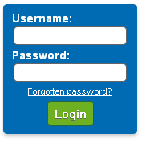
Programming Challenge: Username and Password
Write a program that asks a user for a username and a password
Check to see if BOTH the username and password are correct
If so, provide a Welcome message to the user
If not, provide a Login Failure message to the user

Slide 54
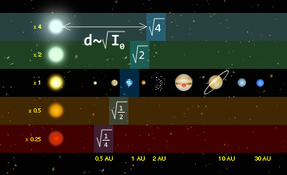
Programming Challenge: Exoplanet "Goldilocks" Zone
The "Goldilocks Zone" is an astrophysics term that is used when describing whether a planet could support life based on its distance from its star
Planets too close to their star could be too hot to support life, and planets too far away could too cold
Write a program to accept a distance value (in miles).
Planets less than 0.5 AU from their star (46 million miles) are too cold
Planets greater than 2.0 AU from their star (184 million miles) are too hot

Slide 55
String Comparison

Slide 56
Programming Challenge: Password Protection
Write a program that asks the user for a password
Check to see if the password that was submitted is equal to the string 'secret'
If it is, print out a "welcome" message
Otherwise, tell them to try again

Slide 57
Basic string manipulation
Python has a huge string manipulation library that allows you to interact with and modify strings. We are going to get more in depth with this package later in the semester.
For now we will only be exploring two small functions in this package – lower() and upper()
The lower() function converts the characters in a string to all lowercase, while the upper() function converts the characters in a string to all uppercase
These functions are not built into the Python library directly, but exist inside the "str" module – as such they must be referred to using "dot syntax"
Example: string_lc = str.lower('Apple Pie') # string_lc = 'apple pie' string_uc = str.upper('Apple Pie') # string_uc = 'APPLE PIE'

Slide 58
Programming Challenge: Case insensitive password
Rewrite your password protection program to be case insensitive (i.e. the password "Secret" will also let you into your program)

Slide 59
String Length
You can ask Python to count the number of characters contained in a string using the len() function
len() returns an integer that represents the total length of a string
Example: myname = 'python' print(len(myname)) # 6

Slide 60
Programming Challenge: Comparing the size of two strings
Ask the user to input two names
Sort the names in size order and print them out to the user

Slide 61
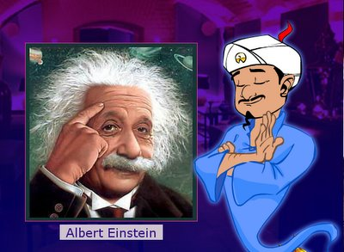
Decision Structures in the Wild

Slide 62
Writing a Diagnostic Program
It's fairly easy to construct your own diagnostic programs, though one as complicated as the Akinator would require a database of tens of thousands of items
Here's the basic workflow:
Identify your subject matter (i.e. Harry Potter Characters)
Assign criteria to your subjects (i.e. Adults, Professors, Females, Males, Studious, Non-Studious, Red haired, Non-Red haired)
Ask the user a question and respond using a series of IF-ELSE statements

Slide 63
Attribute Matrix
- | Female | Male | Adult | Child | Prof | Student | Red Hair | Studious
Harry | - | X | - | X | - | X | - | -
Ron | - | X | - | X | - | X | X | -
Ginny | X | - | - | X | - | X | X | -
Hermione | X | - | - | X | - | X | - | X
Dumbledore | - | X | X | - | X | - | - | -
Mr. Weasley | - | X | X | - | - | - | X | -
Mrs. Weasley | X | - | X | - | - | - | X | -
McGongigal | X | - | X | - | X | - | - | -

Slide 64
Attribute Matrix - Females
- | Female | Male | Adult | Child | Prof | Student | Red Hair | Studious
Ginny | X | - | - | X | - | X | X | -
Hermione | X | - | - | X | - | X | - | X
Mrs. Weasley | X | - | X | - | - | - | X | -
McGongigal | X | - | X | - | X | - | - | -

Slide 65
Attribute Matrix – Female Adults
- | Female | Male | Adult | Child | Prof | Student | Red Hair | Studious
Mrs. Weasley | X | - | X | - | - | - | X | -
McGongigal | X | - | X | - | X | - | - | -

Slide 66
Attribute Matrix – Female Adults with Red Hair
- | Female | Male | Adult | Child | Prof | Student | Red Hair | Studious
Mrs. Weasley | X | - | X | - | - | - | X | -

Slide 67
Conditional Logic Overview

Slide 68
Trace the Output: One-way "if" statements (isolating logical structures)
if _____:
print("one")
if _____:
print("two")
if _____:
print("three")
if _____:
print("four")

Slide 69
Trace the Output: Two-way "if" statements
(isolating logical structures)
if _____:
print("one")
if _____:
print("two")
if _____:
print("three")
if _____:
print("four")
else:
print("five")

Slide 70
Trace the Output: Nested "if" statements
(isolating logical structures)
if _____:
print("one")
else:
if _____:
print("two")
else:
if _____:
print("three") else:
print("four")

Slide 71
Trace the Output: Multi-way "if" statements
(isolating logical structures)
if _____:
print("one")
elif _____:
print("two")
elif _____:
print("three")
elif _____: print("four")
else:
print("five")

Slide 72

Valid Date
Write a program that asks the user for a month (integer) and day (integer)
Determine if this month/day combination is valid.
Months with 30 days:
September, April, June, November
Months with 28 days:
February
All other months have 31 days

