Slide 1
Condition Controlled Loops
CSCI-UA.0002
Introduction to Computer Programming

Slide 2
Generating Random Numbers

Slide 3
Generating a random integer
Sometimes you need your program to generate information that isn’t available when you write your program
One way to solve this problem is to ask your programming language to select a random number which can be used to construct a random set of running conditions
You can generate a random number by using the random.randint function. This function takes two arguments - a starting integer and an ending integer - and returns a random integer in this range.
In order to use the random.randint function you must first import the random module so that Python can access the necessary code library.

Slide 4
Random Integer Example
import random
lucky = random.randint(1,5)
print("Your lucky number is", lucky)

Slide 5

Programming Challenge
Write a "guess the number" game that prompts the user to guess an integer between 1 and 10
Let the user know if their guess is one of the following:
Correct
Too high
Too low
Every time the user plays the secret number should change

Slide 6

Programming Challenge: Rock, Paper, Scissors
Write a program to ask the user to select one of three options - Rock (r), Paper (p) or Scissors (s)
Use the random.randint() function to select an option for the computer
Determine the winner and print the result.
Rock beats Scissor
Scissor beats Paper
Paper beats Rock

Slide 7

Random Painting

Slide 8
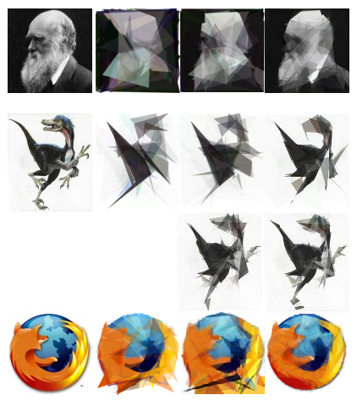
Random Numbers in the Wild: Genetic Algorithms
http://alteredqualia.com/visualization/evolve/

Slide 9
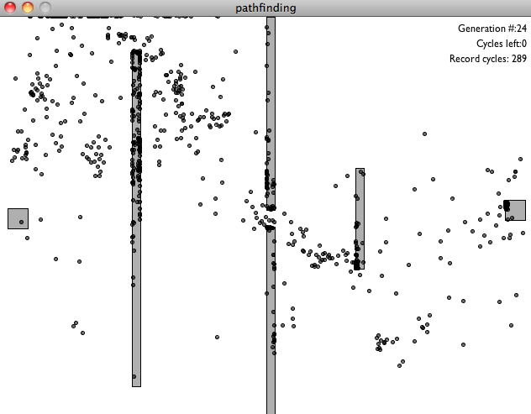
Random Numbers in the Wild: Pathfinding

Slide 10
Repetition Structures

Slide 11
Example: Commission calculator for a sales team
Write a program that allows the user to calculate sales commission earned by each member of a sales team.
Currently there are 3 people on the sales team, but there may be more in the future.
Input
Gross sales (float)
Commission Rate (float)
Process
Commission = gross sales * commission rate
Output
Commission earned

Slide 12
Downsides to Sequence Structures
In the previous example our code ended up being one long sequence structure which contained a lot of duplicate code
There are several disadvantages to this approach
Your programs will tend to get very large
Writing this kind of program can be extremely time consuming
If part of the duplicated code needs to be corrected then the correction must be implemented many times

Slide 13
Repetition Structures to the Rescue!
One solution to this kind of problem is to use a repetition structure, which involves the following:
Write the code for the operation one time
Place the code into a special structure that causes Python to repeat it as many times as necessary
We call this a "repetition structure" or, more commonly, a "loop"
There are a variety of different repetition structures that can be used in Python

Slide 14
The Condition Controlled Loop

Slide 15
Condition Controlled Loop Overview
A condition controlled loop is programming structure that causes a statement or set of statements to repeat as long as a condition evaluates to True

Slide 16
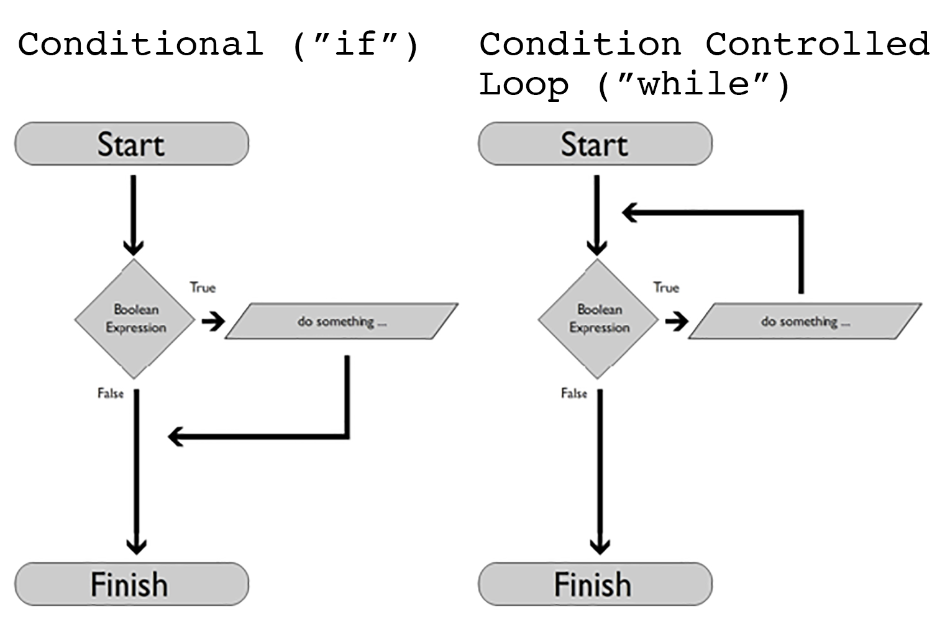
"if" vs. "while"

Slide 17
The "While" Loop
In Python we can implement a condition-controlled loop by writing a "while" loop
"while" loops work as follows:
Evaluate a Boolean expression.
If it evaluates to False, skip the block of statements associated with the while loop and condition the program as normal
If it evaluates to True
Execute a series of statements.
At the end of the statement block re-evaluate the condition
If it is True, repeat the block of statements
If it is False, skip the block of statements associated with the while loop and continue the program as normal

Slide 18
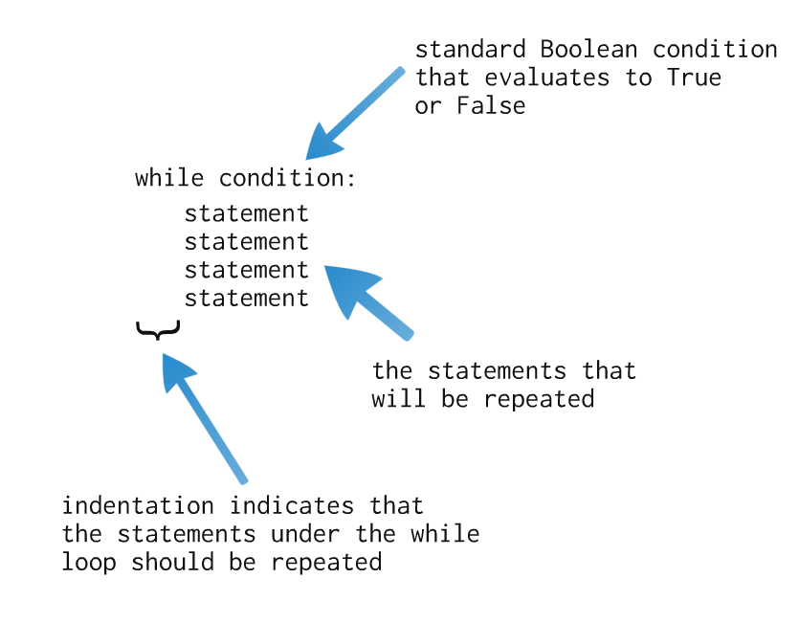
The "While" Loop Deconstructed

Slide 19
Programming Challenge: Commission Calculator
Write a program that allows the user to calculate sales commission earned by each member of a sales team.
Input
Gross sales (float)
Commission Rate (float)
Process
Commission = gross sales * commission rate
Output
Commission earned

Slide 20
Some notes of "while" loops
We refer to the process of going through a loop as an "iteration"
If a loop cycles through 5 times then we say we have "iterated" through it 5 times
The "while" loop is considered a "pre-test" loop, meaning that it only iterates upon the successful evaluation of a condition
This means that you always need to "set up" your loop prior to Python being able to work with it (i.e. setting up a control variable)

Slide 21
Warning!
When working with a "while" loop there is nothing to prevent you from writing a Boolean condition that will never evaluate to False
If this happens your loop will continue executing forever, or until you send an "interrupt" to IDLE using the CTRL-C key combination
We call this an "infinite loop" since it never stops executing
With the exception of a few special cases you want to try and avoid writing infinite loops

Slide 22
Trace the Output
a = 5
while a < 10:
print("A is less than 10!")

Slide 23
Programming Challenge: Temperature Conversion
Write a program that allows the user to convert a temperature in Fahrenheit into Celsius using the following formula
Celsius = (Fahrenheit – 32) * 5/9
After calculating the temperature ask the user if they wish to continue. If so, repeat the conversion with a new number. Otherwise end the program.

Slide 24
Divisibility Tester
Write a program that lets the user test to see if a series of numbers are evenly divisible by another number (3). If they are, print out a status message telling the user.
Let the user end the program by answering a question (i.e. "do you want to test another number?"
Extension: Start off by asking the user to enter in the number that should be used during the test (i.e. enter 5 if you want to test to see if a range of numbers is evenly divisible by 5)

Slide 25
Programming Challenge: Guess the Number
Rewrite the "guess the number" game we wrote back in the selection statement unit to use a "while" loop
Allow the user to continually guess a number until they eventually guess the correct number

Slide 26

Programming Challenge: Arithmetic Quiz
Write a program that asks the user to answer a simple math problem (5 + 6)
Continually prompt the user for the correct answer. If they answer correctly, congratulate them and end the program. If they answer incorrectly you should re-prompt them for the answer a second time.
Extension: Randomize the numbers used in the math problem
Extension: Randomize the type of problem the user is presented with (i.e. addition, subtraction)

Slide 27
Repetition Flow Control

Slide 28
The "break" statement
The "break" statement is a special Python command that can be used to immediately end a loop.
It will not, however, end your program – it simply ends the current repetition structure and allows the program to pick up from the line directly after the end of your loop
Note that when break runs it will immediately terminate the current loop, which prevents any lines of code from running after a break has been encountered

Slide 29
The "continue" statement
The "continue" statement is a special Python command that can be used to immediately jump back to the top the loop and force the condition associated with the loop to be re-evaluated.
The statement itself does not end the loop, but if the condition being tested evaluates to False the loop will end on its own

Slide 30
Accumulator Variables and Augmented Assignment Operators

Slide 31
Accumulator Variables
Many programming tasks require you to calculate a running total of a series of values
We can utilize an "accumulator" variable to do this.

Slide 32
Using Accumulator Variables
Set up your accumulator variables outside of your loops. We generally initialize my accumulator variables right before we enter a repetition structure.
Decide on a value you want to start your accumulator values at. 0 or 0.0 is generally a good starting point depending on whether you are counting whole numbers or numbers with fractional values.
Use a self-referential assignment statement when incrementing an accumulator variable. Example:
counter = counter + 1

Slide 33
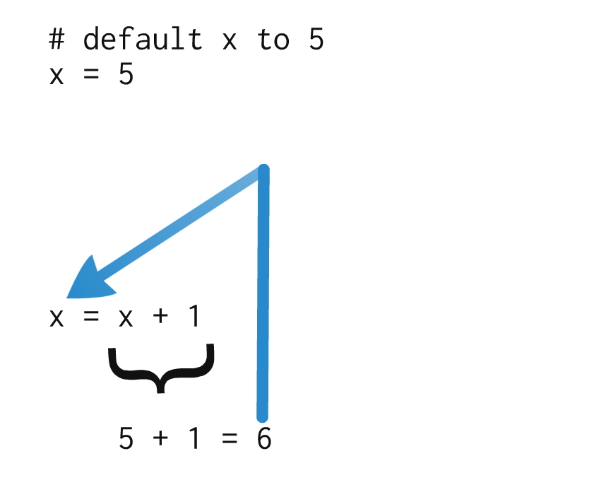
Self-referential assignment statements

Slide 34
Programming Challenge: Average Commission
Write a program that asks the user to continually enter in the following information for a group of employees:
Sales
Commission Rate
Calculate the commission earned by multiplying sales * commission rate
Keep track of the following information and print out a summary document at the end of your loop
Number of employees
Total sales
Average sales
Total commission due

Slide 35
Augmented Assignment Operators
The self-referential assignment statement that we just used is extremely useful, and can be extended to use any of the other math operations we have covered in class so far.
a = a + 1
b = b * 2
c = c / 3
d = d - 4
However, Python (and most other programming languages) contains a series of "shortcuts" that can be used to cut down the amount of typing when working with self-referential assignment statements.
We call these shortcuts the "augmented assignment operators"

Slide 36
Augmented Assignment Operators Chart
Operator | Usage | Equal to
+= | c += 5 | c = c + 5
-= | c -= 2 | c = c – 2
*= | c *= 3 | c = c * 3
/= | c /= 3 | c = c / 3
%= | c %= 3 | c = c % 3

Slide 37
Interactive Classroom Exercises

Slide 38
Programming Challenge: Grocery Checkout Calculator
Write a program that asks the user to enter in a series of price values
Calculate a running total of these values
Ask the user after each price value if they wish to enter additional prices
When you're finished, calculate sales tax (7%) on the total bill and display the result to the user at the end of the program

Slide 39
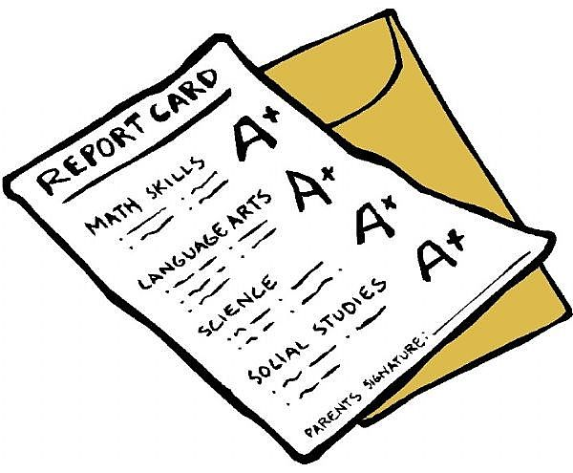
Programming Challenge: My Grades
Write a program that asks the user to enter in a test score
Allow the user to enter in as many scores as he or she wishes
When finished, calculate the user’s average score in the class. Assume that all tests are worth the same # of points (i.e. 100 points)

Slide 40
Programming Challenge: Coin Flips
Write a program that simulates a coin flipping 1 million times
Count the # of heads and tails that result, and display the result to the user after you have finished running the simulation

Slide 41
Programming Challenge: Math Quiz Part II
Write a program that asks the user 5 simple math problems
Each problem should utilize random numbers, but you can standardize on a single operation (i.e. subtraction)
Ask the user a question. If they answer correctly, they earn a point. If not, they do not earn a point.
At the end of the program present the user with their score.

Slide 42

Programming Challenge: AI "Guess a Number" game
Write a program that asks the user to supply a secret number between 1 and 1,000,000
Then have the computer continually guess until they find the secret number
Keep track of the number of attempts and report this to the user
Extension: How can this be optimized?

Slide 43
Programming Challenge: Rock, Paper, Scissors Tournament
Write a program that lets the user play a game of Rock, Paper, Scissors against the computer
End the game when either the player or the computer earns 3 points

Slide 44
Sentinels

Slide 45
Sentinel Overview
Imagine that you want to ask your users to enter in a large number of items that need to be calculated in a certain way.
You don’t know how many values the user will be entering.
Given our current toolset we really only have ways to handle this kind of scenario:
Ask the user at the end of each iteration if they want to continue. This can be annoying and make your program cumbersome if you will be entering in hundreds or thousands of values.
Ask the user ahead of time how many items they will be entering. This can be difficult since the user may not know at the beginning of the loop how many items they will be working with.

Slide 46
Sentinels in Action
A sentinel value is a predefined value that the user can type in to indicate that they are finished entering data
In the example below the value -1 is considered a sentinel -- it indicates to the program that the user is finished entering data.
Sentinels must be distinctive enough that they will not be mistaken for regular data (in the previous example the value -1 was used – there is no way that a "real" test value could be -1) >> Enter a test score (type -1 to end): 100
>> Enter a test score (type -1 to end): 80
>> Enter a test score (type -1 to end): -1
>> Your test average is: 90 %

Slide 47
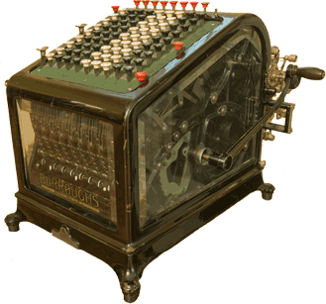
Programming Challenge: Adding Machine
Write a program that continually asks the user for an integer
Add the supplied integer to a total variable
When the user enters "done" end the program and display the sum and average for the user
Extension: find the highest and lowest price

Slide 48

Programming Challenge: Weight Loss Log
Write a program that asks the user to enter in a series of weight measurements taken over a period of days
The user can enter as many or as few weight values as they would like. Entering the value "0" should indicate that the user has finished entering data.
Calculate the user’s average weight during this period
Also calculate their weight change from the beginning of their weight loss program to the end of the program

Slide 49
Data Validation

Slide 50
Data Validation Overview
Often we need to ask the user to supply a value in our programs
But as you know you can't always trust the user to supply you with usable data!
One strategy you can use to ensure that you get "good" data is to "validate" the user's input. This involves asking the user for a value – if it meets our criteria we can continue. If not we will need to ask the user to re-supply the value.

Slide 51
Programming Challenge: Data Validation
Write a program that asks the user for a positive integer
Do not accept a negative value (or zero) – if the user supplies an invalid value you should re-prompt them
Once you have a positive integer you can print that number of stars to the screen. For example: Enter a positive integer: -5 Invalid, try again! Enter a positive integer: 0 Invalid, try again! Enter a positive integer: 5 *****

