Slide 1
Count Controlled Loops
CSCI-UA.0002
Introduction to Computer Programming

Slide 2
Count Controlled vs. Condition Controlled
A count controlled loop is a repetition structure that iterates a specific number of times
In contrast, a condition controlled loop iterates a variable number of times, and we ca control the number of iterations by testing a Boolean condition

Slide 3
Implementing a Count Controlled Loop using a "while" Loop
You can write a count controlled loop using a while loop. For example: counter = 0 while counter < 5: print("This will print 5 times") counter += 1

Slide 4
Count Controlled loops
Python has special a structure that can be used to implement a count controlled loop without needing to use a condition controlled loop
We call this a for loop

Slide 5
The "for" Loop
The "for" loop is Python’s native count controlled loop.
Example: for num in [1,2,3,4,5]: print("This will print 5 times")

Slide 6
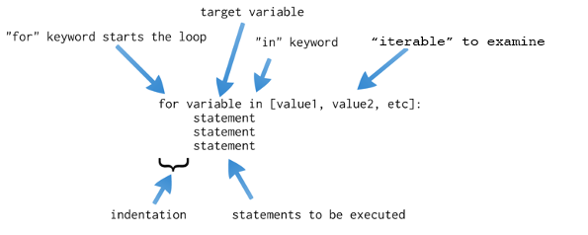
The "for" Loop Deconstructed

Slide 7
"for" Loop Mechanics
The "for" loop will iterate once for each item defined in the "iterable" passed to it when the loop begins
We've already learned one type of iterable - the `string` data type.
Another type of iterable in Python is called a "list". Lists in Python are defined by the square bracket characters "[" and "]". Items in a list are separated by a comma.
The first time a "for" loop iterates the target variable will assume the value of the first item in the iterable
The second time a "for" loop iterates the target variable will assume the value of the second item in the iterable
This continues until you reach the end of the iterable

Slide 8
Sample "for" Loop Output
for c in [1,2,3,4]: print(c)
1
2
3
4

Slide 9
The "for" Loop and Lists
We will talk more about lists in Module 8.
For now, know that lists are collections that can contain collections of different kinds of data. For example: for name in ['Ada', 'Alan', 'Grace']:
print("The current programmer is:", name)

Slide 10
Programming Challenge: The Bug Collector
A bug collector collects bugs every day for seven days.
Write a program that keeps a running total of the number of bugs collected during the seven days (i.e. Monday, Tuesday, Wednesday, etc)
The loop you write should ask for the number of bugs collected for each day, and when it finishes it should display the total number of bugs collected.

Slide 11
Programming Challenge: Student Test Scores
Write a program that iterates over the following student names:
John
Mary
Michael
Sophie
Ask the user to input a test score for each student
Calculate the average test score for the class

Slide 12
Programming Mechanics Challenge: "while" to "for"
Rewrite the following loop as a "for" loop: x = 0 while x < 5: print("hi") x += 1

Slide 13
Programming Mechanics Challenge: "for" to "while"
Rewrite the following loop as a "while" loop: for x in [10,20,30,40]: print("hi")

Slide 14
The "range" function

Slide 15
Disadvantages to List Literals
So far we have been iterating over lists using predefined values in our for loops
Example: for x in [1,2,3,4,5]: print('hi')
The "range" function lets you dynamically generate lists of integers based on a series of arguments

Slide 16
Output of the "range" function
for i in range(5): print('iteration #', i)
iteration # 0
iteration # 1
iteration # 2
iteration # 3
iteration # 4

Slide 17
Behavior of the "range" function
The "range" function takes at least one argument (an integer)
The "range" function returns an "iterable", which is a Python data type similar to a list.
When passed a single integer the range function will generate an iterable that will cause a for loop to iterate from 0 up to the number specified, minus one.

Slide 18
Iterables Generated by the "range" function
range function call
iterable
range(5)
range(10)
[0,1,2,3,4]
[0,1,2,3,4,5,6,7,8,9]

Slide 19
Using Multiple Arguments with "range"
You can pass additional arguments to the "range" function to cause it to behave differently range(1,5) # set a start and end value for the range # [1,2,3,4] range(5,10) # [5,6,7,8,9] range(0,10,2) # set a start, end and step value # [0,2,4,6,8] range(1,10,2) # [1,3,5,7,9]

Slide 20
Using loop targets

Slide 21
Loop targets
In a for loop we generally use the target variable as a reference value for some kind of calculation
Remember that the value of the target variable changes with each iteration of the loop

Slide 22
User controlled ranges
In many cases a programmer knows how many iterations they need in order to accomplish a desired task
However, sometimes we need to ask the user to control the # of iterations within a loop.
You can easily do this by substituting a variable within the "range" function to control the start, end and step values of the iterable that will be generated

Slide 23
Programming Challenge: (imperfect) Lottery # Picker
Write a program that generates random lottery numbers for the user
Ask the user for the number of digits they need as well as the high and low value of each digit (i.e. 6 digit number with digits ranging from 1 to 60)
Generate the desired lottery number

Slide 24
Reverse ranges

Slide 25
Generating Reverse Ranges
The step value passed to the "range" function does not necessarily have to be positive.
If you pass a negative step value to the "range" function it will count backwards for you.

Slide 26
Programming Challenge: Blast Off
Write a countdown program that prompts the user for a max value (e.g. 30)
Print out a countdown from that number down to zero, then print "blast off!"

Slide 27
Poll Everywhere

Slide 28
Programming Challenge: Squares
Write a program that calculates the square of the numbers between 1 and 10
Print out the number and its square as your loop iterates
Number Square
1 1
2 4 3 9 4 16 … … 10 100

Slide 29
Programming Challenge: Left Stair Steps
Write a program that prints out the following pattern of characters: ** **** ****** ******** ********** ************

Slide 30
Programming Challenge: Right Stair Steps
Write a program that prints out the following pattern of characters: ** **** ****** ******** ********** ************

Slide 31
Programming Challenge: Divisibility
Write a program that asks the user to enter two integers
Then find all numbers between 1 and 10,000 that are evenly divisible by both of those integers

Slide 32
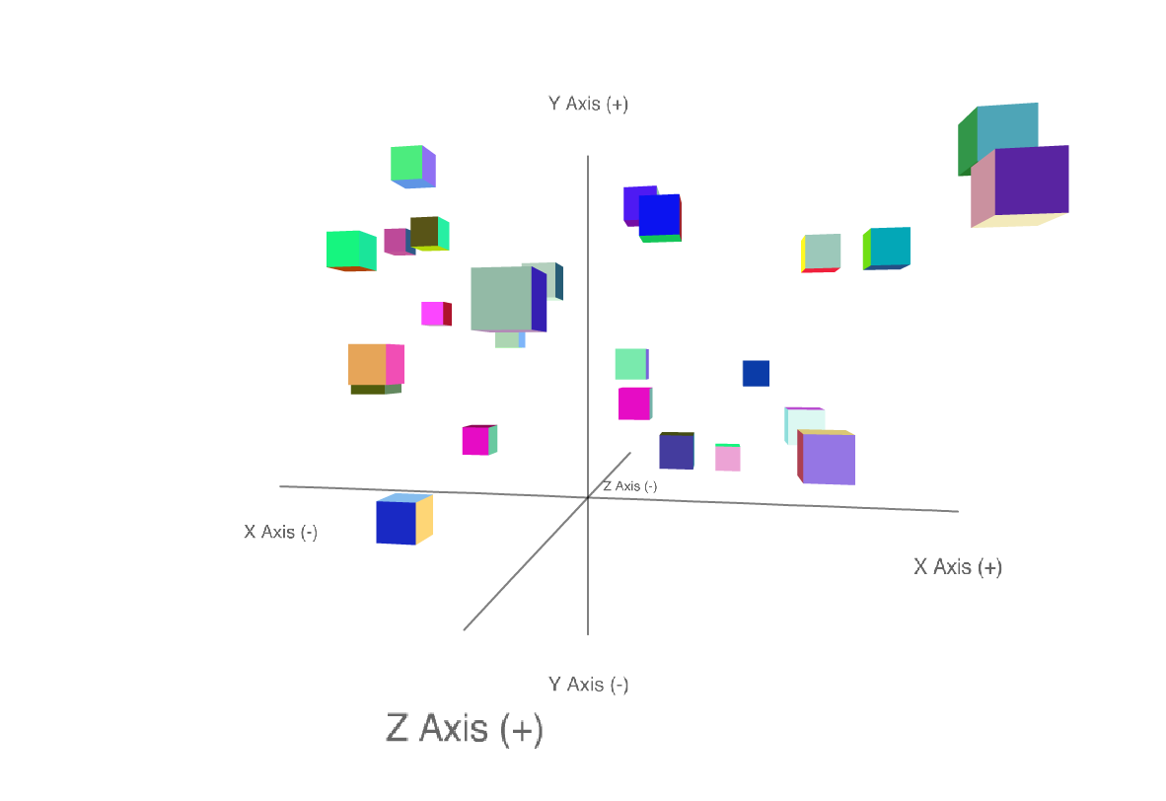
Programming Challenge: PySculpture3D!

Slide 33
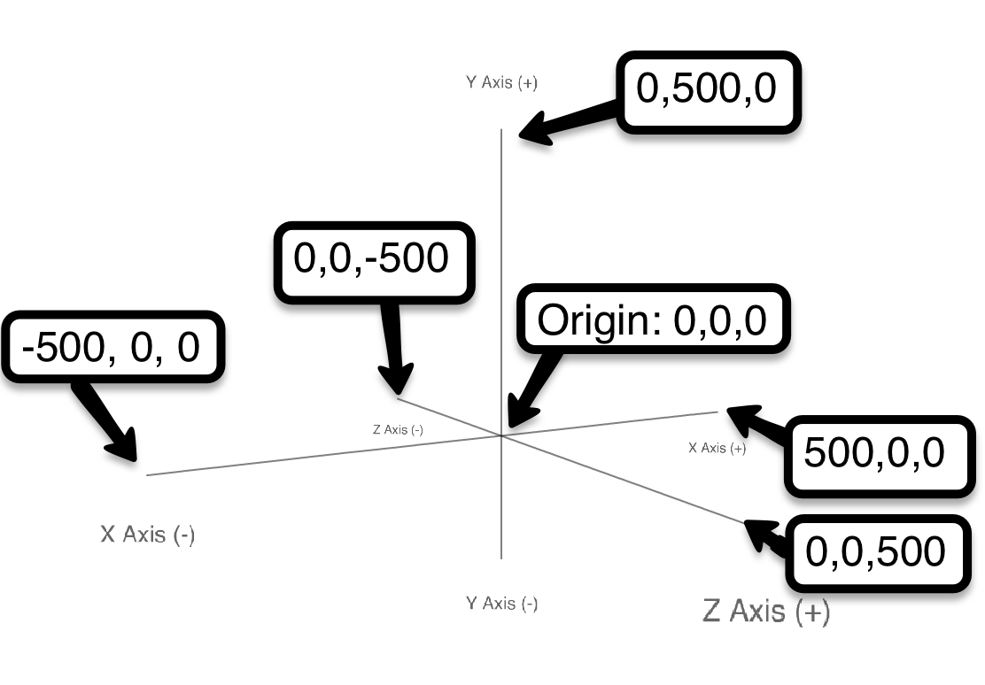
Coordinate System

Slide 34
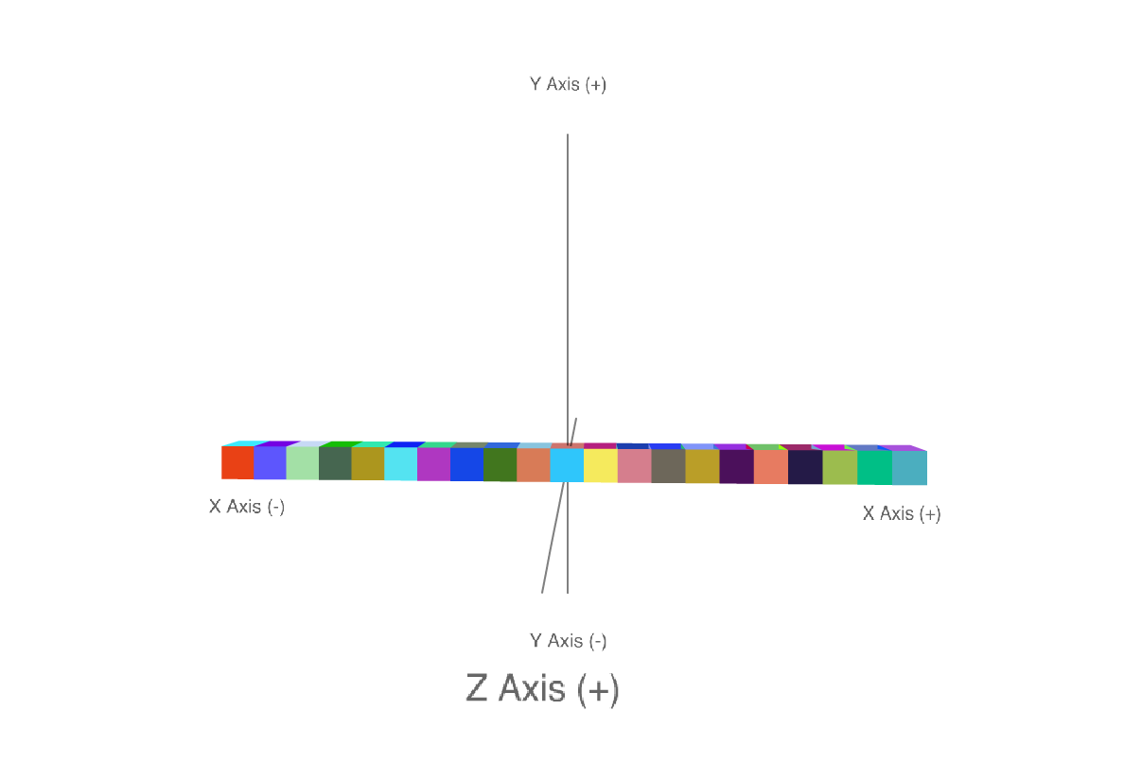
Programming Challenge: Linear Pattern

Slide 35
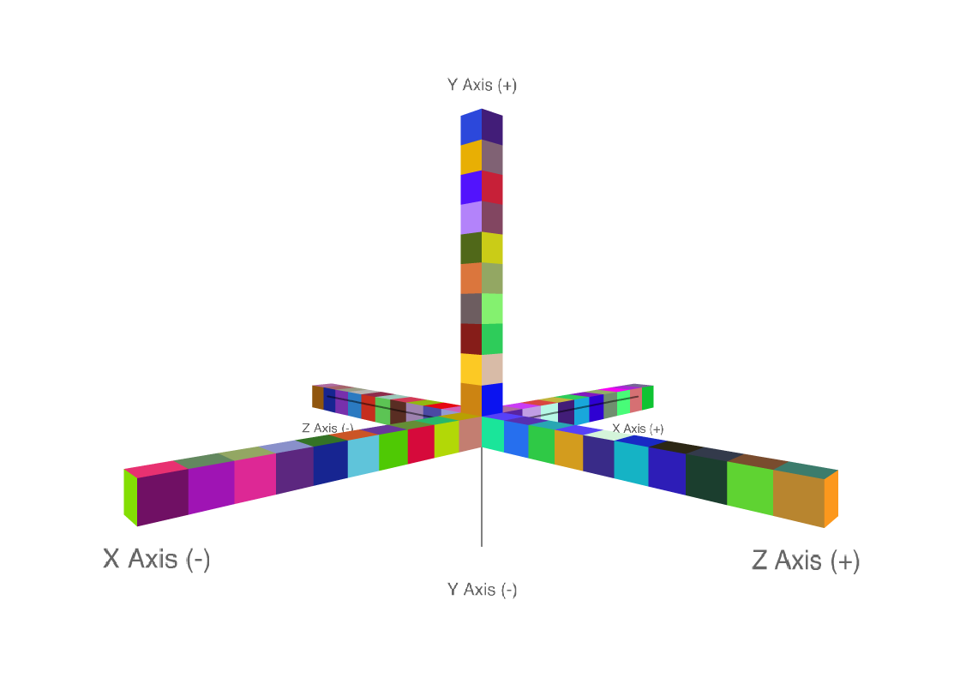
Programming Challenge: X Pattern

Slide 36
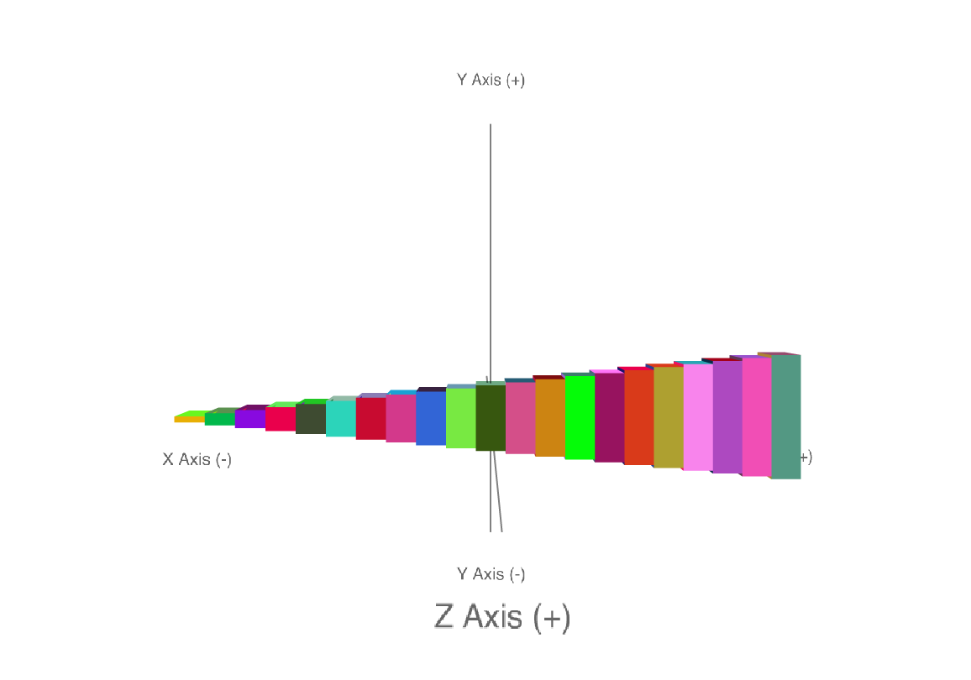
Programming Challenge: Horizontal Pattern

Slide 37
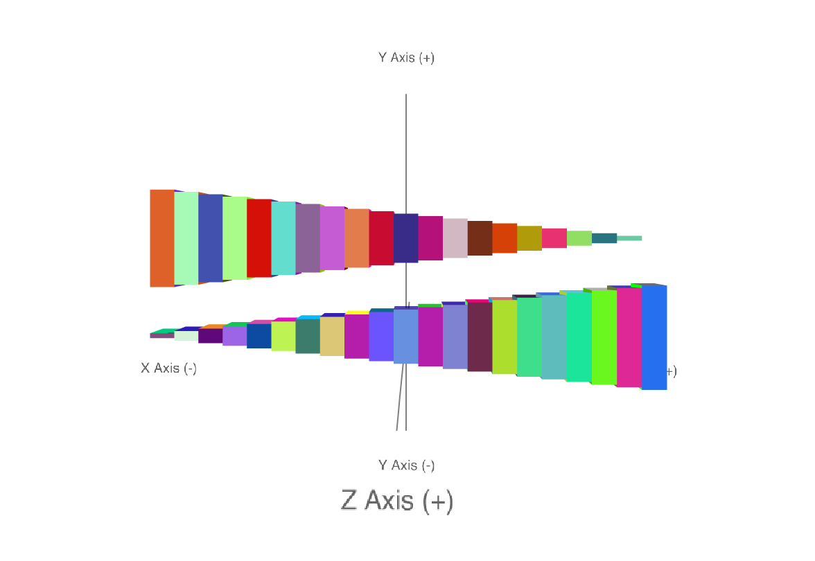
Programming Challenge: Two Patterns

Slide 38
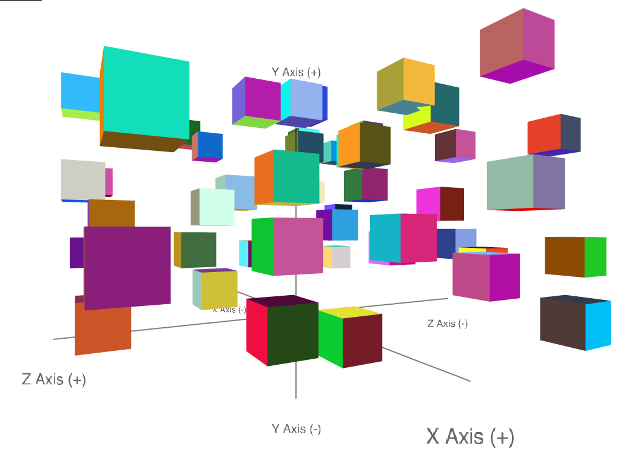
Programming Challenge: Random Cubes
Write a program that asks the user to enter in a number of cubes they want to generate
Also ask them for the size of the desired cubes
Then generate that number of randomly positioned cubes

Slide 39
Nested Loops

Slide 40
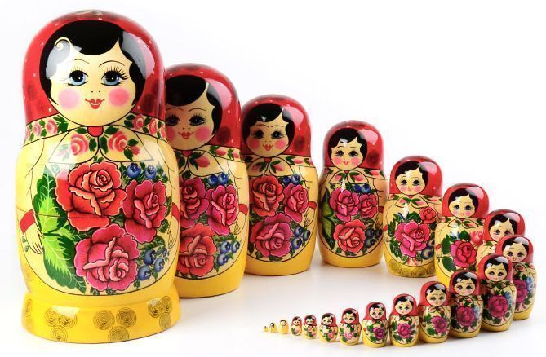
What is a Nested Loop?
A nested loop can be described as a "loop inside of a loop"
It’s the same idea as nested selection statements ("if" statements inside other "if" statements)

Slide 41
Addition Tables
Write a program that prints out a Addition table for the number 5. For example: 5 plus 1 is 6 5 plus 2 is 7 5 plus 3 is 8 … 5 plus 10 is 15

Slide 42
Addition Tables Expanded
Write a program that prints out a Addition table for the numbers 5 and 6. For example: 5 plus 1 is 6 5 plus 2 is 7 5 plus 3 is 8 … 5 plus 10 is 15 6 plus 1 is 7 6 plus 2 is 8 6 plus 3 is 9 … 6 plus 10 is 16

Slide 43
Addition Table Generator
Write a program that prints out the Addition tables for the numbers 1 through 10
Extend your program to allow the user to type in a range of Addition tables they want printed. Example: Addition Table Generator 2000! Enter the first number in your range: 1 Enter the last number for your table: 20

Slide 44
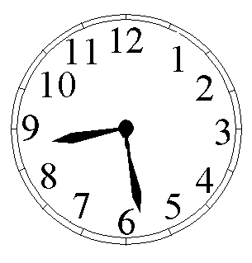
Programming Challenge: Clock Simulator
Write a program that prints out every possible time value for a single day.
Print out the hours, minutes and seconds starting at midnight and continue on to 11:59.59 PM.
Output each value as follows:
0:0:0
0:0:1
0:0:2
…
23:59:59

Slide 45
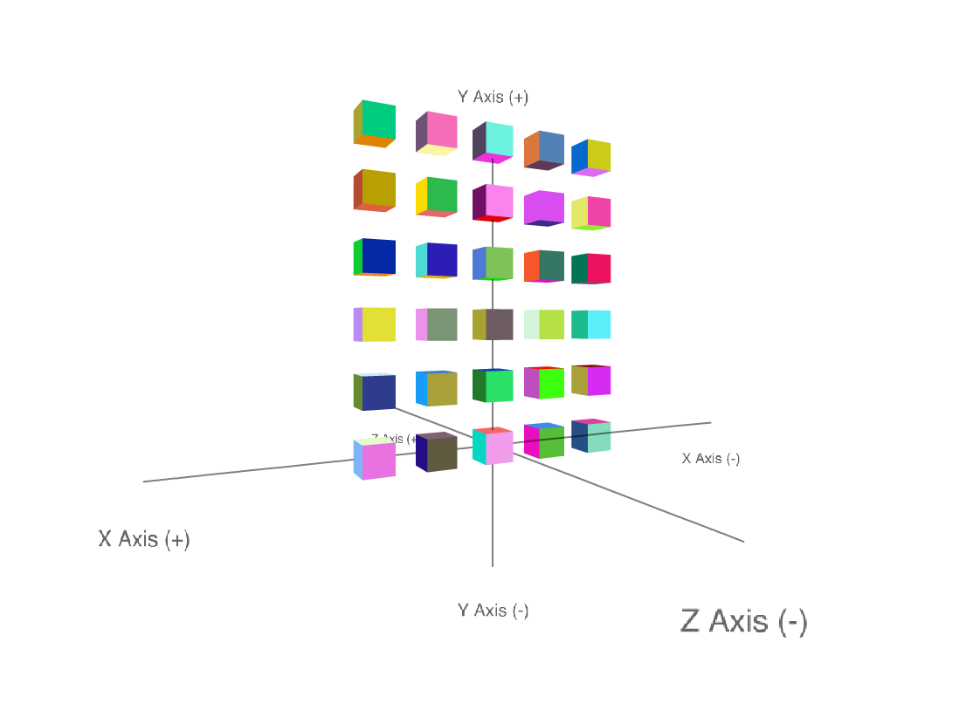
Programming Challenge: Wall of Cubes
Use nested loops to generate a "wall" of cubes

Slide 46
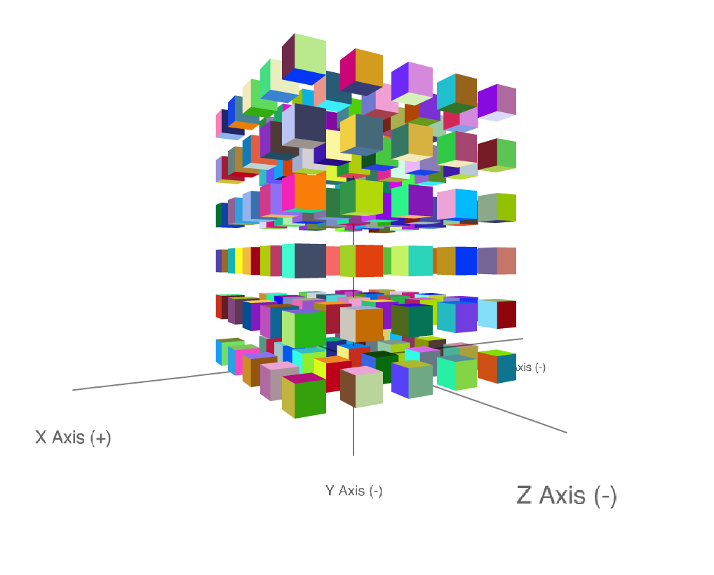
Programming Challenge: Volume of Cubes
Use nested loops to generate a "volume" of cubes

Slide 47
Nested Loops Considerations
The innermost loop will iterate through all its iterations for every single iteration of an outer loop
Inner loops complete their iterations faster than outer loops
To get the total number of iterations of a nested loop, multiply the number of iterations of all the loops

Slide 48
Programming Challenge: Average Rainfall
Write a program that calculates average rainfall over a period of years
Prompt the user for how many years of data they want to enter
For each year, prompt the user enter data for each month (Jan, Feb, Mar, etc.)
Generate the average rainfall per year and the average rainfall across all years.

Slide 49
Programming Challenge: Gradebook System
Write a program that lets a teacher calculate graders for his or her class
Ask the teacher for the # of students in class as well as the # of assignments
Allow the teacher to input the desired values and calculate the average score for each student based on the information given

Slide 50
Programming Challenge: Graphical Pattern
##
# #
# #
# #
# #
# #
# #
# #
# #
# #
Write a program that prints the pattern to the left using nested loops

Slide 51
Programming Challenge: Number Triangle
Reproduce the pattern to the right using nested loops
1
1 2
1 2 3
1 2 3 4
1 2 3 4 5
1 2 3 4 5 6

Slide 52
Programming Challenge: Prime Number Finder
Write a program to test to see if a given number is prime (this does not require a nested loop)
Next, use this program to all prime numbers between 2 and 1,000

