Slide 1
Working with Functions in Python
CSCI-UA.0002
Introduction to Computer Programming

Slide 2
"for" loop review & homework questions

Slide 3
Functions

Slide 4
Functions: What are they?
A function is a group of statements that exist within a program for the purpose of performing a specific task
Since the beginning of the semester we have been using a number of Python's built-in functions, including:
print
format
range
len
random.randint
… etc.

Slide 5
Functions: Usage
Most programs perform tasks that are large enough to be broken down into subtasks
Because of this, programmers often organize their programs into smaller, more manageable chunks by writing their own functions
Instead of writing one large set of statements we can break down a program into several small functions, allowing us to "divide and conquer" a programming problem

Slide 6
Defining Functions
Functions, like variables must be named and created before you can use them
The same naming rules apply for both variables and functions
You can't use any of Python's keywords
No spaces
The first character must be A-Z or a-z or the "_" character
After the first character you can use A-Z, a-z, "_" or 0-9
Uppercase and lowercase characters are distinct

Slide 7
Defining Functions Example
def myfunction():
print ("Printed from inside a function")
# call the function
myfunction()

Slide 8
Some notes on functions
When you run a function you say that you "call" it
Once a function has completed, Python will return back to the line directly after the initial function call
When a function is called programmers commonly say that the "control" of the program has been transferred to the function. The function is responsible for the program's execution.
Functions must be defined before they can be used. In Python we generally place all of our functions at the beginning of our programs.

Slide 9
Flow of Execution

Slide 10
Flow of Execution : Step 1
*
print("Welcome!")
for x in range(3):
print(x)
print("Goodbye!")
Welcome!

Slide 11
Flow of Execution : Step 2
*
print("Welcome!")
for x in range(3):
print(x)
print("Goodbye!")
Welcome!

Slide 12
Flow of Execution : Step 3
*
print("Welcome!")
for x in range(3):
print(x)
print("Goodbye!")
Welcome!
0

Slide 13
Flow of Execution : Step 4
*
print("Welcome!")
for x in range(3):
print(x)
print("Goodbye!")
Welcome!
0

Slide 14
Flow of Execution : Step 5
*
print("Welcome!")
for x in range(3):
print(x)
print("Goodbye!")
Welcome!
0
1

Slide 15
Flow of Execution : Step 6
*
print("Welcome!")
for x in range(3):
print(x)
print("Goodbye!")
Welcome!
0
1

Slide 16
Flow of Execution : Step 7
*
print("Welcome!")
for x in range(3):
print(x)
print("Goodbye!")
Welcome!
0
1
2

Slide 17
Flow of Execution : Step 8
*
print("Welcome!")
for x in range(3):
print(x)
print("Goodbye!")
Welcome!
0
1
2

Slide 18
Flow of Execution : Step 9
*
print("Welcome!")
for x in range(3):
print(x)
print("Goodbye!")
Welcome!
0
1
2
Goodbye!

Slide 19
Flow of Execution – With Functions

Slide 20
Flow of Execution with Functions : Step 1
*
def say_hello():
print("Hello!")
print("Start")
say_hello()
print("End")

Slide 21
Flow of Execution with Functions : Step 2
*
def say_hello():
print("Hello!")
print("Start")
say_hello()
print("End")
Start

Slide 22
Flow of Execution with Functions : Step 3
*
def say_hello():
print("Hello!")
print("Start")
say_hello()
print("End")
Start

Slide 23
Flow of Execution with Functions : Step 4
*
-
def say_hello():
print("Hello!")
print("Start")
say_hello()
print("End")
Start

Slide 24
Flow of Execution with Functions : Step 5
*
-
def say_hello():
print("Hello!")
print("Start")
say_hello()
print("End")
Start
Hello!

Slide 25
Flow of Execution with Functions : Step 6
*
def say_hello():
print("Hello!")
print("Start")
say_hello()
print("End")
Start
Hello!

Slide 26
Flow of Execution with Functions : Step 7
*
def say_hello():
print("Hello!")
print("Start")
say_hello()
print("End")
Start
Hello!
End

Slide 27
Multiple Functions

Slide 28
Multiple Functions Example
def hello():
print ("Hello there!")
def goodbye():
print ("See ya!")
hello()
goodbye()

Slide 29
Calling functions inside functions
def main():
print ("I have a message for you.")
message()
print ("Goodbye!")
def message():
print ("The password is 'foo'")
main()

Slide 30
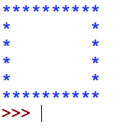
Programming Challenge: Hollow Square
Write a program that prints the pattern to the right using functions

Slide 31
Programming Challenge: User Controlled Hollow Rectangle
Ask the user for the height for a rectangle
Then draw a rectangle of that height

Slide 32
Local Variables

Slide 33
Local Variables:Variables within a Function
Functions are like "mini programs"
You can create variables inside functions just as you would in your main program

Slide 34
Local Variables Example
def bugs():
numbugs = int(input('How many bugs? '))
print (numbugs)
bugs()

Slide 35
Local Variables Scope
However, variables that are defined inside of a function are considered "local" to that function.
This means that they are only accessible within that function. Objects outside the "scope" of the function will not be able to access that variable
When the function ends any local variables will be lost unless communicated back to the caller of the function via the ‘return’ statement

Slide 36
Local Variables Scope Example
def bugs():
numbugs = int(input('How many bugs? '))
print (numbugs)
bugs()
print (numbugs) # error! Variable numbugs
# doesn't exist in this scope!

Slide 37
Variable Scope in Functions
Different functions can have their own local variables that use the same variable name
These local variables will not overwrite one another since they exist in different "scopes"

Slide 38
Variable Scope in Functions Example
def newjersey():
numbugs = 1000
print ("NJ has", numbugs, "bugs")
def newyork():
#print("NJ has", numbugs, "bugs")
numbugs = 2000
print ("NY has", numbugs, "bugs")
newjersey()
newyork()

Slide 39
Passing Arguments to a Function

Slide 40
Passing Data to Functions: Function Arguments
Sometimes it's useful to not only call a function but also send it one or more pieces of data as an argument
This process is identical to what you've been doing with the built-in functions we have studied so far
x = random.randint(1,5) # send 2 integers
y = len('Pikachu') # send 1 string

Slide 41
Passing Arguments to a Function Example
def square(num):
print(num**2) # num assumes the value of the
# argument that is passed to
# the function (5)
square(5)

Slide 42
Specifying Data Expectations with Function Parameters
When passing arguments, you need to let your function know what kind of data it should expect in your function definition
You can do this by establishing a “parameter” variable in the function definition.
This variable will be auto declared every time you call your function and will assume the value of the argument passed to the function.

Slide 43
Passing Multiple Arguments to a Function
You can pass any number of arguments to a function
One way to do this is to pass in arguments "by position"

Slide 44
Passing Multiple Arguments to a Function Example
def average(num1, num2, num3):
sum = num1+num2+num3
avg = sum / 3
print (avg)
average(100,90,92)

Slide 45
Programming Challenge: Tip Calculator
Write a function that accepts a restaurant check and a tip %
Print out the tip that should be left on the table as well as the total bill
If the tip is less than 15% you should tell the user that they might want to leave a little more on the table

Slide 46
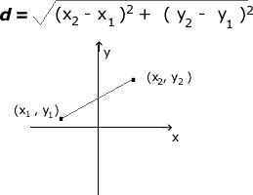
Programming Challenge: Distance Formula
Write a program that asks the user to enter two points on a 2D plane (i.e. enter X1 & Y1, enter X2 & Y2)
Compute the distance between those points using a function.
Continually ask the user for numbers until they wish to quit

Slide 47
Programming Challenge: Knock Knock Joke
Write a "joke" generator that prints out a random knock knock joke.
Extension: Write a "drum roll" function that pauses the program for dramatic effect! Have the drum roll function accept a parameter that controls how long it should pause.

Slide 48
Argument Mechanics

Slide 49
How Function Arguments Work: A Closer Look
When we pass an argument to a function in Python we are passing a reference to the memory address that holds the variable, not the value of the variable itself.
You can think of the memory address like a "hyperlink" that points to the value that the variable is holding.
For the data types we have learned so far (integers, floats, Booleans and strings) this means that for all practical purposes, the value of the variable is communicated into the function and stored in a new, separate variable.
Changing the newly created variable has no bearing on the original variable.
We will revisit this discussion and will cover this in much greater detail when we get to modules 7 & 8 and discuss the concepts of immutability and mutability of data types.

Slide 50
Argument Mechanics Example
def change_me(v):
print("function got:", v) v = 10 print("argument is now:", v)
myvar = 5
print("starting with:", myvar)
change_me(myvar)
print("ending with:", myvar)

Slide 51
Global Variables

Slide 52
Local and Global Variables
When you create a variable inside a function we say that the variable is "local" to that function
This means that it can only be accessed by statements inside the function that created it
When a variable is created outside all of your functions it is considered a "global variable"
Global variables can be accessed by any statement in your program file, including by statements in any function
All of the variables we have been creating so far in class (outside of those created inside of functions) have been global variables

Slide 53
Global Variables Example
name = 'Pikachu'
def showname():
print("Function:", name)
print("Main program:", name)
showname()

Slide 54
Updating Global Variables
If you want to be able to change a global variable inside of a function you must first tell Python that you wish to do this using the "global" keyword inside your function.
This gives the function the ability to overwrite the memory address of the variable in question and store a new value. We will discuss how memory works in greater detail when we get to Module 08.

Slide 55
Updating Global Variables Example
name = 'Pikachu'
def showname():
global name print("Function 1:", name) name = 'John' print("Function 2:", name)
print("Main program 1:", name)
showname()
print("Main program 2:", name)

Slide 56
Considerations When Using Global Variables
Global variables can make debugging difficult
Functions that use global variables are generally dependent on those variables, making your code less portable
With that said, there are many situations where using global variables makes a lot of sense.

Slide 57
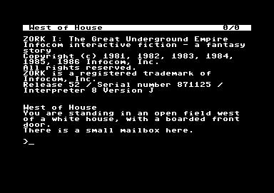

Programming Challenge: Zork
Write a very brief "choose your own adventure" style game using functions
Reference: http://textadventures.co.uk/games/play/5zyoqrsugeopel3ffhz_vq

Slide 58
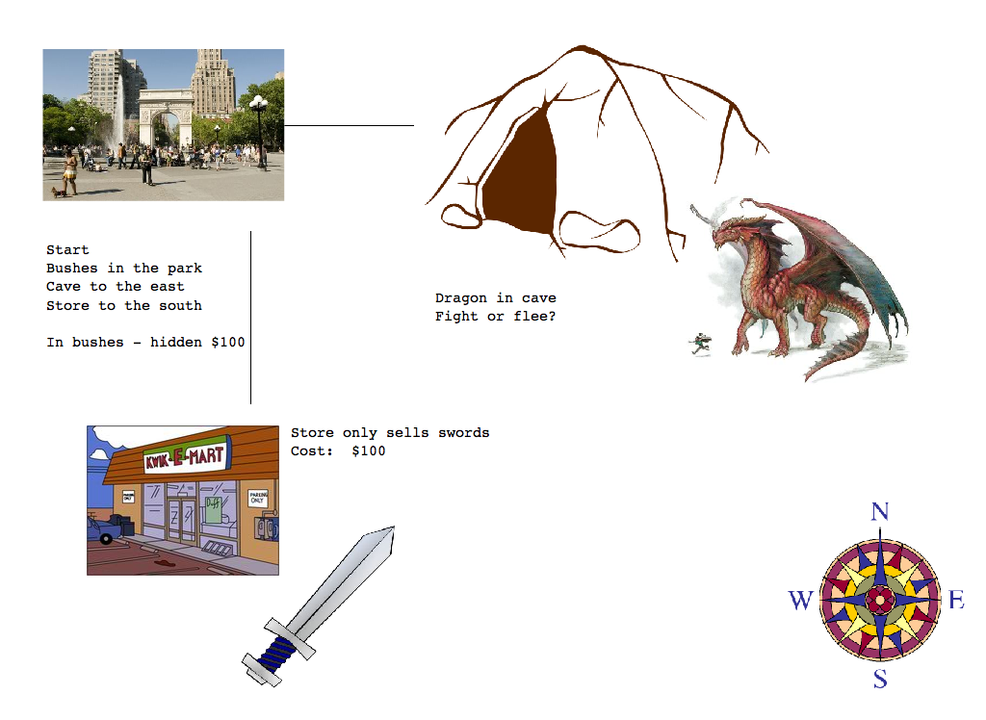
Programming Challenge: Text game

Slide 59
Value Returning Functions

Slide 60
Value Returning Functions: : Functions with Results
Value returning functions are functions that return a value to the part of the program that initiated the function call
They are almost identical to the type of functions we have been writing so far, but they have the added ability to send back information at the end of the function call
We have secretly been using these all semester!
somestring = input("Tell me your name")
somenumber = random.randint(1,5)

Slide 61
Writing your own value returning functions
You use almost the same syntax for writing a value returning function as you would for writing a normal function
The only difference is that you need to include a "return" statement in your function to tell Python that you intend to return a value to the calling program
The return statement causes a function to end immediately. It's like the break statement for a loop.
A function will not proceed past its return statement once encountered. Control of the program is returned back to the caller.

Slide 62
Value Returning Functions Example
def myfunction(arg1, arg2):
statement
statement
…
statement
return expression
# call the function
returnvalue = myfunction(10, 50)

Slide 63
"return" != "print"

Slide 64
"RETURN" != "PRINT"

Slide 65
"RETURN" != "PRINT"

Slide 66
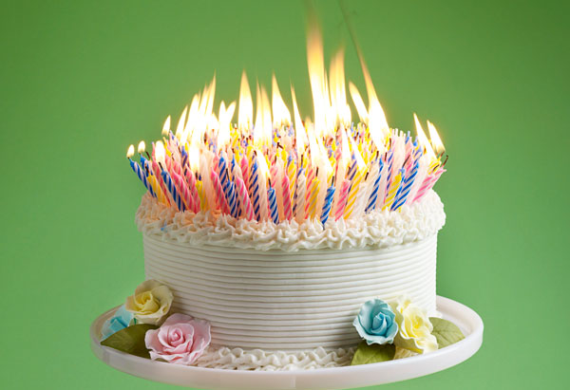
Programming Challenge: Combined Age
Write a function that takes two age values as integers, adds them up and returns the result as an integer

Slide 67

Programming Challenge: Discounted Pricing
Prompt the user for an item price (using a function)
Apply a 20% discount to the price (using a function)
Print the starting price and the discounted price
Extension:
Don't accept price values less than $0.05 – repeatedly ask the user to enter new data if this happens
Repeat the discounting process until the user elects to stop entering data

Slide 68
Programming Challenge: Revisiting Distance Formula
Write a program that asks the user to enter a point on a 2D plane (i.e. enter X & Y)
Compute the distance between that point and the origin of the plane (0,0)
If the distance is < 10, tell them they hit a bullseye. If the distance is >= 10, they missed!

Slide 69
IPO Notation
As you start writing more advanced functions you should think about documenting them based on their Input, Processing and Output (IPO)
Example: def add_ages(age1, age2): ''' function: add_ages input: age1 (integer), age2 (integer) processing: combines the two integers output: returns the combined value ''' sum = age1+age2 return sum

Slide 70
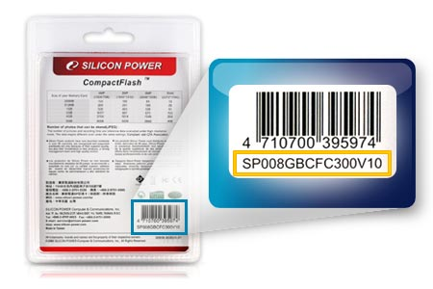
Returning Boolean Values
Boolean values can drastically simplify decision and repetition structures
Example:
Write a program that asks the user for a part number
Only accept part #'s that are on the following list:
100
200
300
400
500
Continually prompt the user for a part # until they enter a correct value

Slide 71
Returning multiple values
Functions can also return multiple values using the following syntax: def testfunction(): x = 5 y = 10 return x, y p, q = testfunction()

Slide 72
Programming Challenge: Two Dice
Write a function that simulates the rolling of two dice
The function should accept a size parameter (i.e. how many sides does each die have)
The function should return two values which represent the result of each roll
Extension:
Make sure both numbers that you return are different (i.e. you can't roll doubles or snake eyes)
Build in an argument that lets you specify whether you want to enforce the no doubles policy

Slide 73
Programming Challenge: Feet to Inches
Write a function that converts feet to inches. It should accept a number of feet as an argument and return the equivalent number of inches.

Slide 74
Programming Challenge: Maximum of two values
Write a function named "maximum" that accepts two integer values and returns the one that the greater of the two to the calling program

Slide 75
Modules

Slide 76
Python's Standard Library and Module Imports
All programming languages come pre-packaged with a standard library of functions that are designed to make your job as a programmer easier
Some of these functions are built right into the "core" of Python (print, input, range, etc)
Other more specialized functions are stored in a series of files called "modules" that Python can access upon request by using the "import" statement
import random
import time

Slide 77
Exploring Python Modules
On a Mac you can see these files here:
/Library/Frameworks/Python.framework/Versions/Current/lib/python3.XX/
To see information about a module, you can do the following in IDLE:
import modulename
help(modulename)

Slide 78
Importing Modules: Accessing External Functionality
The import statement tells Python to load the functions that exist within a specific module into memory and make them available in your code
Because you don't see the inner workings of a function inside a module we sometimes call them "black boxes"
A "black box" describes a mechanism that accepts input, performs an operation that can't be seen using that input, and produces some kind of output

Slide 79
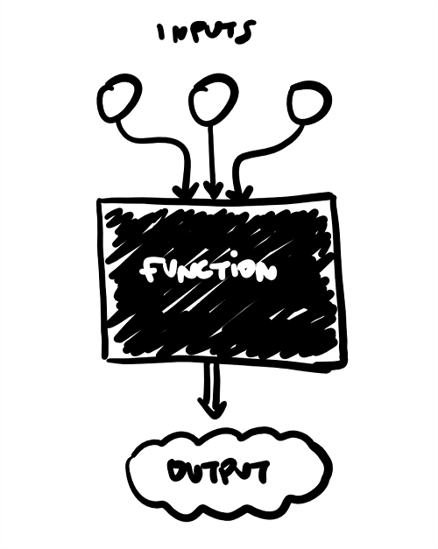
"Black Box" model

Slide 80
Functions in modules
We call functions that exist within a module by using "dot notation" to tell Python to run a function that exists in that module
Example:
num = random.randint(1,5)

Slide 81
Listing functions in a module
You can list the functions that exist in a particular module by using the help() function
The help() function takes one argument (a string that represents the name of the module) and returns the user manual for that module

Slide 82
Creating your own modules
You can easily create your own modules that you can populate with your own functions. Here's how:
Create a new python script (i.e. "myfunctions.py")
Place your function definitions in this script
Create a second python script (i..e "myprogram.py")
Import your function module using the import statement: import myfunctions
Call your functions using dot notation myfunctions.function1() myfunctions.dosomethingelse()

Slide 83
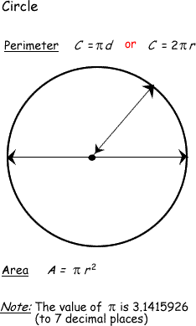
Programming Challenge: Circles
Create a module called "geometry_helper"
Write two functions in this module:
Area of circle
Perimeter of circle
Each of these functions will accept one argument (a radius) and will print out the result to the user.

Slide 84
Some additional functions inside the random module
Floating point random #'s
num = random.random()
# generates a float between 0 and 1
num = random.uniform(1,10)
# generates a float between 1 and 10

Slide 85
Seeding the random number generator
As we mentioned in an earlier class, the computer does not have the ability to generate a truly random #
It uses a series of complicated mathematical formulas that are based on a known value (usually the system clock)
The seed function in the random module allows you to specify the "seed" value for the random #'s that the various random number functions generate
You can seed the random # generator with whatever value you want – and you can even reproduce a random range this way!

