Slide 1
Functions Continued
Introduction to Programming - Python

Slide 2
Homework Questions?

Slide 3
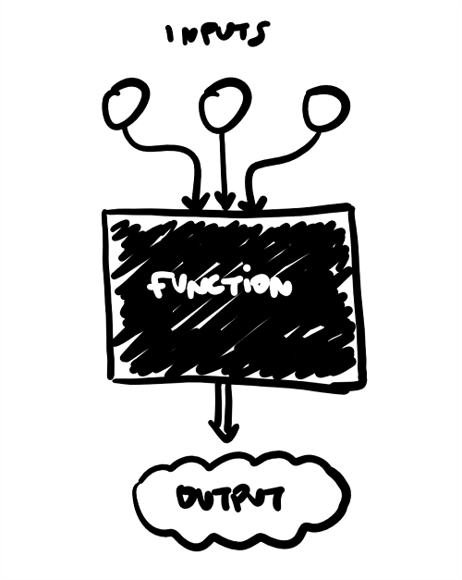
The “Opaque Box” model

Slide 4
Value Returning Functions
Value returning functions are functions that return a value to the part of the program that initiated the function call
They are almost identical to the type of functions we have been writing so far, but they have the added ability to send back information at the end of the function call
We have secretly been using these all semester!
somestring = input("Tell me your name")
somenumber = random.randint(1,5)

Slide 5
Writing your own value returning functions
You use almost the same syntax for writing a value returning function as you would for writing a normal function
The only difference is that you need to include a “return” statement in your function to tell Python that you intend to return a value to the calling program

Slide 6
Value Returning Functions : Example
def myfunction(arg1, arg2):
statement
statement … statement return expression
# call the function
returnvalue = myfunction(10, 50)

Slide 7
"return" != "print"

Slide 8
"RETURN" != "PRINT"

Slide 9
IPO Notation
As you start writing more advanced functions you should think about documenting them based on their Input, Processing and Output (IPO)
Example: def add_ages(age1, age2): ''' function: add_ages input: age1 (integer), age2 (integer) processing: combines the two integers output: returns the combined value ''' sum = age1+age2 return sum

Slide 10
Returning other data types
Functions can return any kind of data type
Example:
Write a program that gets the user’s full name and two distinct strings. Combine those strings and return them to the calling program.

Slide 11
Returning multiple values
Functions can also return multiple values using the following syntax: def testfunction(): x = 5 y = 10 return x, y p, q = testfunction()

Slide 12
Programming Challenge: Feet to Inches
Write a function that converts feet to inches. It should accept a number of feet as an argument and return the equivalent number of inches.
Create a second function that converts inches to feet and returns the result.

Slide 13
Programming Challenge: Combined Age
Write a function that takes two age values as integers, adds them up and returns the result as an integer

Slide 14
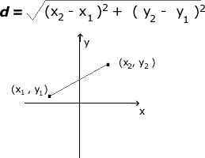
Programming Challenge: Distance Formula
Write a program that asks the user to enter a point on a 2D plane (i.e. enter X & Y)
Compute the distance between that point and the origin of the plane (0,0)
If the distance is < 10, tell them they hit a bullseye. If the distance is >= 10, they missed!

Slide 15
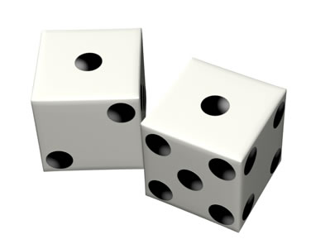
Programming Challenge: Two Dice
Write a function that simulates the rolling of two dice
The function should accept a size parameter (i.e. how many sides does each die have)
The function should return two values which represent the result of each roll
Extension:
Make sure both numbers that you return are different (i.e. you can’t roll doubles or snake eyes)
Build in an argument that lets you specify whether you want to enforce the no doubles policy

Slide 16
Programming Challenge: Test Average and Grade
Write a program that asks the user to enter in 5 test scores.
Write a function called “determine_grade” that accepts a test score as an argument and returns the letter grade
Write a function called “calc_average” that accepts five test scores as arguments and returns the score average and the letter grade of the average score
Extension: have your function accept a potentially unlimited number of test scores (use the “*” prefix to have your function accept a variable number of arguments)

Slide 17
Python Modules

Slide 18
Modules
All programming languages come pre-packaged with a standard library of functions that are designed to make your job as a programmer easier
Some of these functions are built right into the “core” of Python (print, input, range, etc)
Other more specialized functions are stored in a series of files called “modules” that Python can access upon request by using the “import” statement
import random
import time

Slide 19
Continued: Modules
On a Mac you can see these files here:
/Library/Frameworks/Python.framework/Versions/Current/lib/python3.9/
To see information about a module, you can do the following in IDLE:
import modulename
help(modulename)

Slide 20
More on Modules
The import statement tells Python to load the functions that exist within a specific module into memory and make them available in your code
Because you don’t see the inner workings of a function inside a module we sometimes call them “black boxes”
A “black box” describes a mechanism that accepts input, performs an operation that can’t be seen using that input, and produces some kind of output

Slide 21
Functions in modules
We call functions that exist within a module by using “dot notation” to tell Python to run a function that exists in that module
Example:
num = random.randint(1,5)

Slide 22
Listing functions in a module
You can list the functions that exist in a particular module by using the help() function
The help() function takes one argument (a string that represents the name of the module) and returns the user manual for that module

Slide 23
Programming Challenge
Create a module called “geometry_helper”
Write two functions in this module:
Area of circle
Perimeter of circle
Each of these functions will accept one argument (a radius) and will return the result to the user.

Slide 24
Some Practice Problems

Slide 25
Fireworks Function
You are working for a fireworks company that wants to try out a new marketing strategy. They would like to try a new promotion that gives away free fireworks to customers who purchase a certain quantity – the more you buy, the more free fireworks you get!
Here is their current promotion:
Buy between 1 and 10 fireworks, get 0 free
Buy between 11 and 20 fireworks, get 1 free
Buy between 21 and 30 fireworks, get 3 free
Buy more than 31 fireworks, get 5 free
Write a function that accepts one argument (# of fireworks) and returns the number of free fireworks that should be given away with that order.

Slide 26
Fireworks Program
Write a program that prompts the user for an amount of fireworks.
Then use your fireworks function that you wrote for the previous problem to figure out how many free fireworks they are eligible for.
Print out a summary like the following and allow the user to continue entering quantities if desired. Enter a quantity: 100 You are eligible for 5 free fireworks! Would you like to calculate another quantity? (yes/no): yes Enter a quantity: 3 Sorry, you are not eligible for any free fireworks. Would you like to calculate another quantity? (yes/no): no

Slide 27
Letter Grade Determination
Write a function that accepts a grade as a single floating point value and returns its letter equivalent.
Letters grades can be determined using the following table:
100-90: A
80-89.99: B
70-79.99: C
65-69.99: D
Lower than 65: F

