Slide 1
Midterm Exam Review
Introduction to Programming - Python

Slide 2
Quiz #1 Statistics
Average score: 75.1%
Median score: 80.7%
Mode: 100.0% (22 students)
Note: There were 14 possible points on the multiple choice portion of the quiz, but I graded the quiz out of 12. This had the effect of boosting everyone's score slightly.

Slide 3
Midterm Exam Format
Delivered IN PERSON on Wednesday 10/22/2025 from 9:30am - 10:45am in our regular classroom
Question types: Multiple choice, True/False, Fill in the blank, Matching, writing short programs
Time limit: 1 hour 5 minutes (+ extra time for students with documented accommodations through the Moses Center)
10 minutes reserved at the beginning of class to check in for the exam
Closed book, closed notes (Python command + function index and ASCII code will be made available on the exam)

Slide 4
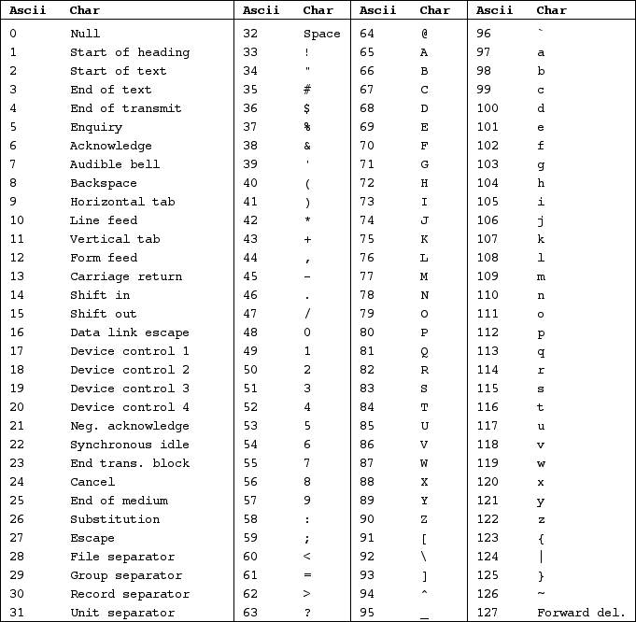
Python Command Index
len
not
or
print
return
str
while
random.randint
str.lower
str.upper
and
break
continue
def
elif
else
float
for
format
if
in
import
input
int

Slide 5
Midterm Exam Policies & Procedures
You must be physically present on the day of the exam
You should arrive early to class to “check in” – you will do this by showing your NYU ID to me and/or our course assistants
Once you are checked in you will be given a sheet of paper which will tell you where to sit during the exam

Slide 6
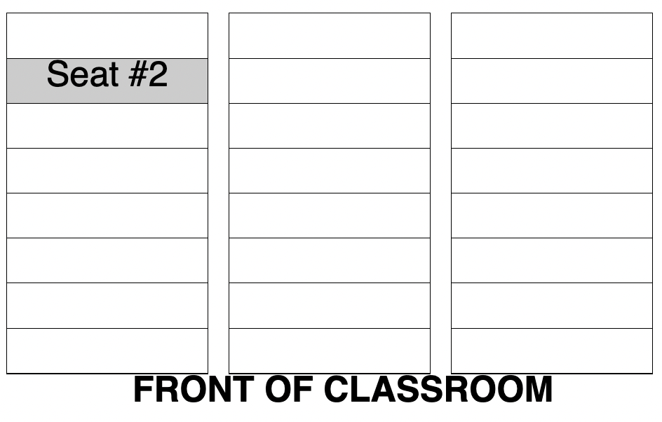
Check-in Sheet & Exam Policies
This is a closed-book, closed notes, closed-neighbor exam. You may only use your computer during the exam. No other electronic devices are allowed, and you may not communicate with another human or digital agent during the test, including but not limited to AI enabled websites, tools and apps.
The following actions will result in an immediate grade of 0 on the midterm exam:
Attempting to use unauthorized resources during the exam.
Communicating or attempting to communicate with another student during the exam.
Looking at another student's computer during the exam, or sharing your work with another student.
Continuing to write code the exam has officially ended

Slide 7
Midterm Exam Concepts

Slide 8
Programming Mechanics
Functions (what are they, using them, arguments, return values, etc)
Commenting your code
Variables (what are they, creating them, using them, naming rules, etc.)
Reading input from the keyboard with the input() function

Slide 9
Math Expressions
Math operators (+, -, /, //, *)
Writing math expressions
Evaluating math expressions
Storing & printing the results of math expressions
Difference between the two division operators (/ and //)
Order of operations in math expressions
The exponent operator (**)
The modulo operator (%)
Generating random numbers

Slide 10
Data Types
General concept — what is a data type?
Strings
Numeric data types
Integers (int)
Floating point numbers (float)
Mixed type expressions
User input & data types (converting strings to floats / ints for calculation purposes)
Using the float() and int() function to convert strings into numbers
The Boolean data type
Boolean variables

Slide 11
Output
General use of the print function and its default behavior
Custom line endings (end=")
Custom item separators (sep=")
Escape characters
"\n"
"\t"
"hello \"world\"!"

Slide 12
Basic String Manipulation
Combining two strings (concatenation)
Multiplying a string (x = 'hi' * 5)
Formatting numbers using the format() function
Case manipulation (x = str.lower('APPLE') # converts the string literal 'APPLE' to 'apple')
Calculating string length using the len() function

Slide 13
Formatting
General usage of the format function
Formatting strings
Formatting integers
Formatting floating point numbers
Formatting using f-strings

Slide 14
Debugging & Error types
Identify the 3 types of errors
Syntax
Runtime
Logic
Be able to spot errors in code and identify their types
Be able to suggest solutions to fix specific errors when detected

Slide 15
Selection Statements
The structure of an IF statement (IF keyword, condition, colon, indentation)
Writing a condition for an IF statement
Boolean operators (<, >, ==, !=, >=, <=)
Comparing numeric values using Boolean expressions
Comparing string values using Boolean expressions
Using the IF-ELSE statement
Nesting decision structures (IF statements inside other IF statements)
The IF-ELIF-ELSE statement
Logical operators (and, or, not)

Slide 16
Condition-Controlled Loops
Loop mechanics & how they work
Setting up conditions for a while loop
Infinite loops and how to avoid them
Sentinels (defining a value that the user enters that causes the loop to end)
Data validation loops (asking the user to continually enter a value until that value matches some condition)
Setting up and using accumulator variables
Self referential assignment statements (e.g. counter = counter + 1)
Augmented assignment operators (e.g. counter += 1)

Slide 17
Count-Controlled Loops
Mechanics and how they work
Iterating over a list (e.g. for x in [1,2,3,4,5]:)
Using the target variable in a for loop
Nested loops (loops inside of other loops)
Comparing and contrasting "for" loops with "while" loops (when to use each loop, main advantages of each structure, etc)
The range function:
Mechanics and how the function works
Creating simple ranges (i.e. range(5))
Creating ranges with defined start and end points (i.e. range(3,10))
Creating ranges with a step value (i.e. range(5,50,5))
Creating ranges that count backwards (i.e. range(50,5,-5))
User controlled ranges (i.e. range(1, somevariable))

Slide 18
User-Defined Functions
Mechanics and how functions work
The "opaque box" model
Function definitions
Arguments
Return values
Calling a function
Local variables (variables that are defined inside a function and can only be accessed inside that function)

Slide 19
User-Defined Functions (continued)
Passing arguments to your own functions
Passing multiple arguments to your own functions
Global variables (variables created outside a function that can be accessed by any part of your program)
Making changes to global variables inside a function using the ‘global’ keyword
Writing a value returning function (i.e. using the ‘return’ keyword to send a result from your function to the part of your program that called that function)
Returning multiple values from a function
Input, Processing & Output notation

