Slide 1
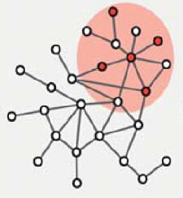
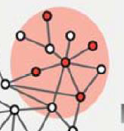
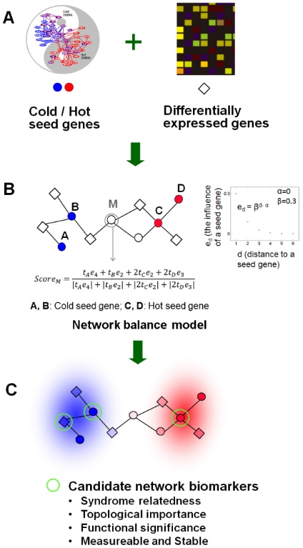
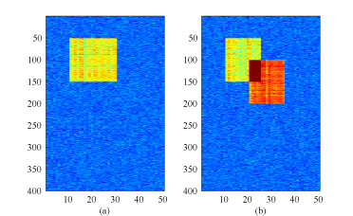
Multilevel
Multilayer network
Biomarker module Propagation
Module analysis & annotation
Knowledge
Co-occurence
CSPN
GO enrichment
Literature
gene
Prognosis
Diagnosis
predictive
Biomarker-related pathway analysis
Pharmacological
Intervention analysis
Database
prognosis
Omics data
pathway
Mutation
driver vs passenger
Network
construction
CNV
………
TCM Syndrome analysis
Prediction
Data: curated biomarkers/database
DEGs DCEs（Transcriptome）
CIPHER[6]
Cohort-specific
biomarker analysis
gene
HPM[3]
Proteomic DB[4]
HPA[5]
DEGs
DCEs
Fisher exact test
Tissue-specific
Proteome
analysis
[1]A. Sharma et al., Hum Mol Genet, 2015
Clinical feature
[2]Mitra.K., Nat Rev Genet. 2013
Criterion & annotation:
Known biomarker?
Expression?
Tissue-specific?
[3]M. S. Kim et al. Nature. 2014
Molecular biomarker
[4]Wilhelm et al. Nature. 2014
[5]Mathias Uhlén et al.Science.2015
[6] Wu X et al. MSB, 2008

Slide 2
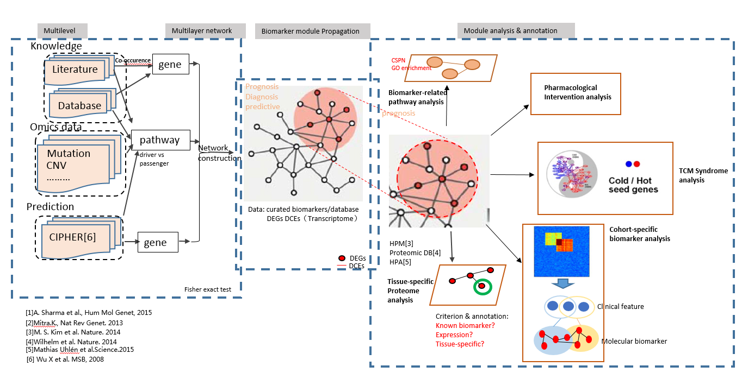
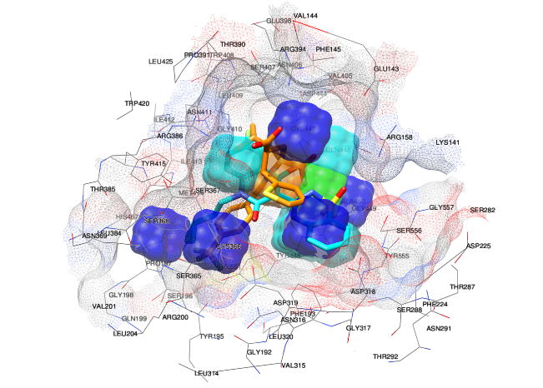
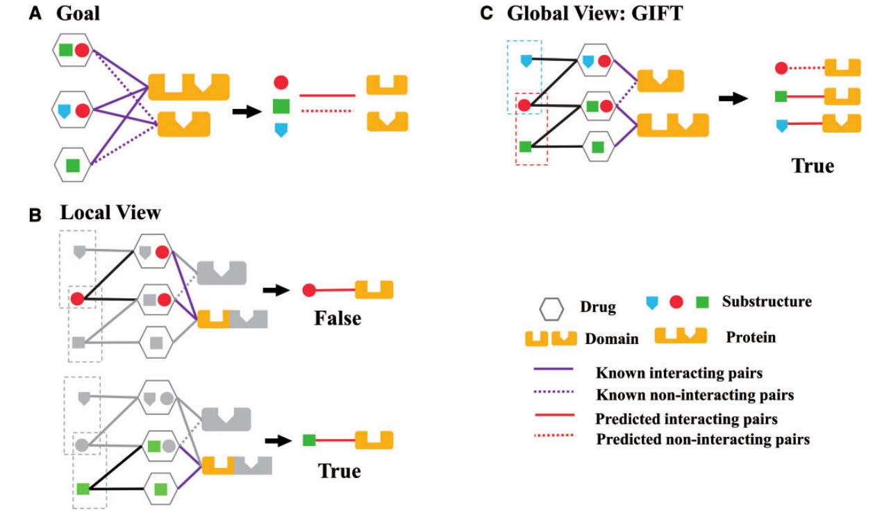
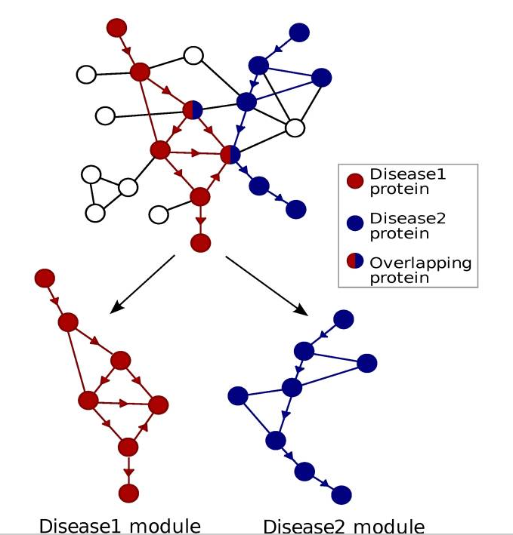
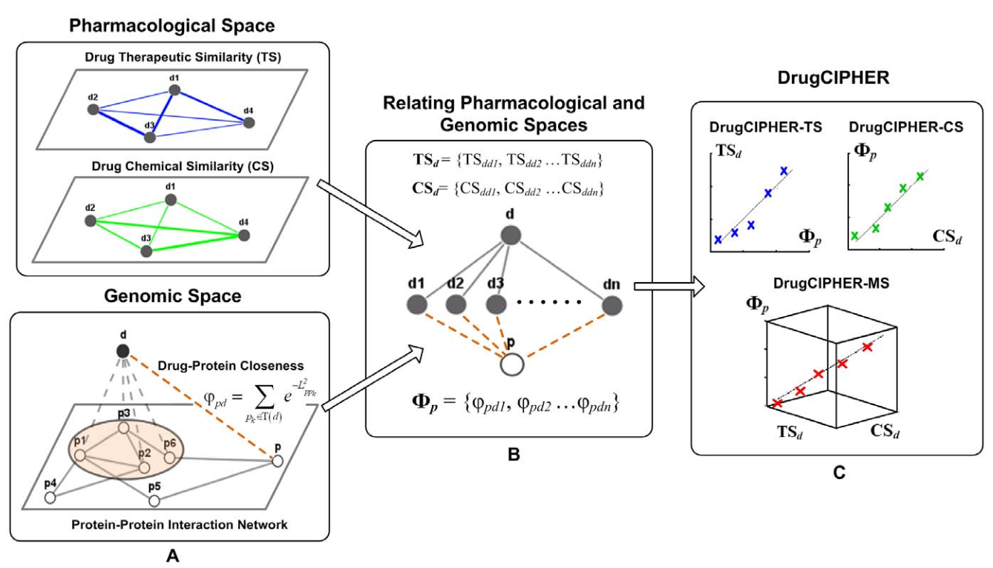
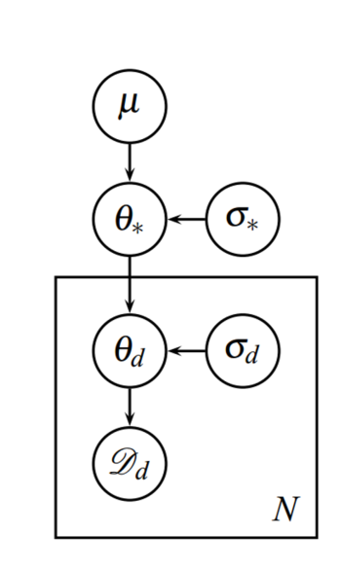
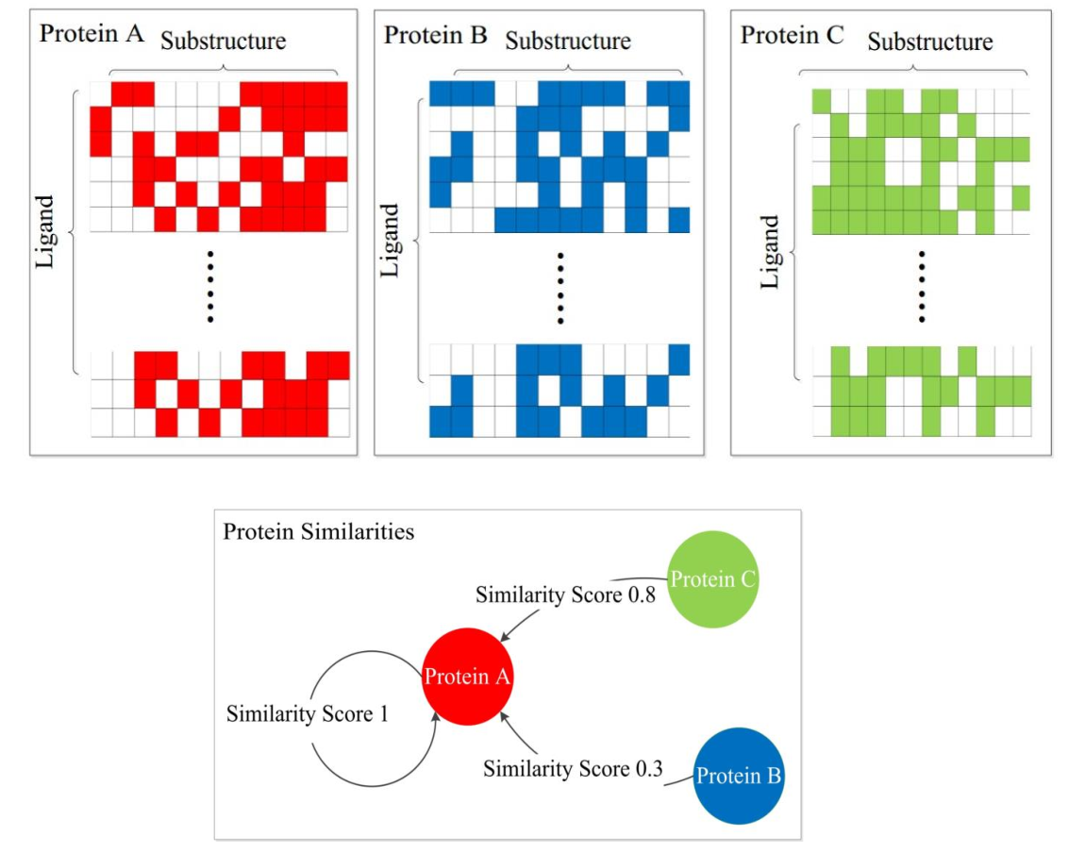
Disease Network Construction
Quantitative Structure-Activity
Relationship
Network and Chemogenomic-based
Target Prediction
Structure-based QSAR
GIFT
Human Protein-Protein
Interaction Network
DrugCIPHER
Ligand-based QSAR
Disease module
Predicted targets

Slide 3
Input
Basic Information
Method
Output
Phenotype
CIPHER
Phenotype Network
Paper &
Experiment
PPI Network
Mapping
Enrichment
A complete understanding
of how this compound works
on this target
Target list
Pathway
PPI Network
Compound Similarity
Compound
DrugCIPHER
Calculating
QSAR Model
CIPHER
利用表型与基因之间的两层网络关系预测疾病的致病基因，充分利用了已有信息，准确程度高。
Feature & Advantage
综合利用化合物的结构相似性信息和基因之间的网络相关性，更准确地预测化合物的潜在靶标。
DrugCIPHER
QSAR Model
利用化合物的结构信息和物化性质，定量预测化合物与靶标的作用强度，对DrugCIPHER的预测结构进行修正。

Slide 4
Pharmacologic and genomic network-based approach: DrugCIPHER
Structure-based approach: Molecular Dynamics
Advantage:
Involving the network information
Protein structure independent
Disadvantage:
Hard to find new structure scaffold
Functional or physical interactions.
Advantage:
Predicting the interaction sites in much details
Disadvantage:
Protein structure limited
Binding pockets should be given
Hard to simulate the dynamics in reality.
Chemogenomic-based approach: GIFT
Chemoinformatics-based
machine learning approach: MultiQSAR
Advantage:
Predicting the possible interaction sites.
Protein structure independent
Disadvantage:
Cannot distinguish proteins with the same protein domains
Advantage:
Large-scale Quantitative predictions.
Protein structure independent
Disadvantage:
Ignore the genomic information
High dimensional chemical features problem

Slide 5
Pharmacologic and genomic network-based approach: DrugCIPHER
Structure-based approach: Molecular Dynamics
Advantage:
Involving the network information
Protein structure independent
Disadvantage:
Hard to find new structure scaffold
Functional or physical interactions.
Advantage:
Predicting the interaction sites in much details
Disadvantage:
Protein structure limited
Binding pockets should be given
Hard to simulate the dynamics in reality.
Chemogenomic-based approach: GIFT
Chemoinformatics-based
machine learning approach: MultiQSAR
Advantage:
Predicting the possible interaction sites.
Protein structure independent
Disadvantage:
Cannot distinguish proteins with the same protein domains
Advantage:
Large-scale Quantitative predictions.
Protein structure independent
Disadvantage:
Ignore the genomic information
High dimensional chemical features problem

Slide 6
Summary of the approaches on predicting compound-protein interactions
Chemogenomic-based approach
Structure-based approach
Network-based approach

Slide 7
Given a protein
Given a Compound
Compound screen library
Protein screen library
Chemical Fingerprints calculation
Chemical Fingerprints calculation
Network-based
approach: DrugCIPHER
Network-based
approach: DrugCIPHER
Qualitative
Prediction
Qualitative
Prediction
Chemogenomic-based
approach: GIFT
Chemogenomic-based
approach: GIFT
Structure-based
approach: Docking
Structure-based
approach: Docking
Quantitative
Prediction
Quantitative
Prediction
Chemoinformatics-based
approach: MultiQSAR
Chemoinformatics-based
approach: MultiQSAR
Possible Compounds against this protein
Possible Proteins against this compound

