Slide 1
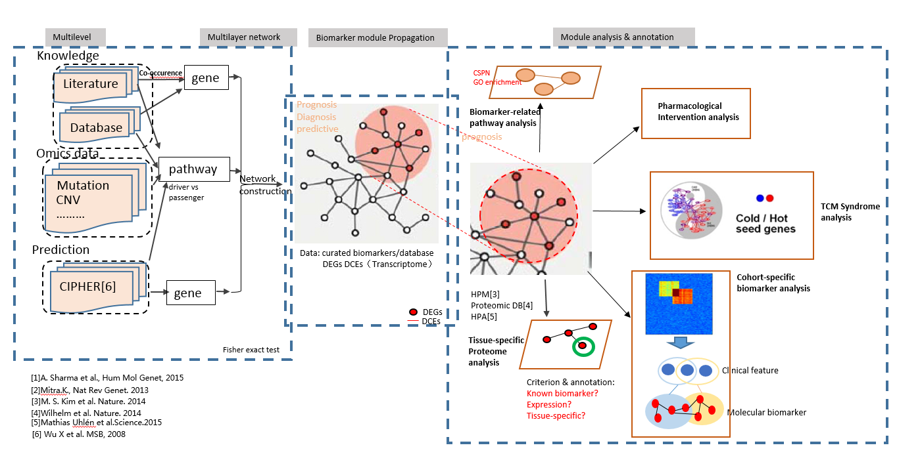
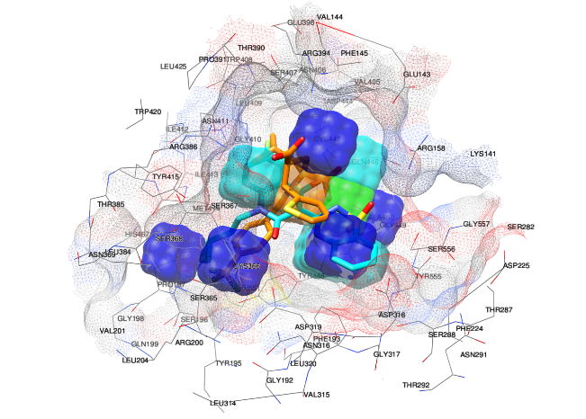
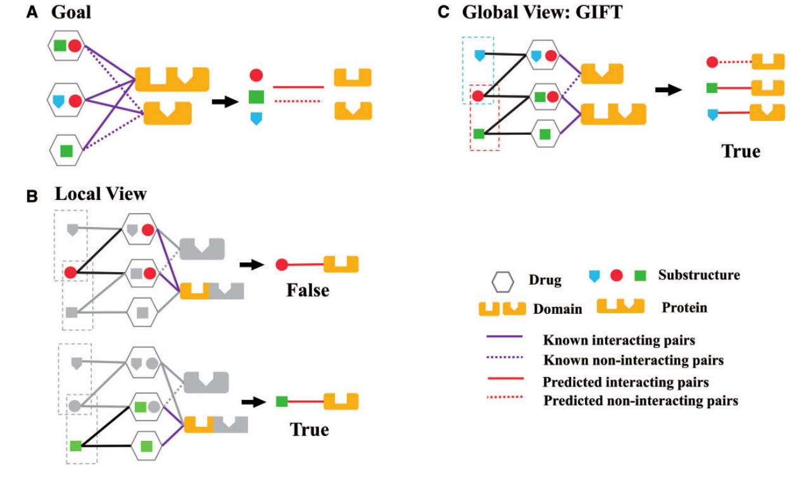
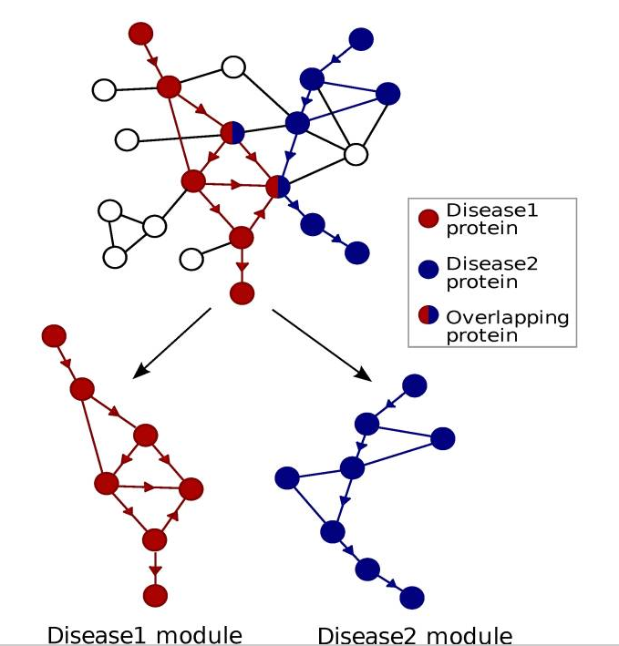
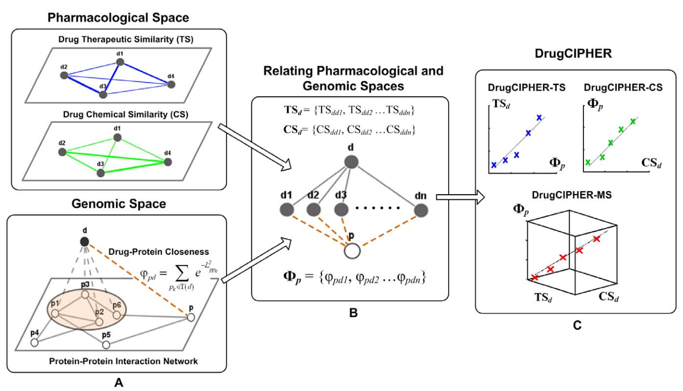
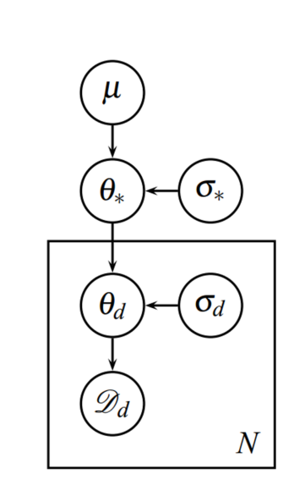
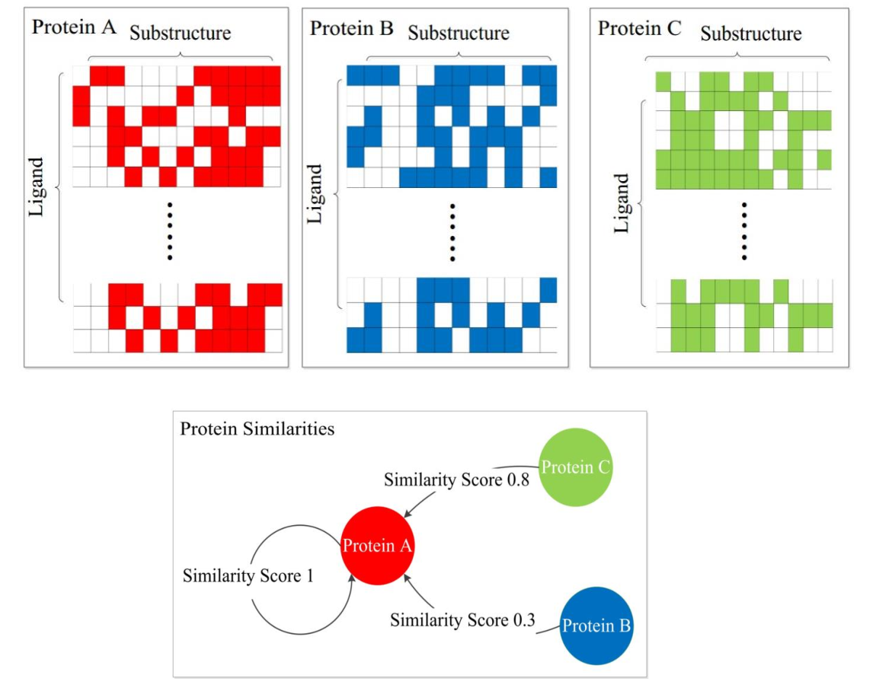
Disease Network Construction
Quantitative Structure-Activity
Relationship
Network and Chemogenomic-based
Target Prediction
Structure-based QSAR
GIFT
Human Protein-Protein
Interaction Network
DrugCIPHER
Ligand-based QSAR
Disease module
Predicted targets

