Slide 1
Predicting Compound-Protein Interactions From Machine Learning Perspective
PhD Candidate: Songpeng Zu
Advisor: Prof. Shao Li
Department of Automation, Tsinghua University
2015-08-20

Slide 2
Content
Introduction on Compound-Protein Interactions (CPIs)
Inference on the latent features from CPIs by EM algorithm
Quantitative prediction on CPIs by multi-task learning
Graph partition based prediction on CPIs
Summary

Slide 3
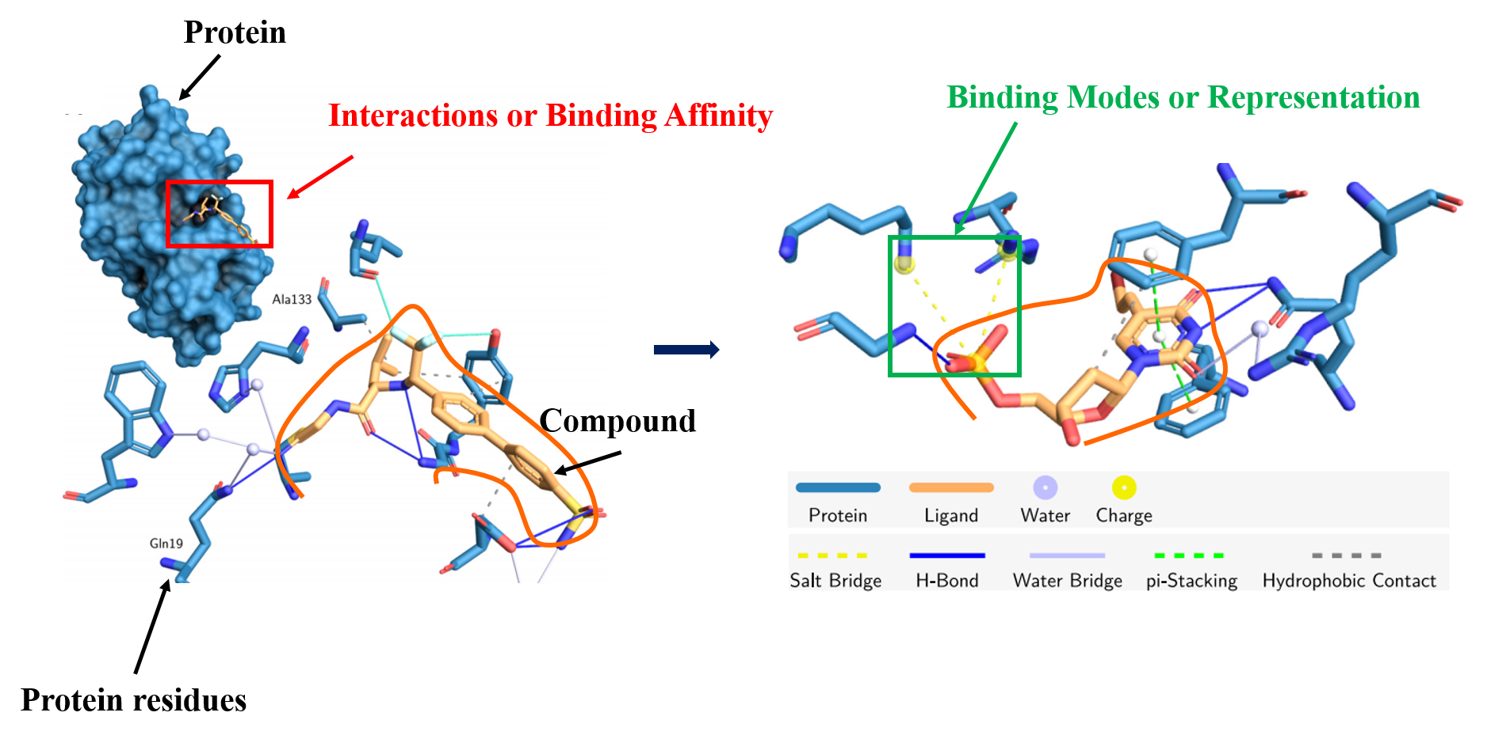
Introduction

Slide 4
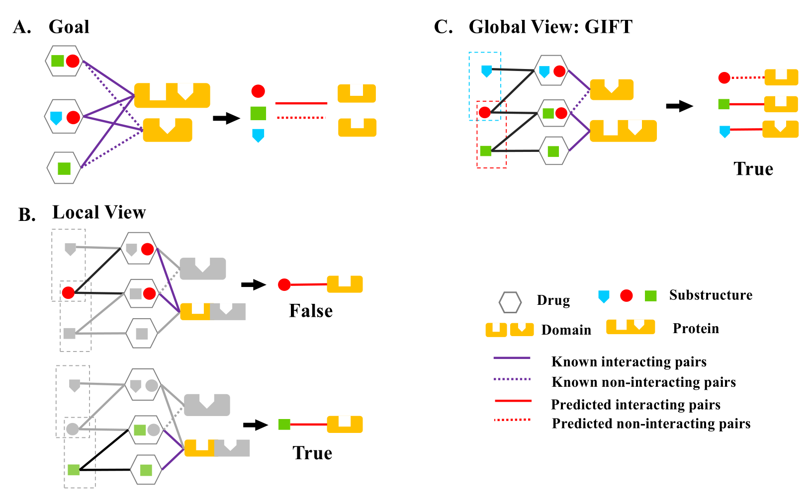
Inference on the latent features from CPIs by EM algorithm
Zu, S. et al., Bioinformatics,2015

Slide 5
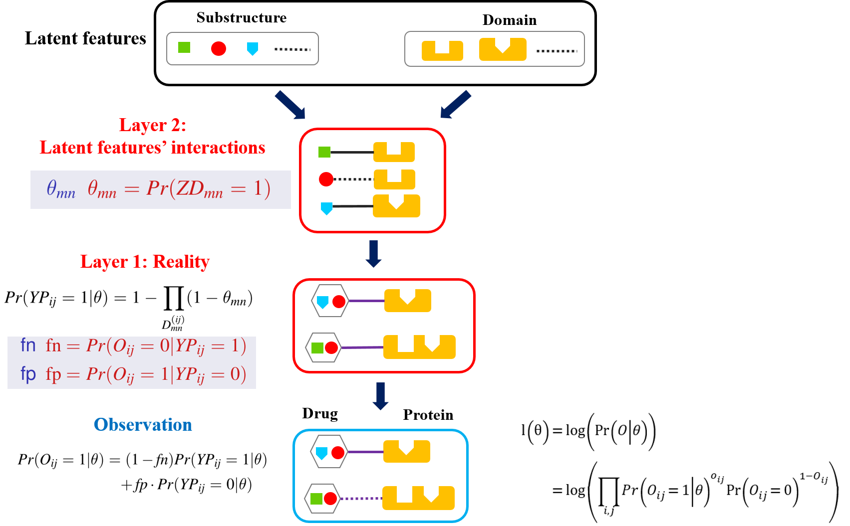
Inference on the latent features from CPIs by EM algorithm

Slide 6
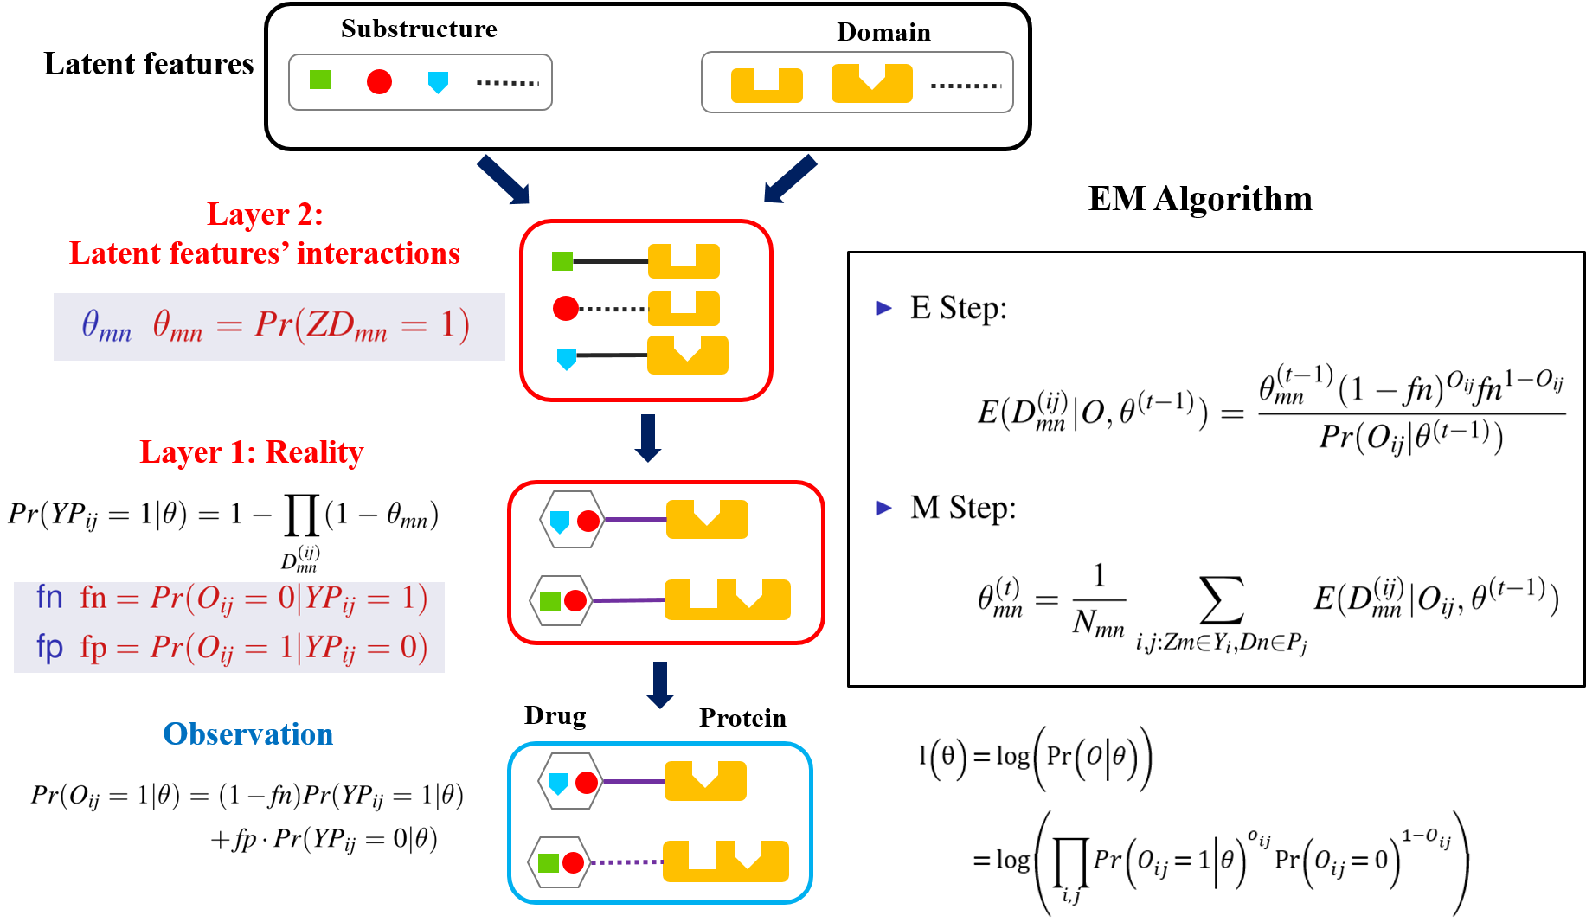
Inference on the latent features from CPIs by EM algorithm

Slide 7
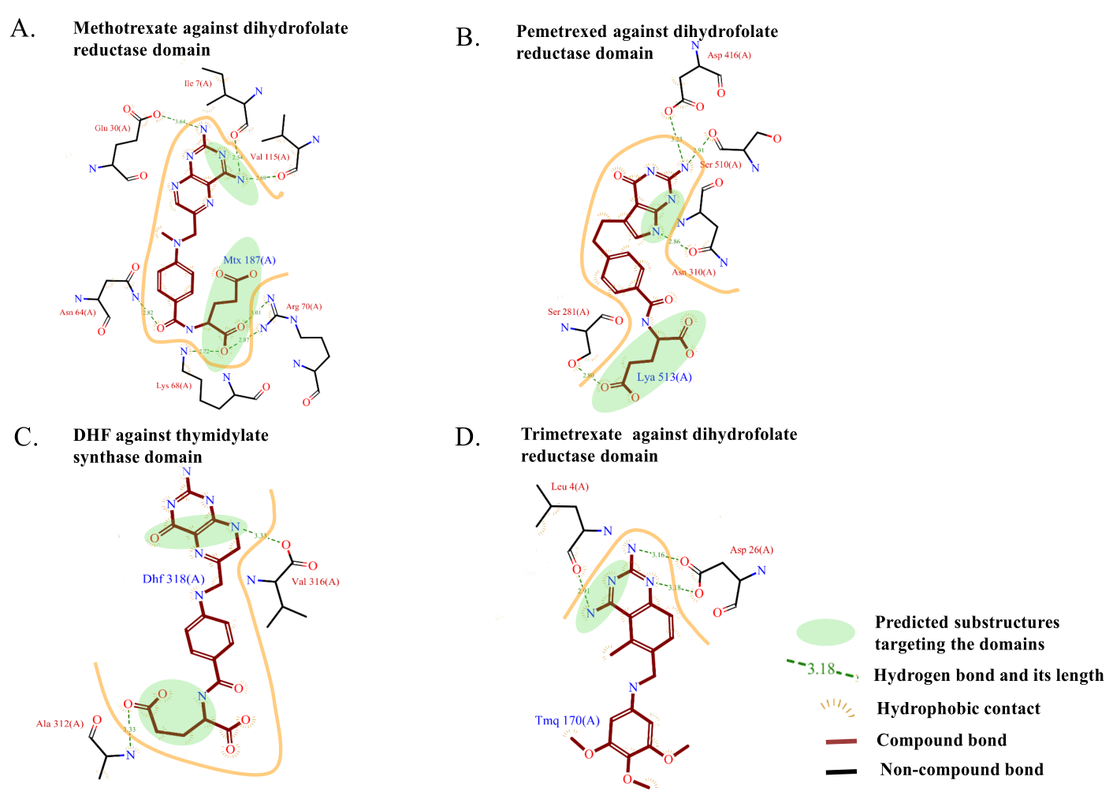
Inference on the latent features from CPIs by EM algorithm

Slide 8
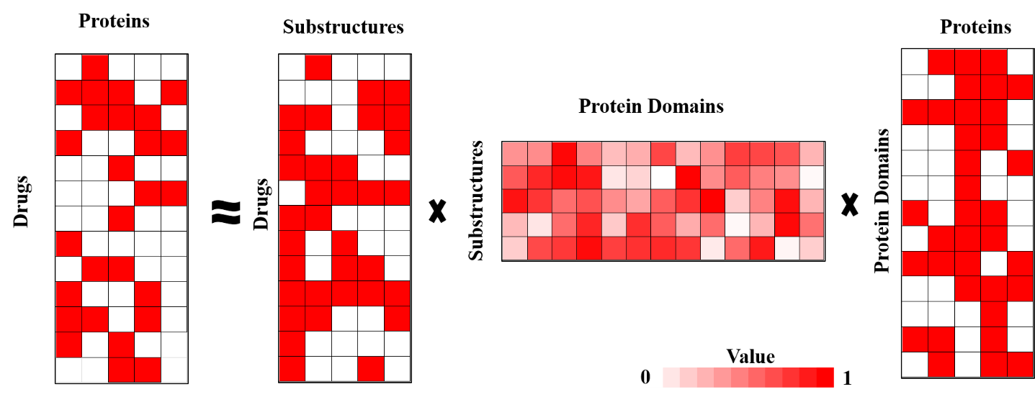
Discussion
It can be roughly treated as an approximation below.

Slide 9
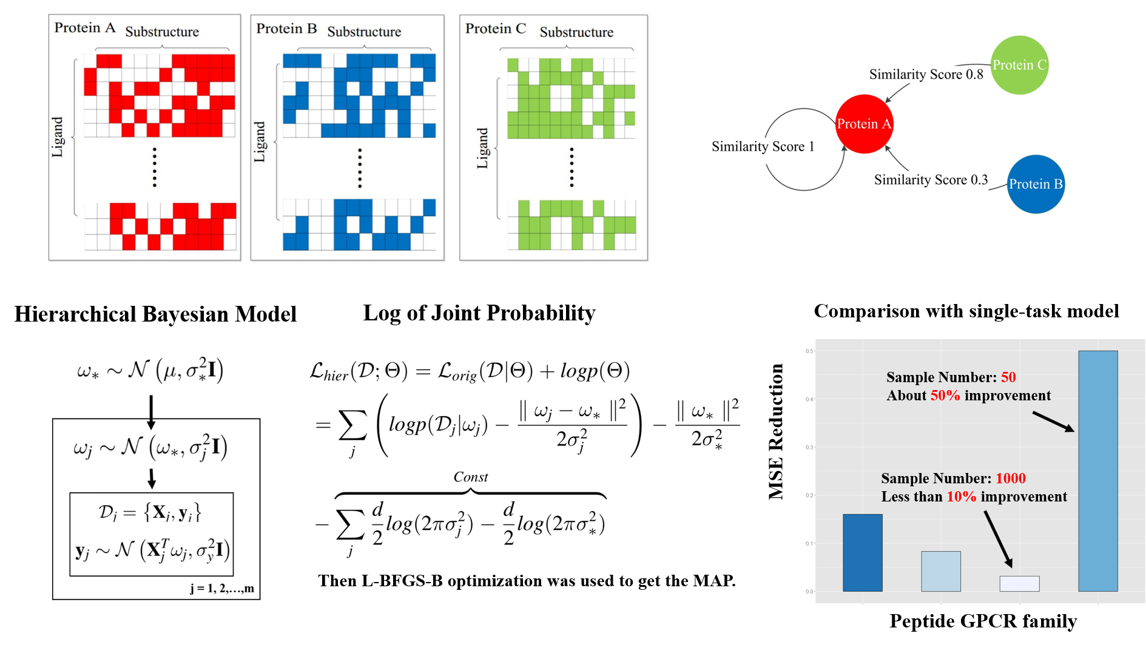
Quantitative prediction multi-task learning

Slide 10
Quantitative prediction multi-task learning

Slide 11
Quantitative prediction multi-task learning

Slide 12
Quantitative prediction multi-task learning

Slide 13
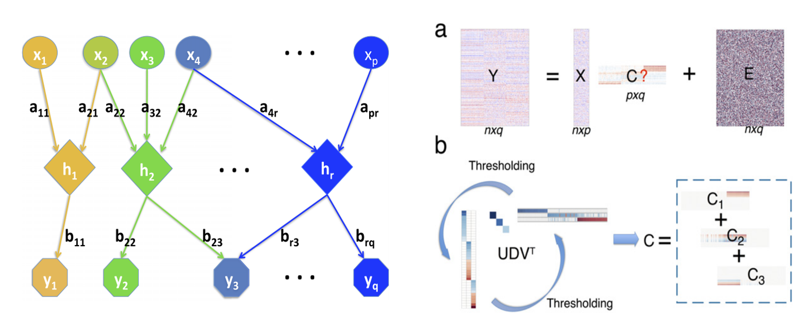
Quantitative prediction multi-task learning
Structure Learning
Xin Ma, Luo Xiao, and Wing Hung Wong. PNAS, 2014

Slide 14
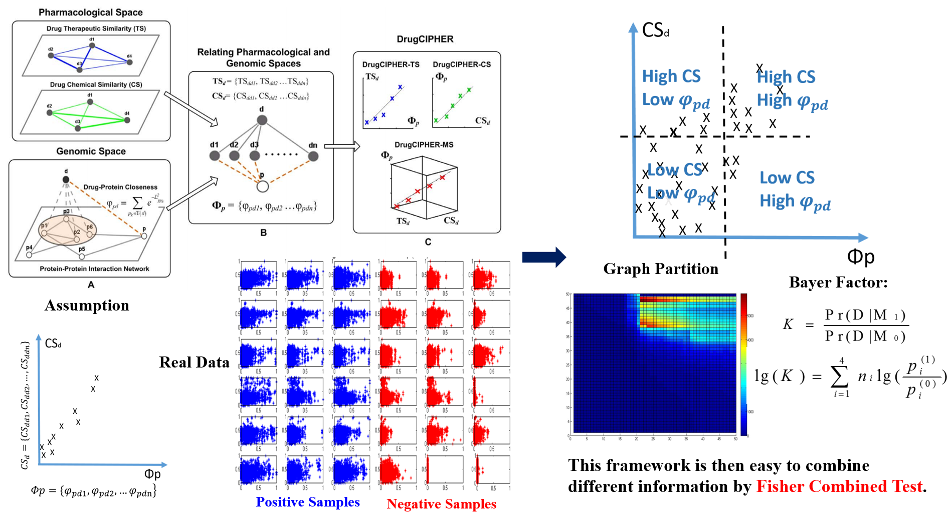
Graph partition based prediction on CPIs

Slide 15
Graph partition based prediction on CPIs

Slide 16
Graph partition based prediction on CPIs

Slide 17
Graph partition based prediction on CPIs

Slide 18
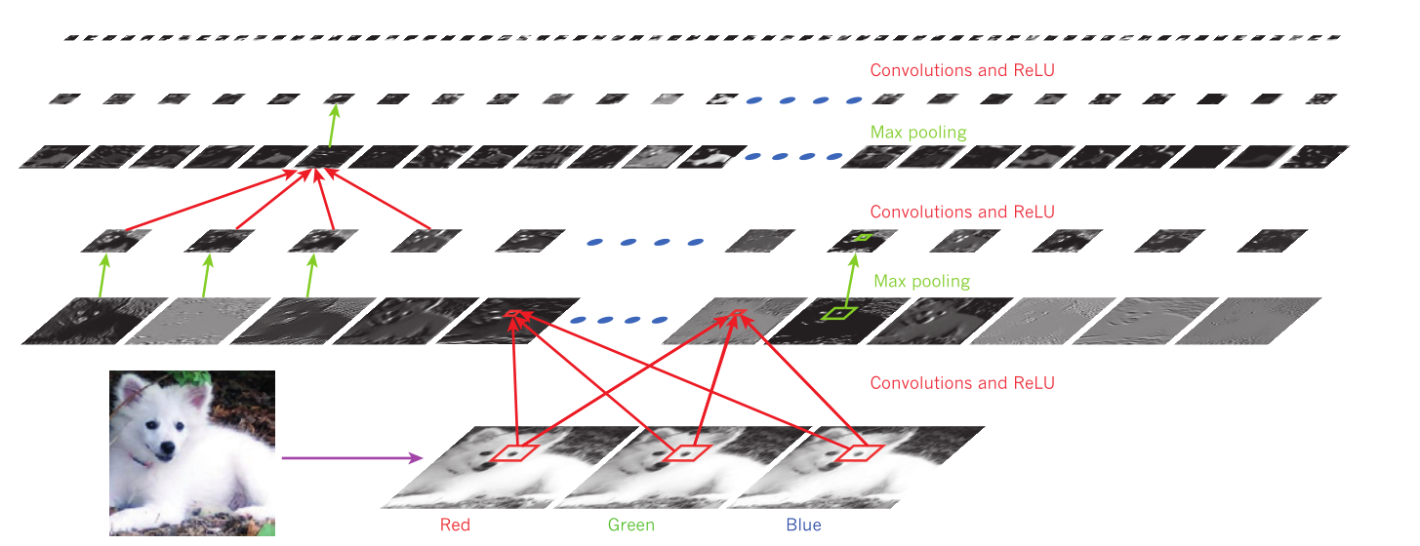
Summary
Prediction on CPIs:
Discover the latent features: an EM algorithm framework
Quantitative prediction: a multi-task learning procedure
Similarity-based Graph Partition
Further Direction:
Representation Learning, especially deep learning.
Yann LeCun, Yoshua Bengio & Geoffrey Hinton. Nature, 2015

Slide 19
Thanks for your listening !

