Slide 1


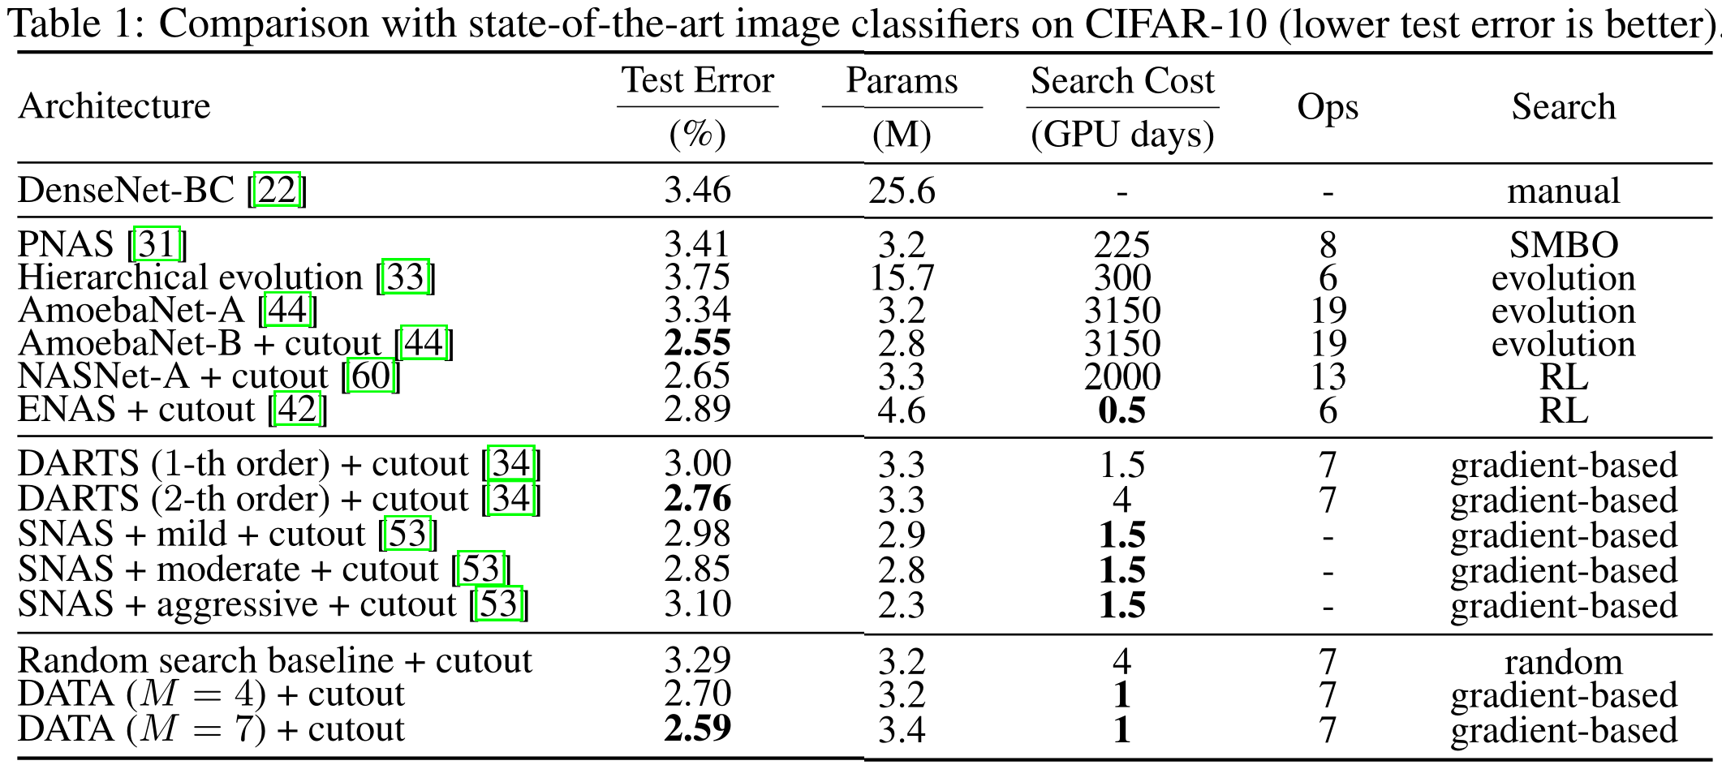
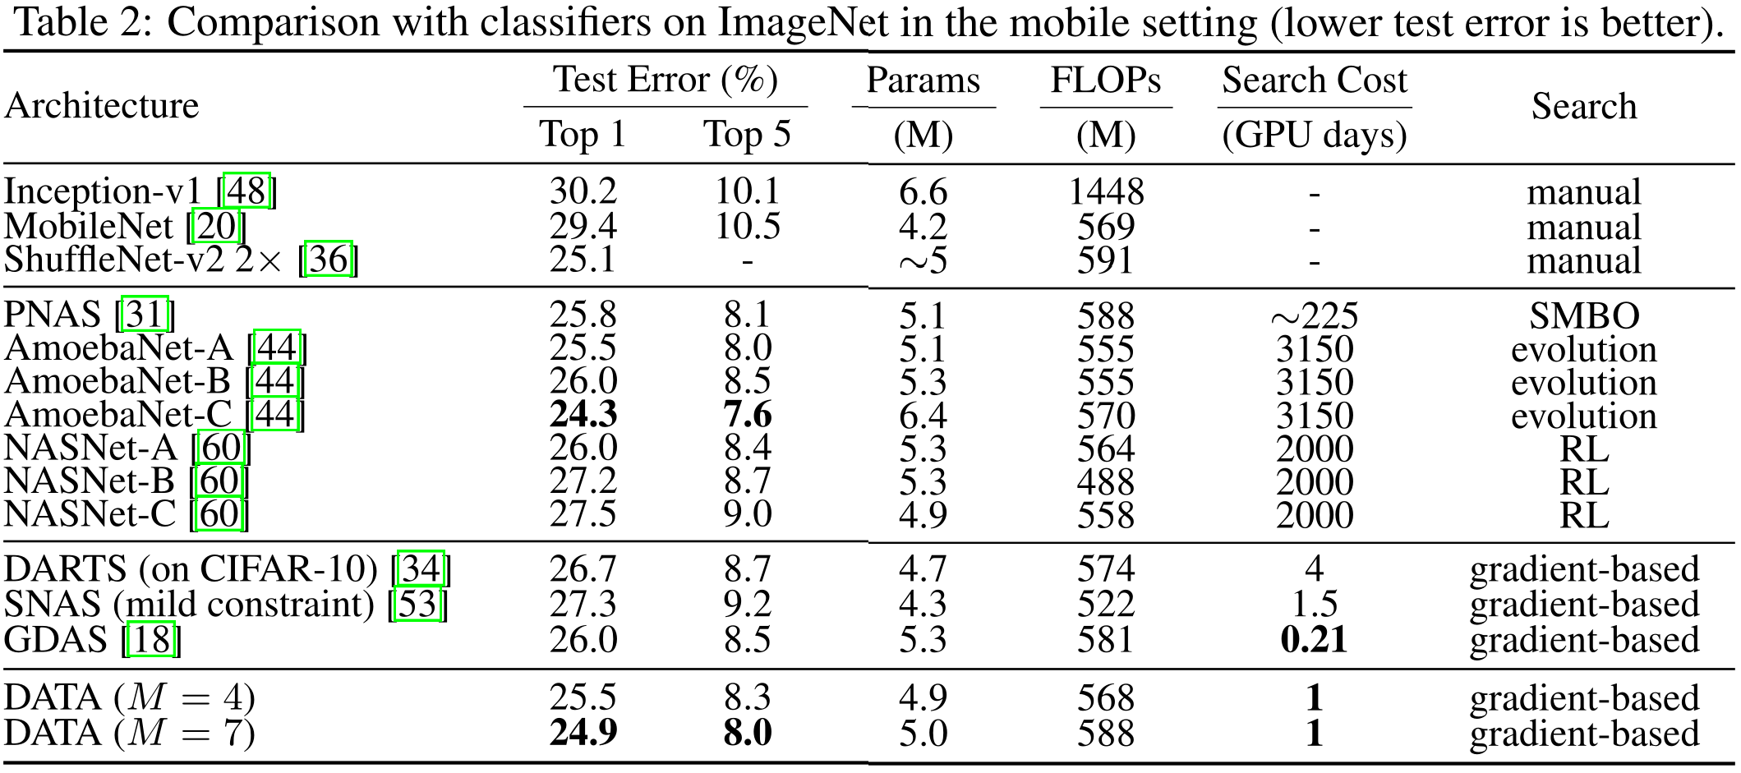
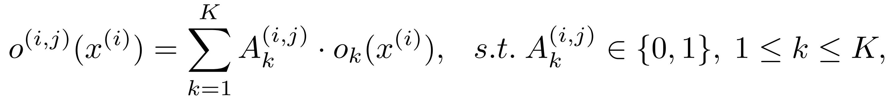
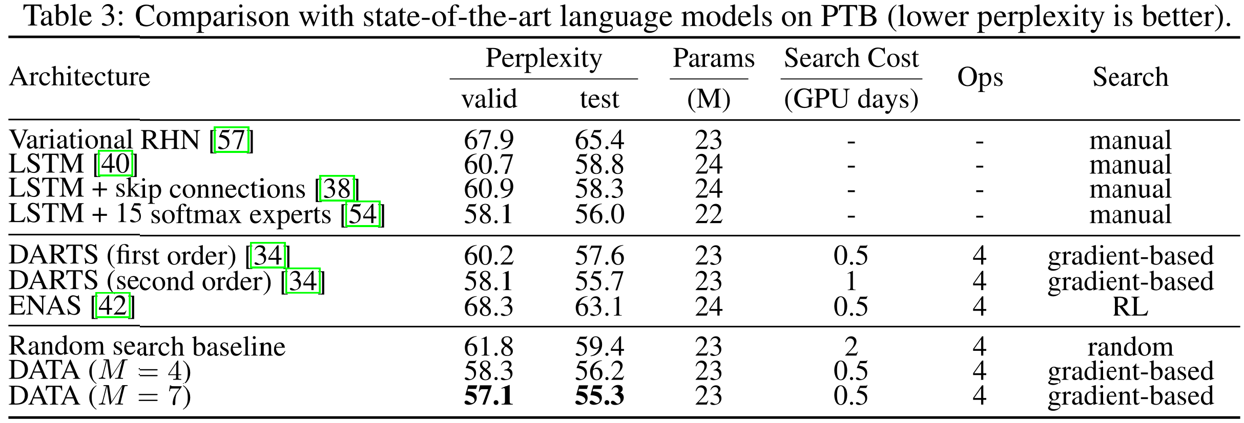
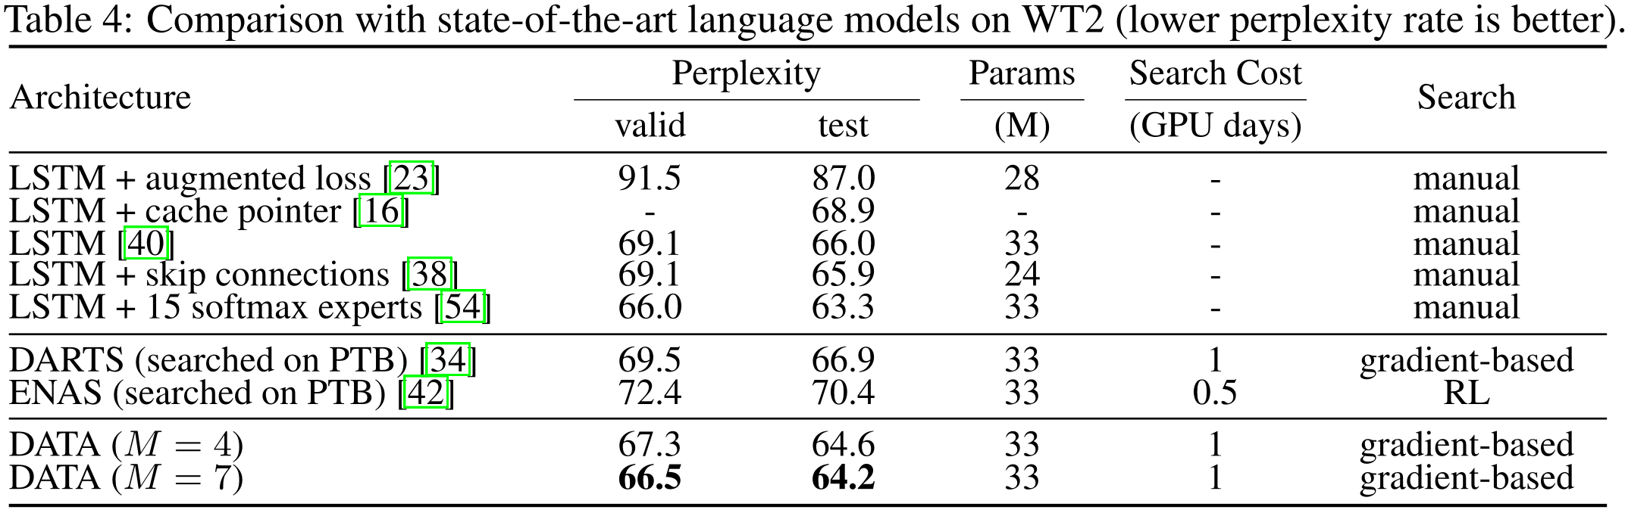
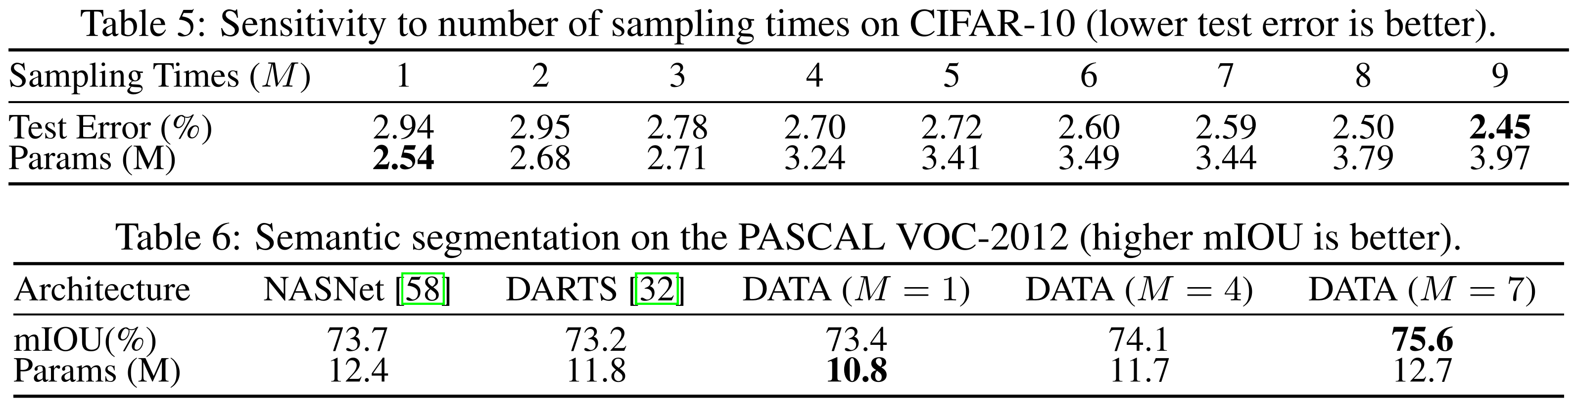
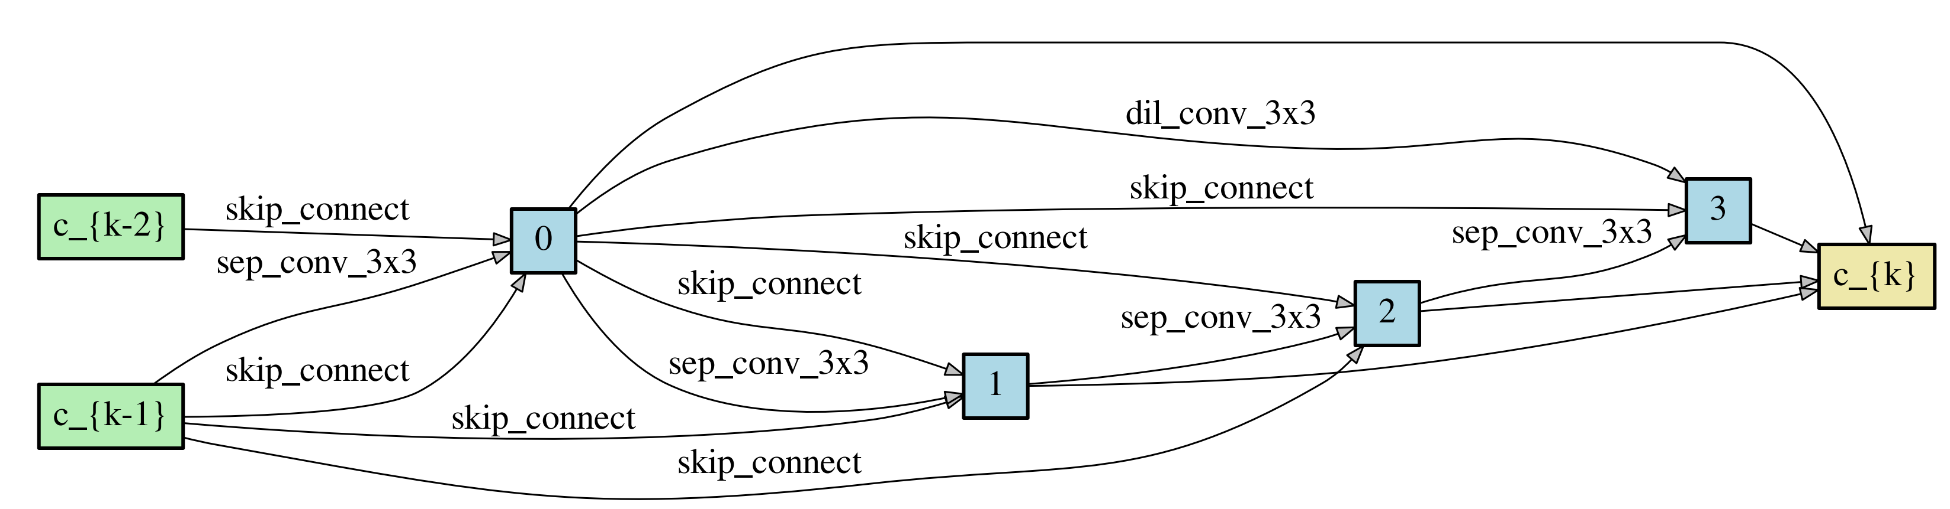
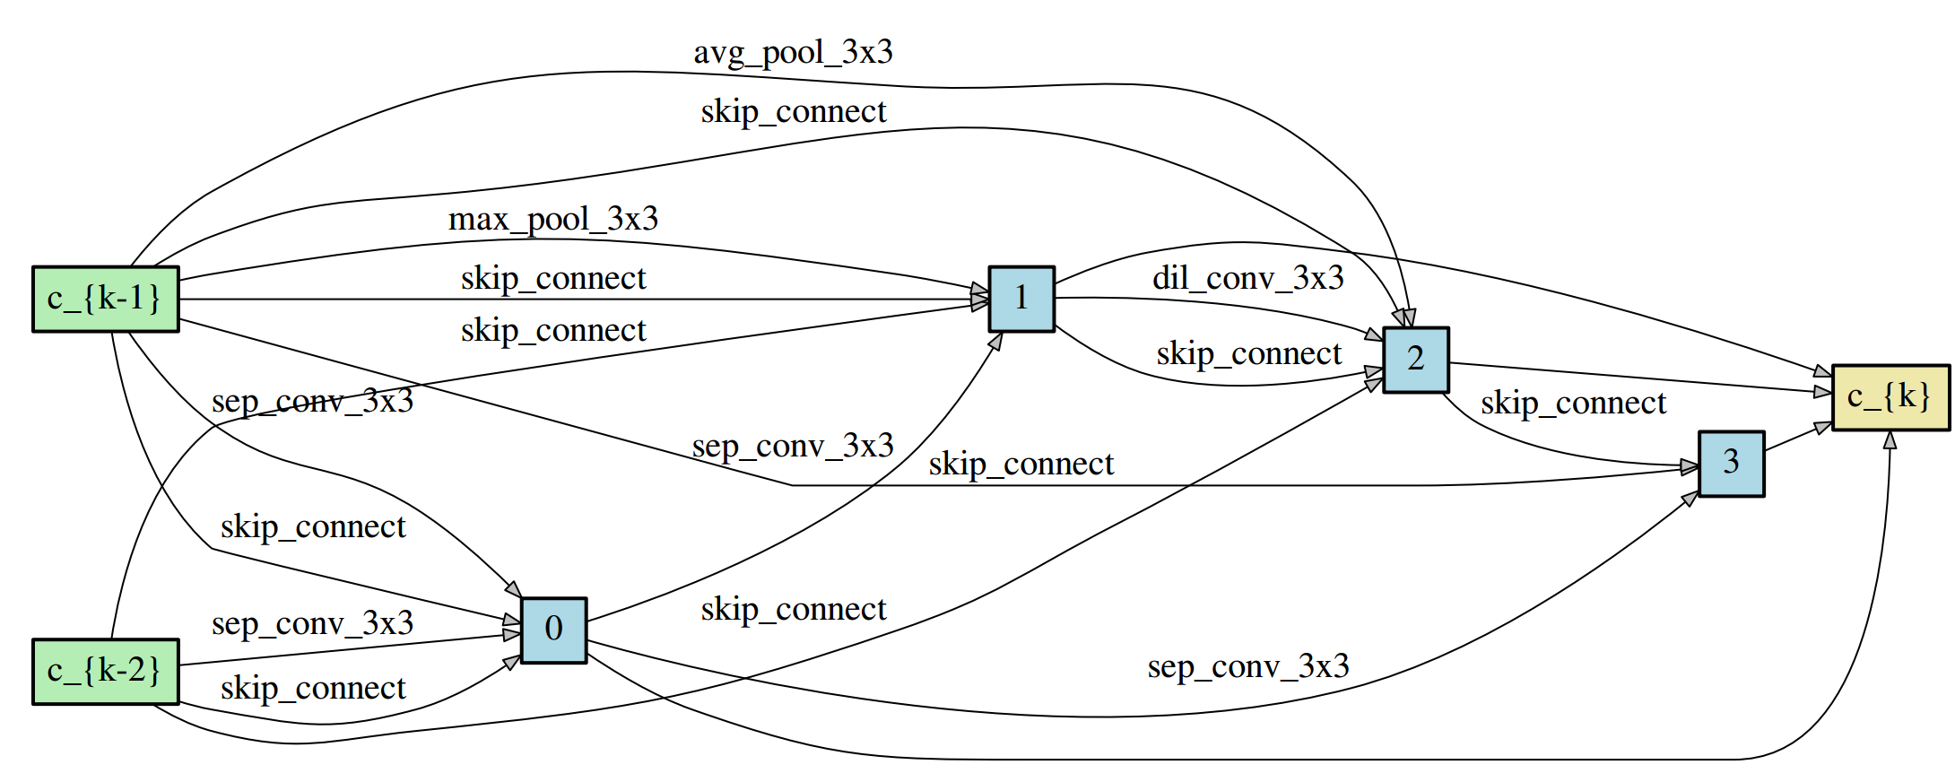
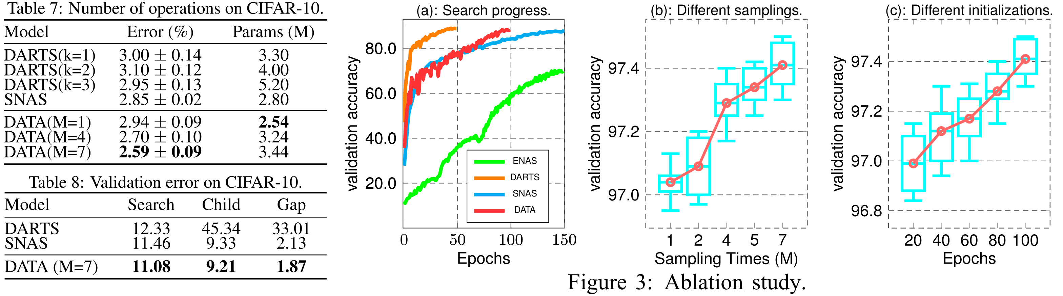
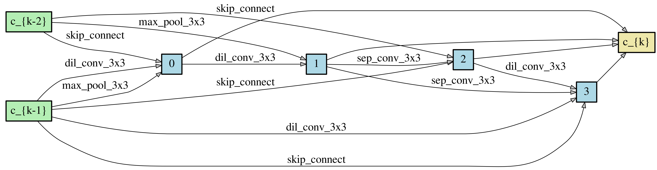
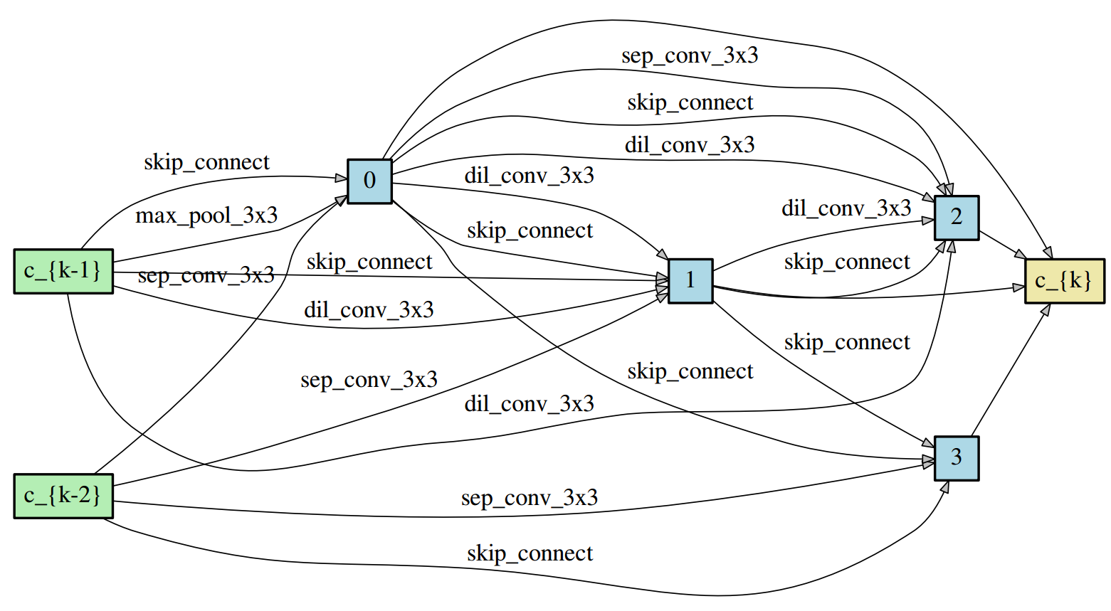
DATA: Differentiable ArchiTecture Approximation
33nd Conference on Neural Information Processing Systems (NeurIPS 2019), Vancouver, Canada
Jianlong Chang, Xinbang Zhang, Yiwen Guo, Gaofeng Meng, Zhouchen Lin, Shiming Xiang, Chunhong Pan
Differentiable Architecture Search
Experiments
Intrinsically, the goal in NAS is to find a graph that minimizes the validation loss, where the network weights associated with the architecture α∗are obtained by minimizing the training loss.
This implies that the essence of NAS is to solve a bi-level optimization problem, which is hard to optimize because of the nested relationship between architecture parameters and network weights. To handle this issue, we parameterize architectures with binary codes, and devote to jointly learning architectures and network weights in a differentiable way.
Table 1 gives the searched architectures and classification results on CIFAR-10, which shows that DATA achieves comparable results with the state-of-the-art with less computation resources.
Table 2 indicates that the cell searched on CIFAR-10 can be smoothly employed to deal with the large-scale classification task.
Table 3 signifies that DATA also is in a position to search recurrent architectures effectively.
Table 4 demonstrates that the transferability is also retentive on recurrent architectures.
Parameterizing Architectures with Binary Codes
The function in the edge (i,j) can be decomposed into a superposition of primitive operations, i.e.,
Benefiting from the uniqueness property of our architecture code A, the task of learning an architecture can therefore be converted to learning the optimal binary code A.
From Probability Vectors to Binary Codes - Ensemble Gumbel-Softmax
We introduce a binary function f(·) to approach the optimal binary codes with probability vectors, which can be easily obtained in deep models. The function f(·) is formulated with the ensemble Gumbel-softmax. During the forward propagation, with three candidate primitive operations (i.e., green, orange and cyan lines), the binary function f(·) is employed to generate a network in a differentiable manner. During the backward propagation, the standard back-propagation algorithm is utilized to simultaneously calculate the gradients of the both architecture parameters and network weights.
For a probability vector p=[0.5,0.5], Gumbel-Softmax solely pertains to sample only two binary codes with the same probability, i.e., P([1,0])=P([0,1])=0.5. The ensemble Gumbel-Softmax is capable of sampling more binary codes, i.e., [1,0], [1,1] and [0,1]. Furthermore, the probabilities of sampling these binary codes are logical. It is intuitive that the probability of sampling [1,1] is larger than the probabilities of sampling the others since the probabilities in p=[0.5,0.5] are equal.
Ablation study
Table 5 means that larger M indicates higher performance, while more parameters will be introduced as M increases.
Table 6 verifies that DATA have more prominent superiority on more complex tasks, not just toy tasks on the tiny datasets, because of a large search space that is proportional to the sampling time M.
Table 7 shows the stds of DATA and the variances of DATA with different sampling time M.
Table 8 reports the validation errors at the end of search and after architecture derivation without fine-tuning.
Figure (a) illustrates the search progresses of different models. Figure (b) and (c) study the influence of initializations and the contribution of ensemble Gumbel-Softmax.
Architectures on CIFAR-10
M=4 normal cell
M=7 normal cell
M=4 reduction cell
M=7 reduction cell

