Slide 1
Image blending
Annie Dai, Xinbei Fu
CS 189 Final Project

Slide 2
Laplacian pyramid blending

Slide 3
Laplacian pyramid blending
Last level = gaussian last level
Laplacian level i = gaussian level i – expand(gaussian level i+1)
Notes:
Some theory here

Slide 4
Laplacian pyramid blending
General approach :
Build Laplacian pyramids LA and LB from images A and B
Build a Gaussian pyramid GR from selected region R
Form a combined pyramid LS from LA and LB using nodes of GR as weights:
LS(i, j) = GR(i, j) * LA(i, j) + (1 – GR(i, j)) * LB(i, j)
Collapse the LS pyramid to get the final balanced image
Notes:
Show some result images here

Slide 5
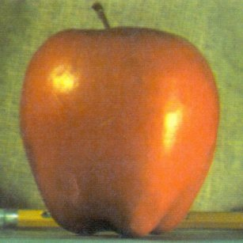
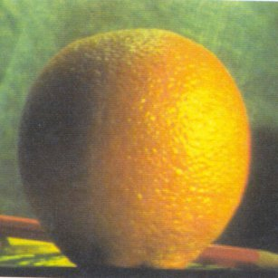
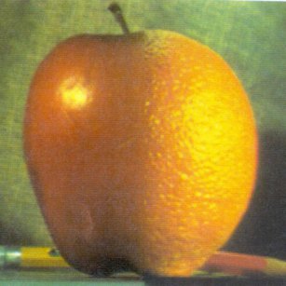
Laplacian pyramid blending
+
=
Notes:
Show some result images here
Change to our own image

Slide 6
Poisson blending

Slide 7
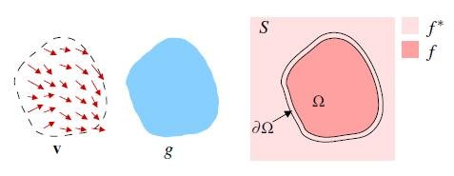
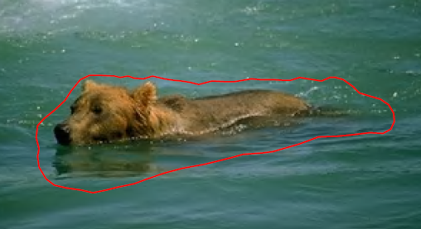
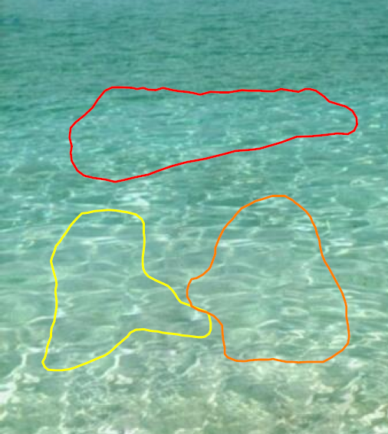
Poisson blending
v – Gradient of a region in an image
g – Selected region of source
f* – Known functions that exist in domain S
f – Unknown functions that exist in domain Ω
Ω – Region g that is now placed on domain S
∂Ω – Boundaries between the source and target regions
Notes:
theory

Slide 8




Poisson blending
, with
, for all
Solution:
A
$$∗$$
$$f_{p}$$
$$=$$
$$b$$

Slide 9
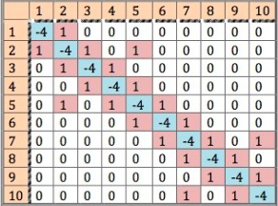
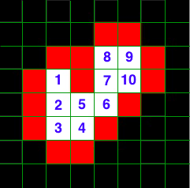



Poisson blending
$$A$$
$$b\left[i\right]=div\left(source\left(i\right)\right)+NeighborOnBoundary\left(target(i)\right)$$
$$b$$

Slide 10
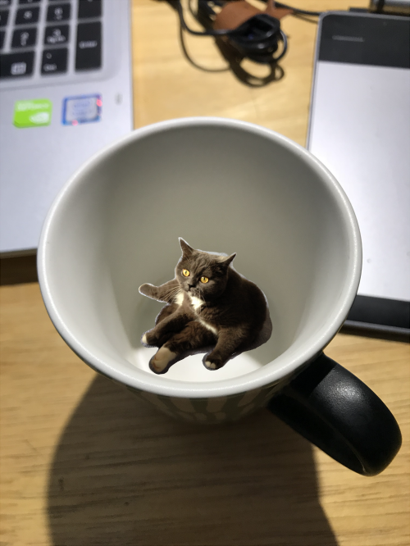
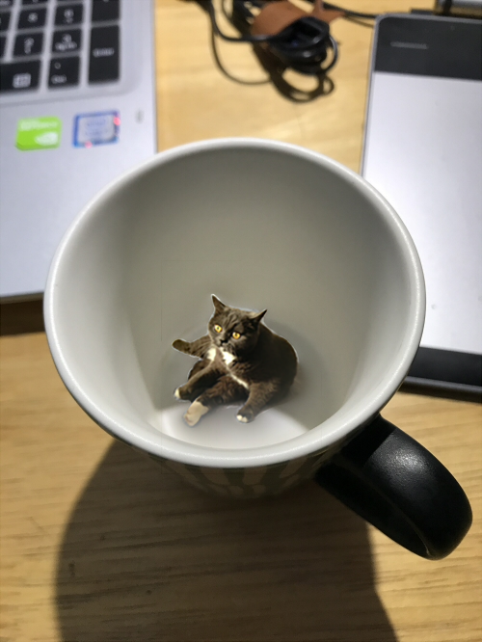
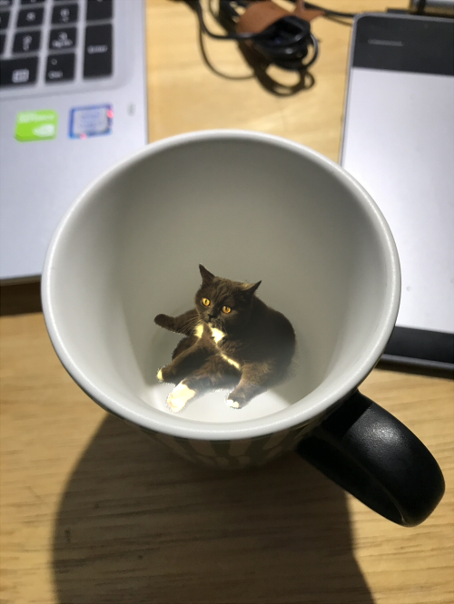
Poisson blending
Cut and paste
Laplacian blending
Poisson blending
Notes:
show some results

Slide 11
Poisson blending : take logarithm
Notes:
show some results

Slide 12
Poisson blending : mixture gradient

Slide 13
Poisson blending : texture flattening

Slide 14
Poisson blending : local illumination change

Slide 15
Poisson blending : local color change

Slide 16
Poisson blending : seamless tiling

Slide 17
reference

