Slide 1
PV-EL APP DEMO
Core R&D: Bingru Xin, Yan Ma, Yang Liu
09/22/2024

Slide 2
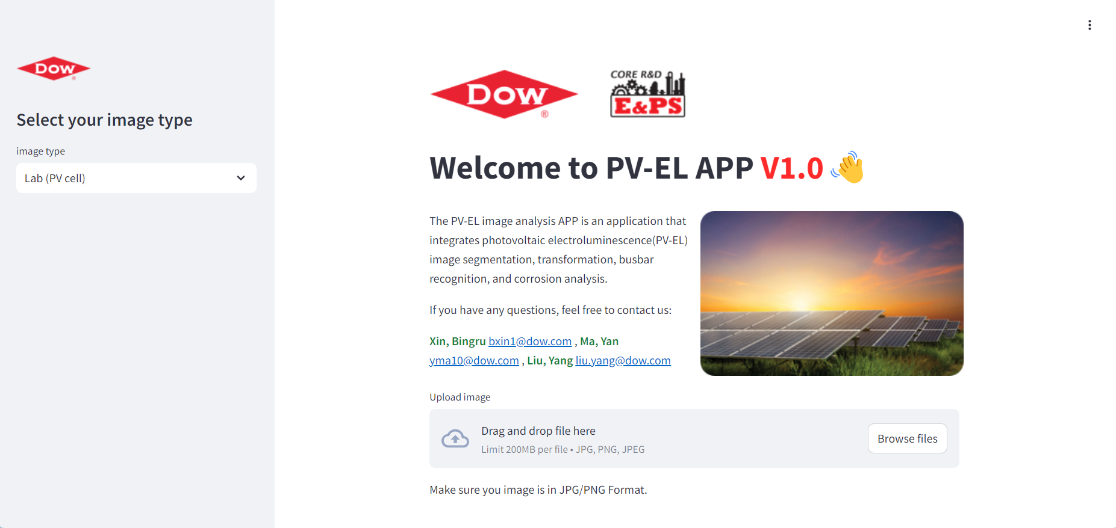
PV-EL image processing APP V1.0 based on SAM and OpenCV
Web page layout
Logo: Development team logo
Sidebar：
Contains some custom feature modules
Title: APP Web
Function introduction: Introduction of PV-EL project and the function of APP
Image input:
jpg/png format only

Slide 3
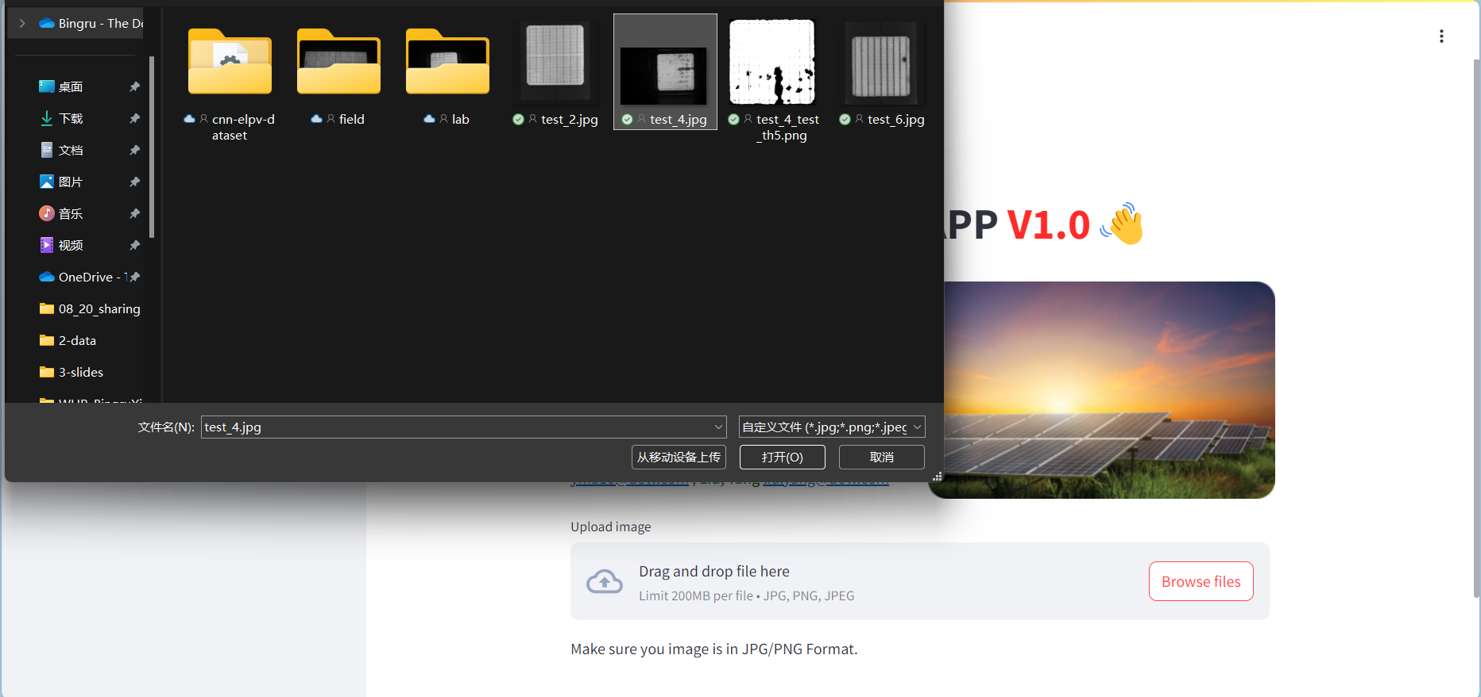
1. Upload (jpg/png format only)
Your image folder
1. Upload your original PV-EL image：
JPG/png format only, select from your local folder.

Slide 4
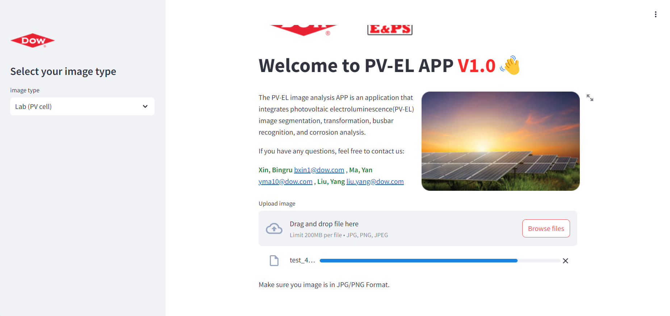
2. Progress bar
Wait for the upload

Slide 5
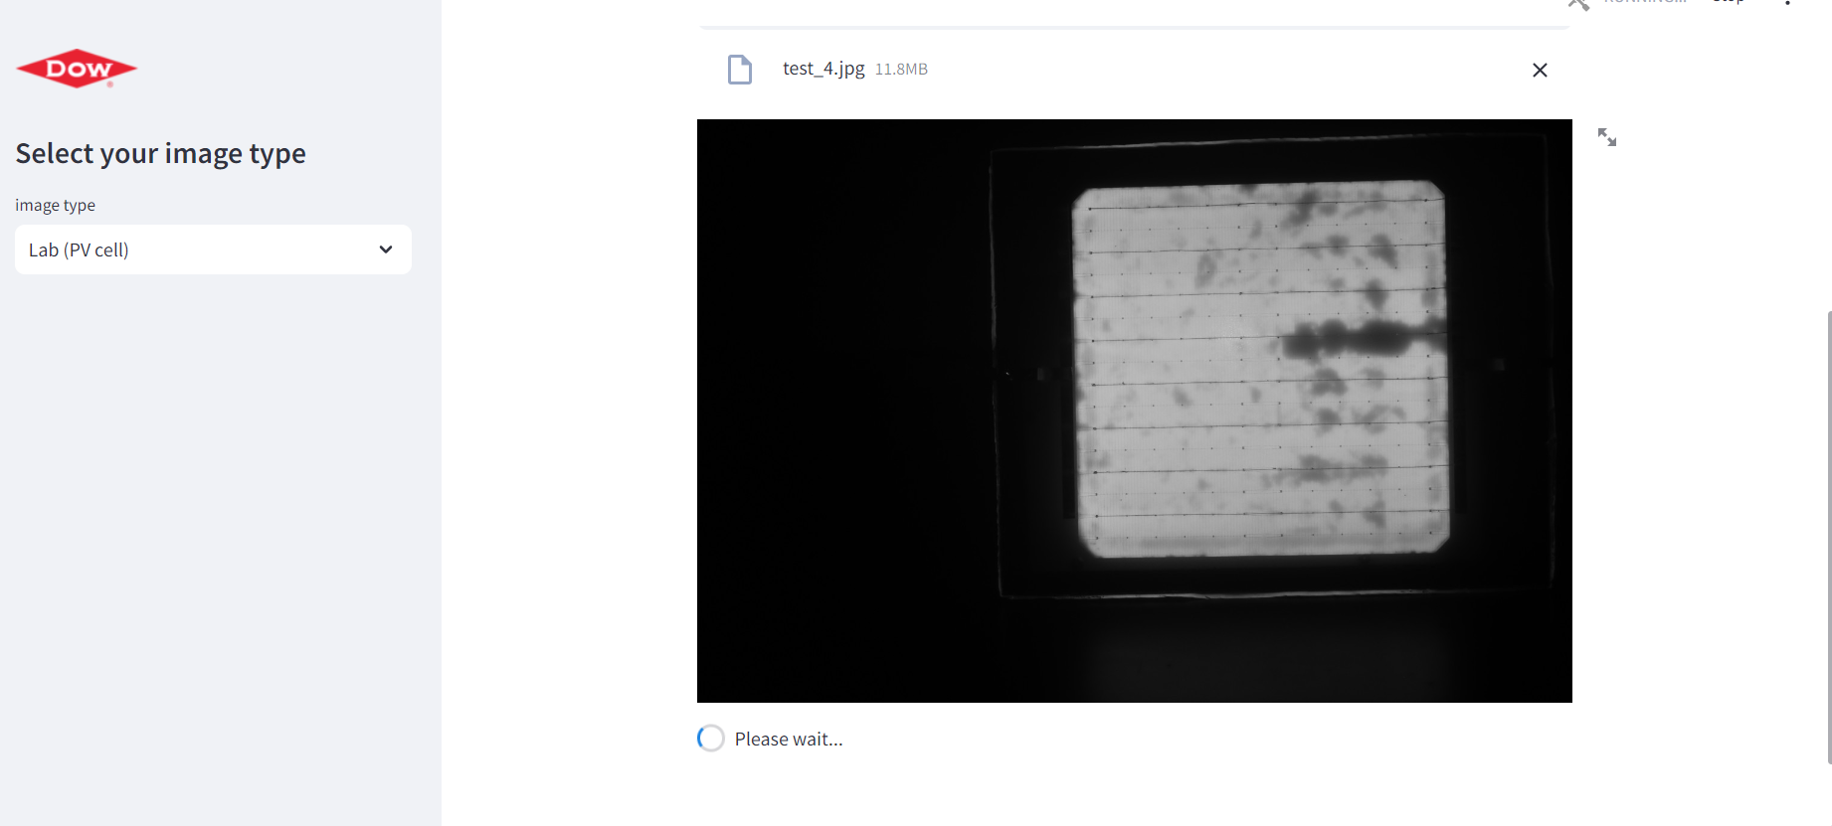
3. Test Image display
Show your PV-EL image

Slide 6
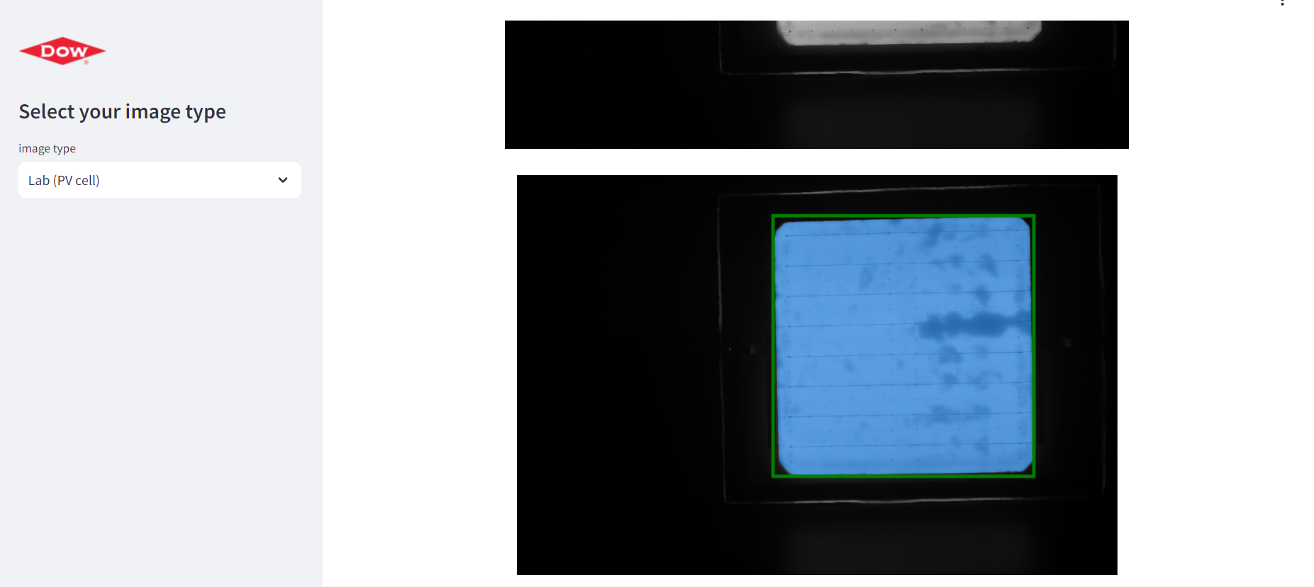
4. Automated image segmentation based on SAM
Segmentation:
The maximum external quadrilateral is automatically calculated, and the PV-EL image segmentation is carried out based on SAM

Slide 7
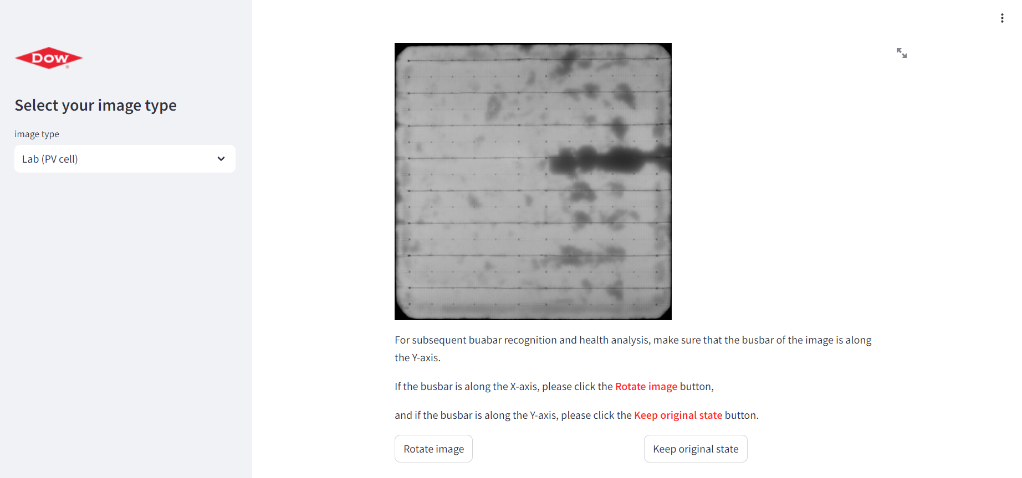
5. Image transform
Transform:
transform the segmented image to a size of 1024*1024
Image rotation judgment button:
Since the subsequent image analysis process needs to ensure that the busbar of the PV-EL image is along the Y axis, the user needs to click to rotate 90 degrees or not to rotate after judgment
or

Slide 8
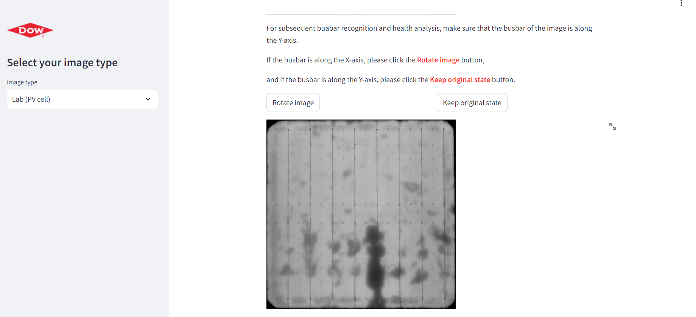
6. Image rotation
rotation:
transform the segmented image to a size of 1024*1024

Slide 9
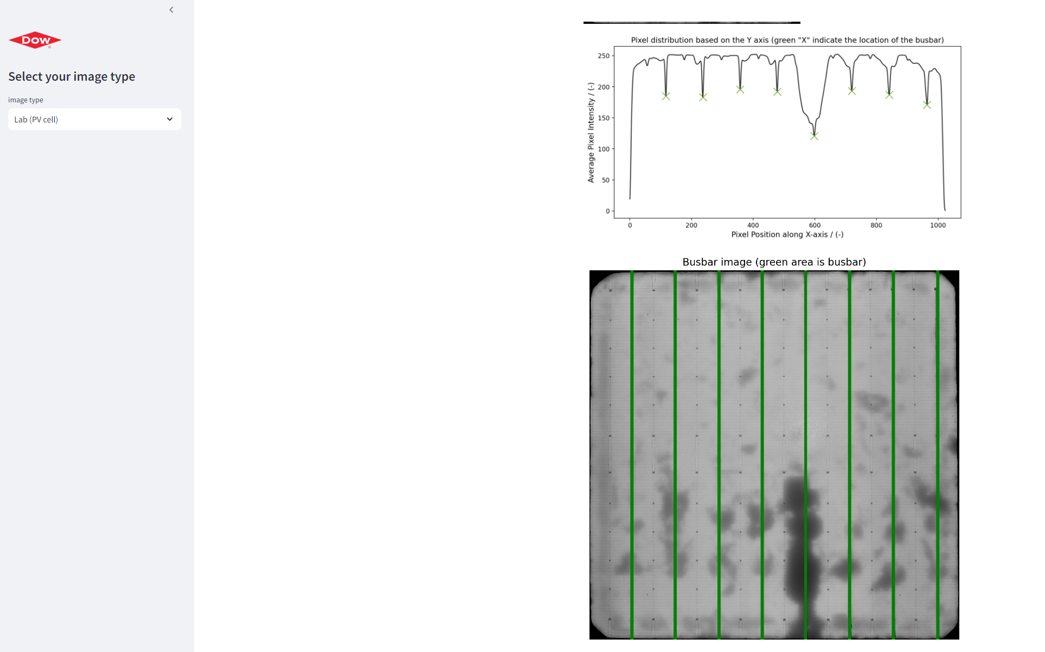
7. Find and show busbar of PV-EL
The pixel distribution along the X-axis:
Pixel distribution along the x-axis, with the peak position of the green cross being the busbar
Show busbar :
The green area is the busbar

Slide 10
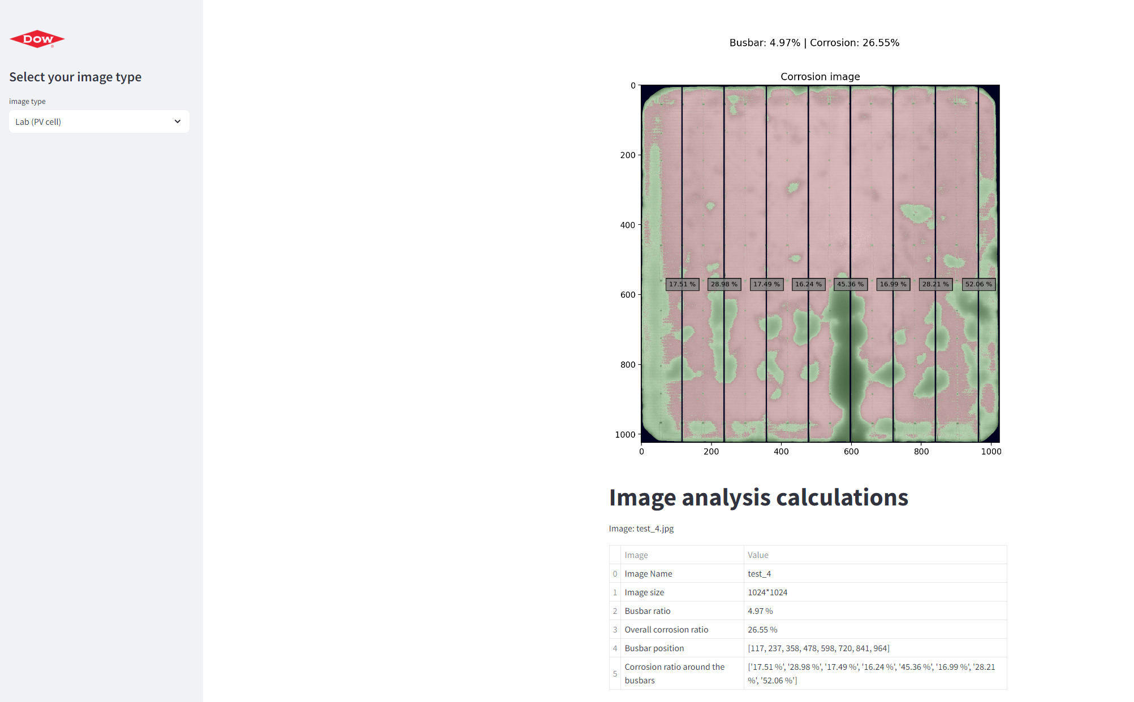
8. Corrosion calculations
Black area: busbar and background
Green area: corrosion
Red area: Healthy area
% Figure: Percentage of corrosion area along the busbar

Slide 11
9. Data table
Table
Image name
Image size (after processing)
Busbar ratio
Corrosion ratio (overall)
Busbar position based on X-axis
Corrosion ratio around the busbar

Slide 12
PV-EL APP DEMO
Core R&D: Bingru Xin, Yan Ma, Yang Liu
09/22/2024

