Slide 1

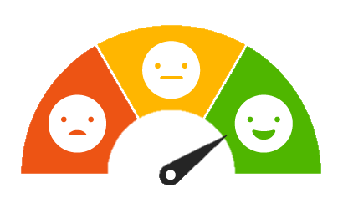
Speech Sentiment Analysis
Βυτινιώτης Κωνσταντίνος
Παπαδόπουλος Δημήτριος Ιάσων
Σιδηρόπουλος Μιχαήλ

Slide 2




Agenda
Problem statement
Datasets overview
Feature engineering
Model training
Model evaluation
Demo
Conclusions

Slide 3
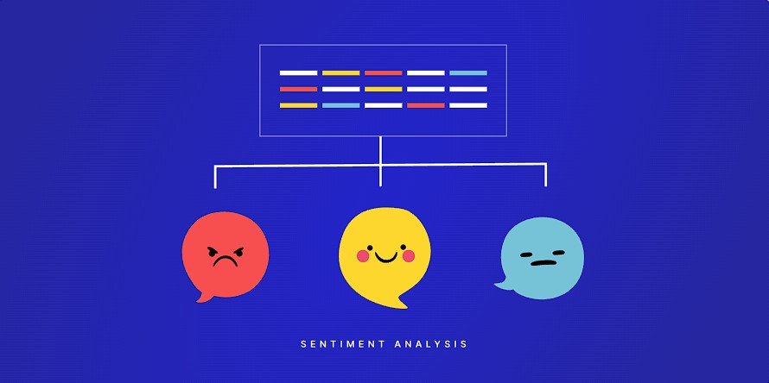
Problem statement

Slide 4









Dataset overview
neutral
calm
happy
sad
angry
fear
disgust
surprised
Ravdess
1440 wav files
24 actors
12 men
12 women
Features: 170
Dataset size: 2460
neutral
happy
sad
angry
fear
disgust
pleasant surprise
TESS
2800 wav files
2 actors
1 young woman
1 old woman

Slide 5

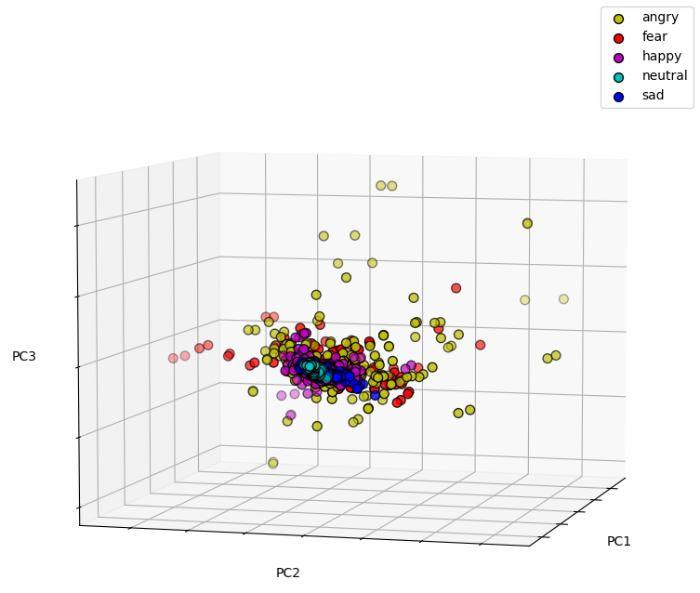
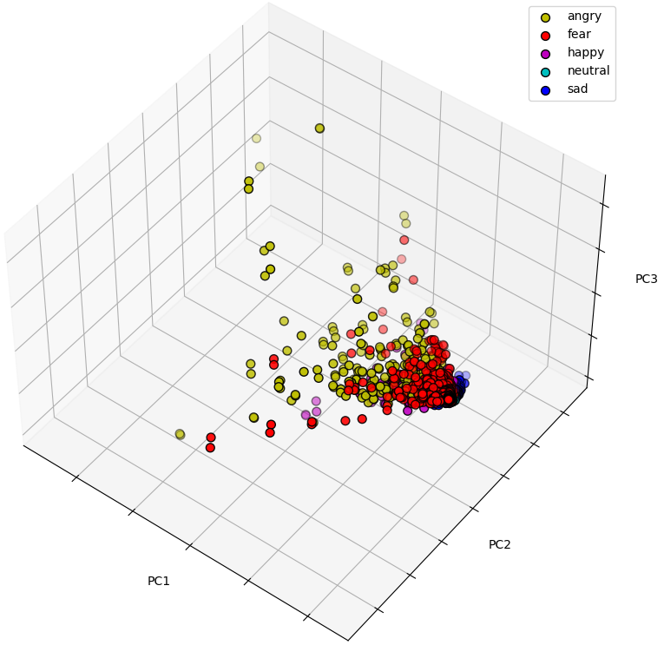
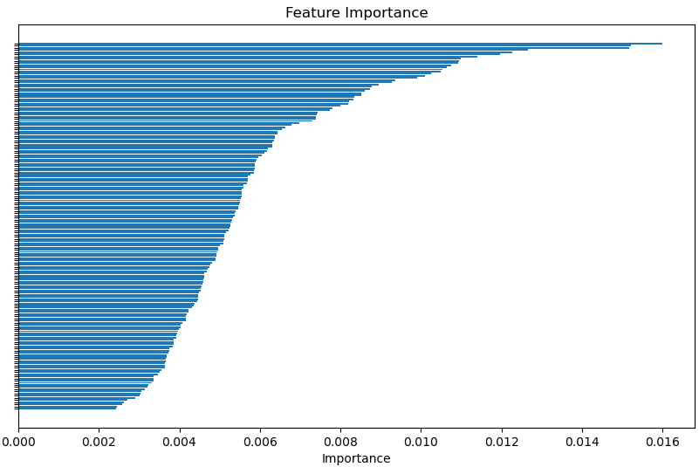
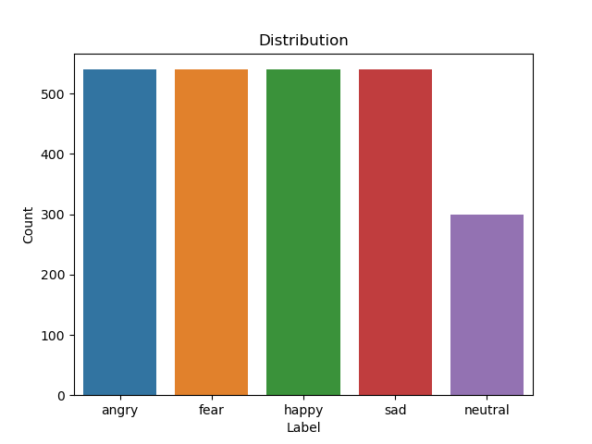
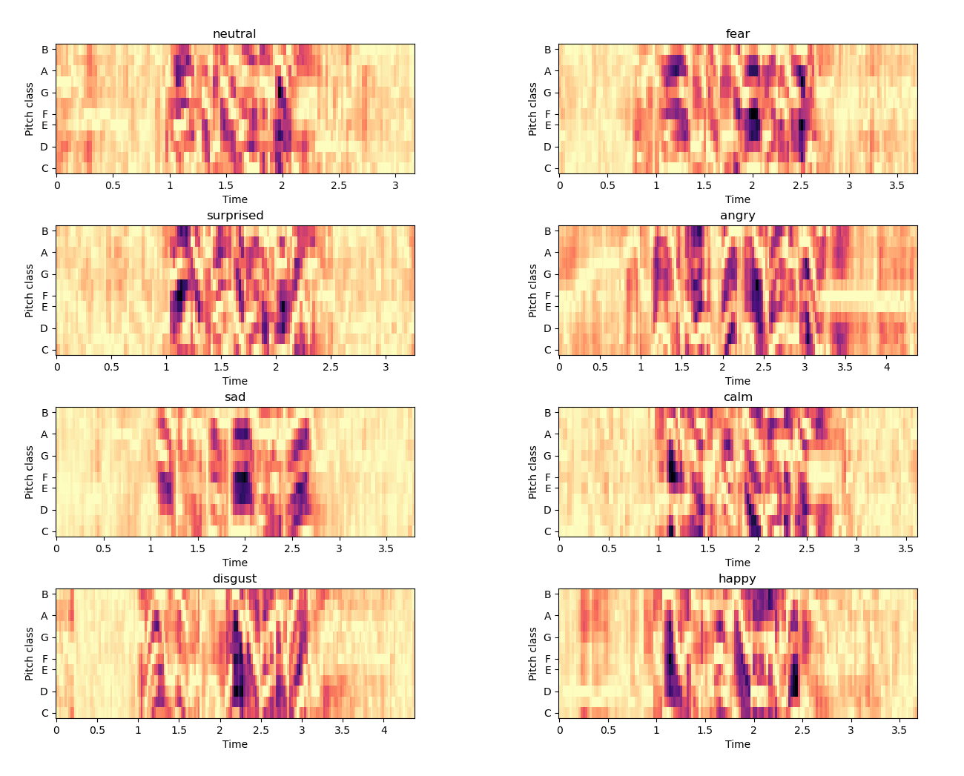
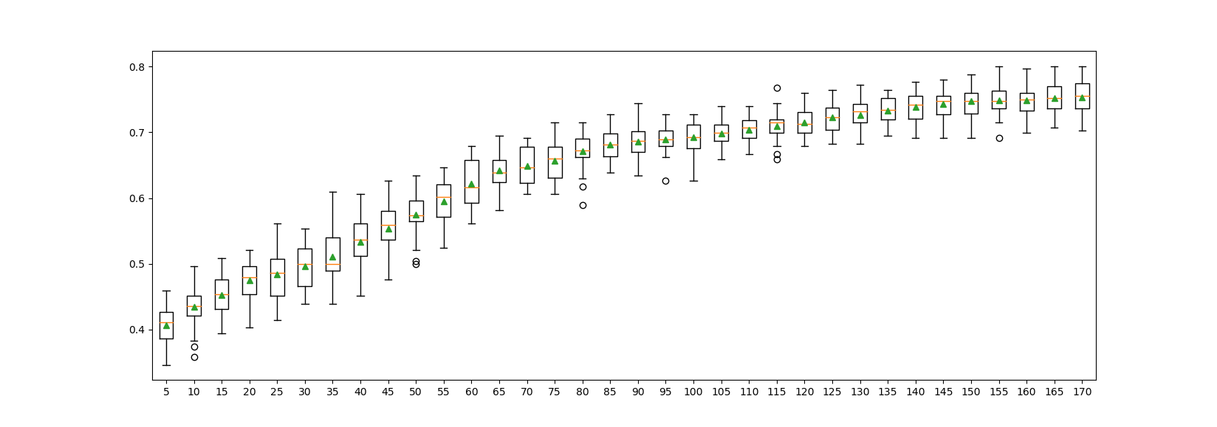
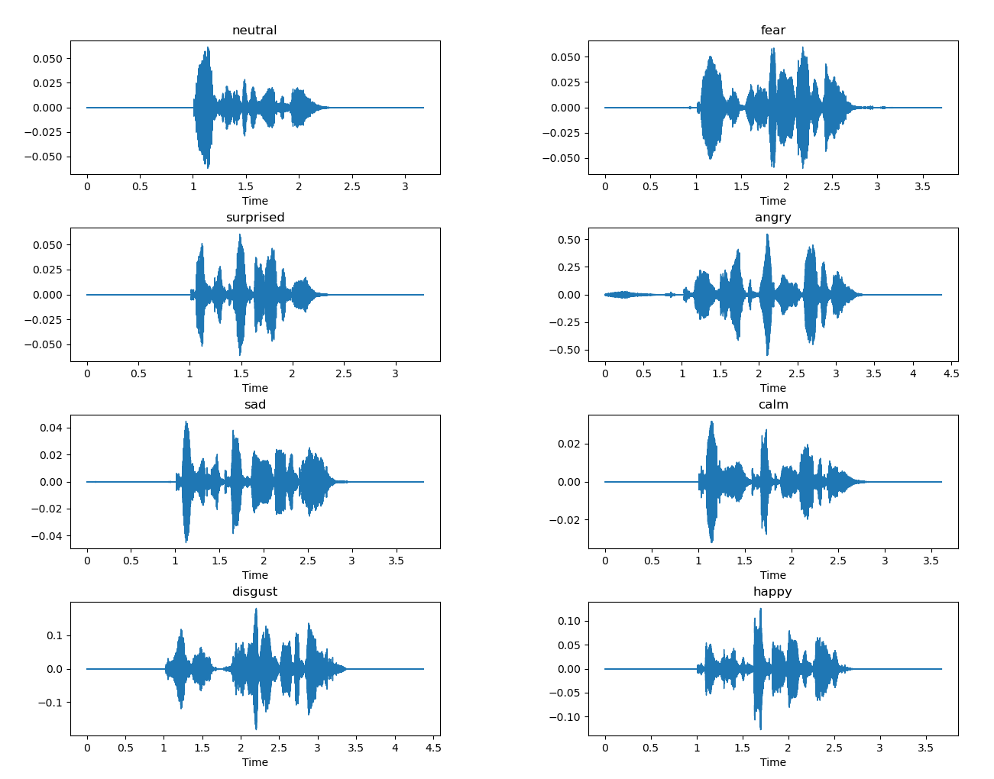
Feature engineering
Librosa
PCA
Random Forests
(feature importance)
Mel frequency cepstral coefficients (MFCC)
Root mean square
Mel frequency
Spectral centroid
Zero crossing rate
RFE

Slide 6
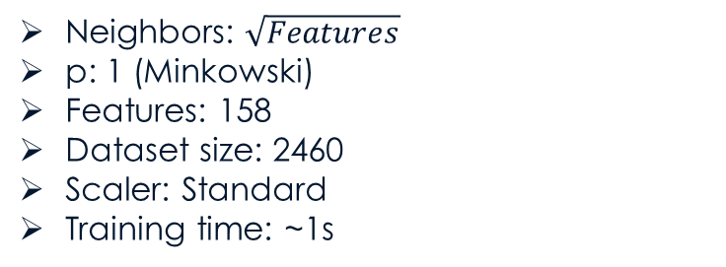
Model training
SVM
KNN
Utilized GridSearchCV to optimize hyperparameters
C: 3
Kernel: rbf
Gamma: 0.01
Features: 158
Dataset size: 2460
Scaler: Standard
Training time: ~2s
Neighbors: $\sqrt{Features}$
p: 1 (Minkowski)
Features: 158
Dataset size: 2460
Scaler: Standard
Training time: ~1s
Training Results
Training Results
Accuracy: 0.833
Precision: 0.843
Recall: 0.825
F1: 0.831
Matthews Correlation Coefficient: 0.791
Accuracy: 0.707
Precision: 0.712
Recall: 0.707
F1: 0.705
Matthews Correlation Coefficient: 0.635

Slide 7
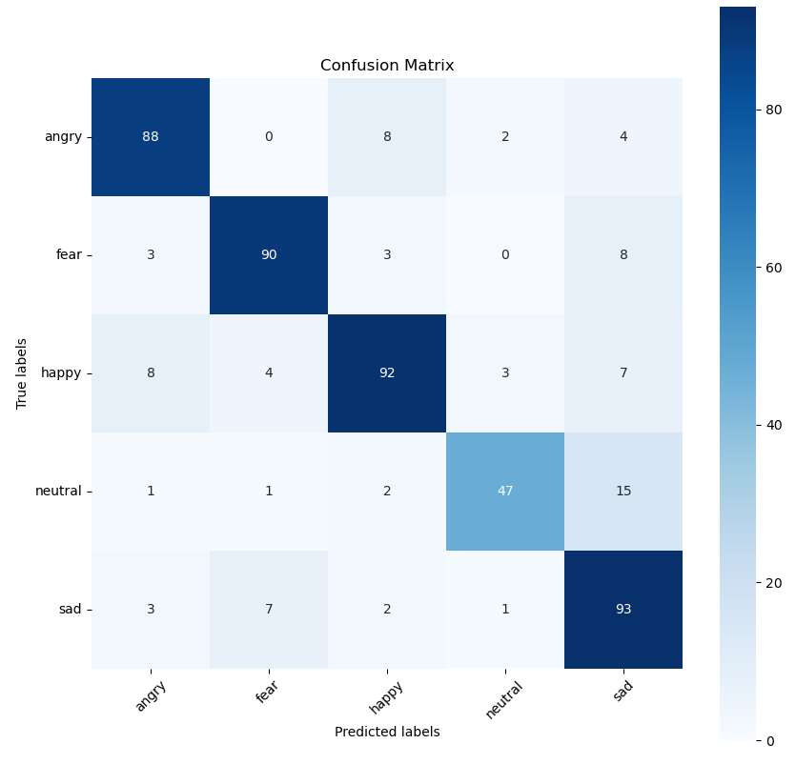
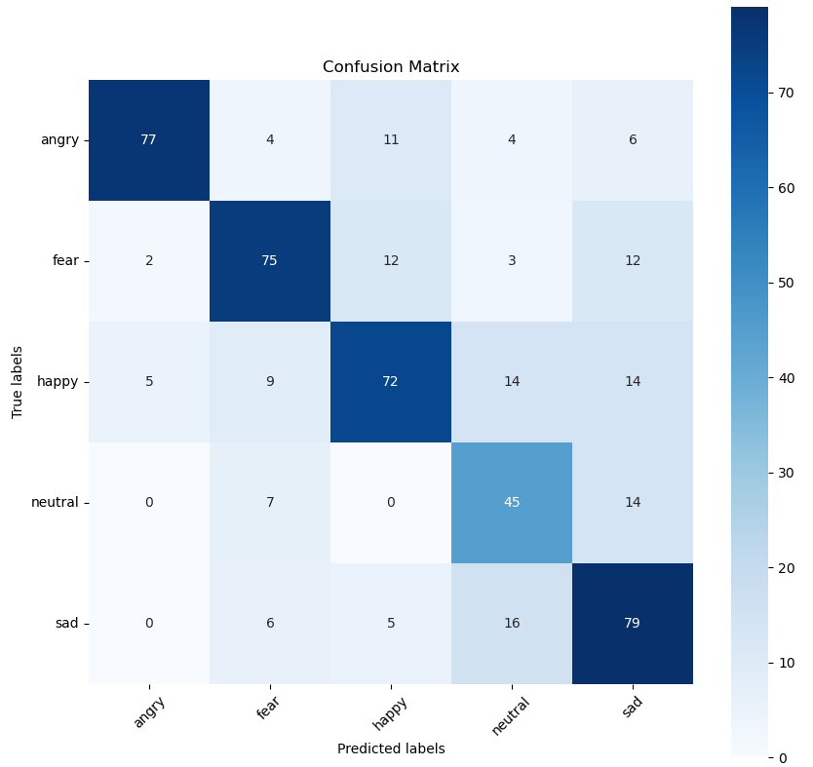
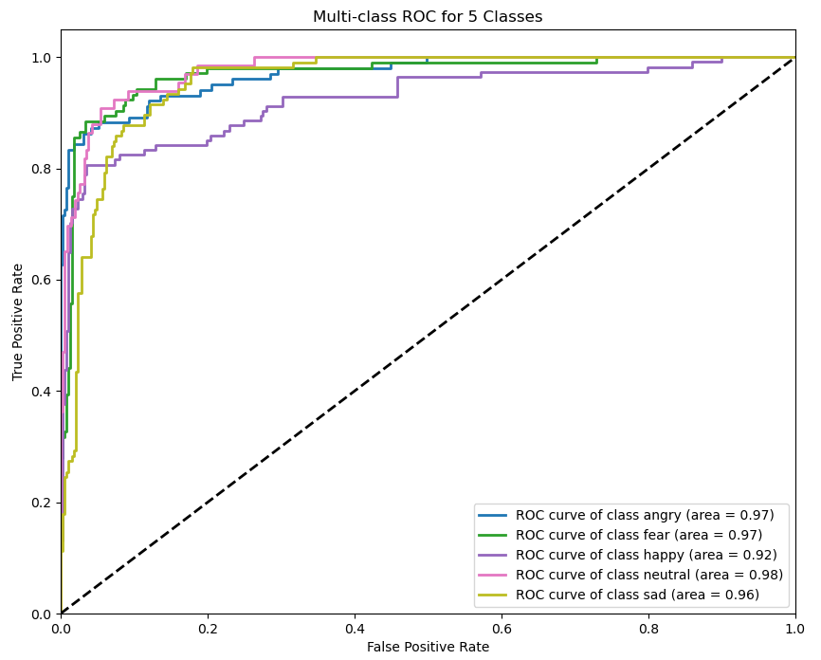
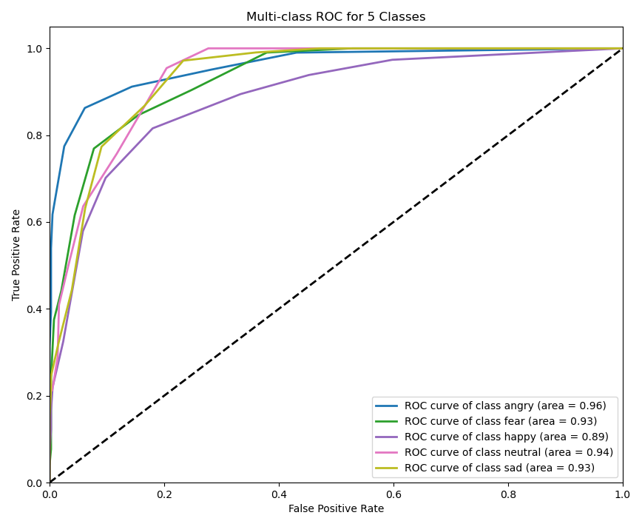
Model evaluation
SVM
KNN

Slide 8
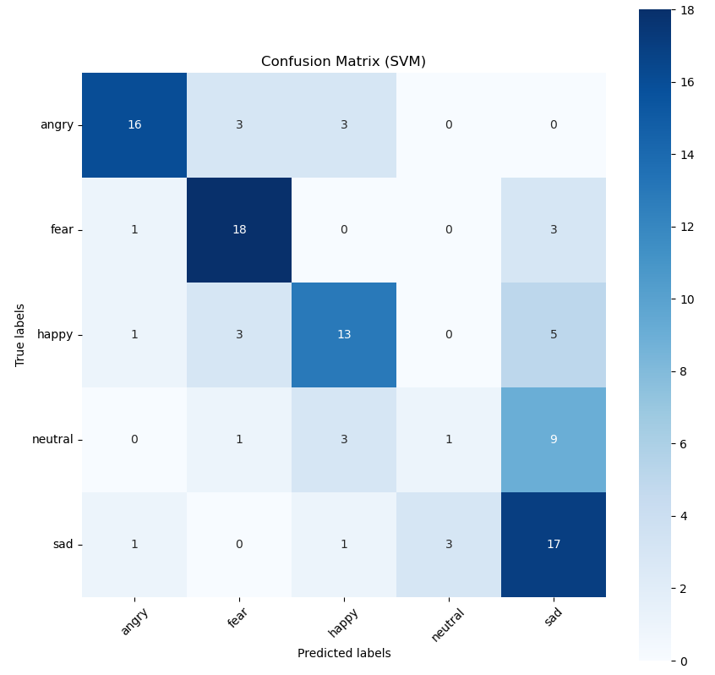
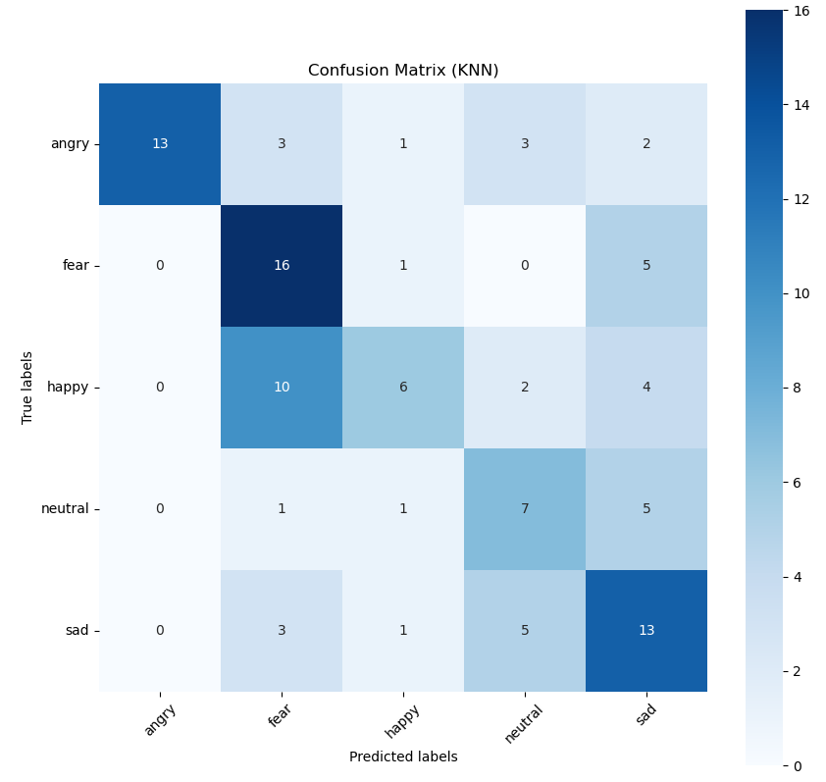
Demo
SVM Results
KNN Results
Accuracy: 0.637
Precision: 0.592
Recall: 0.596
F1: 0.577
Matthews Correlation Coefficient: 0.548
Accuracy: 0.539
Precision: 0.589
Recall: 0.536
F1: 0.532
Matthews Correlation Coefficient: 0.433

Slide 9
Conclusions
Preferred classifier: SVM
Better results than KNN
Time consuming tuning
Slower in training

