Slide 1
A Contextual Synthetic Control Method:
Assessing effect of GPU ban on AI models from China
Xingyuan Zhao

Slide 2
Bureau of Industry and Security GPU Ban
October 2022: First set of controls to prevent certain foreign military and intelligence services from obtaining advanced GPUs
October 2023: BIS expanded export controls specifically aiming at limiting the PRC’s AI capabilities
The GPU ban temporarily reduced the development of the PRC’s AI models performance.

Slide 3
Uniqueness of the AI Performance Data
The scale between the treated unit and the controlled units can very different;
One unit in the control group is heavily relied on;
Pretreatment period and number or units are limited.

Slide 4
Feasibility of Synthetic Control Method
Donor units must be sufficiently similar to the treated unit
The treated unit can be approximated by the control units
Unit weights must be nonnegative and add up to one to avoid extrapolation
Larger donor pool than pre-treatment period can lead to overfitting
Pre-treatment outcomes unaffected by future intervention
No spillover effects
… …

Slide 5
Requirements for a Solution
The treated unit and controlled units should be comparable
Such transformation needs to robust
Not just spamming units and characteristics, for larger number of characteristics than pre-treatment time steps may cause over fitting

Slide 6
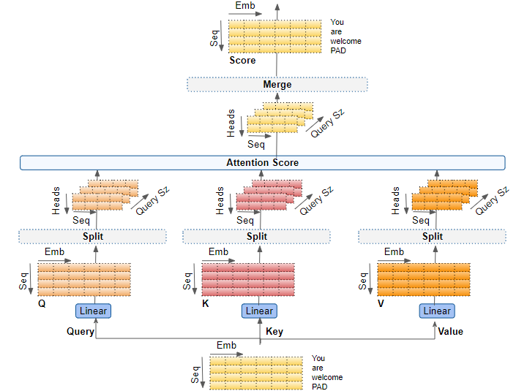
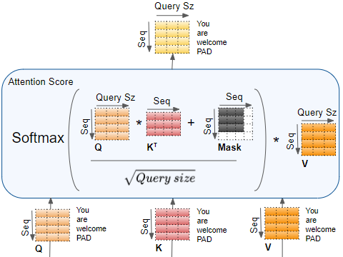
Multi-head Attention Mechanism

Slide 7
Multi-head Attention Mechanism
The interaction between Q, K and V matrices captures:
the integrated information of the whole sequence;
importance of the information from other units.
The head-splits allows:
different interactions to be captured;
diversified information capturing reduces risk of missing important information;
robustness against noise.

Slide 8
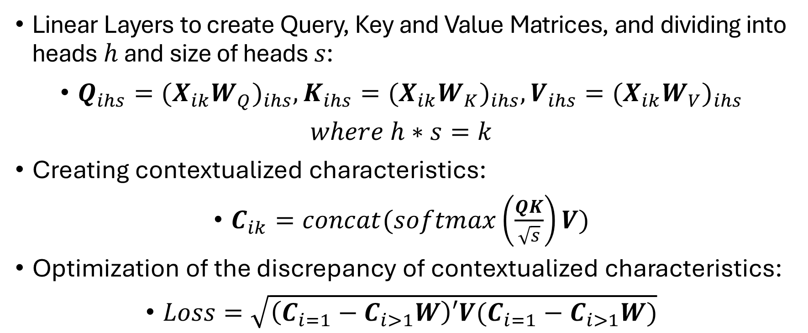
Multi-head Attention Mechanism in SCM
Linear Layers to create Query, Key and Value Matrices, and dividing into heads$h$ and size of heads $s$:
$Q_{ihs}=(X_{ik}{W_{Q})}_{ihs}, K_{ihs}=(X_{ik}{W_{K})}_{ihs}, V_{ihs}=(X_{ik}{W_{V})}_{ihs}$
$where h∗s=k$
Creating contextualized characteristics:
$C_{ik}=concat(softmax\left(\frac{QK}{\sqrt{s}}\right)V)$
Optimization of the discrepancy of contextualized characteristics:
$Loss=\sqrt{\left(C_{i=1}−C_{i>1}W\right)′V(C_{i=1}−C_{i>1}W)}$

Slide 9

Multi-head Attention Mechanism in SCM
Choosing a $V$ matrix that represent the relation among the characteristics:
$MSE=mean{\left(Y_{i=1}−WMultiheadAttention\left(Y_{i>1}\right)\right)}^{2}$

Slide 10
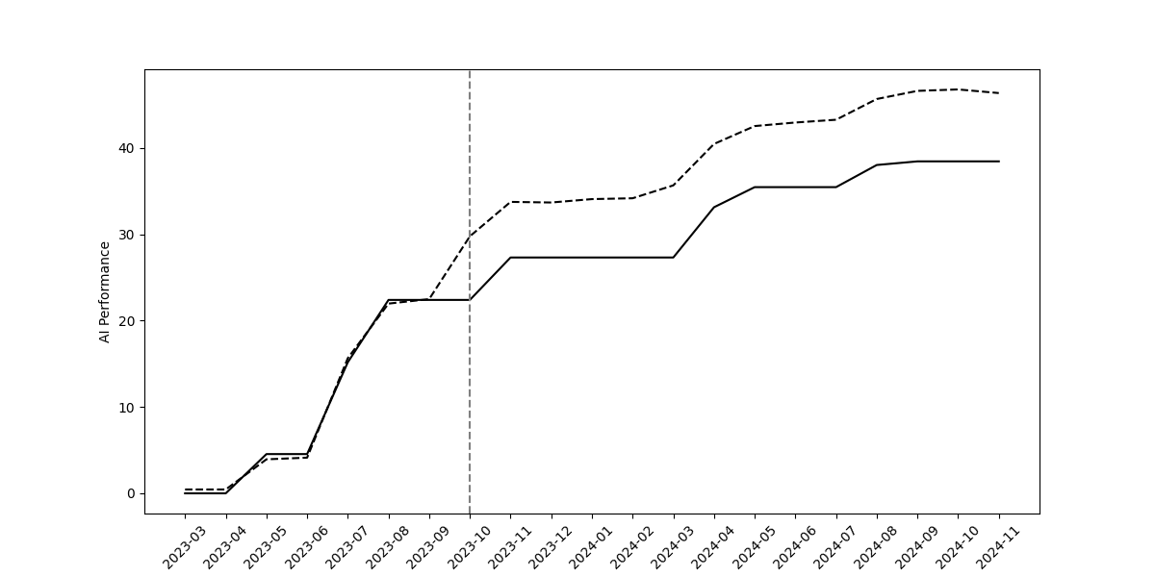
Results: Synthetic Control Unit

Slide 11
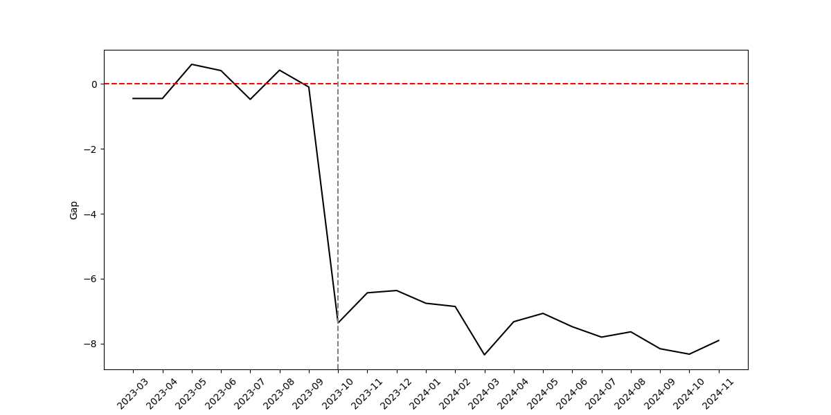
Results: Treatment Effect

Slide 12
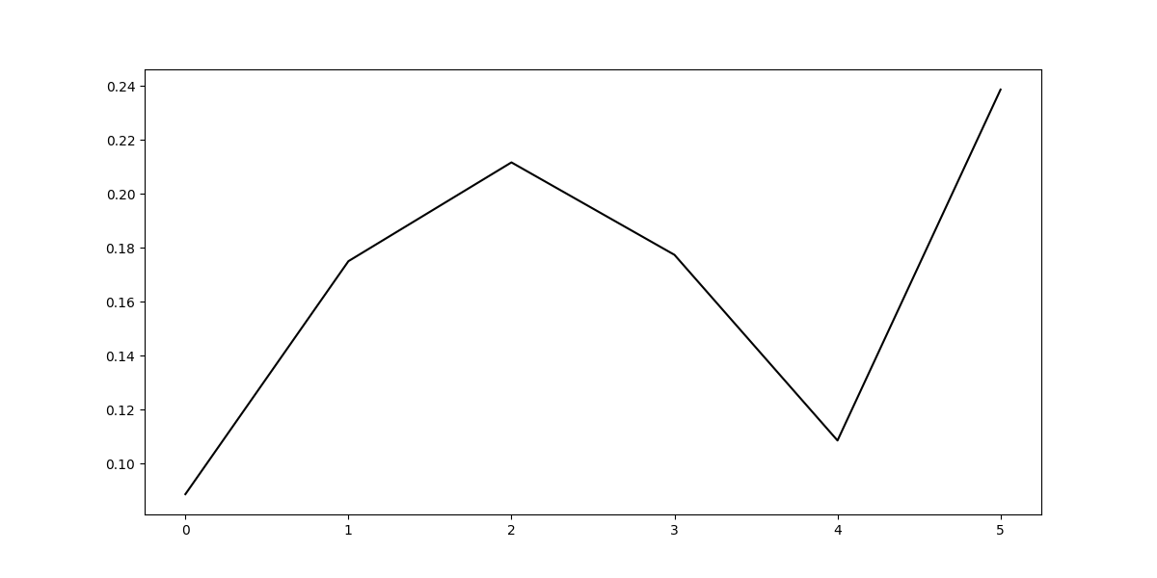
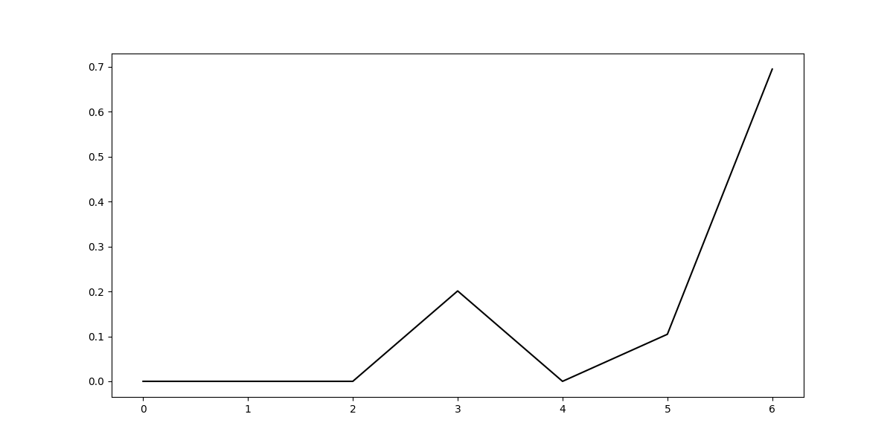
Results: Donor Units Weights

Slide 13
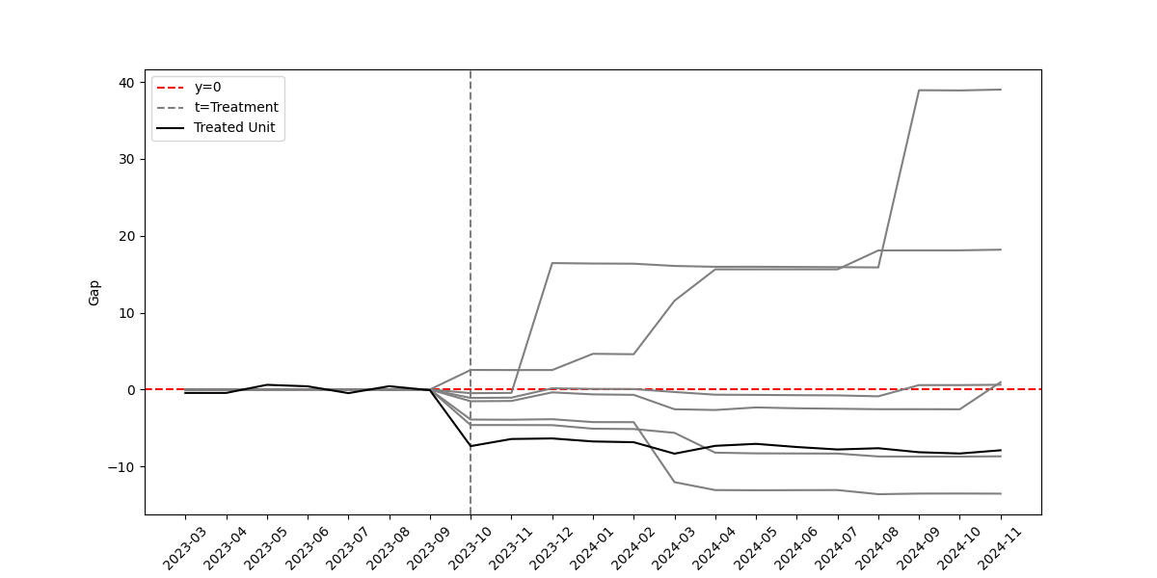
Placebo Tests: Placebo Units

Slide 14
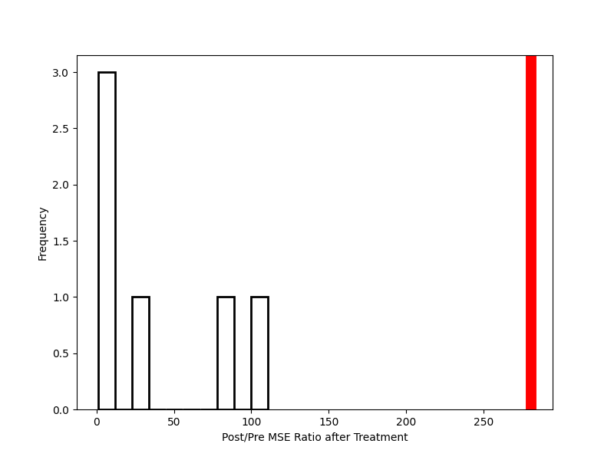
Placebo Tests: Post/Pre MSE Ratio

Slide 15
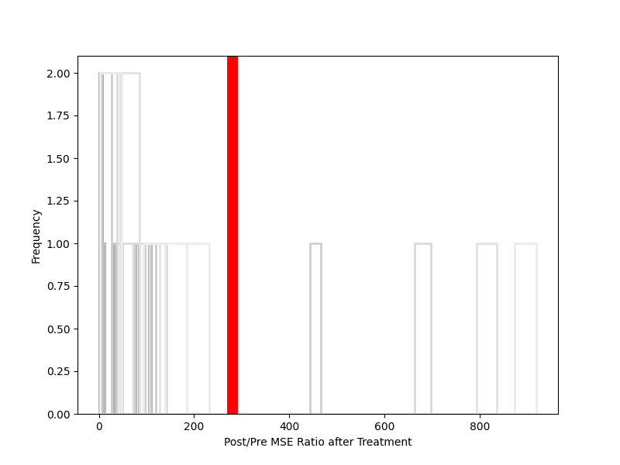
Placebo Tests: Ratio of other cutoffs

Slide 16
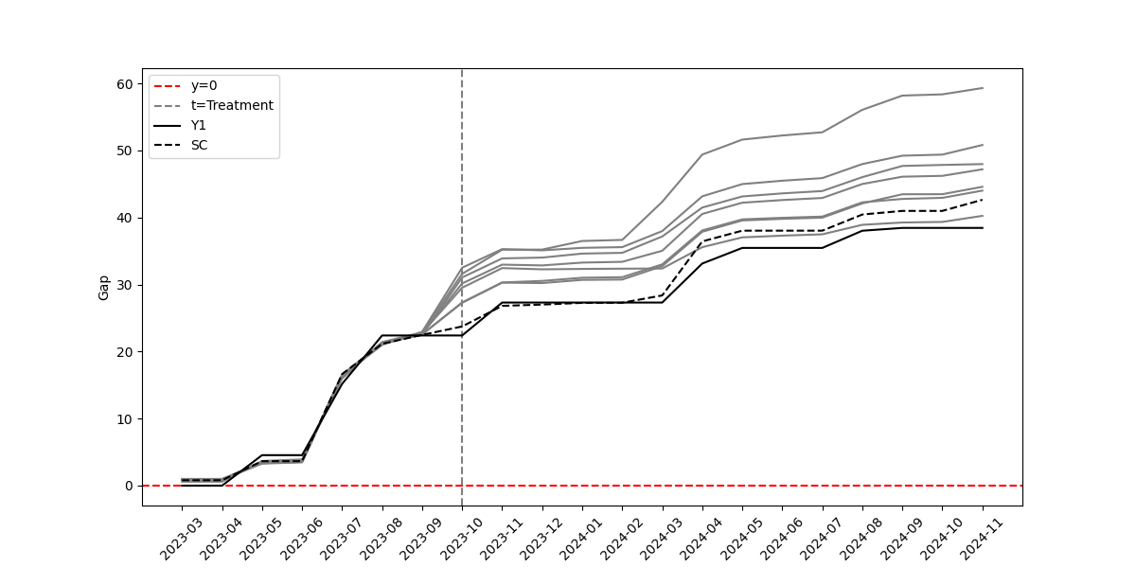
Placebo Tests: Leave-one-out

Slide 17
End
Thank you for your attention!

