Slide 1
Democratic Militarism: Voting, Wealth, and War
Xingyuan Zhao’s Final Book Presentation

Slide 2
1- BRIEF Book Summary:
Main research question:
Anomalies:
Democracies are the top spender of defense budgets.
Democracies initiated more wars than before.
Research question:
Why are democracies pursuing more military conflicts, but achieving worse results?

Slide 3
1- BRIEF Book Summary:
Main argument:
War by democracies are now a financial mobilization instead of a social mobilization

Slide 4
Main argument:
Inequality
Unconventional wars
Military doctrines reform
Technologies advancements
↓ ↓ ↓ ↓
Capital intensified military
↓
Reduced cost of war for average voters
↓
Democracies wage more war

Slide 5
1- BRIEF Book Summary:
Research design:
Quantitative: Linear Models
Qualitative: British Empire, US in Vietnam and Israel public opinion cases

Slide 6
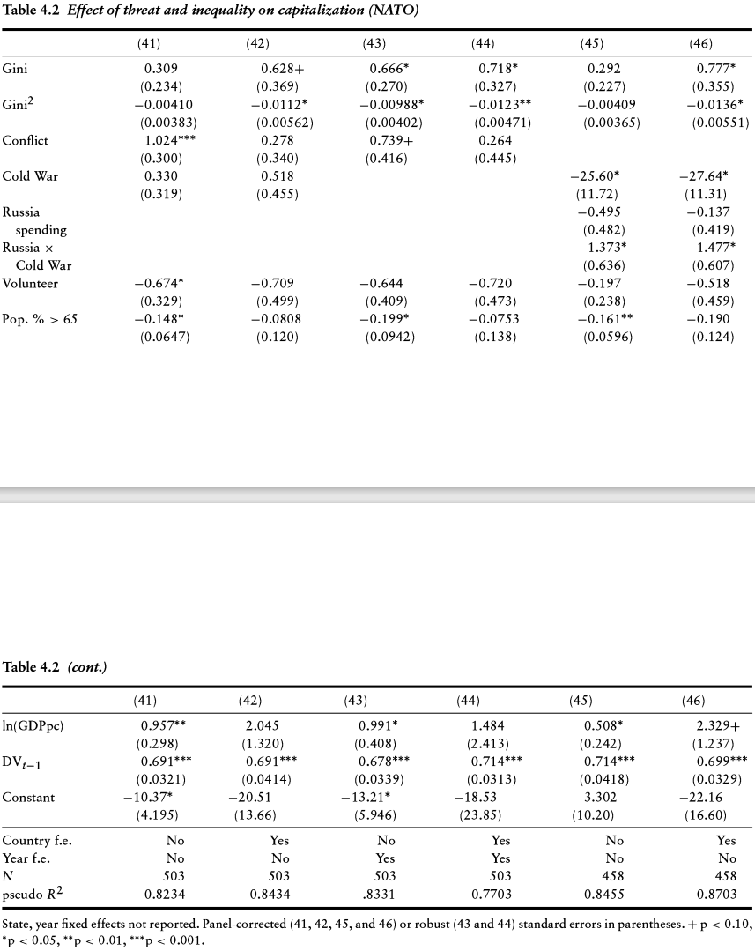
1- BRIEF Book Summary:
Empirical Evidence:

Slide 7
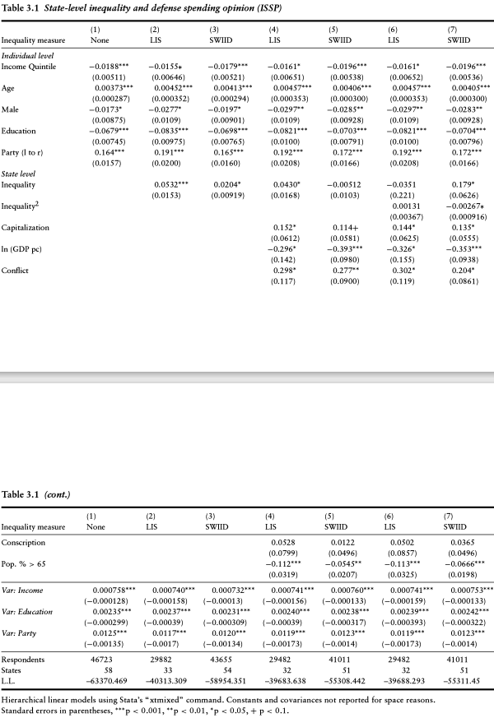
1- BRIEF Book Summary:
Empirical Evidence:

Slide 8
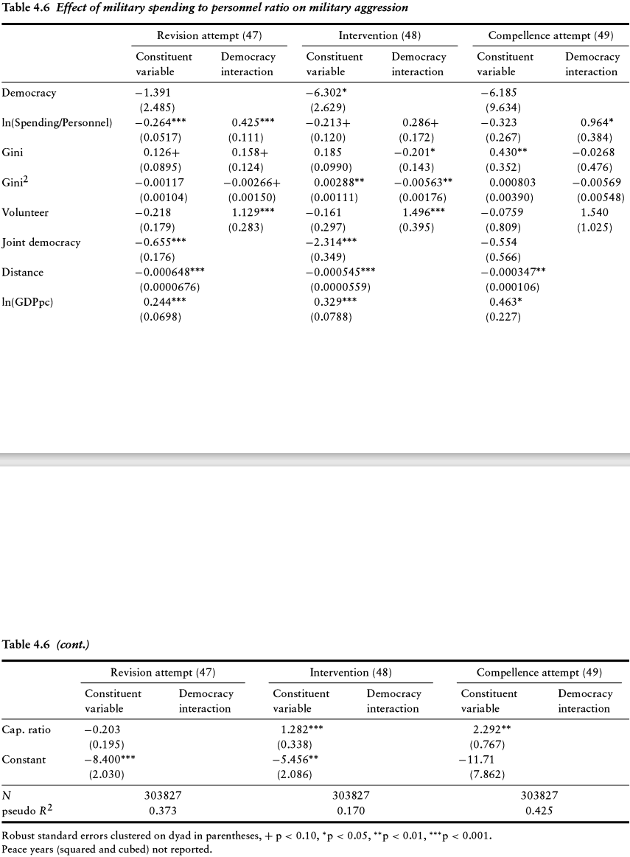
1- BRIEF Book Summary:
Empirical Evidence:

Slide 9
2- Critiques / Fixes:
Conceptualization problem: War vs Battle
fix: differentiate effectiveness in war and battle

Slide 10
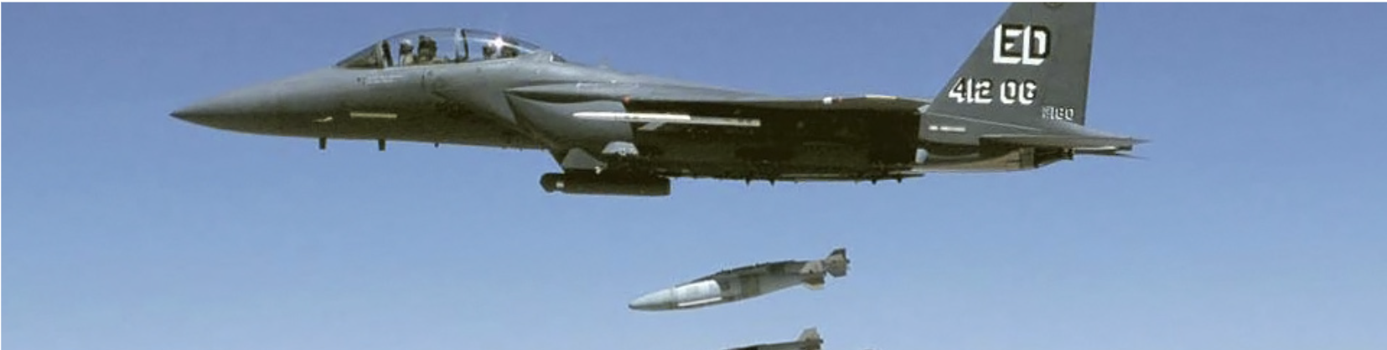
(1)effectiveness difference between war and battle:

Slide 11
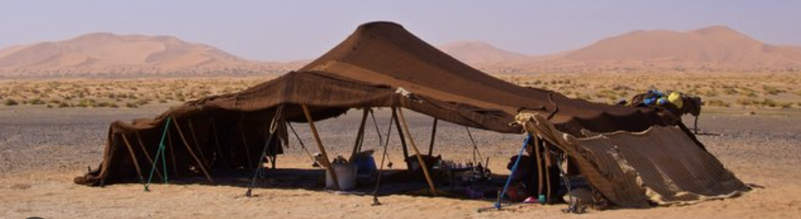
VS

Slide 12
(2)factors impacting war outcome. i.e.: Audience cost
VS

Slide 13
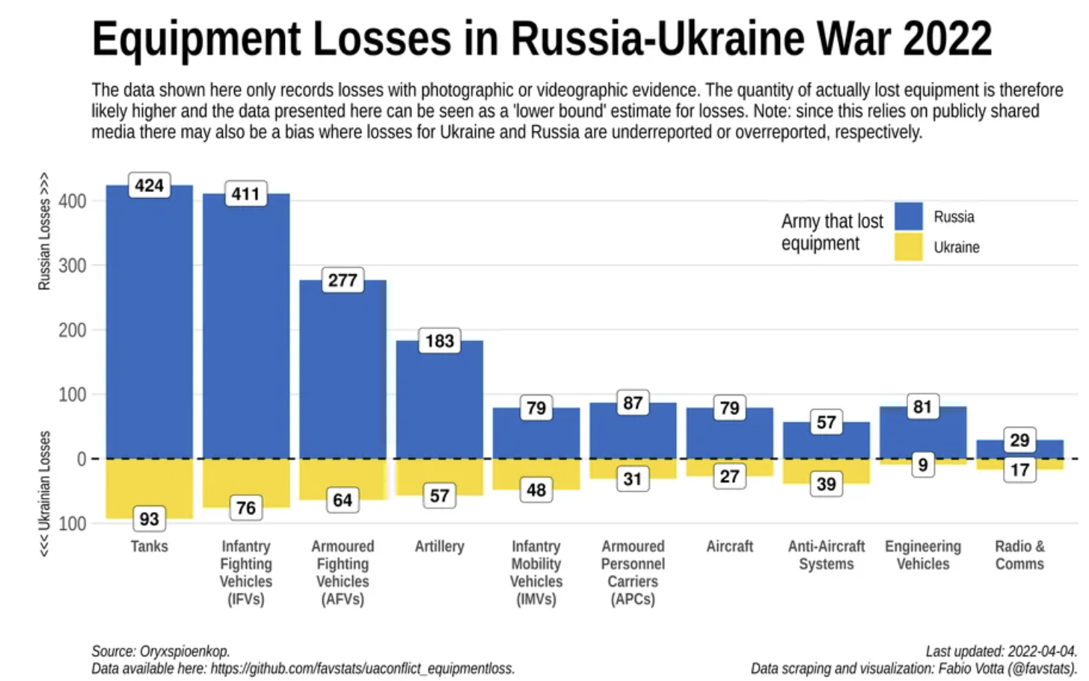
2- Critiques / Fixes:
Scope Limitation:
The findings cannot be applied to conventional warfare, where technology and equipment are more decisive.

Slide 14
fix: incorporate more data

Slide 15
2- Critiques / Fixes:
Research design:
(1)Empirical evidence only proved some parts of the causal pathway.
(2)More evidence is needed for the internal mechanism.
(3)To establish causality, they may need more methods.
fix: time series analysis

Slide 16
2- Critiques / Fixes:
Case Selection: British Empire

Slide 17
3- My Take:
Adjustments for the public opinion models:
Measurements: actually measure the cost of war for average voter (Fazal 2021)
Research Design:
Incorporate time series design to make stronger causal arguments
Incorporate spacial data test the cost of war using the difference between the states, such as enlistment rates

Slide 18
3- My Take:
Adjustments for the military aggression models:
Variables:
DV: Differentiate war/battle and their effectiveness and outcome
Control variables: Types of wars

Slide 19
4- Connections to Class Readings/Themes:
Lake(1992)
Democracies are:
Powerful Pacifists (X)
More invested in wars (✔)

Slide 20
4- Connections to Class Readings/Themes:
Tomz and Tweeks (2013)
Democratic leaders are beholden by voters for cost of war (✔)
which leads to democracies behaving peacefully (X)
Lyall (2010)
Democracies are not uniquely prone to losing counterinsurgency wars (X)

Slide 21
5- Implications and Relevant Event:
(1)Events that Can Potentially Be Explained by the book:
Unconventional/asymmetrical wars:
War on terror;
France’s interventions in Africa;
Proxy wars during the cold war.

Slide 22
5- Implications and Relevant Event:
(2)Events that Cannot Be Explained by the book:
Less Unconventional/asymmetrical wars:
Russia-Ukraine War
(3)Events that Can Somewhat Be Explained by the book:
Partial mobilization in Russia

Slide 23
5- Implications and Relevant Event:
(4)Real World / Policy Implications:
For policy makers in developed democracies: War weariness can be reduced by avoiding the average voters’ paying for it;
For average voters: Not paying for it for now does not mean not paying for it forever;
For Military industrial complex: Populism is your friend;
To promote peace: The vast majority must share the feelings of the war-torn people.

Slide 24
The End
Return to Home

