Slide 1
Week 5
PHYS2002
Lecture 8 - Capacitance
AWAIS KHAN
CGT, BIT Zhuhai

Slide 2

What is Capacitance?
From the word “capacity,” it describes how much charge an arrangement of conductors can hold for a given voltage applied.
ΔV=1.5 V
_
+
+ charges
Charges will flow until the right conductor’s potential is the same as the + side of the battery, and the left conductor’s potential is the same as the – side of the battery.
electrons
+
1.5 V
battery
“Charging”
the capacitor
_
How much charge is needed to produce an electric field whose potential difference is 1.5 V?
Depends on capacitance:
electrons
+ charges
definition of capacitance

Slide 3

Capacitance Depends on Geometry
What happens when the two conductors are moved closer together?
ΔV=1.5 V
ΔV=1.5 V
_
_
+
+
They are still connected to the battery, so the potential difference cannot change.
+ charges
But recall that .
Since the distance between them decreases, the E field has to increase.
+
1.5 V
battery
increases
constant
_
Charges have to flow to make that happen, so now these two conductors can hold more charge. I.e. the capacitance increases.
+ charges
increases

Slide 4
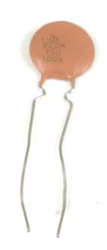
Capacitance Depends on Geometry
ΔV=1.5 V
_
+
What happens if we replace the small conducting spheres with large conducting plates?
The plates can hold a lot more charge, so the capacitance goes way up.
Circular plates
+ charges
Here is a capacitor that you can use in an electronic circuit.
We will discuss several ways in which capacitors are useful.
But first, let’s look in more detail at what capacitance is.
+
1.5 V
battery
_
+ charges

Slide 5



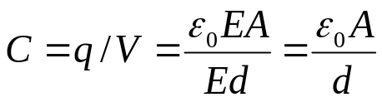

Capacitance for Parallel Plates
separation
d
Parallel plates make a great example for calculating capacitance, because
  The E field is constant, so easy to calculate.
  The geometry is simple, only the area and plate separation are important.
To calculate capacitance, we first need to determine the E field between the plates. We use Gauss’ Law, with one end of our gaussian surface closed inside one plate, and the other closed in the region between the plates (neglect fringing at ends):
E and dA
parallel
area A
line of
integration
V₊
V₋
Total charge q
on inside of plate
so
Need to find potential difference
Since E=constant, we have , so the capacitance is

Slide 6
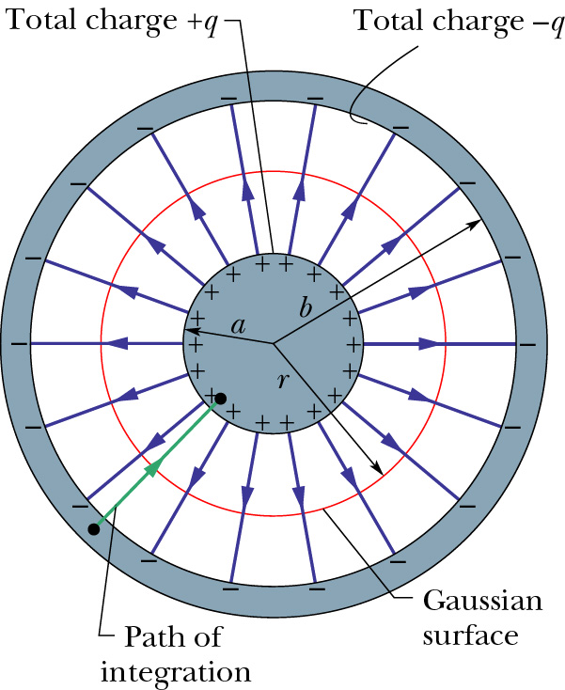


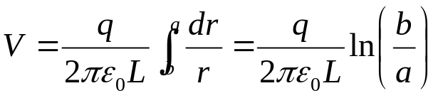
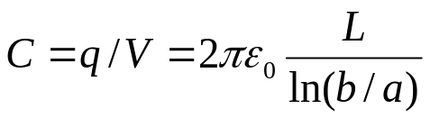
Capacitance for Other Configurations (Cylindrical)
Cylindrical capacitor
  The E field falls off as 1/r.
  The geometry is fairly simple, but the V integration is slightly more difficult.
To calculate capacitance, we first need to determine the E field between the plates. We use Gauss’ Law, with a cylindrical gaussian surface closed in the region between the plates (neglect fringing at ends):
So or
Need to find potential difference
Since E~1/r, we have , so the capacitance is

Slide 7


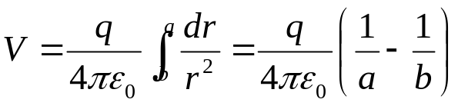
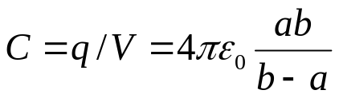
Capacitance for Other Configurations (Spherical)
Spherical capacitor
  The E field falls off as 1/r².
  The geometry is fairly simple, and the V integration is similar to the cylindrical case.
To calculate capacitance, we first need to determine the E field between the spheres. We use Gauss’ Law, with a spherical gaussian surface closed in the region between the spheres:
So or
Need to find potential difference
Since E~1/r², we have , so the capacitance is

Slide 8
Problem 1
An isolated, charged conducting sphere of radius 12.0 cm creates an electric field of 4.9*10⁴ N/C at a distance 21.0 cm from its center.
What is its surface charge density?
What is its capacitance?

Slide 9
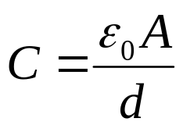
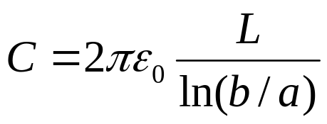
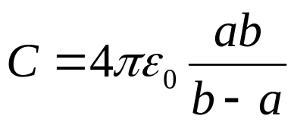

Capacitance Summary
Parallel Plate Capacitor
Cylindrical (nested cylinder) Capacitor
Spherical (nested sphere) Capacitor
Capacitance for isolated Sphere
Units: ε₀×length = C²/Nm = F (farad), named after Michael Faraday. [note: ε₀ = 8.85 pF/m]

Slide 10

Units of Capacitance
Given these expressions, and ε₀ = 8.85 x 10⁻¹² C²/N∙m², what are the units of capacitance?
The units are different in the different expressions.
The units are C²/N∙m².
The units are C²/N∙m.
The units are C²/N.
The units are C/V.
Units: ε₀×length = C²/N∙m = F (farad), named after Michael Faraday. [note: ε₀ = 8.85 pF/m]

Slide 11
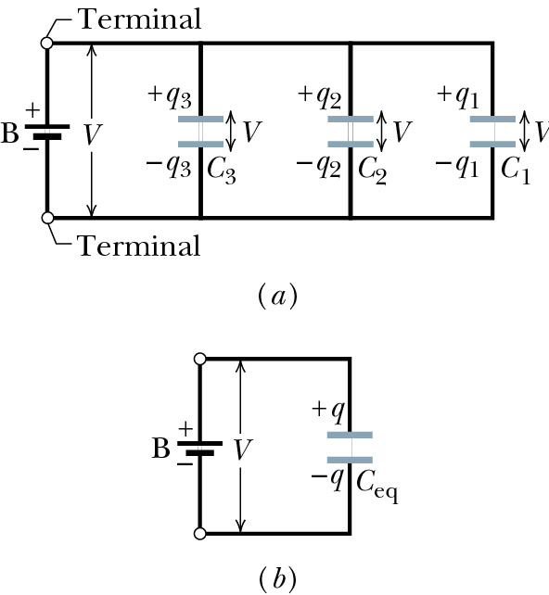
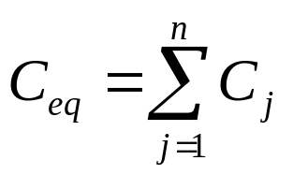
Capacitors in Parallel
No difference between
3C
and
V
C
C
C
Capacitors in parallel:

Slide 12
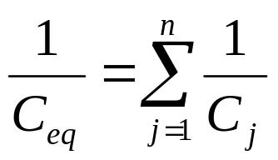
Capacitors in Series
There is a difference between
and
C
3C
C
C
Charge on lower plate of one and upper plate of next are equal and opposite. (show by gaussian surface around the two plates).
Total charge is q, but voltage on each is only V/3.
Capacitors in series:

Slide 13
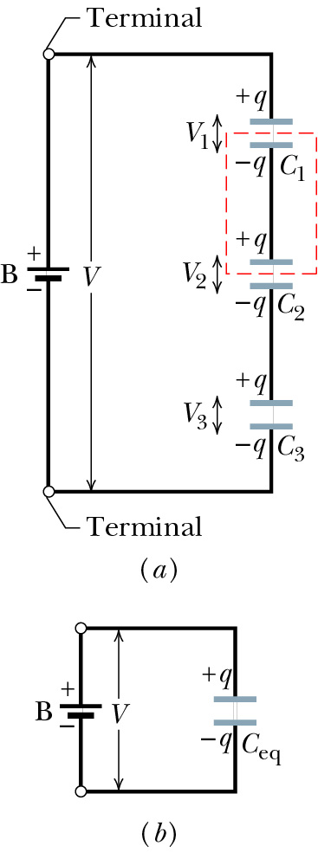
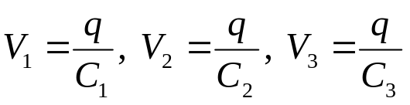
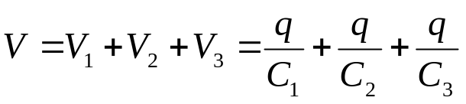
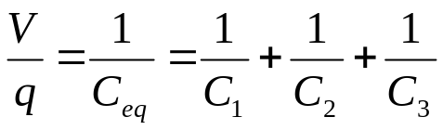
Capacitors in Series
To see the series formula, consider the individual voltages across each capacitor
The sum of these voltages is the total voltage of the battery, V
Since V/q = 1/C_{eq}, we have

Slide 14
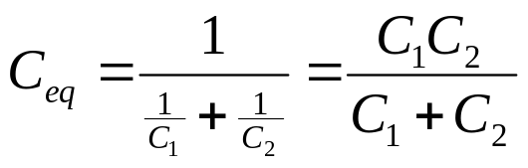
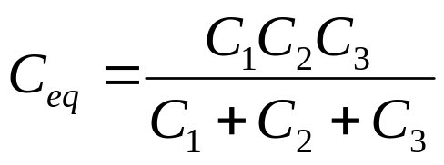
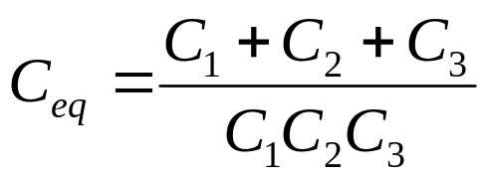
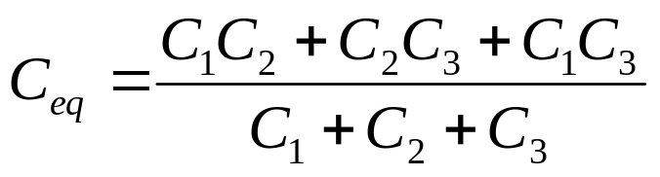
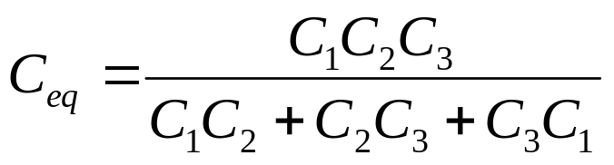
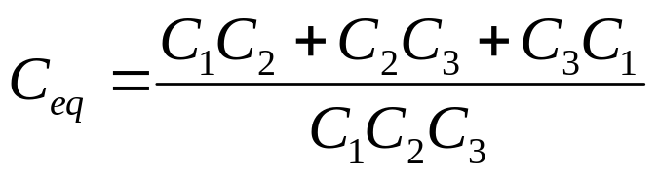
Three Capacitors in Series
The equivalent capacitance for two capacitors in series is .
What is the equivalent capacitance for three capacitors in series?

Slide 15

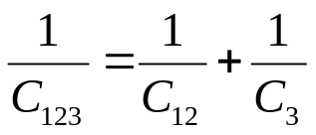
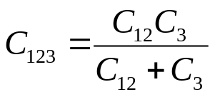
Example Capacitor Circuit
Step 1
Step 2
C₁
C₂
C₁₂
parallel
V
V
series
V
C₁₂₃
C₃
C₃
C₁ = 12.0 μF, C₂ = 5.3 μF, C₃ = 4.5 μF
C₁₂₃ = (12 + 5.3)4.5/(12+5.3+4.5) μF = 3.57 μF

Slide 16

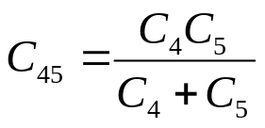

Another Example
parallel
C₄
C₆
C₁
C₄₅
C₆
C₅
V
series
C₂
C₃
C₃
C₃
parallel

Slide 17
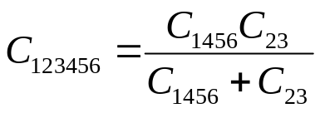
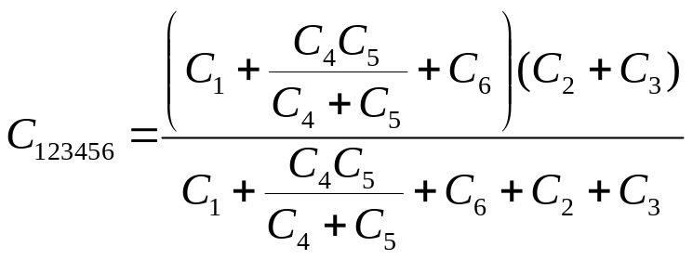
Another Example
C₁₄₅₆
series
V
C₂₃
Complete solution

Slide 18
Series or Parallel
In the circuits below, which ones show capacitors 1 and 2 in series?
I, II, III
I, III
II, IV
III, IV
None
C₂
C₃
I
II
C₁
V
C₁
V
C₃
C₂
C₁
III
C₃
IV
V
C₁
C₂
C₂
C₃
V

Slide 19
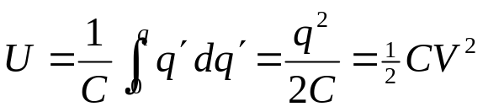
Capacitors Store Energy
ΔV=1.5 V
When charges flow from the battery, energy stored in the battery is lost. Where does it go?
We learned last time that an arrangement of charge is associated with potential energy. One way to look at it is that the charge arrangement stores the energy.
Recall the definition of electric potential V = U/q
For a distribution of charge on a capacitor, a small element dq will store potential energy dU = V dq
Thus, the energy stored by charging a capacitor from charge 0 to q is
_
+
+ charges
+
1.5 V
battery
_
+ charges
Movie 1
Movie 2

Slide 20
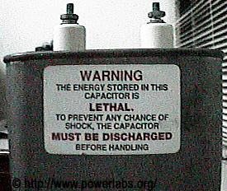
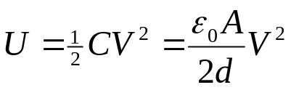
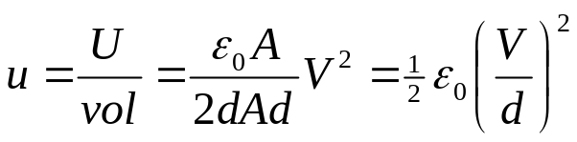

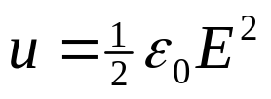
Capacitors Store Energy
Another way to think about the stored energy is to consider it to be stored in the electric field itself.
The total energy in a parallel plate capacitor is
The volume of space filled by the electric field in the capacitor is vol = Ad, so the energy density is
But for a parallel plate capacitor, so
Energy stored in electric field

Slide 21


What Changes?
A parallel plate capacitor is connected to a battery of voltage V. If the plate separation is decreased, which of the following increase?
II, III and IV.
I, IV, V and VI.
I, II and III.
All except II.
All increase.
I. | Capacitance of capacitor
II. | Voltage across capacitor
III. | Charge on capacitor
IV. | Energy stored on capacitor
V. | Electric field magnitude between plates
VI. | Energy density of E field

Slide 22
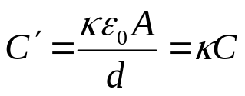
Dielectrics
You may have wondered why we write ε₀ (permittivity of free space), with a little zero subscript. It turns out that other materials (water, paper, plastic, even air) have different permittivities ε = κε₀. The κ is called the dielectric constant, and is a unitless number. For air, κ = 1.00054 (so ε for air is for our purposes the same as for “free space.”)
In all of our equations where you see ε₀, you can substitute κε₀ when considering some other materials (called dielectrics).
The nice thing about this is that we can increase the capacitance of a parallel plate capacitor by filling the space with a dielectric:
Material | Dielectric Constant κ | Dielectric Strength (kV/mm)
Air | 1.00054 | 3
Polystyrene | 2.6 | 24
Paper | 3.5 | 16
Transformer Oil | 4.5
Pyrex | 4.7 | 14
Ruby Mica | 5.4
Porcelain | 6.5
Silicon | 12
Germanium | 16
Ethanol | 25
Water (20º C) | 80.4
Water (50º C) | 78.5
Titania Ceramic | 130
Strontium Titanate | 310 | 8

Slide 23
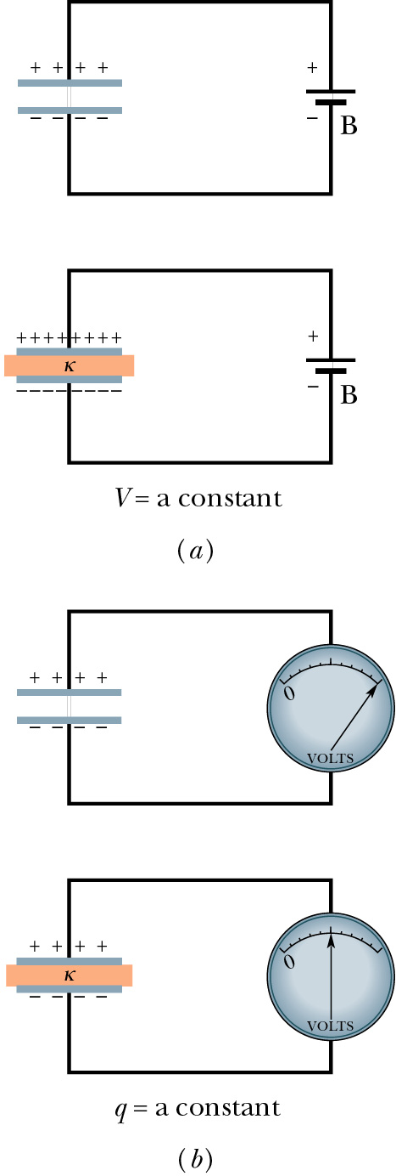
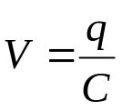

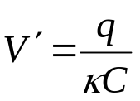
What Happens When You Insert a Dielectric?
With battery attached, V=const, so more charge flows to the capacitor
With battery disconnected, q=const, so voltage (for given q) drops.

Slide 24
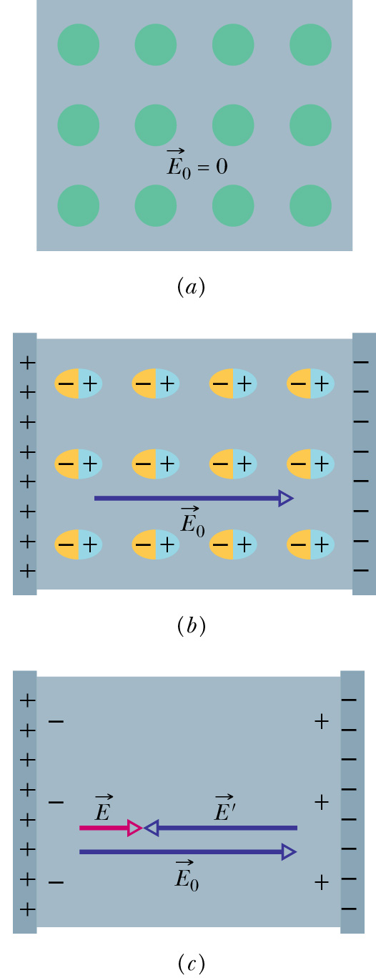
What Does the Dielectric Do?
A dielectric material is made of molecules.
Polar dielectrics already have a dipole moment (like the water molecule).
Non-polar dielectrics are not naturally polar, but actually stretch in an electric field, to become polar.
The molecules of the dielectric align with the applied electric field in a manner to oppose the electric field.
This reduces the electric field, so that the net electric field is less than it was for a given charge on the plates.
This lowers the potential (case b of the previous slide).
If the plates are attached to a battery (case a of the previous slide), more charge has to flow onto the plates.

Slide 25
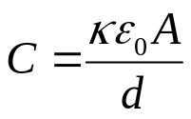
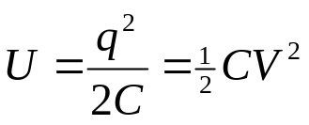
What Changes?
Two identical parallel plate capacitors are connected in series to a battery as shown below. If a dielectric is inserted in the lower capacitor, which of the following increase for that capacitor?
I and III.
I, II and IV.
I, II and III.
All except II.
All increase.
I. | Capacitance of capacitor
II. | Voltage across capacitor
III. | Charge on capacitor
IV. | Energy stored on capacitor
C
V
κ
C

Slide 26
A Closer Look
Insert dielectric
Capacitance goes up by κ
q
q’
Charge increases
C
V
Charge on upper plate comes from upper capacitor, so its charge also increases.
V
Since q’ = CV₁ increases on upper capacitor, V₁ must increase on upper capacitor.
q
q’
κ
κC
C
V
Since total V = V₁ + V₂ = constant, V₂ must decrease.

Slide 27
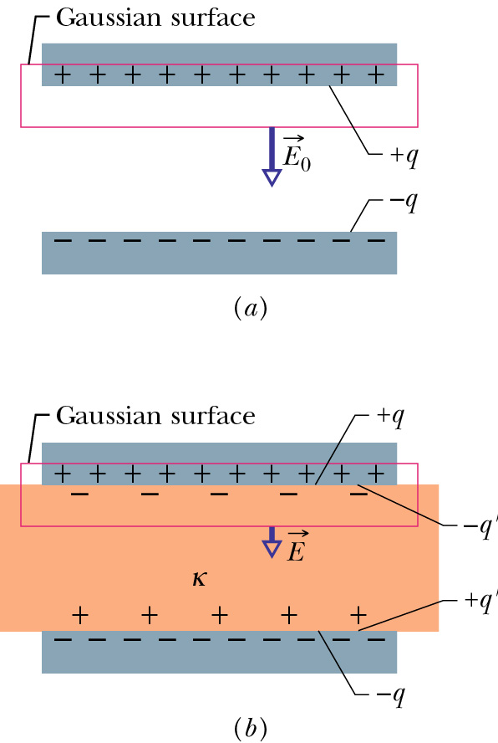
Dielectrics and Gauss’ Law
Gauss’ Law holds without modification, but notice that the charge enclosed by our gaussian surface is less, because it includes the induced charge q’ on the dielectric.
For a given charge q on the plate, the charge enclosed is q – q’, which means that the electric field must be smaller. The effect is to weaken the field.
When attached to a battery, of course, more charge will flow onto the plates until the electric field is again E₀.

Slide 28

Summary
Capacitance says how much charge is on an arrangement of conductors for a given potential.
Capacitance depends only on geometry
  Parallel Plate Capacitor
  Cylindrical Capacitor
  Spherical Capacitor
  Isolated Sphere
Units, F (farad) = C²/Nm or C/V (note ε₀ = 8.85 pF/m)
Capacitors in parallel in series
Energy and energy density stored by capacitor
Dielectric constant increases capacitance due to induced, opposing field. κ is a unitless number.

Slide 29
Add by zpsong

