Slide 1
Learning Machine Task 1:
Obstacle Avoidance
Group Papa:
Daniyal Selani, Kristian Pal’uch
Sebastiaan Peek, Xingkai Wang

Slide 2
Problem definition
Simplifying the problem: Robot has to move and not hit obstacles
Robot has no end/goal state

Slide 3
Methodology
Q-Learning
States chosen: Stuck or not, sense something or not
Rewards: Incentivize movement but not at the risk of collision
Actions: Limited to 6 (smaller state-action space)
Policy: Epsilon - Greedy
Controller: q-table
Notes:
Mention that design decisions were made with the limitations of vrep in mind (very slow)
Supervised learning could not be used (no prior data), reinforcement learning was chosen because task can be represented in the agent, reward, state criteria
8 sensors and 1 stuck (stuck when robots coordinates do not change within a certain threshold between 2 consecutive steps) variable were chosen to represent the state. They were represented as bool values (1 or 0) because it reduces state space (lower state space means faster learning, Vrep is already very slow)
Rewards: Want to incentivize always moving but not at the cost of bumping into anything (if all 5 front sensors return 1 value, then reward is -5 for staying there)
Actions: Self explanatory
Epsilon - greedy: Not ideal but good for the simple Q learning implementation chosen, ensures exploration and not getting stuck in loop
Controller being learnt is the q table, which is a 2x2x2x2x2x2x2x2x2x6 numpy array ( 9 2s and 1 6)

Slide 4
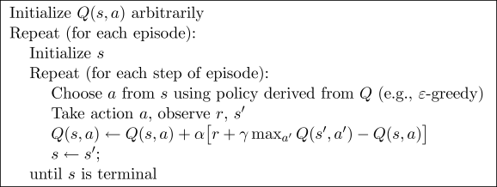
Methodology
State (Boolean) | Reward
Stuck | -2
Sensor detection | -1 per sensor that detects an object
No detection | 0
Actions | Parameters (v = velocity)
forward | (v, v, millisecond)
backward | (-v, -v, millisecond)
hardleft (90 degrees) | (-20, 20, 2250)
softleft (45 degrees) | (-20, 20, 1250)
hardright (90 degrees) | (20, -20, 2250)
softright (45 degrees) | (20, -20, 1250)
Q-Learning
States chosen: Stuck or not, sense something or not
Rewards: Incentivize movement but not at the risk of collision
Actions: Limited to 6 (smaller state-action space)
Move in a small and high-density space and use sensors to detect obstacles and make corresponding avoidance actions
Controller → Q - table
Describe what our Q table looks like
Learning algorithm → Q - learning (ε-greedy policy)
Formula:
Q(sₜ,aₜ)←Q(sₜ,aₜ) + α[rₜ₊₁ + 𝛾maxQ(sₜ₊₁, a) - Q(sₜ, aₜ)]
Notes:
Supervised learning could not be used (no prior data), reinforcement learning was chosen because task can be represented in the agent, reward, state criteria
8 sensors and 1 stuck variable were chosen to represent the state. They were represented as bool values (1 or 0) because it reduces state space (lower state space means faster learning, Vrep is already very slow)
Rewards: Want to incentivize always moving but not at the cost of bumping into anything (if all 5 front sensors return 1 value, then reward is -5 for staying there)
We chose 3 states which forces the robot to keep moving. Because when it’s standing still (stuck) it’s getting a negative reward. Also each sensor gives a negative reward when it detects something.
The actions are as few as possible. To get a some sort of smooth drive, we decided to do a soft and hard turn.
There are actually 9 states, due to the fact that each sensor has its own state, therefore there are 512 parameters (because boolean 2^9).

Slide 5
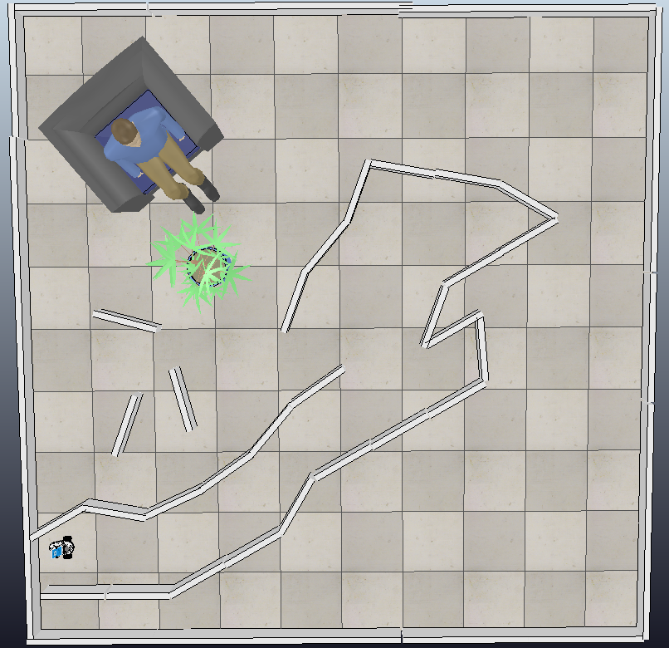
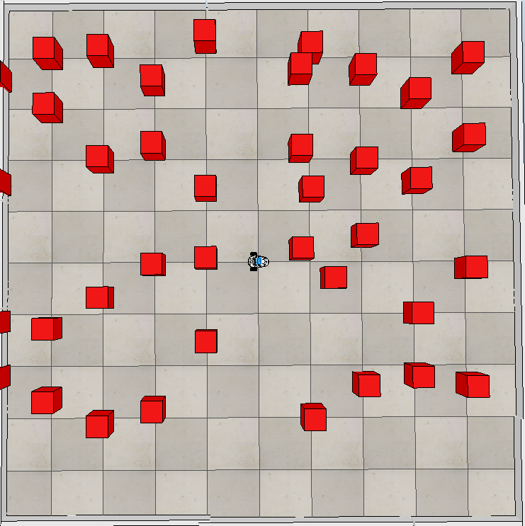
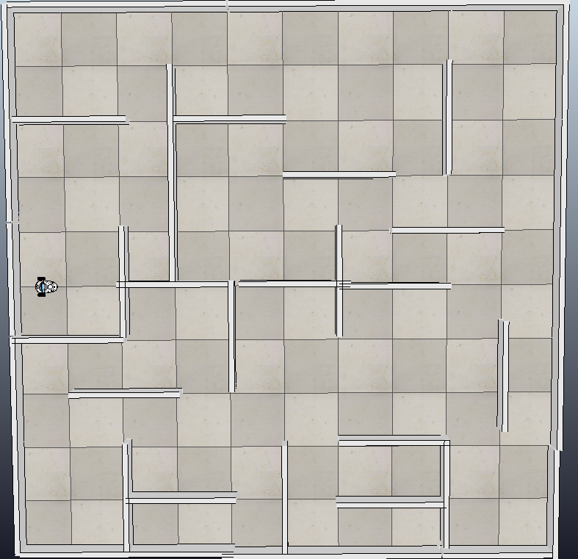
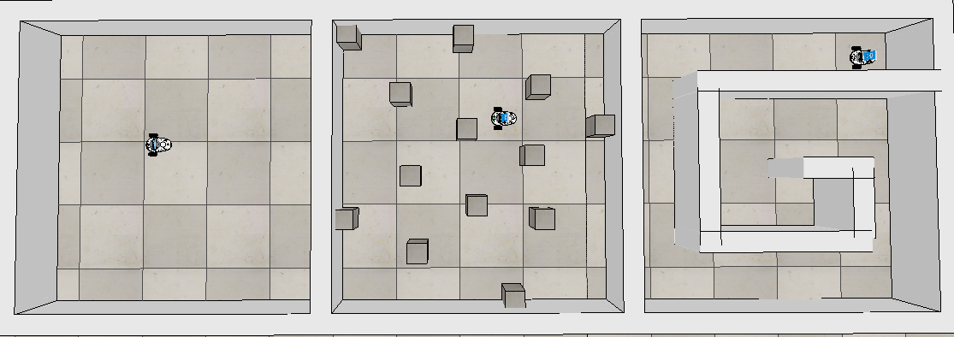
Experimental setup
Environment selection: Diversity for training and testing
Notes:
Randomizing environements so the robot doesnt learn to navigate or cheat the arena.. (Also explain how fully randomizing the arena was not possible because it was buggy and slow, sometimes it would start, sometimes it wouldnt, etc)
Explain randomization of obs arena, The training arenas were completely sparse (empty), to moderately dense (grid), to extremely dense (narrow maze) (each box trained for equal episodes)

Slide 7
Experimental Setup
Performance Metrics:
Cumulative Reward
Number of collisions
Parameters:
Epsilon-greedy: 0.15
Stuck threshold: 0.075
Number of episodes: 39
Number of max steps: 60
Notes:
Very self explanatory: Collisions detected when there is atleast one sensor giving a reading above a threshold, and the robot hasnt moved within a threshold between 2 consecutive iterations (we call it full_stuck in the code)
Epsilong-greedy: 0.15, if too low then robot gets stuck in loop (robot can just move in a circle or slight forwards and backwards to not stay in one place and not hit anything)
Stuck threshold: The difference betwee 2 consecutive coordinates of the robot. If 0 then it is very strict and robot is almost never stuck, if too high then robot is always stuck because robot cant move fast enough to change coordinates between steps. 0.075 goldilock zone, when turning robot is identified in stuck state so robot is incentivized to turn as less possible and go in straight lines.
Max steps neccesary because no end state

Slide 8
Experimental setup
Performance measures
Cumulative reward
Number of collision
Parameters
Episodes: ##
Steps: ##
Alpha (learning rate): ##
Gamma (discount rate): ##
Epsilon: ##
Environments
Training was done on bottom three environments
The upper 3 environments are designed by us
Time and technical issues
Notes:
The upper 3 environments are made by us. The first represents a living room, the second is a environment which randomize blocks after each episode of learning. Therefore is doesn’t learn a specific path. At last we have designed a maze which the robot could discover.
The parameters we used are as follows ….
Due to some techinical issues we wanted to use the bottom 3 environments as a validation arena. However the upper 3 envr where really slow in training and due to some technical issues and therefore shortage of time we decided to only train on de validation environments. Which were a lot quicker in training.
The training was done iteratively over the three rooms. So first room 1 then room 2 and at last room 3. This loop is repeated 5 times. So in the end we have 15 episodes, 5 in each room.
This means that we actually don’t have a validation set. Therefore also don’t really know how well our robot would perform in a totally different environment.

Slide 9
Results
Summary:
Robot performed admirably in most scenarios, except for the narrow maze
Very little/gradual increase in cumulative rewards
Very little/gradual decrease in the amount of times robot got stuck
Noticeable trend in the amount of times robot collided (full_stuck_count)
Notes:
This will be shown in video
THis is true for all arenas but you can see that some arenas have a higher avergae rewards than others, indicates that q learning adapts to the arena
This is true for all arenas as well, could be explained by the fact that the robot has to turn a lot in all of them, although average values are different
This is only true grid arena, maze arena is very hard for robot, as it is narrow and epsilon greedy policy means that it is bound to make a bad move sometimes (less forgiving). The empty arena does not have many obstacles so this metric doesnt apply

Slide 10
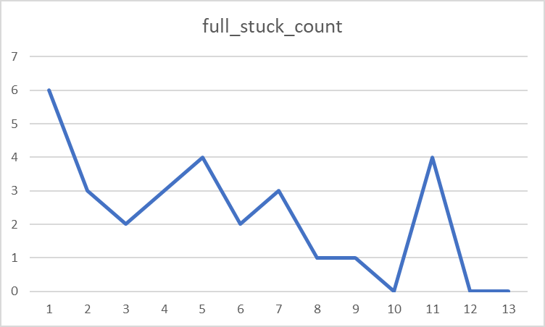
Grid Obstacles

Slide 11
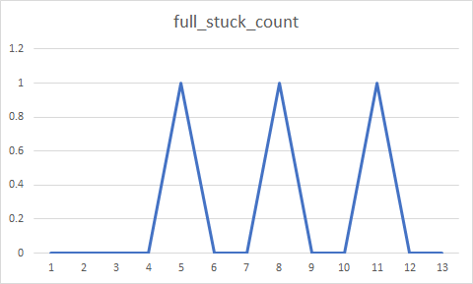
Empty Arena

Slide 12
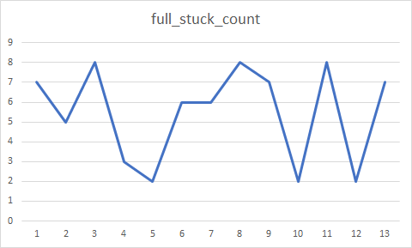
Maze

Slide 13
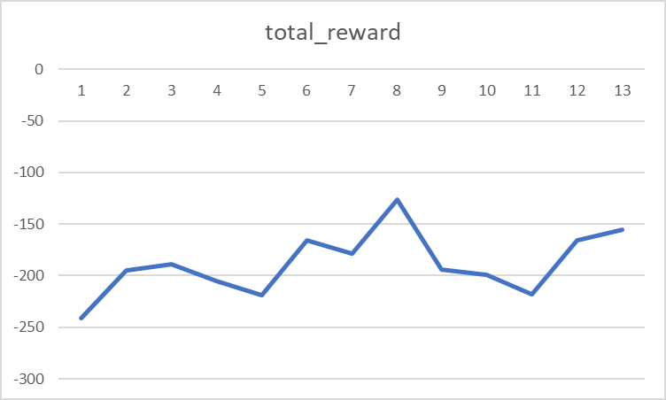
Grid Arena

Slide 14
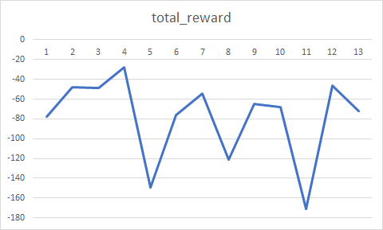
Empty Arena

Slide 15
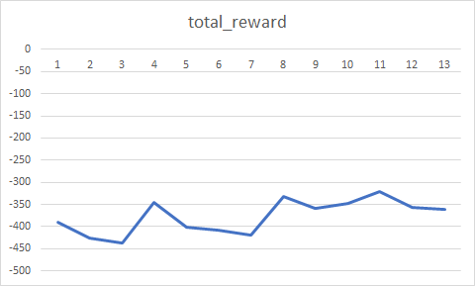
Maze

Slide 16
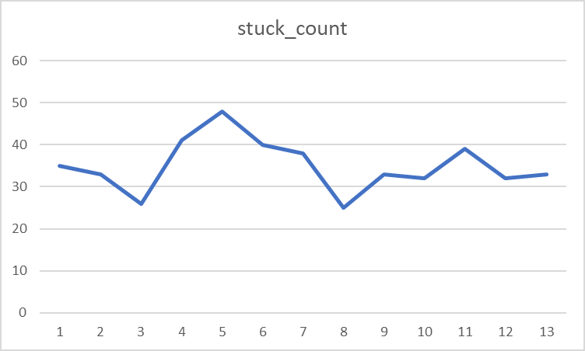
Grid Arena

Slide 17
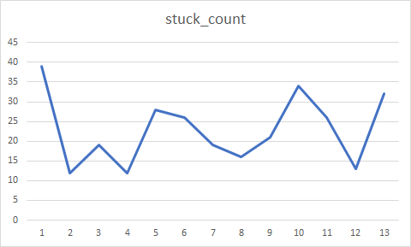
Empty Arena

Slide 18
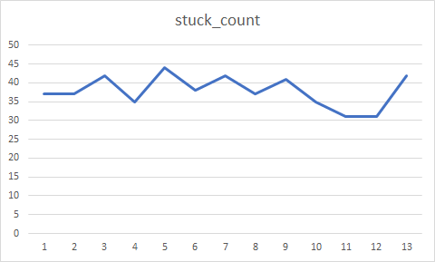
Maze

Slide 19
Conclusion
Assessment:
Decision shaped by limitations
Q learning appropriate algorithm for task
Design decisions (states, rewards, actions, arenas, parameters) somewhat validated by results
Parameter tuning and movement calibration affect results
Robot not practical for real life
Promising but imperfect results
Recommendations and improvements
State space should be more descriptive
Goal state needs to be added
Epsilon decay with earl stopping
UCB instead of epsilon greedy
Notes:
Mention limitations of vrep
Q learning works as shown by results (and video)
Results validate our design decisions, even though it was simple it worked,
Talk about how lower epsilon greedy values are good for narrow mazes but not good for grids or sparsely populated arenas
Real life tasks always have end states and goals, talk about how robot does not work well in all circumstances.
The state space should describe the world around the robot in much more detail, binary representations are not always enough
Goal state would stop robot from getting stuck in loops and wandering aimlessly
Epsilon value should go down over time (less need to explore), but this should be used in conjunction with early stopping of training so that q table is not over written with q value calculated using smaller and smaller epsioln values
UCB could be a better alternative to epsilon greedy, as it takes into account which states have not been explord

