Slide 1
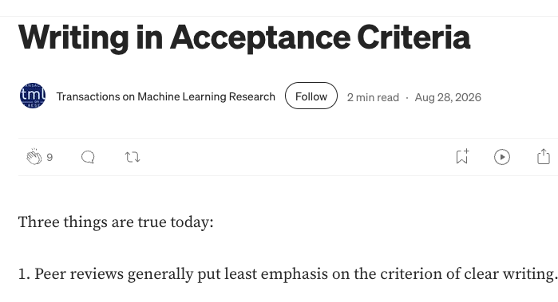
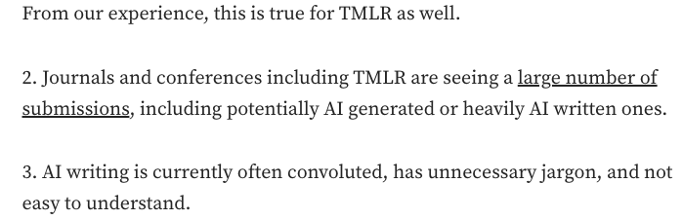

Slide 2

Vocabulary
$$p_{LM}$$
Selected token
mango
0.50
lychee
0.30
… my favourite tropical fruit is
lychee
papaya
0.15
durian
0.05

Slide 3
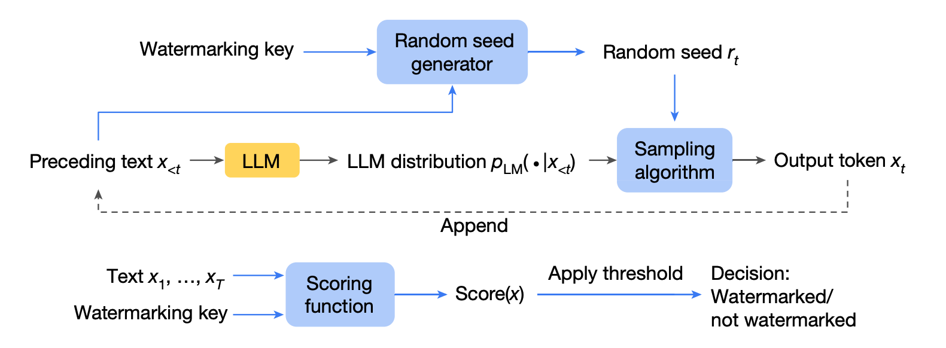
watermarking
detection

Slide 4
Keep a growing record and check against it for matches.
Requires scale and coordination; raises privacy concerns.
Retrieval-based detection
Use the statistical features of text or train an ML-based classifier.
Computationally expensive; inconsistent performance (especially out-of-domain)
Post hoc detection
Watermarking
Mark generated text so that it can be subsequently identified.
Quality (of generated texts) and effect (of detection) trade-off.
Three approaches:
  During generation.
  Editing already generated text.
  Altering LLM training data.
This paper

